Slide 2
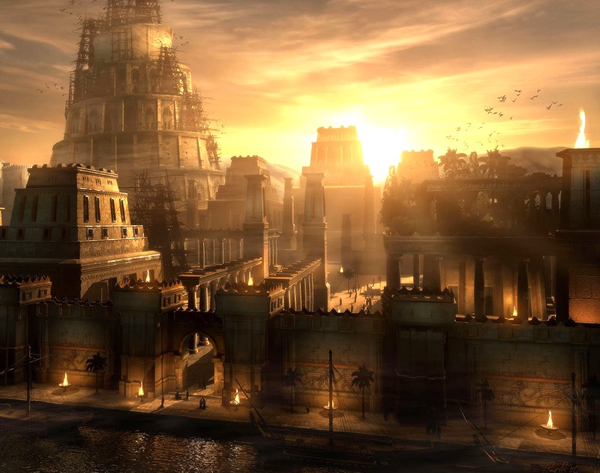

Slide 3
The Fiery Furnace

Slide 4
Daniel 3
King Nebuchadnezzar’s Image (vs. 1)
The Great Assembly (vss. 2-7)
The Accusations (vss. 3:8-12)
A Last Chance, Then Judgment (vss 13-23)
Jahweh’s Miraculous Intervention (vss. 24-27)
A Humbled King Nebuchadnezzar (vss. 28-30)

Slide 5
Lessons for us
Conviction – unwavering faith in God
Trust – God will take care of us
Calm under pressure – result of trust
God will honor those who honor Him
You can bow to an image or step into your destiny.
But you cannot do both.

