Slide 1
“The Most High is Ruler Over The Realm of Mankind”
a study of Daniel
download lesson at www.builtbyhim.com

Slide 2
Nebuchadnezzar Victorious
Daniel 1:1–2 (NASB95)
¹In the third year of the reign of Jehoiakim king of Judah, Nebuchadnezzar king of Babylon came to Jerusalem and besieged it.
²The Lord gave Jehoiakim king of Judah into his hand, along with some of the vessels of the house of God; and he brought them to the land of Shinar, to the house of his god, and he brought the vessels into the treasury of his god.

Slide 3
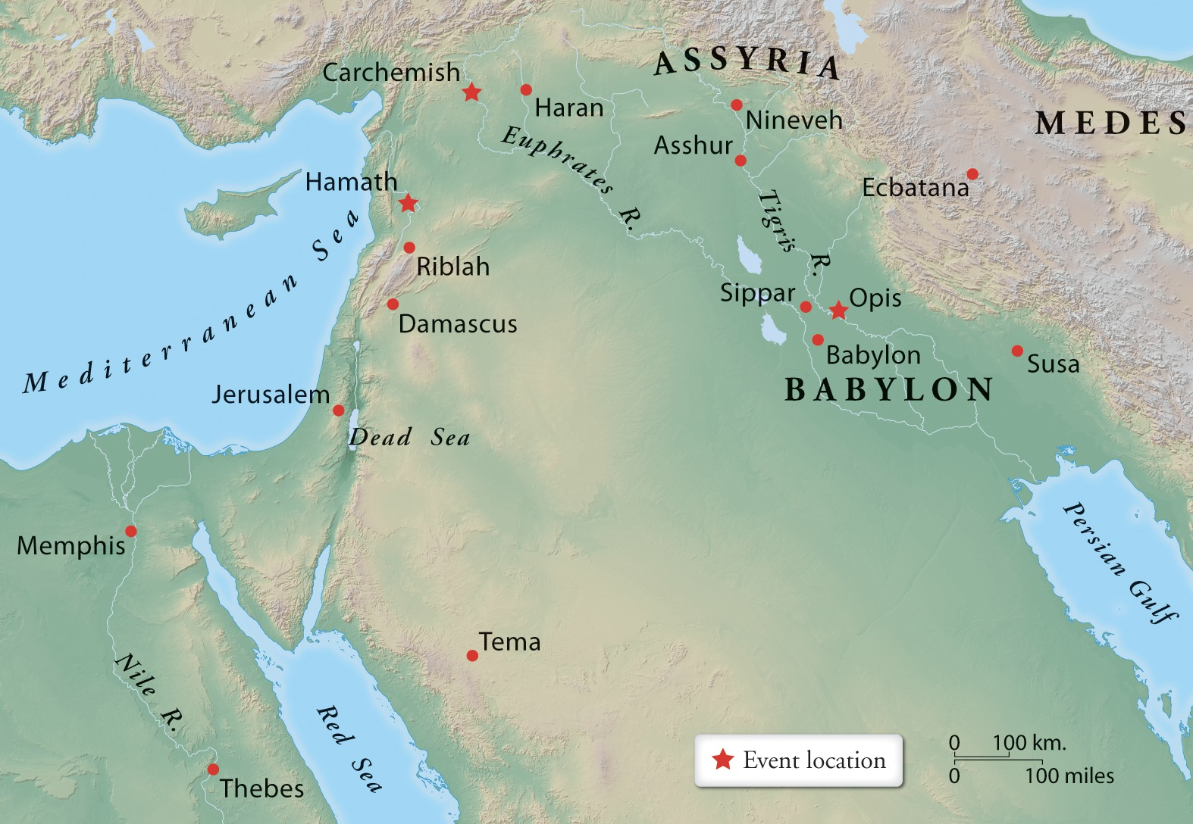

Slide 9
Nebuchadnezzar Victorious
Daniel 1:1–2 (NASB95)
¹In the third year of the reign of Jehoiakim king of Judah, Nebuchadnezzar king of Babylon came to Jerusalem and besieged it.
²The Lord gave Jehoiakim king of Judah into his hand, along with some of the vessels of the house of God; and he brought them to the land of Shinar, to the house of his god, and he brought the vessels into the treasury of his god.

Slide 10
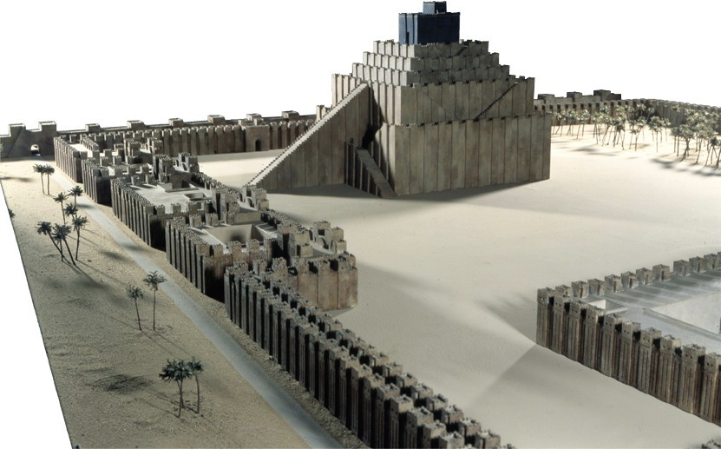

Slide 11
Daniel Tested
³Then the king ordered Ashpenaz, the chief of his officials, to bring in some of the sons of Israel, including some of the royal family and of the nobles,
⁴youths in whom was no defect, who were good-looking, showing intelligence in every branch of wisdom, endowed with understanding and discerning knowledge, and who had ability for serving in the king’s court; and he ordered him to teach them the literature and language of the Chaldeans.
⁵The king appointed for them a daily ration from the king’s choice food and from the wine which he drank, and appointed that they should be educated three years, at the end of which they were to enter the king’s personal service.

Slide 12
Daniel Tested
⁶Now among them from the sons of Judah were Daniel, Hananiah, Mishael and Azariah.
⁷Then the commander of the officials assigned new names to them; and to Daniel he assigned the name Belteshazzar, to Hananiah Shadrach, to Mishael Meshach and to Azariah Abed-nego.
⁸But Daniel made up his mind that he would not defile himself with the king’s choice food or with the wine which he drank; so he sought permission from the commander of the officials that he might not defile himself.

Slide 13
Daniel Tested
⁹Now God granted Daniel favor and compassion in the sight of the commander of the officials,
¹⁰and the commander of the officials said to Daniel, “I am afraid of my lord the king, who has appointed your food and your drink; for why should he see your faces looking more haggard than the youths who are your own age? Then you would make me forfeit my head to the king.”

Slide 14
Daniel Tested
¹¹But Daniel said to the overseer whom the commander of the officials had appointed over Daniel, Hananiah, Mishael and Azariah,
¹²“Please test your servants for ten days, and let us be given some vegetables to eat and water to drink.
¹³“Then let our appearance be observed in your presence and the appearance of the youths who are eating the king’s choice food; and deal with your servants according to what you see.”

Slide 15
Daniel Tested
¹⁴So he listened to them in this matter and tested them for ten days.
¹⁵At the end of ten days their appearance seemed better and they were fatter than all the youths who had been eating the king’s choice food.
¹⁶So the overseer continued to withhold their choice food and the wine they were to drink, and kept giving them vegetables.

Slide 16
Daniel Exalted
¹⁷As for these four youths, God gave them knowledge and intelligence in every branch of literature and wisdom; Daniel even understood all kinds of visions and dreams.

Slide 17
Daniel Exalted
¹⁸Then at the end of the days which the king had specified for presenting them, the commander of the officials presented them before Nebuchadnezzar.
¹⁹The king talked with them, and out of them all not one was found like Daniel, Hananiah, Mishael and Azariah; so they entered the king’s personal service.
²⁰As for every matter of wisdom and understanding about which the king consulted them, he found them ten times better than all the magicians and conjurers who were in all his realm.
²¹And Daniel continued until the first year of Cyrus the king.

Slide 18
“The Most High is Ruler Over The Realm of Mankind”
a study of Daniel

