Slide 1
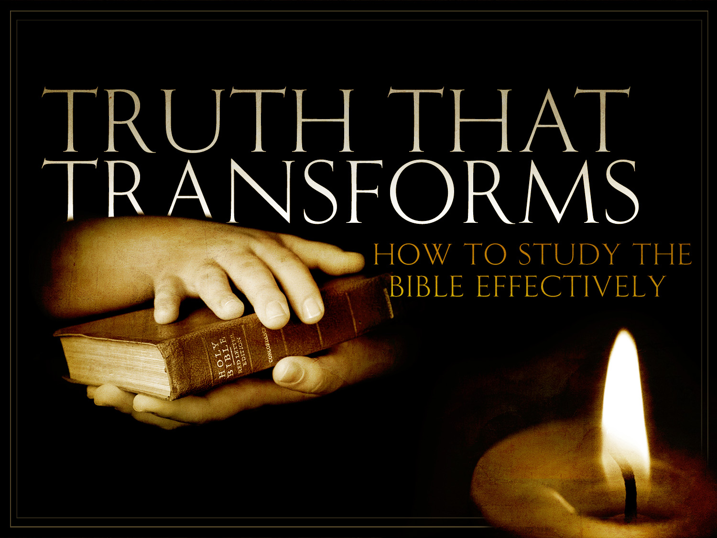

Slide 2
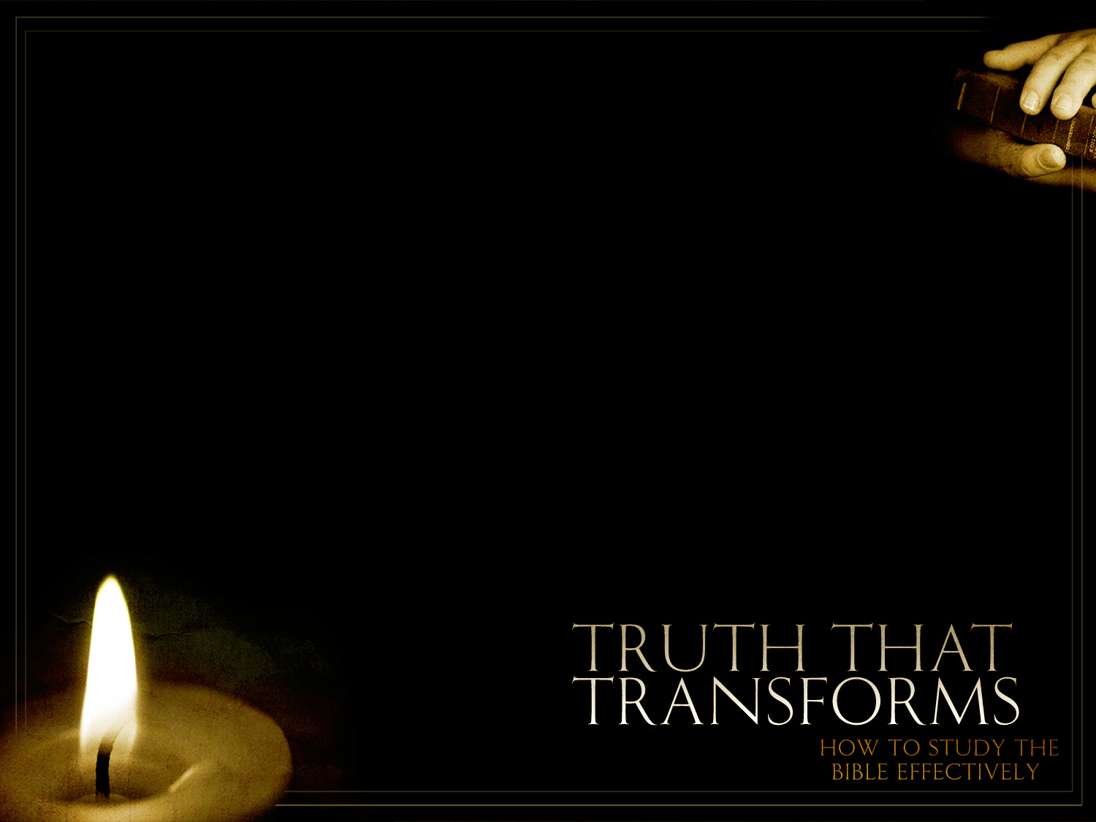
Summarize
Your
Observations

Slide 3
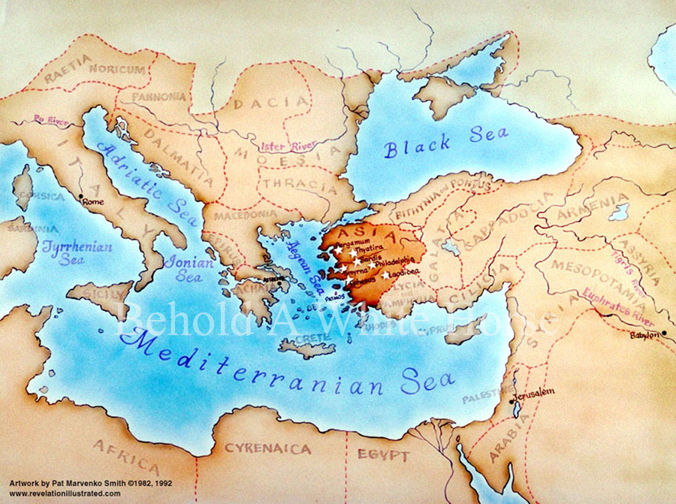

Slide 4
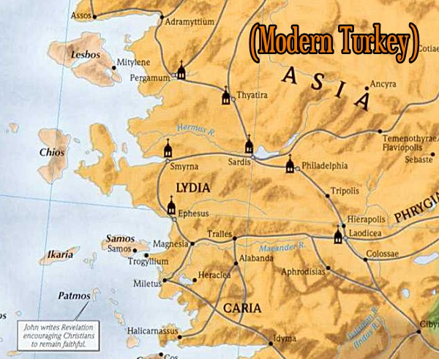

Slide 5
7 Churches of Asia Minor
Revelation 2-3
Descriptive Terms for Christ
Church
Accolades
Criticism
Action

Slide 6
7 Churches of Asia Minor
Revelation 2-3
Key Descriptive Phrase
Church
Consequences
(Negative/Positive)
He that hath ear . . if overcomes

Slide 7
7 Churches of Asia Minor
Revelation 2-3
Descriptive Terms for Christ
Church
Accolades
Criticism
Action
Ephesus
2:1-7
Holds 7 stars in rt hand
Walks in midst of 7 candlesticks
2:1
Knows toils and patience
Cannot bear evil
Found false prophets
Hates work of the Nicolaitans
2:2-3, 6
Left your first love
2:4
Remember from where you are fallen
Repent
Do 1st works
2:5

Slide 8
7 Churches of Asia Minor
Revelation 2-3
Key Descriptive Phrase
Church
Consequences
(Negative/Positive)
He that hath ear . . if overcomes
Ephesus
2:1-7
Remove their candlesticks
(N)
2:5
Given tree of life to eat from
2:7
Left your first love
2:4

Slide 9
7 Churches of Asia Minor
Revelation 2-3
Descriptive Terms for Christ
Church
Accolades
Criticism
Action
Smyrna
2:8-11
The first and the last
Who was dead/lived again
2:8
Knows tribulation and poverty
Are rich
Confront blasphemy of the Jews
2:9
Fear not – about to suffer
Be faithful unto death
2:10

Slide 10
7 Churches of Asia Minor
Revelation 2-3
Key Descriptive Phrase
Church
Consequences
(Negative/Positive)
He that hath ear . . if overcomes
Smyrna
2:8-11
Give the crown of life
(P)
2:10
Not hurt with the 2nd death
2:11
Be faithful unto death
2:10

Slide 11
7 Churches of Asia Minor
Revelation 2-3
Descriptive Terms for Christ
Church
Accolades
Criticism
Action
Pergamum
2:12-17
Hath the 2-edged sword
2:12
Hold fast my name
Did not deny my faith
2:13
Few . . .
Teaching of Balaam
Eat food sacrificed to idols
Sexual Immoral
Teaching of Nicolaitans
2:14-15
Repent
2:16

Slide 12
7 Churches of Asia Minor
Revelation 2-3
Key Descriptive Phrase
Church
Consequences
(Negative/Positive)
He that hath ear . . if overcomes
Pergamum
2:12-17
He will come quickly
Make war with them
(N)
2:16
Will give . . .
Hidden manna
White stone
New name
2:17
Did not deny my faith . . . But have few things against you
2:13-4

Slide 13
7 Churches of Asia Minor
Revelation 2-3
Descriptive Terms for Christ
Church
Accolades
Criticism
Action
Thyatira
2:18-29
Son of God
Eyes like flames of fire
Feet like burnished bronze
2:18
Thy works
Love, faith, service, patient endurance
Last works more than the first
2:19
Listened to Jezebel the prophetess
Sexual immorality
Eat meat sacrificed to idols
2:20-21
Repent
Hold fast of what you have
2:22; 25

Slide 14
7 Churches of Asia Minor
Revelation 2-3
Key Descriptive Phrase
Church
Consequences
(Negative/Positive)
He that hath ear . . if overcomes
Thyatira
2:18-29
Great tribulation
Strike dead
Give to each according to his works
(N)
2:22-23
Will give . . .
Authority over nations
The morning star
2:26-28
Latter works exceed the first
2:19

Slide 15
7 Churches of Asia Minor
Revelation 2-3
Descriptive Terms for Christ
Church
Accolades
Criticism
Action
Sardis
3:1-6
Hath 7 Spirits of God and 7 stars
3:1
Few
Walk with Me
Worthy
3:4
Are dead
Works aren't complete
3:1-2
Wake up
Strengthen what is to die
Remember and keep what you’ve heard
Repent
3:2-3

Slide 16
7 Churches of Asia Minor
Revelation 2-3
Key Descriptive Phrase
Church
Consequences
(Negative/Positive)
He that hath ear . . if overcomes
Sardis
3:1-6
Come like a thief
(N)
3:3
Clothed in white
Name
never blotted out
Will be confessed before the Father
3:5
Alive, but you are dead
3:1

Slide 17
7 Churches of Asia Minor
Revelation 2-3
Descriptive Terms for Christ
Church
Accolades
Criticism
Action
Philadelphia
3:7-13
Holy
True
Hath the key of David
Open and none shut
Shut and none open
3:7
Open door
Kept My word
Not denied My name
Patient endurance
3:8; 10
.
Hold fast
3:11

Slide 18
7 Churches of Asia Minor
Revelation 2-3
Key Descriptive Phrase
Church
Consequences
(Negative/Positive)
He that hath ear . . if overcomes
Philadelphia
3:7-13
Kept from hour of trial
(P)
3:10
Make pillar in temple of God
Write on him
the name of God
Name of new Jerusalem
His own new name
3:12
Patient endurance
3:10

Slide 19
7 Churches of Asia Minor
Revelation 2-3
Descriptive Terms for Christ
Church
Accolades
Criticism
Action
Laodicea
3:14-22
The Amen
The faithful and true Witness
The beginning of God’s creation
3:14
.
Lukewarm
Wretched
Pitiable
Poor
Blind
Naked
3:16-17
Buy gold
To be rich
Buy garments
To be clothed
Buy salve
To anoint your eyes
Be zealous and repent
3:18-19

Slide 20
7 Churches of Asia Minor
Revelation 2-3
Key Descriptive Phrase
Church
Consequences
(Negative/Positive)
He that hath ear . . if overcomes
Laodicea
3:14-22
Spit you out of My mouth
Those I love . .
Reprove and discipline
3:16; 19
Sit with Him on throne
3:21
Lukewarm
3:16

