Slide 1
Philippians

Slide 2
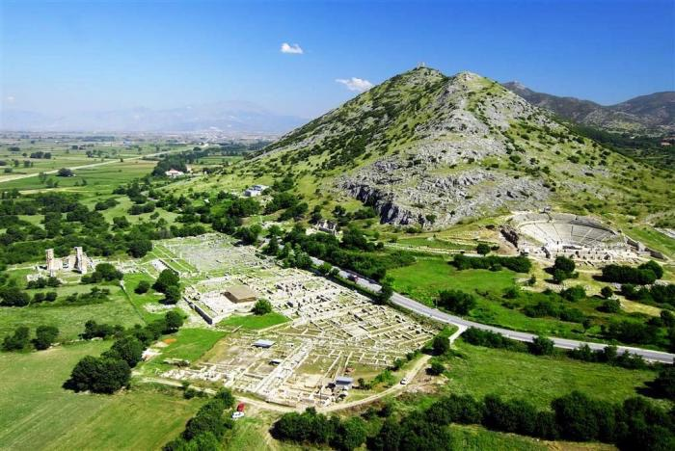
The City of Philippi
Became part of the Roman Empire in the 2nd BC
Was the place of the battle between Brutus and Cassius and Antony and Octavian in 42 BC
Octavian later rebuilt it in 30 BC

Slide 3
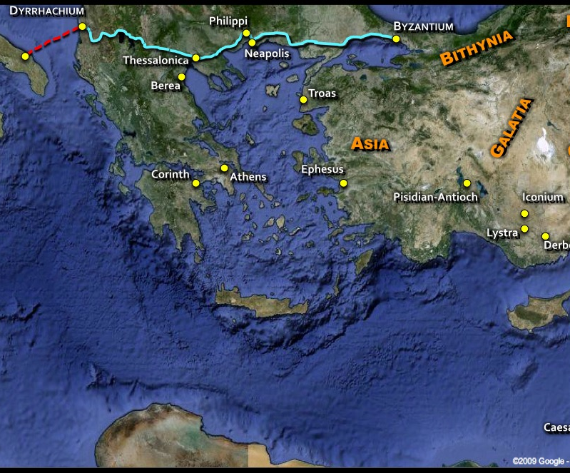
The Ignatian Way

Slide 4
Paul’s first encounter with the city
Acts 16:12 We remained in this city some days. ¹³ And on the Sabbath day we went outside the gate to the riverside, where we supposed there was a place of prayer, and we sat down and spoke to the women who had come together. ¹⁴ One who heard us was a woman named Lydia, from the city of Thyatira, a seller of purple goods, who was a worshiper of God. The Lord opened her heart to pay attention to what was said by Paul. ¹⁵ And after she was baptized, and her household as well, she urged us, saying, “If you have judged me to be faithful to the Lord, come to my house and stay.” And she prevailed upon us.

Slide 5
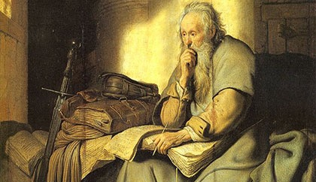
Place of Writing
Paul is in prison (1.7)
But where?
Rome
Ephesus
Corinth
Caesarea

Slide 6
Place of Writing
Rome
Elsewhere (Ephesus)
2nd AD Marcionite prologue and the subscription says Rome
The mention of a praetorium and “those of Caesar’s household.”
Several trips took place between Philippi and the place of writing
Rome was far away and all the trips could almost definitely not have been made within the two year period (about 50 days one way).
The journey to Ephesus could have been made in a week.

Slide 7
Journeys mentioned in Philippians
Actual journeys
Planned journeys
Timothy comes to Paul in prison and was mentioned when he wrote the letter (1:1) but was NOT with him in Rome (Acts 26-28).
The Philippians receive a letter telling them that he is a prisoner
Epaphroditus brings the gift of the Philippians to Paul (4:18)
Epaphroditus falls ill and the Philippians learn about it (2:26)
Paul receives a message stating that the Philippians know about the sickness of Epaphroditus
Epaphroditus will be the letter carrier (2:25)
Timothy plans to go to Philippi from where Paul is imprisoned (2:19)
Paul anticipates good news when Timothy returns (2:19)
Paul wants to visit them “soon” (2:24)

Slide 8
Outline of Philippians
1. Introduction (1:1-11)
2. News and Instructions (1:12-2:30)
3. Warning against false teachers (3:1-21)
4. Exhortations and gratitude (4:1-20)
5. Conclusion (4:21-23)

Slide 9
Joy Toward the Philippians
Philippians 1:1 Paul and Timothy, servants of Christ Jesus, To all the saints in Christ Jesus who are at Philippi, with the overseers and deacons:² Grace to you and peace from God our Father and the Lord Jesus Christ.³ I thank my God in all my remembrance of you,⁴ always in every prayer of mine for you all making my prayer with joy,⁵ because of your partnership in the gospel from the first day until now.⁶ And I am sure of this, that he who began a good work in you will bring it to completion at the day of Jesus Christ.⁷ It is right for me to feel this way about you all, because I hold you in my heart, for you are all partakers with me of grace, both in my imprisonment and in the defense and confirmation of the gospel.

Slide 10
Joy Toward the Philippians
Philippians 1:8 For God is my witness, how I yearn for you all with the affection of Christ Jesus. ⁹ And it is my prayer that your love may abound more and more, with knowledge and all discernment, ¹⁰ so that you may approve what is excellent, and so be pure and blameless for the day of Christ, ¹¹ filled with the fruit of righteousness that comes through Jesus Christ, to the glory and praise of God.

Slide 11
Imprisonment…is good?
I want you to know, brothers, that what has happened to me has really served to advance the gospel,¹³ so that it has become known throughout the whole praetorium and to all the rest that my imprisonment is for Christ.¹⁴ And most of the brothers, having become confident in the Lord by my imprisonment, are much more bold to speak the word without fear.¹⁵ Some indeed preach Christ from envy and rivalry, but others from good will.¹⁶ The latter do it out of love, knowing that I am put here for the defense of the gospel.¹⁷ The former proclaim Christ out of selfish ambition, not sincerely but thinking to afflict me in my imprisonment. (Phil. 1:12-17)

Slide 12
Praetorium
The governor’s palace
Often used for places outside Rome
Then the soldiers of the governor took Jesus into the praetorium, and they gathered the whole battalion before him (Mat. 27:27).
And he commanded him to be guarded in Herod's praetorium (Acts 23:5).

Slide 13
Imprisonment…is good?
I want you to know, brothers, that what has happened to me has really served to advance the gospel,¹³ so that it has become known throughout the whole praetorium and to all the rest that my imprisonment is for Christ.¹⁴ And most of the brothers, having become confident in the Lord by my imprisonment, are much more bold to speak the word without fear.¹⁵ Some indeed preach Christ from envy and rivalry, but others from good will.¹⁶ The latter do it out of love, knowing that I am put here for the defense of the gospel.¹⁷ The former proclaim Christ out of selfish ambition, not sincerely but thinking to afflict me in my imprisonment. (Phil. 1:12-17)

Slide 14
Envy and rivalry, but against whom?
Against Roman authorities?
Against the Jews?
Against Paul?
What then? Only that in every way, whether in pretense or in truth, Christ is proclaimed, and in that I rejoice.
“The fact, however, that he could conquer his indignation with forgiveness and could replace his irritation with joy provides a model for Christian living and thus is a sufficient reason for allowing this exposure of the darker side of Christian conduct to stand,” Hawthorne, Martin, Philippians, 48.

Slide 15
Imprisonment is…good?
Yes, and I will rejoice,¹⁹ for I know that through your prayers and the help of the Spirit of Jesus Christ this will turn out for my deliverance,²⁰ as it is my eager expectation and hope that I will not be at all ashamed, but that with full courage now as always Christ will be honored in my body, whether by life or by death.²¹ For to me to live is Christ, and to die is gain.²² If I am to live in the flesh, that means fruitful labor for me. Yet which I shall choose I cannot tell.²³ I am hard pressed between the two. My desire is to depart and be with Christ, for that is far better.²⁴ But to remain in the flesh is more necessary on your account.²⁵ Convinced of this, I know that I will remain and continue with you all, for your progress and joy in the faith,²⁶ so that in me you may have ample cause to glory in Christ Jesus, because of my coming to you again. (Phil. 1:18-26)

Slide 16
Standing firm in one spirit
Only live as a citizen worthy of the gospel of Christ, so that whether I come and see you or am absent, I may hear of you that you are standing firm in one spirit, with one mind striving side by side for the faith of the gospel, 28 and not frightened in anything by your opponents. This is a clear sign to them of their destruction, but of your salvation, and that from God. 29 For it has been granted to you that for the sake of Christ you should not only believe in him but also suffer for his sake, 30 engaged in the same conflict that you saw I had and now hear that I still have. (Phil. 1:27-30)

Slide 17
The Problems in Philippians
Fellow Christians opposed Paul (ch. 1)
Jews or Jewish-Christian missionaries (ch. 3)
Some members of the congregation weren’t getting along (chs. 4; 2)

Slide 18
Be of one mind
So if there is any encouragement in Christ, any comfort from love, any participation in the Spirit, any affection and sympathy, 2 complete my joy by being of the same mind, having the same love, being in full accord and of one mind. 3 Do nothing from selfish ambition or conceit, but in humility count others more significant than yourselves. 4 Let each of you look not only to his own interests, but also to the interests of others. 5 Have this mind among yourselves, which is yours in Christ Jesus, (Philippians 2:1-5).

Slide 19
Carmen Christi
“This is the most important section in the letter and surely the most difficult to interpret. The number of genuine exegetical problems and the sheer mass of books and articles it has called forth leaves one wondering where to begin, despairing about adding anything new and well-nigh stricken with mental paralysis,” Hawthorne, Martin, Philippians, 99.

Slide 20
Carmen Christi- An early Christian hymn?
In spite of such disagreement, scholars agree this is a fragment of an early Christian hymn
This could be the earliest example that we have
“They asserted, however, that the sum and substance of their fault or error had been that they were accustomed to meet on a fixed day before dawn and sing responsively a hymn to Christ as to a god, and to bind themselves by oath, not to do some crime, but not to commit fraud, theft, or adultery, not falsify their trust, nor to refuse to return a trust when called upon to do so. When this was over, it was their custom to depart and to assemble again to partake of food — but ordinary and innocent food,” Pliny, Epistle 10.96

Slide 21
Carmen Christi
6 who, though he was in the form of God, did not count equality with God a thing to be grasped, 7 but emptied himself, by taking the form of a servant, being born in the likeness of men. 8 And being found in human form, he humbled himself by becoming obedient to the point of death, even death on a cross. 9 Therefore God has highly exalted him and bestowed on him the name that is above every name, 10 so that at the name of Jesus every knee should bow, in heaven and on earth and under the earth, 11 and every tongue confess that Jesus Christ is Lord, to the glory of God the Father.(Phil. 2:6-11)

Slide 22
The “Form” of God
Form = image
Then God said, “Let us make man in our image (eikon), after our likeness. And let them have dominion over the fish of the sea and over the birds of the heavens and over the livestock and over all the earth and over every creeping thing that creeps on the earth.” (Gen. 1.26)
“He is the image (eikon) of the invisible God, the firstborn of all creation.” (Colossians 1:15).

Slide 23
Carmen Christi
6 who, though he was in the form of God, did not count equality with God a thing to be grasped (or “robbery”), 7 but emptied himself, by taking the form of a servant, being born in the likeness of men. 8 And being found in human form, he humbled himself by becoming obedient to the point of death, even death on a cross. 9 Therefore God has highly exalted him and bestowed on him the name that is above every name, 10 so that at the name of Jesus every knee should bow, in heaven and on earth and under the earth, 11 and every tongue confess that Jesus Christ is Lord, to the glory of God the Father.(Phil. 2:6-11)

Slide 24
First Adam- Last Adam typology
Adam
Made in the image of God (Gen. 1.26-27)
Thought that being like God is something to be grasped (Gen. 3.5-6)
He sought to be exalted and sinned resulting in expulsion (Gen. 3.6ff)
Therefore God condemned him to death and entire race suffered the same penalty (Romans 5.12-14)
Jesus
Was in the form of God
Thought that being like God is not something to be grasped
He decided to be humbled and took the form of a servant and died, even death on a cross
Therefore God exalted him and the entire race will call his name

Slide 25
Carmen Christi
6 who, though he was in the form of God, did not count equality with God a thing to be grasped (or “robbery”), 7 but emptied himself, by taking the form of a servant, being born in the likeness of men. 8 And being found in human form, he humbled himself by becoming obedient to the point of death, even death on a cross. 9 Therefore God has highly exalted him and bestowed on him the name that is above every name, 10 so that at the name of Jesus every knee should bow, in heaven and on earth and under the earth, 11 and every tongue confess that Jesus Christ is Lord, to the glory of God the Father.(Phil. 2:6-11)

Slide 26
Carmen Christi
“Of Tiberius Claudius Ceasar the Lord (kurios)” (P.Oxy. I 37, 5)
“Of Nero Caesar the Lord (kurios)” (P.Oxy. II, 246).

Slide 27
Carmen Christi
"Turn to me and be saved, all the ends of the earth! For I am God, and there is no other.²³ By myself I have sworn; from my mouth has gone out in righteousness a word that shall not return: 'To me every knee shall bow, every tongue shall swear allegiance.'²⁴ "Only in Yahweh (Gk. Lord), it shall be said of me, are righteousness and strength; to him shall come and be ashamed all who were incensed against him.²⁵ In Yahweh all the offspring of Israel shall be justified and shall glory." (Isa. 45:22-25)

