Slide 2


Slide 3
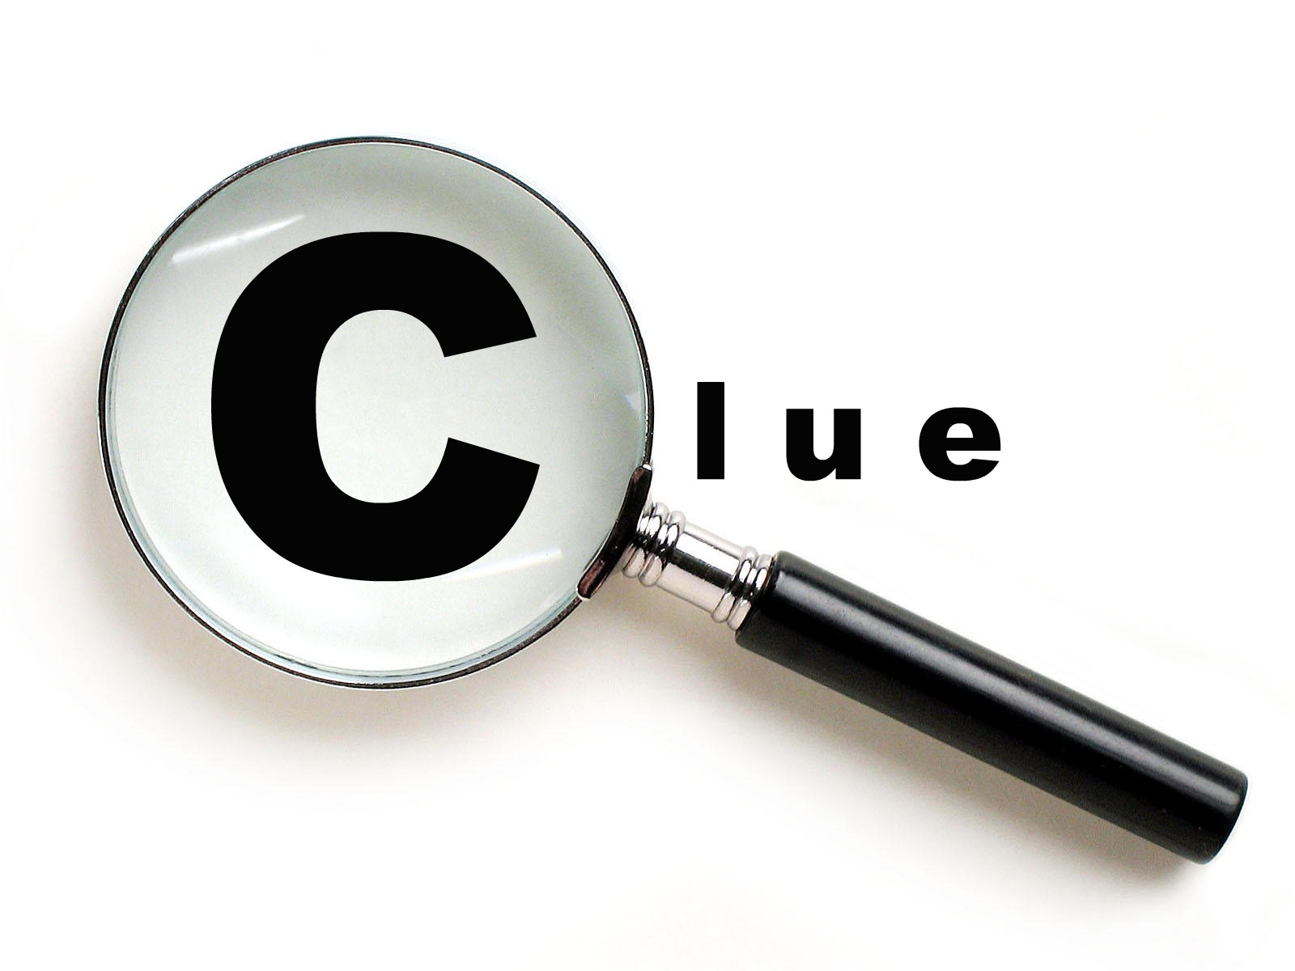
6
s
To Look For

Slide 4

Things That Are Emphasized
  Amount of space
    Genesis
    Matthew
    Epistles of Paul

Slide 5
Things That Are Emphasized
  Amount of space
  Stated purpose
    John 20:30-31
    Proverbs 1:2-6

Slide 6
Things That Are Emphasized
  Amount of space
  Stated purpose
  Order
    Genesis 2-3
    Luke 3 & 4
    Luke 6:14-16

Slide 7
Things That Are Emphasized
  Amount of space
  Stated purpose
  Order
  Movement from the lesser to the greater, and vice versa
    II Samuel 11-12
    Acts 2

Slide 8
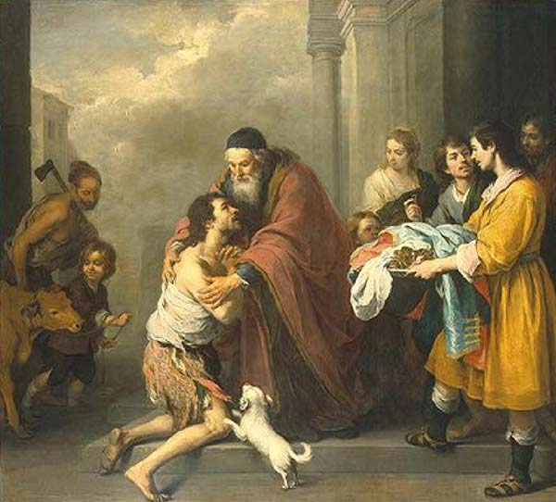

Slide 9
Things That Are Emphasized
Things That Are Repeated

Slide 10
Things That Are Repeated
  Terms, phrases and clauses
    Psalm 136:1-2
    Hebrews 11
    I Corinthians 15:12-28

Slide 11
Things That Are Repeated
  Terms, phrases and clauses
  Characters
    Barnabas

Slide 12
Things That Are Repeated
  Terms, phrases and clauses
  Characters
  Incidents and circumstances
    Judges
    Matthew

Slide 13
Things That Are Repeated
  Terms, phrases and clauses
  Characters
  Incidents and circumstances
  Patterns
    The life of Joseph and the life of Jesus
    The experience of Israel and that of Jesus
    Saul and David

Slide 14
Things That Are Repeated
  Terms, phrases and clauses
  Characters
  Incidents and circumstances
  Patterns
  New Testament use of OT passages
    The story of Jonah
    Hebrews

Slide 15
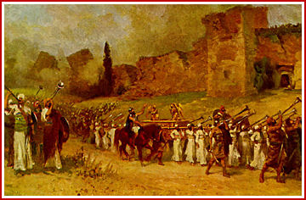

Slide 16
Things That Are Emphasized
Things That Are Repeated
Things That Are Related

Slide 17
Things That Are Related
  Movement from the general to the specific
    Matthew 6:1-18
    Genesis 1

Slide 18
Things That Are Related
  Movement from the general to the specific
  Questions & Answers
    Romans 6:1, 15
    Job 38:3; 40:3-5
    Matthew 6:27; 26:40; Mark 4:40

Slide 19
Things That Are Related
  Movement from the general to the specific
  Questions & Answers
  Cause and Effect
    Acts 8:1
    Nehemiah 1

Slide 20
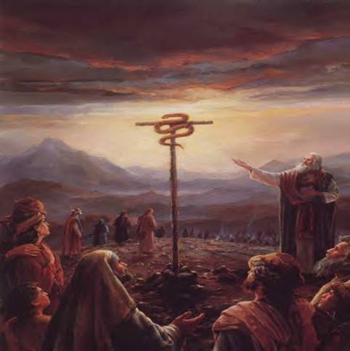

Slide 21
Things That Are Emphasized
Things That Are Repeated
Things That Are Related
Things That Are Alike

Slide 22
Things That Are Alike
  Similes
    Psalm 42:1
    I Peter 2:2
    Isaiah 44:6-7

Slide 23
Things That Are Alike
  Similes
  Metaphors
    John 15:1
    John 3:3-7, 14

Slide 24


Slide 25
Things That Are Emphasized
Things That Are Repeated
Things That Are Related
Things That Are Alike
Things That Are Unlike

Slide 26
Things That Are Unlike
  Use of but
    Galatians 5:19-22
    Acts 8

Slide 27
Things That Are Unlike
  Use of but
  Metaphors
    Luke 18

Slide 28
Things That Are Unlike
  Use of but
  Metaphors
  Irony
    Luke 8

Slide 29
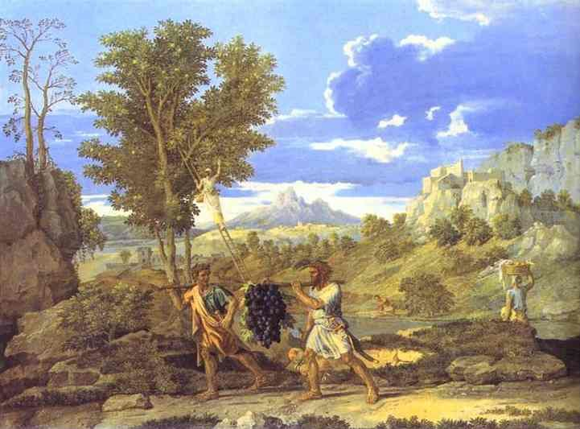

Slide 30
Things That Are Emphasized
Things That Are Repeated
Things That Are Related
Things That Are Alike
Things That Are Unlike
Things That Are True To Life

Slide 31
Things That Are True To Life
  Abraham – Genesis 22
  Moses – Numbers 20:1-13
  Noah – Genesis 9:20-21
  David
  Peter
  John Mark

Slide 32
