Slide 2
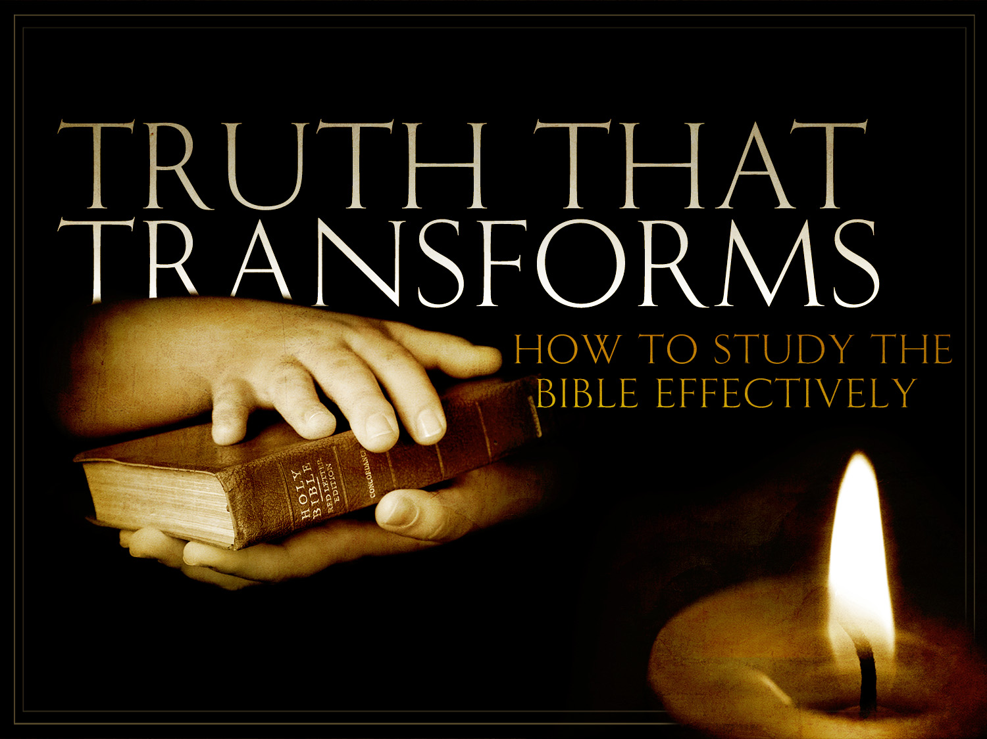

Slide 3

“Never before has the world been so desperately asking for answers to crucial questions, and never before has the world been so frantically committed to the idea that no answers are possible. To paraphrase the Bible, the modern attitude is, ‘Father forgive us, for we know not what we are doing – and please don’t tell us!’”

Slide 4
Why Study the Bible?

Slide 5

In your opinion, what are the benefits of Bible study?
What’s in it for me?
If I invest my time in this manner, what’s the payoff?
What difference will it make in my life?

Slide 6
Benefits of Bible Study
Bible Study Is Essential to Growth

Slide 7
as newborn babes, long for the spiritual milk which is without guile, that ye may grow thereby unto salvation;
I Peter 2:2

Slide 8
Read I Peter 2:2. What are three key words that are critical in understanding this verse?
Attitude
Appetite

Slide 9
More to be desired are they than gold, yea, than much fine gold; Sweeter also than honey and the droppings of the honeycomb.
Psalms 19:10

Slide 10


Slide 11


Slide 12


Slide 13
Read I Peter 2:2. What are three key words that are critical in understanding this verse?
Attitude
Appetite
Aim

Slide 14
According to I Peter 2:2, what is the aim of the Bible?

Slide 15
Certainly we cannot grow without knowing.
But you can know and not grow.
The Bible was written not to satisfy our curiosity but to help us conform to Christ’s image.
Not to make us a smarter sinner, but to make us like the Savior.
Not to fill our heads with a collection of Biblical facts, but to transform our lives.

Slide 16

How about you?
How long have you been a Christian?
Nine months?
Seven or eight years?
Thirty nine years?
How much have you grown up?

Slide 17
Benefits of Bible Study
Bible Study Is Essential to Growth
Bible Study Is Essential to Spiritual Maturity

Slide 18
Of whom we have many things to say, and hard of interpretation, seeing ye are become dull of hearing. For when by reason of the time ye ought to be teachers, ye have need again that some one teach you the rudiments of the first principles of the oracles of God; and are become such as have need of milk, and not of solid food.

Slide 19
For every one that partaketh of milk is without experience of the word of righteousness; for he is a babe. But solid food is for fullgrown men, even those who by reason of use have their senses exercised to discern good and evil.
Hebrews 5:11-14

Slide 20
In Hebrews 5:11-14, the writer says he has a lot to say, but it is hard to explain. Why? Who are the mature?

Slide 21
Benefits of Bible Study
Bible Study Is Essential to Growth
Bible Study Is Essential to Spiritual Maturity
Bible Study Is Essential to Spiritual Effectiveness

Slide 22
Every scripture inspired of God is also profitable for teaching, for reproof, for correction, for instruction which is in righteousness. That the man of God may be complete, furnished completely unto every good work.
2 Timothy 3:16-17

Slide 23
Paul says in II Timothy 3:16-17 that all Scripture is profitable. Profitable for what?

Slide 24
Profitable. . .
for doctrine or teaching.
for rebuke.

Slide 25


Slide 26
Profitable. . .
for doctrine or teaching.
for rebuke.
for correction.

Slide 27


Slide 28
Profitable. . .
for doctrine or teaching.
for rebuke.
for correction.
for training in righteous living.

Slide 29
Have you ever wished your life was more effective for Christ? If so, what have you done to prepare yourself?

