Slide 2
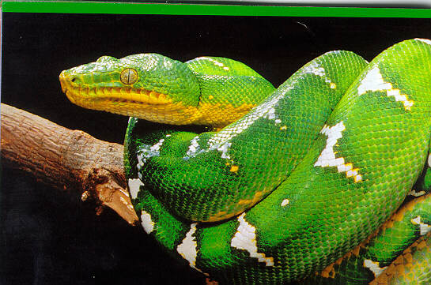

Slide 3


Slide 4


Slide 5

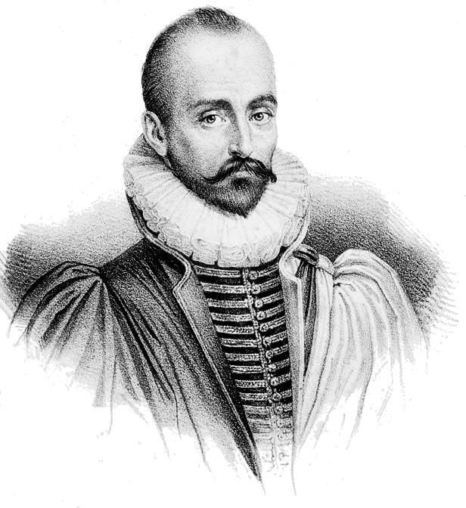
I undervalue the things that I possess, just because I possess them, and attach a higher value to things that are not mine, but belong to another and are beyond my reach. This habit of mind . . . causes husbands to view their wives, and many fathers to view their children, with an unjust disdain — II, 17: On Presumption.

Slide 6


Slide 7

Disdain
a feeling of contempt for someone or something regarded as unworthy or inferior.
literally “treat as unworthy.”

Slide 8
“Husbands, love your wives, and be not bitter against them.”
Colossians 3:19

Slide 9
“Husbands, love your wives, and be not bitter against them.”
Colossians 3:19

Slide 10
“Thou shalt not covet thy neighbour's house, thou shalt not covet thy neighbour's wife . . . nor anything that is thy neighbor’s”
Exodus 20:17

Slide 11
“Husbands, love your wives, even as Christ also loved the church, and gave himself up for it; that he might sanctify it, having cleansed it by the washing of water with the word, that he might present the church to himself a glorious church, not having spot or wrinkle or any such thing; but that it should be holy and without blemish. Even so ought husbands also to love their own wives as their own bodies. He that loveth his own wife loveth himself: for no man ever hated his own flesh; but nourisheth and cherisheth it, even as Christ also the church; because we are members of his body.”
Ephesians 5:25-30

Slide 12
“Husbands, love your wives, even as Christ also loved the church, and gave himself up for it; that he might sanctify it, having cleansed it by the washing of water with the word, that he might present the church to himself a glorious church, not having spot or wrinkle or any such thing; but that it should be holy and without blemish. Even so ought husbands also to love their own wives as their own bodies. He that loveth his own wife loveth himself: for no man ever hated his own flesh; but nourisheth and cherisheth it, even as Christ also the church; because we are members of his body.”
Ephesians 5:25-30

Slide 13
“And no marvel; for even Satan fashioneth himself into an angel of light.”
2 Corinthians 11:14

Slide 14
“Ye husbands, in like manner, dwell with your wives according to knowledge, giving honor unto the woman, as unto the weaker vessel, as being also joint-heirs of the grace of life; to the end that your prayers be not hindered.” I Peter 3:7

Slide 15
“And Jehovah God said, It is not good that the man should be alone; I will make him a help meet for him.” Genesis 2:18

Slide 16
Husbands, love your wives, even as Christ also loved the church
Husbands, love your wives, and be not bitter against them

Slide 17
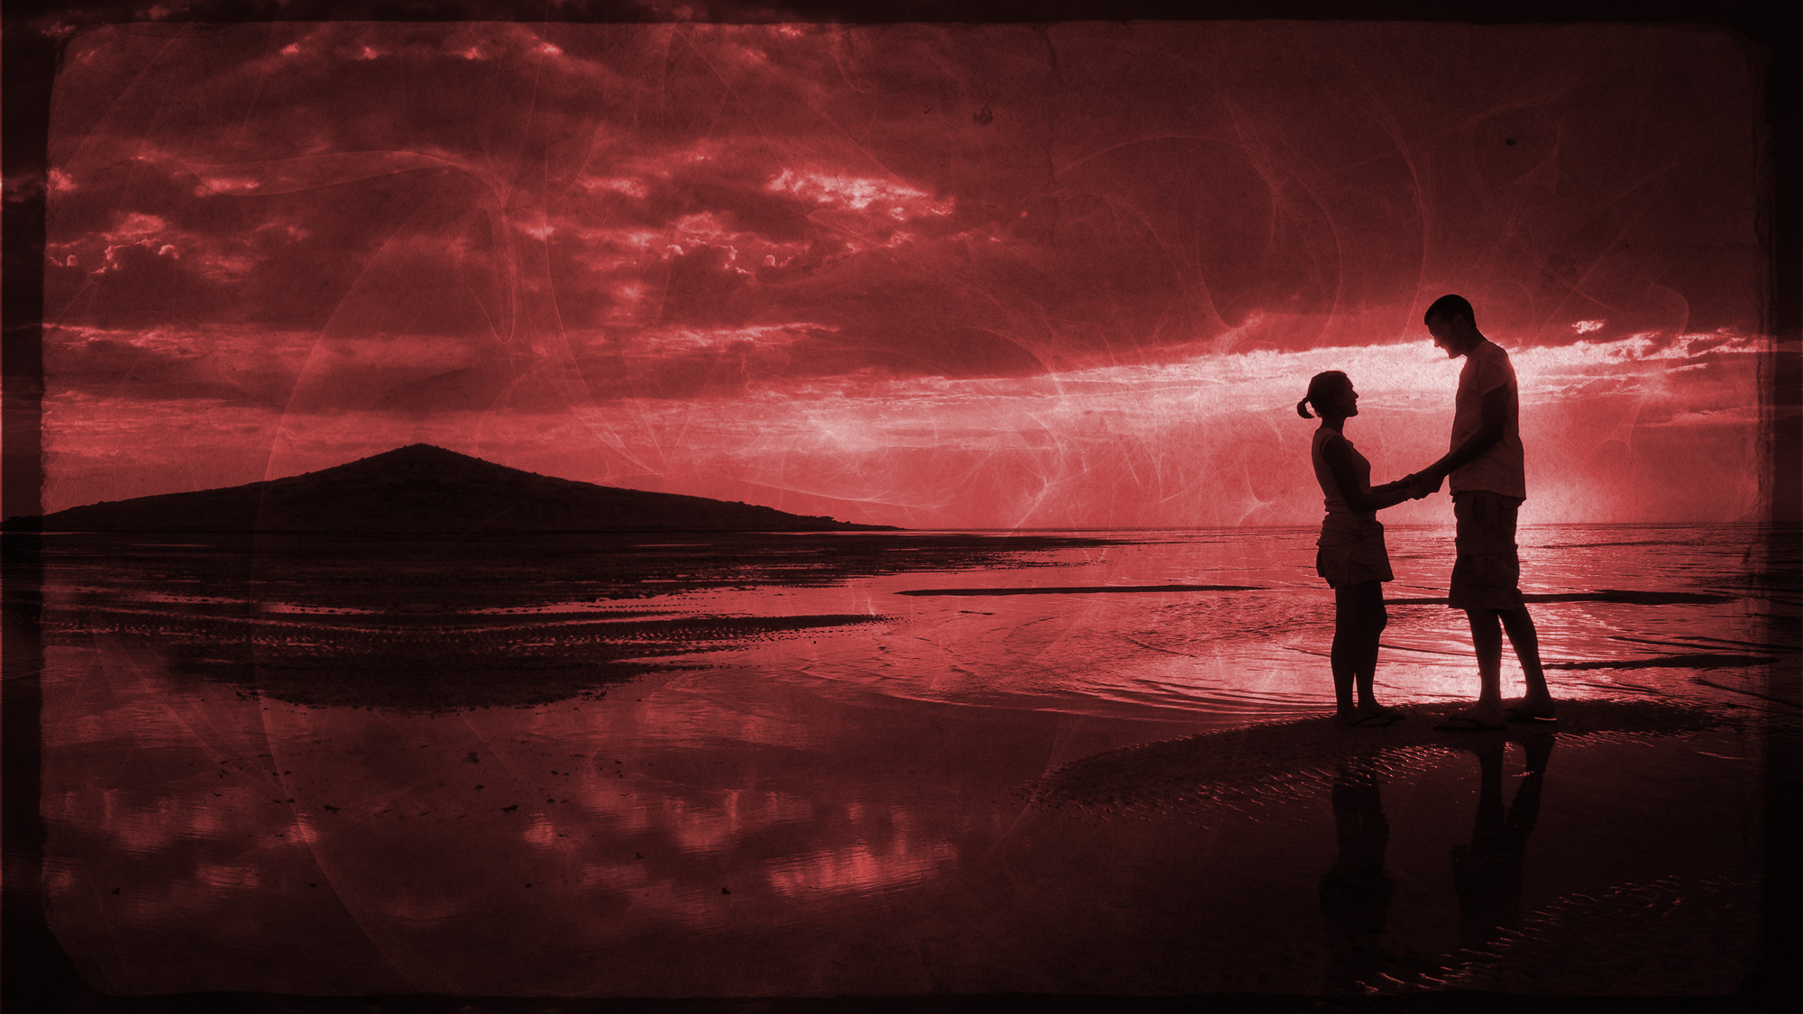
“Let none deal treacherously against the wife of his youth” Malachi 2:15

