Slide 2
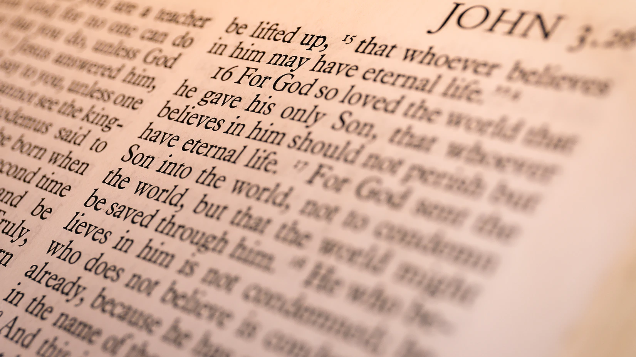
1 John 1.4
“These things we write, so that our joy may be made complete.”

Slide 3
Abiding In Him…

Slide 4
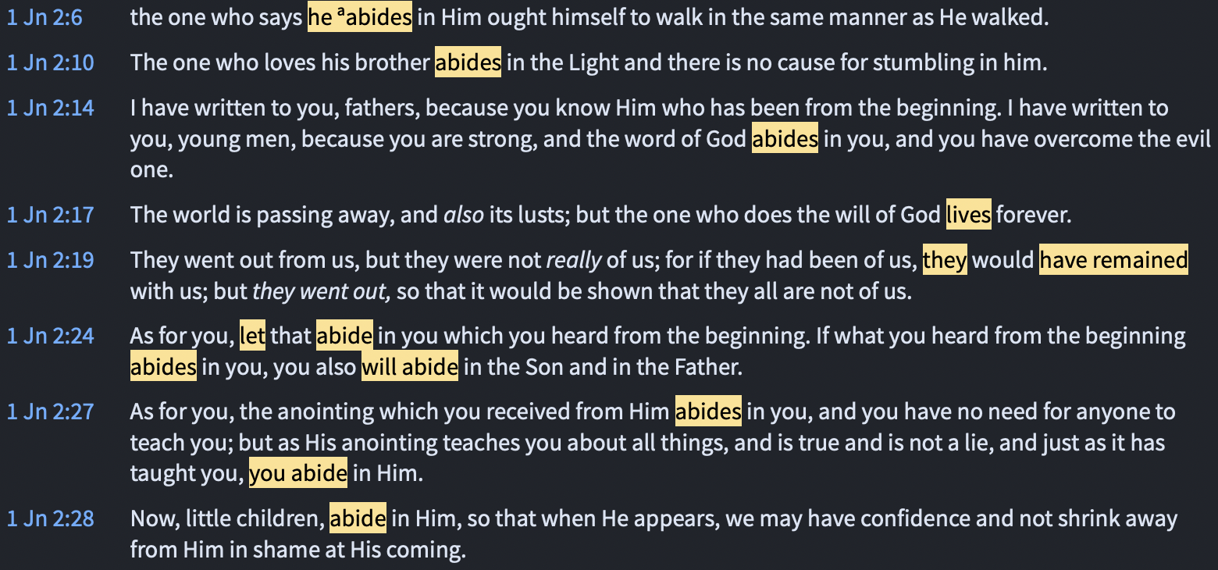

Slide 5
Abiding In Him Depends On What You Know

Slide 6
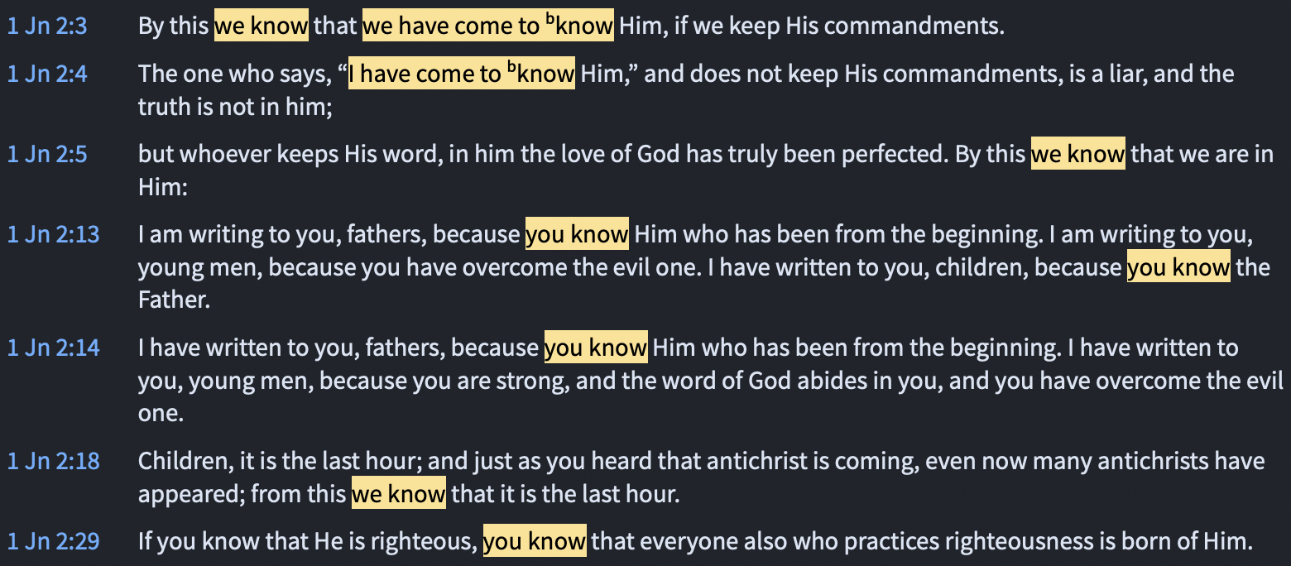

Slide 7
The Joy Of truth

Slide 8
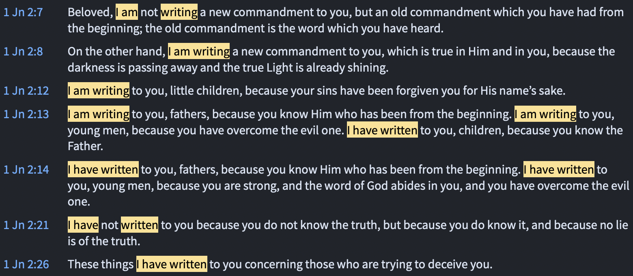

Slide 9
The Joy Of truth
John wrote so that by keeping His word we could know we are in Him (vs. 5)
John wrote so that the word could abide in us, and we could abide in Him (vs. 24)
John wrote so that we could not only know what He commands, but how He walked (vs. 6)

