Slide 1
Contentment
Philippians 4:10 I rejoiced in the Lord greatly that now at length you have revived your concern for me. You were indeed concerned for me, but you had no opportunity. 11 Not that I am speaking of being in need, for I have learned in whatever situation I am to be content. 12 I know how to be brought low, and I know how to abound. In any and every circumstance, I have learned the secret of facing plenty and hunger, abundance and need. 13 I can do all things through him who strengthens me.

Slide 2
Colossians
Introduction

Slide 3
Paul and Secretaries
Romans 16:22 I Tertius, the writer (ha graphas) of this letter, greet you in the Lord
Some scholars doubt the authenticity of certain Pauline epistles (including Colossians)
This is based upon the assumption that we know with certainty what Paul's letters should look like in terms of style and content

Slide 4
Colossae
Was once a great city, but greatly reduced in NT times
Part of the reason for this is the successes of Laodicea and Hierapolis

Slide 5
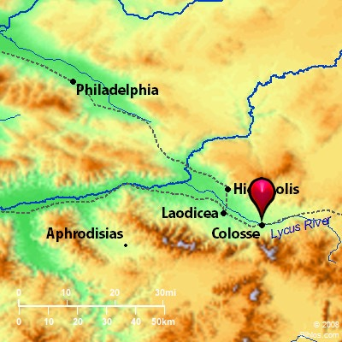

Slide 6
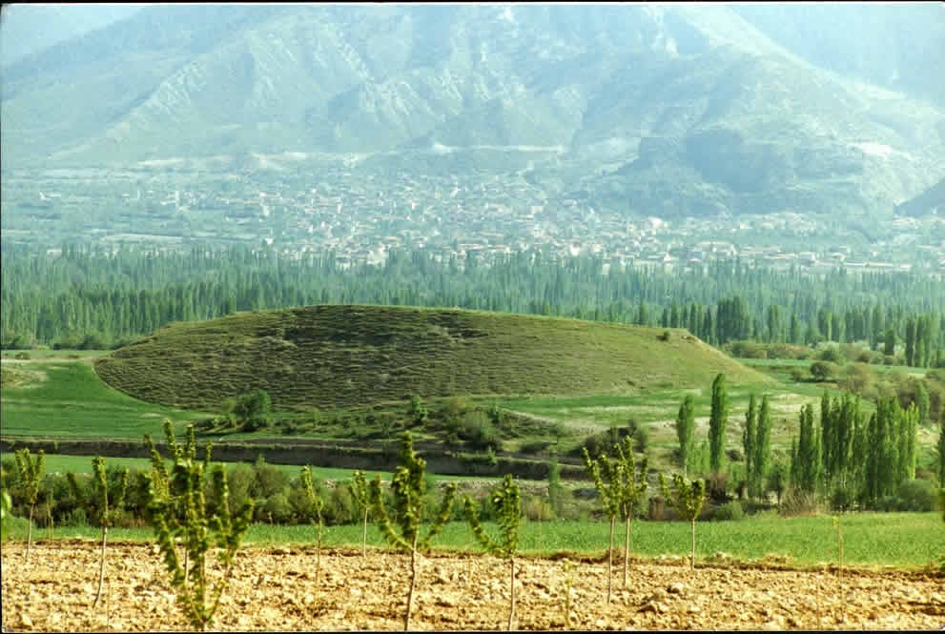
Colossae
Perhaps destroyed by an earthquake in 60-61 AD
Pretty much untouched since then
There was a Jewish population there

Slide 7
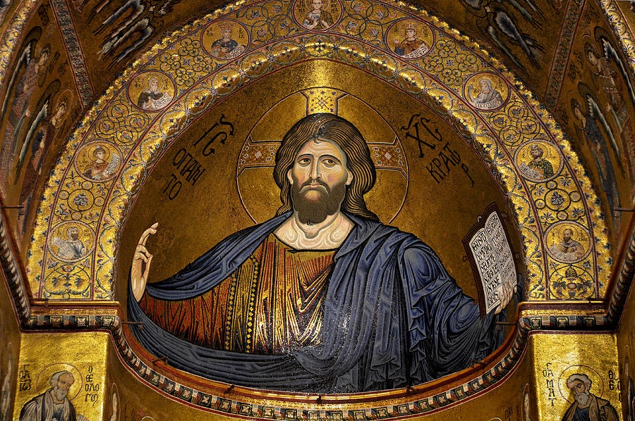
The Occasion for the Letter
Generally, the supremacy of Christ was being questioned.
Specifically, this is known as the Colossian heresy.
The nature of this heresy is highly debated.

Slide 8
The Colossian Heresy
⁸ See to it that no one takes you captive by philosophy and empty deceit, according to human tradition, according to the elemental spirits of the world, and not according to Christ 9 For in him all the fullness of deity dwells bodily… ¹⁶ Therefore let no one pass judgment on you in questions of food and drink, or with regard to a festival or a new moon or a Sabbath…Let no one disqualify you, insisting on asceticism and worship of angels, going on in detail about visions, puffed up without reason by his sensuous mind… ²⁰ If with Christ you died to the elemental spirits of the world, why, as if you were still alive in the world, do you submit to regulations--²¹ "Do not handle, Do not taste, Do not touch"²² (referring to things that all perish as they are used)-- according to human precepts and teachings?²³ These have indeed an appearance of wisdom in promoting self-made religion and asceticism and severity to the body, but they are of no value in stopping the indulgence of the flesh. (Col. 2:8, 16, 20-23)

Slide 9
The Colossian Heresy
"Dear Colossians, we know that you are experiencing hardships: no doubt you aware that there are evil spirits and powers that have authority over our mortal world. These powers prey on the weakness of human bodies and flesh. Thus our world is fraught with cosmic chaos. We can offer, though, knowledge, wisdom, and teachings (traditions) that can protect you from these malevolent forces. By controlling, combating, and disciplining your own frail body, you can resist these powers. Circumcision and strict ritual Torah observance are particularly effective in counteracting these hostile spirits. Once you have submitted yourself to such disciplines of the body, you will gain access to the celestial world—receiving divine wisdom, visions, and provisions to fight against the weakness of the flesh that the evil powers use against you. We can offer you the proper route to spritual fulness and perfection," N. Gupta, Colossians, 18.

Slide 10
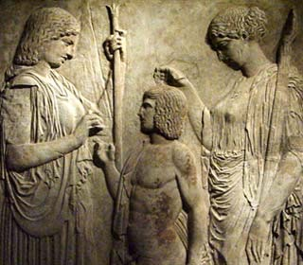
The Colossian Heresy
Pre-Gnostic syncretism?
An unknown Jewish sect?
Jewish Gnosticism?
Christian Gnosticism?

Slide 11
The Structure of Colossians
Opening and Hymn to Christ (1:1-2:5)
Theme of the letter: Superiority of Christ and the pattern of living (2:6-4:6)
Conclusion (4:7-18)

Slide 12
The Significance of Colossians
“God has conquered the powers, delivered all humans from sin and its powers, and reconciled the entire cosmos to himself in, through, and under Christ…The central aspect of the religious significance of Colossians is that it occurs a vision of human victory in the face of an evil that can reach cosmic proportions,” McKnight, Colossians, 3.

Slide 13
The Church at Colossae
Epaphras founded the church.
Did Paul personally visit them?
Ephesus was his center of operations (Acts 19:10)
Of this you have heard before in the word of the truth, the gospel,⁶ which has come to you, as indeed in the whole world it is bearing fruit and increasing-- as it also does among you, since the day you heard it and understood the grace of God in truth,⁷ just as you learned it from Epaphras our beloved fellow servant. He is a faithful minister of Christ on your behalf (Col. 1:5-7)

Slide 14
The gospel bears fruit
Colossians 1:3 In our prayers for you we always thank God, the Father of our Lord Jesus Christ, 4 for we have heard of your faith in Christ Jesus and of the love that you have for all the saints, 5 because of the hope laid up for you in heaven. You have heard of this hope before in the word of the truth, the gospel 6 that has come to you. Just as it is bearing fruit and growing in the whole world, so it has been bearing fruit among yourselves from the day you heard it and truly comprehended the grace of God. 7 This you learned from Epaphras, our beloved fellow servant. He is a faithful minister of Christ on your behalf, 8 and he has made known to us your love in the Spirit.

Slide 15
Transferal to the kingdom
Colossians 1:9 For this reason, since the day we heard it, we have not ceased praying for you and asking that you may be filled with the knowledge of God’s will in all spiritual wisdom and understanding, 10 so that you may lead lives worthy of the Lord, fully pleasing to him, as you bear fruit in every good work and as you grow in the knowledge of God. 11 May you be made strong with all the strength that comes from his glorious power, and may you be prepared to endure everything with patience, while joyfully 12 giving thanks to the Father, who has enabled you to share in the inheritance of the saints in the light. 13 He has rescued us from the power of darkness and transferred us into the kingdom of his beloved Son, 14 in whom we have redemption, the forgiveness of sins.

Slide 16
Rescue and Redemption
Exodus 6:6 Say therefore to the sons of Israel, ‘I am the Lord, and I will rescue you from the burdens of the Egyptians and deliver you from slavery to them. I will redeem you with an outstretched arm and with mighty acts of judgment

Slide 17
Transferal to the kingdom
Colossians 1:9 For this reason, since the day we heard it, we have not ceased praying for you and asking that you may be filled with the knowledge of God’s will in all spiritual wisdom and understanding, 10 so that you may lead lives worthy of the Lord, fully pleasing to him, as you bear fruit in every good work and as you grow in the knowledge of God. 11 May you be made strong with all the strength that comes from his glorious power, and may you be prepared to endure everything with patience, while joyfully 12 giving thanks to the Father, who has enabled you to share in the inheritance of the saints in the light. 13 He has rescued us from the power of darkness and transferred us into the kingdom of his beloved Son, 14 in whom we have redemption, the forgiveness of sins.

Slide 18
What is the kingdom?
Conceptually, “the reign of God”
Jesus discussed the topic very frequently
Not equivalent with the church
The reign of God manifested in the person of Jesus and demonstrated through the church

Slide 19
The Hymn of Superiority
Colossians 1:15 He is the image of the invisible God, the firstborn of all creation; 16 for in him all things in heaven and on earth were created, things visible and invisible, whether thrones or dominions or rulers or powers—all things have been created through him and for him. 17 He himself is before all things, and in him all things hold together. 18 He is the head of the body, the church; he is the beginning, the firstborn from the dead, so that he might come to have first place in everything. 19 For in him all the fullness of God was pleased to dwell, 20 and through him God was pleased to reconcile to himself all things, whether on earth or in heaven, by making peace through the blood of his cross.

Slide 20
Pre-requisite texts for the Superiority Hymn
Genesis 1:1- In the beginning, God created the heavens and the earth
Genesis 1:26-27— Then God said, Let us make mankind in our image, in our likeness…so God created mankind in his own image, in the image of God he created them.
Proverbs 8:22- Yahweh brought me (Wisdom) forth as the first of his works, before his deeds of old
Psalm 104:24- How many are your works, Yahweh! In wisdom you made them all; the earth is full of your creatures.

Slide 21
Pre-requisite texts for the Superiority Hymn
Sirach 43.26- Because of him each of his messengers succeeds, and by his word all things hold together.
Wisdom 7:22-25- There is in her (Wisdom) a spirit that is intelligent, holy, unique, manifold, subtle, mobile, clear, unpolluted, distinct, invulnerable, loving the good, keen, irresistible, beneficent…all-powerful, overseeing all, and penetrating through all spirits that are intelligent, pure and altogether subtle. For wisdom is more mobile than any motion; because of her pureness, she pervades and penetrates all things. For she is a breath of the power of God, and a pure emanation of the glory of the Almighty; therefore nothing defiled gains entrance into her.

Slide 22
Pre-requisite texts for the Superiority Hymn
“The divine Word who is high above all these, has not been visibly portrayed, being likened to none of the sense perceptible objects. No, He is himself the Image of God, highest of all beings intellectually perceived, placed nearest, with no intervening distance to the Along truly existent One. For we read, “I will talk with you from above the mercy-seat between the two Cherubim,” (Ex. 25.21), words which show that while the Word is the charioteer of the Powers, He who talks is seated in the chariot, giving directions to the charioteer for the right wielding of the reins of the Universe,” Philo, Flight, 101.

Slide 23
The Hymn of Superiority
Colossians 1:15 He is the image of the invisible God, the firstborn of all creation; 16 for in him all things in heaven and on earth were created, things visible and invisible, whether thrones or dominions or rulers or powers—all things have been created through him and for him. 17 He himself is before all things, and in him all things hold together. 18 He is the head of the body, the church; he is the beginning, the firstborn from the dead, so that he might come to have first place in everything. 19 For in him all the fullness of God was pleased to dwell, 20 and through him God was pleased to reconcile to himself all things, whether on earth or in heaven, by making peace through the blood of his cross.

