Slide 1

Lesson 1: Disciples Prioritize
Studies to Help Disciples Grow Stronger

Slide 2

Disciples Prioritize
Lesson 1
What do you want the most? What is your top priority?
“They brought their boats to land, forsook all and followed Him”
(Luke 5:11).
  A disciple is a learner-follower, one who learns from and follows his master. He does as the master instructs.
  Luke 5:11 shows Peter, Andrew, James and John doing this.
  They made the same choice that you have made: to be a disciple of Christ.
  The expression “forsook all and followed Him” shows how this decision radically changed their priorities in life.
In this lesson you will learn:
  What the disciple’s single priority must be.
  How the disciple’s sole priority affects one’s life.

Slide 3
What does the disciple want most?
Lesson 1: Disciples Prioritize
Studies to Help Disciples Grow Stronger

Slide 4
What does the disciple want most?
Lesson 1: Disciples Prioritize
The disciple wants to be like his/her teacher.
  Jesus says: “A disciple is not above his __________, but everyone who is perfectly trained will be like his teacher” (Luke 6:40).
  Discipleship means becoming like our Master, Jesus: “to be conformed to the image of His Son” (Romans 8:29).
  There are many definitions for “religion” or “being religious.” Discipleship should not be confused with worldly concepts of religion. Discipleship (Christianity) is the process of becoming like Jesus Christ.

Slide 5
What does the disciple want most?
Lesson 1: Disciples Prioritize
This is the essence of Christianity (discipleship): to become like Jesus.
  “to this you were called, because __________ also suffered for us, leaving us an __________, that you should follow His steps.”
  (1 Peter 2:21)
  In every situation, in every circumstance, the disciple asks, “How would Jesus act in this situation?,” “What would He say?,” “What would he do?,” or “How can I conduct myself to bring glory to Him?”
  This point is crucial to all spiritual development. Christianity is the process of changing self to be like Christ.
  Jesus calls this “following Me:” “If anyone desires to __________ after Me, let him __________ himself, and take up his __________ daily, and follow me” (Luke 9:23).
  Whether it is termed Christianity, following Jesus, or discipleship the meaning
  is the same: becoming like Jesus.

Slide 6
What does the disciple want most?
Lesson 1: Disciples Prioritize
What motivates the disciple to change and become more like Jesus?
  The eternal reward of heaven gives the disciple courage, motivation, and endurance to continue discipleship on a daily basis (see 2 Corinthians 4:16-18).
  Luke urges the disciple to strive for heaven. He bluntly, but honestly, contrasts the terrors of hell with the joys of heaven.
  Read Luke 16:19-31. What was the end result of each man’s life?
  List the horrors of eternal torment the rich man is enduring.
  List the glories of heaven that Lazarus is enjoying.
  Luke’s message is obvious: don’t miss heaven! What is the only way to get to heaven (see John 14:6)?

Slide 7
What does the disciple want most?
Lesson 1: Disciples Prioritize
Is heaven the only motivator for Christians?
  No. Jesus taught that Christians are winners now, in this life here on earth.
  Read John 10:10. What kind of life does Jesus offer His followers now?
  Read Philippians 4:11-13. Does Paul sound like an unhappy Christian?
  Think carefully. How will your Christianity make your life better now? How does becoming like Jesus make you a better spouse, employee, or neighbor? Identify some specific advantages Christians have over those who do not know Jesus.

Slide 8
What does the disciple want most?
Lesson 1: Disciples Prioritize
Summary: Disciples desire to be like Jesus for two reasons:
  Becoming like Christ is the only way to heaven.
  Becoming like Christ is the only means to true happiness here on this earth.

Slide 9
How do we “deny self” to be like Jesus?
Lesson 1: Disciples Prioritize
Studies to Help Disciples Grow Stronger

Slide 10
How do we “deny self” to be like Jesus?
Lesson 1: Disciples Prioritize
The disciple obeys God instead of pleasing self.
  Obedience is an attitude of submission to God and compliance with His will in all things.
  Every part of life is made to conform to God’s will, not our own.
  Read Ephesians 4:22-24. Paul says we have “put off” the old man and “put on” the new man. Who controls the new man?
  The essence of obedience is submission. Read Luke 5:4-5
    Did Peter want to go fishing again?
    Did Peter think he would catch anything?
    Why did Peter go fishing anyway?
    What does this teach us about obeying Jesus even when we do not understand or agree with His commands?

Slide 11
How do we “deny self” to be like Jesus?
Lesson 1: Disciples Prioritize
The disciple obeys God instead of pleasing self.
  Obedience is the test of our discipleship: “But why do you call __________ ‘Lord, Lord,’ and do not __________ the things which I __________?” (Luke 6:46)
  If we truly love God and His Son, obedience will be our way of life:
  “If you __________ Me, keep __________ commandments” (John 14:15).
  We deny self to be like Jesus by obeying Him and His word.

Slide 12
How do we “deny self” to be like Jesus?
Lesson 1: Disciples Prioritize
The disciple obeys Jesus, even if family is opposed to it.
  “If anyone comes to Me and does not __________ his father and mother, wife and children, brothers and sisters, yes, and his __________ life also, he cannot be My __________“ (Luke 14:26).
  What does it mean to “hate” family?
  How should a disciple react if family criticizes, ridicules, or discourages his or her new relationship with Jesus?
  Does “family time” (ball games, picnics, outings, etc.) come before serving Jesus?
  Jesus gives specific instructions regarding the disciple’s treatment of family in Ephesians 5-6. We will examine those instructions in another lesson, but at this point you must understand that following Jesus is more important than pleasing your family.

Slide 13
How do we “deny self” to be like Jesus?
Lesson 1: Disciples Prioritize
The disciple obeys Jesus and does not allow possessions to control him.
  Many are driven by and obsessed with their material possessions such as money, cars, houses, and clothes.
  Luke gives us Jesus’ perspective on material goods in Luke 12:15. Read this passage now.
    What is covetousness?
    Are possessions more important than following Jesus?
    Should the desire for more “stuff” destroy our ability to follow Jesus Christ?
  Read Luke 18:18-23. Why didn’t this man follow Jesus?
  The disciple needs to be certain that possessions do not dictate how life is lived: “For what __________ is it to a man if he gains the whole world, and is himself
  destroyed or lost?” (Luke 9:25).

Slide 14
How do we “deny self” to be like Jesus?
Lesson 1: Disciples Prioritize
The disciple obeys Jesus at all times.
  Jesus teaches us to take up our cross “daily” (Luke 9:23).
  Christianity is not performed only on Sunday in a church building.
  The disciple continually follows Jesus, i.e., the disciple changes self to be like Jesus.
  At work, if an employer or superior asks a disciple to do wrong will he or she do so?
  At school, will a disciple cheat on an exam or copy someone else’s homework assignment?
  At home, will each partner try to get his or her own way, so fighting and strife mar the home?
  Ultimately discipleship becomes something we are, not something we do.
  It is a continual manner of life.

Slide 15
How do we “deny self” to be like Jesus?
Lesson 1: Disciples Prioritize
The disciple obeys Jesus despite opposition from the world.
  The world cannot understand disciples. They think we are missing out on all the “fun” of sin and wonder why we are not joining them (read 1 Peter 4:4).
  However, disciples find great contentment and joy from living as Jesus commands because they know this way of life leads to heaven (John 14:1-6). Disciples understand that reaching heaven is far more important than pleasing their peers.
  Disciples can resist peer pressure by remembering that life in the world is ultimately vain and empty because it does not lead to heaven. Abundant living and contentment can only be found in Jesus (John 10:10).
  Make up your mind now that you will never go back to the vanity of worldliness but will continue to learn more and more about being a disciple of Christ.
  ”No one, having put his hand to the plow, and looking back, is fit for the
  kingdom of God” (Luke 9:62). Don’t look back!

Slide 16
Conclusion
Lesson 1: Disciples Prioritize
Studies to Help Disciples Grow Stronger

Slide 17
Conclusion
Lesson 1: Disciples Prioritize
Christianity is a way of life in which we attempt to become like Jesus.
In every situation and circumstance Christ’s disciple asks, “What would Jesus do?,” or “How would Jesus act in this situation?”
Obedience to Jesus determines whether we are true disciples of Christ.
The disciple lives in obedience to Jesus because this is the only way to receive the reward of heaven.

Slide 18
Conclusion
Lesson 1: Disciples Prioritize
What parts of your life are not like Jesus? Use the following space to write down some specific actions and behaviors that need changing. No one will look at your list or use it to embarrass or shame you. This exercise is for your personal use only and will help you identify problem areas that need prayer, discipline, and effort. Note: this is not something only new Christians need to do. All Christians must continually evaluate themselves and their walk with God (see 2 Corinthians 13:5).
  Home
  Job
  Truth and Integrity
  Influencing others
  Resisting temptation

Slide 19
Lesson 1: Disciples Prioritize
Studies to Help Disciples Grow Stronger

Slide 20
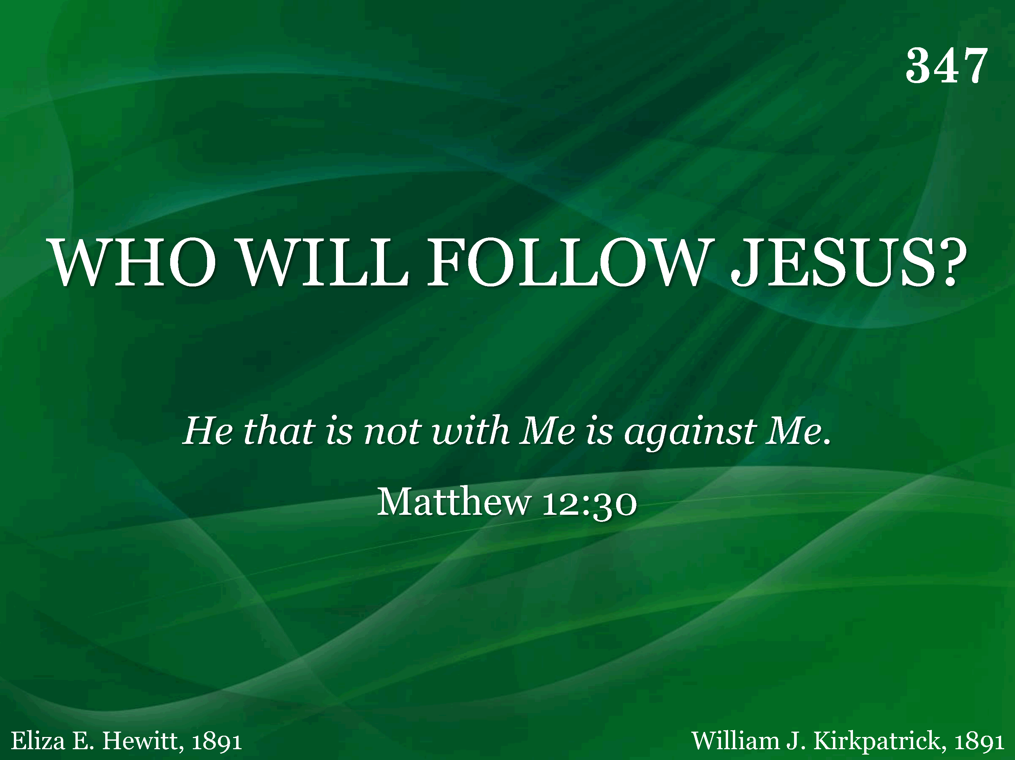
347 - Who Will Follow Jesus - Title

Slide 21
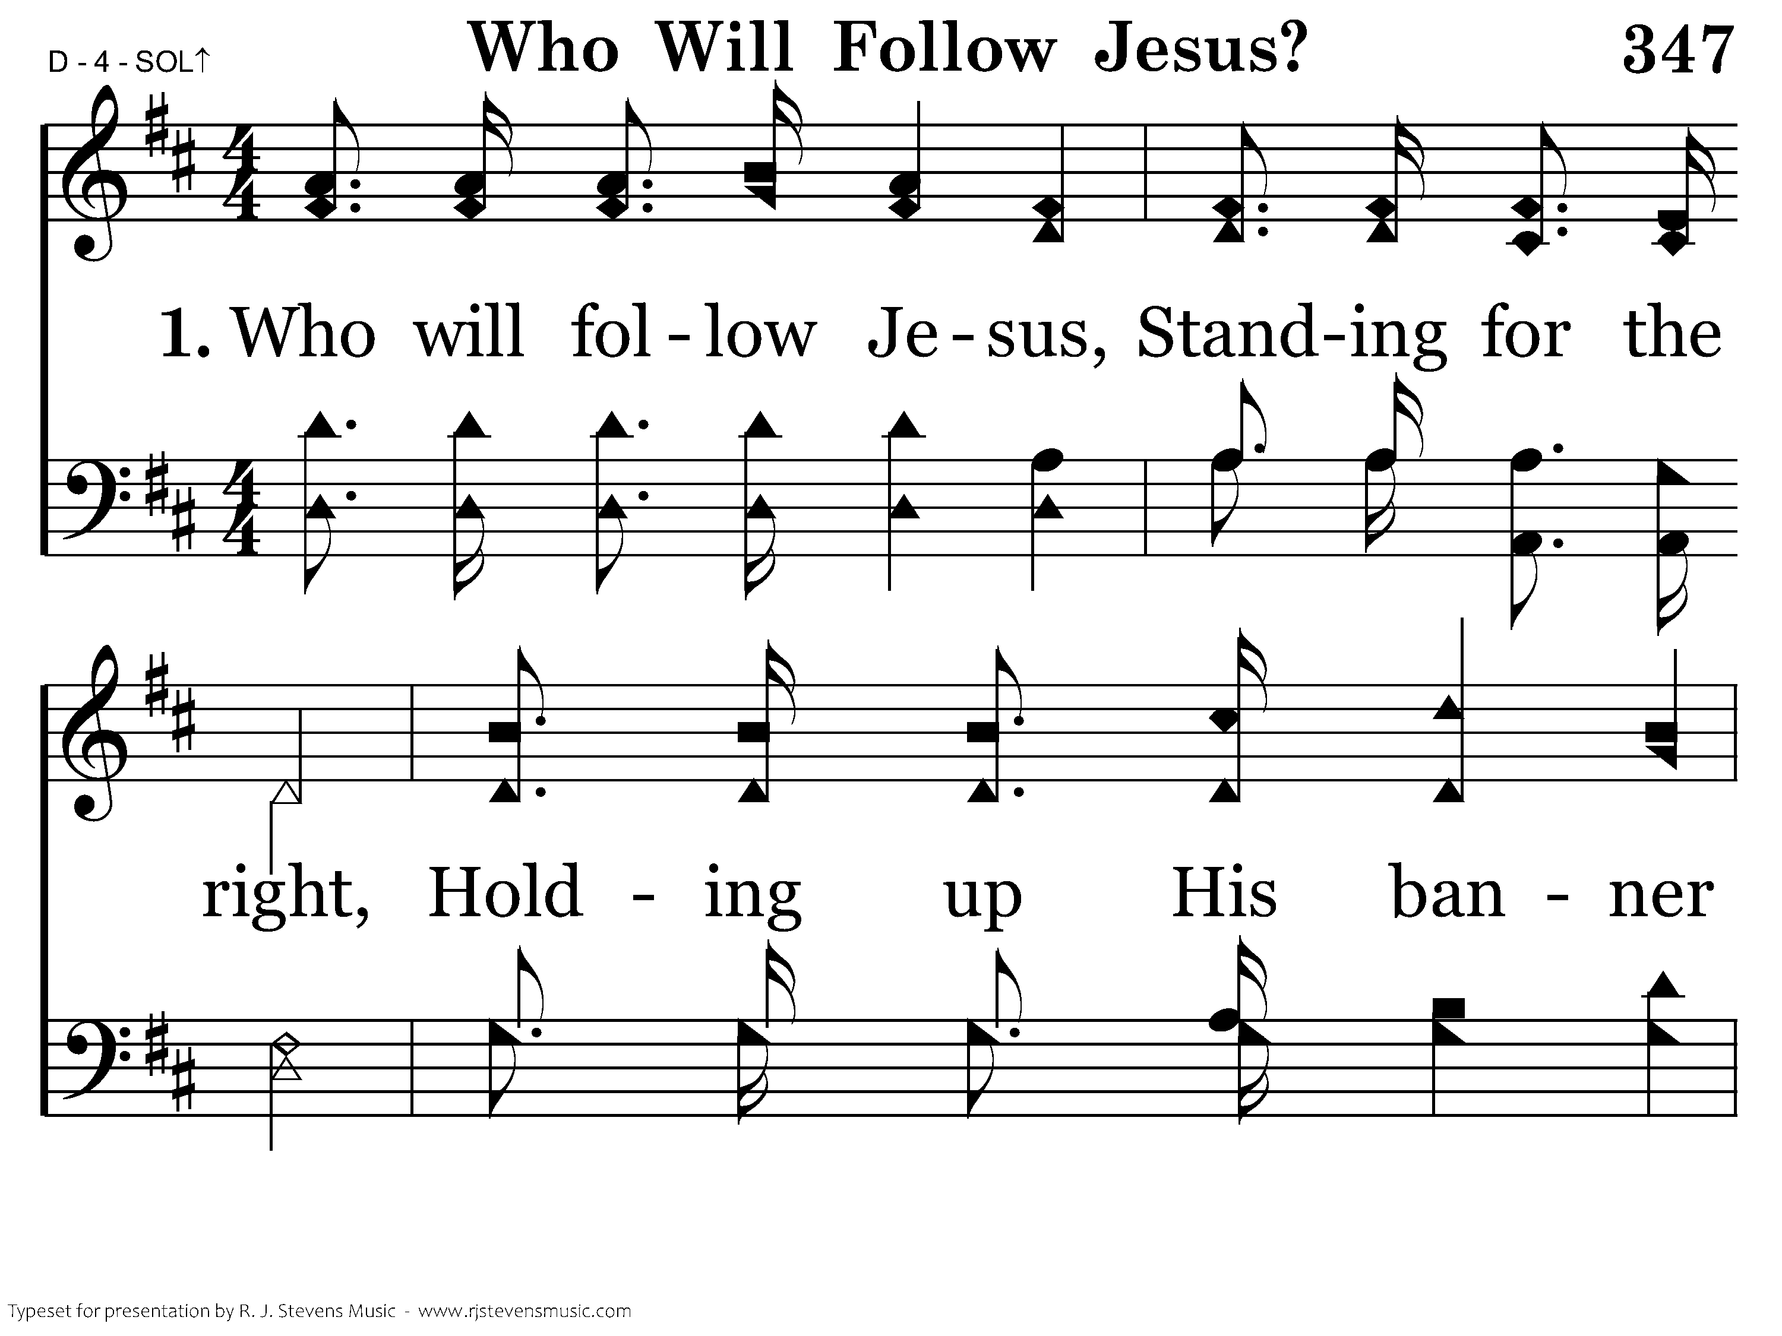
347 - Who Will Follow Jesus - 1.1

Slide 22
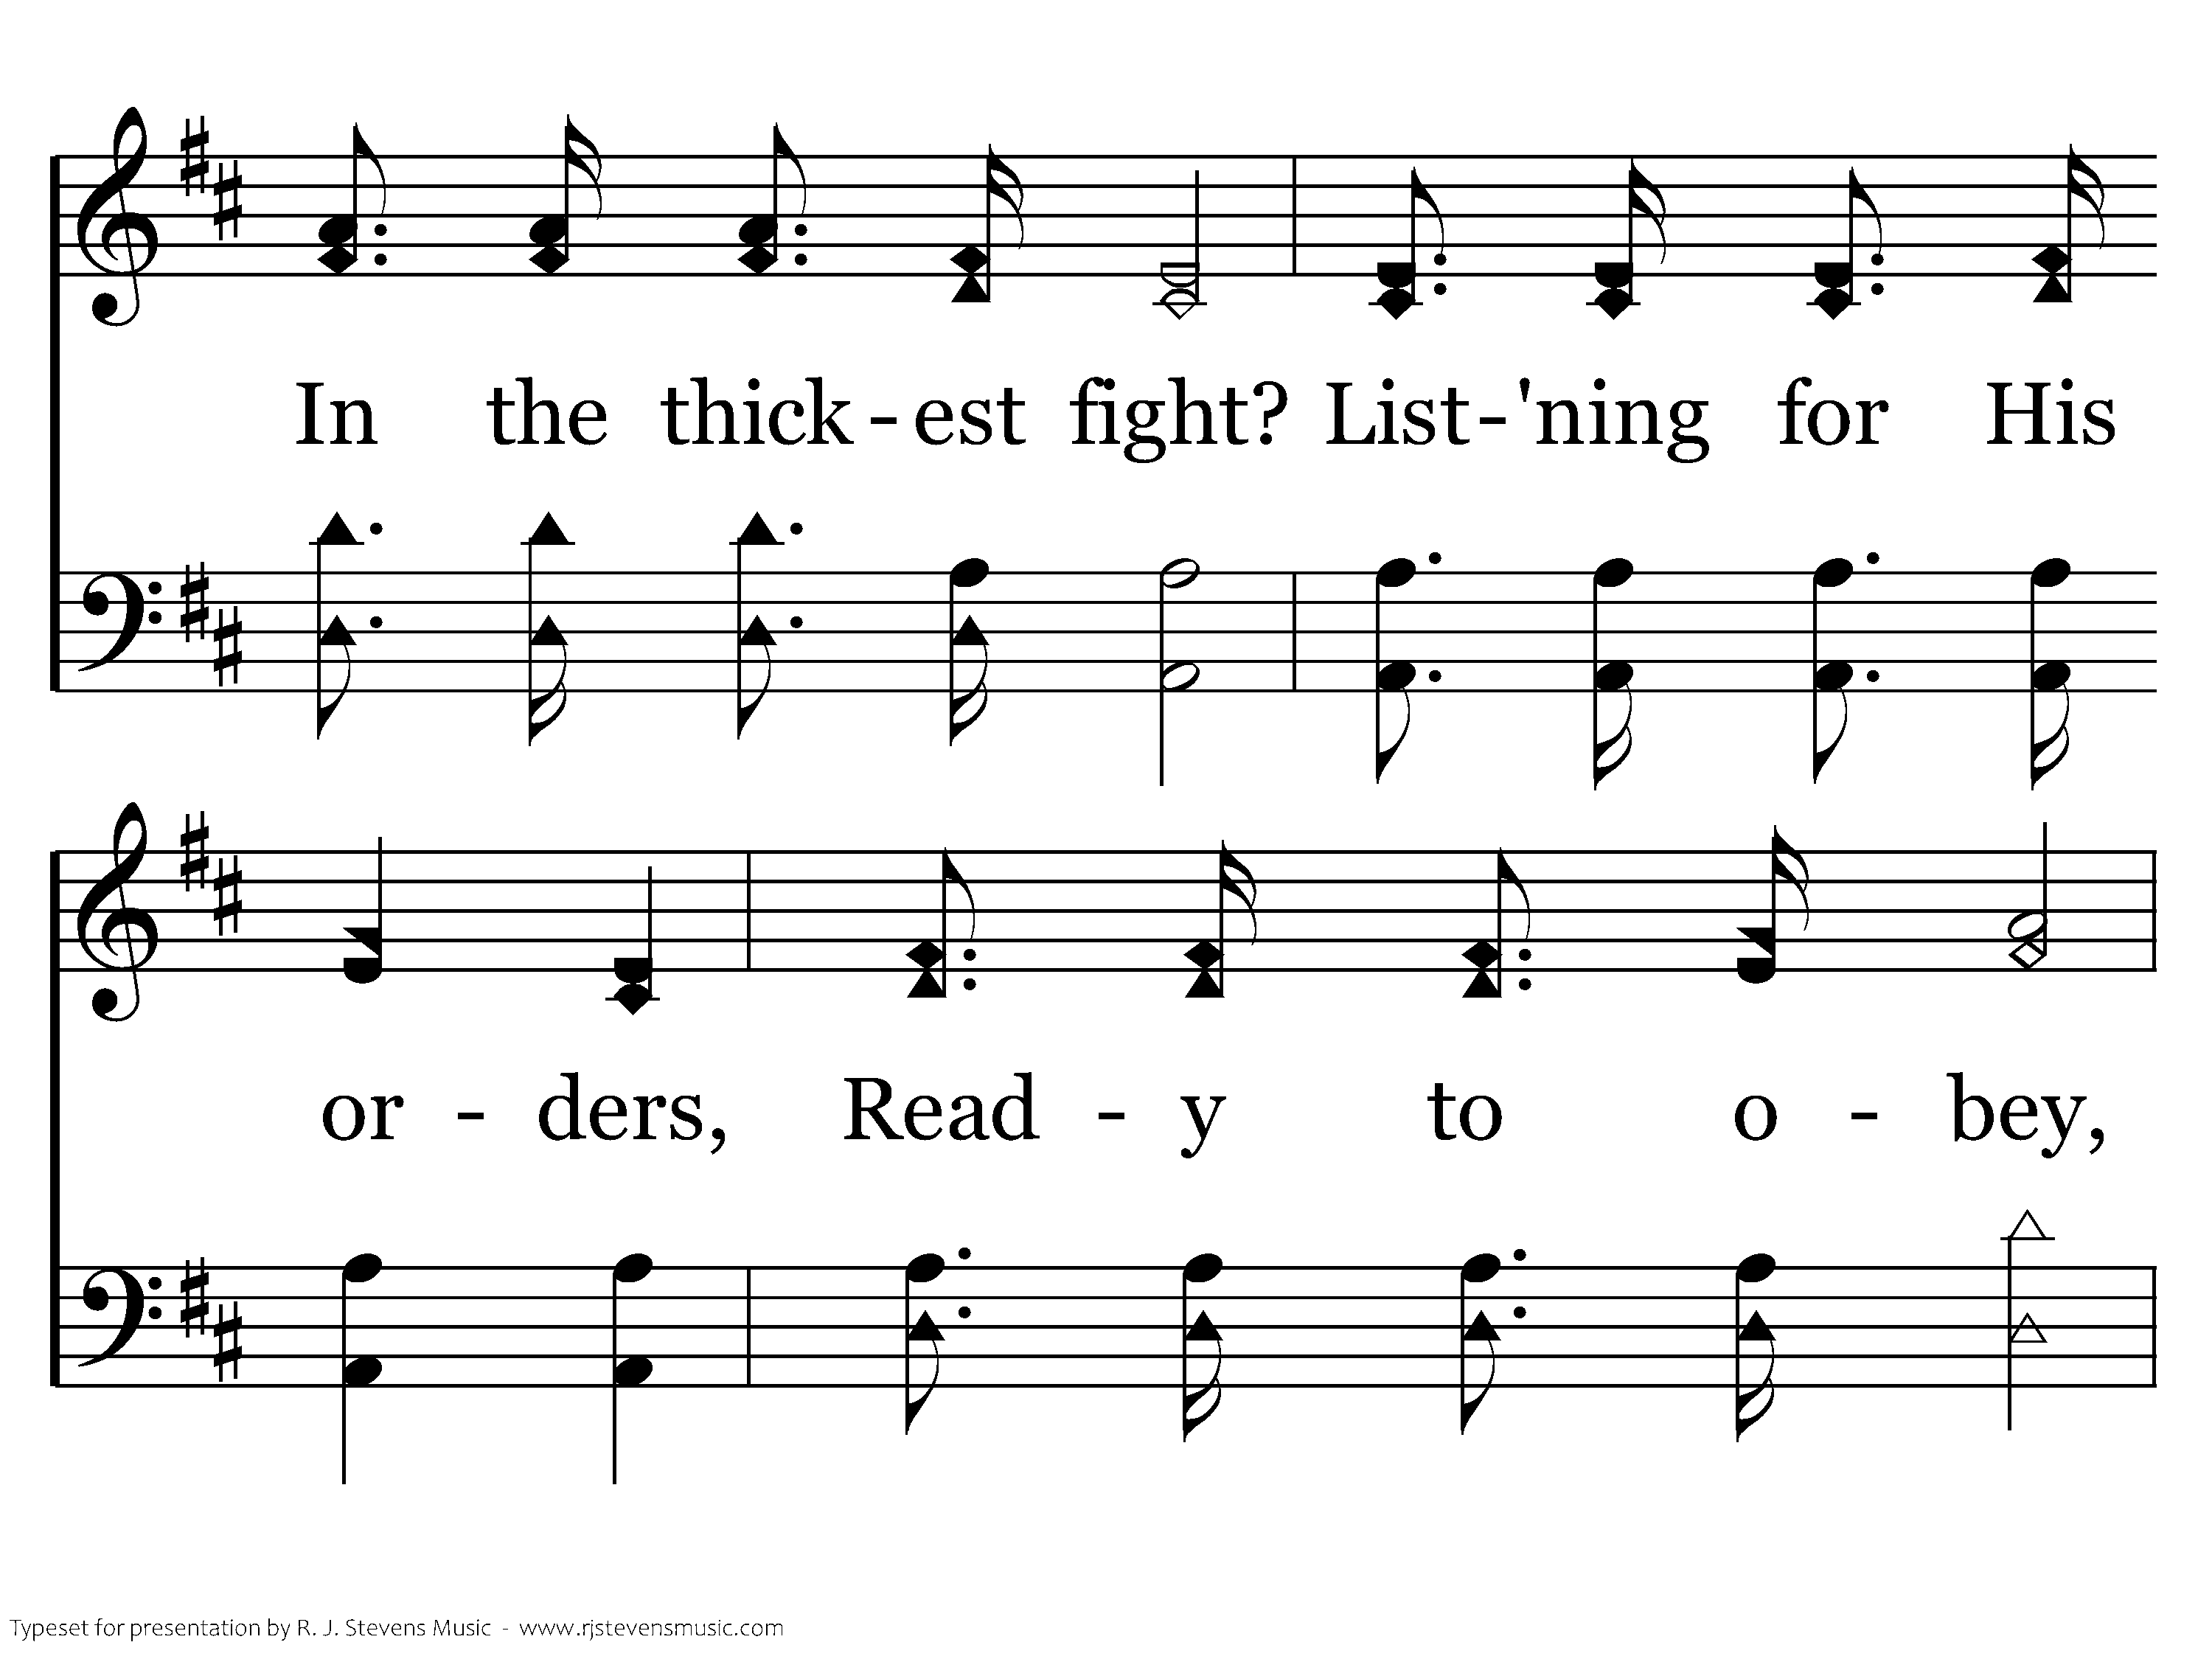
347 - Who Will Follow Jesus - 1.2

Slide 23
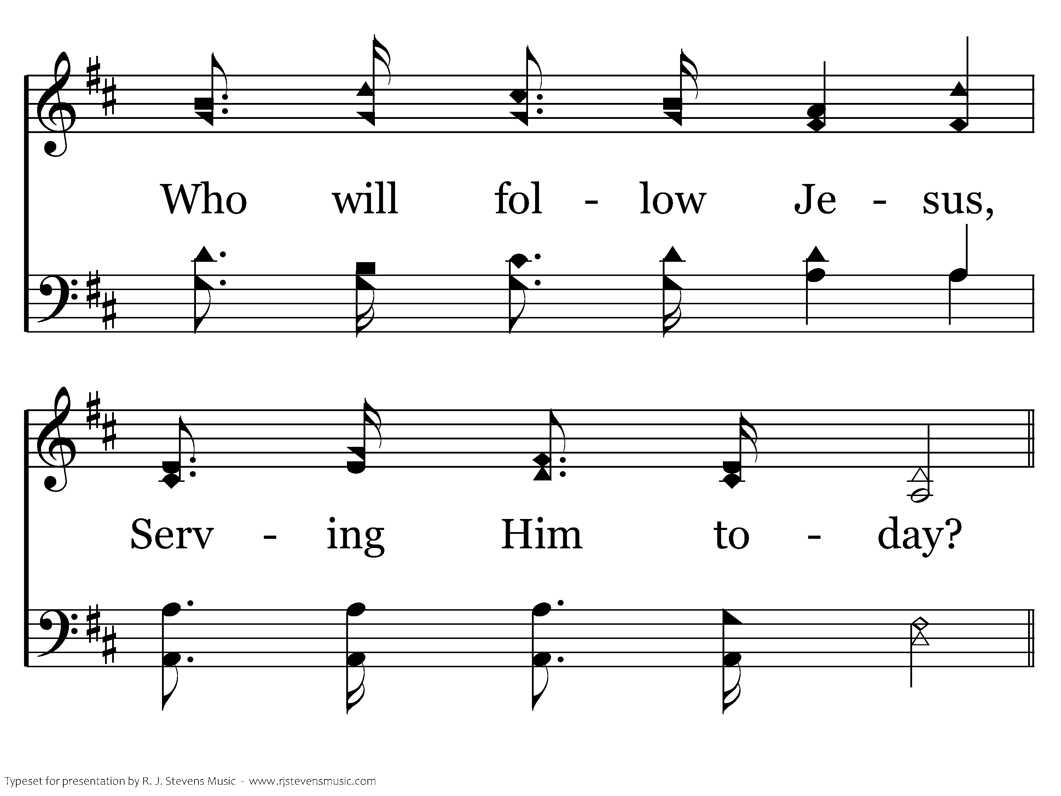
347 - Who Will Follow Jesus - 1.3

Slide 24
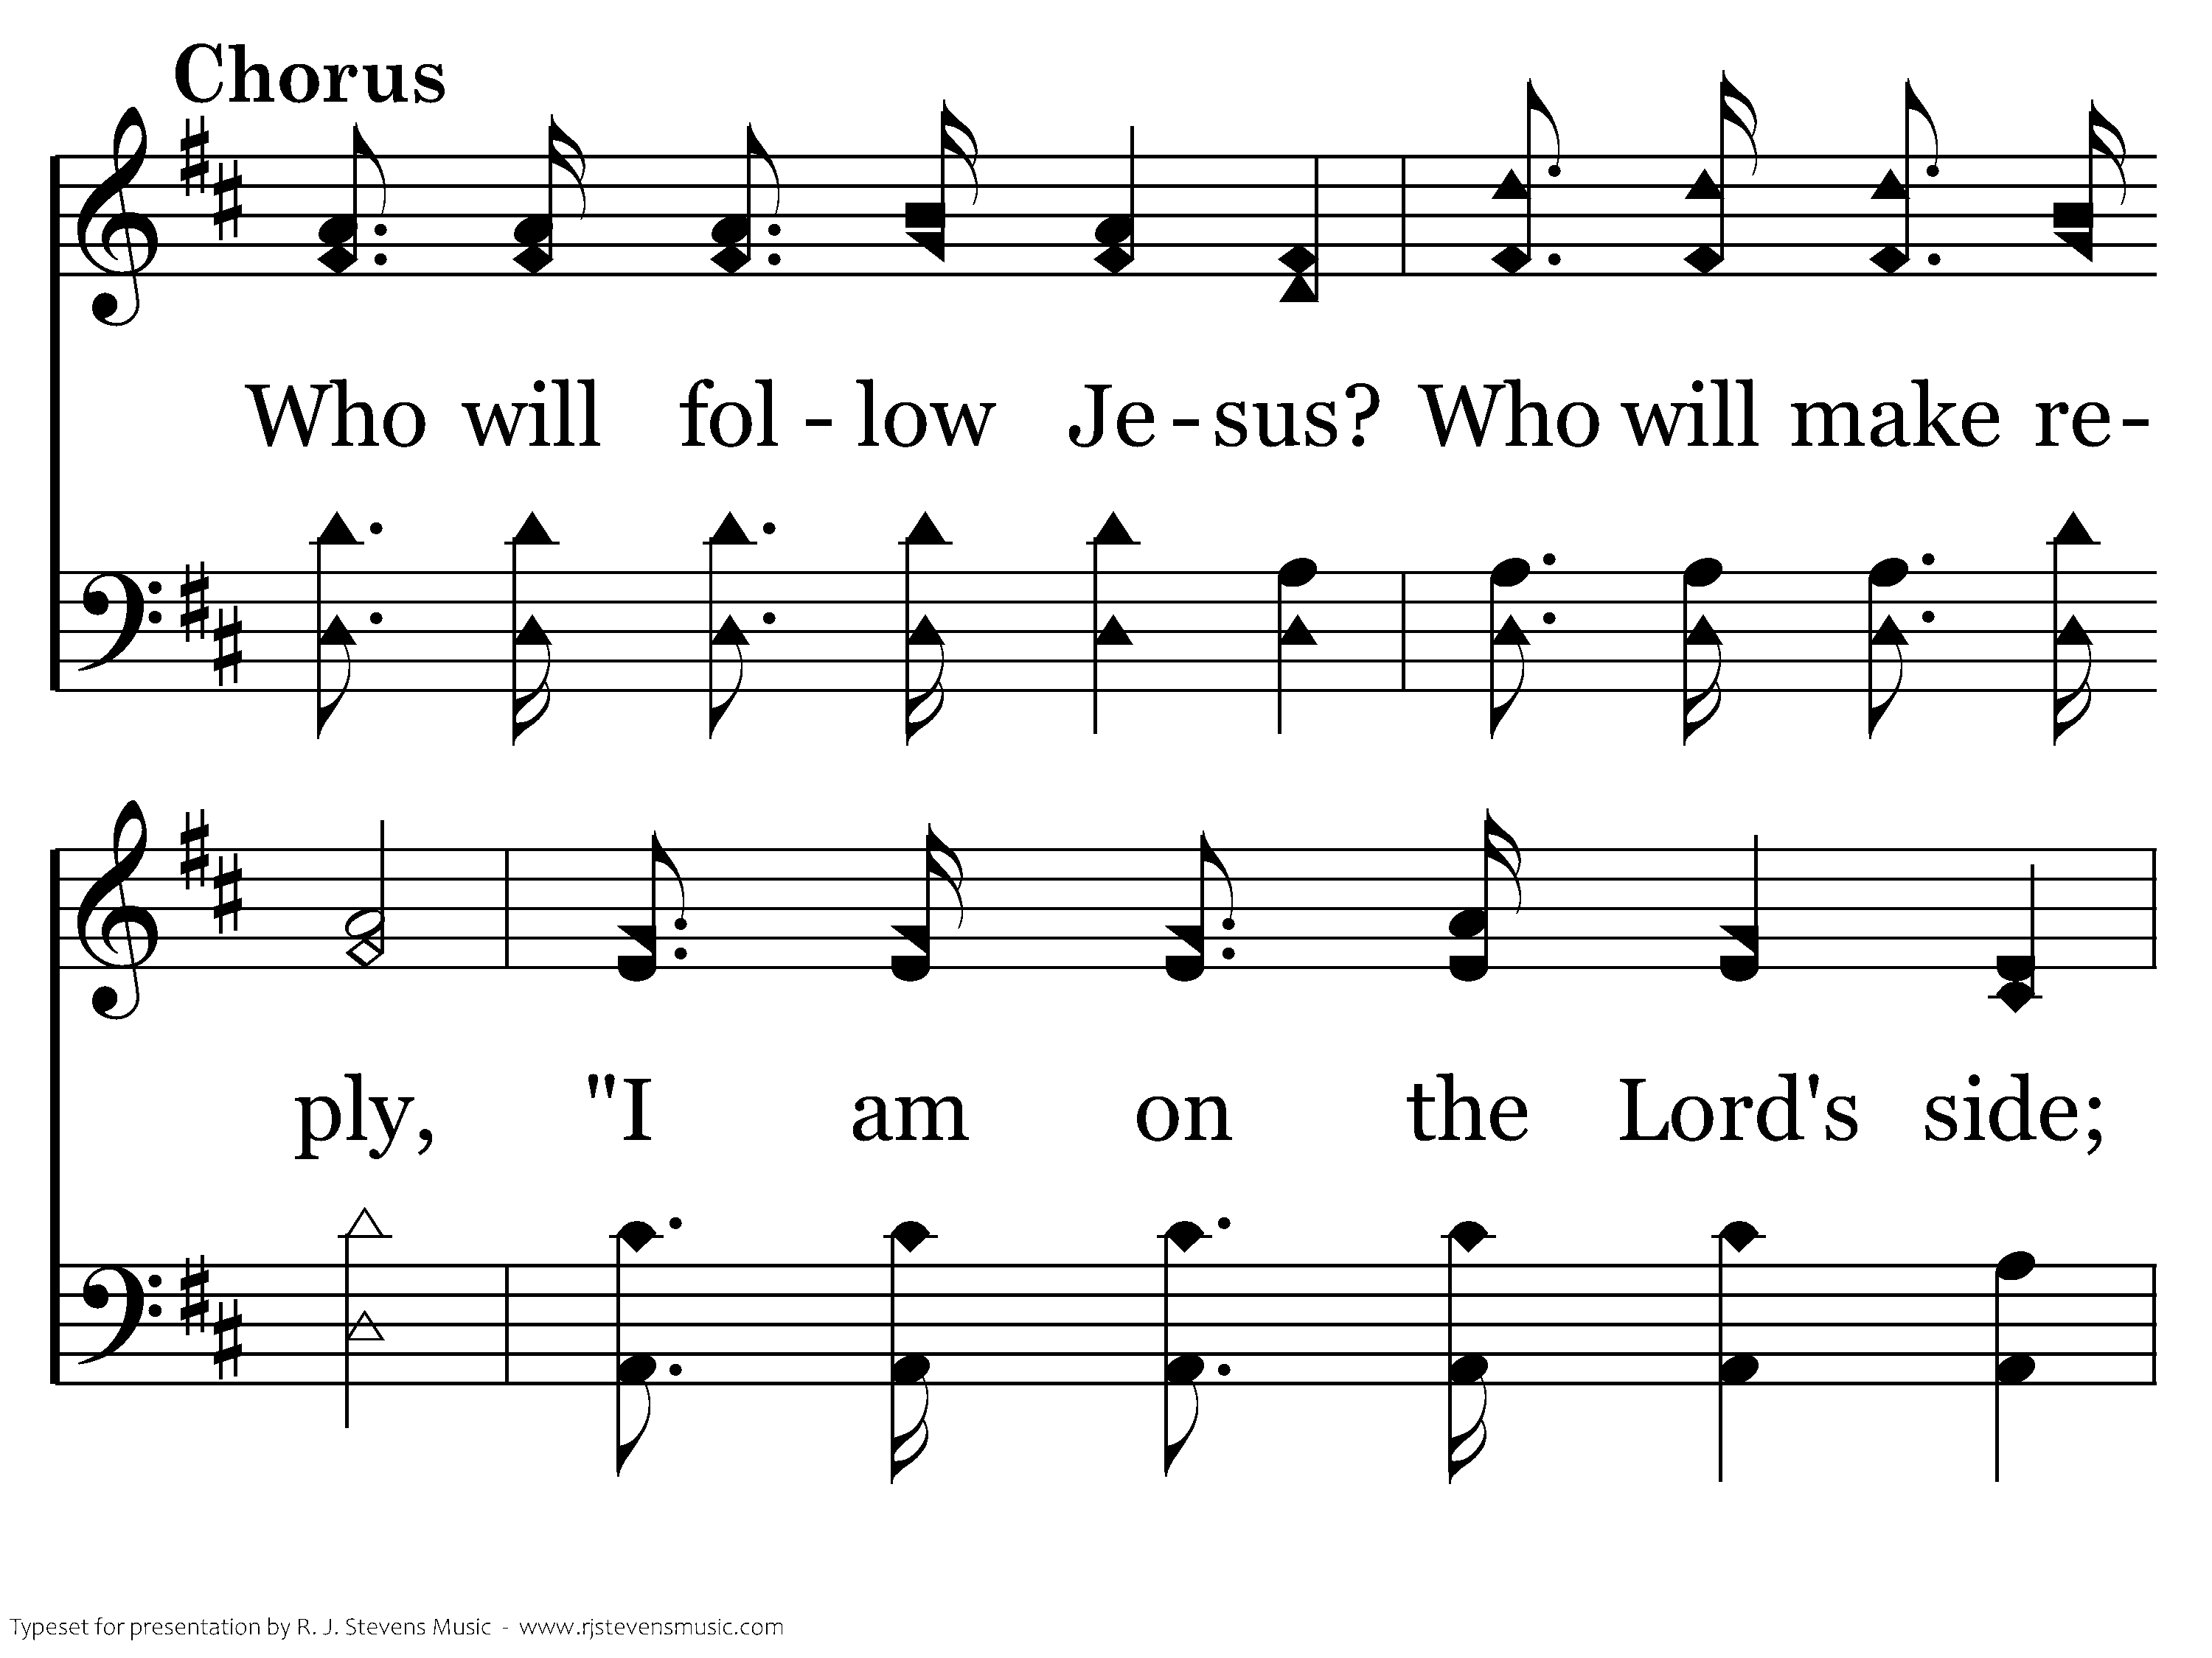
347 - Who Will Follow Jesus - C.1

Slide 25
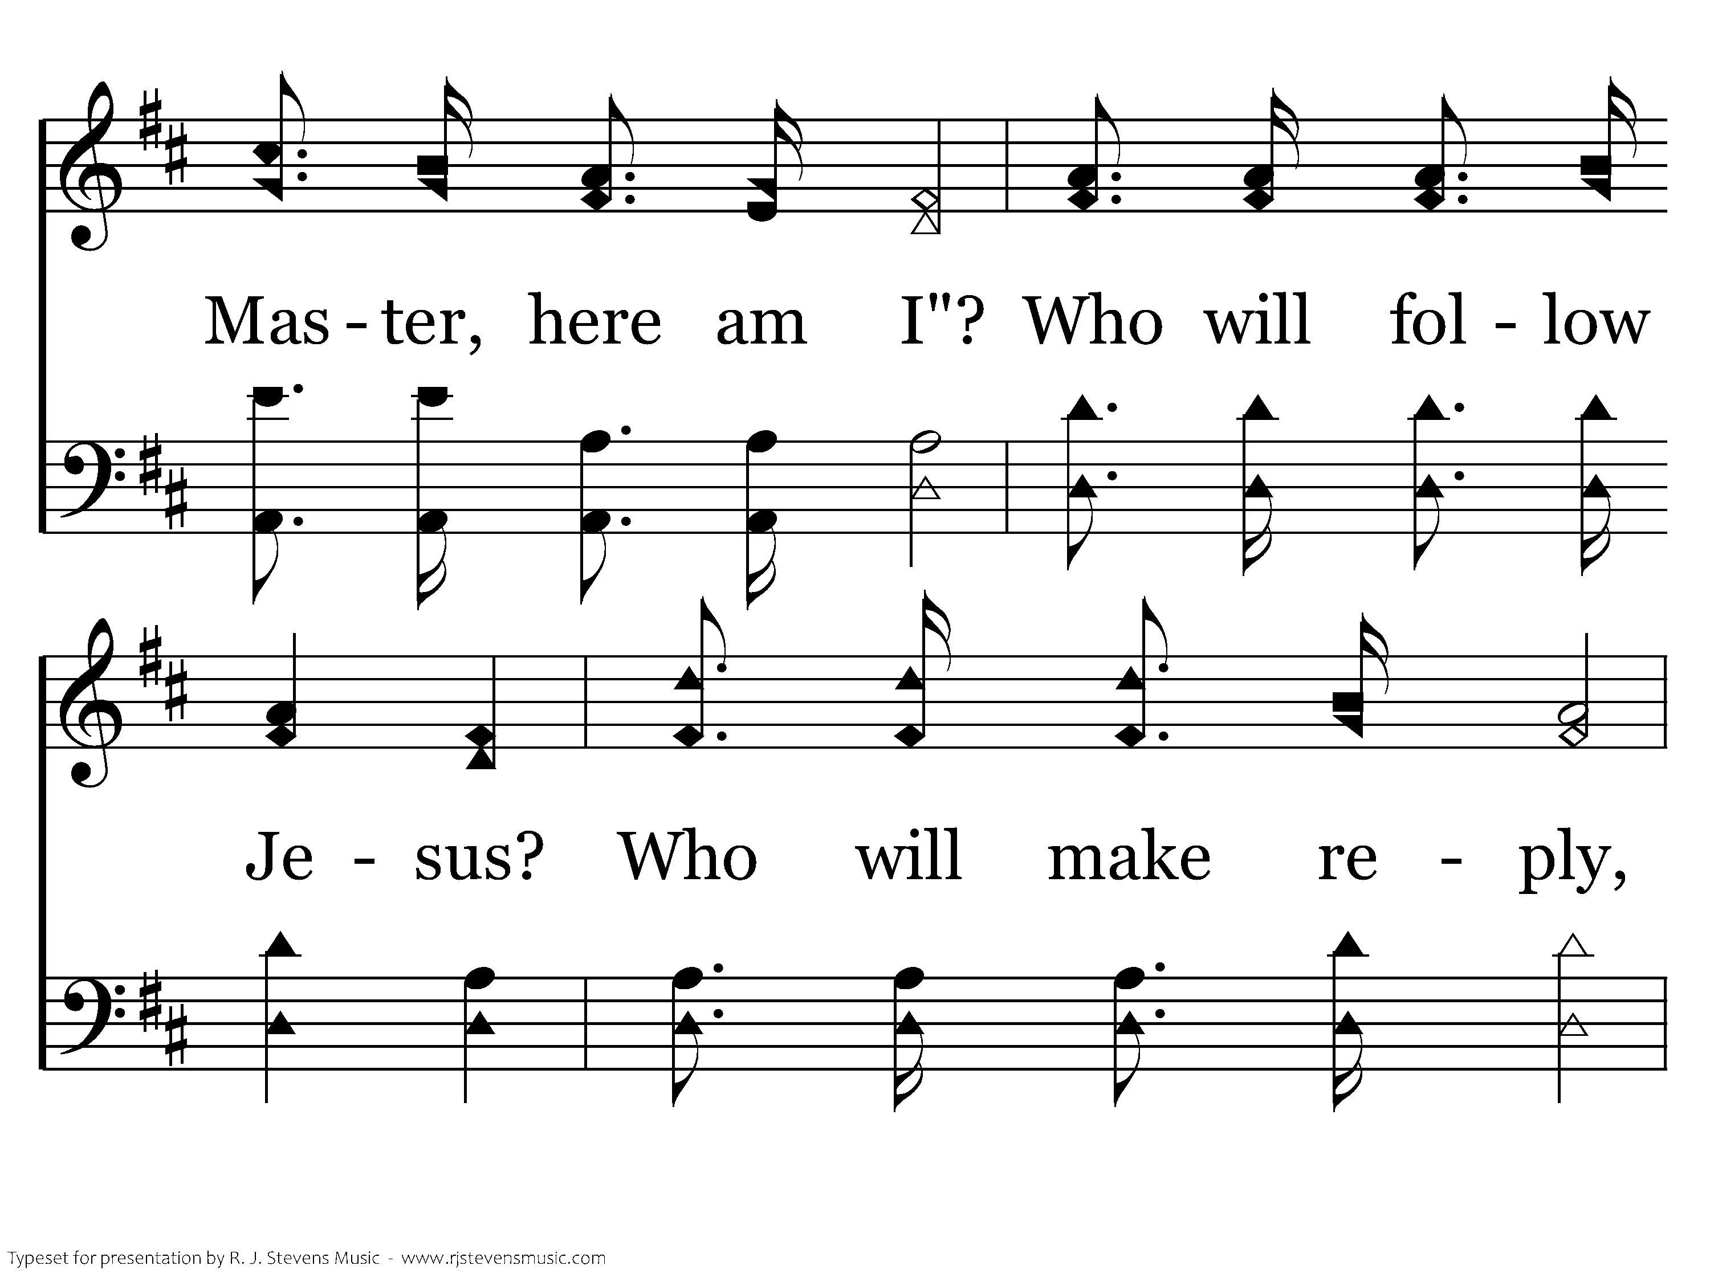
347 - Who Will Follow Jesus - C.2

Slide 26
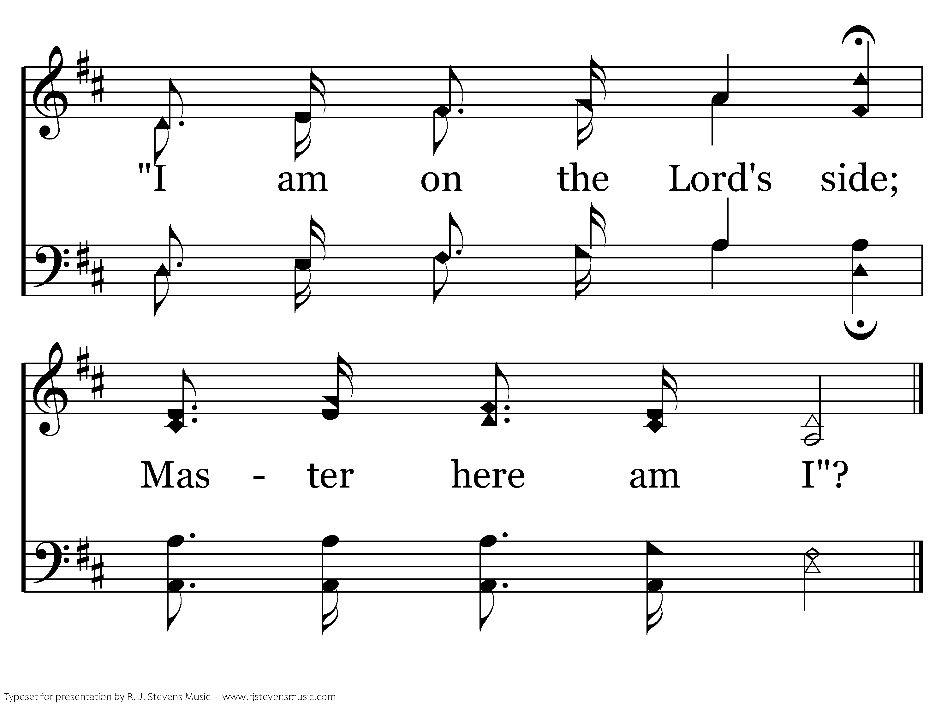
347 - Who Will Follow Jesus - C.3
End of Verse 1

Slide 27
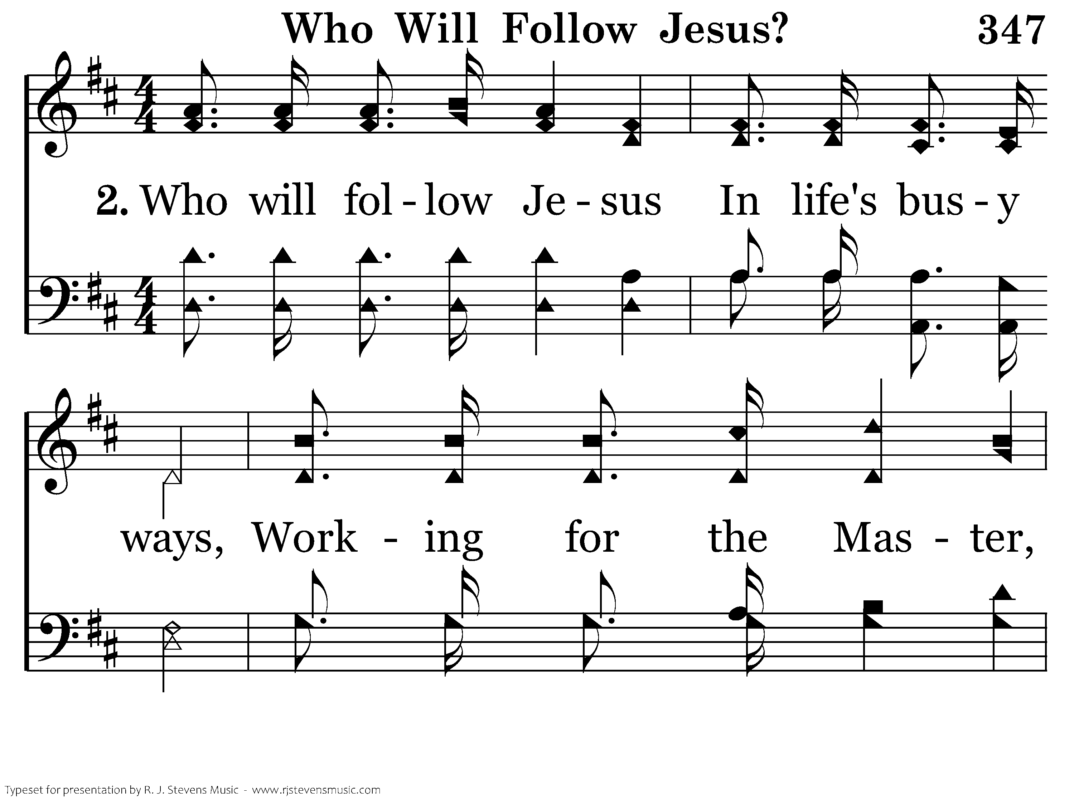
347 - Who Will Follow Jesus - 2.1

Slide 28
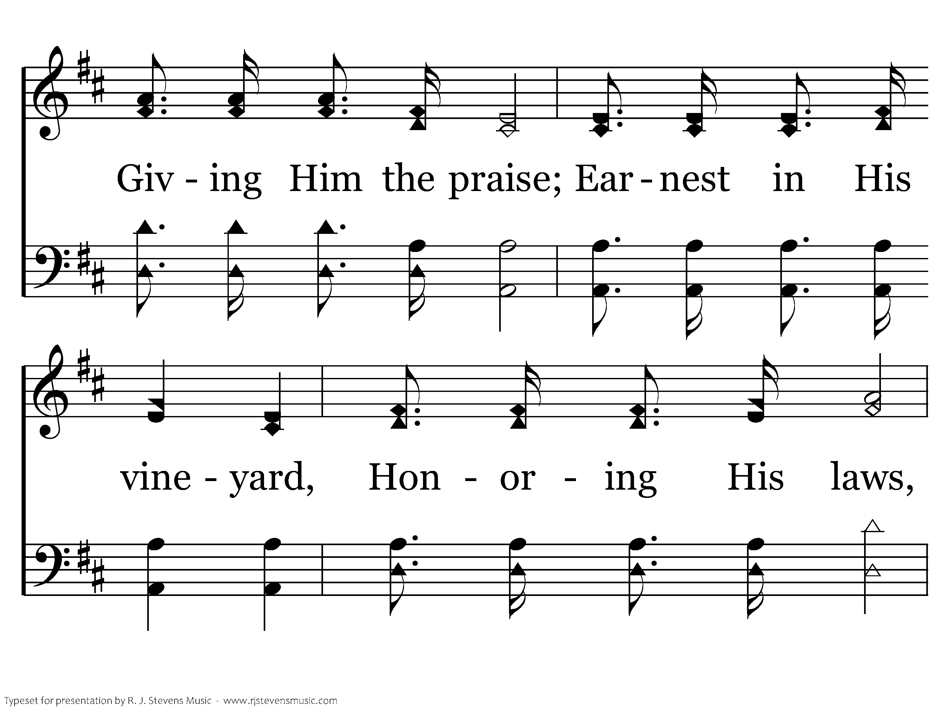
347 - Who Will Follow Jesus - 2.2

Slide 29
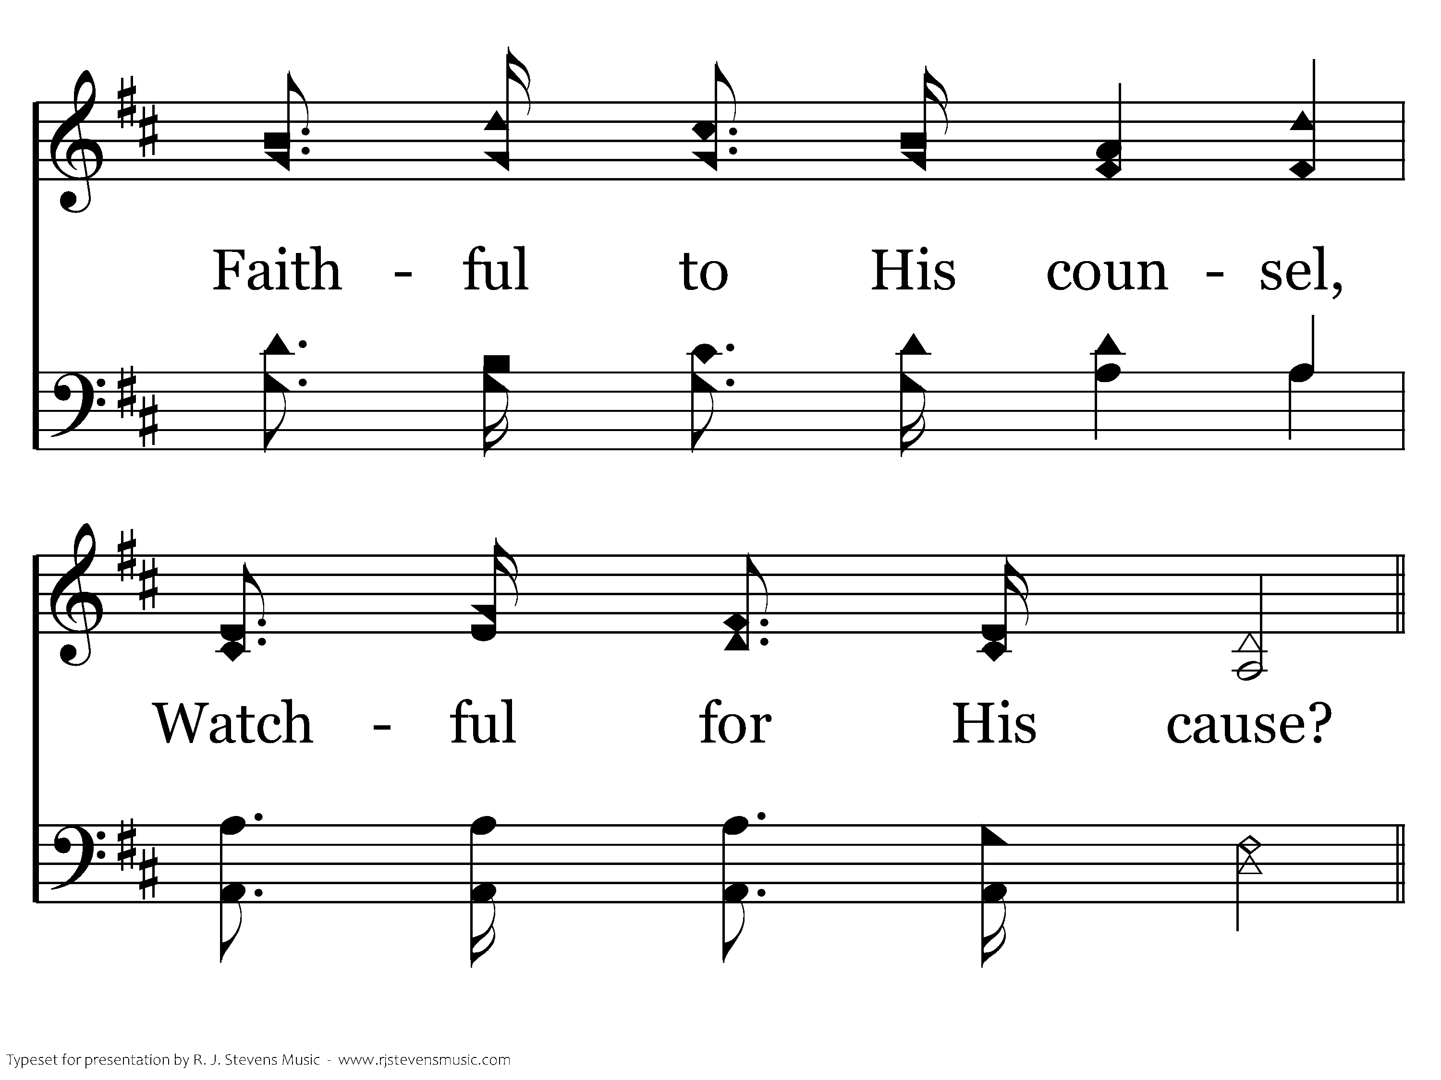
347 - Who Will Follow Jesus - 2.3

Slide 30
347 - Who Will Follow Jesus - C.1

Slide 31
347 - Who Will Follow Jesus - C.2

Slide 32
347 - Who Will Follow Jesus - C.3
End of Verse 2

Slide 33
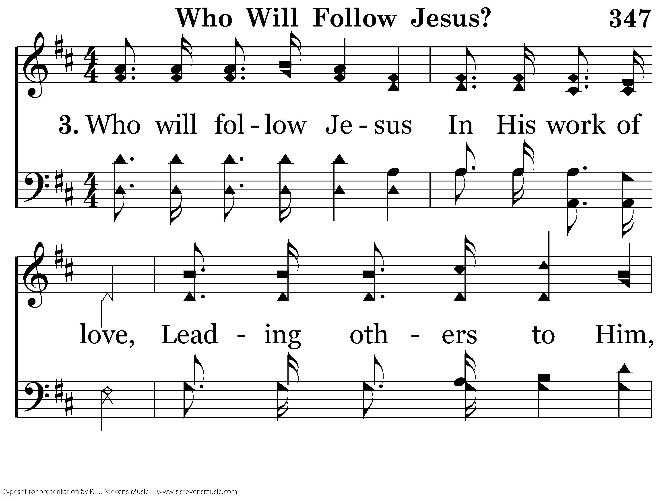
347 - Who Will Follow Jesus - 3.1

Slide 34
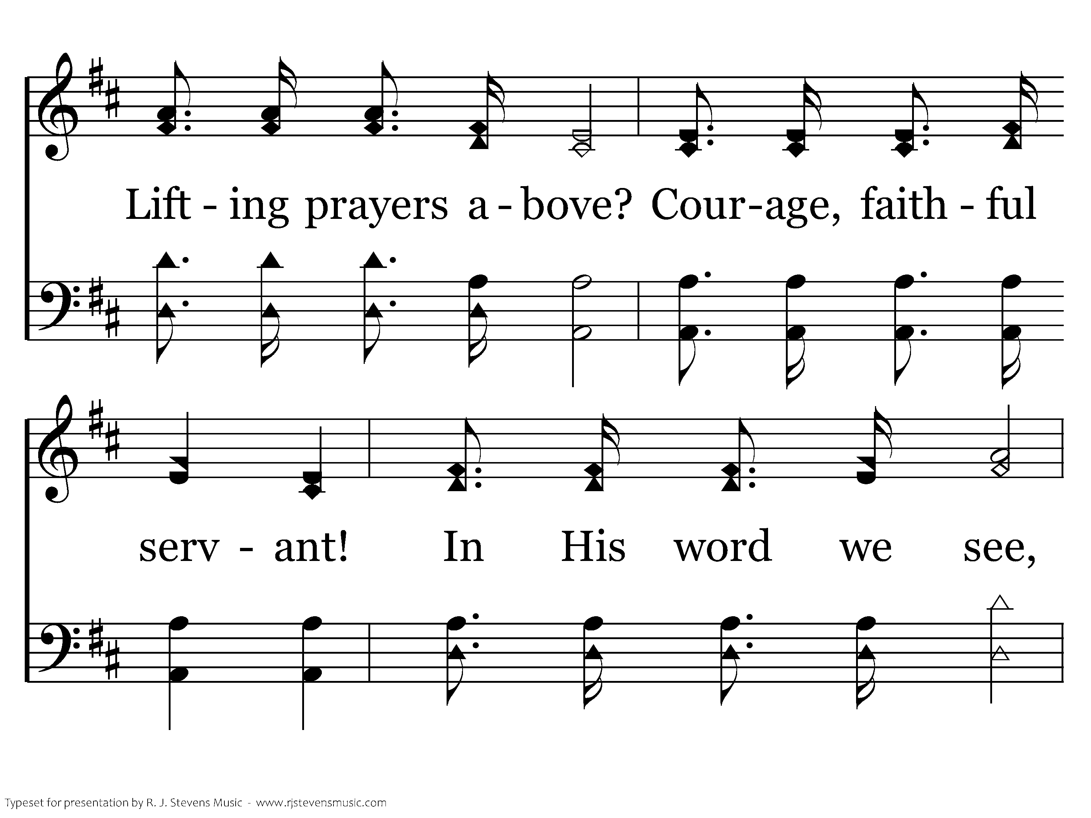
347 - Who Will Follow Jesus - 3.2

Slide 35
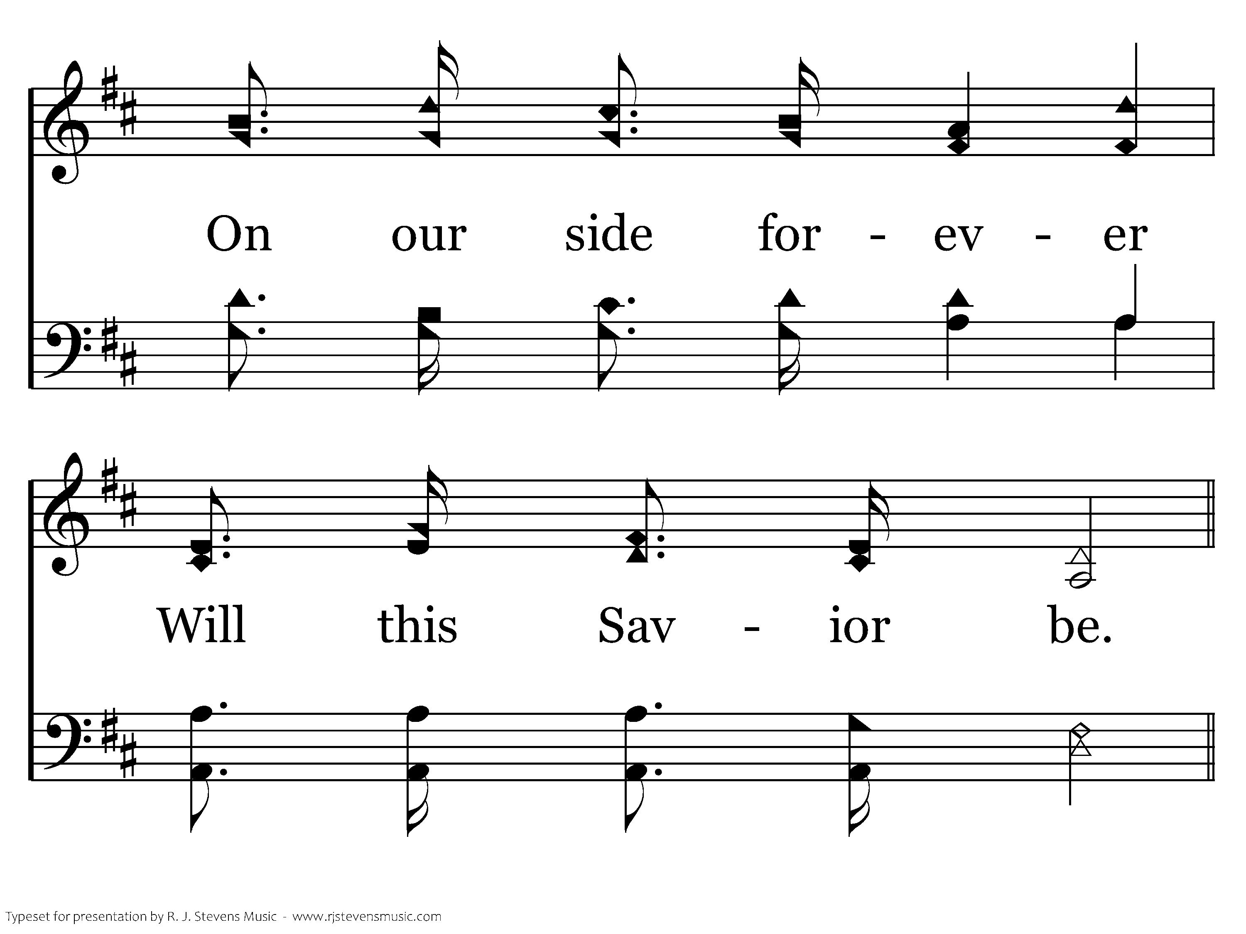
347 - Who Will Follow Jesus - 3.3

Slide 36
347 - Who Will Follow Jesus - C.1

Slide 37
347 - Who Will Follow Jesus - C.2

Slide 38
347 - Who Will Follow Jesus - C.3
End of Song

Slide 39
Lesson 1: Disciples Prioritize
Studies to Help Disciples Grow Stronger

