Slide 1

Lesson 3: Disciples Work Together
Studies to Help Disciples Grow Stronger

Slide 2
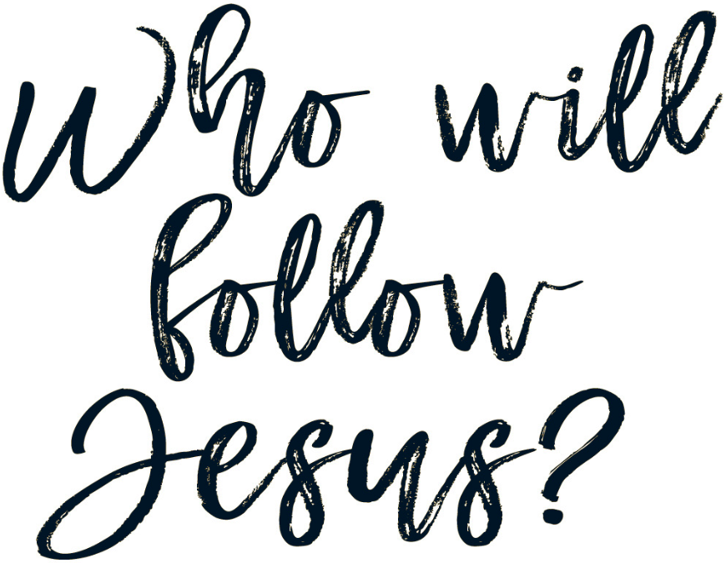
Disciples Work Together
Lesson 3
Is being a disciple a solo venture? What is the disciple’s relationship to other followers of Jesus?
Luke 6:12-16 records the call of the apostles. Read this text now.
  Significantly, Jesus did not call only one apostle.
  Instead, a group was assembled. They worked together as Jesus’ ambassadors to spread the gospel into all the world.
  Luke’s account of these followers continues in his sequel work, Acts. This book shows the apostles as the beginning and foundation of the church, the saved actively following Jesus.
  Jesus did not mean for disciples to function alone. Disciples come together in a special group arrangement known as the church.

Slide 3
Disciples Work Together
Lesson 3
In this lesson you will learn:
  What the local church means to the disciple.
  Why a disciple should join a local church.
  What obligations and responsibilities disciples have to the local church.

Slide 4
What is the local church?
Lesson 3: Disciples Work Together
Studies to Help Disciples Grow Stronger

Slide 5
What is the local church?
Lesson 3: Disciples Work Together
The New Testament uses the term “church” in two different ways:
  It designates all saved people: “To the general assembly and __________ of the firstborn who are registered in heaven” (Hebrews 12:23).
  It designates a group of disciples in a certain city or community: “To the church of God which is at __________” (1 Corinthians 1:2).
  When referring to all the saved, we are speaking of the universal church. The universal church is composed of everyone who is a Christian, living or dead. Some members of the universal church are on earth, and some are in heaven.
    In the universal sense there is only one church (Ephesians 4:4).
    There exists no earthly organization or headquarters for the universal church. Jesus Christ is its Head (Ephesians 1:22-23).

Slide 6
What is the local church?
Lesson 3: Disciples Work Together
The New Testament uses the term “church” in two different ways:
  If one is speaking of a certain group of Christians, one may speak of the local church. This is the band of disciples in a certain place. In the local sense there are many congregations.
  Neither “universal church” nor “local church” are terms found specifically in the Bible, but they express scriptural concepts. Do you understand the difference in these terms?

Slide 7
What is the local church?
Lesson 3: Disciples Work Together
Can you join the church?
  No one can join the universal church because its membership is not controlled by humans.
  Read Acts 2:47. Who adds people to the universal church?
  What is the entrance requirement for the universal church?
  While we cannot join the universal church, but must be added to it by God, it is possible to attach oneself to a local body of Christians.
  Read what Luke wrote about Saul in Acts 9:26-28. What did Saul want to do?
  We too must join a local church.

Slide 8
What is the local church?
Lesson 3: Disciples Work Together
What does it mean to place membership (join) a local church?
  Joining a local congregation is a serious commitment because the local church has important work to accomplish.
  Every member is needed to carry out the local church’s threefold mission:
    Preach the gospel to all the lost: Matthew 28:19-20.
    Build up Christians spiritually: Ephesians 4:11-16.
    Relieve needy Christians: 1 Timothy 5:16.
  When a disciple joins a local church he or she is announcing the intention to help that congregation fulfill the assignments for the local church.

Slide 9
Why should a disciple join a local church?
Lesson 3: Disciples Work Together
Studies to Help Disciples Grow Stronger

Slide 10
Why should a disciple join a local church?
Lesson 3: Disciples Work Together
The local church promotes accountability.
  Sometimes, following Jesus is difficult. Disciples can be tempted to abandon Christianity.
  Yet, we know that if we quit the Lord, other disciples will ask about our conduct and actions. This helps us remain faithful.
  Read Galatians 6:1. Should brethren assist each other?
  Accountability and restoration are two key functions of elders. Read Hebrews 13:17. Should we respect the elders?
  No one has the right to pry into private matters just to satisfy personal curiosity. However, Christians should expect the family of God to assist them in growing stronger by holding them accountable for their actions.

Slide 11
Why should a disciple join a local church?
Lesson 3: Disciples Work Together
The local church provides instruction.
  The local church’s main focus is teaching the lost the gospel, and teaching Christians how to be better disciples (1 Timothy 3:15).
  Every Christian should expect the local congregation to provide instruction in discipleship.
  The basis for such instruction must be the Scriptures. Read Luke 24:27. What did Jesus explain in His teaching?
  Good Bible study is not made up of sharing opinions or reading books written by human authors. Instead, the local church teaches the Bible, showing how the Scriptures relate to Jesus and His will for disciples.

Slide 12
Why should a disciple join a local church?
Lesson 3: Disciples Work Together
The local church is where the disciple can develop his or her talents.
  Disciples do not all have the same ability, but every disciple has some talent that can be used in the Kingdom of God.
  ”For as we have many members in one body, but all the members do not have the same function, so we, being many, are one body in Christ, and individually members of one another” (Romans 12:4-5).
  Some can teach Bible classes, others can do physical work around the meeting place, while still others visit the sick and elderly. The list of activities needed in a local church never ends!
  Find someone at the local church who is already doing what you might be able to do. Ask them to help you learn how to put your talent to use for the Lord.
  Every talent, no matter how small it may seem to others, is needed in the
  Body of Christ.
  Read 1 Corinthians 12:20-21. Are you needed in the church?

Slide 13
What obligations and responsibilities do disciples have to a local church?
Lesson 3: Disciples Work Together
Studies to Help Disciples Grow Stronger

Slide 14
What obligations and responsibilities do disciples have to the local church?
Disciples accept responsibility.
  Read Luke 10:1-3. Jesus charged these disciples with certain tasks.
  Christianity is not a “free ride” in which everyone constantly caters to your every need.
  It is vital that you understand the duties, obligations, and responsibilities that God has given you to fulfill in the local church.

Slide 15
What obligations and responsibilities do disciples have to the local church?
Disciples help keep the local church united.
  Unity among disciples is extremely important to Jesus.
  Read John 17:20-21. Should Jesus’ disciples be divided?
  Fussing, fighting, and dividing are strongly condemned throughout the New Testament (see 1 Corinthians 1:10-13; Ephesians 4:31).
  Unity cannot be maintained at the expense of truth (Galatians 1:8-9), but division over anything but truth is inexcusable.
  You can assist the local church in building and maintaining unity by refusing to gossip (1 Timothy 5:13, 19), by not taking part in arguments over inconsequential matters (2 Timothy 2:23), and by being a peacemaker to brethren with
  problems (Matthew 5:9).

Slide 16
What obligations and responsibilities do disciples have to the local church?
Disciples attend worship services faithfully.
  We are commanded to “not __________ the assembling of ourselves together, as is the manner of some” (Hebrews 10:25).
  Perhaps nothing else will make or break your spiritual vitality as much as your attitude toward attendance. Those who fail to attend fail at Christianity. This means they will be lost.
  Regular attendance provides the Christian with the opportunity to examine his or her life and rededicate self to the Lord, recharge spiritually, and serve others.
  Attending regularly begins with deciding to be at every service possible, a complete refusal to excuse or rationalize failure to attend, and a determination to schedule everything else around service times. Faithful attendance is a habit: once it is started, it is easy to maintain. Begin building this habit now!

Slide 17
What obligations and responsibilities do disciples have to the local church?
Disciples worship sincerely and genuinely.
  We must “worship in spirit and truth.” (John 4:24).
  True worship means we have the right attitude (the heart or spirit) and the right actions (as set forth by God’s truth, the Bible).
  The right attitude demands that we worship with an awareness that God is watching our worship and every action must please Him.
    Reverence, a deep respect for God, controls us as we worship.
    It is not possible for one to be self-centered, or flippant in mind and heart while worshipping God (see Psalms 89:7).

Slide 18
What obligations and responsibilities do disciples have to the local church?
Disciples worship sincerely and genuinely.
  Worship includes singing. Read Ephesians 5:19. What is important in singing: musical ability or thinking about the words sung?
  Prayer is part of worship – Acts 2:42.
  Giving counts! Study 1 Corinthians 16:1-2; 2 Corinthians 8:9.
    Does God set a certain percentage that disciples must give?
    Proper giving involves planning, generosity, and a glad heart.
  Teaching or preaching is part of worship – read 2 Timothy 4:2. What should preaching do?
  The Lord’s Supper is essential – read 1 Corinthians 11:23-29.
    What does the disciple do during the Lord’s Supper?
    What is the purpose of the Lord’s Supper?

Slide 19
What obligations and responsibilities do disciples have to the local church?
Disciples worship sincerely and genuinely.
  Worship is a verb. It is an action word. Make certain you are actively taking
  part in the worship services by involving your mind and body in worship that
  pleases God.

Slide 20
What obligations and responsibilities do disciples have to the local church?
Disciples live a life that reflects well on the local church.
  Christians are a living advertisement for (or against) Christianity.
  “Walk in __________ toward those who are outside” (Colossians 4:5)
  Some unbelievers delight in seeing Christians who are living sinfully. Are such Christians truly following Jesus?
  The disciple wants to set a positive example before unbelievers so that opportunities to teach the lost will be created (1 Peter 2:12)

Slide 21
Conclusion
Lesson 3: Disciples Work Together
Studies to Help Disciples Grow Stronger

Slide 22
Conclusion
Lesson 3: Disciples Work Together
Discipleship is not a solo task. The disciple needs other disciples.
  While one cannot join the universal church, it is important that every disciple become part of a local church.
  The local church provides excellent opportunities for service, growth, and faithfulness.
  With the blessings of the local church also come great responsibilities. The disciple must accept these obligations as part of following Jesus.
Young Christians are so vulnerable to the devil’s tricks and temptations.
  Do not isolate yourself from other Christians. Doing so invites spiritual disaster.
  Become part of a local congregation of the Lord’s people.
  Being a working part of a local church is essential to being an effective disciple.

Slide 23
Lesson 3: Disciples Work Together
Studies to Help Disciples Grow Stronger

Slide 24
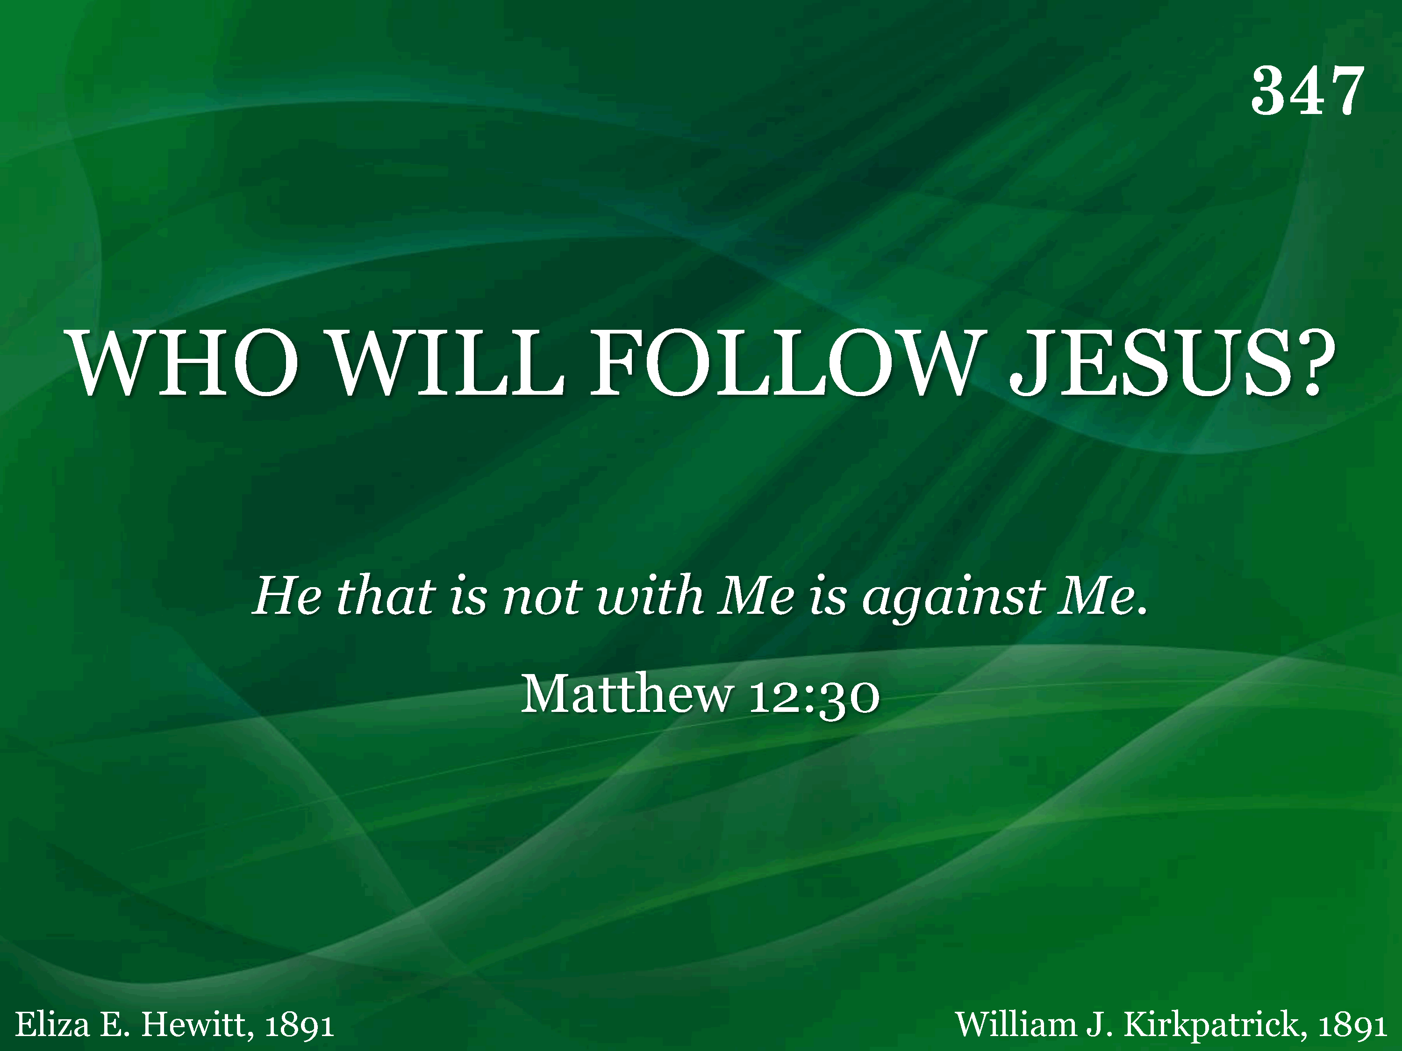
347 - Who Will Follow Jesus - Title

Slide 25
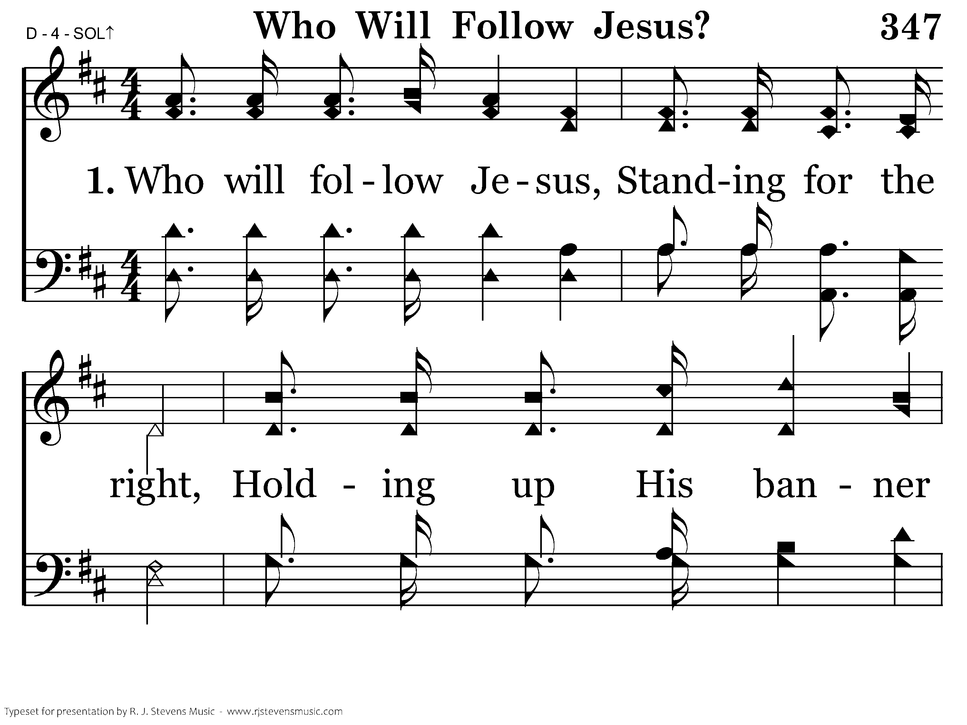
347 - Who Will Follow Jesus - 1.1

Slide 26
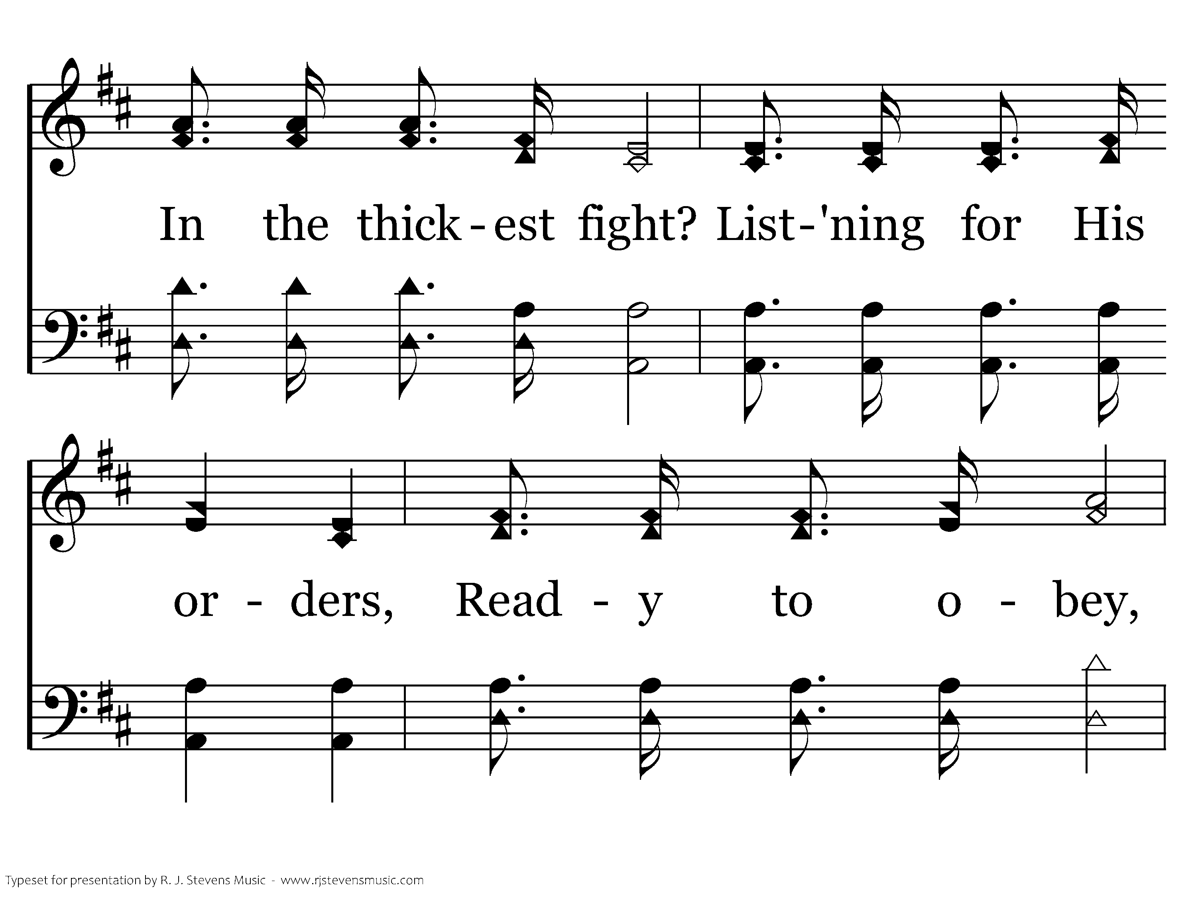
347 - Who Will Follow Jesus - 1.2

Slide 27
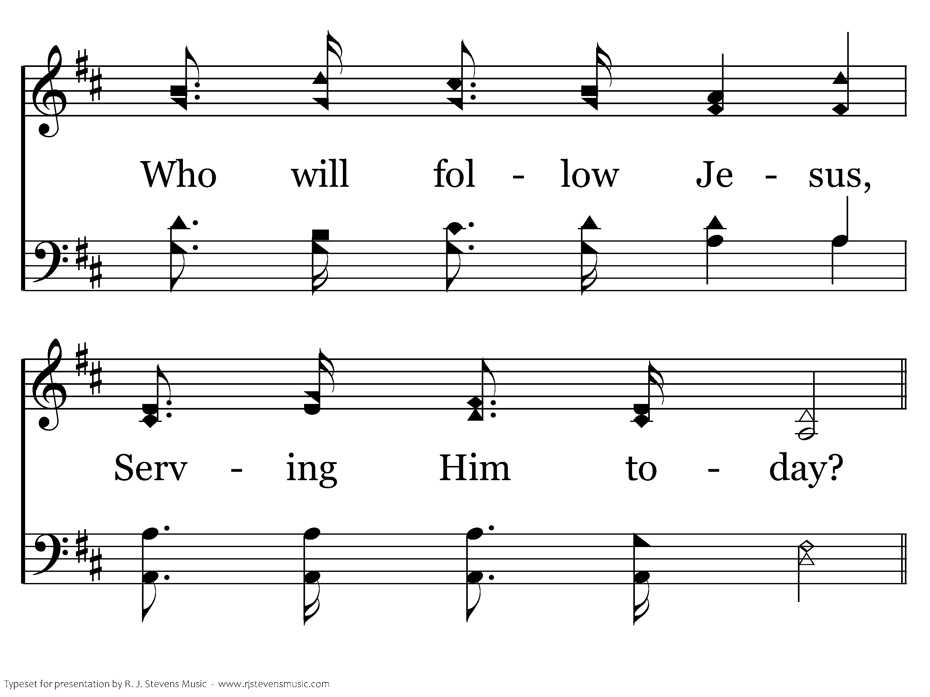
347 - Who Will Follow Jesus - 1.3

Slide 28
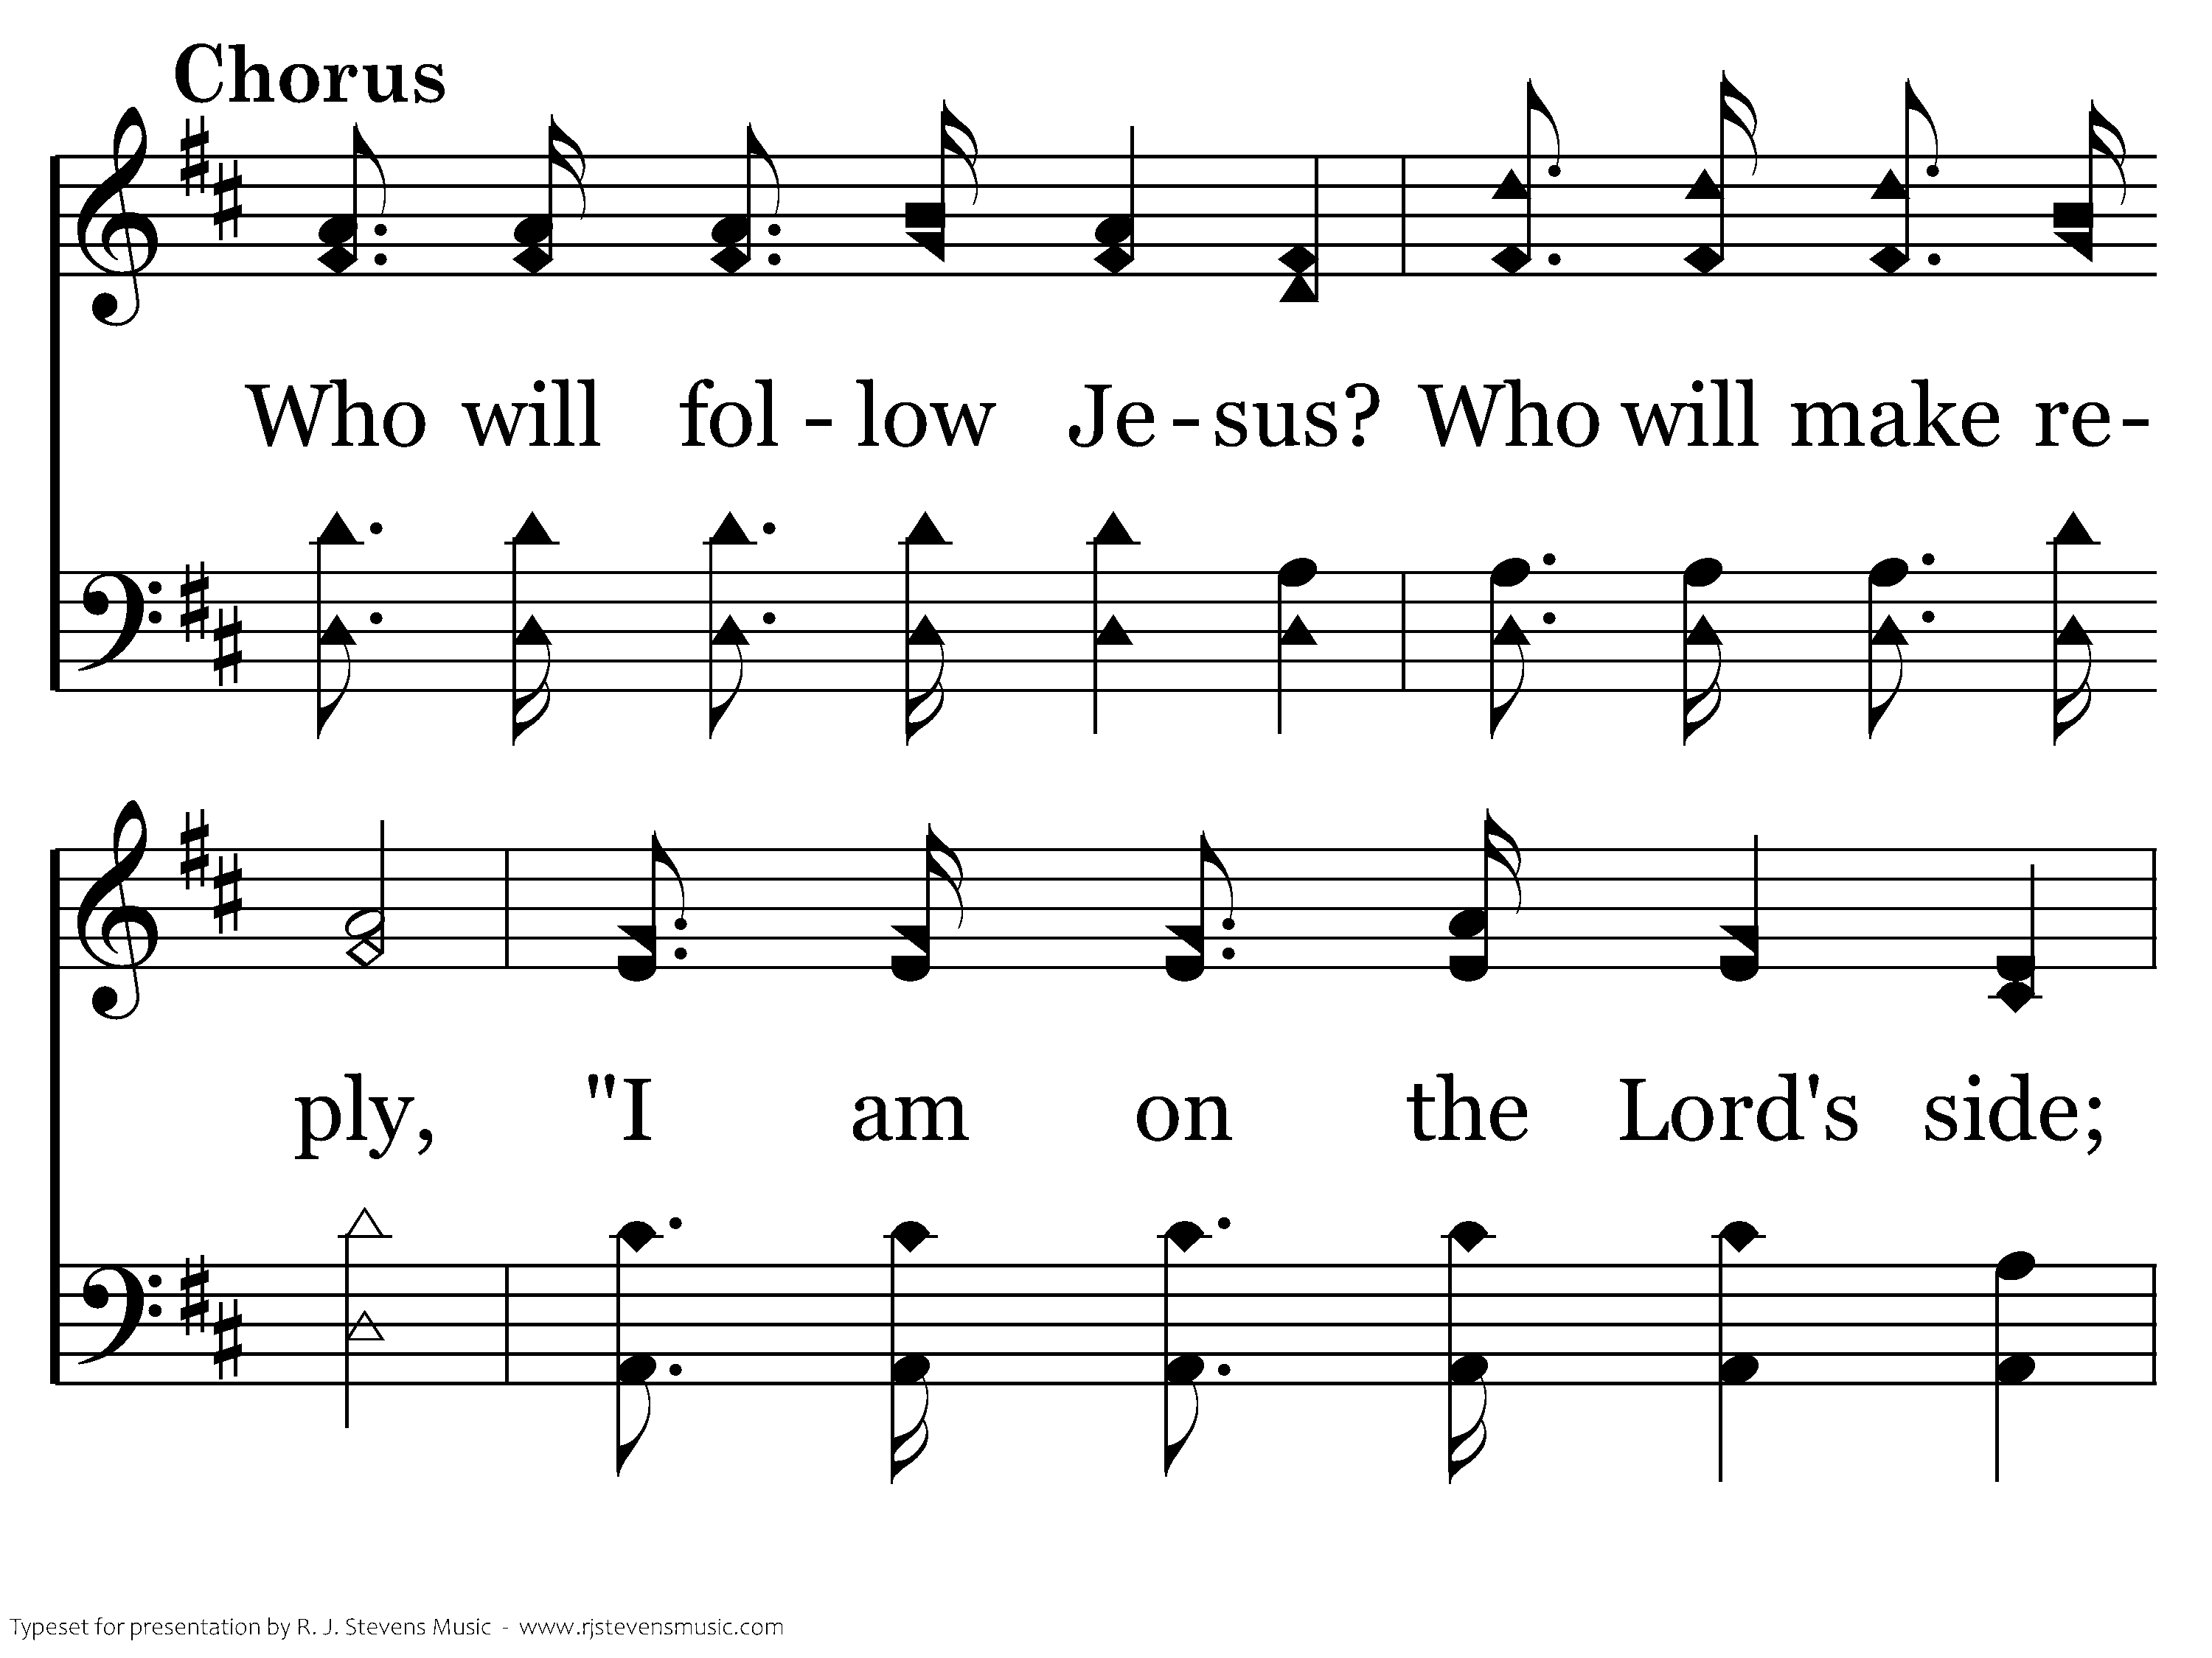
347 - Who Will Follow Jesus - C.1

Slide 29
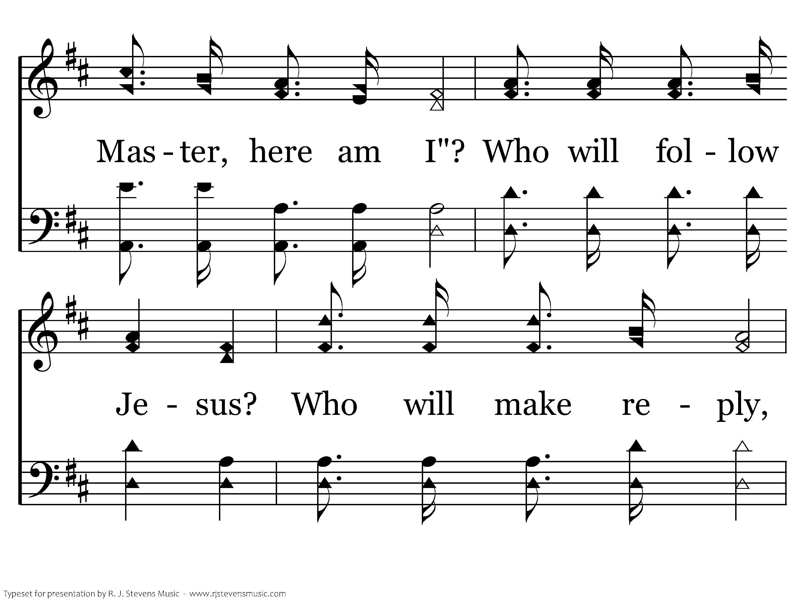
347 - Who Will Follow Jesus - C.2

Slide 30
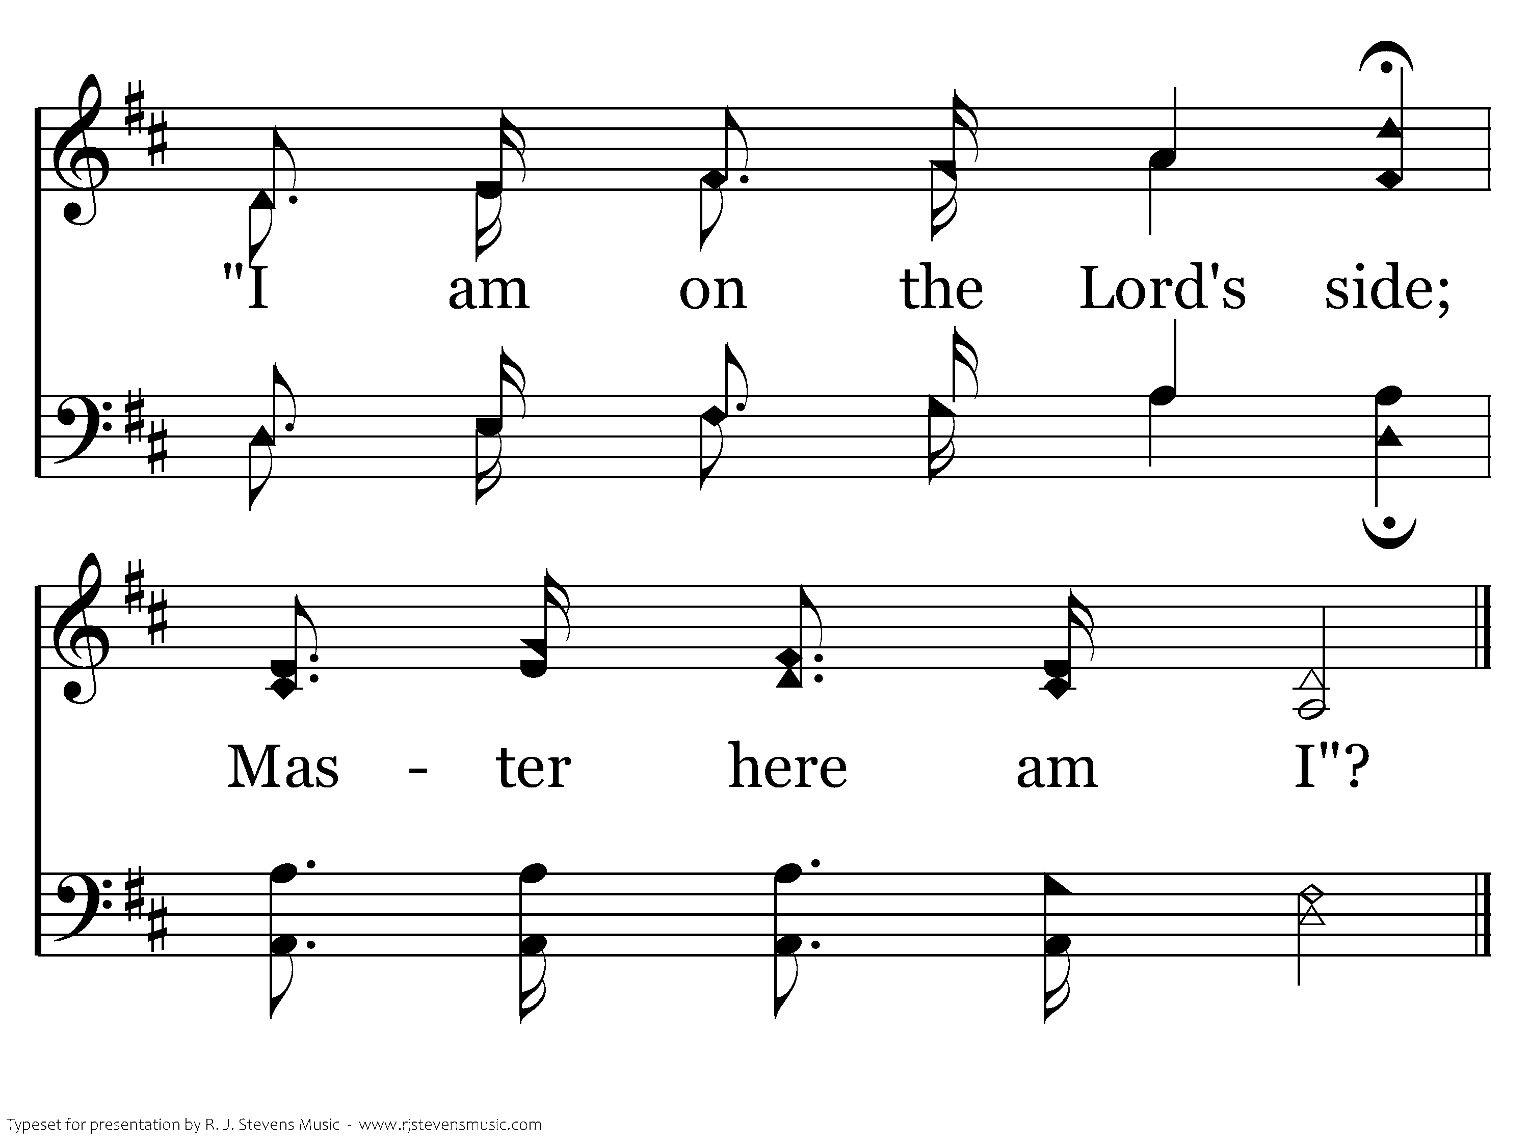
347 - Who Will Follow Jesus - C.3
End of Verse 1

Slide 31
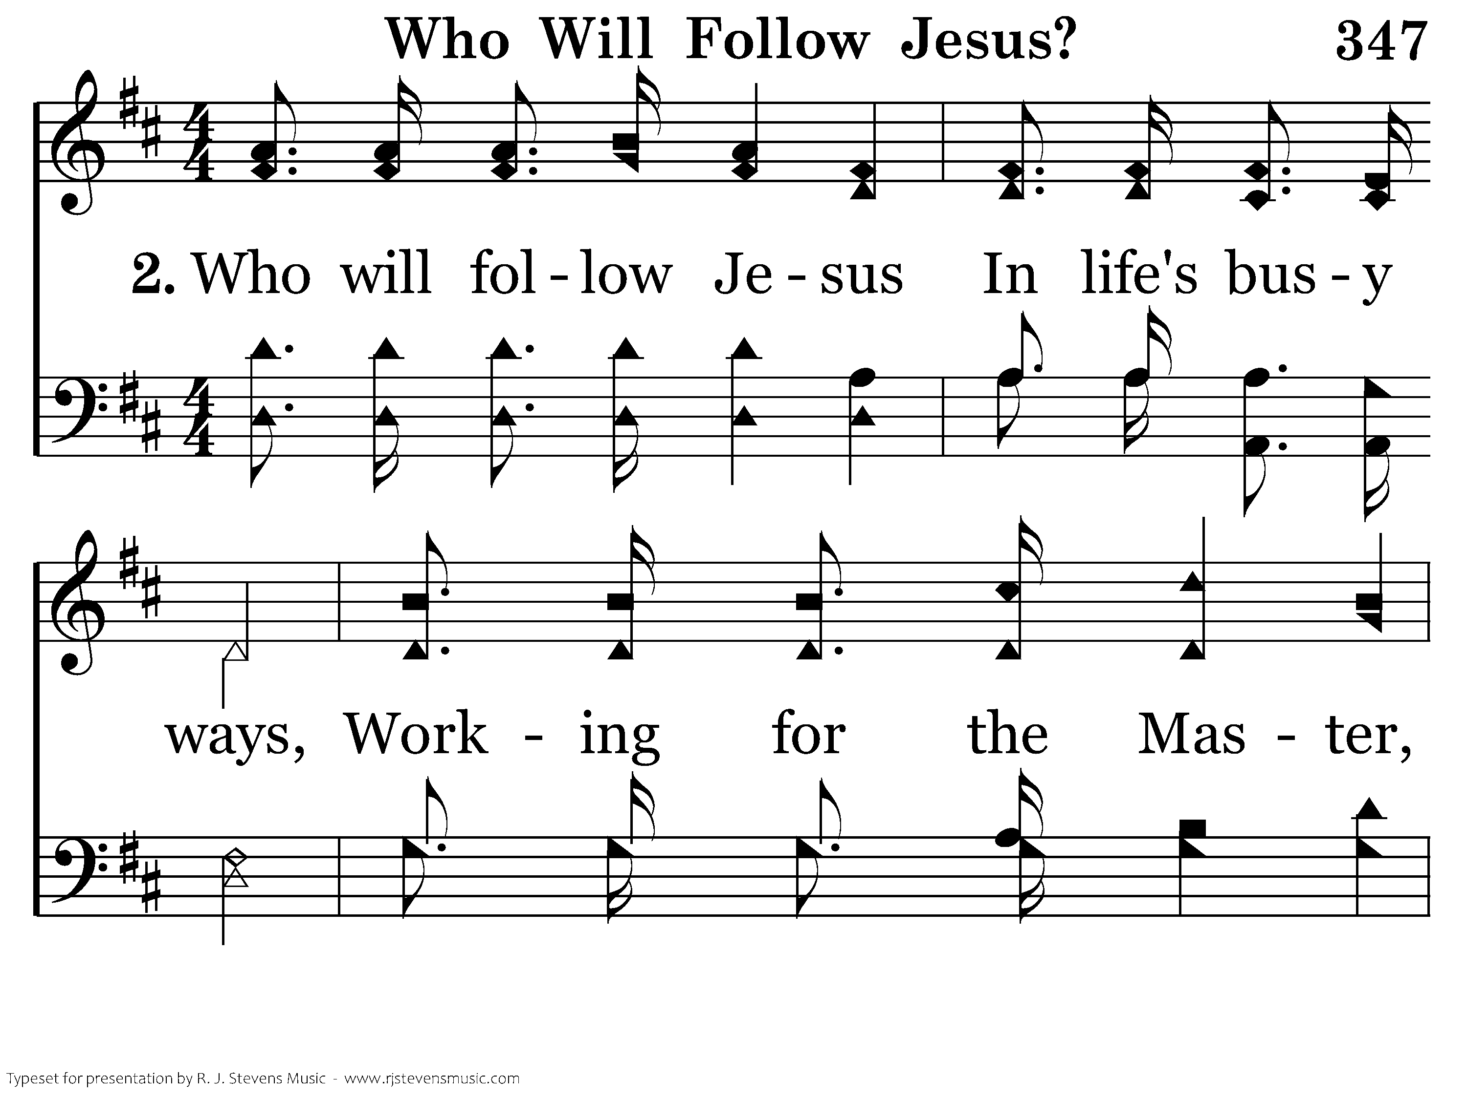
347 - Who Will Follow Jesus - 2.1

Slide 32
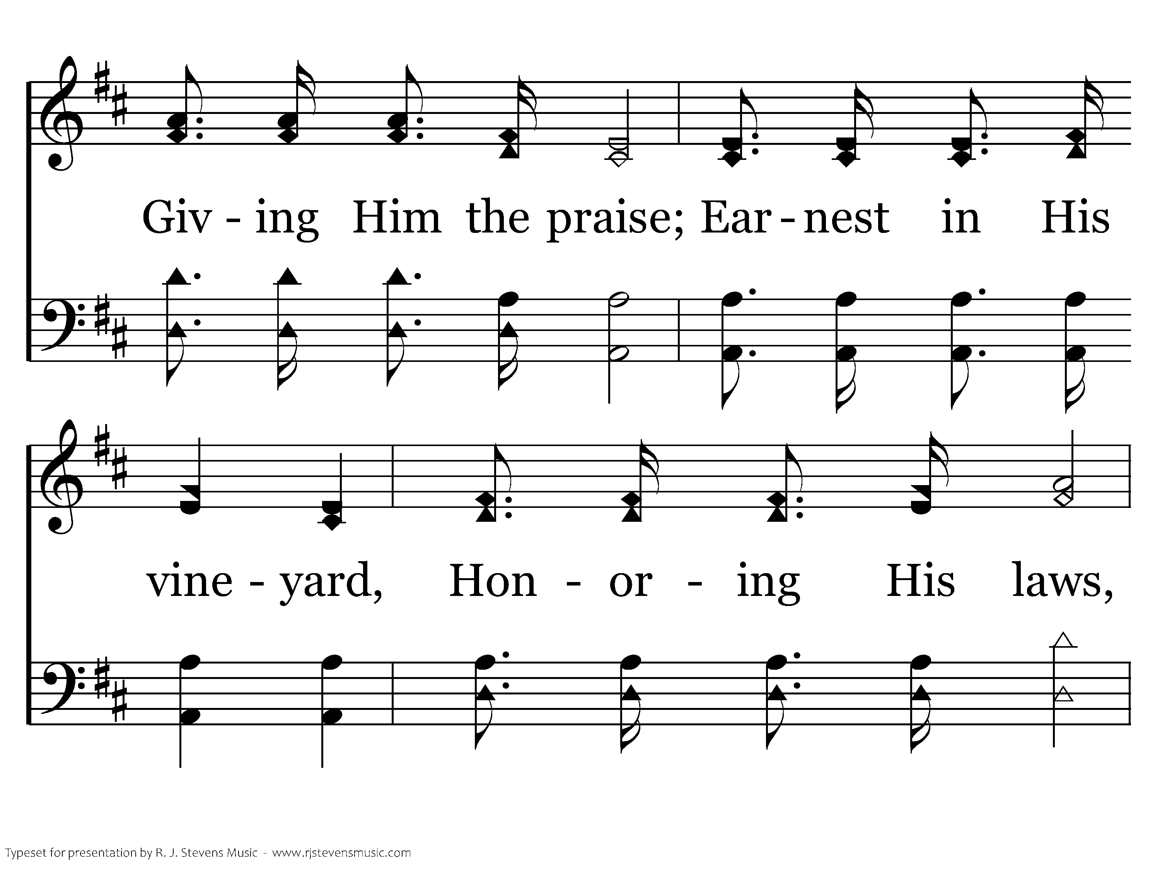
347 - Who Will Follow Jesus - 2.2

Slide 33
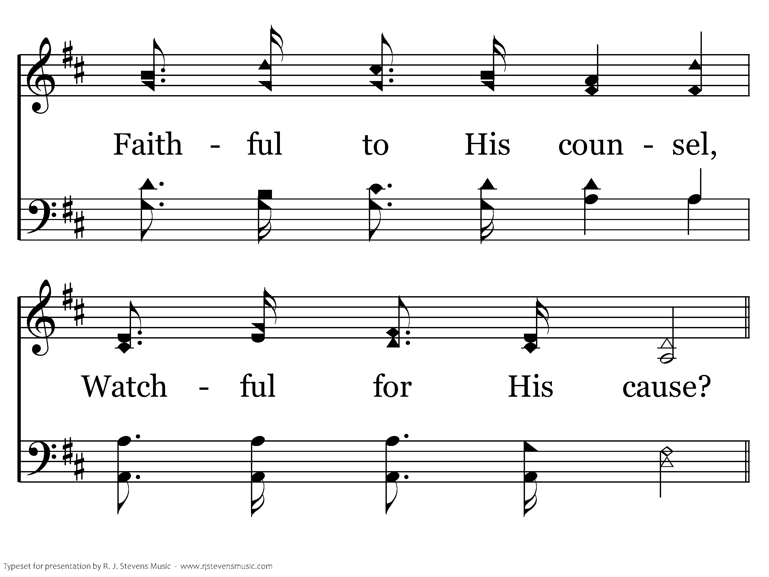
347 - Who Will Follow Jesus - 2.3

Slide 34
347 - Who Will Follow Jesus - C.1

Slide 35
347 - Who Will Follow Jesus - C.2

Slide 36
347 - Who Will Follow Jesus - C.3
End of Verse 2

Slide 37
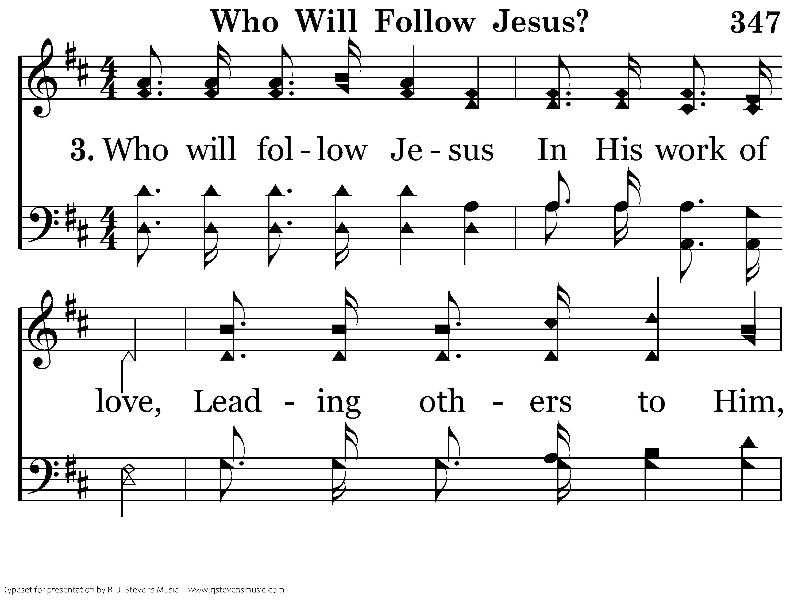
347 - Who Will Follow Jesus - 3.1

Slide 38
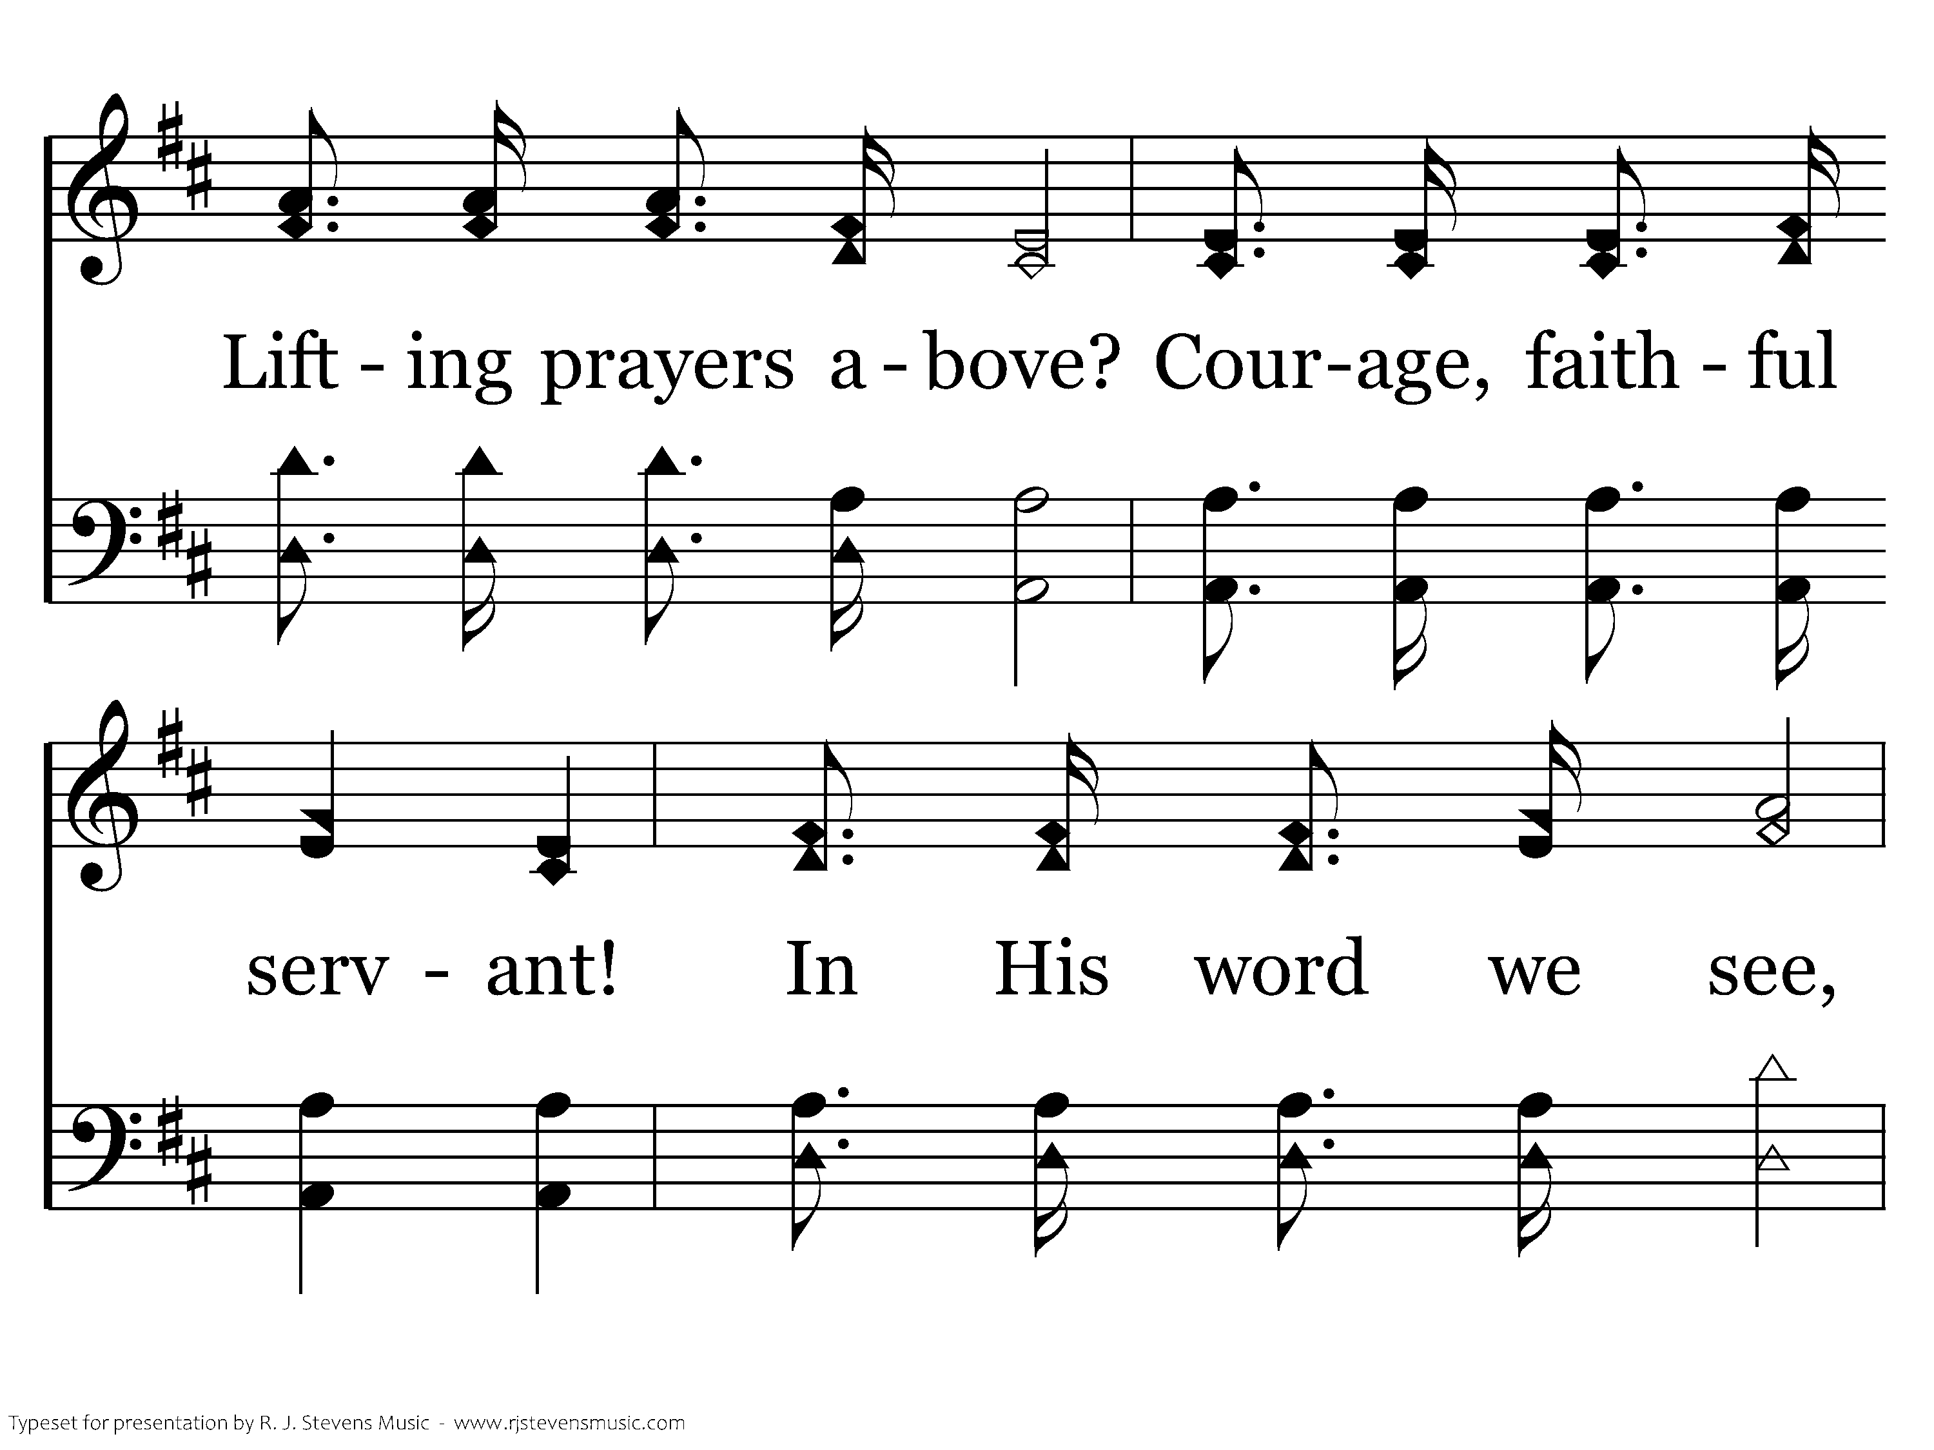
347 - Who Will Follow Jesus - 3.2

Slide 39
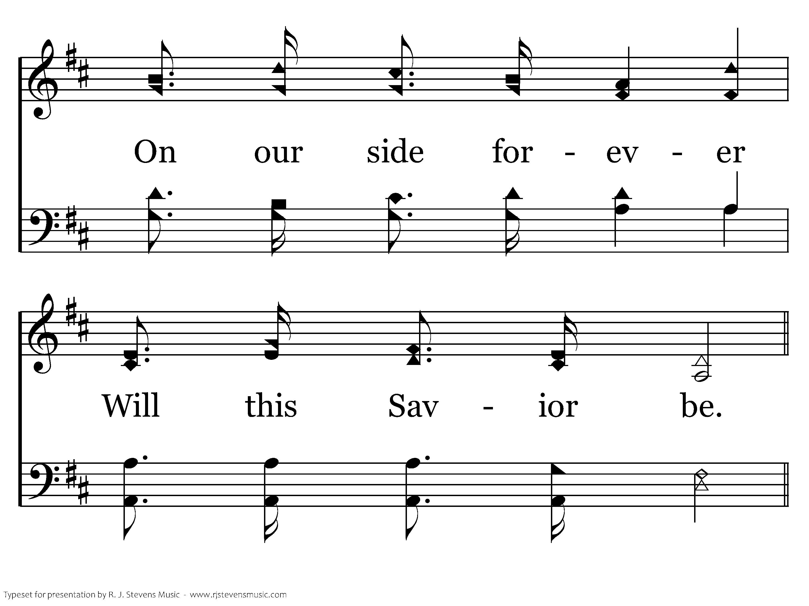
347 - Who Will Follow Jesus - 3.3

Slide 40
347 - Who Will Follow Jesus - C.1

Slide 41
347 - Who Will Follow Jesus - C.2

Slide 42
347 - Who Will Follow Jesus - C.3
End of Song

Slide 43
Lesson 3: Disciples Work Together
Studies to Help Disciples Grow Stronger

