Slide 1

Lesson 5: Disciples Love Others
Studies to Help Disciples Grow Stronger

Slide 2

Disciples Love Others
Lesson 5
As a disciple how do I treat others? What do I do when people treat me badly? What is my attitude toward others?
Being a follower of Christ radically changes your relationships with others. In this lesson you will learn:
  What it means to love others
  Specific applications of the principle of love.
Text: Luke 6:27-38 – read this now.

Slide 3
What does it mean to love others?
Lesson 5: Disciples Love Others
Studies to Help Disciples Grow Stronger

Slide 4
What does it mean to love others?
Lesson 5: Disciples Love Others
Today, many are confused by the term “love.”
  Many different concepts are implied by the word “love.”
  People readily acknowledge that they love their country, pets, favorite foods, favorite sports team, and family.
  There are different kinds of love, even though we use one term to describe all of them.
  In the New Testament, originally written in Greek, there are different words for love. Each term expresses a unique relationship.

Slide 5
What does it mean to love others?
Lesson 5: Disciples Love Others
What does Jesus mean when He says, “Love your enemies” (Luke 6:27)?
  Jesus is not speaking of erotic, sensual love (Greek: eros).
  This is not brotherly, “good friend” love (Greek: phileo). Phileo love is what we feel for people we find likable and who like us.
  Jesus uses the Greek term agape. This term came to mean a special love that puts the best interests of others ahead of our own desires and wants.
  This is not a feeling but a conscious act of will. The disciple constantly seeks other’s good.
  Read Romans 5:8. Have God and Jesus shown us agape love?
  If we are to be like Christ, what kind of love must we have for others,
  even if they are our enemies?

Slide 6
How does agape love act?
Lesson 5: Disciples Love Others
Studies to Help Disciples Grow Stronger

Slide 7
How does agape love act?
Lesson 5: Disciples Love Others
Agape love refuses to seek personal revenge.
  Read Luke 6:27-29 again. List the wrongs Jesus says the disciple endures without striking back: __________
  Study Romans 12:17-21: “Do not __________ anyone evil for evil…Beloved, never __________ yourselves, but leave room for the wrath of God; for it is written, Vengeance is mine, I will repay, says the Lord…Do not be __________ by evil, but overcome evil with good.”
  Can the disciple take revenge?
  Whose job is vengeance?
  How do disciples overcome evil?

Slide 8
How does agape love act?
Lesson 5: Disciples Love Others
Agape love helps the needy, even if they cannot repay it.
  “But __________ your enemies, do good, and lend, hoping for __________ in return; and your __________ will be great, and you will be sons of the Most High” (Luke 6:35).
  Read Jesus’ story on helping the helpless in Luke 10:30-37.
  List some of the specific ways the Good Samaritan helped the wounded man: __________
  Did the Good Samaritan help only those who could repay him?
  Did the Good Samaritan show agape love to the robbery victim?

Slide 9
How does agape love act?
Lesson 5: Disciples Love Others
Agape love refuses to be judgmental.
  “Judge not, and you shall not be __________. Condemn not, and you shall not be __________. Forgive, and you will be __________” (Luke 6:37).
  Some people are always condemning others. This was the attitude of the Pharisees, who even condemned Jesus for healing people on the Sabbath (Luke 6:6-11). This only shows hard-heartedness.
  Disciples accept and care for others. They realize that each one of us is a sinner who needs God’s help (Romans 3:23).
  Does this mean that disciples cannot tell someone that they are lost or that they are transgressing God’s law?
    What does John 7:24 tell us about this?
    Read Matthew 7:1-5. What kind of judging is Jesus forbidding (note verse 5)?

Slide 10
Who needs agape love?
Lesson 5: Disciples Love Others
Studies to Help Disciples Grow Stronger

Slide 11
Who needs agape love?
Lesson 5: Disciples Love Others
Enemies need agape love.
  When we stand for righteousness, some will oppose us.
  “This is the condemnation, that the __________ has come into the world, and men loved __________ rather than light, because their deeds were evil. For everyone practicing __________ hates the light and does not come to the light, lest his __________ should be exposed” (John 3:19-20).
  We must still seek our enemies’ best interest by trying to bring them to Jesus Christ.
  Praying for those who oppose us may be the greatest expression of loving enemies.

Slide 12
Who needs agape love?
Lesson 5: Disciples Love Others
Our homes need agape love.
  If we treat our enemies with agape love, we should definitely treat our family with the same consideration and love.
  Read Ephesians 5:22-29.
    How can a wife show love for her husband?
    After whom do husbands model love for their wives?
    Would any marriage fail if both partners committed themselves to agape love?

Slide 13
Who needs agape love?
Lesson 5: Disciples Love Others
The church needs agape love.
  The New Testament clearly instructs disciples to love and care for one another.
  If a brother or sister is in need: “But whoever has this world’s goods, and sees his __________ in need, and shuts up his heart from him, how does the __________ of God abide in him? My little children, let us not __________ in word or in tongue, but in deed and in truth” (1 John 3:17-18).
  If a brother or sister is caught up in sin: “Brethren, if a man is __________ in any trespass, you who are spiritual __________ such a one in a spirit of gentleness, considering yourself lest you also be tempted. __________ one another’s burdens, and so fulfill the law of Christ” (Galatians 6:1-2).

Slide 14
Who needs agape love?
Lesson 5: Disciples Love Others
The church needs agape love.
  When we disagree or have been wronged by another Christian: “Therefore, as the elect of God, holy and beloved, put on tender mercies, __________, humility, meekness, longsuffering, bearing with one another, and __________ one another, if anyone has a __________ against another; even as Christ forgave you, so you also must do. But above all these things put on __________ which is the bond of perfection” (Colossians 3:12-14).
  God hates contention among brethren (Proverbs 6:19). Satan rejoices when brethren refuse to get along and help each other because it destroys the church’s ability to proclaim the gospel (John 13:33-34).
  Would any church ever suffer inner strife and division if every brother
  and sister in Christ determined to love with agape love?

Slide 15
Conclusion
Lesson 5: Disciples Love Others
Studies to Help Disciples Grow Stronger

Slide 16
Conclusion
Lesson 5: Disciples Love Others
Being a disciple of Christ changes how we treat everyone.
  In every relationship the disciple of Christ practices agape love.
  This means disciples seek what is best for others.
  Agape love is the love that Jesus demonstrated for us (1 John 4:19) and must be part of our lives if we are going to be like Him.
Every relationship can benefit from agape love.
  From enemies, to the home, to the church we find people needing sincere, genuine love.
  As the disciple models Christ’s love in every place and situation, others can see the difference being a Christian makes.
  “Let your light so shine before men, that they may see your good works and
  glorify your Father in heaven” (Matthew 5:16).

Slide 17
Lesson 5: Disciples Love Others
Studies to Help Disciples Grow Stronger

Slide 18

347 - Who Will Follow Jesus - Title

Slide 19
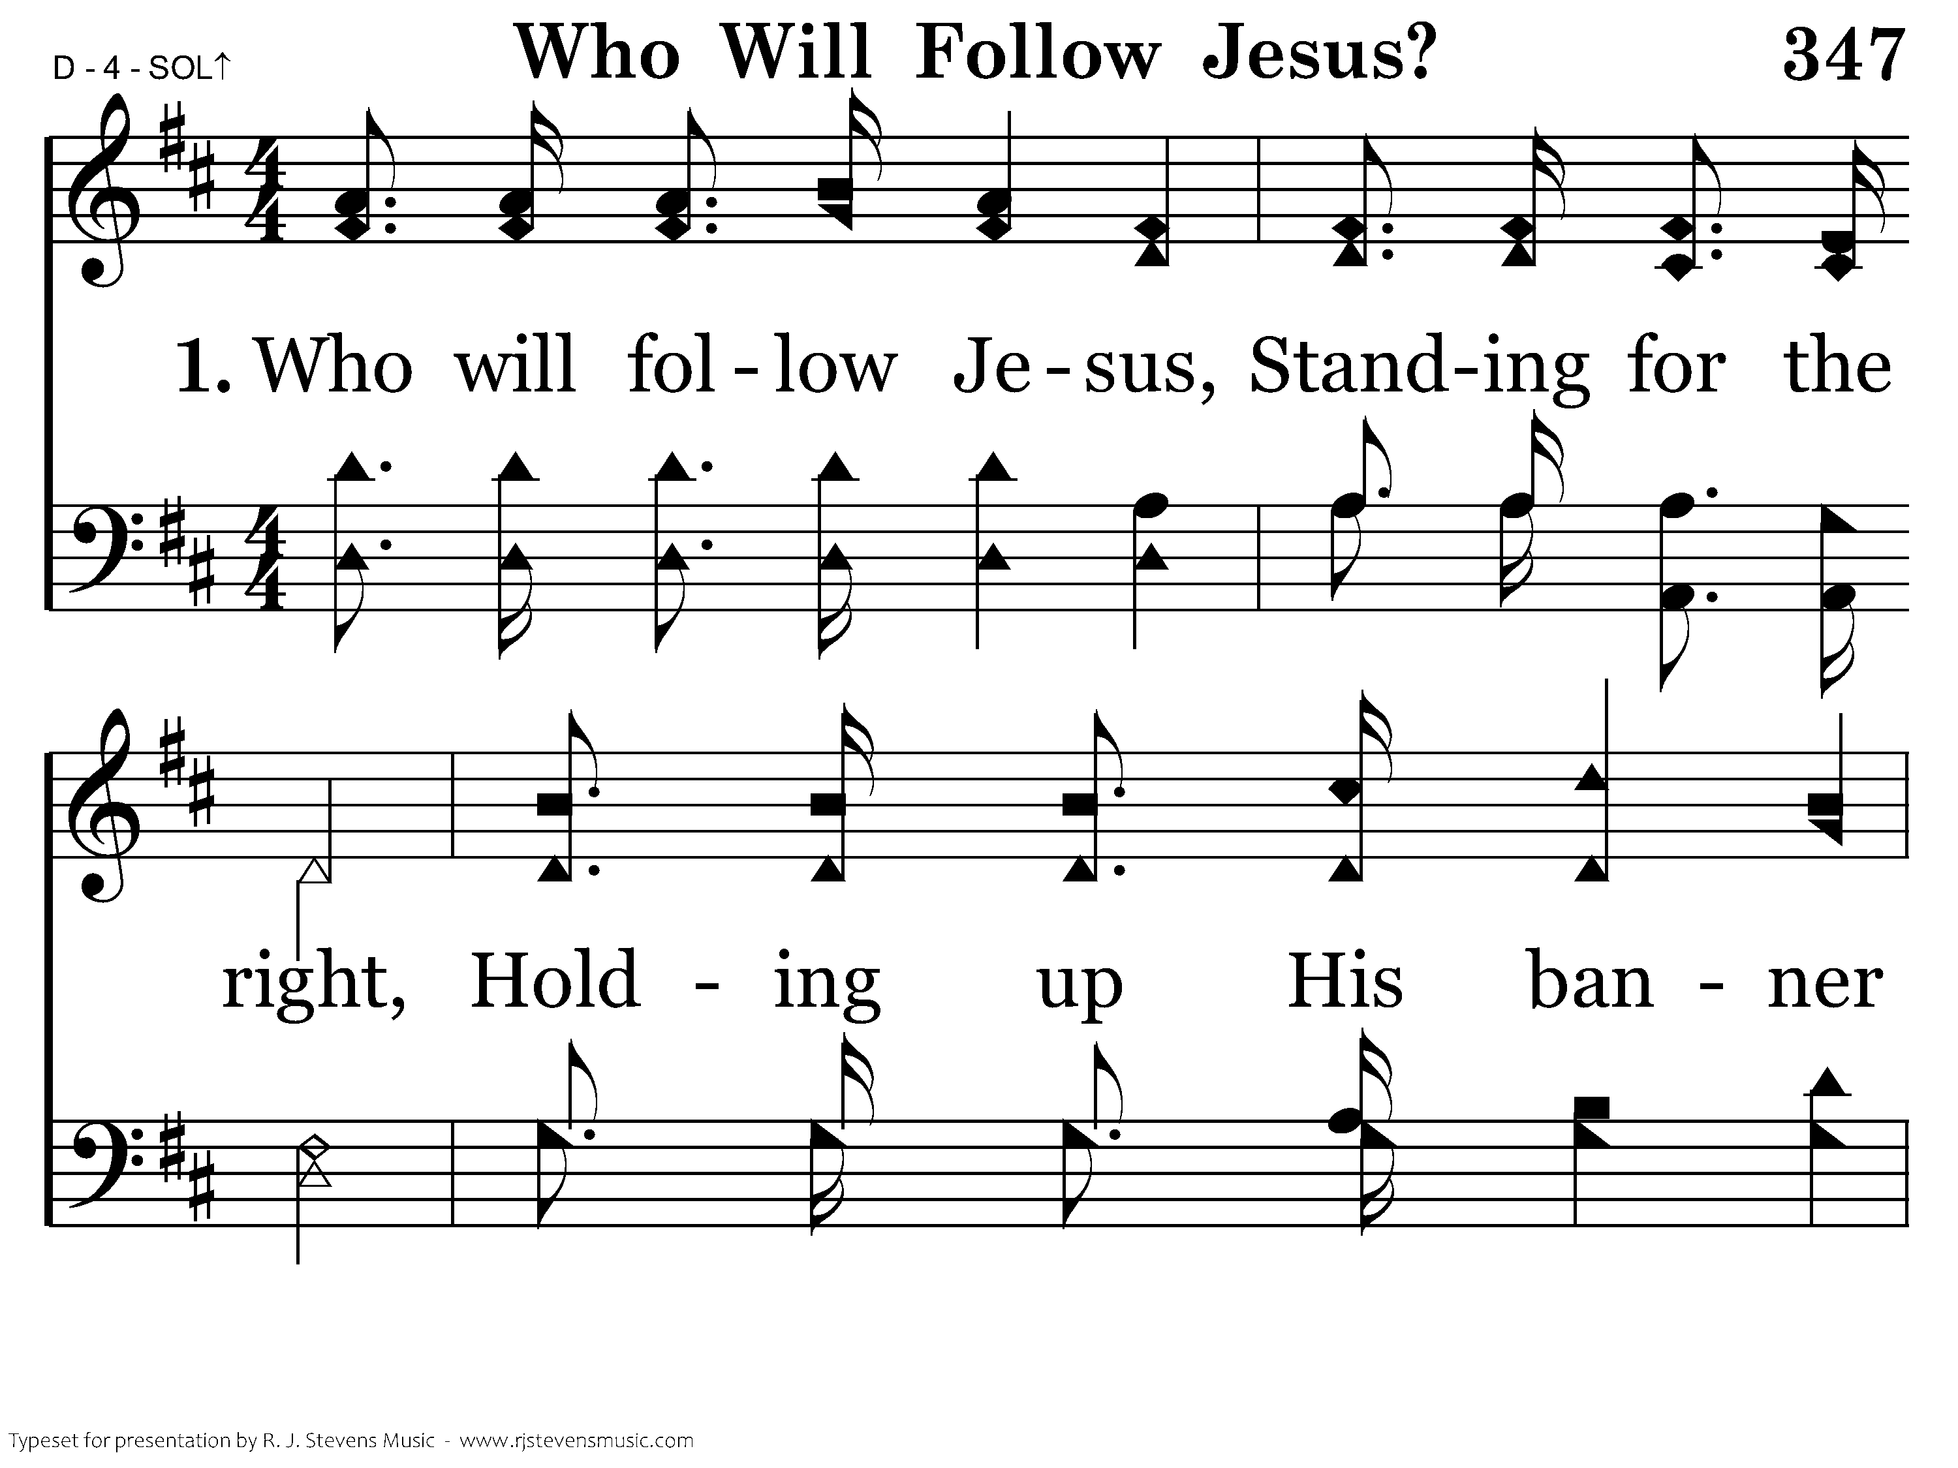
347 - Who Will Follow Jesus - 1.1

Slide 20
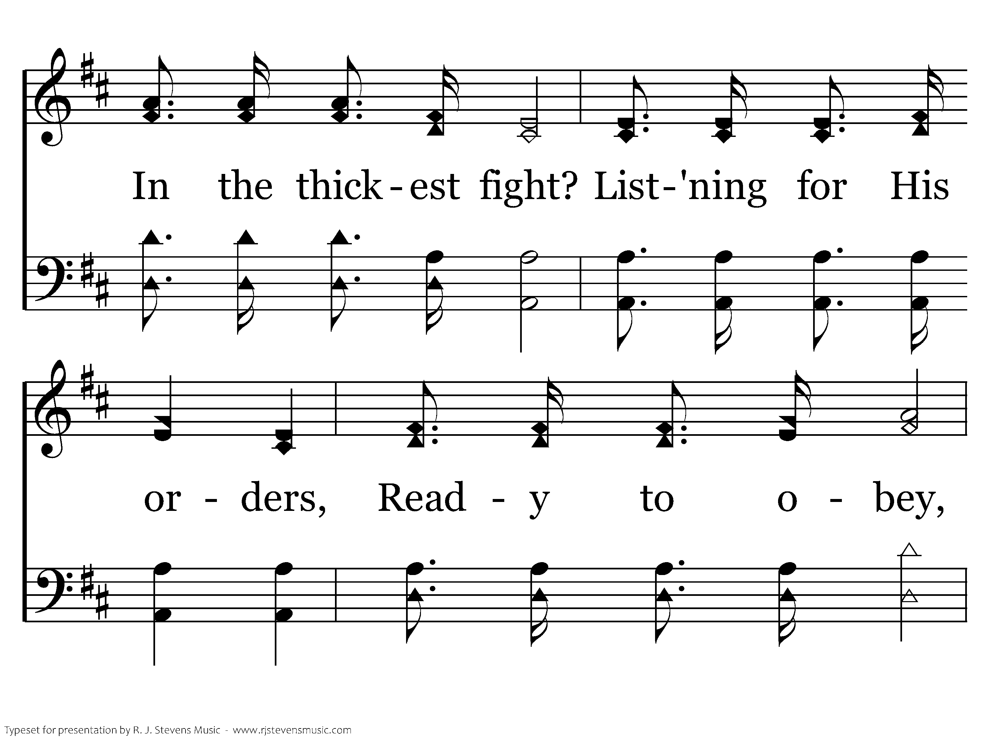
347 - Who Will Follow Jesus - 1.2

Slide 21
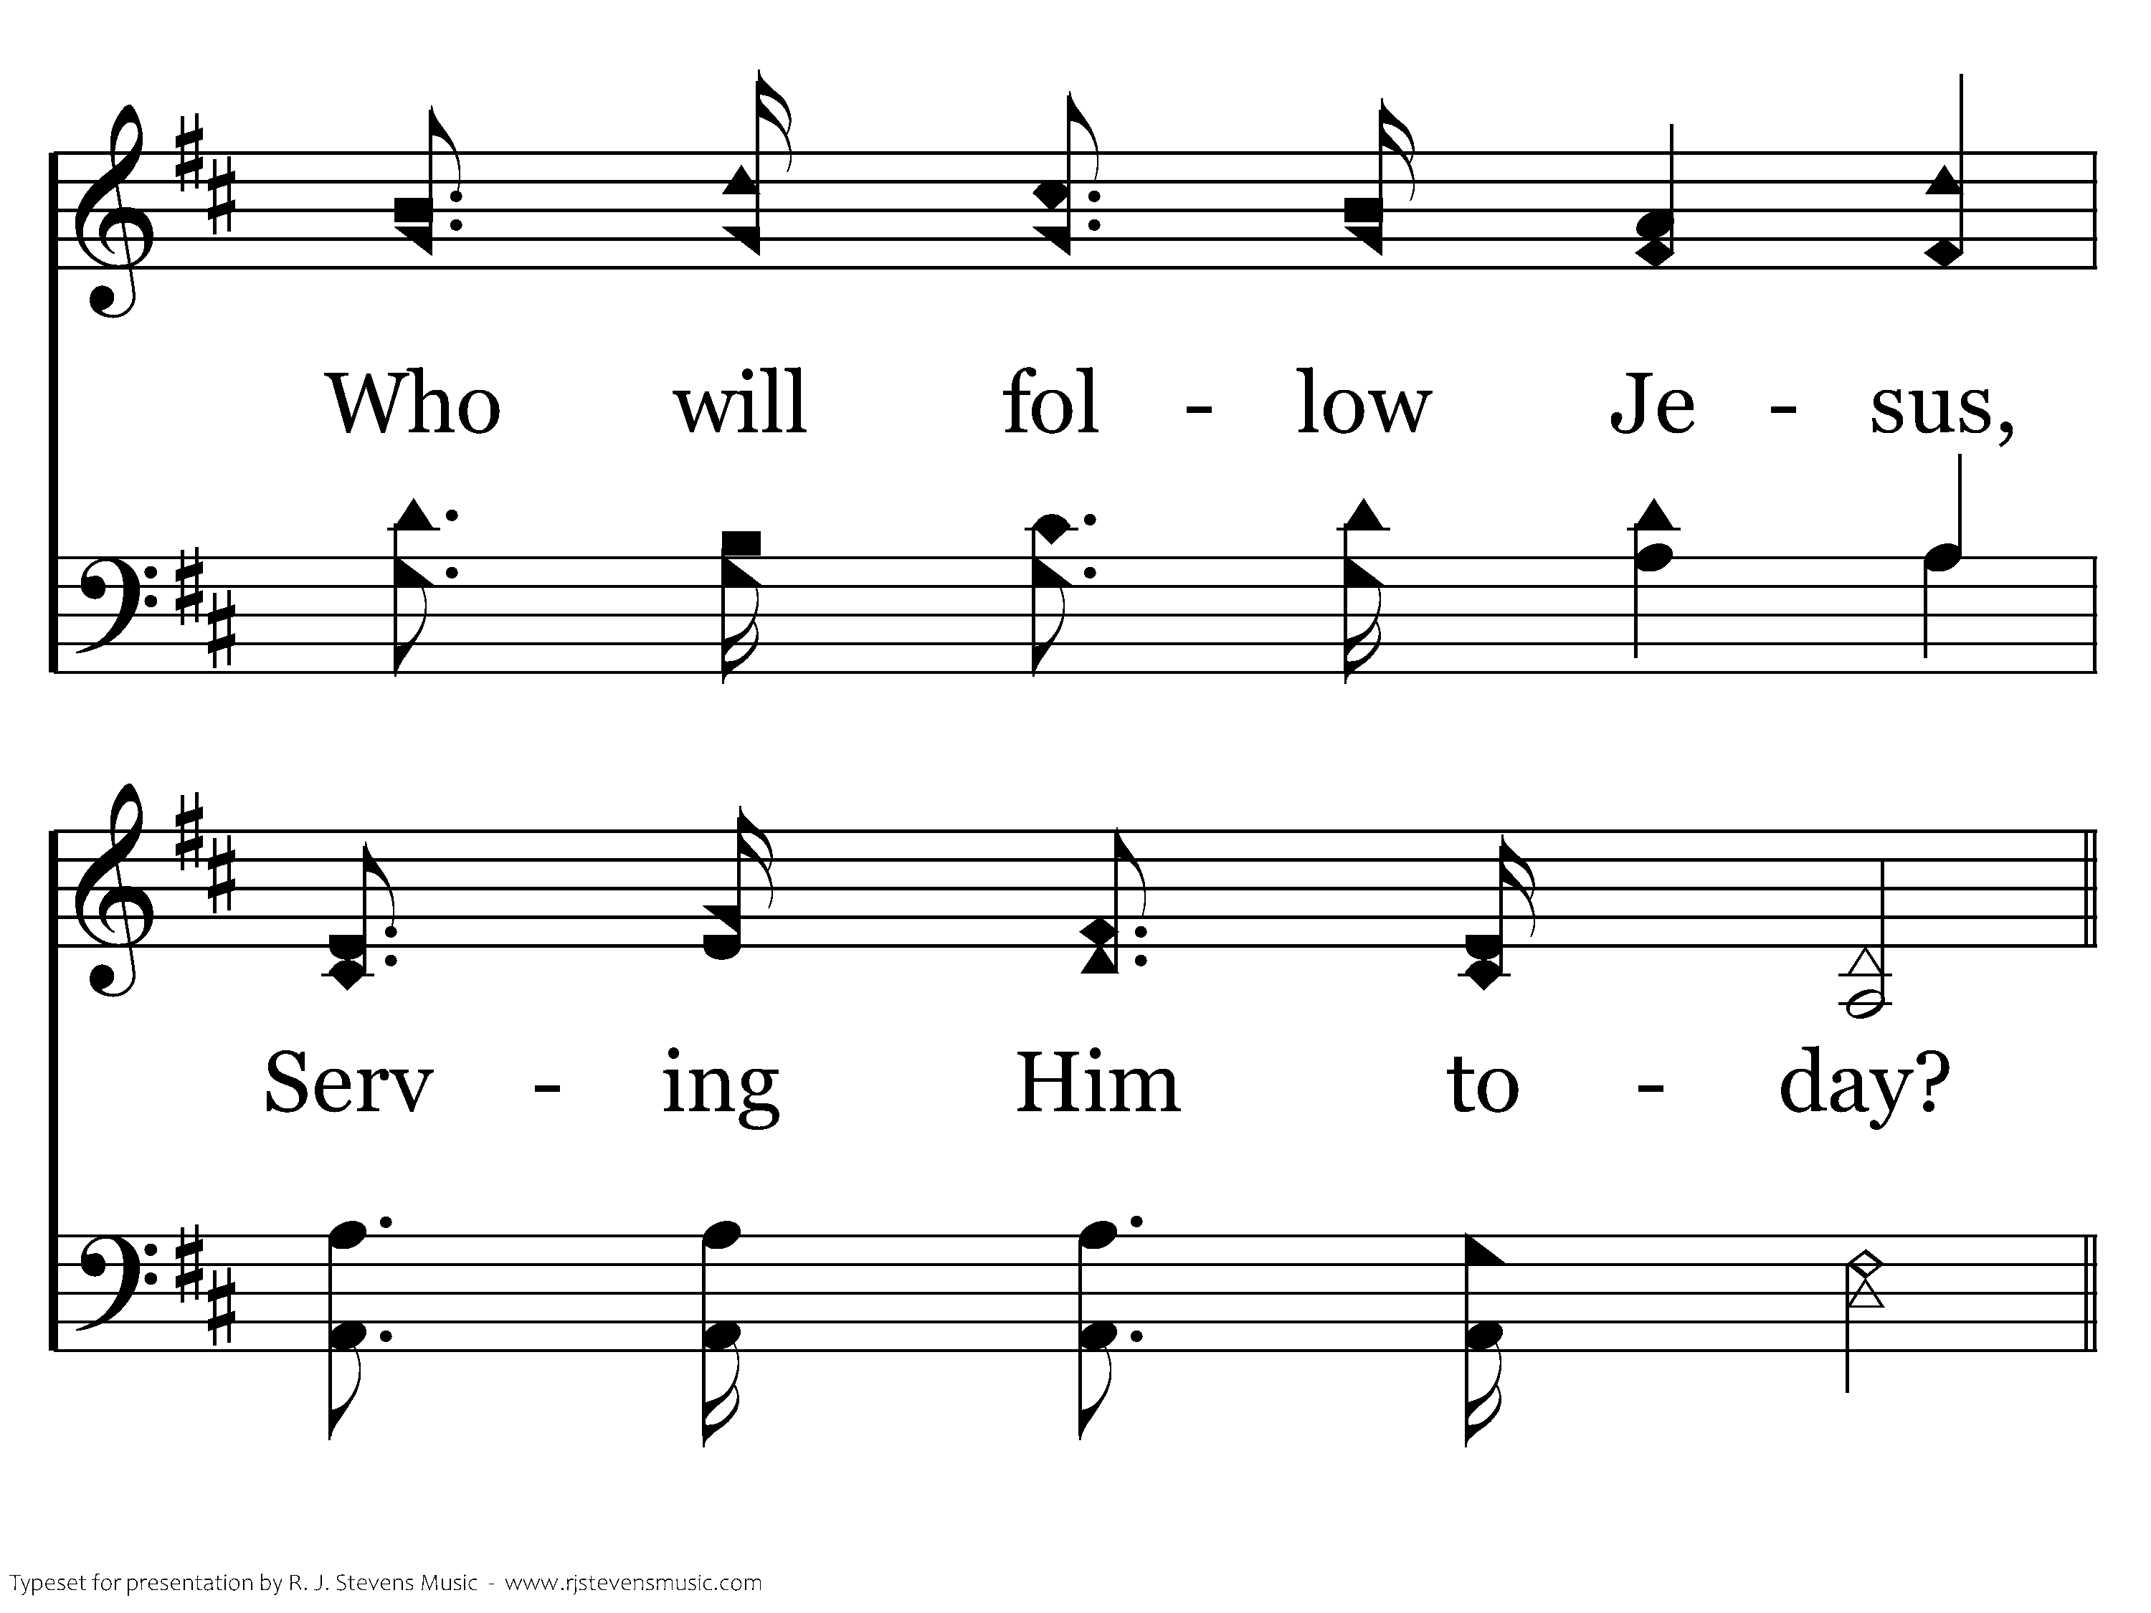
347 - Who Will Follow Jesus - 1.3

Slide 22
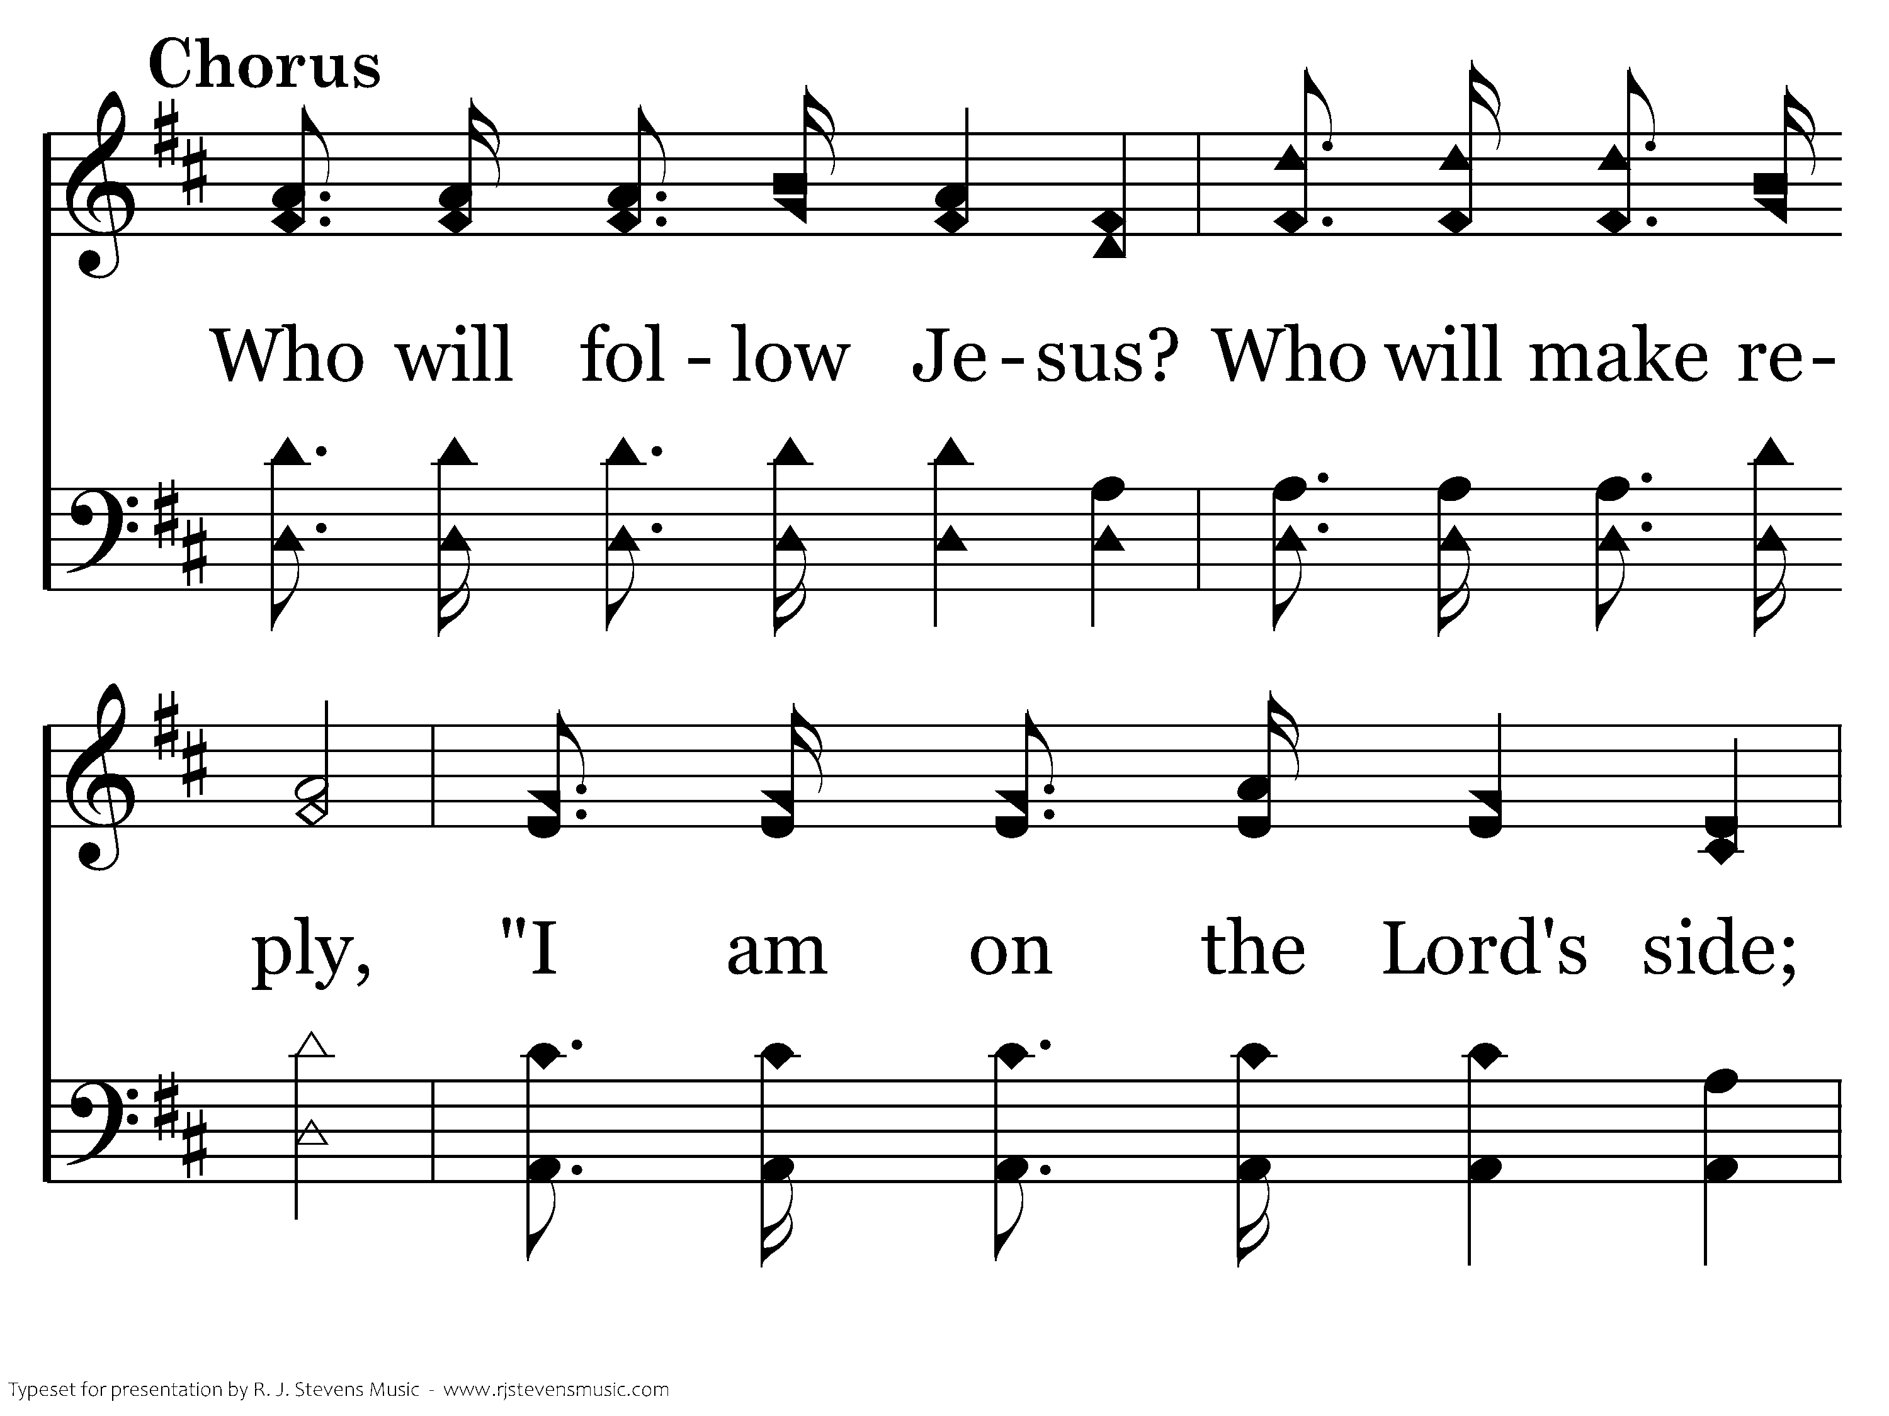
347 - Who Will Follow Jesus - C.1

Slide 23
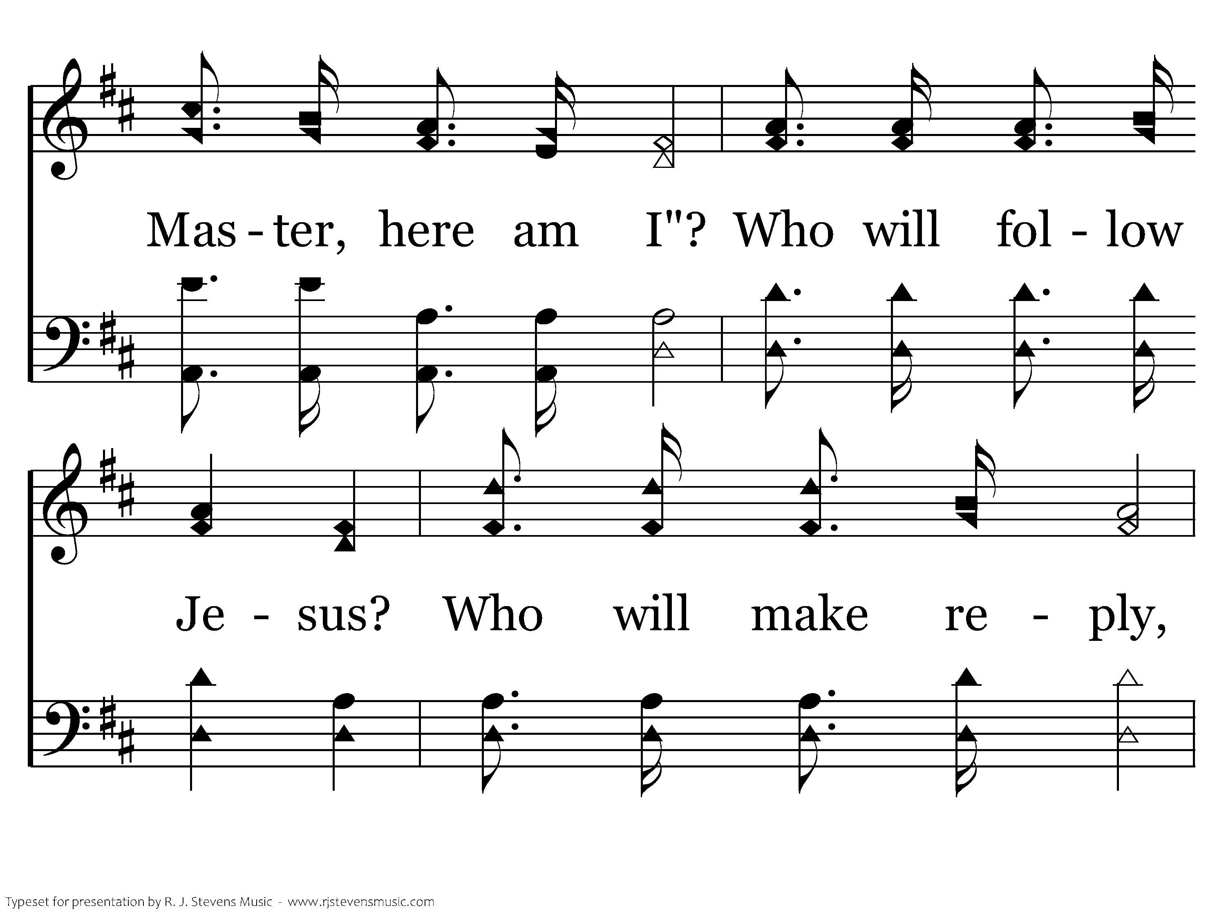
347 - Who Will Follow Jesus - C.2

Slide 24
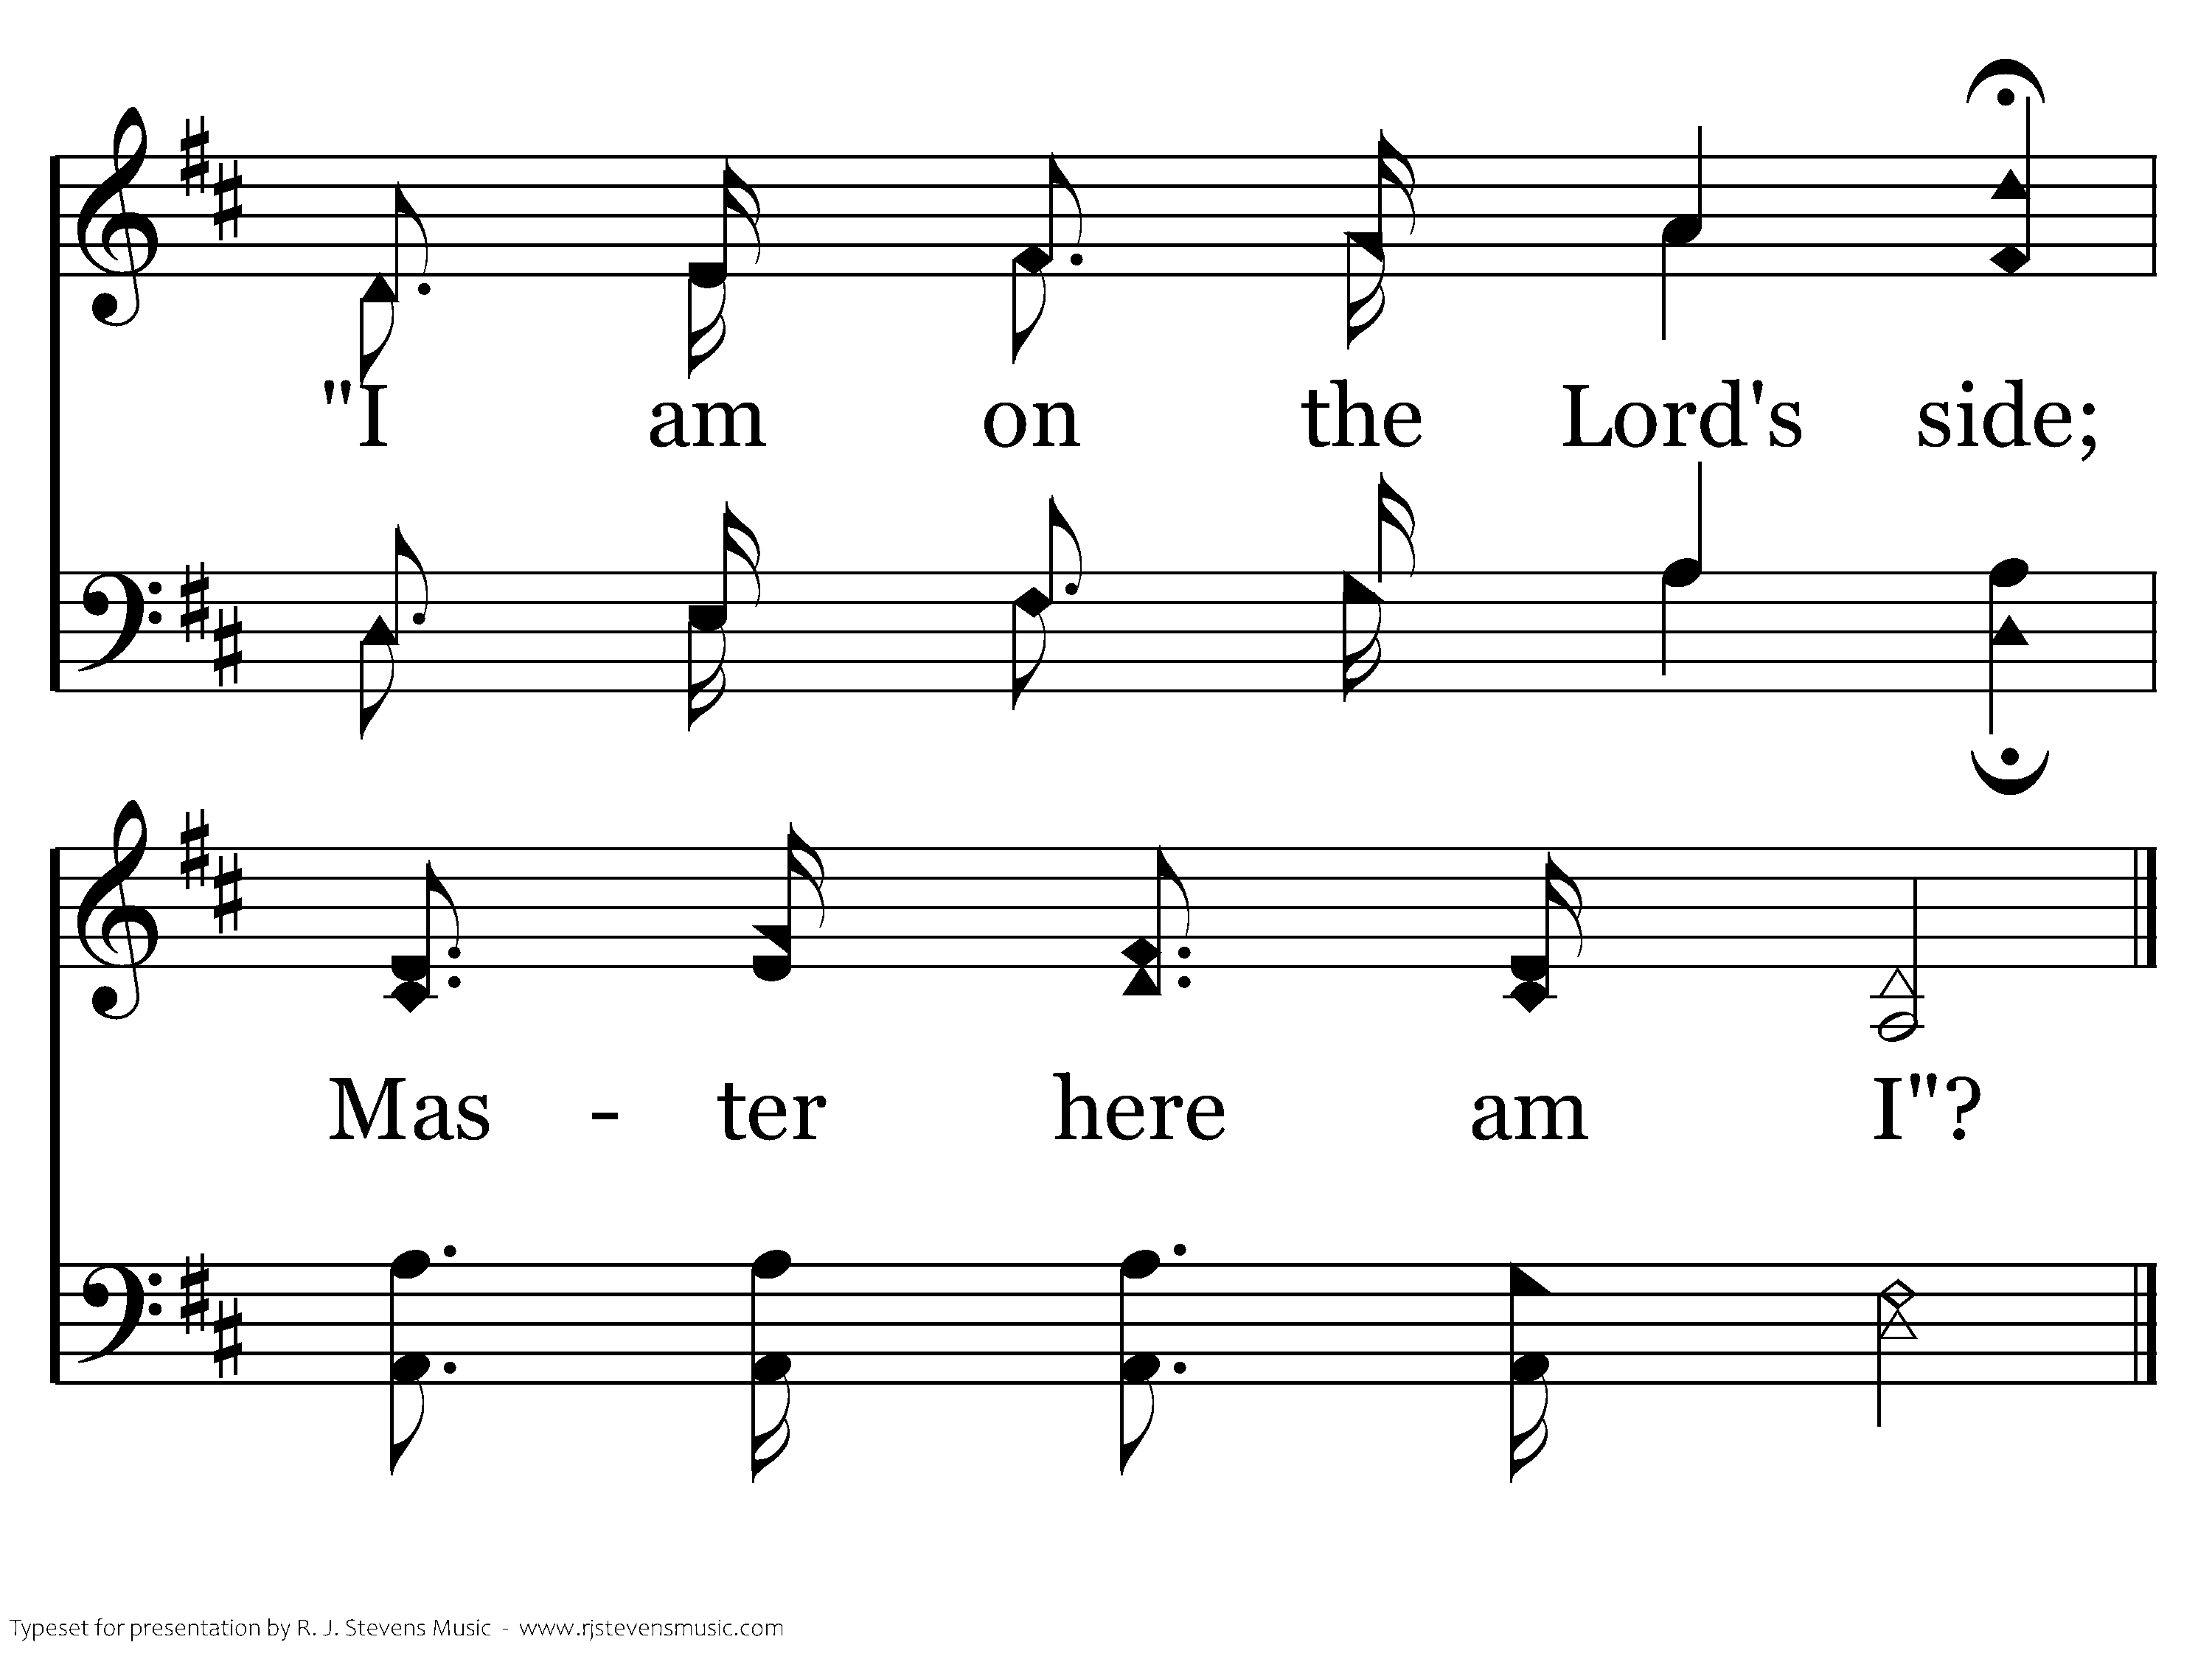
347 - Who Will Follow Jesus - C.3
End of Verse 1

Slide 25
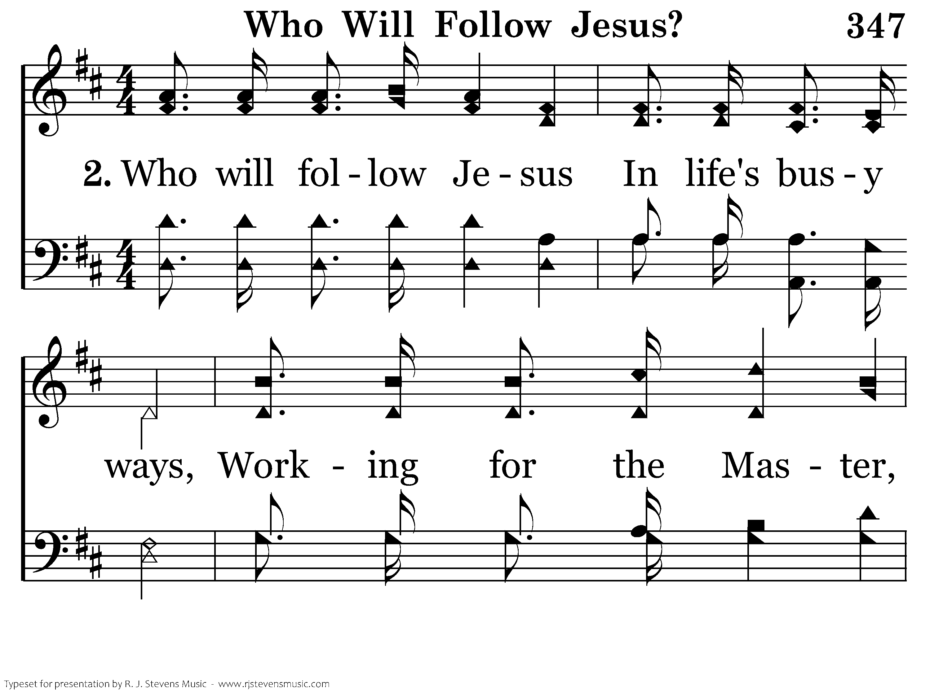
347 - Who Will Follow Jesus - 2.1

Slide 26

347 - Who Will Follow Jesus - 2.2

Slide 27
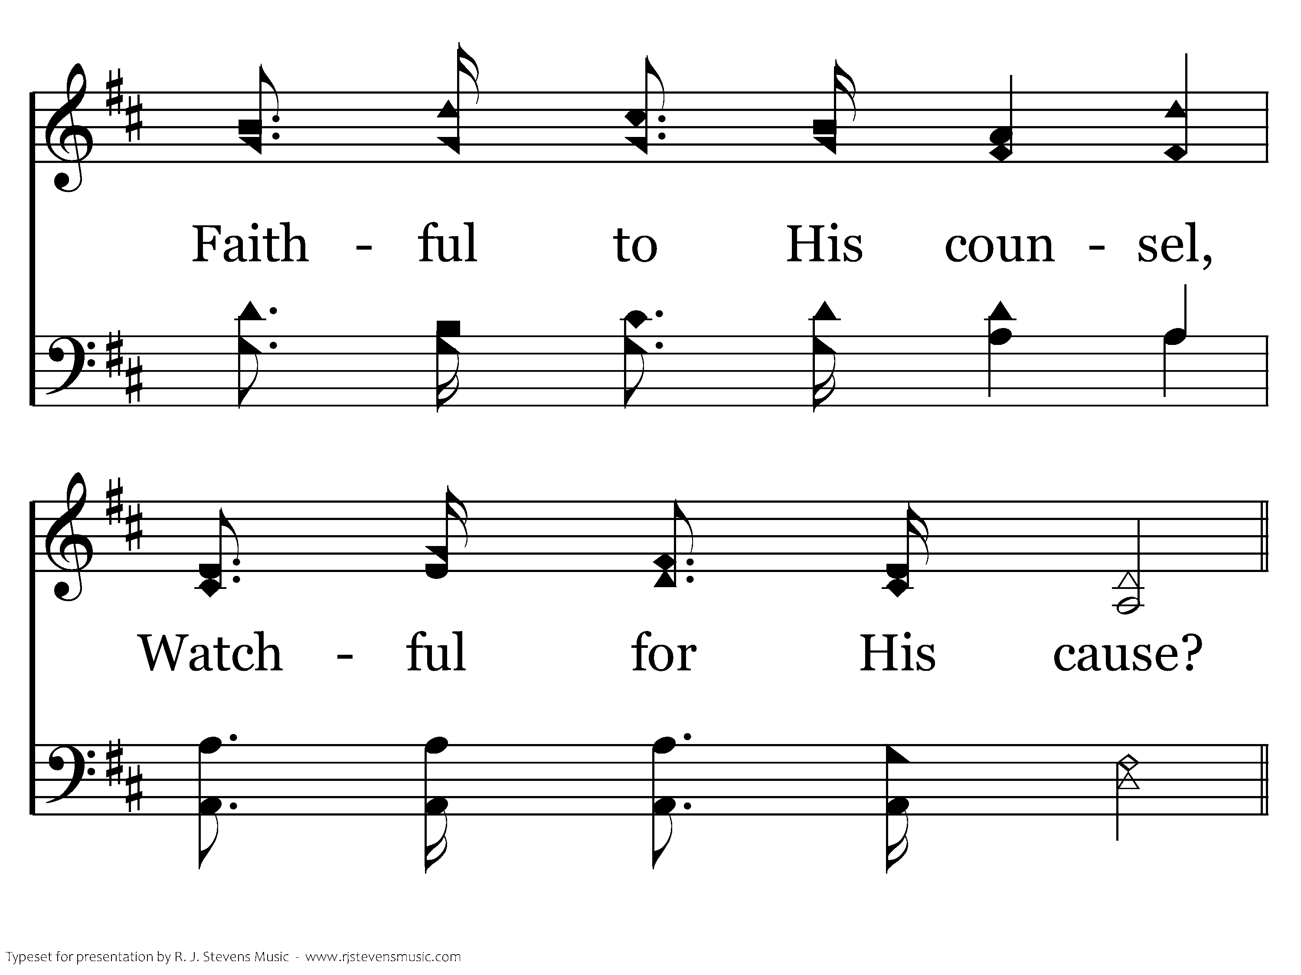
347 - Who Will Follow Jesus - 2.3

Slide 28
347 - Who Will Follow Jesus - C.1

Slide 29
347 - Who Will Follow Jesus - C.2

Slide 30
347 - Who Will Follow Jesus - C.3
End of Verse 2

Slide 31
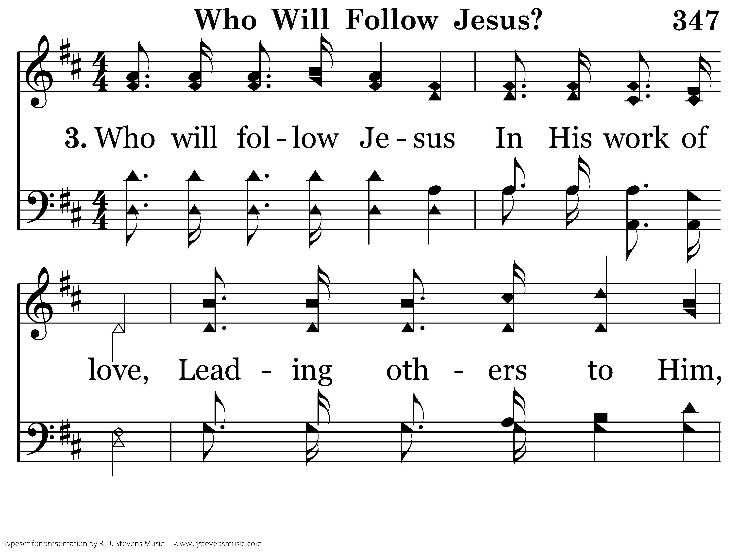
347 - Who Will Follow Jesus - 3.1

Slide 32
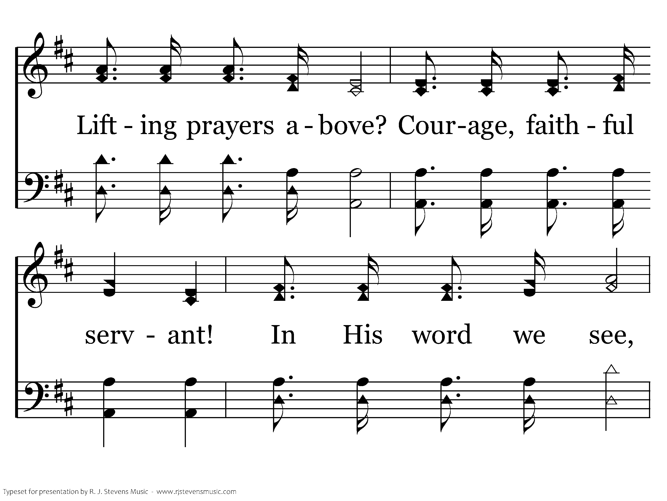
347 - Who Will Follow Jesus - 3.2

Slide 33
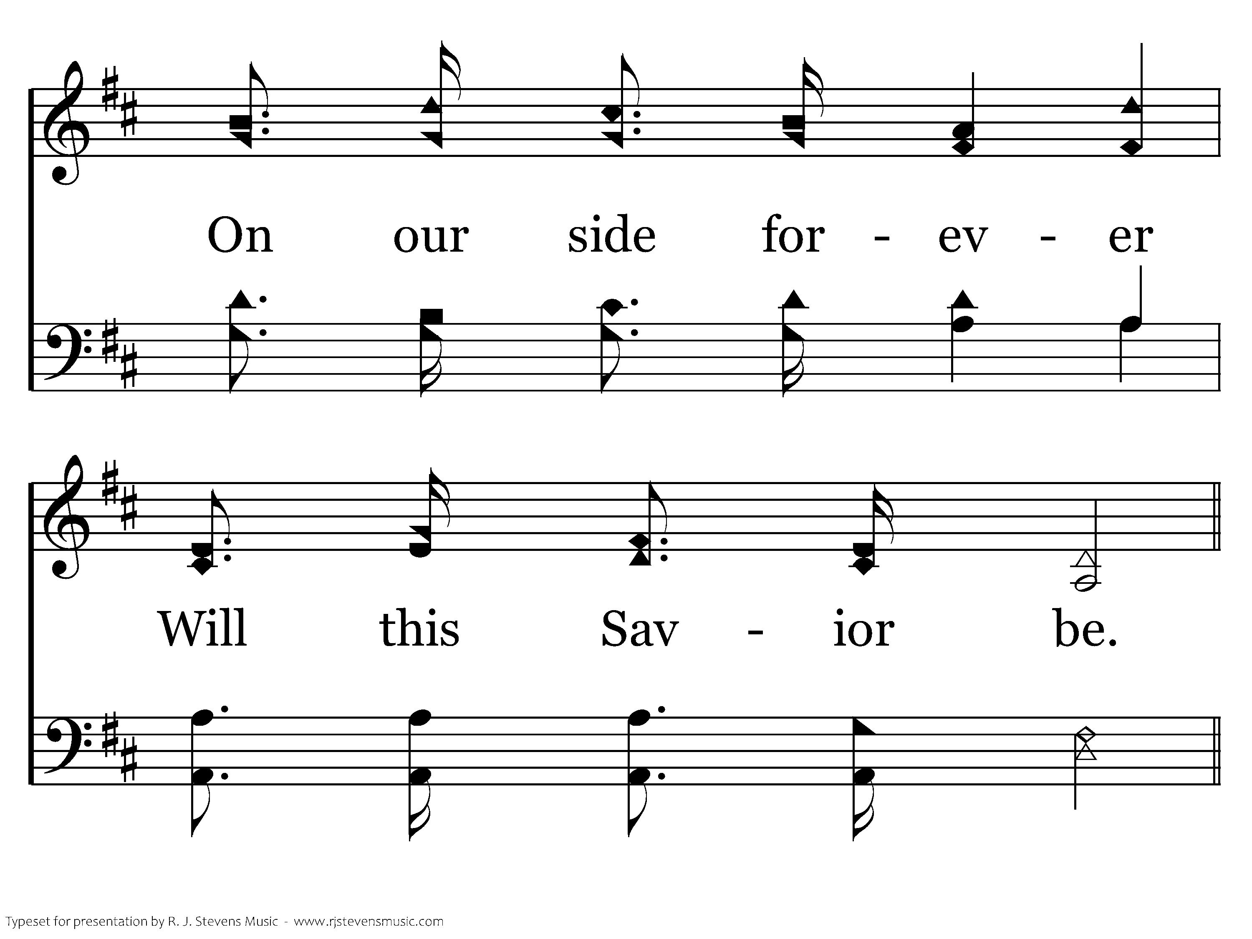
347 - Who Will Follow Jesus - 3.3

Slide 34
347 - Who Will Follow Jesus - C.1

Slide 35
347 - Who Will Follow Jesus - C.2

Slide 36
347 - Who Will Follow Jesus - C.3
End of Song

Slide 37
Lesson 5: Disciples Love Others
Studies to Help Disciples Grow Stronger

