Slide 1

Lesson 6: Disciples Teach Others
Studies to Help Disciples Grow Stronger

Slide 2

Disciples Teach Others
Lesson 6
How should disciples help others come to know Jesus Christ? Can you be an effective teacher of the gospel?
Jesus wants all of His disciples to be teaching others about Him: “Go and make disciples of all the nations, baptizing them in the name of the Father and of the Son and of the Holy Spirit, teaching them to observe all things that I have commanded you” (Matthew 28:19-20).
In this lesson you will learn:
  How to prepare yourself to teach others.
  What the disciple should teach.
  Keys to effective teaching.

Slide 3
Getting Ready to Teach
Lesson 6: Disciples Teach Others
Studies to Help Disciples Grow Stronger

Slide 4
Getting Ready to Teach
Lesson 6: Disciples Teach Others
A. Recognize the responsibility of teaching.
  The teacher must be sure to never lead students away from the truth.
  To drive people away from Christ Jesus with our tactics or techniques is clearly a mistake.
  Teaching the Bible is a serious task – it influences the eternal destiny of souls (James 3:1)!

Slide 5
Getting Ready to Teach
Lesson 6: Disciples Teach Others
Pray
  Prayer is the beginning of all gospel teaching ventures.
  Hear Jesus: “The __________ truly is great, but the laborers are few; therefore __________ the Lord of the harvest to send out __________ into His harvest” (Luke 10:2).
  The New Testament church was continually involved in prayer. Note what they prayed for:
    Acts 4:24-31
    Acts 13:2-3
  Without God’s blessings upon us we are sure to fail miserably. We must pray if we are going to succeed.
  In the context of evangelism, for what should we pray?
    Pray for opportunities to teach.
    Pray that the ones you teach will be receptive.
    Pray that you will have wisdom while teaching.

Slide 6
Getting Ready to Teach
Lesson 6: Disciples Teach Others
Assemble your knowledge.
  Every disciple needs to be ready to justify and defend Christianity.
  “But sanctify the Lord God in your __________, and always be ready to give a __________ to everyone who asks you a __________ for the hope that is in you, with meekness and fear” (1 Peter 3:15).
  We need to know why we believe what we believe and be ready to explain this to anyone who asks.
  This involves knowing:
    Why we believe in God.
    Why we believe the Bible is His word.
    What God has done so we may be saved.
    How we respond to God’s grace so that we may be saved.

Slide 7
Getting Ready to Teach
Lesson 6: Disciples Teach Others
Assemble your knowledge.
  You already have a head start on these concepts because these are the very things you have just learned and done to become a Christian.
  Consider memorizing key passages of scripture that you will need in teaching others (such as Acts 2:38; 22:16; Galatians 1:8-9).
  Many books, videos, and other aids can help you strengthen your ability to communicate soul-saving truths. If you need help, ask the one who taught you the gospel or is teaching this lesson, or the elders or preacher at the congregation where you are a member.

Slide 8
What to Teach
Lesson 6: Disciples Teach Others
Studies to Help Disciples Grow Stronger

Slide 9
What to Teach
Lesson 6: Disciples Teach Others
Focus on Christ Jesus.
  The disciple’s message is based on the fact that Christ Jesus came to earth, died for everyone’s sins, arose from the dead, and will return one day to judge the world (1 Corinthians 15:1-5).
  This is the apostolic message which has been preached from Pentecost until now: “Because he has appointed a __________ on which He will judge the world in __________ by the Man whom he has ordained…” (Acts 17:31).
  We must be certain that we are not preaching ourselves or our own ideas but that we are preaching Jesus Christ.

Slide 10
What to Teach
Lesson 6: Disciples Teach Others
Focus on the authority of the Bible.
  For too many people the Bible is only a “good book,” which is full of old stores and interesting people, but it is not seen as the authoritative word of God.
  Many do not understand that they cannot add to or take away from the Bible (Galatians 1:8-9). Others do not understand the difference between the Old and New Testaments (Galatians 3:23-24).
  Many do not accept the Bible as being God’s instruction book which they must obey.
  In order to help others respond to Jesus, we must help them see that the Bible is not just a good book. It is God’s book which contains God’s will for their lives.

Slide 11
What to Teach
Lesson 6: Disciples Teach Others
Focus on the authority of the Bible.
  “He who __________ Me, and does not receive My words, has that which __________ him; the word that I have spoken will judge him in the last day”
  (John 12:48).
  Until a person accepts the Bible as the absolute standard in his or her life, it is useless to discuss anything else.
  So we must ask people, “What do you think of the Bible?” and work to bring them to the point where they have genuine faith in God’s word.

Slide 12
What to Teach
Lesson 6: Disciples Teach Others
Do not quibble or quarrel.
  “And a servant of the Lord must not __________ but be gentle to all, able to __________, patient in humility correcting those who are in opposition”
  (2 Timothy 2:24-25).
  Some people just want to “play games,” argue, and squabble about religion.
  They have no intention of changing, placing trust in Jesus Christ, or seeking truth. They just enjoy a good fuss.
  Disciples need to be careful not to be drawn into fruitless, endless controversy.

Slide 13
What to Teach
Lesson 6: Disciples Teach Others
Do not quibble or quarrel.
  Jesus refused to quibble with people. Read Luke 20:1-8.
    What question did the Pharisees ask Jesus?
    What question did Jesus ask them?
    Why wouldn’t Jesus answer their question?
  Arguing about how many angels can dance on the head of a pin, did Adam have a belly button, etc. is vain and useless. Don’t waste your time on such nonsense
  (2 Timothy 2:16).

Slide 14
Keys to
Effective Teaching
Lesson 6: Disciples Teach Others
Studies to Help Disciples Grow Stronger

Slide 15
Keys to Effective Teaching
Lesson 6: Disciples Teach Others
Be patient.
  Some will not see the truth as quickly as others.
  Many preconceived notions and prejudices must be overcome.
  Let people learn at their own pace, not yours!
  Jesus was long-suffering with people (see John 4:6-26). We must be like Christ and be patient.

Slide 16
Keys to Effective Teaching
Lesson 6: Disciples Teach Others
Listen.
  In the Gospel of Luke we see Jesus continually asking people questions and then listening carefully to their response (Luke 9:20).
  Jesus knew that He could find out where people were in their development and knowledge by asking questions.
  We need to do the same – listen, listen, listen.

Slide 17
Keys to Effective Teaching
Lesson 6: Disciples Teach Others
Be a friend.
  People are very suspicious of “hard sell” types who appear to be trying to “pawn off” some slick product.
  Be like Jesus – concerned about other people in a genuine, caring way. How did Jesus show He cared in the following scriptures?
    Luke 5:13
    Luke 7:11-16
    Luke 8:41-48
    Luke 18:15-17
  Because there is much false religion and teaching in our world, many times you must earn a hearing for the gospel message by showing how it works in your own life.
  “Let your __________ so shine before men, that they may see your good
  __________ and glorify your __________ in heaven” (Matthew 5:16).

Slide 18
Keys to Effective Teaching
Lesson 6: Disciples Teach Others
Do the work of evangelism.
  We can only prepare and plan so long. Eventually we must be about the business of teaching the lost.
  Commit a definite amount of time to evangelism every week.
  Look for contacts by greeting every non-Christian visitor at the worship services, getting acquainted with your neighbors and co-workers, or by inviting someone to a regular service of the church.
  Other ideas: Distribute DVDs or CDs of Bible teaching, hand out tracts, use social media to post about the Bible and church, have a stronger Christian teach a small-group Bible study in your home, or message, email or phone acquaintances to ask them to read the Bible with you.
  There are many ways we can be involved in evangelism. Work a method that
  you are comfortable with – but be sure to work!

Slide 19
Conclusion
Lesson 6: Disciples Teach Others
Studies to Help Disciples Grow Stronger

Slide 20
Conclusion
Lesson 6: Disciples Teach Others
All disciples need to be teaching others about Jesus Christ.
  Prepare yourself so you can be an effective teacher of the gospel.
  Always watch for opportunities to teach people about Jesus
  While you may not feel extremely confident now, you can still learn more, and you can still tell others what you did to become a Christian and why you did those things.

Slide 21
Conclusion
Lesson 6: Disciples Teach Others
Some become discouraged when teaching, but they should not.
  Yes, it is disappointing that not everyone will do what the Bible says and become a Christian.
  However, Jesus has not charged us with converting people but teaching people. Read the Great Commission text (Matthew 28:19-20) and note the priority of teaching.
  We teach. The prospect then decides what to do with the information we give him or her (read 1 Corinthians 3:5-9).
  Do not put too much pressure on yourself. You please God when you try–and anyone can try!

Slide 22
Conclusion
Lesson 6: Disciples Teach Others
List five people you want to talk with about the gospel. Begin praying for
these people and looking for an opportunity to discuss Jesus with them.

Slide 23
Lesson 6: Disciples Teach Others
Studies to Help Disciples Grow Stronger

Slide 24

347 - Who Will Follow Jesus - Title

Slide 25
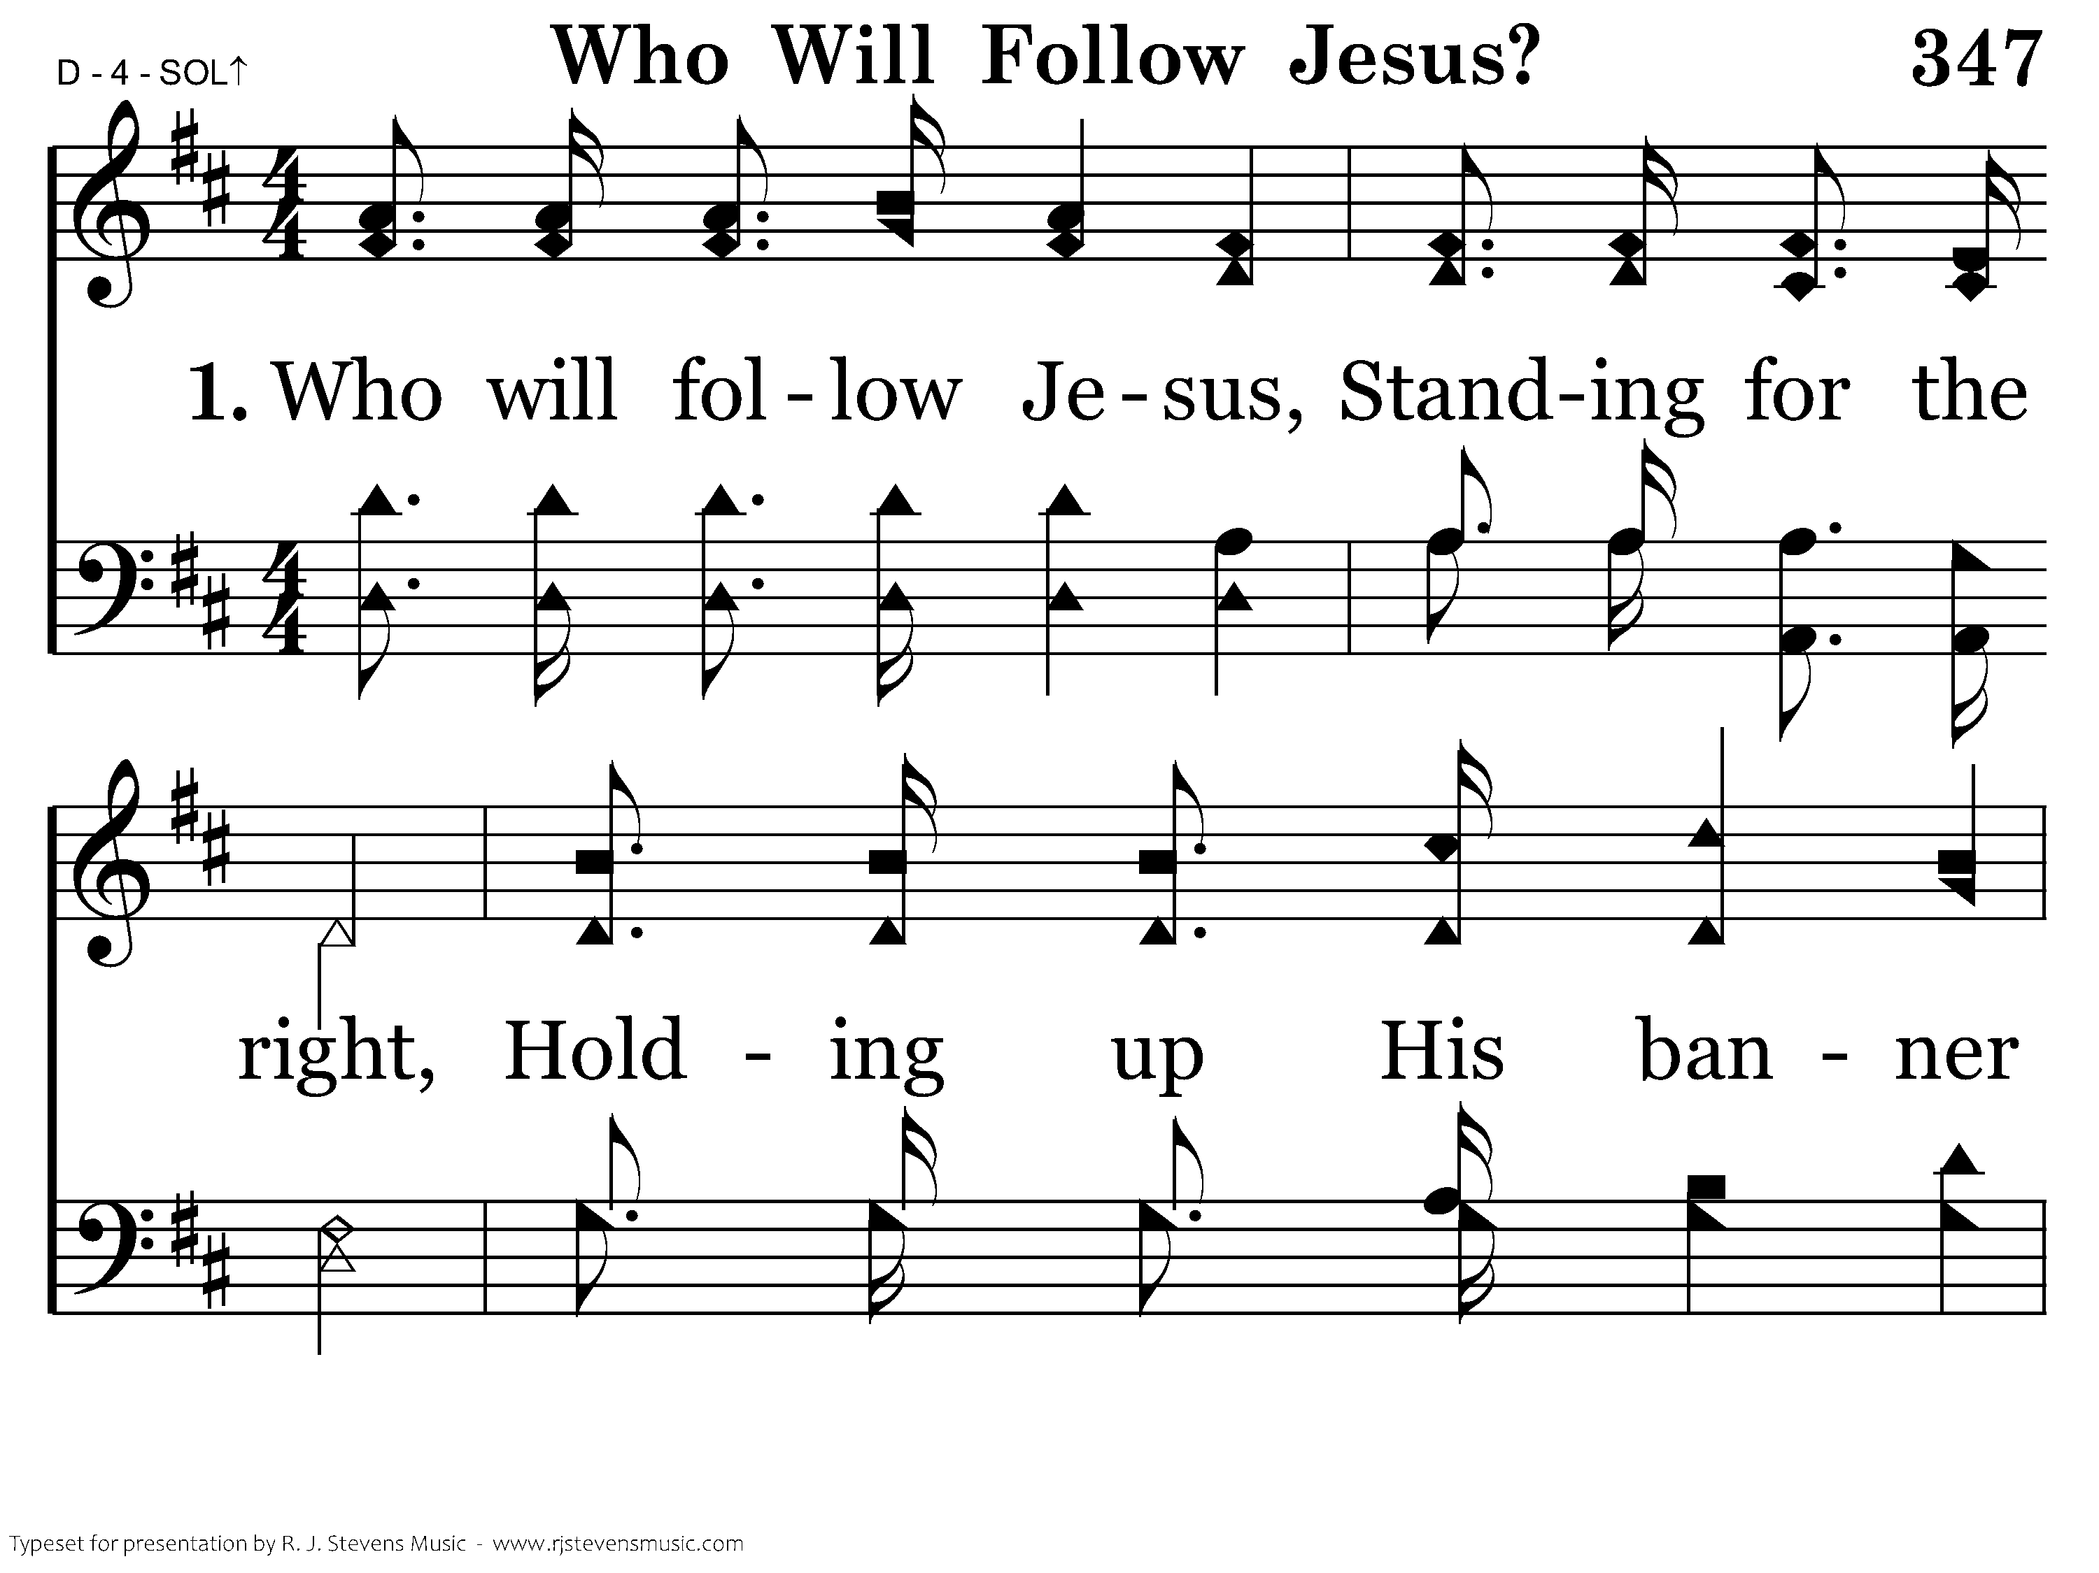
347 - Who Will Follow Jesus - 1.1

Slide 26
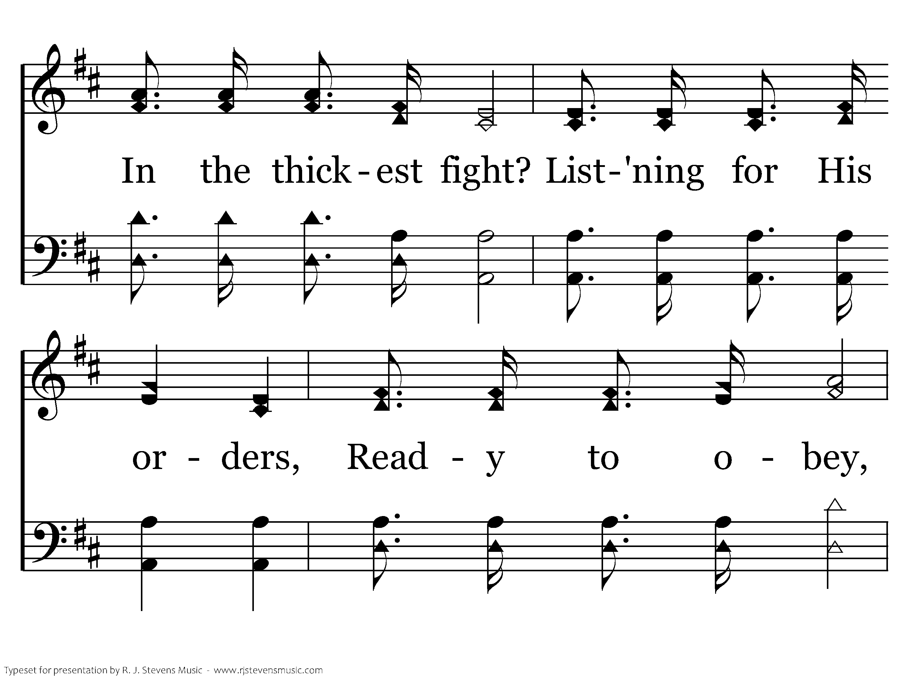
347 - Who Will Follow Jesus - 1.2

Slide 27
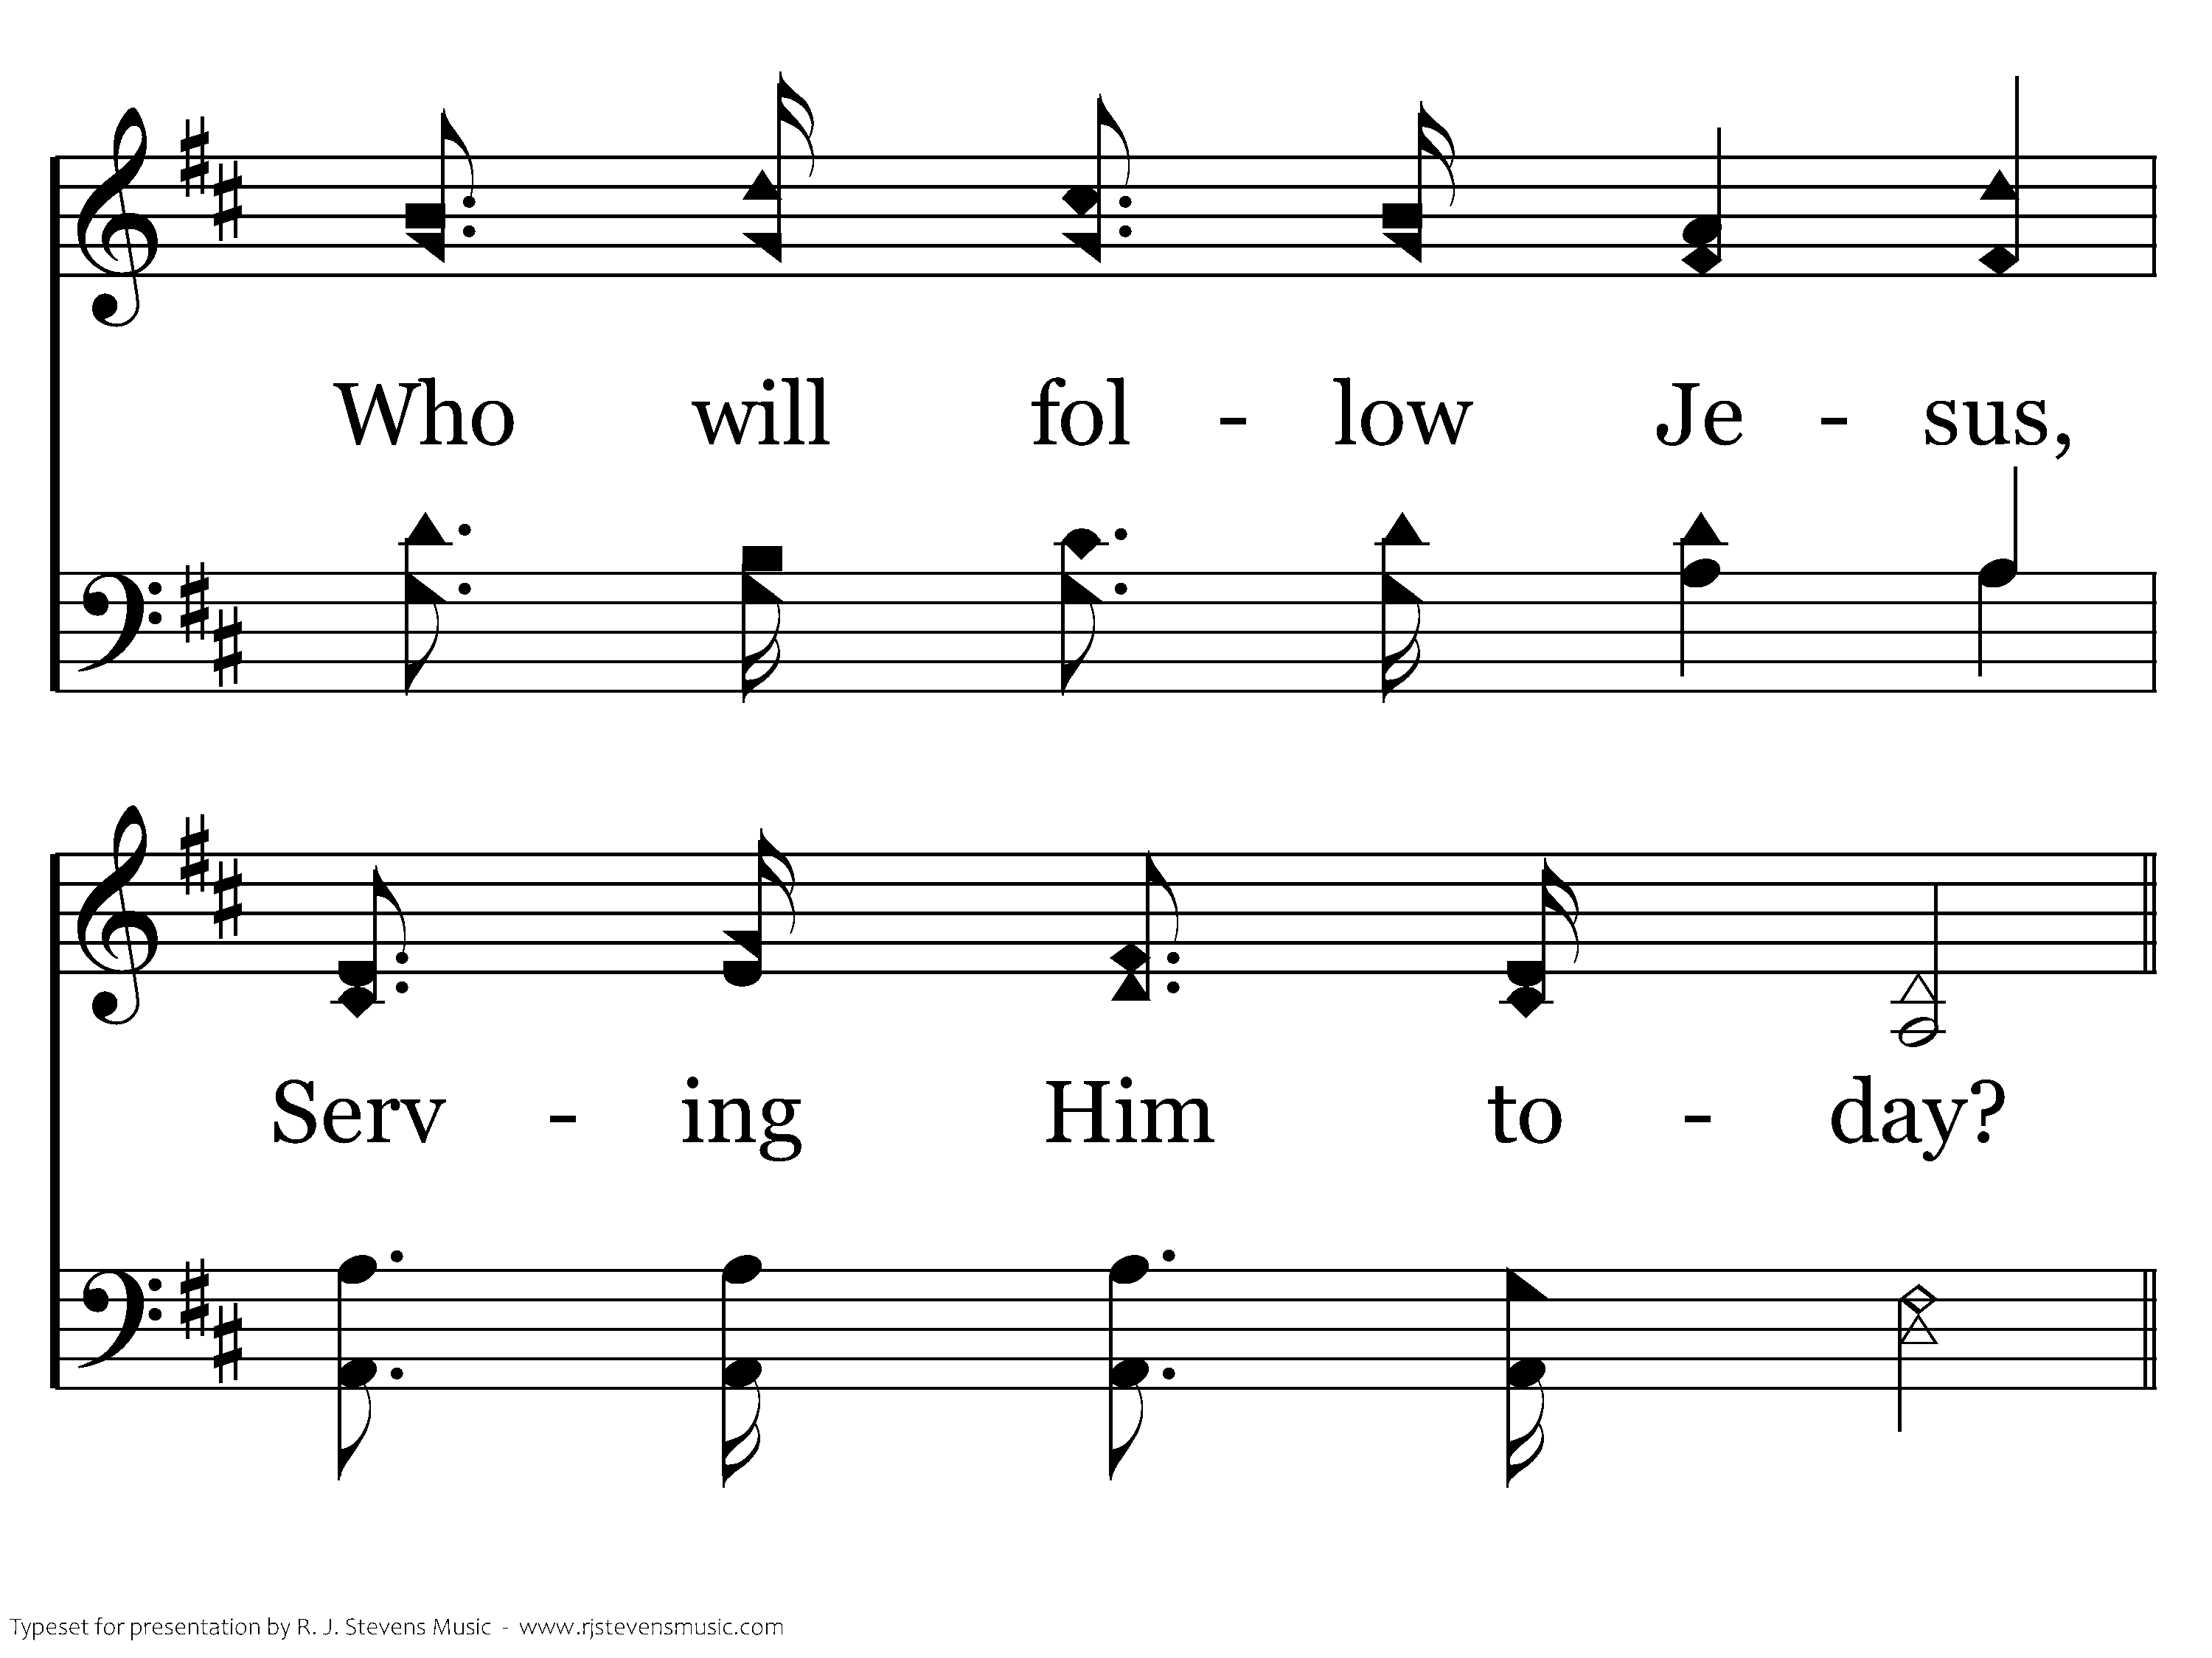
347 - Who Will Follow Jesus - 1.3

Slide 28
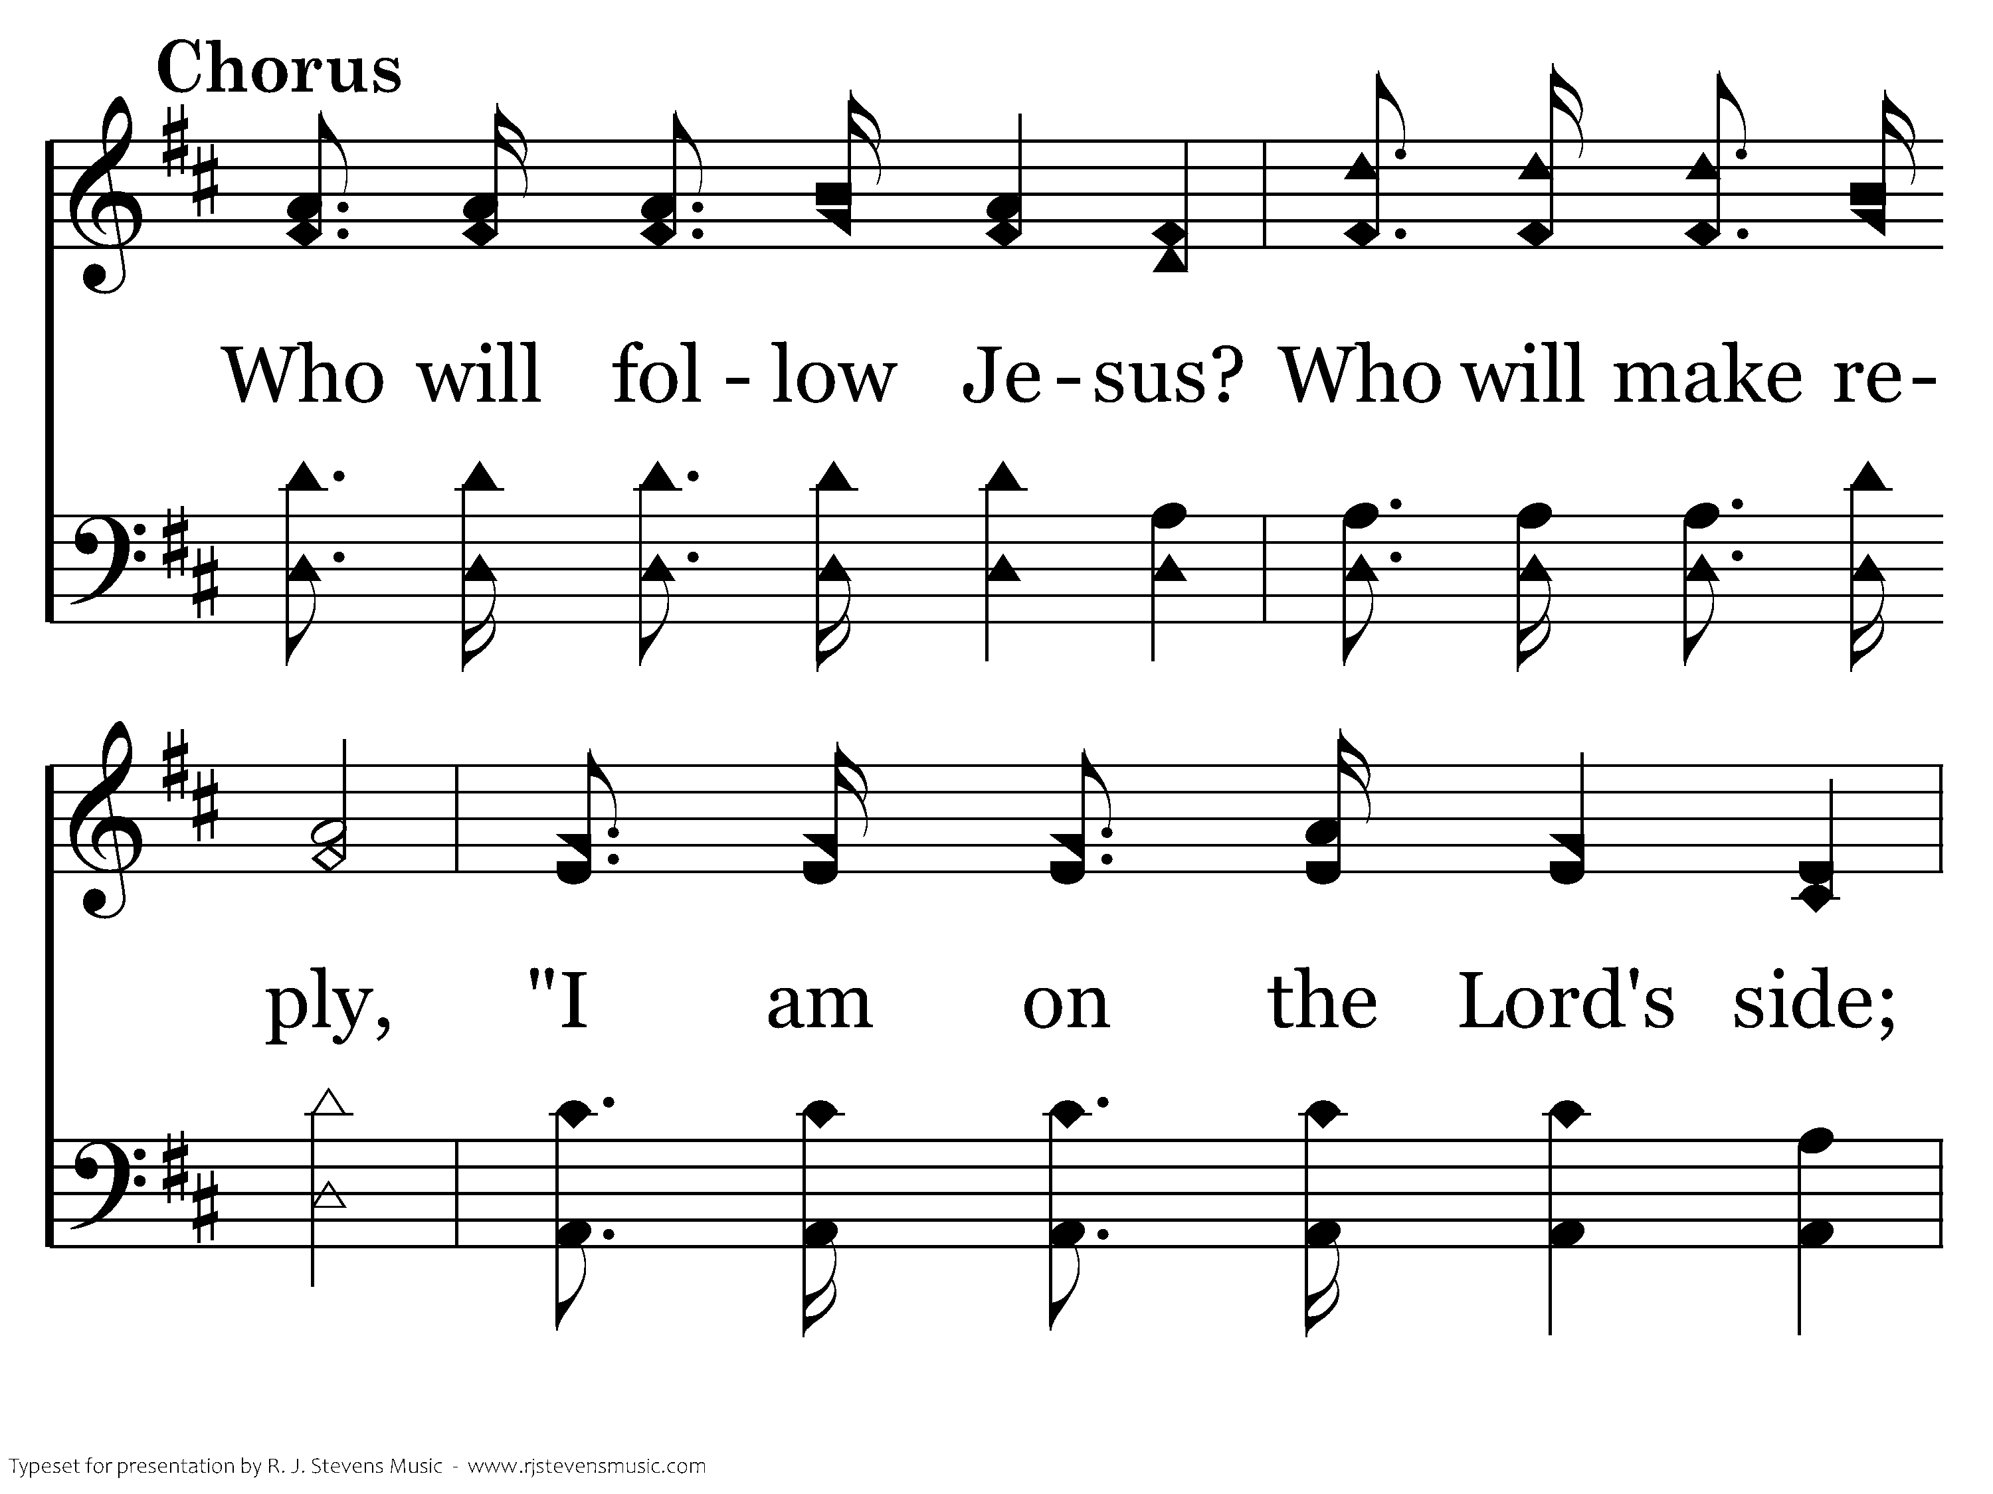
347 - Who Will Follow Jesus - C.1

Slide 29
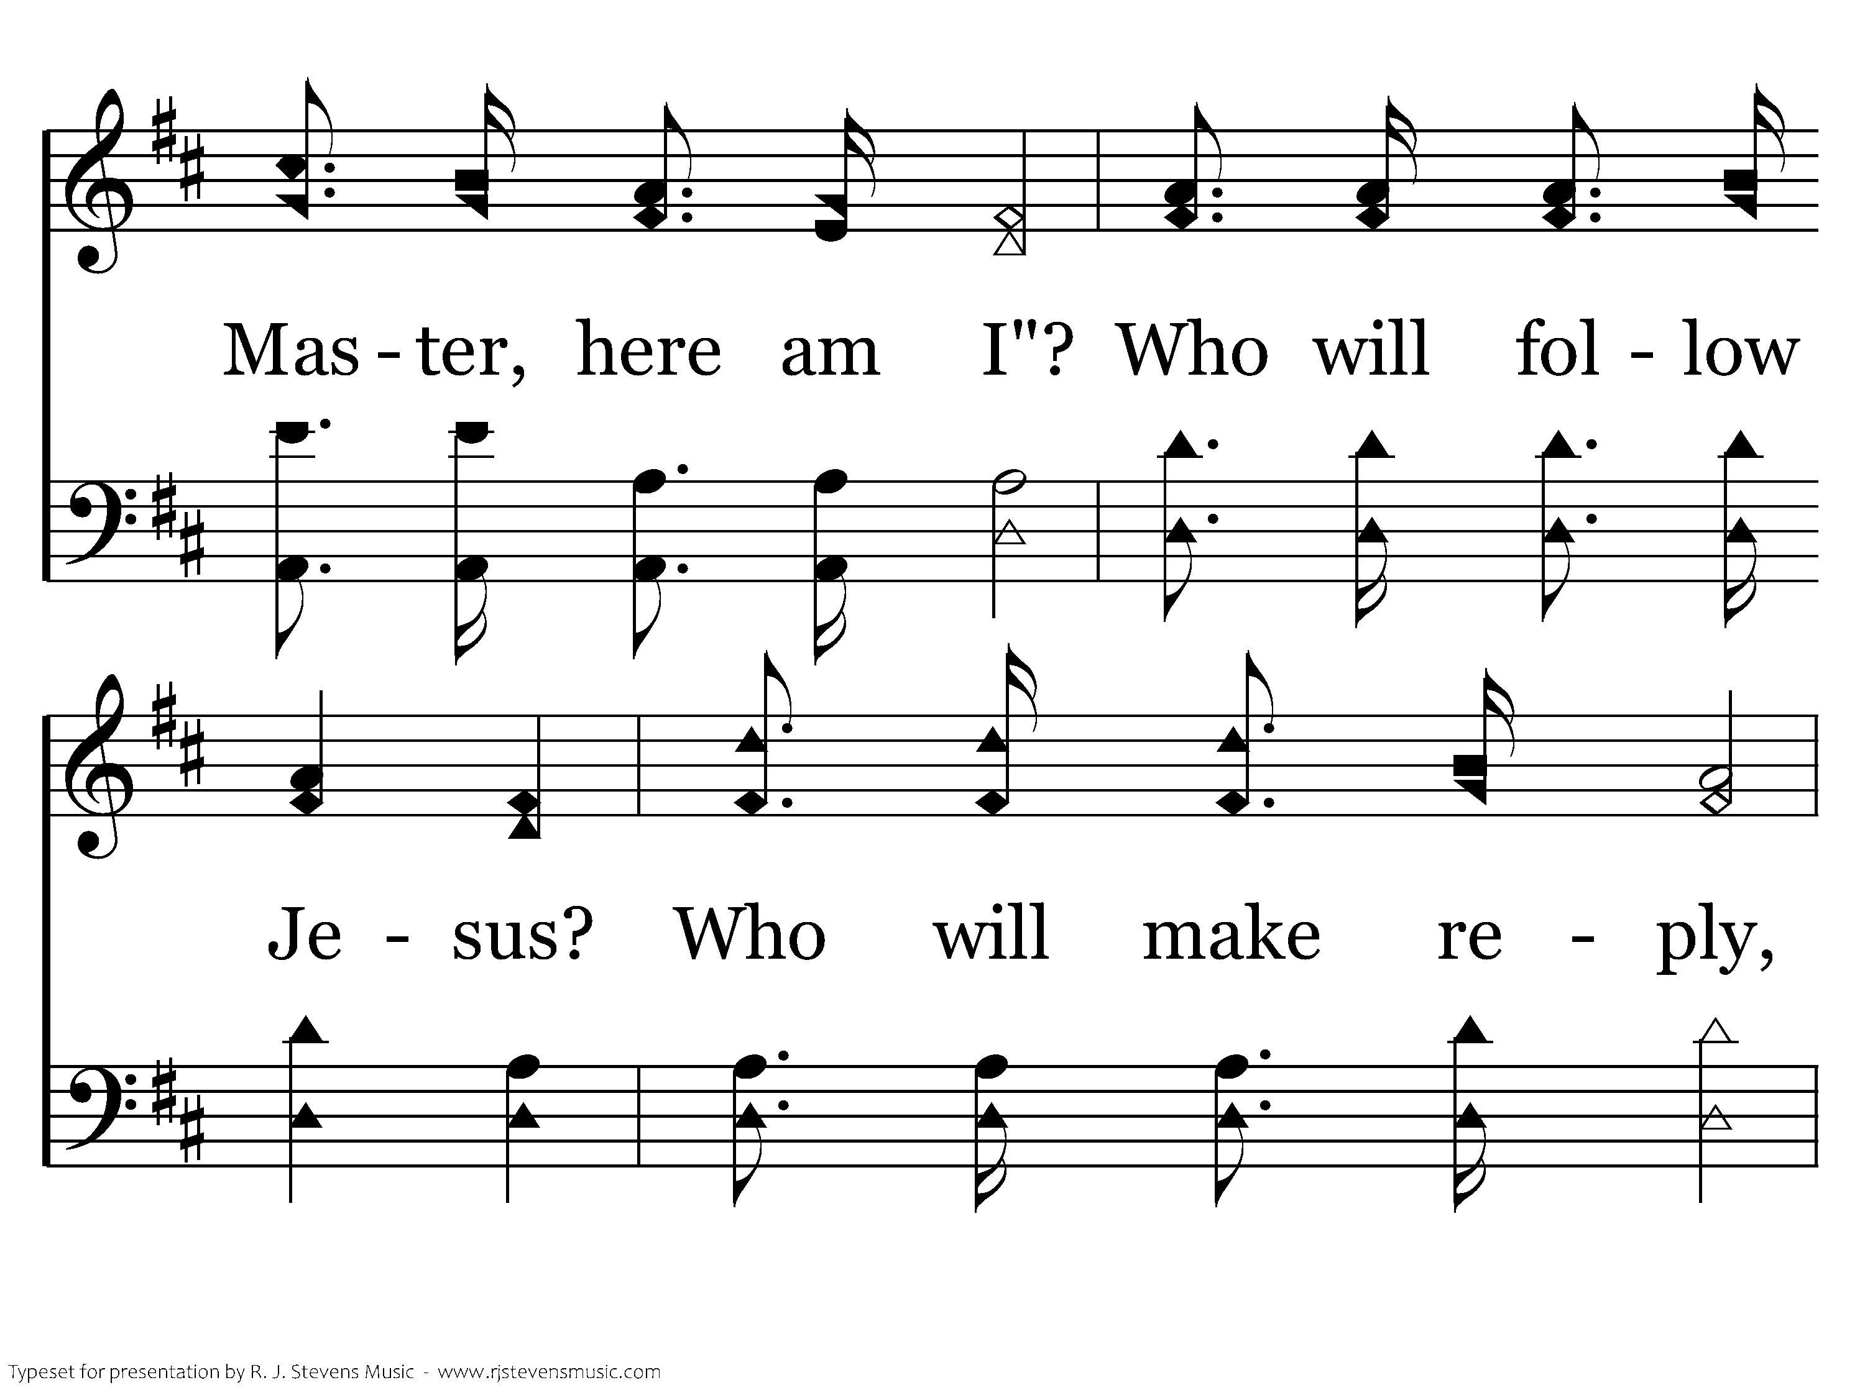
347 - Who Will Follow Jesus - C.2

Slide 30
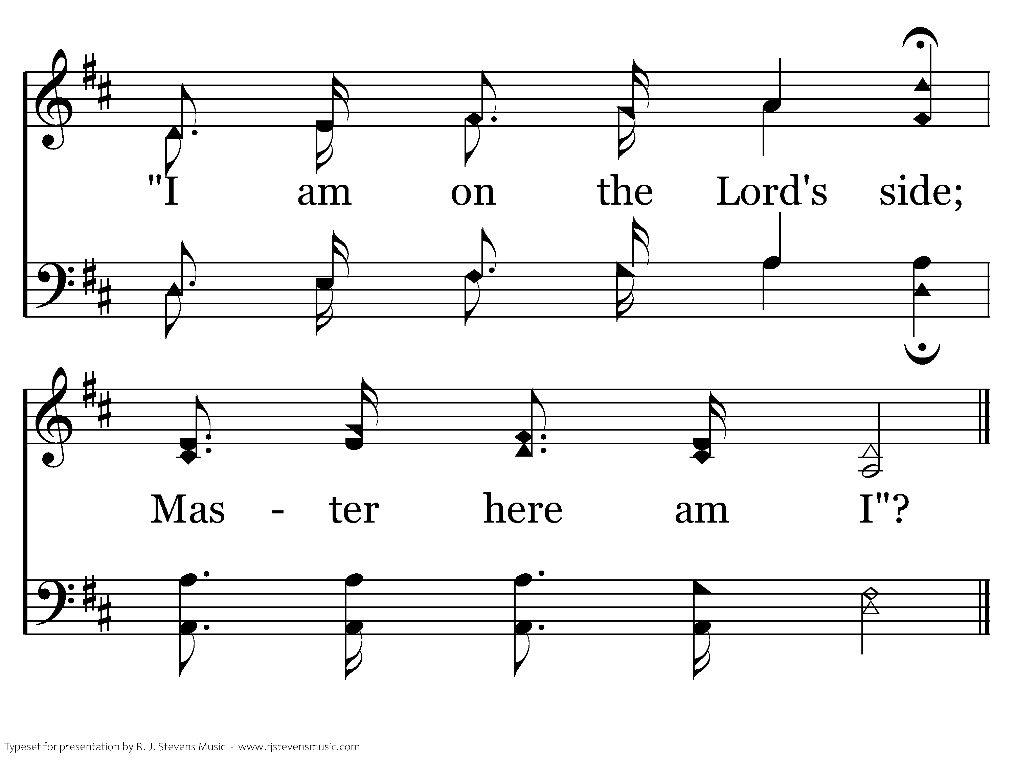
347 - Who Will Follow Jesus - C.3
End of Verse 1

Slide 31
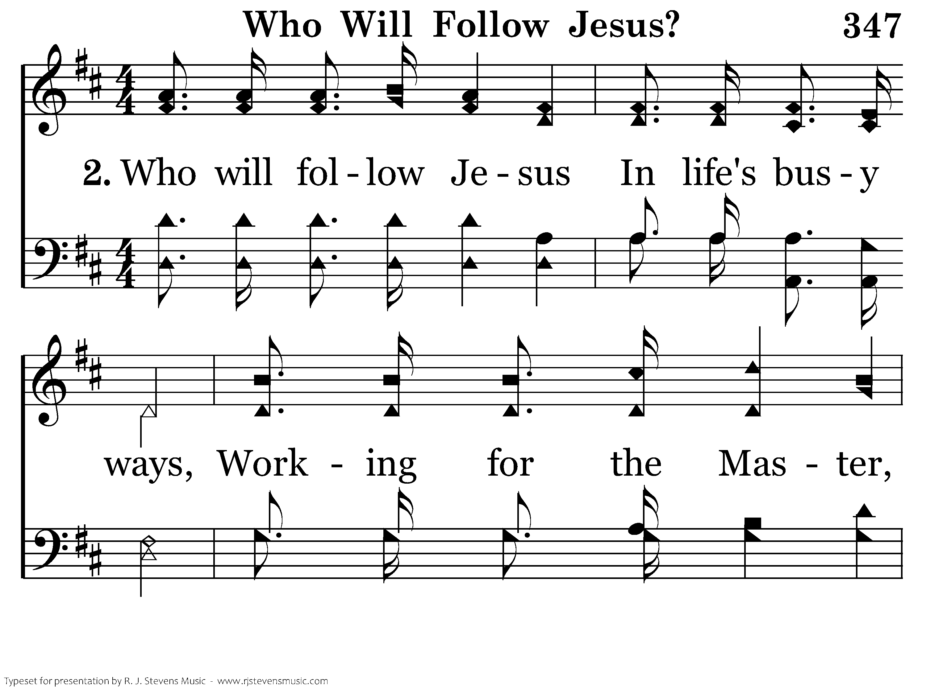
347 - Who Will Follow Jesus - 2.1

Slide 32
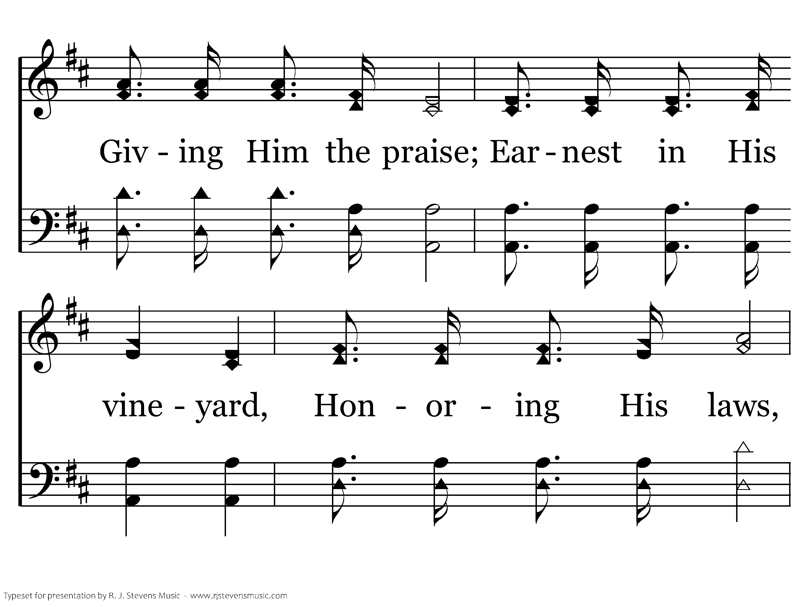
347 - Who Will Follow Jesus - 2.2

Slide 33
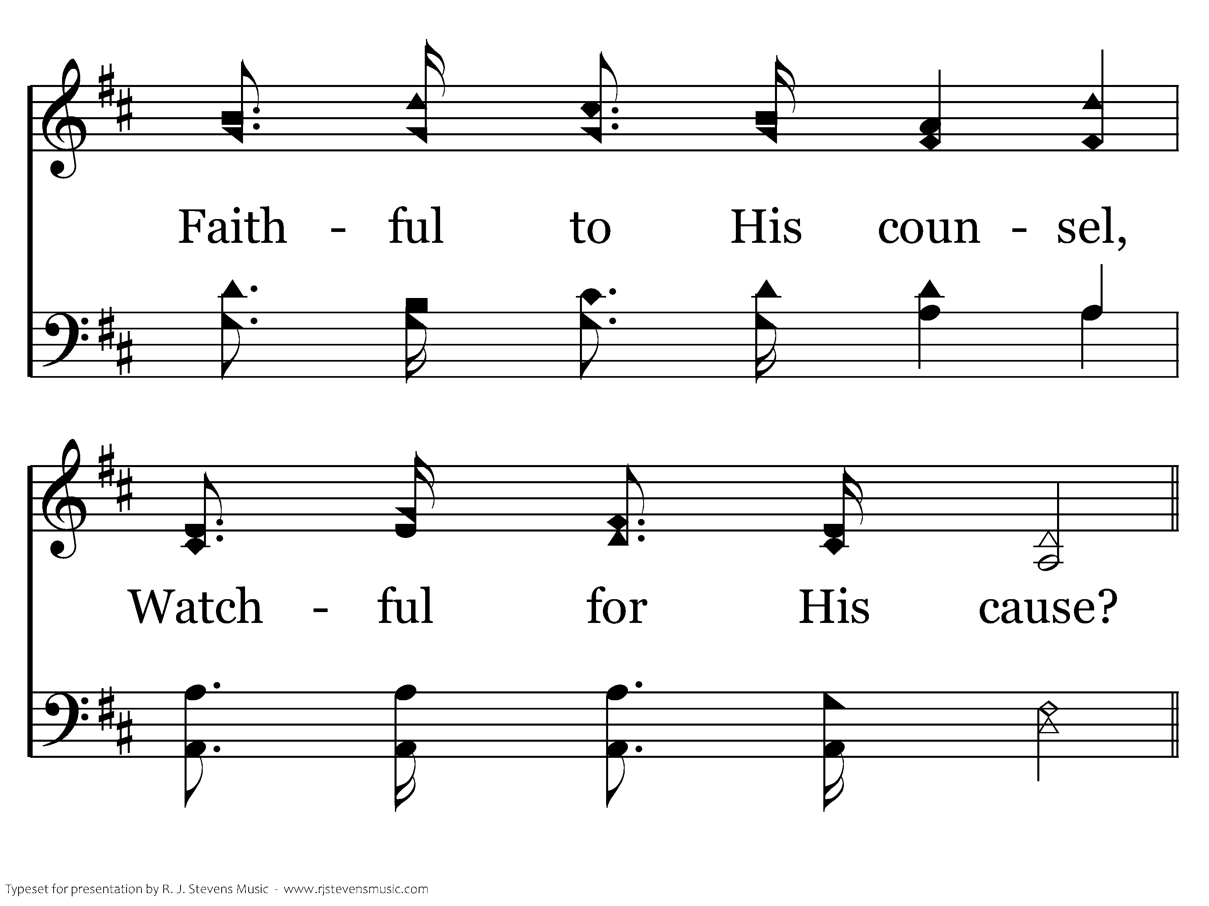
347 - Who Will Follow Jesus - 2.3

Slide 34
347 - Who Will Follow Jesus - C.1

Slide 35
347 - Who Will Follow Jesus - C.2

Slide 36
347 - Who Will Follow Jesus - C.3
End of Verse 2

Slide 37
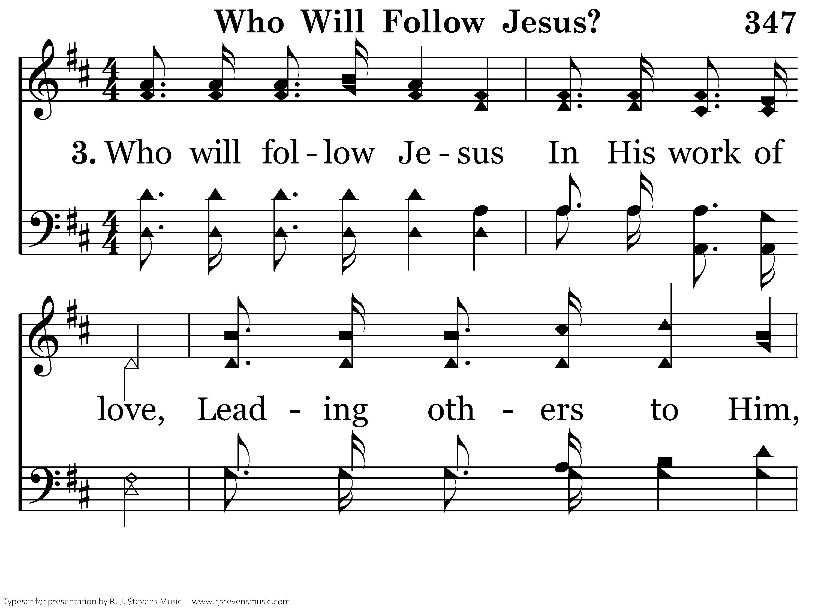
347 - Who Will Follow Jesus - 3.1

Slide 38
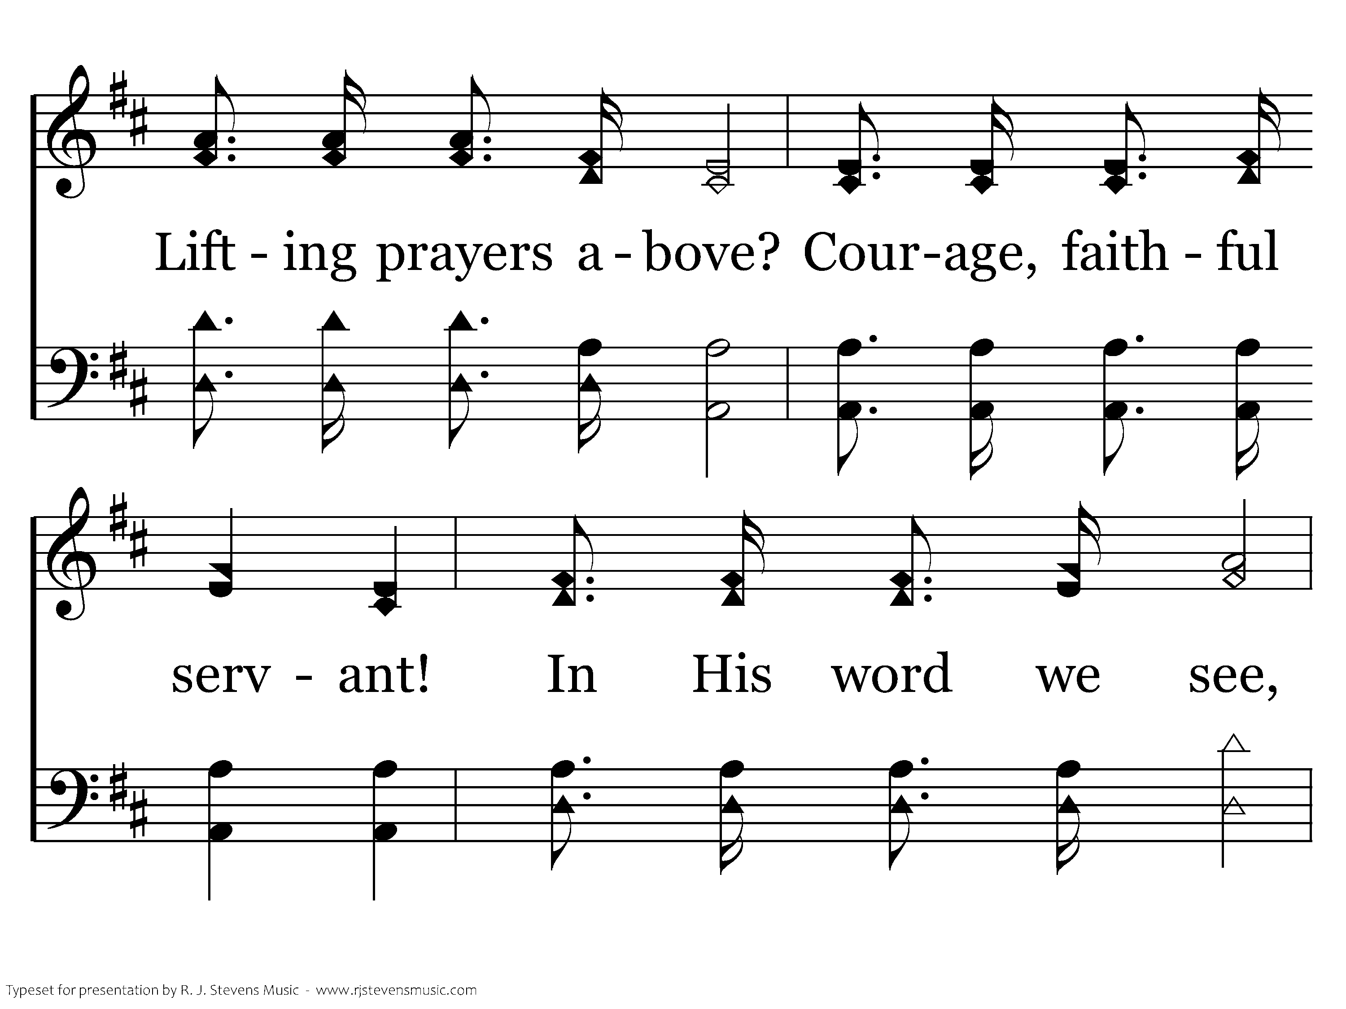
347 - Who Will Follow Jesus - 3.2

Slide 39
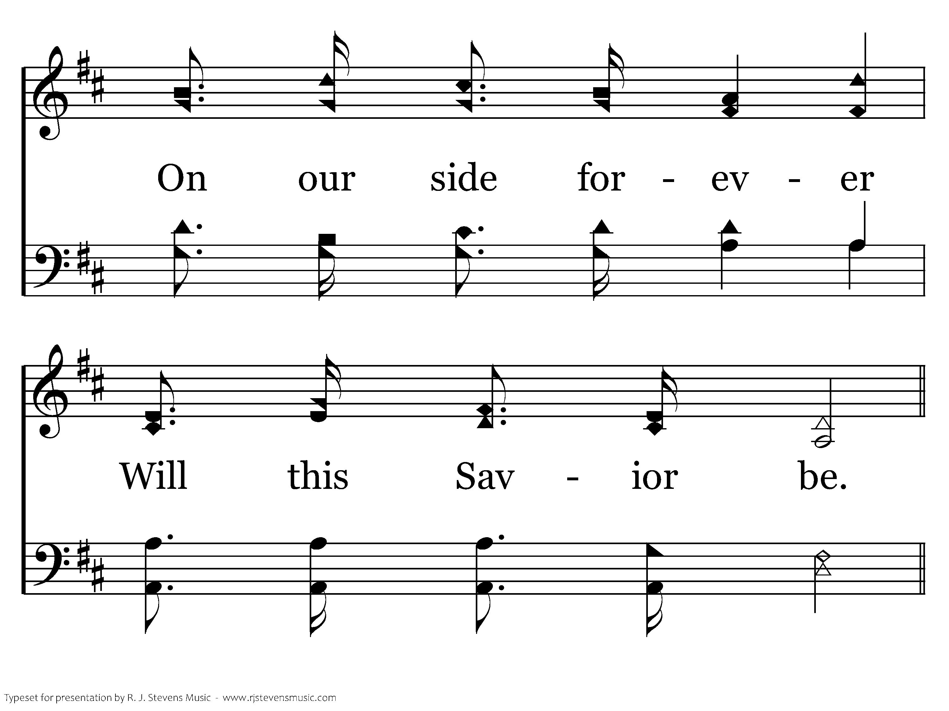
347 - Who Will Follow Jesus - 3.3

Slide 40
347 - Who Will Follow Jesus - C.1

Slide 41
347 - Who Will Follow Jesus - C.2

Slide 42
347 - Who Will Follow Jesus - C.3
End of Song

Slide 43
Lesson 6: Disciples Teach Others
Studies to Help Disciples Grow Stronger

