Slide 1

Lesson 7: Disciples Fail but Never Quit
Studies to Help Disciples Grow Stronger

Slide 2

Disciples Fail but Never Quit
Lesson 7
What do I do when I sin? Do I need to be baptized again after I sin? What does Jesus think of me when I fail Him?
New disciples quickly realize that they have not mastered sin. No matter how hard they try, disciples find that they will, in some areas, do wrong. In this lesson you will learn:
  That disciples will fail.
  Why disciples fail.
  What disciples do when they fail.

Slide 3
Do disciples fail?
Lesson 7: Disciples Fail but Never Quit
Studies to Help Disciples Grow Stronger

Slide 4
Do disciples fail?
Lesson 7: Disciples Fail but Never Quit
Jesus’ disciples failed Him often:
  Read Luke 8:9. Did the disciples understand the parable?
  Read Luke 8:24. Did the disciples trust Jesus as they should have?
  Read Luke 9:40. Could the disciples cast out the demon?
  Read Luke 9:46. What were the disciples arguing about?
  Should disciples argue this way?
  Read Luke 22:46. Did the disciples help Jesus prepare for the suffering of the cross?

Slide 5
Do disciples fail?
Lesson 7: Disciples Fail but Never Quit
Yes, the disciples failed often.
  But did they give up? Did the disciples get mad and quit? Did the disciples decide to start following some other teacher?
  No, they continued to do the best they could. They kept following Jesus, and they kept trying to do better.
  Notice the example of Peter. Read Luke 22:55-62.
    How many times did Peter deny Jesus?
    Was Peter sorry he did this?
    Read Luke 24:12. Did Peter give up on following Jesus?

Slide 6
Do disciples fail?
Lesson 7: Disciples Fail but Never Quit
Disciples do not quit.
  They turn back to Jesus and start following Him again.
  Endurance is an important part of discipleship: “Therefore we also, since we are surrounded by so great a cloud of witnesses, let us lay aside every __________ and the __________ which so easily ensnares us, and let us run with __________ the race that is set before us” (Hebrews 12:1).
  First-century Christians who were being terribly persecuted were told: “Be __________ until death, and I will give you the crown of __________”
  (Revelation 2:10).

Slide 7
Why do disciples sin?
Lesson 7: Disciples Fail but Never Quit
Studies to Help Disciples Grow Stronger

Slide 8
Why do disciples sin?
Lesson 7: Disciples Fail but Never Quit
Because we need to grow in Christ Jesus.
  When you first are born into Christ, you do not know everything about righteousness or sin.
  The New Testament refers to the new convert as a “babe” and points out how he or she must grow: “For everyone who partakes only of milk is unskilled in the word of righteousness, for he is a __________. But solid food belongs to those who are of full age, that is, those who by reason of use have their __________ exercised to discern both good and evil. Therefore, leaving the discussion of the __________ principles of Christ, let us go on to perfection, not laying again the foundation of __________ from dead works and of faith toward God” (Hebrews 5:13-6:1).
  We cannot continue in the “elementary principles of Christ” but must grow stronger and more mature in Jesus Christ.
  As you continue following Jesus and resisting the devil, you will get better and better at being a disciple. This is the growth and maturity process.

Slide 9
Why do disciples sin?
Lesson 7: Disciples Fail but Never Quit
Because the devil continually tempts us.
  The devil tempted Jesus. Read Luke 4:1-13.
    What was the first temptation?
    What was the second temptation?
    What was the third temptation?
    When the devil had tempted Jesus these three times, did he leave Jesus alone (note verse 13)?
  Why did Judas Iscariot betray our Lord (Luke 22:3)?
  Why do people sin today (James 1:13-15)?
  Who is our adversary (1 Peter 5:8)?
  Important: Can we resist the devil, or is falling to his temptations inevitable
  (James 4:7)?

Slide 10
Why do disciples sin?
Lesson 7: Disciples Fail but Never Quit
Because we do not always correctly discern good and evil.
  Some actions and thoughts are clearly shown in Scripture as wrong and forbidden to the Christian.
  Read Galatians 5:19-21. These sins, known as the works of the flesh, represent broad categories of wrongdoing. Study this list carefully. While it does not cover every possible kind of sin, it does detail many common sins.
  When we fail to heed the Scripture’s warnings and fail to use scriptural principles to discover righteousness and evil, we will sin.

Slide 11
Why do disciples sin?
Lesson 7: Disciples Fail but Never Quit
Because we do not always correctly discern good and evil.
  Discerning good and evil is a skill we acquire through diligent practice: “But solid food belongs to those who are of full age, that is, those who by reason of use have their senses __________ to discern both good and evil” (Hebrews 5:14).
  A help in discerning good from evil is to ask questions such as, “Would Jesus do this?,” “What will others think if they see me doing this?,” and “Will this lead to further temptation and sin?”
    What question did the Pharisees ask Jesus?
    What question did Jesus ask them?
    Why wouldn’t Jesus answer their question?

Slide 12
Why do disciples sin?
Lesson 7: Disciples Fail but Never Quit
Summary: The greatest barrier to discipleship is the devil’s continual tempting.
  We want to grow and be a better disciple.
  Satan continually tempts us to go backward and live for self again.
  The disciple resists this temptation and goes forward with Jesus.

Slide 13
What do disciples do when they fail?
Lesson 7: Disciples Fail but Never Quit
Studies to Help Disciples Grow Stronger

Slide 14
What do disciples do when they fail?
Lesson 7: Disciples Fail but Never Quit
Repent
  Repentance is turning away from sin.
  Too many believe that admitting they are in sin is all there is to do. They think that once they admit sin, they may remain in it.
  Many excuse sin by saying, “That’s just how I am.”
  Excuses do not help us overcome failure but keep us locked in the patterns of sin.
  Repentance includes the determination to stop sinning and is essential for the disciple who wants to overcome sin.
  But unless you __________ you will all likewise perish” (Luke 13:5).

Slide 15
What do disciples do when they fail?
Lesson 7: Disciples Fail but Never Quit
Confess
  Confession is saying the same thing that God says.
  Before you were baptized, you confessed Jesus Christ as the Son of God. This was saying the same thing about Jesus that God says about Him, i.e. that He is the Son of God.
  Confession of sin is saying the same thing about sin that God says, i.e. that it is not right, causes a person to be separated from his God, and will cause people to be eternally lost.
  All attempts to rationalize away sin, blame others for it, or make excuses for what we have done run counter to the meaning of confession.
  Confession of sin is essential: “If we __________ our sins, He is faithful and just to forgive us our sins an to cleanse us from all unrighteousness” (1 John 1:9).

Slide 16
What do disciples do when they fail?
Lesson 7: Disciples Fail but Never Quit
Pray
  Confession and repentance lead one to pray and ask for forgiveness.
  The Christian does not need to be baptized again and again after every sin because being a child of God gives one the right to pray and ask for forgiveness
  (1 John 1:9).
  Read the account of Simon the sorcerer in Acts 8:13-24.
    Was Simon a Christian?
    What was Simon’s sin?
    What did Peter tell him to do about it?
    What did Simon ask Peter to do?
  Prayer is our powerful ally in overcoming sin: “Confess your __________ to one another, and __________ for one another, that you may be healed. The
  effective, fervent __________ of a righteous man avails much” (James 5:16).

Slide 17
What do disciples do when they fail?
Lesson 7: Disciples Fail but Never Quit
Work on mastering temptation
  Sin is not inevitable. We can improve our ability to conquer temptation.
  We do this with a three-part strategy:
    Controlling our desires – self control is all important. Read 2 Peter 1:5-10. Notice that self-control is a key link in the growth process that leads to ”never stumbling” (verse 10).
    Limiting opportunities – read Genesis 39:7-13. Did Joseph flirt with Potiphar’s wife, tease her, or otherwise constantly expose himself to temptation?
    Praying for wisdom – read James 1:5. Will God give us the wisdom to defeat temptation?
  God wants you to overcome sin and will help you. “No temptation has overtaken you except such as is common to man; but __________ is faithful, who will not __________ you to be tempted beyond what you are able, but with the __________ will also make the way of escape, that you may be able to bear it”
  (1 Corinthians 10:13).
  Pray for God’s help, look for the way of escape, and you can defeat the
  enticement of sin.

Slide 18
Conclusion
Lesson 7: Disciples Fail but Never Quit
Studies to Help Disciples Grow Stronger

Slide 19
Conclusion
Lesson 7: Disciples Fail but Never Quit
Becoming a disciple does not mean we will never sin again.
  Just as Jesus’ disciple did, we still fail the Lord.
  But through repentance, confession, and prayer we can be restored to the Lord to follow Him again.
This means one of the keys to Christianity is endurance.
  Do not allow yourself to become discouraged because you are not progressing as quickly as you want to or because you are still tempted to sin.
  Keep thinking about heaven and press on. Never entertain any ideas of quitting or not getting to heaven.
  Continue to work on mastering temptation and God will bless you.
  Trust Him and refuse to give up!

Slide 20
Conclusion
Lesson 7: Disciples Fail but Never Quit
You have concluded the Who Will Follow Jesus? Book. Discuss with the elders of the church or your teacher what materials you should study now. Don’t stop learning and working on discipleship just because you have completed this material.
Keep trying to be like Jesus!

Slide 21
Lesson 7: Disciples Fail but Never Quit
Studies to Help Disciples Grow Stronger

Slide 22
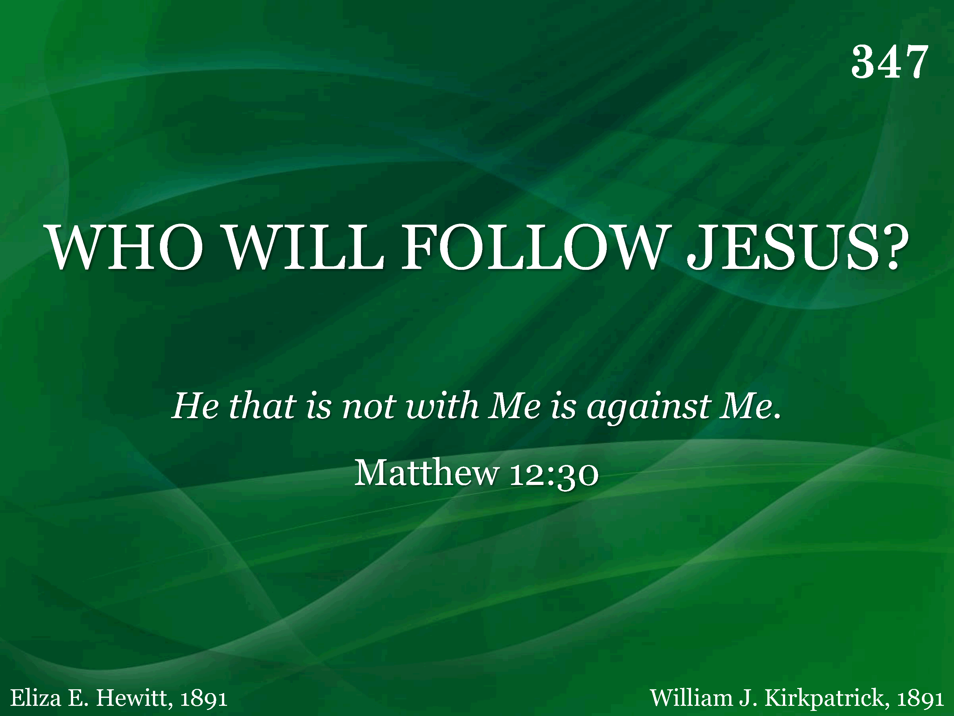
347 - Who Will Follow Jesus - Title

Slide 23
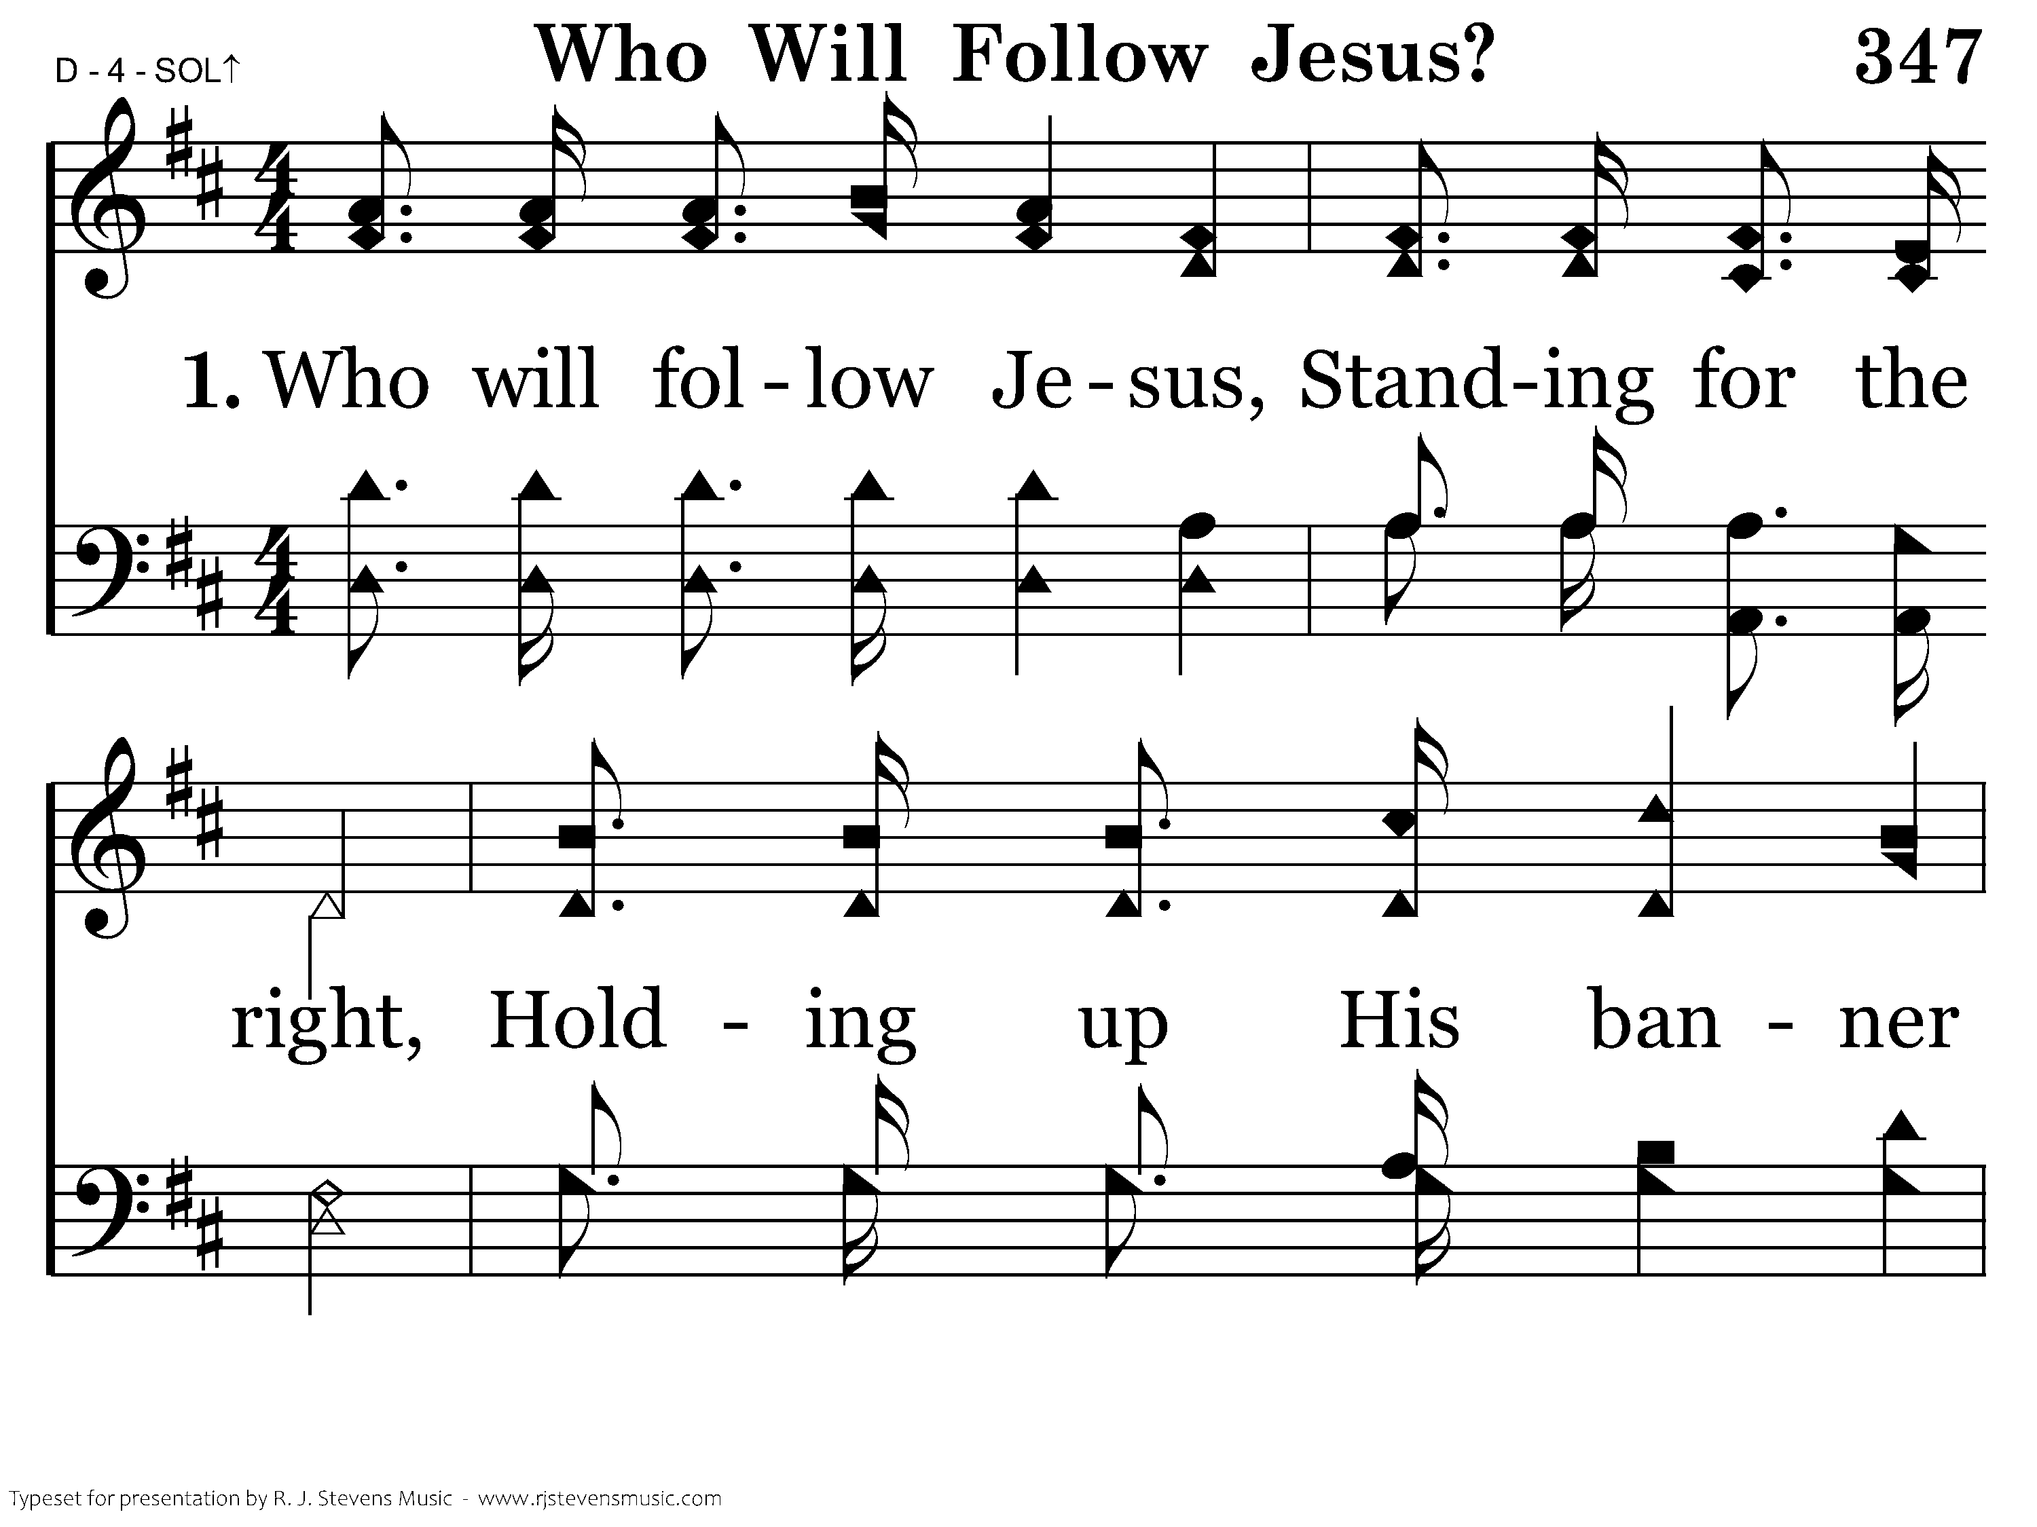
347 - Who Will Follow Jesus - 1.1

Slide 24
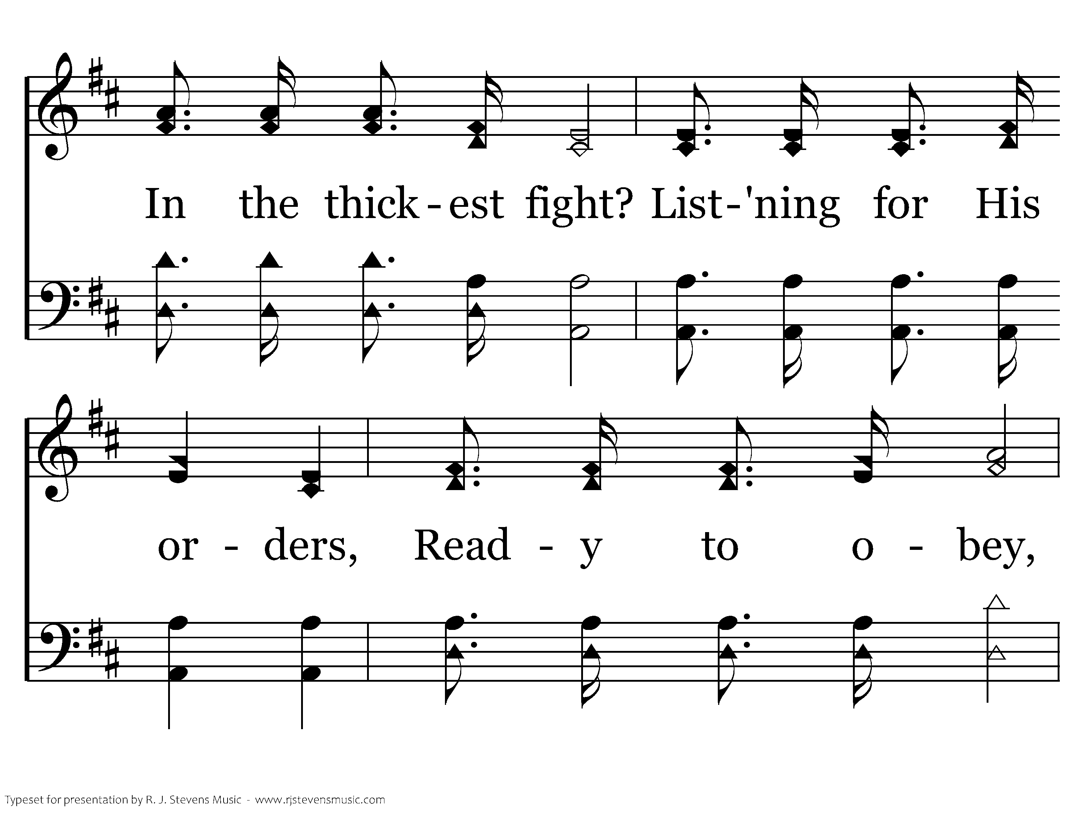
347 - Who Will Follow Jesus - 1.2

Slide 25
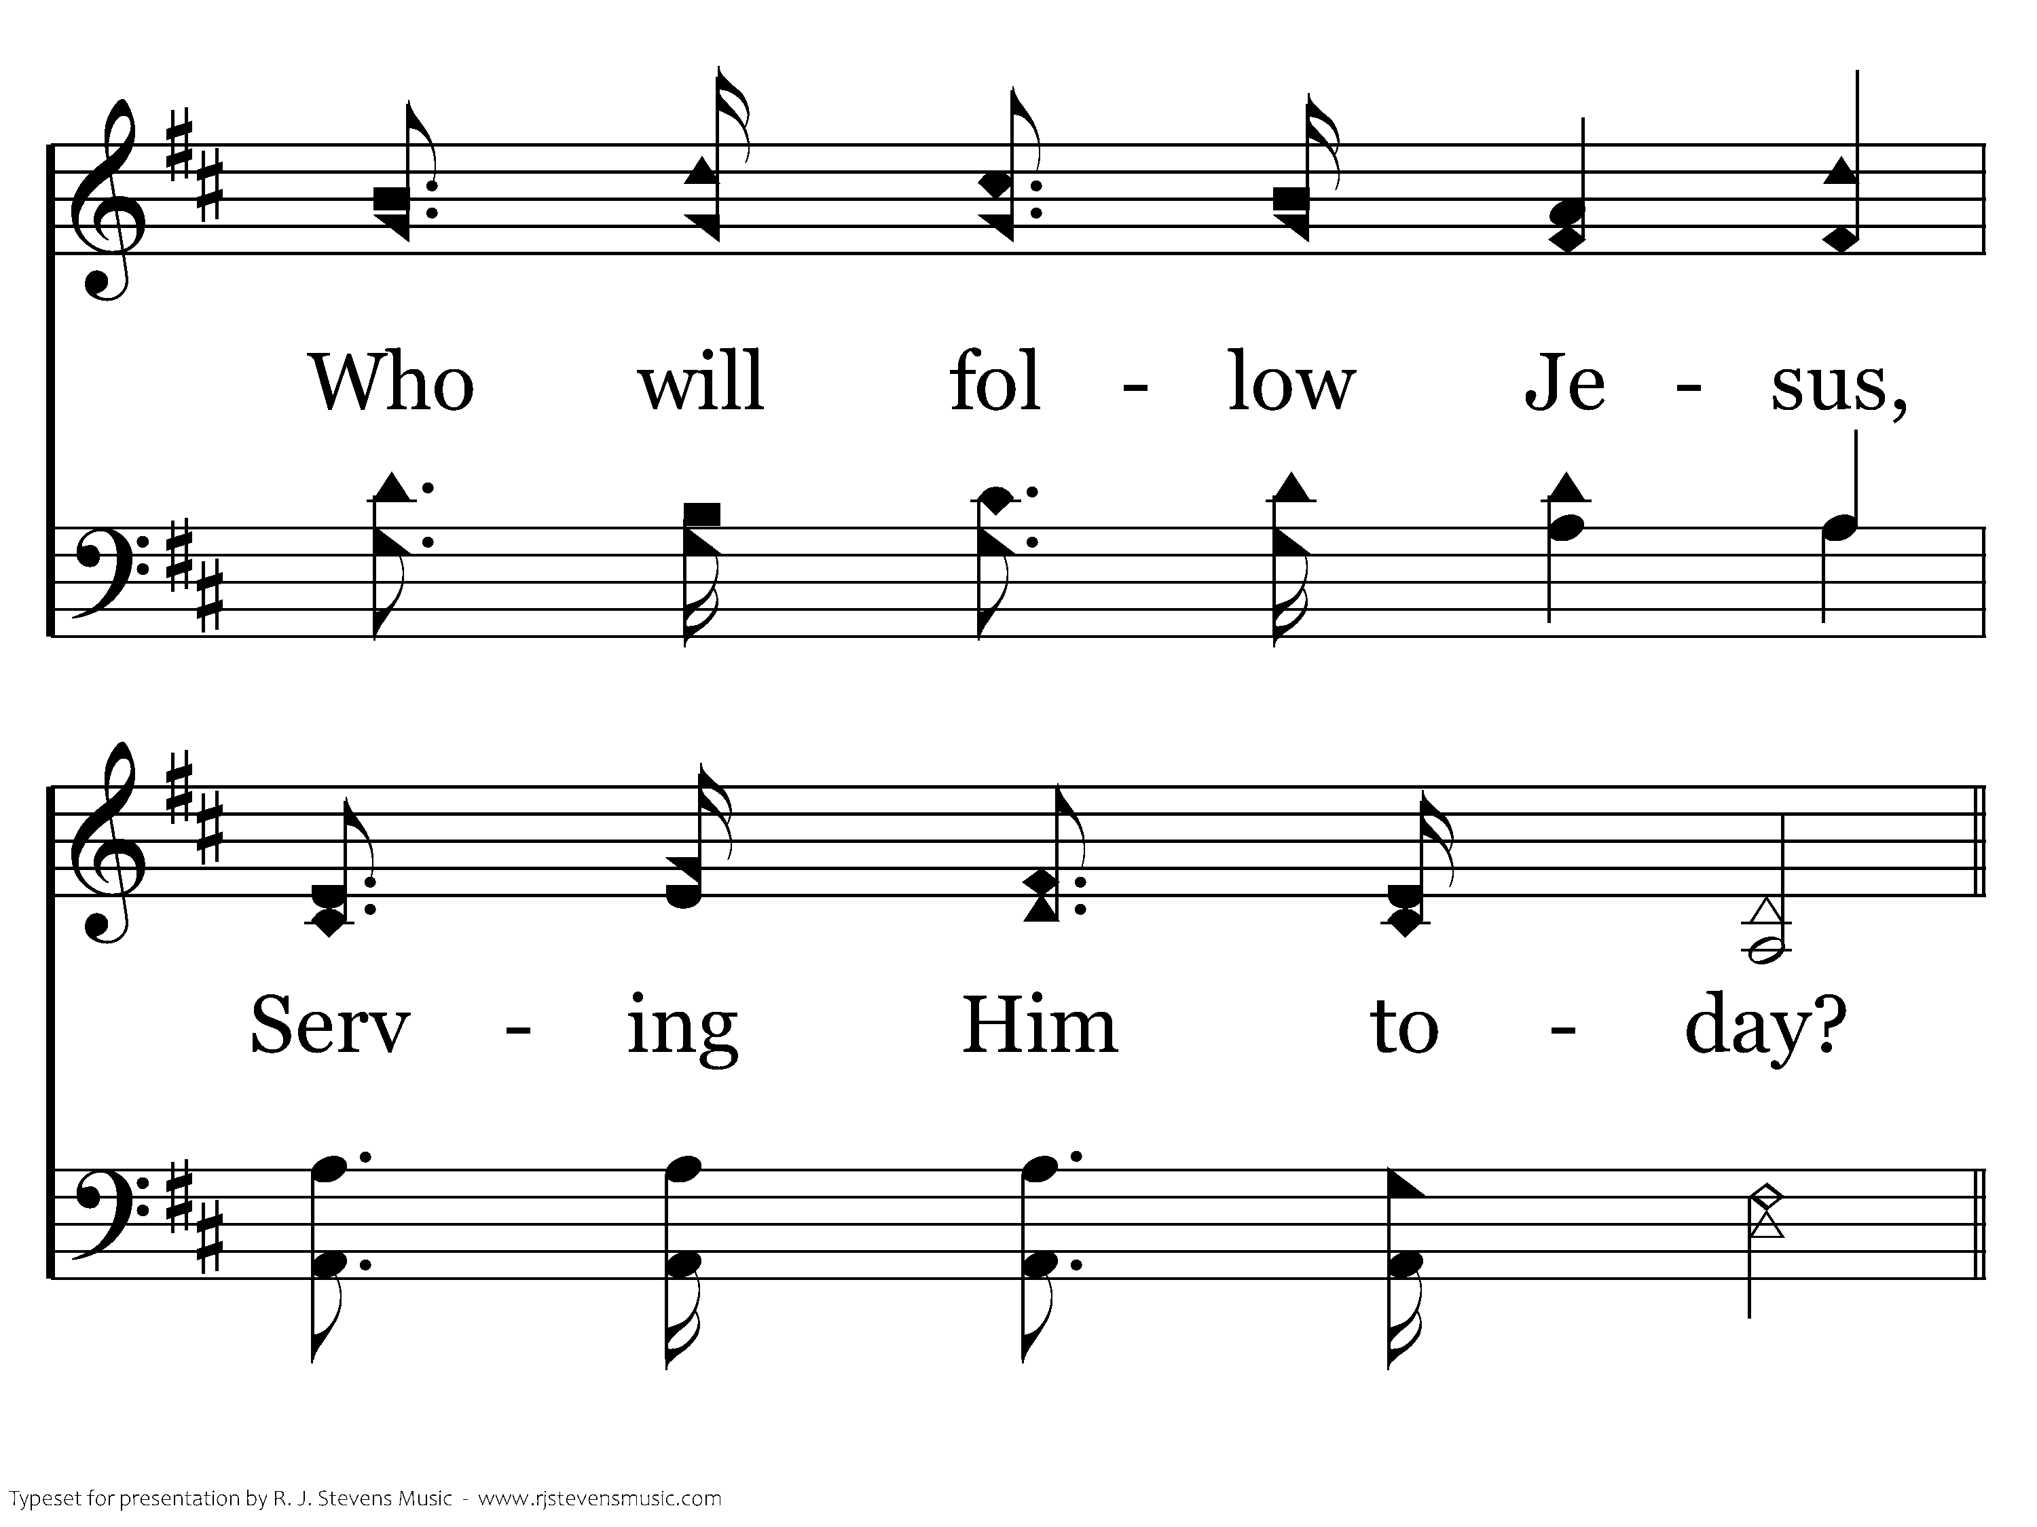
347 - Who Will Follow Jesus - 1.3

Slide 26
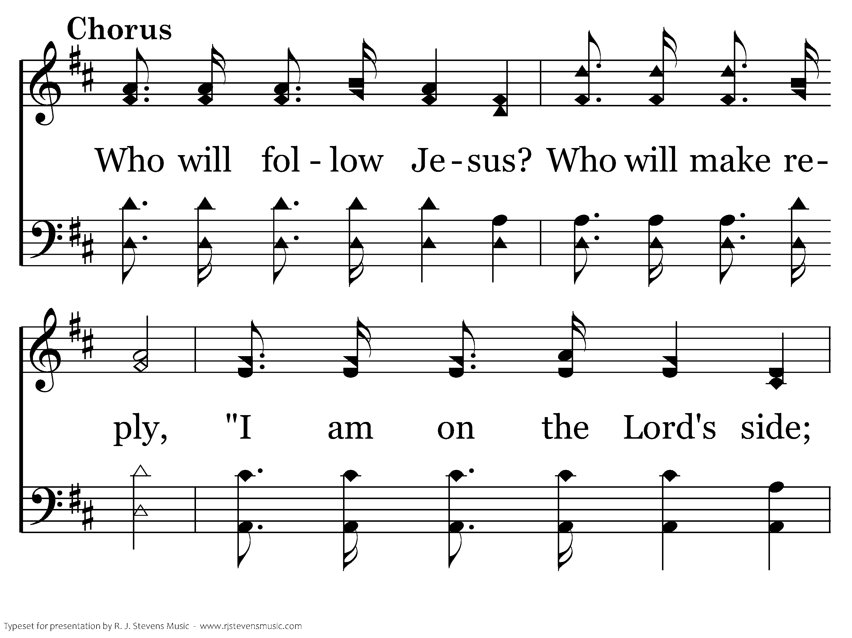
347 - Who Will Follow Jesus - C.1

Slide 27
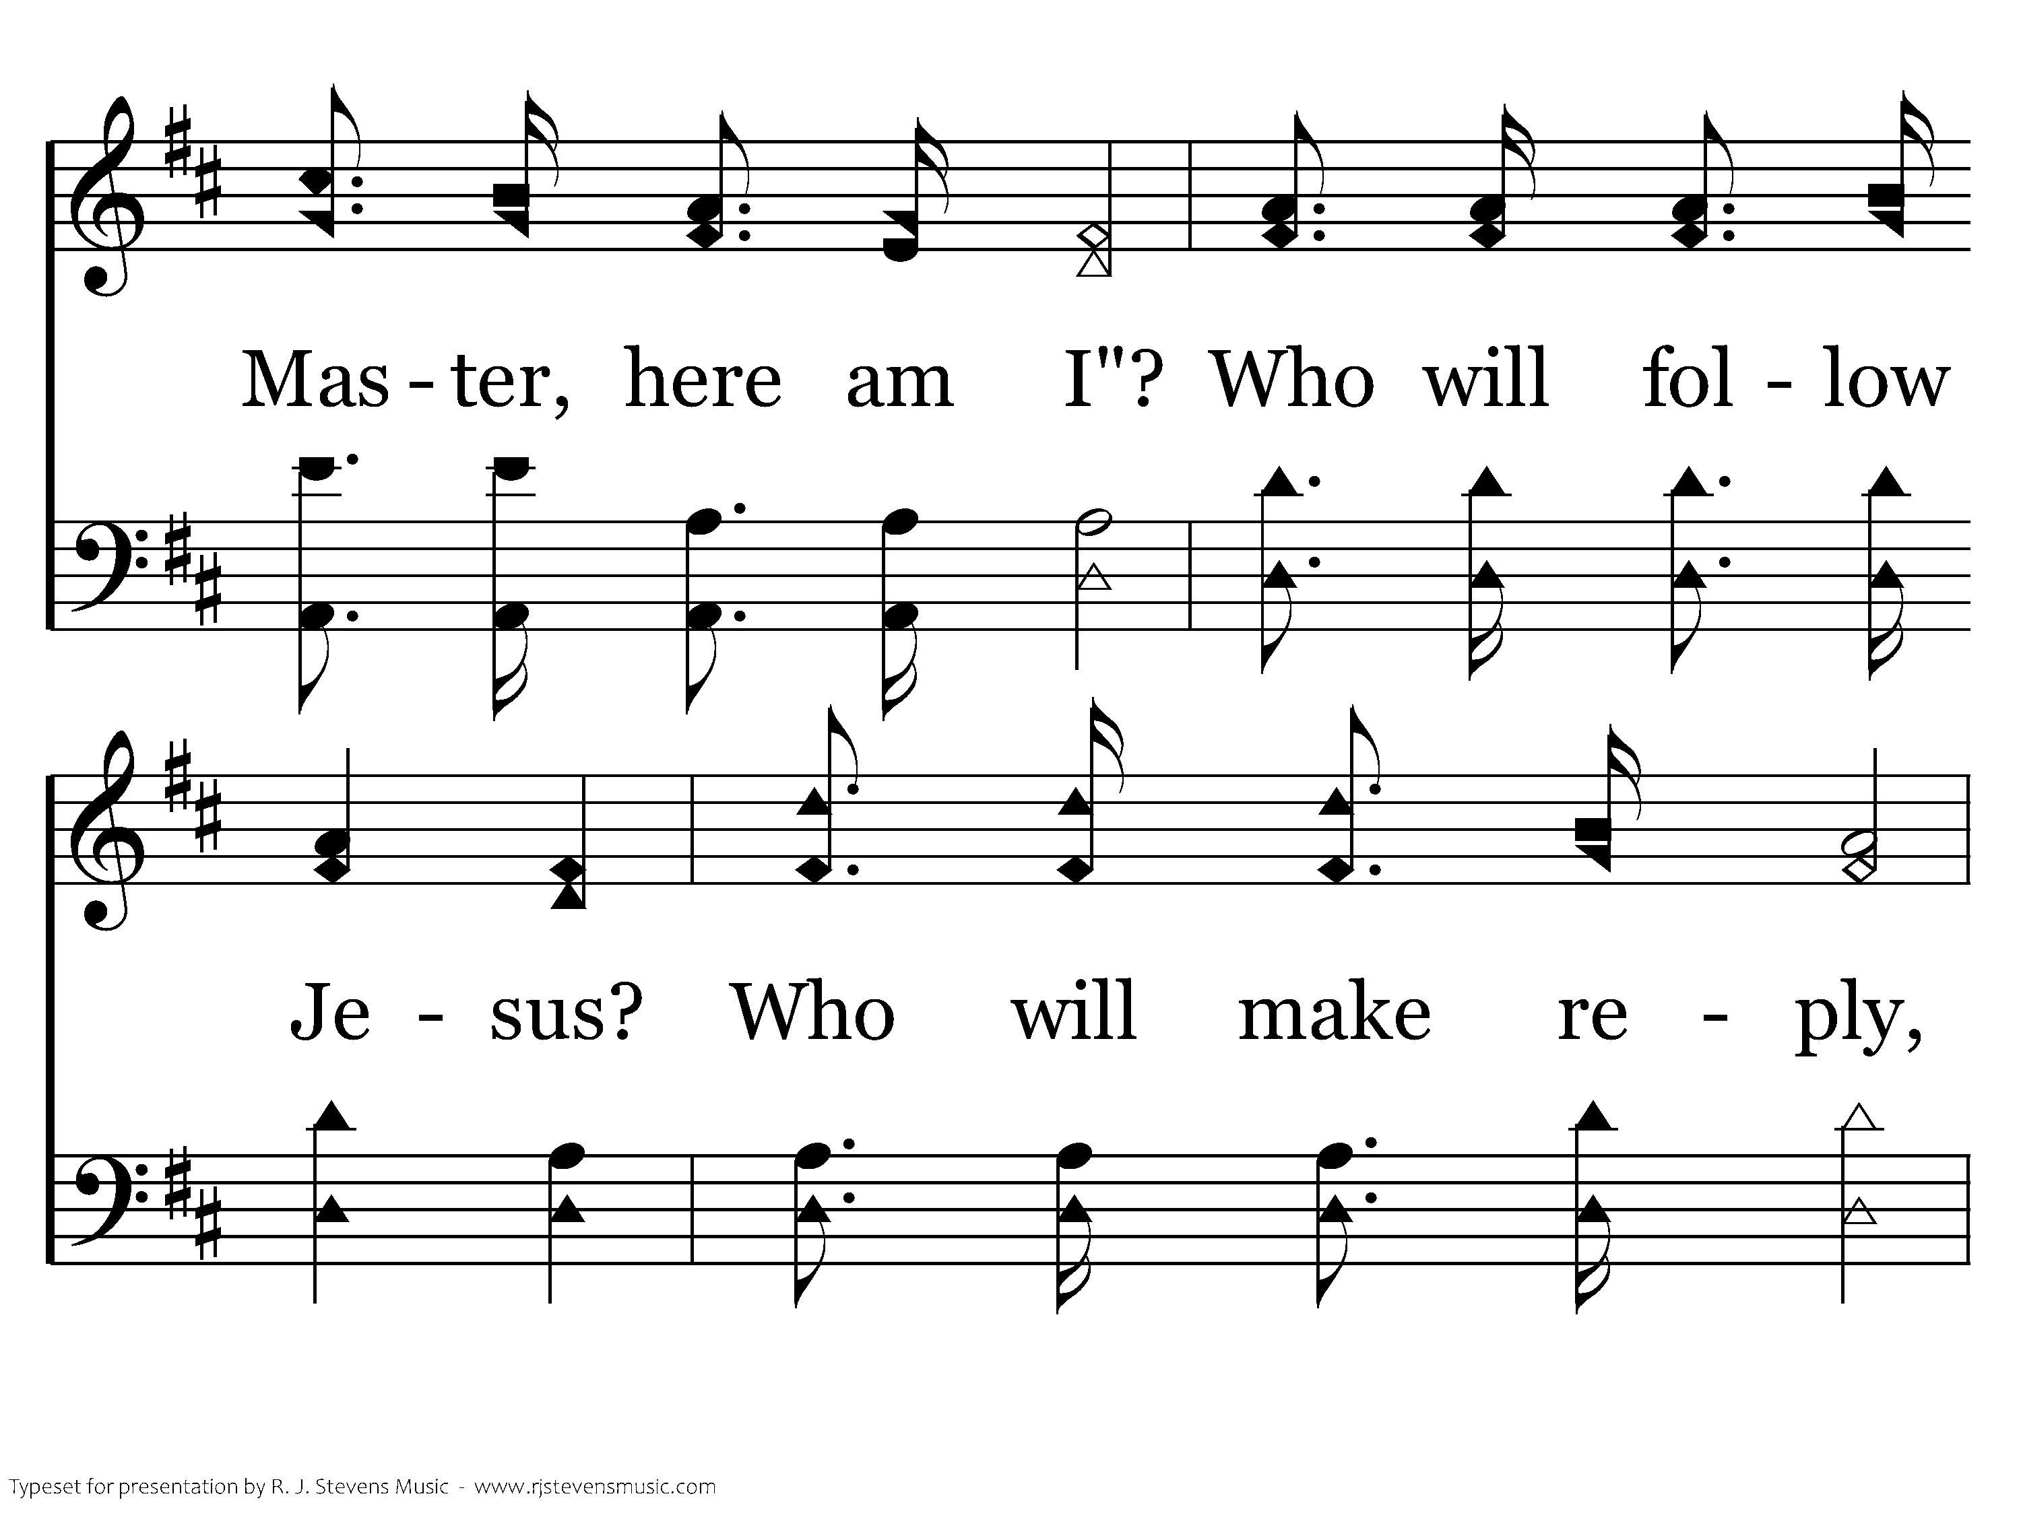
347 - Who Will Follow Jesus - C.2

Slide 28
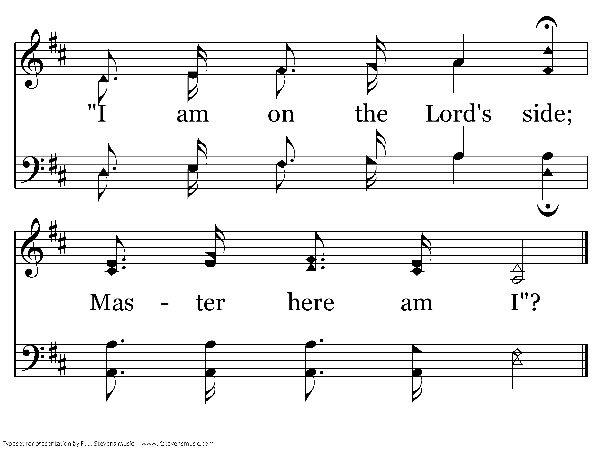
347 - Who Will Follow Jesus - C.3
End of Verse 1

Slide 29
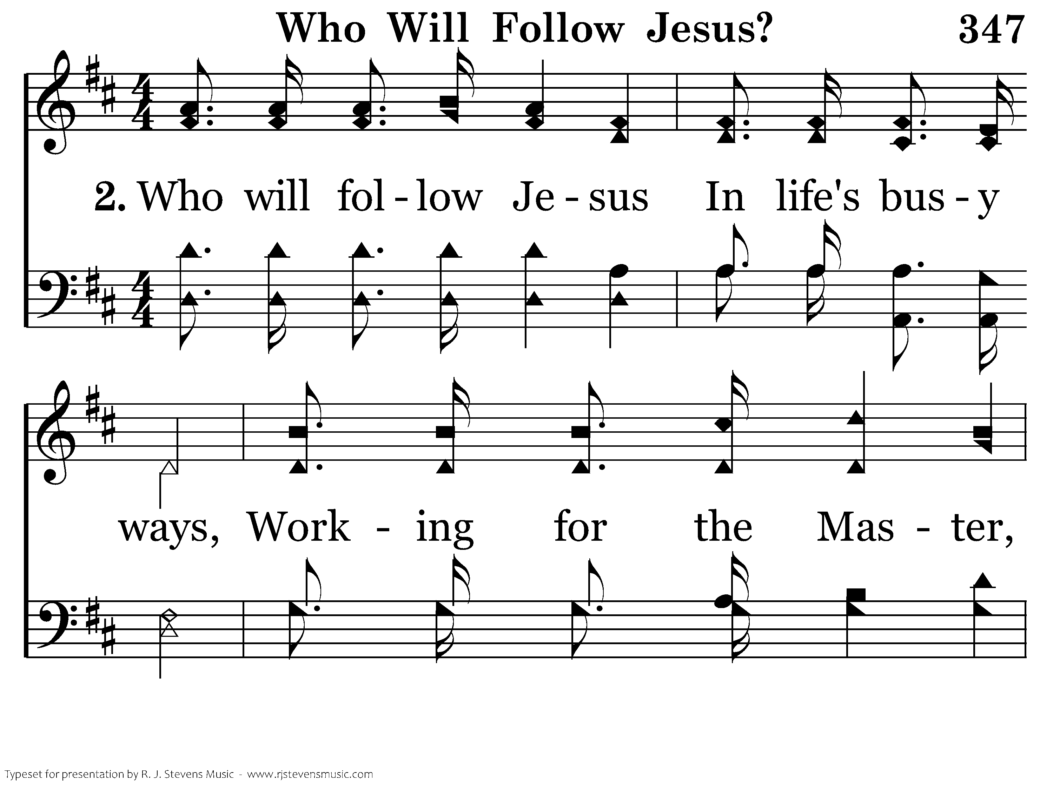
347 - Who Will Follow Jesus - 2.1

Slide 30
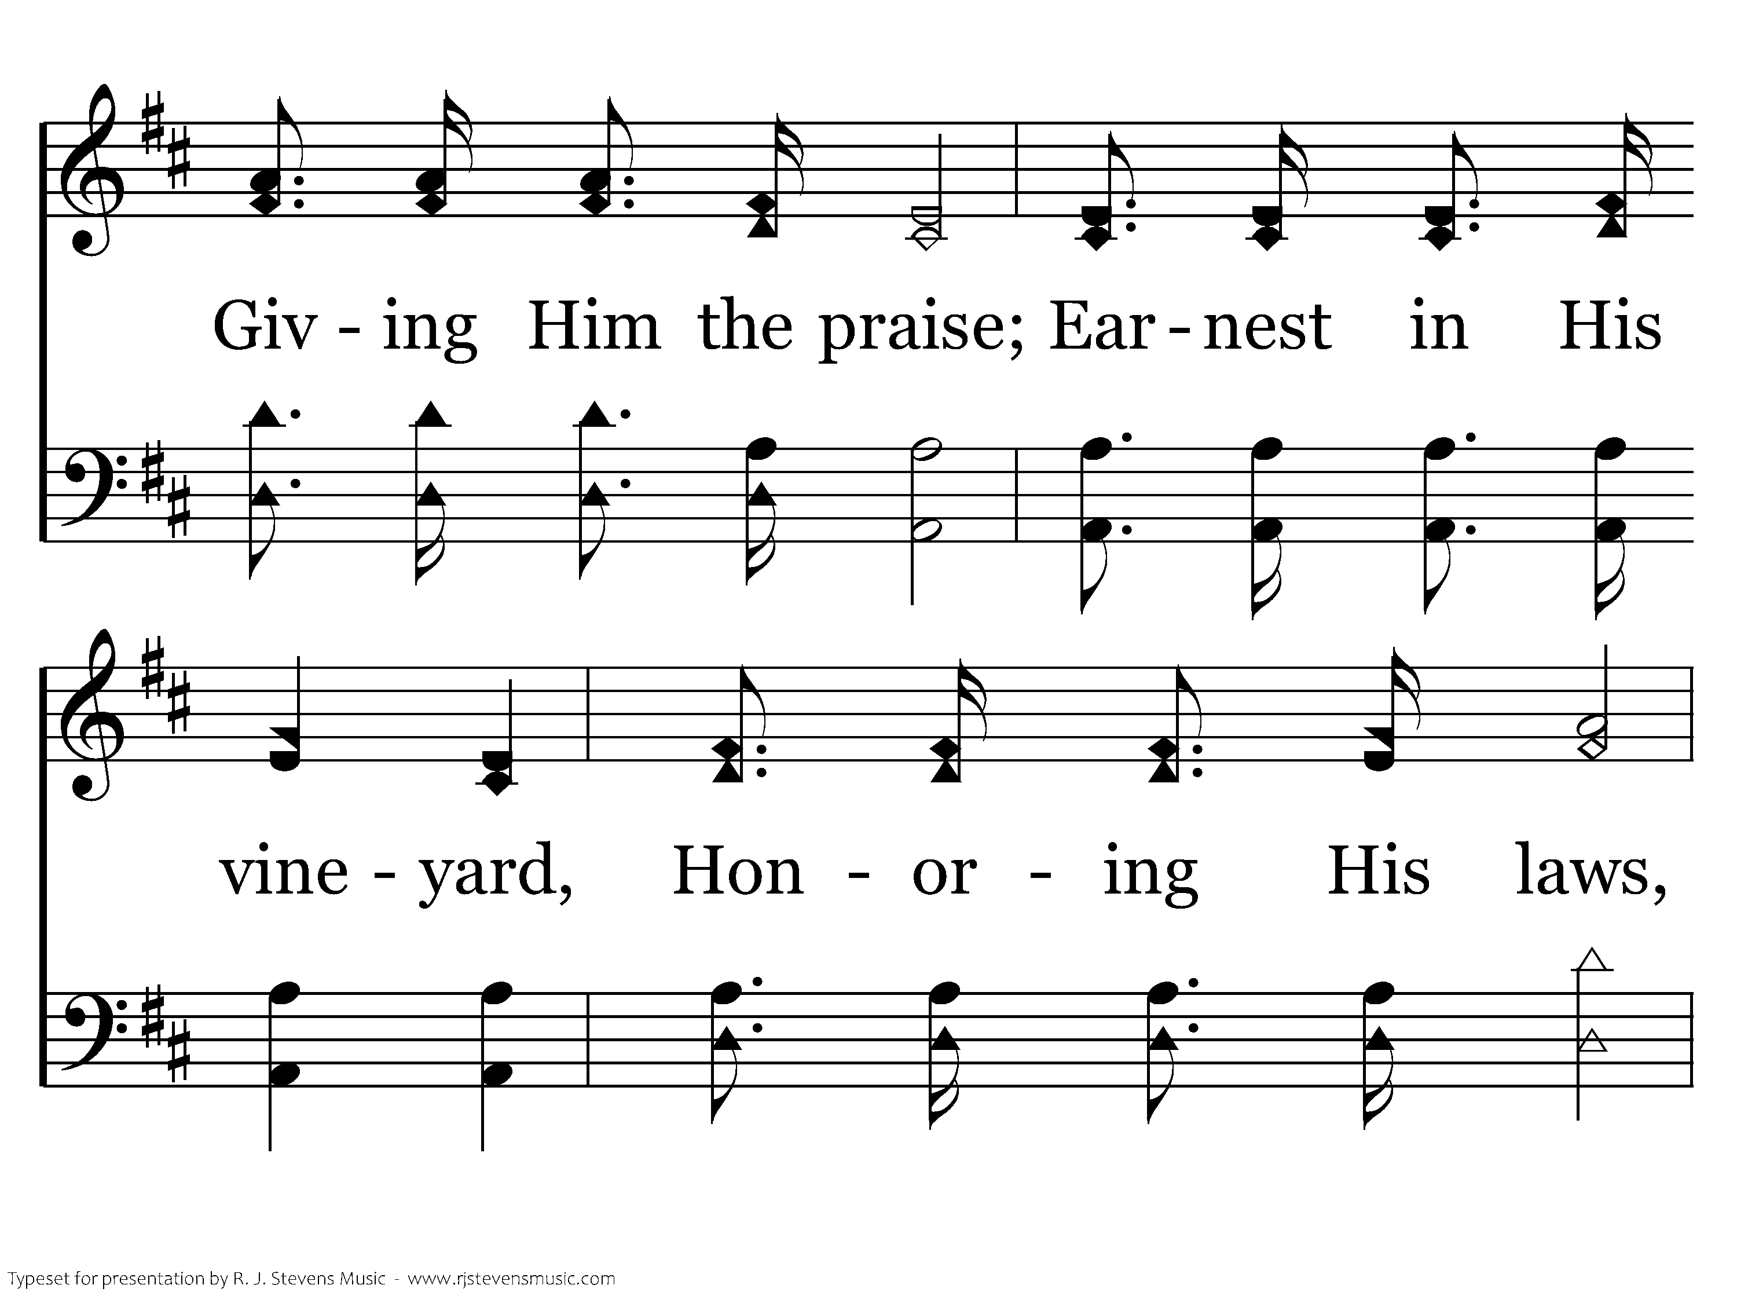
347 - Who Will Follow Jesus - 2.2

Slide 31
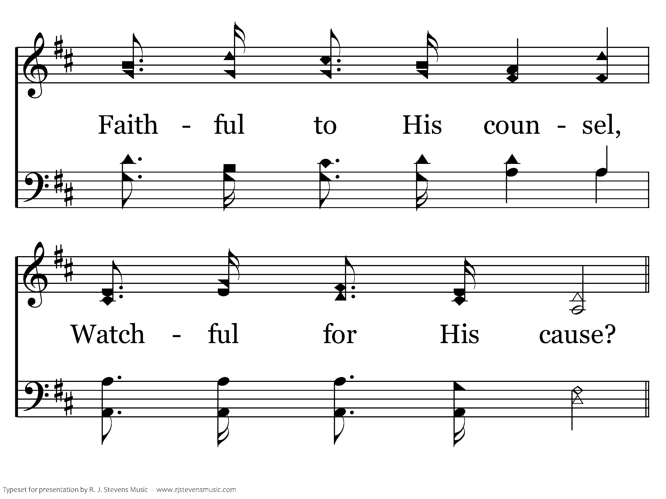
347 - Who Will Follow Jesus - 2.3

Slide 32
347 - Who Will Follow Jesus - C.1

Slide 33
347 - Who Will Follow Jesus - C.2

Slide 34
347 - Who Will Follow Jesus - C.3
End of Verse 2

Slide 35
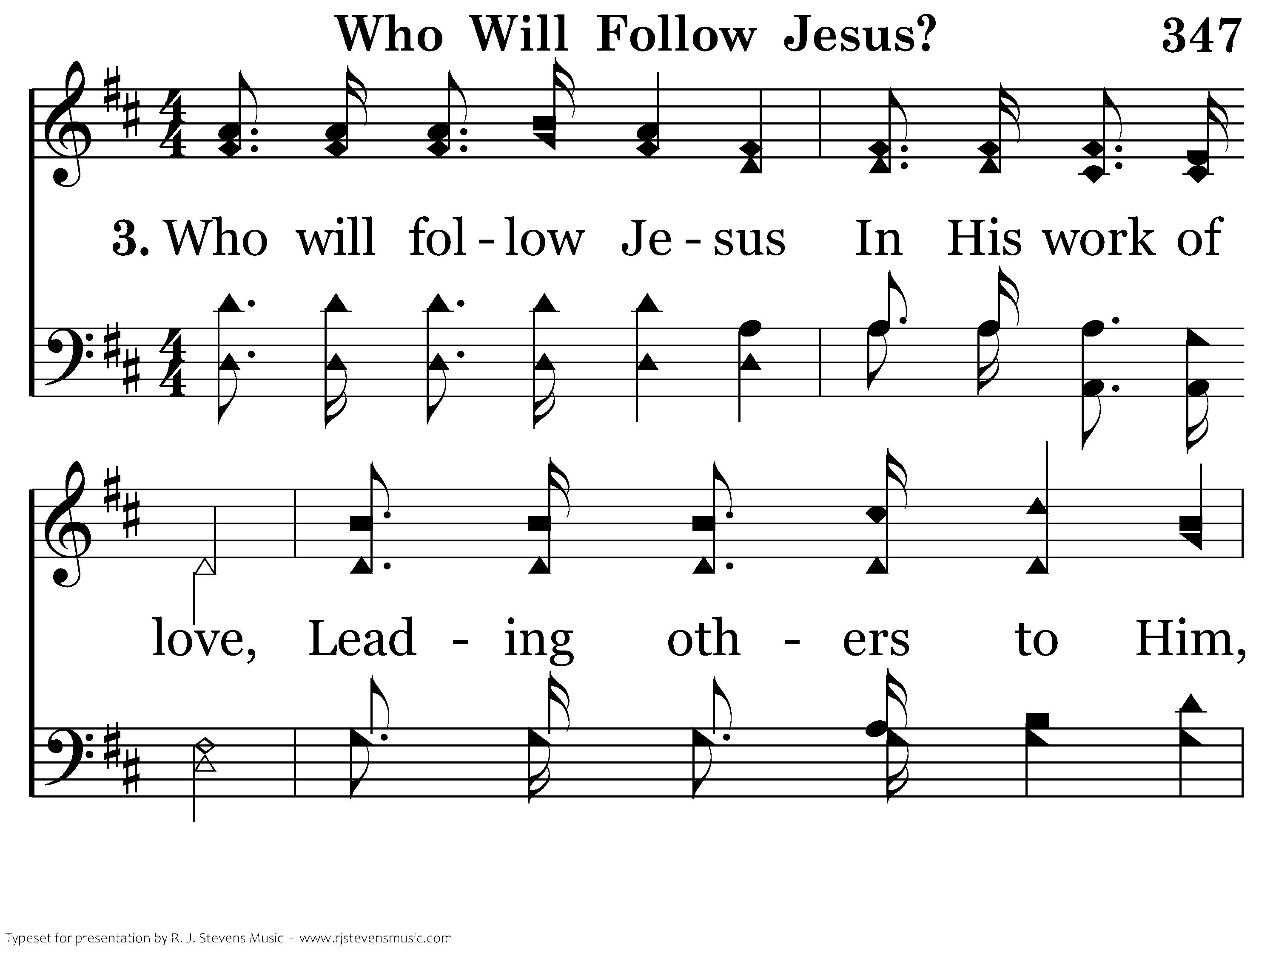
347 - Who Will Follow Jesus - 3.1

Slide 36
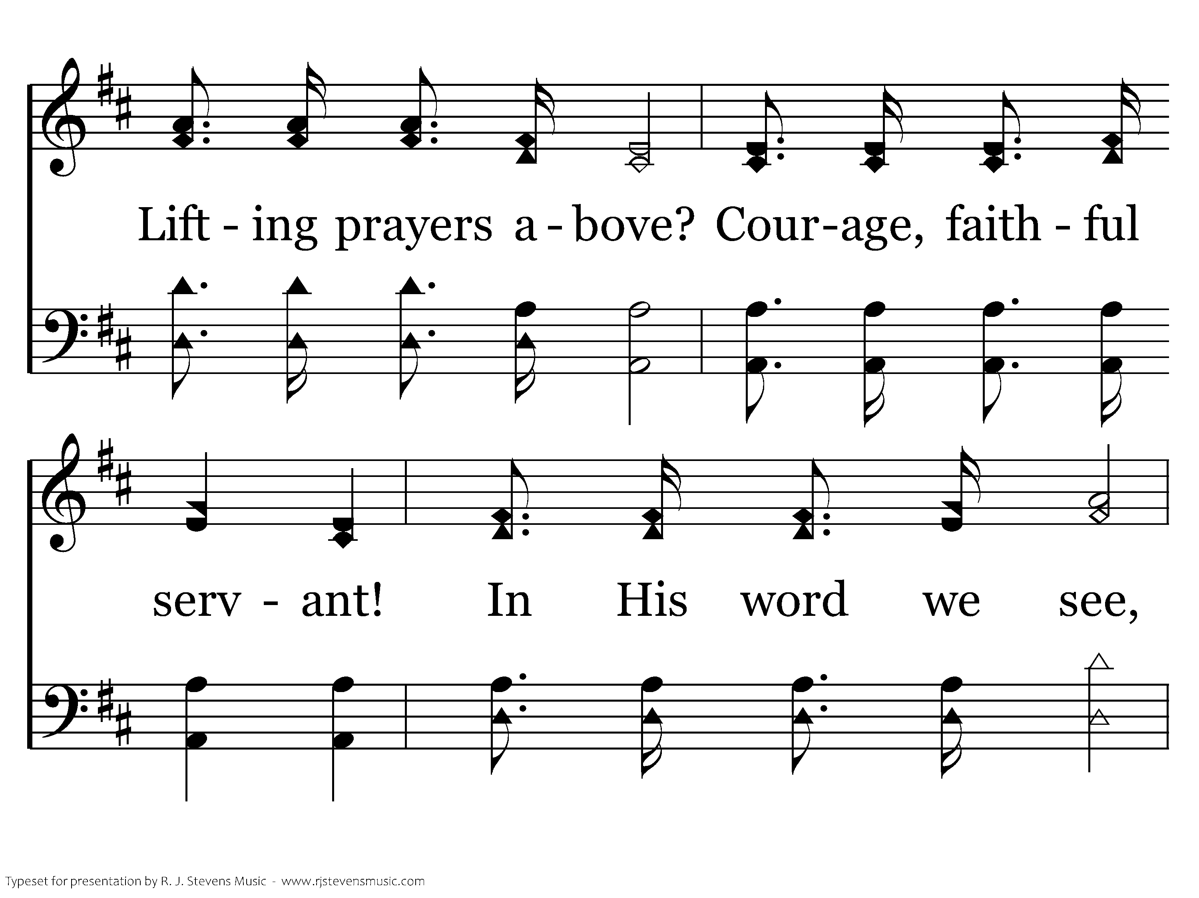
347 - Who Will Follow Jesus - 3.2

Slide 37
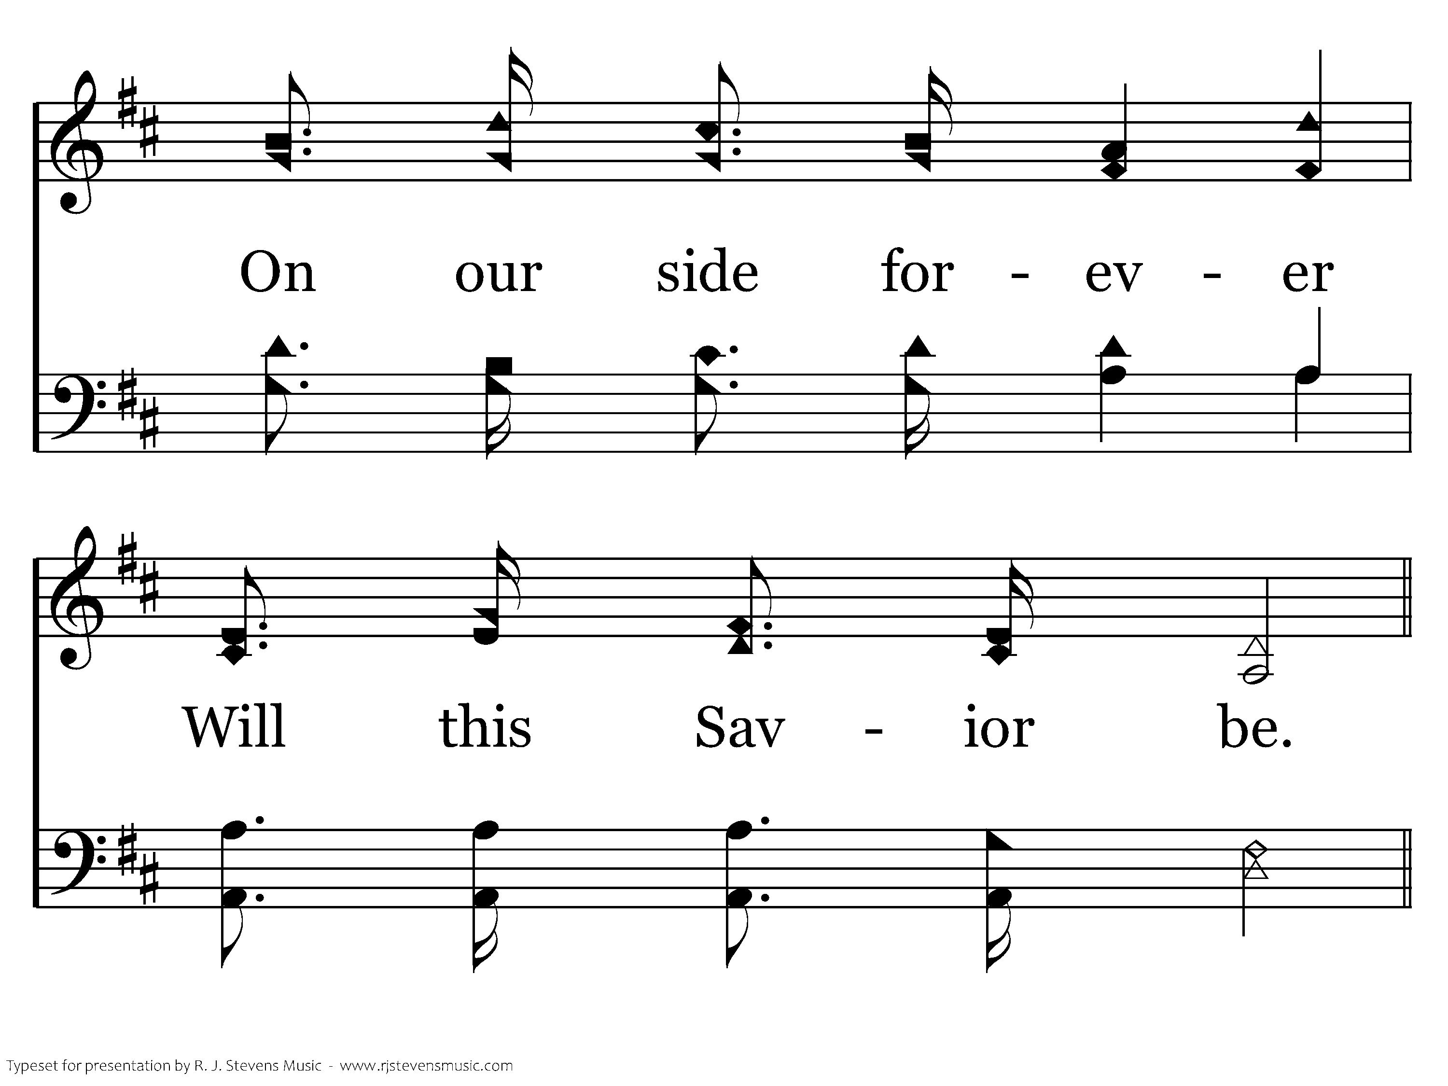
347 - Who Will Follow Jesus - 3.3

Slide 38
347 - Who Will Follow Jesus - C.1

Slide 39
347 - Who Will Follow Jesus - C.2

Slide 40
347 - Who Will Follow Jesus - C.3
End of Song

Slide 41
Lesson 7: Disciples Fail but Never Quit
Studies to Help Disciples Grow Stronger

