Slide 2
God’s
Mighty
Men

Slide 3
¹³ He was with David at Pasdammim when the Philistines were gathered together there to battle, and there was a plot of ground full of barley; and the people fled before the Philistines. ¹⁴ They took their stand in the midst of the plot and defended it, and struck down the Philistines; and the Lord saved them by a great victory.
1Chronicles 11.13-14
God’s Mighty Men Take a Stand

Slide 4
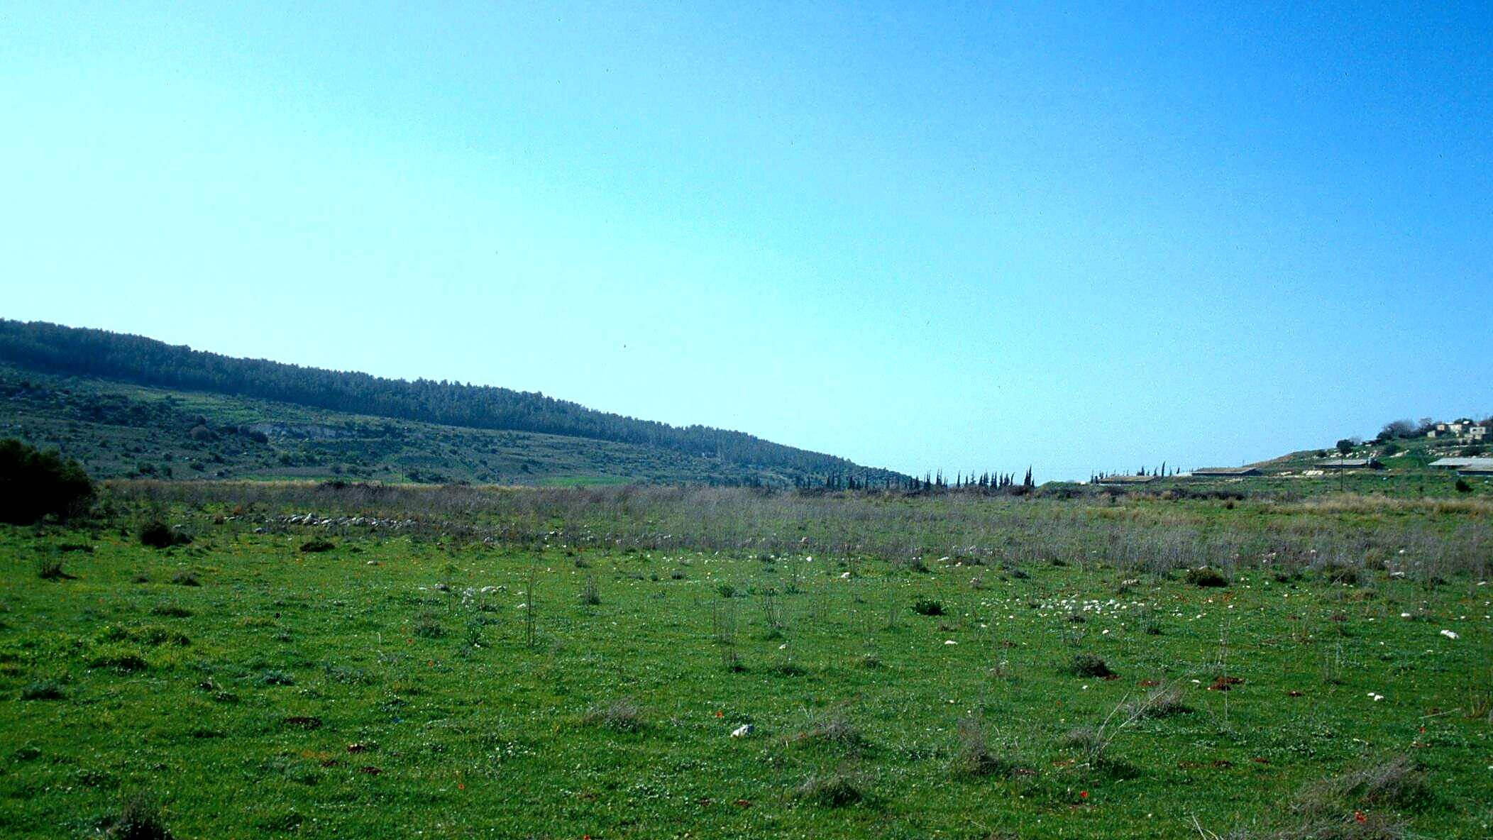
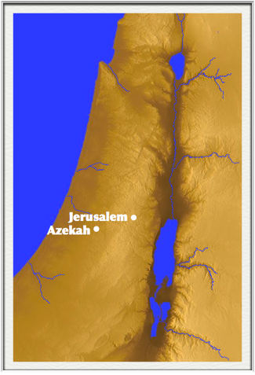

Slide 5
¹³ He was with David at Pasdammim when the Philistines were gathered together there to battle, and there was a plot of ground full of barley; and the people fled before the Philistines. ¹⁴ They took their stand in the midst of the plot and defended it, and struck down the Philistines; and the Lord saved them by a great victory.
1Chronicles 11.13-14
God’s Mighty Men Take a Stand

Slide 6
⁹ and after him was Eleazar the son of Dodo the Ahohite, one of the three mighty men with David when they defied the Philistines who were gathered there to battle and the men of Israel had withdrawn. ¹⁰ He arose and struck the Philistines until his hand was weary and clung to the sword, and the Lord brought about a great victory that day; and the people returned after him only to strip the slain. (2Samuel 23.9-10)
God’s Mighty Men Keep Fighting

Slide 7
⁹ and after him was Eleazar the son of Dodo the Ahohite, one of the three mighty men with David when they defied the Philistines who were gathered there to battle and the men of Israel had withdrawn. ¹⁰ He arose and struck the Philistines until his hand was weary and clung to the sword, and the Lord brought about a great victory that day; and the people returned after him only to strip the slain. (2Samuel 23.9-10)
God’s Mighty Men Credit the Lord

Slide 8
¹³ He was with David at Pasdammim when the Philistines were gathered together there to battle, and there was a plot of ground full of barley; and the people fled before the Philistines. ¹⁴ They took their stand in the midst of the plot and defended it, and struck down the Philistines; and the Lord saved them by a great victory.
1Chronicles 11.13-14
God’s Mighty Men Credit the Lord

