Slide 2
Welcome and Announcements
Scott Sloan

Slide 3
Song Leader
Bryce Cline

Slide 4
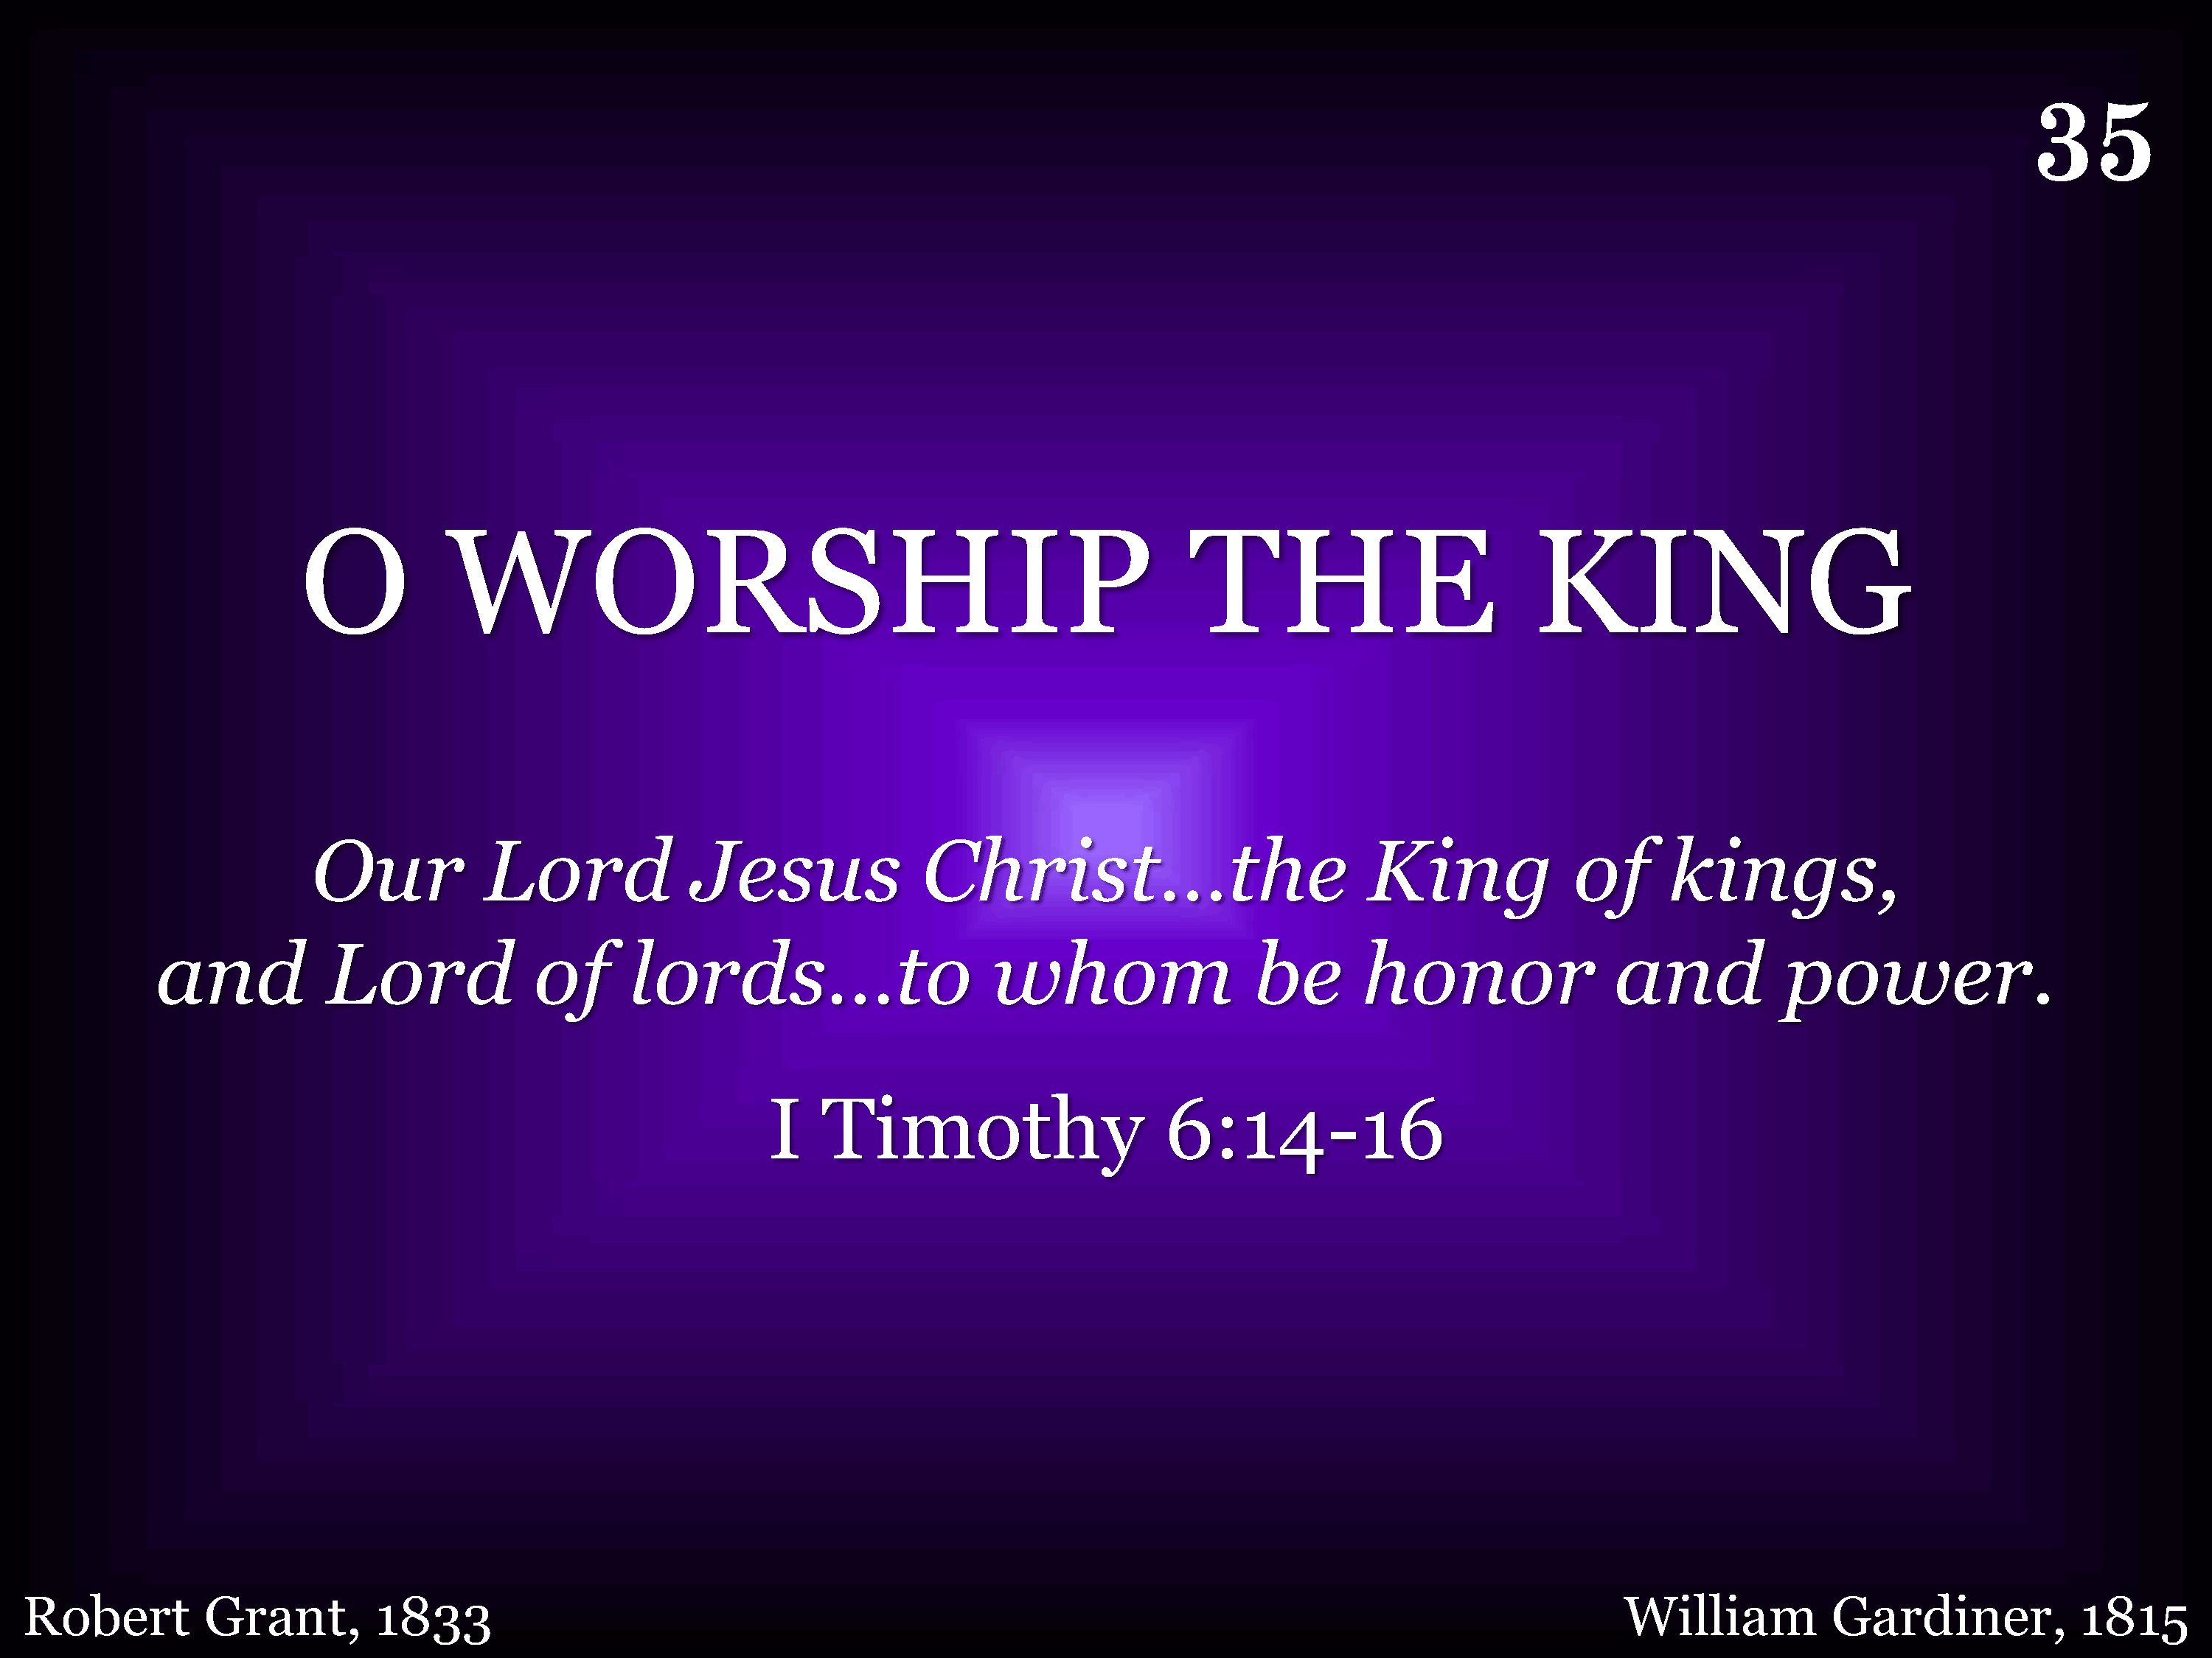
035 - O Worship The King - Title

Slide 5
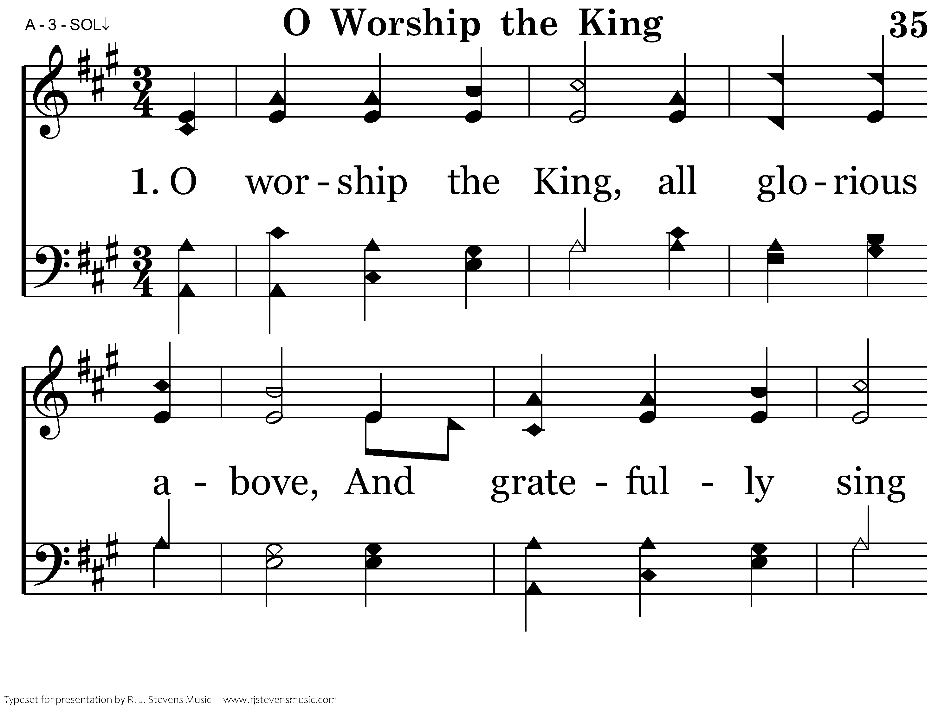
035 - O Worship The King - 1.1

Slide 6
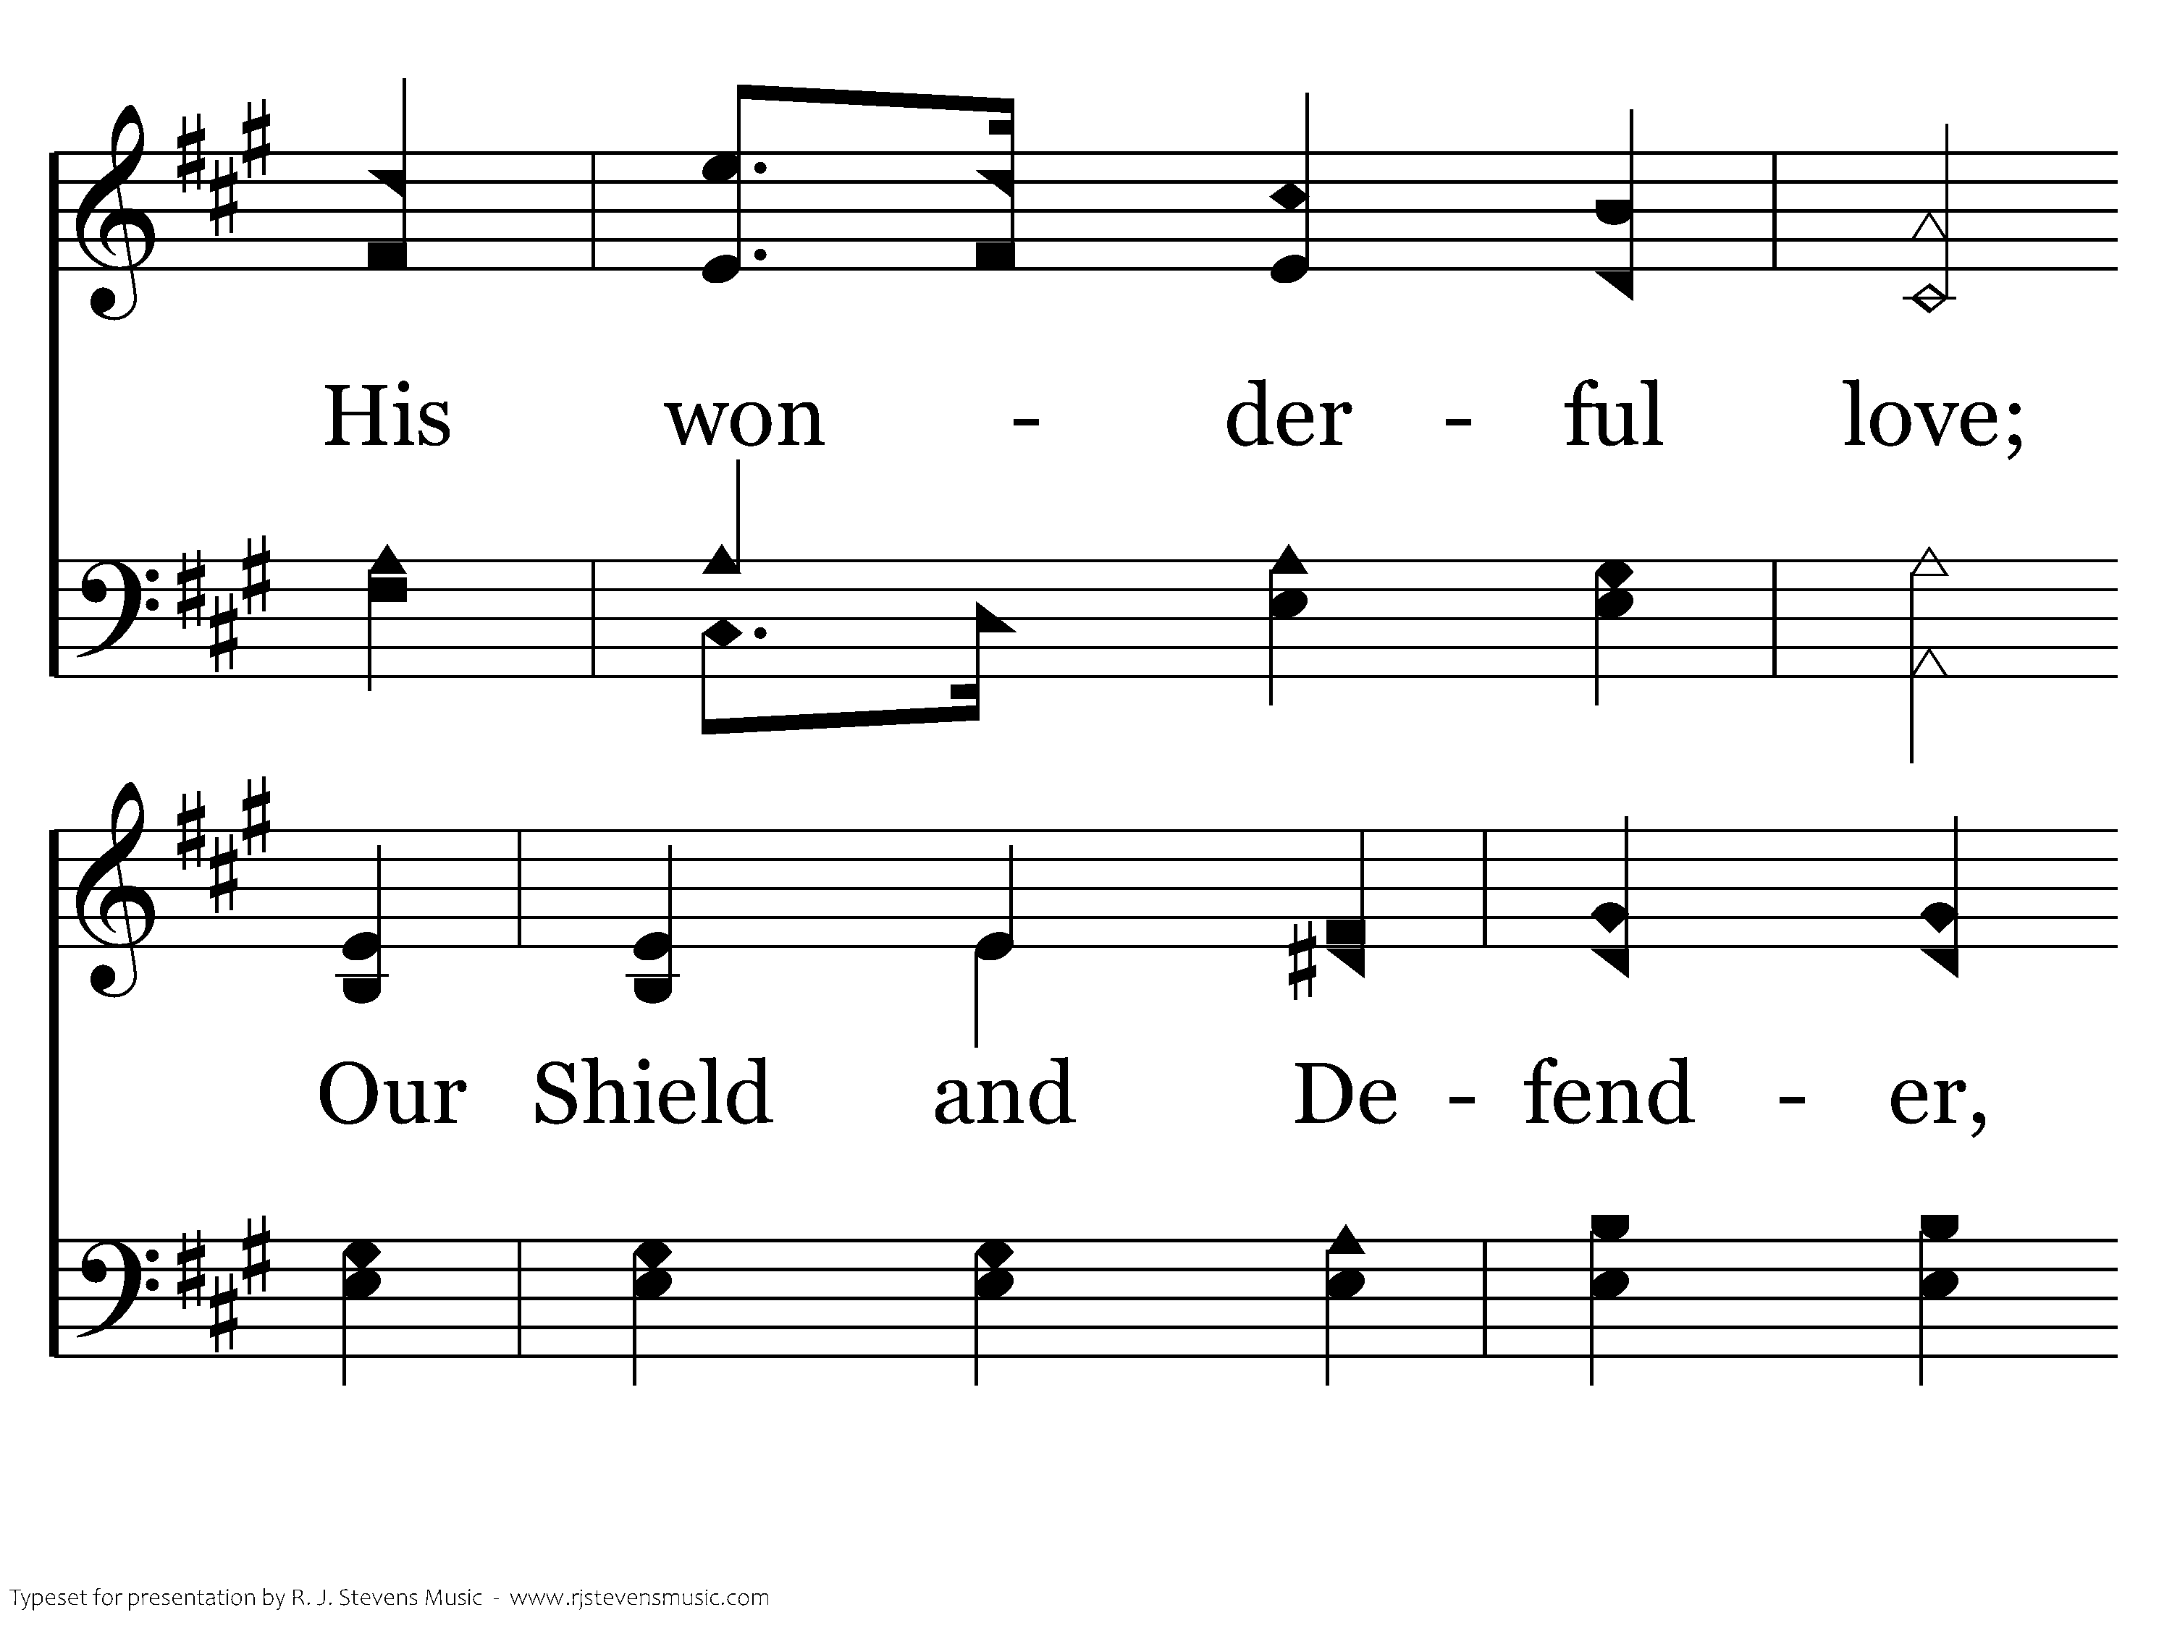
035 - O Worship The King - 1.2

Slide 7
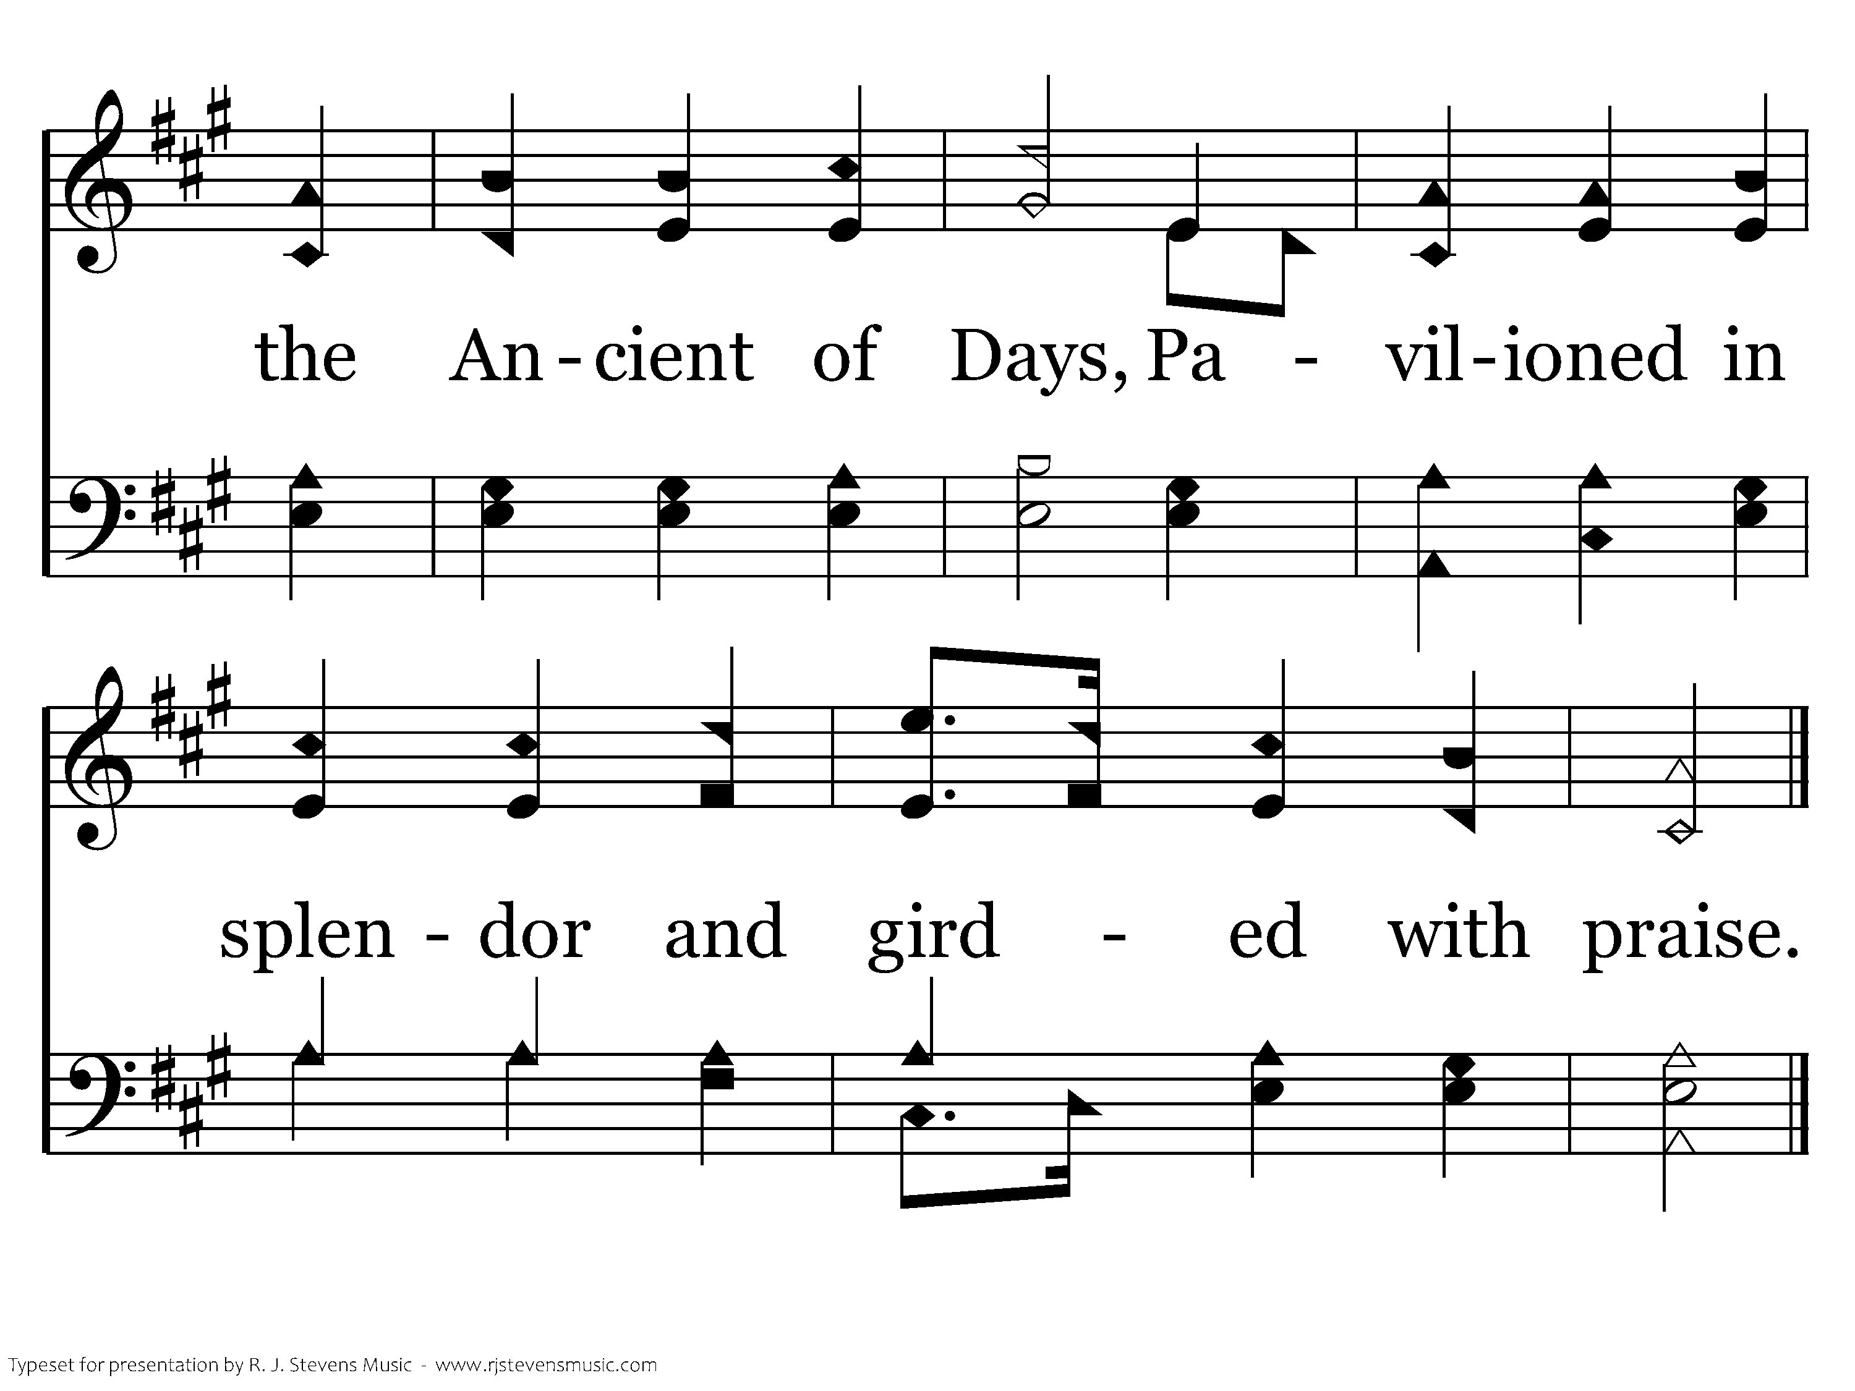
035 - O Worship The King - 1.3
End of Verse 1

Slide 8
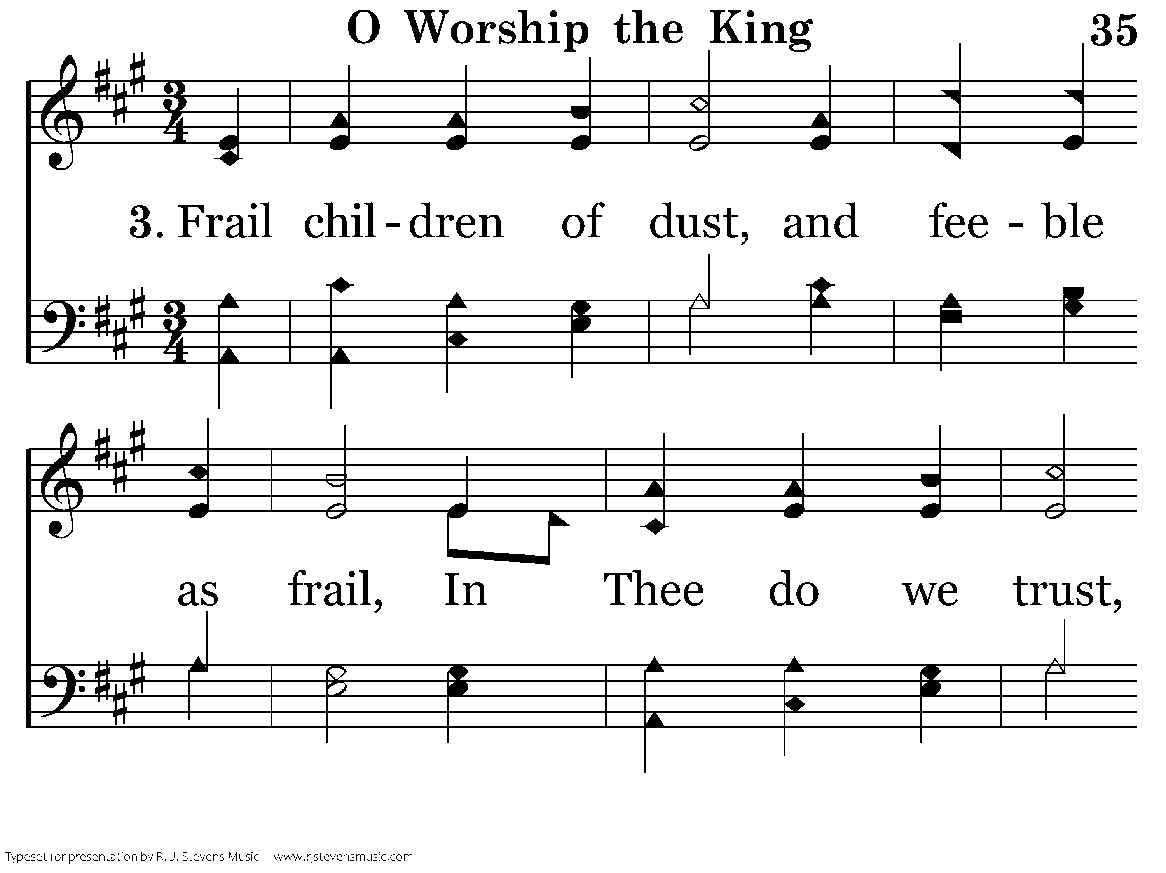
035 - O Worship The King - 3.1

Slide 9
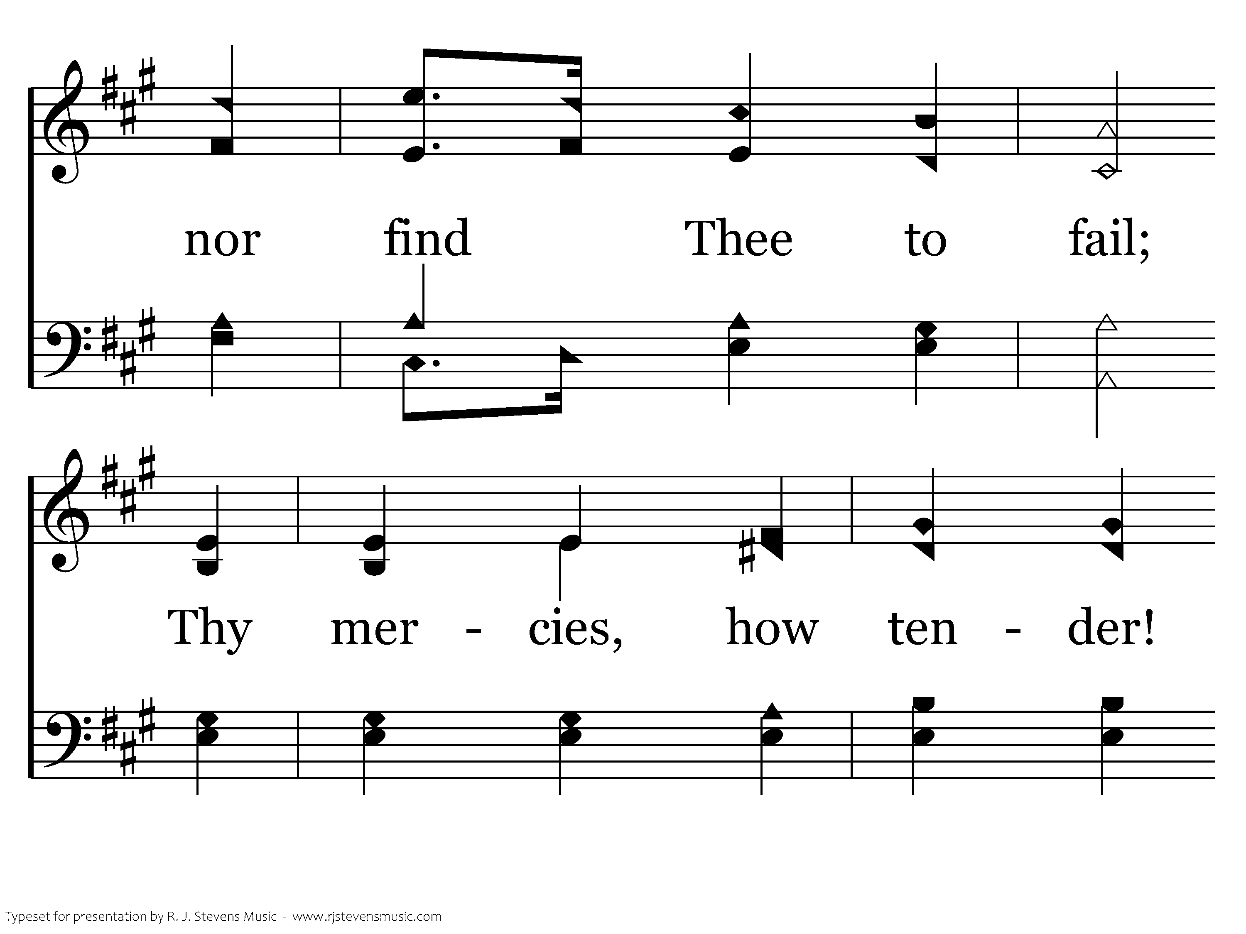
035 - O Worship The King - 3.2

Slide 10
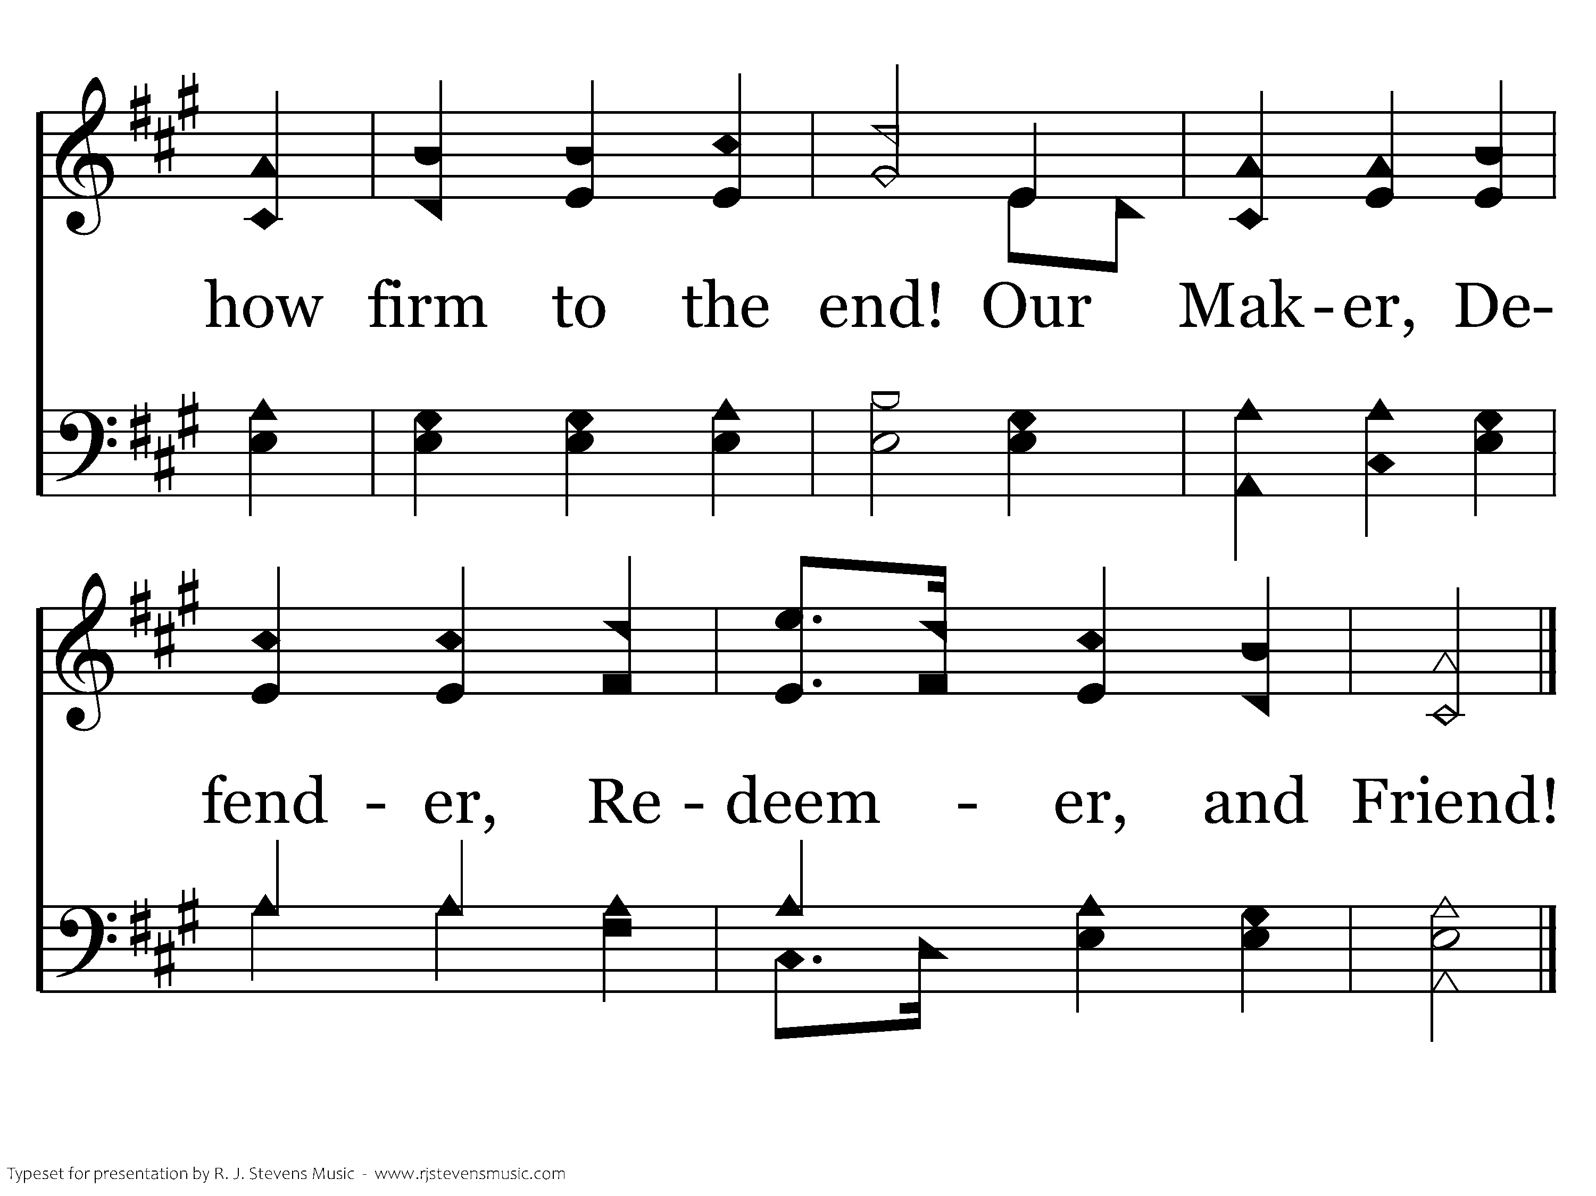
035 - O Worship The King - 3.3
End of Song

Slide 12

1142 - Lord, Be Glorified - Title

Slide 13
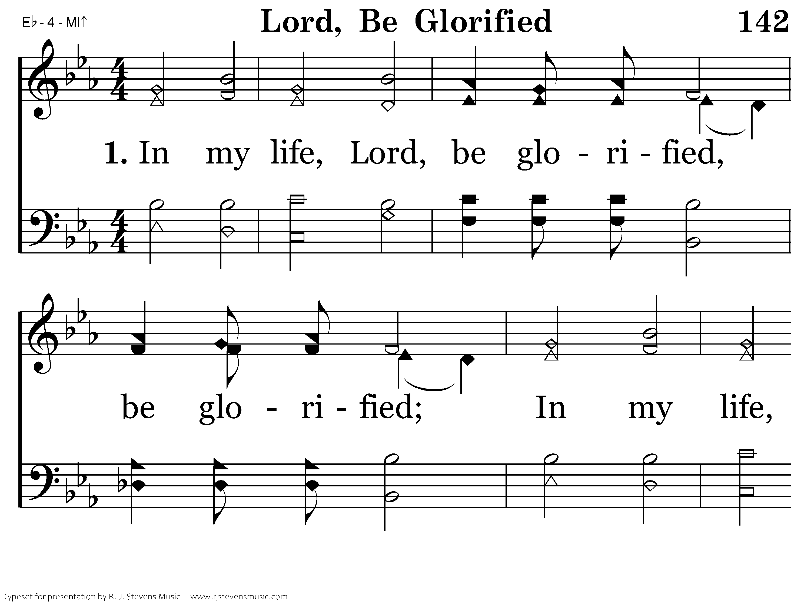
1142 - Lord, Be Glorified - 1.1

Slide 14
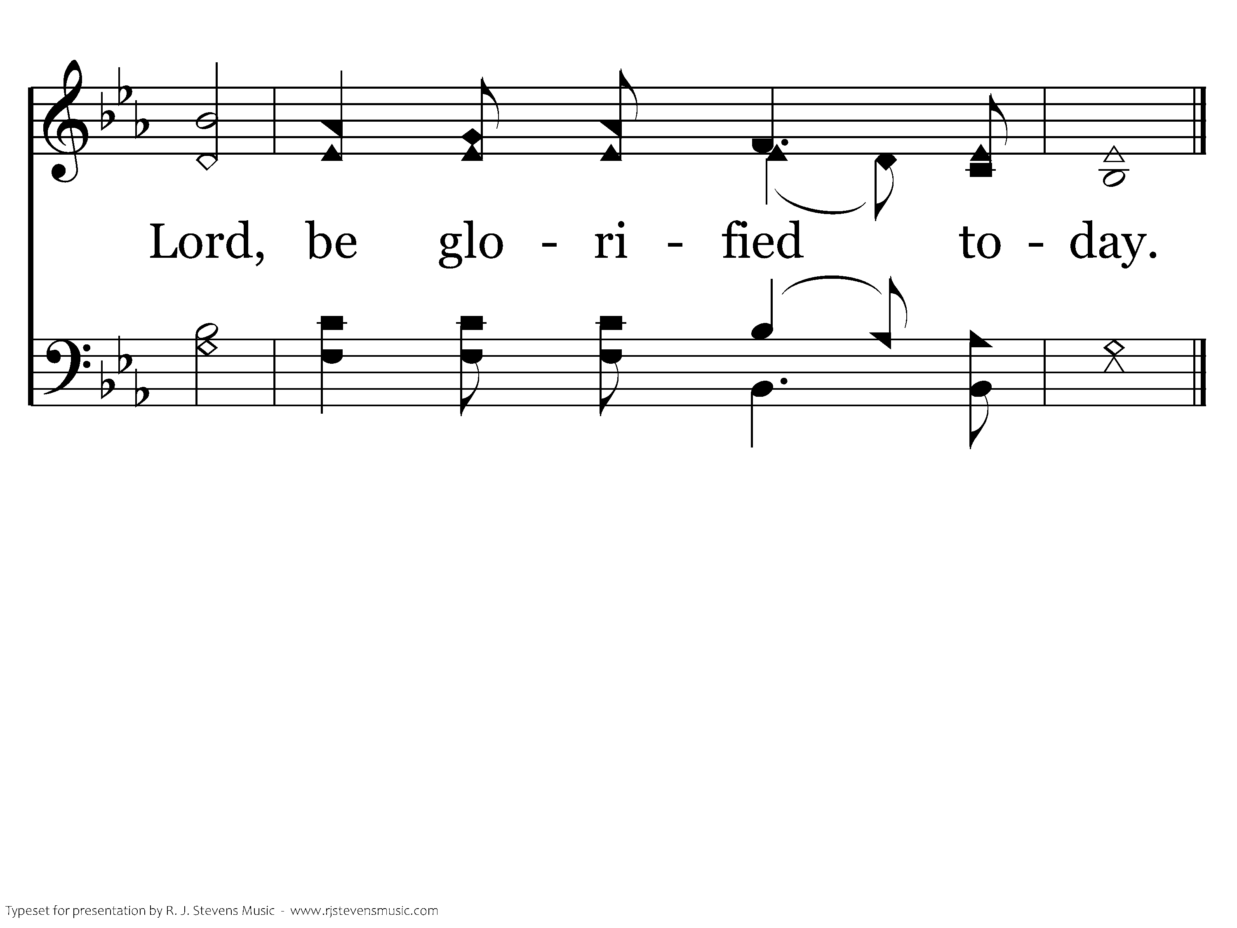
1142 - Lord, Be Glorified - 1.2
End of Verse 1

Slide 15
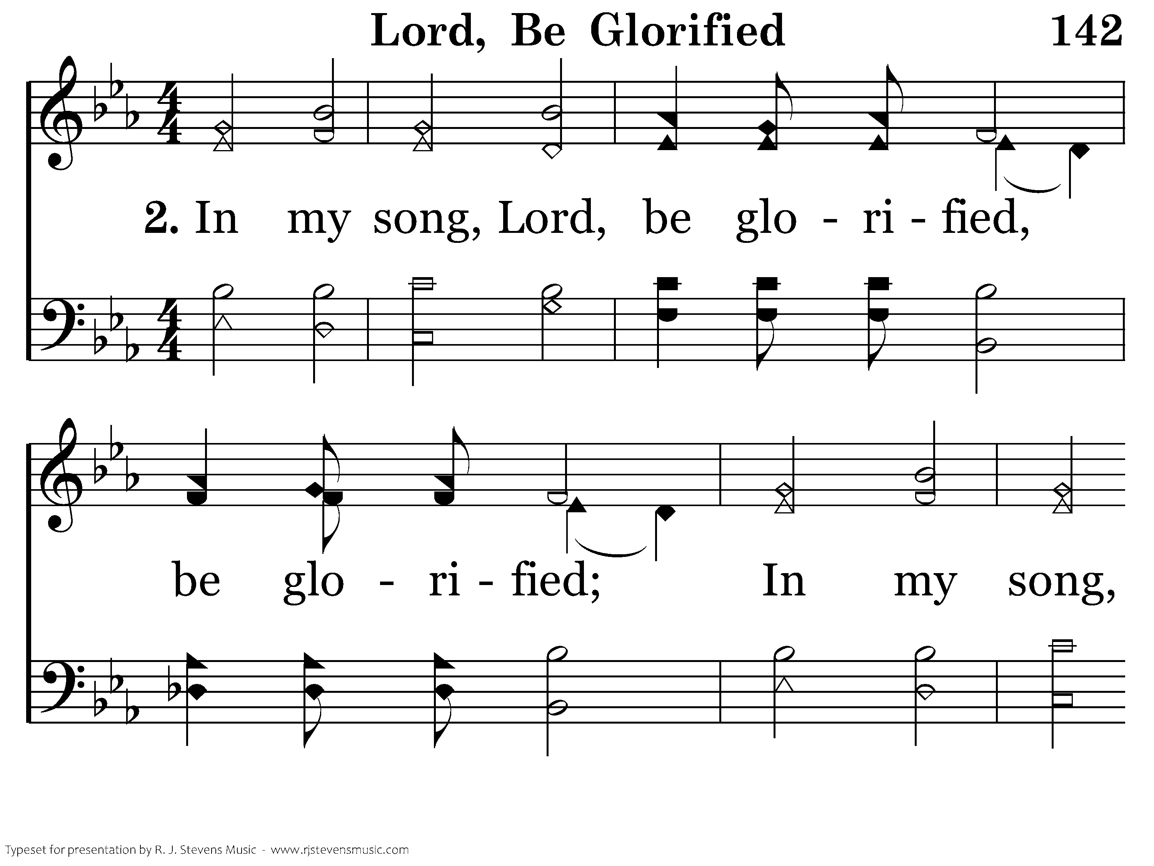
1142 - Lord, Be Glorified - 2.1

Slide 16
1142 - Lord, Be Glorified - 2.2
End of Verse 2

Slide 17
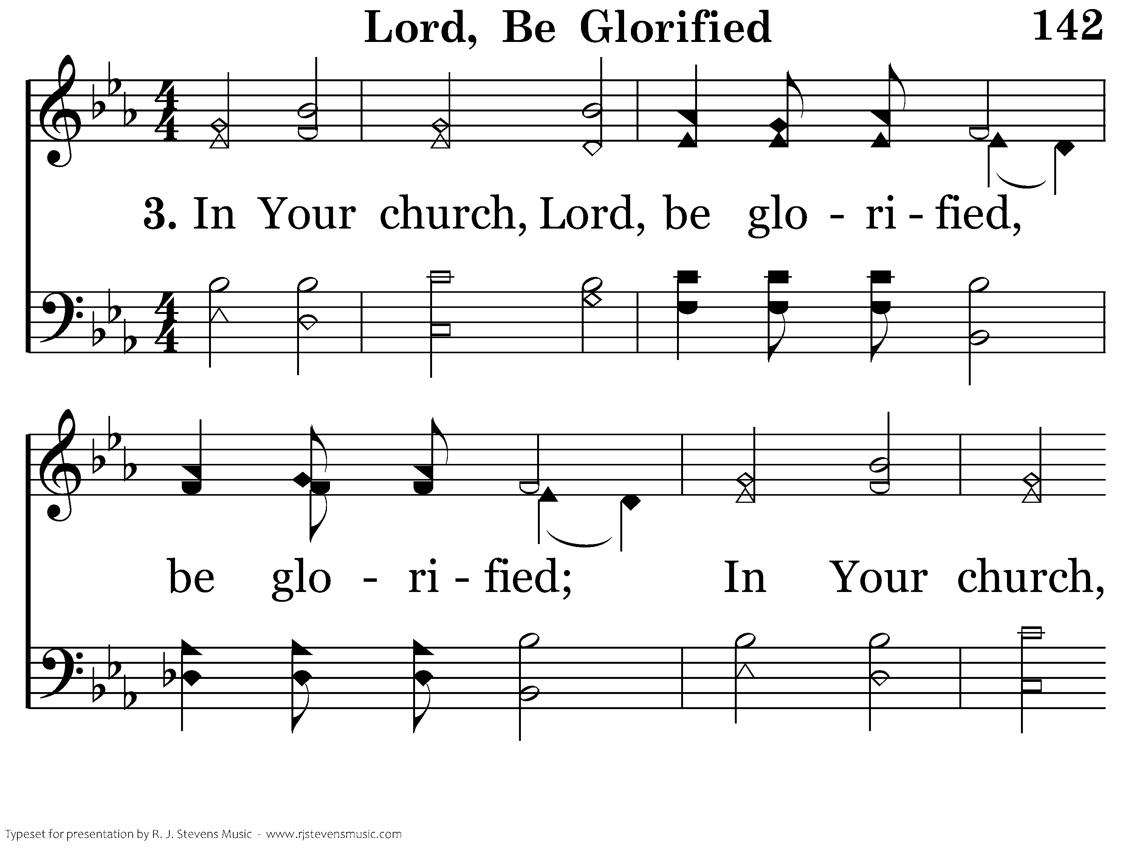
1142 - Lord, Be Glorified - 3.1

Slide 18
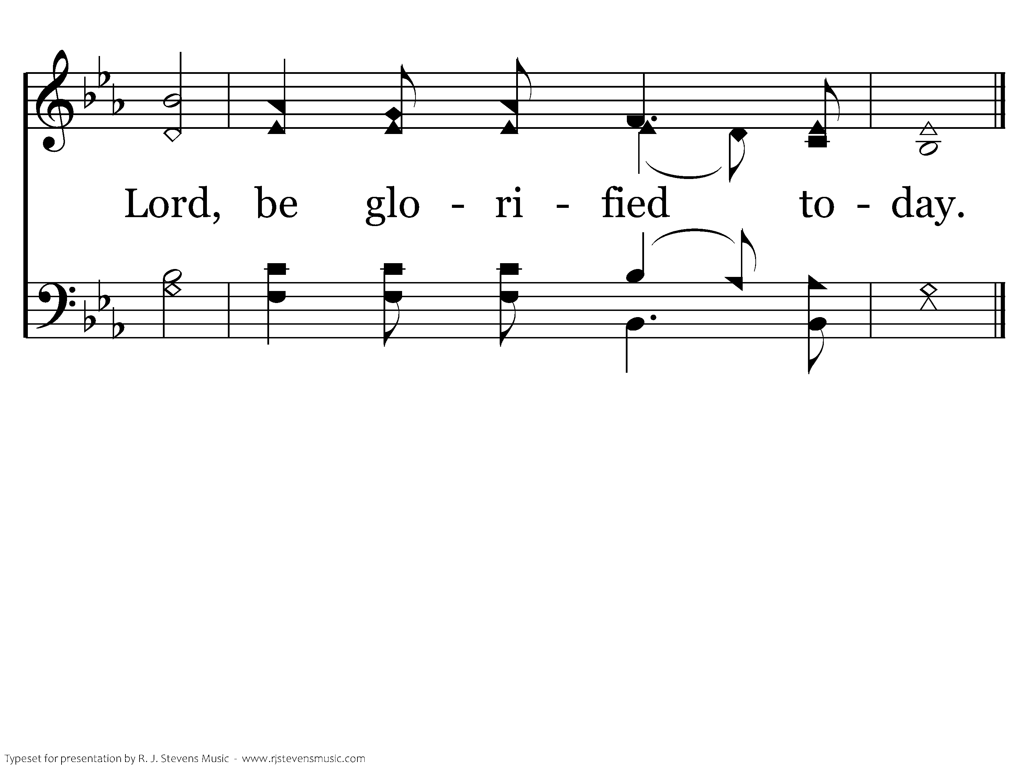
1142 - Lord, Be Glorified - 3.2
End of Song

Slide 20
Opening Prayer
Brenden Winslett

Slide 22
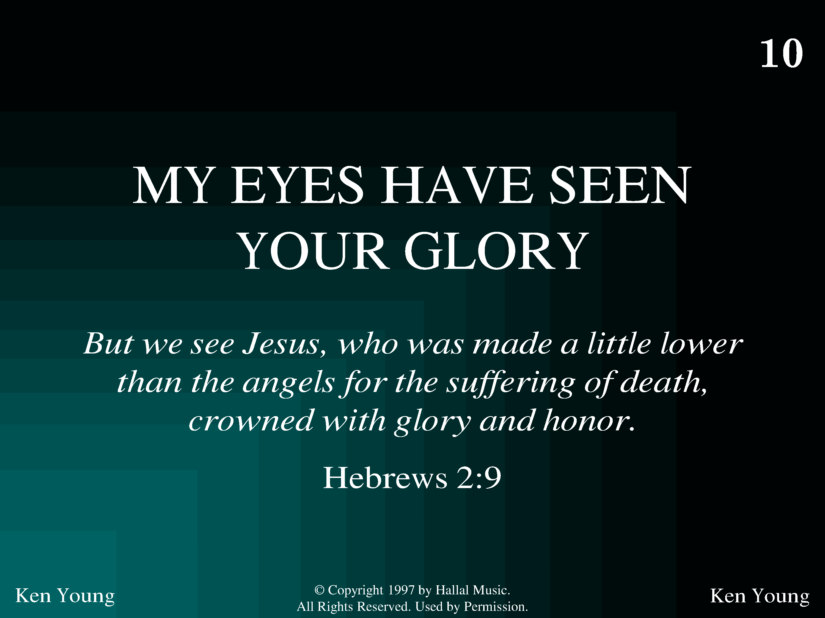
1010 - My Eyes Have Seen Your Glory - Title

Slide 23
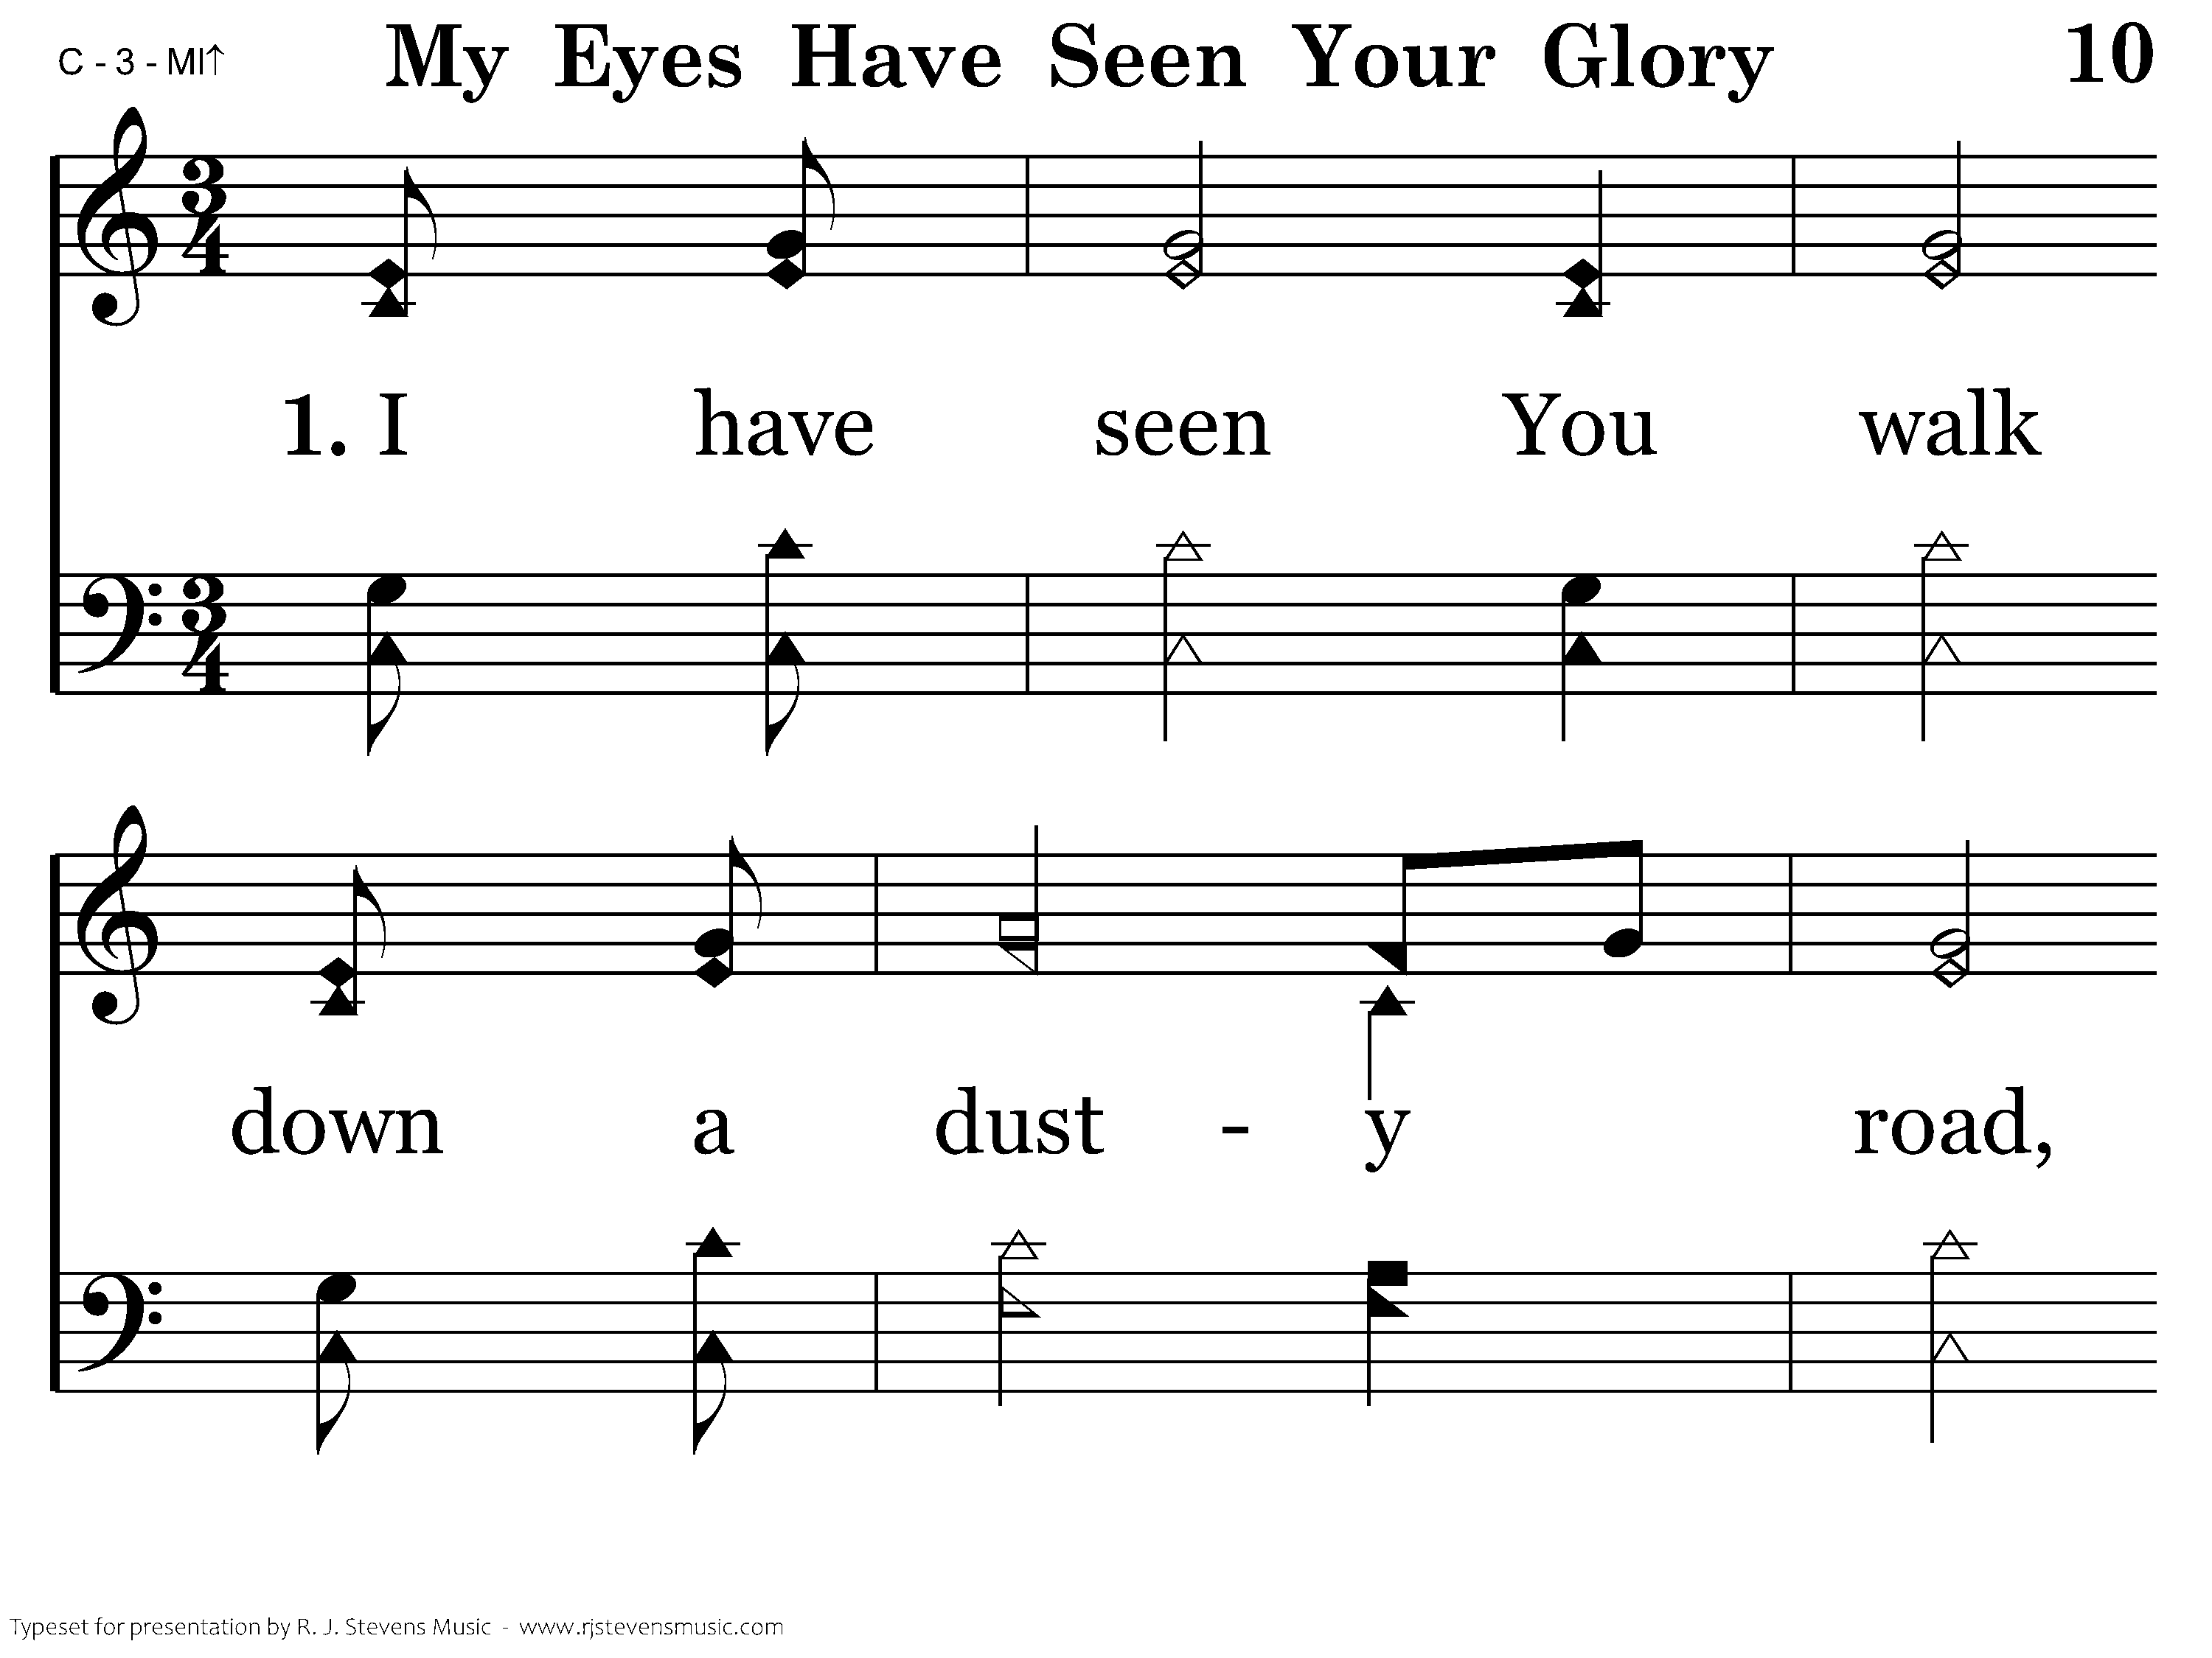
1010 - My Eyes Have Seen Your Glory - 1.1

Slide 24
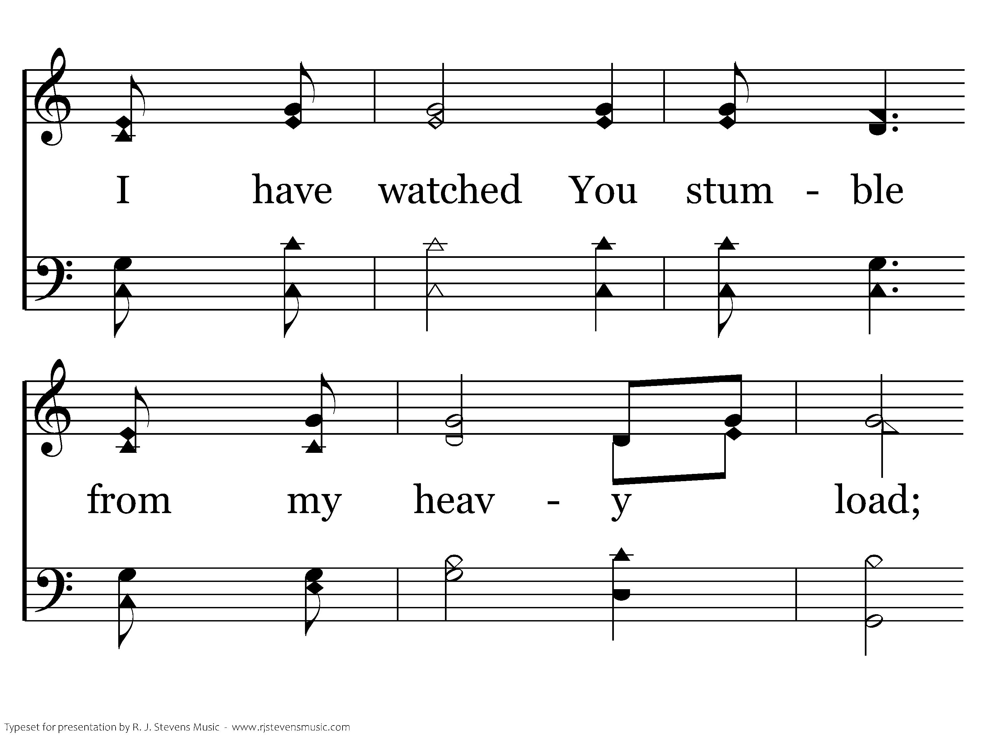
1010 - My Eyes Have Seen Your Glory - 1.2

Slide 25
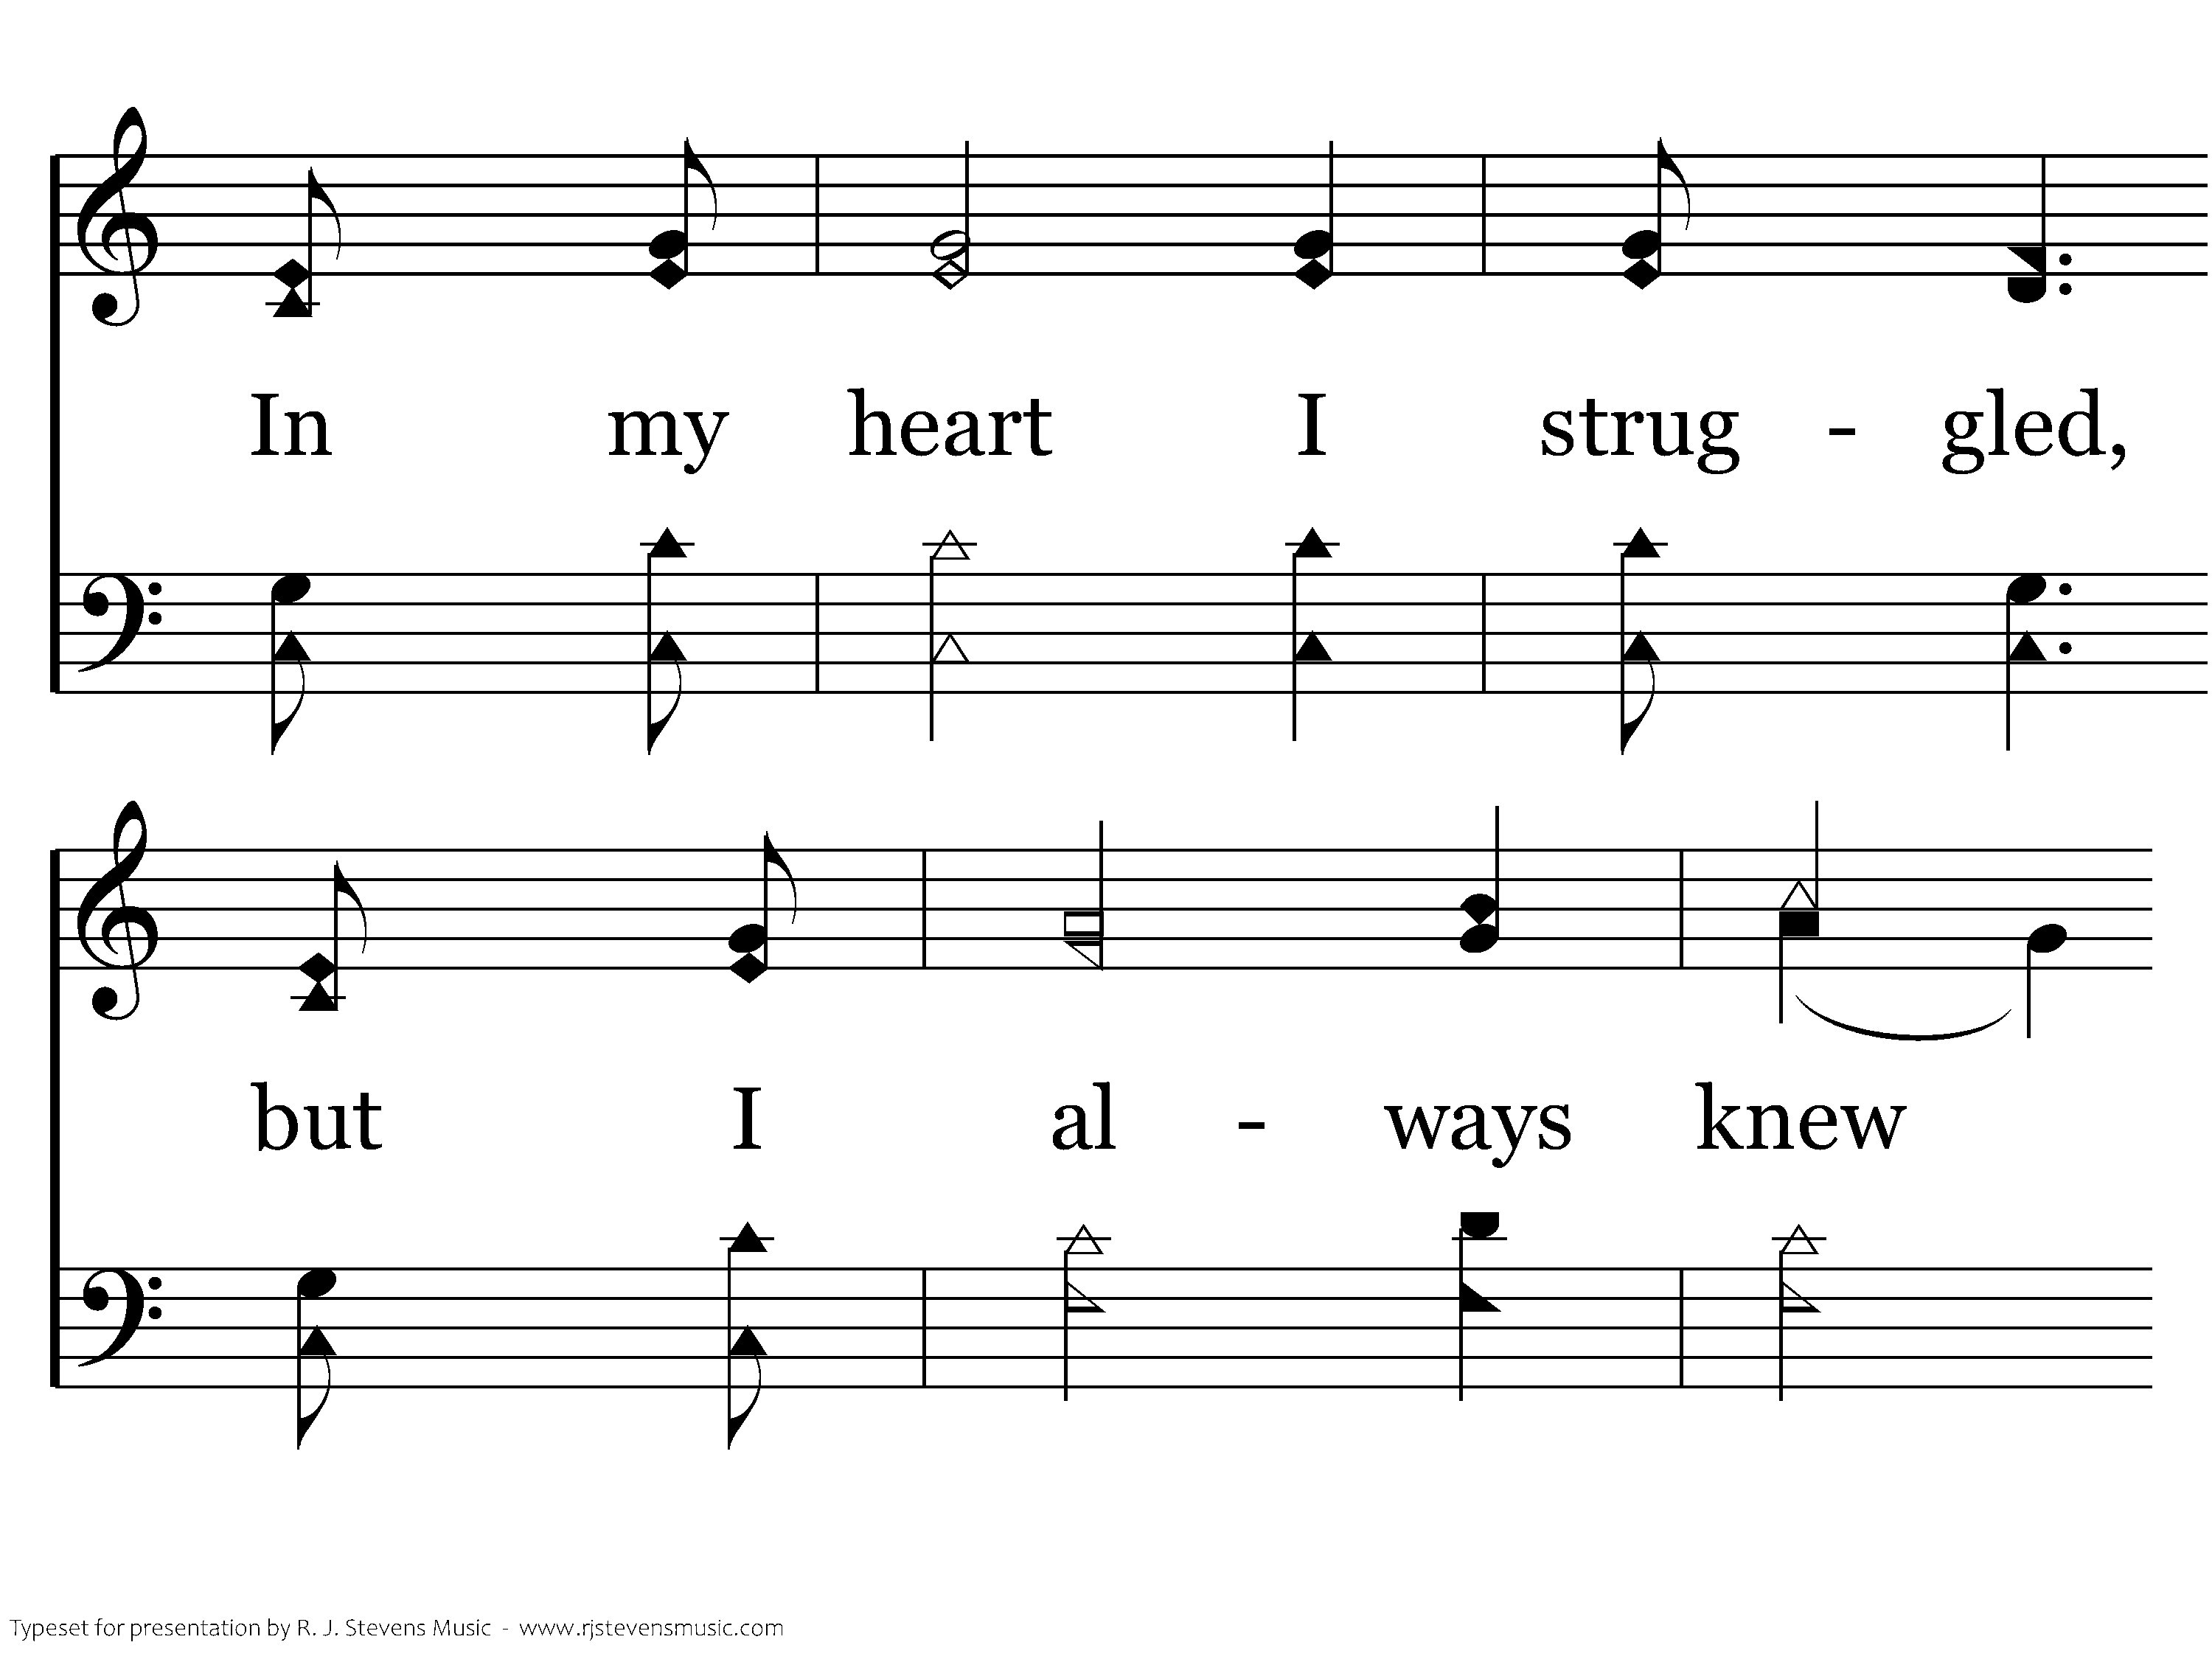
1010 - My Eyes Have Seen Your Glory - 1.3

Slide 26
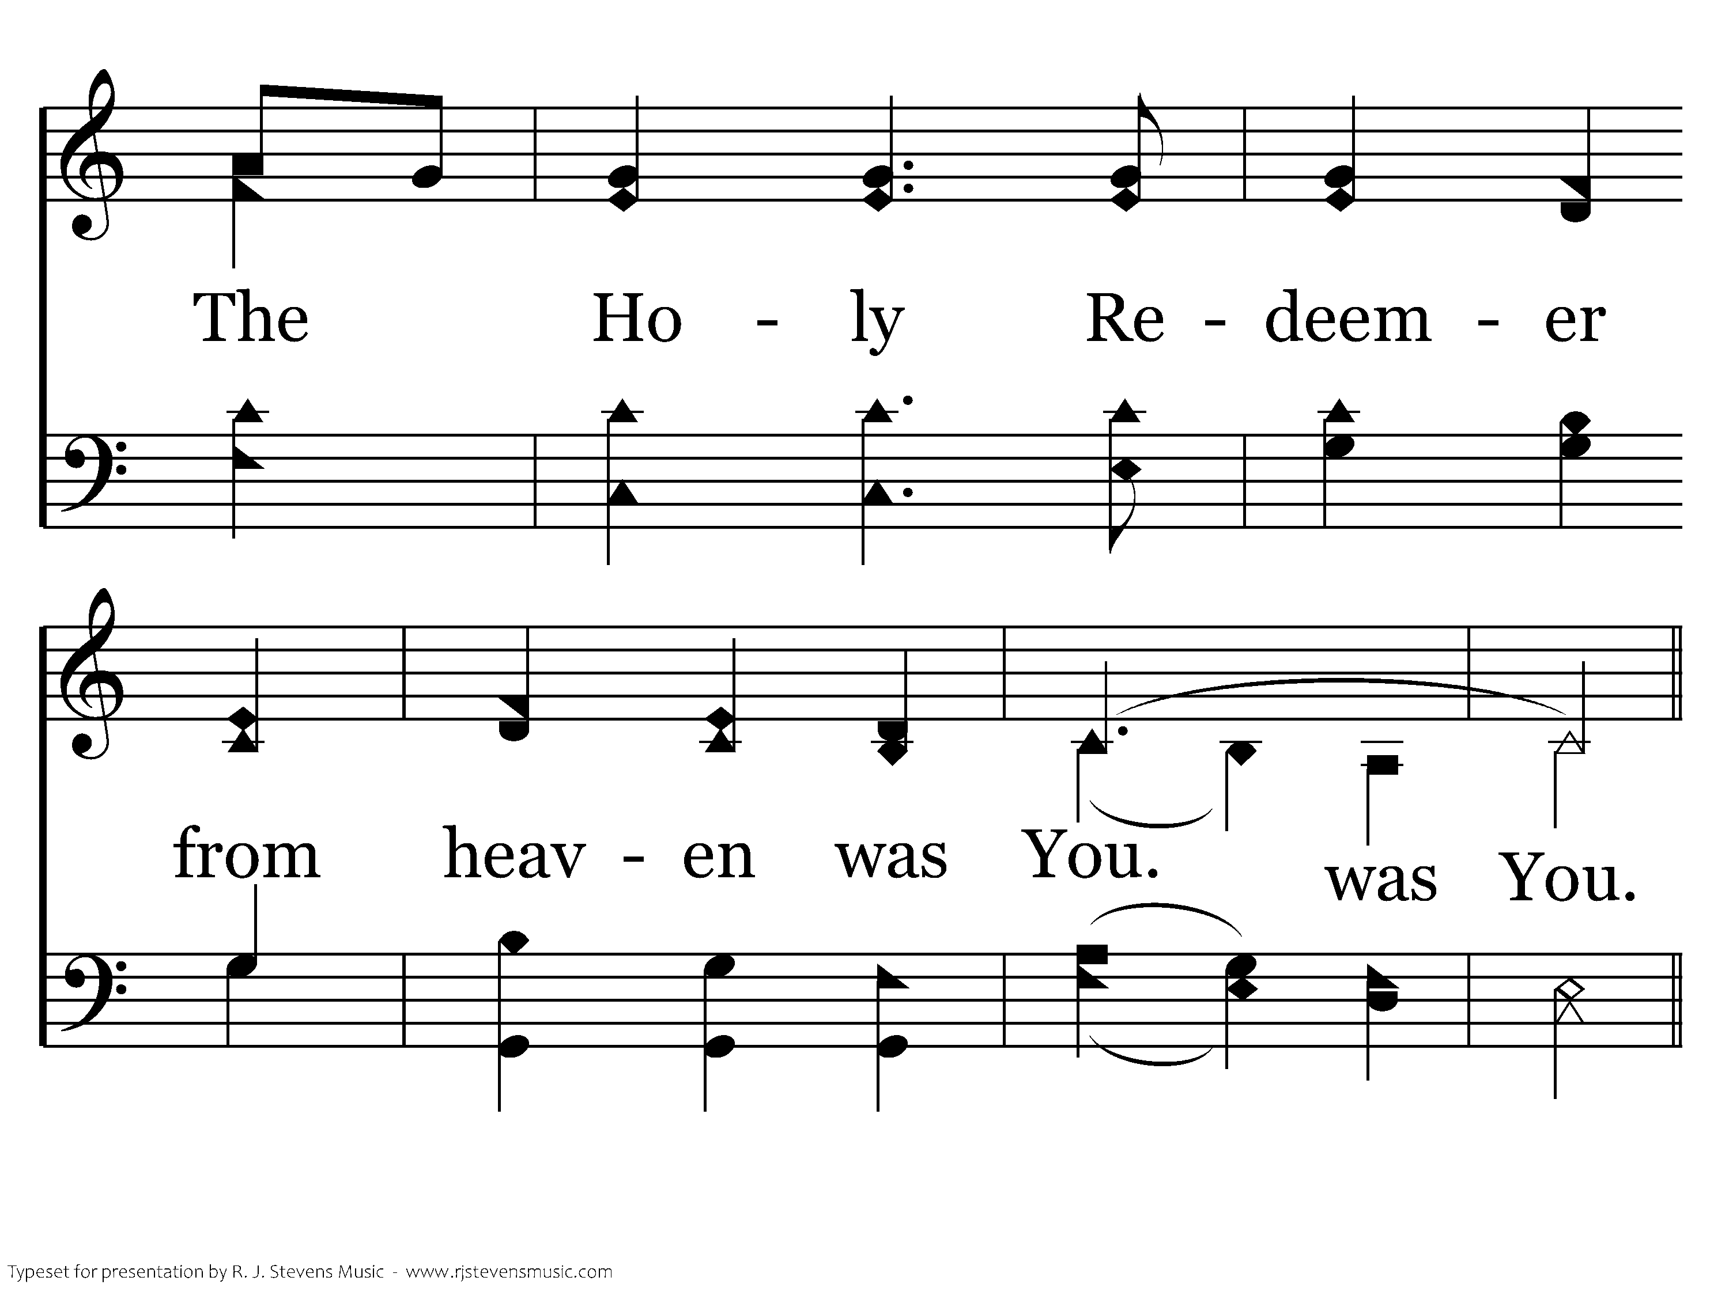
1010 - My Eyes Have Seen Your Glory - 1.4
End of Verse 1

Slide 27
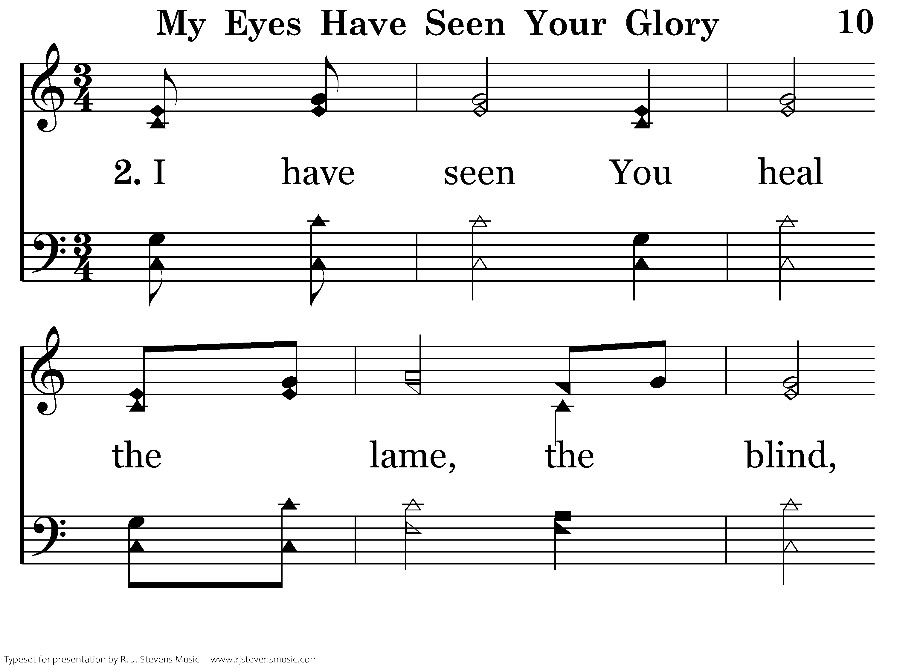
1010 - My Eyes Have Seen Your Glory - 2.1

Slide 28
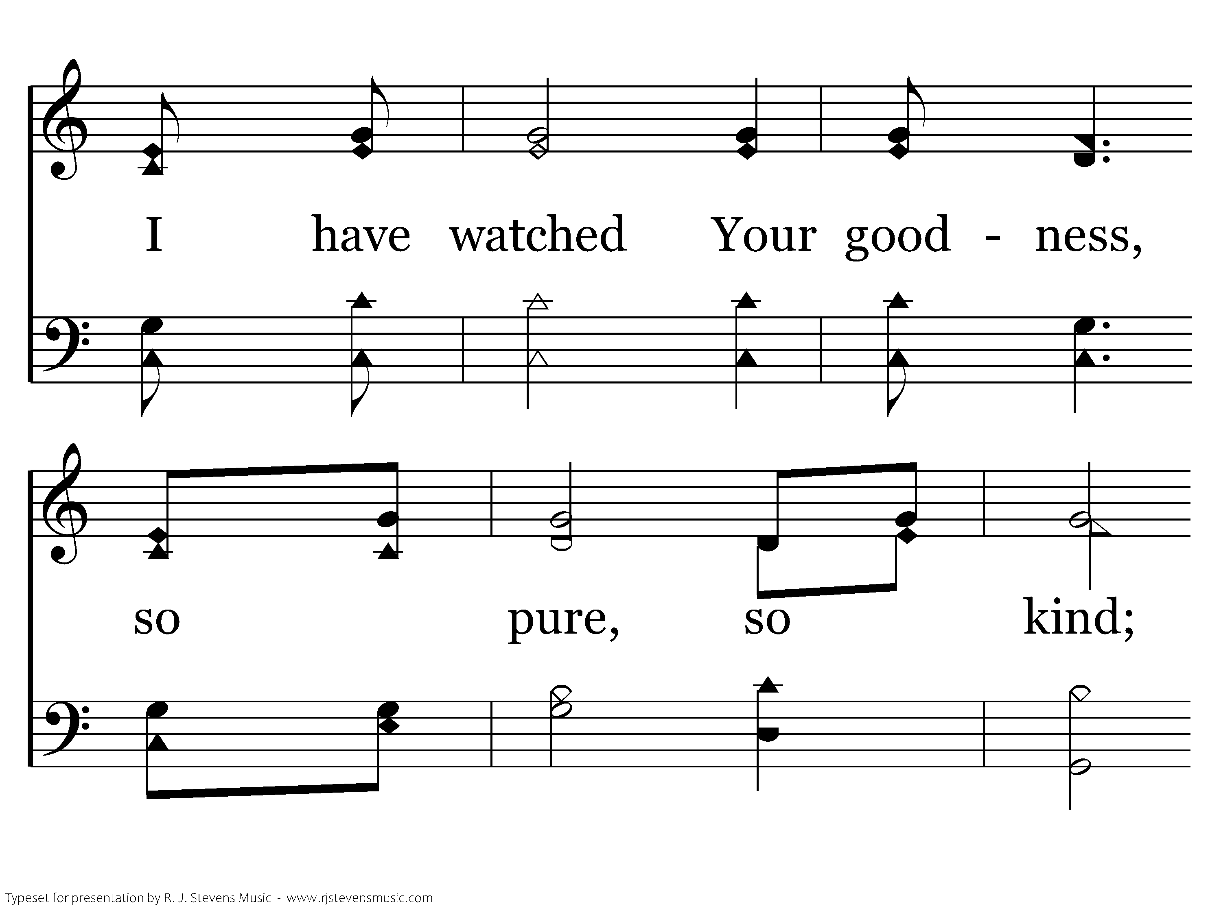
1010 - My Eyes Have Seen Your Glory - 2.2

Slide 29
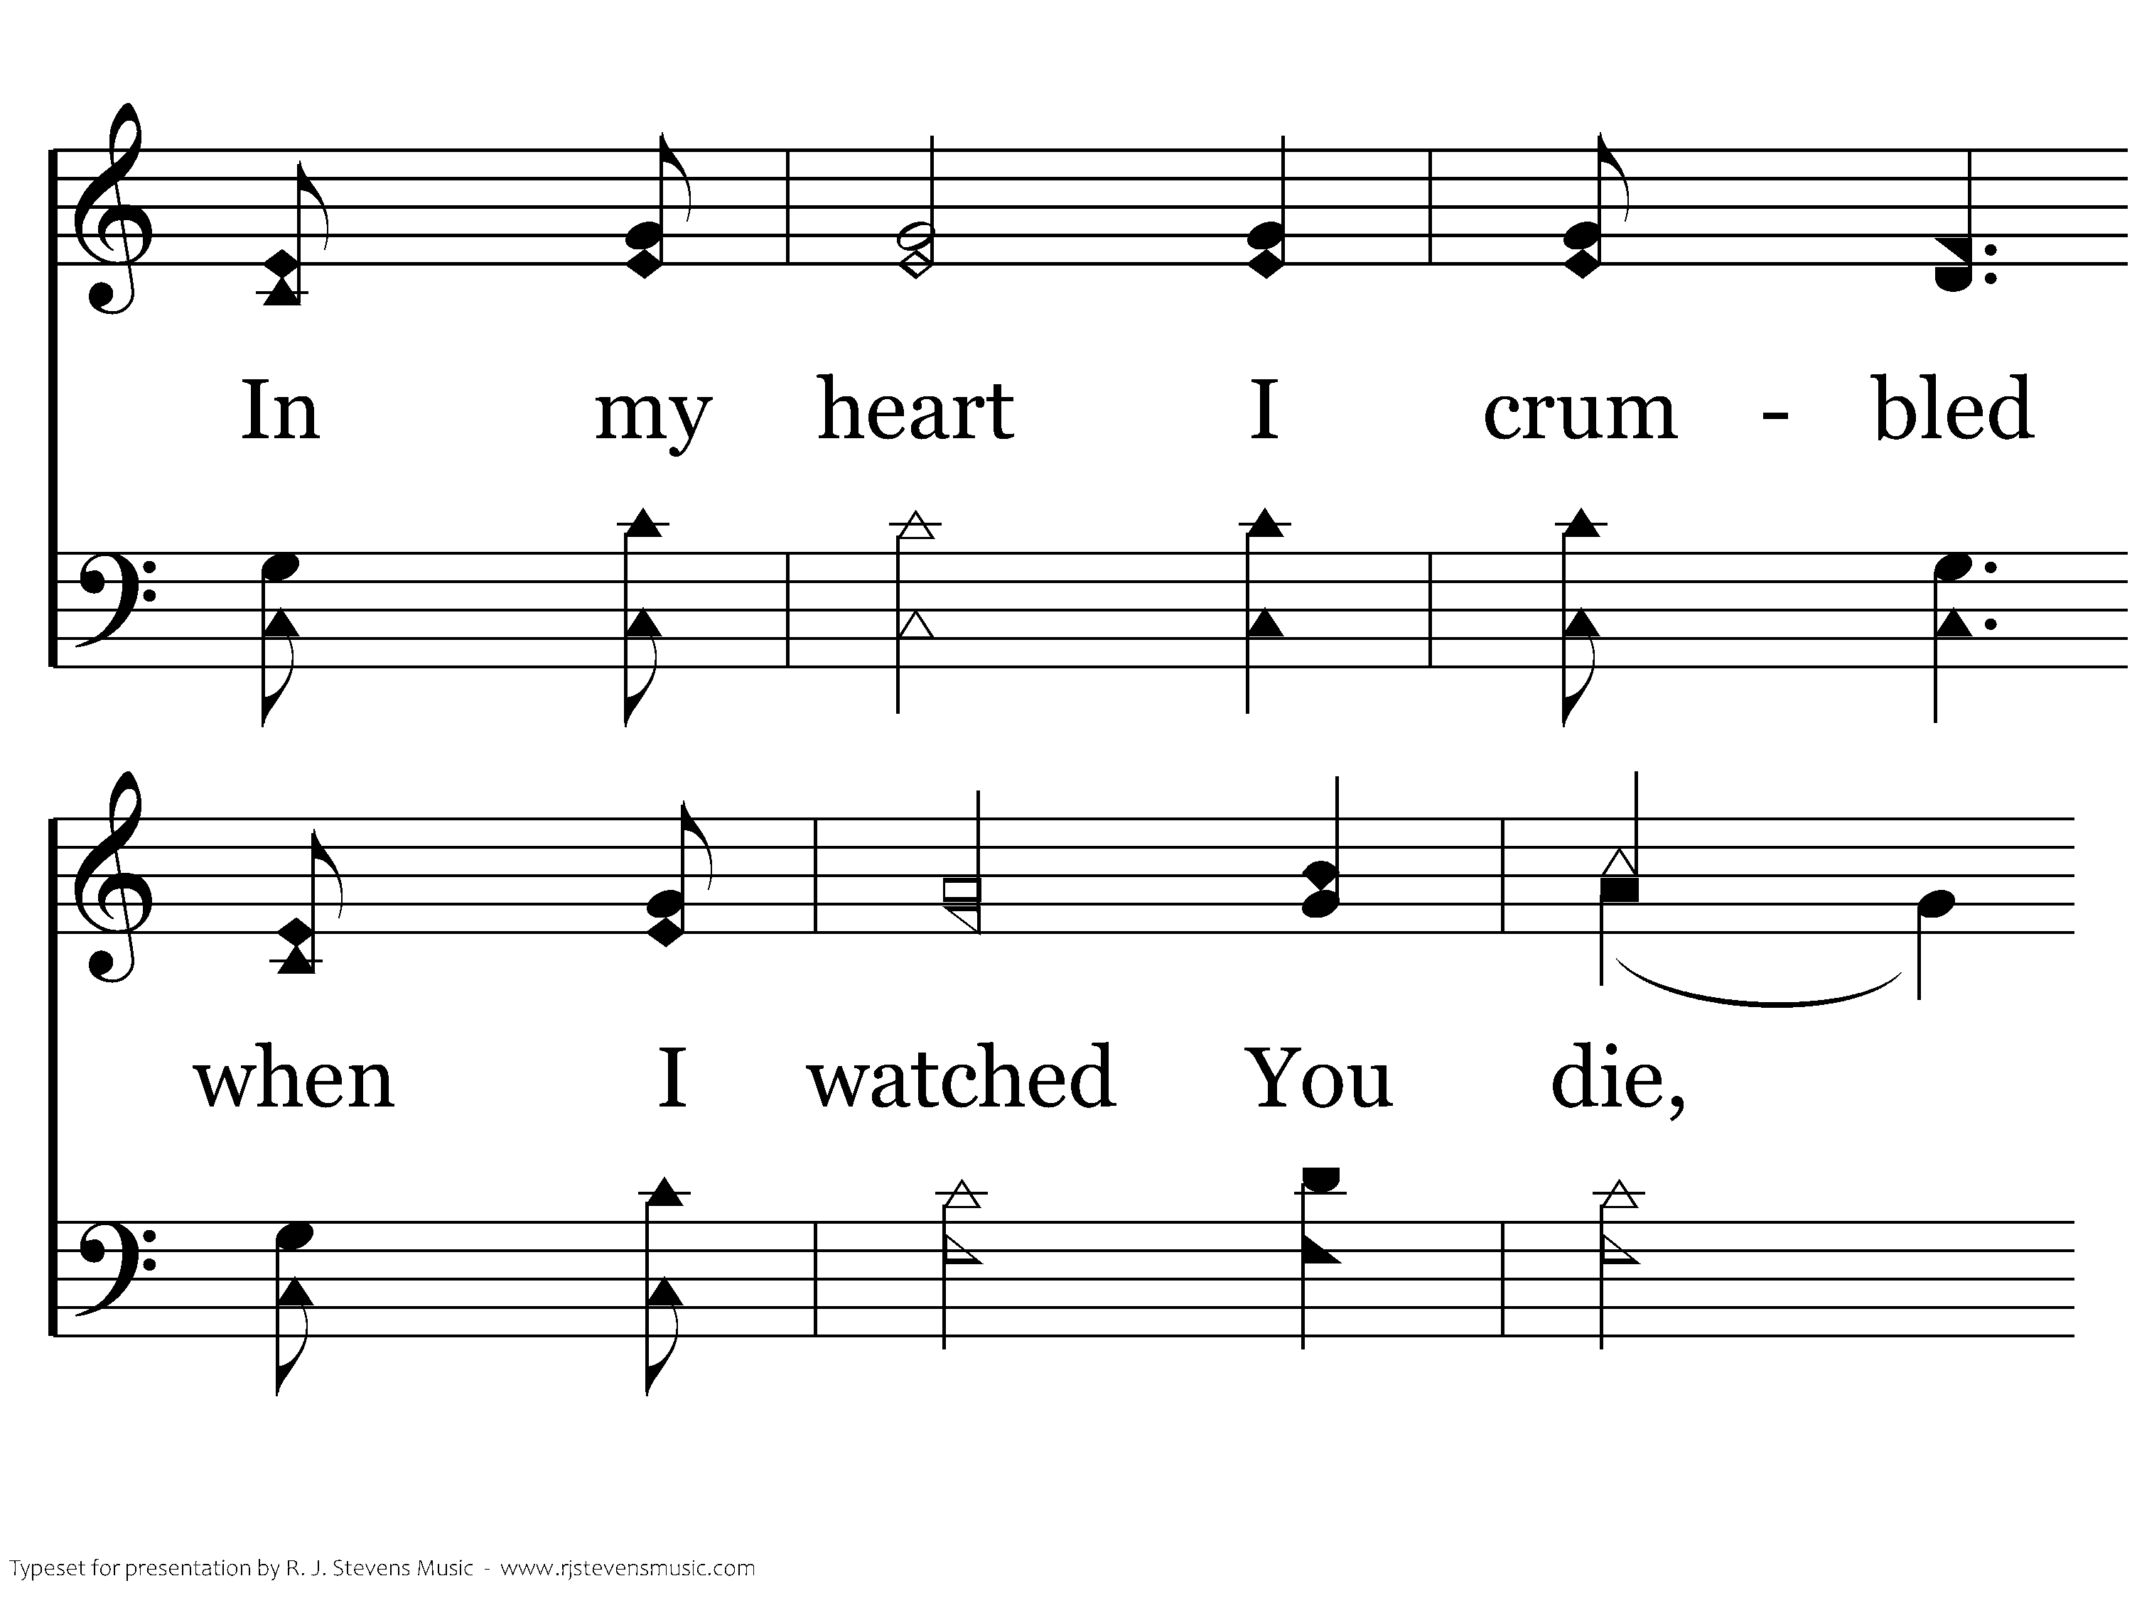
1010 - My Eyes Have Seen Your Glory - 2.3

Slide 30
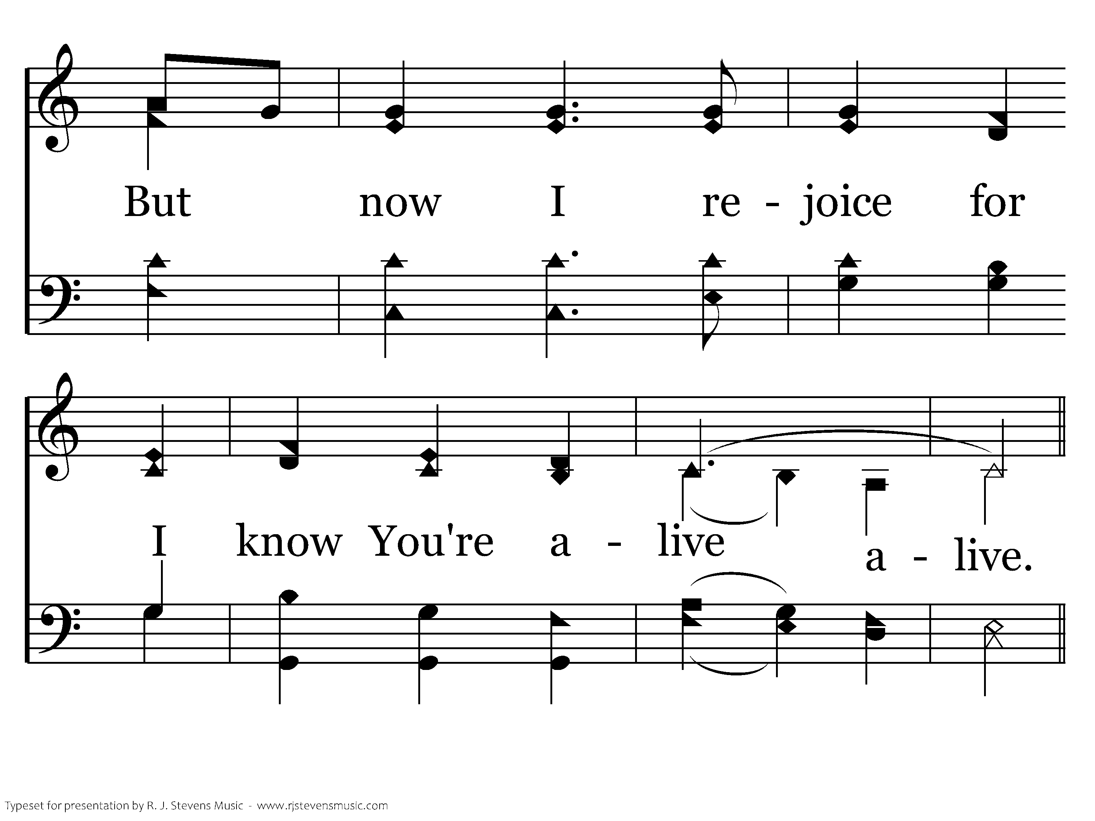
1010 - My Eyes Have Seen Your Glory - 2.4

Slide 31
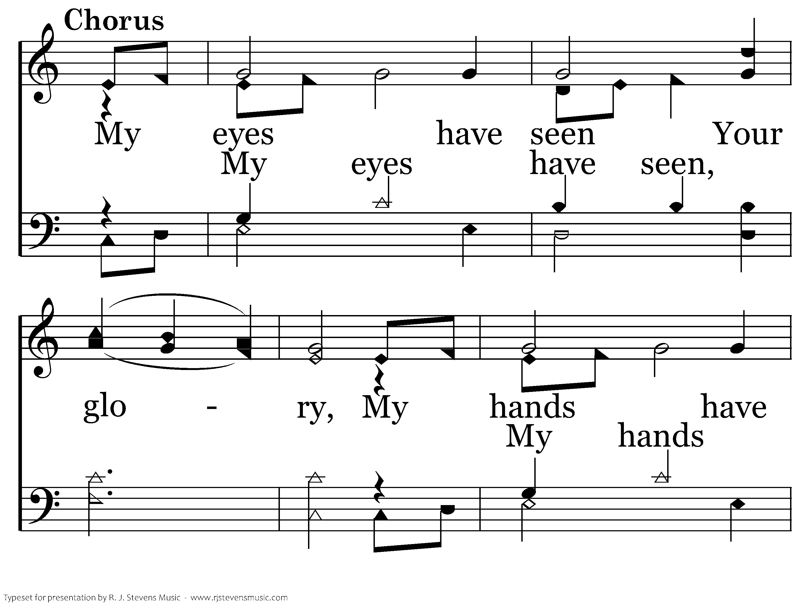
1010 - My Eyes Have Seen Your Glory - C.1

Slide 32
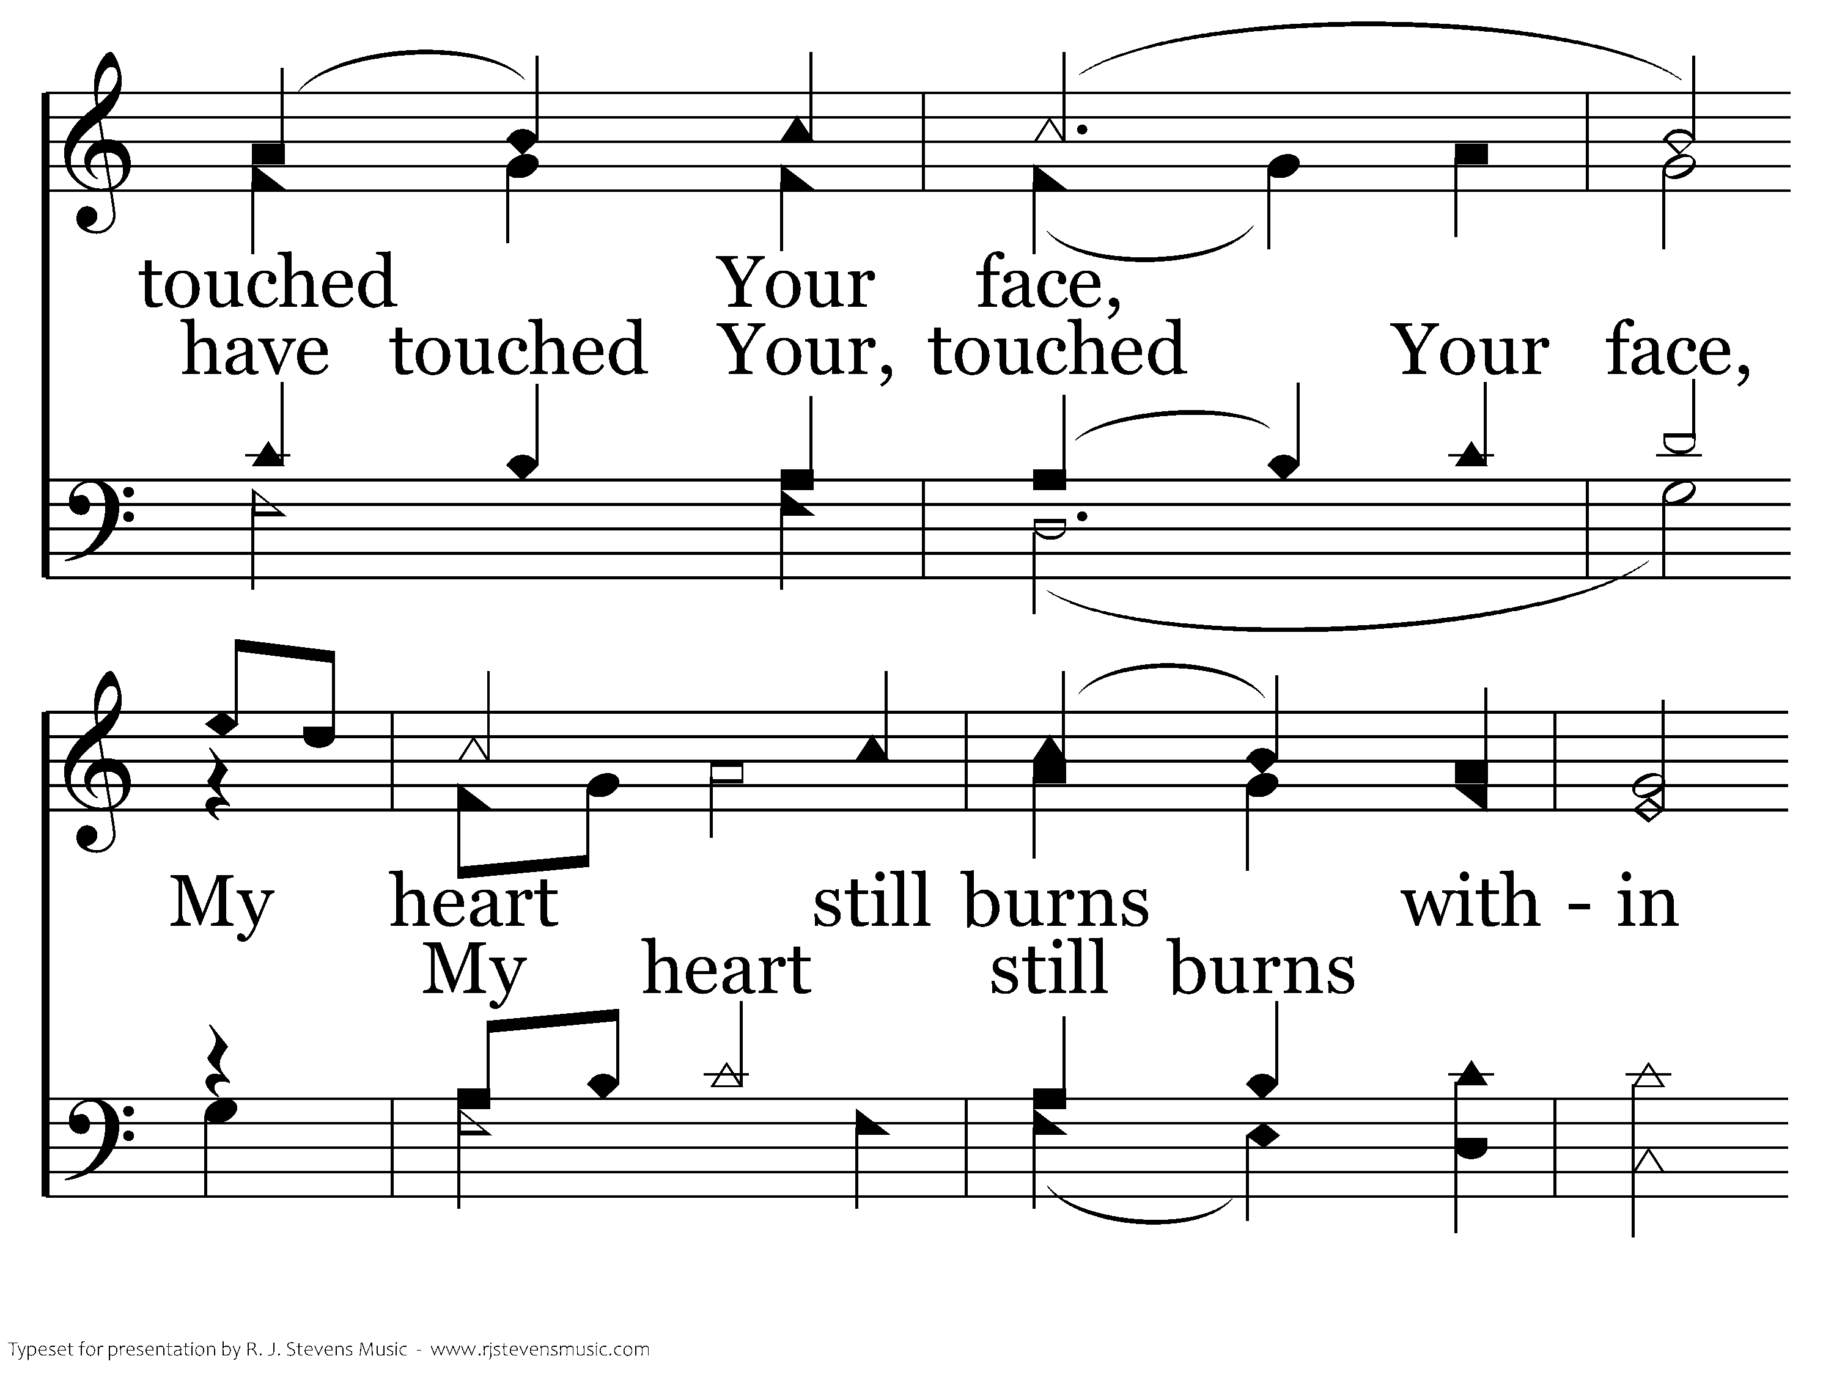
1010 - My Eyes Have Seen Your Glory - C.2

Slide 33
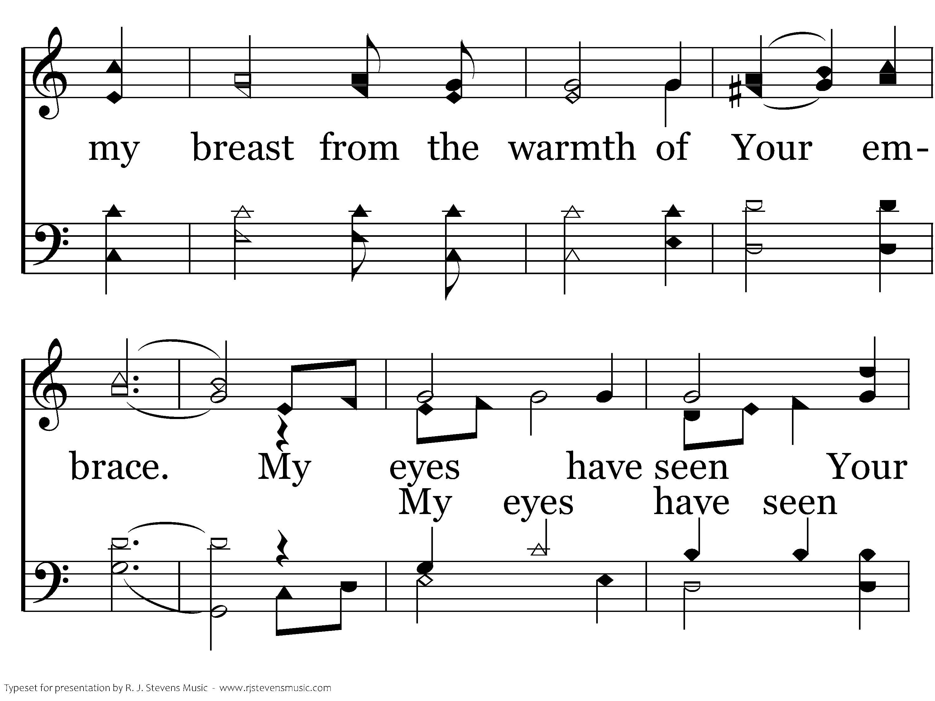
1010 - My Eyes Have Seen Your Glory - C.3

Slide 34
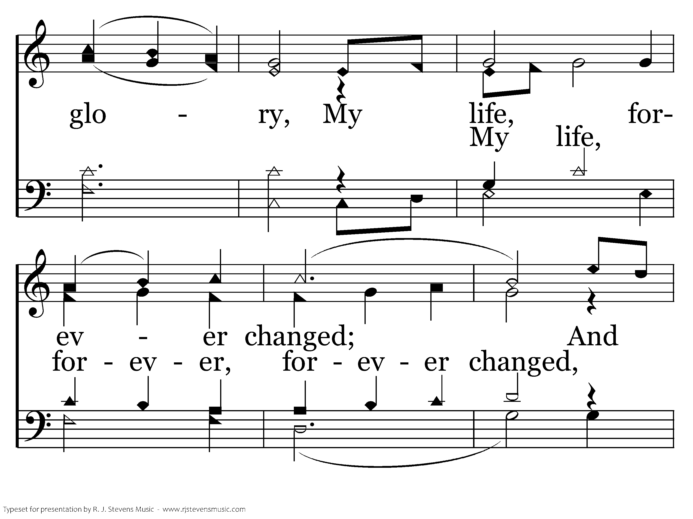
1010 - My Eyes Have Seen Your Glory - C.4

Slide 35
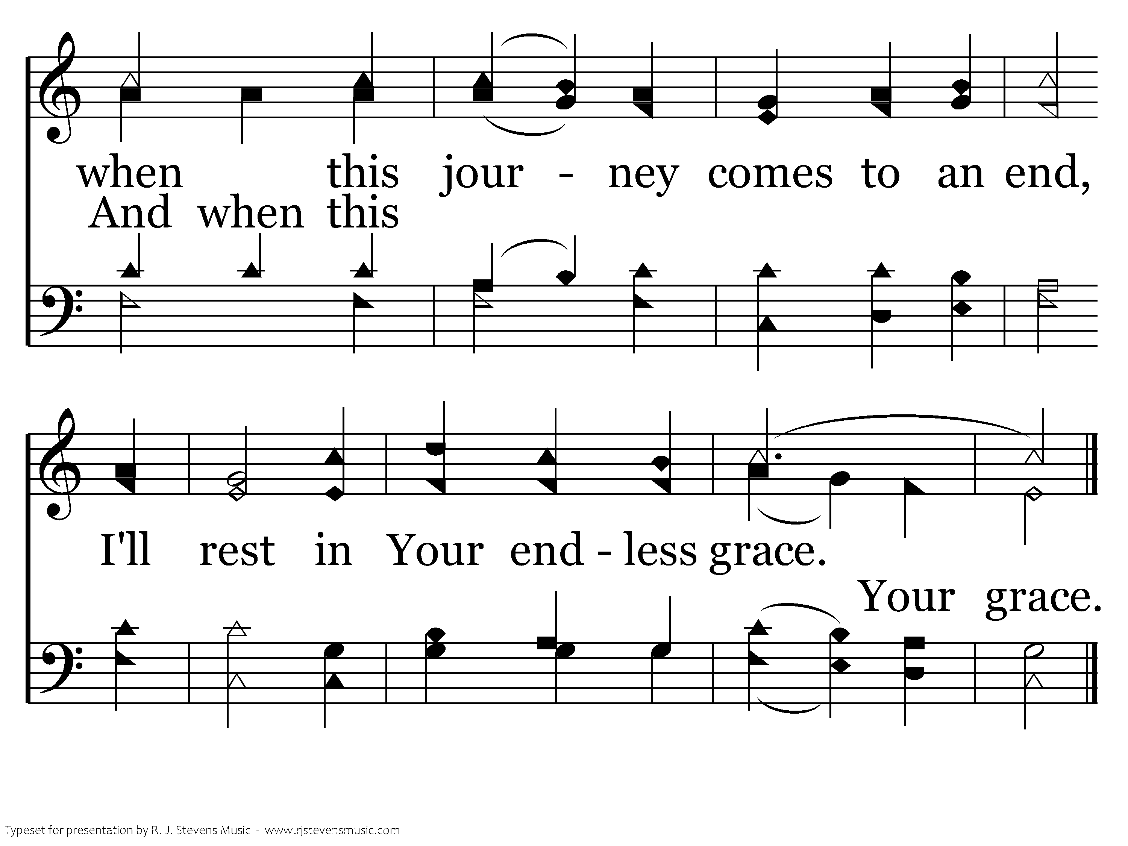
1010 - My Eyes Have Seen Your Glory - C.5
End of Song

Slide 37
Lord’s Supper
Tim Caldwell

Slide 39

21 For to this you have been called, because Christ also suffered for you, leaving you an example, so that you might follow in his steps. 22 He committed no sin, neither was deceit found in his mouth. 23 When he was reviled, he did not revile in return; when he suffered, he did not threaten, but continued entrusting himself to him who judges justly. 24 He himself bore our sins in his body on the tree, that we might die to sin and live to righteousness. By his wounds you have been healed.
1 Peter 2.21-24

Slide 41
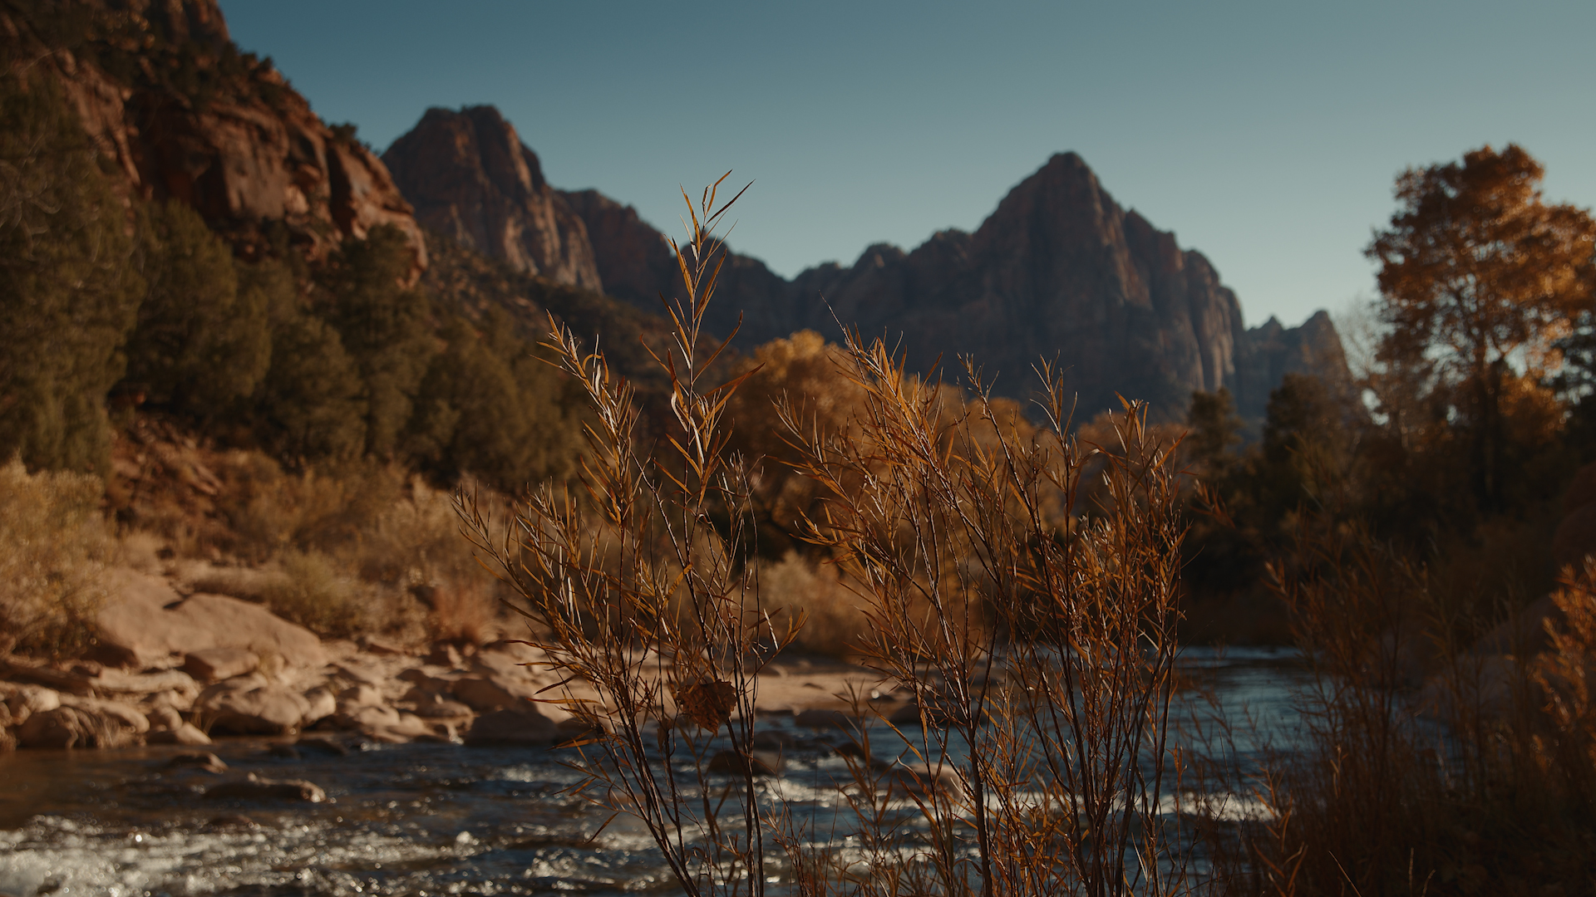
²³ For I received from the Lord what I also delivered to you, that the Lord Jesus on the night when he was betrayed took bread, ²⁴ and when he had given thanks, he broke it, and said, “This is my body, which is for you. Do this in remembrance of me.” ²⁵ In the same way also he took the cup, after supper, saying, “This cup is the new covenant in my blood. Do this, as often as you drink it, in remembrance of me.” ²⁶ For as often as you eat this bread and drink the cup, you proclaim the Lord's death until he comes.
1 Corinthians 11:23-26

Slide 42
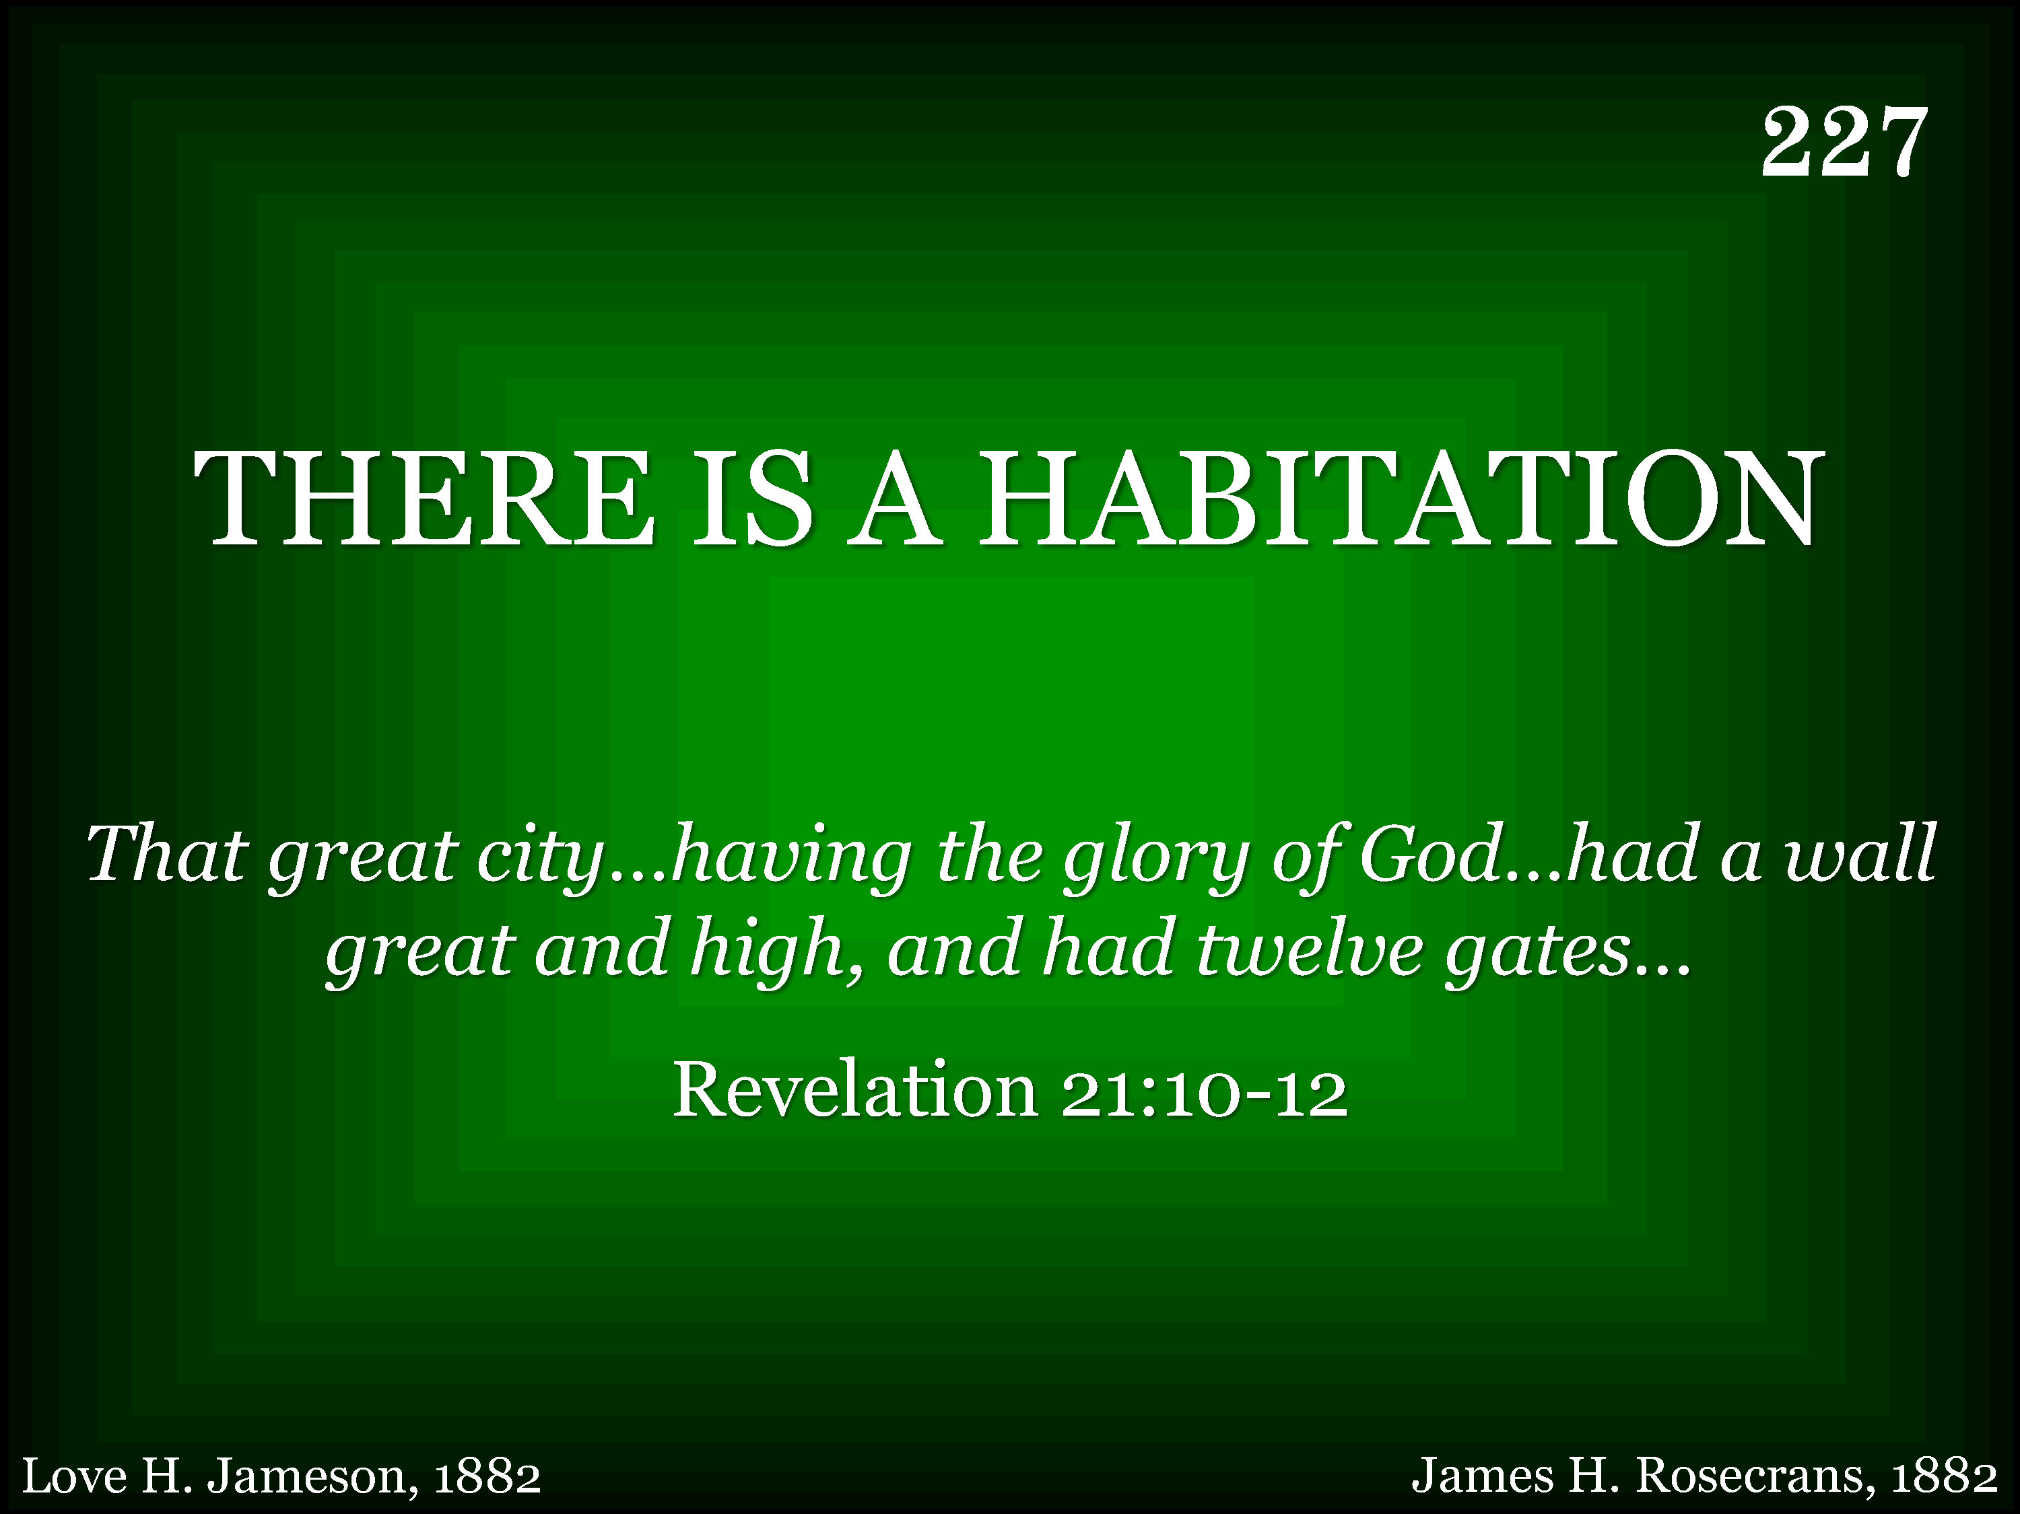
227 - There Is A Habitation - Title

Slide 43
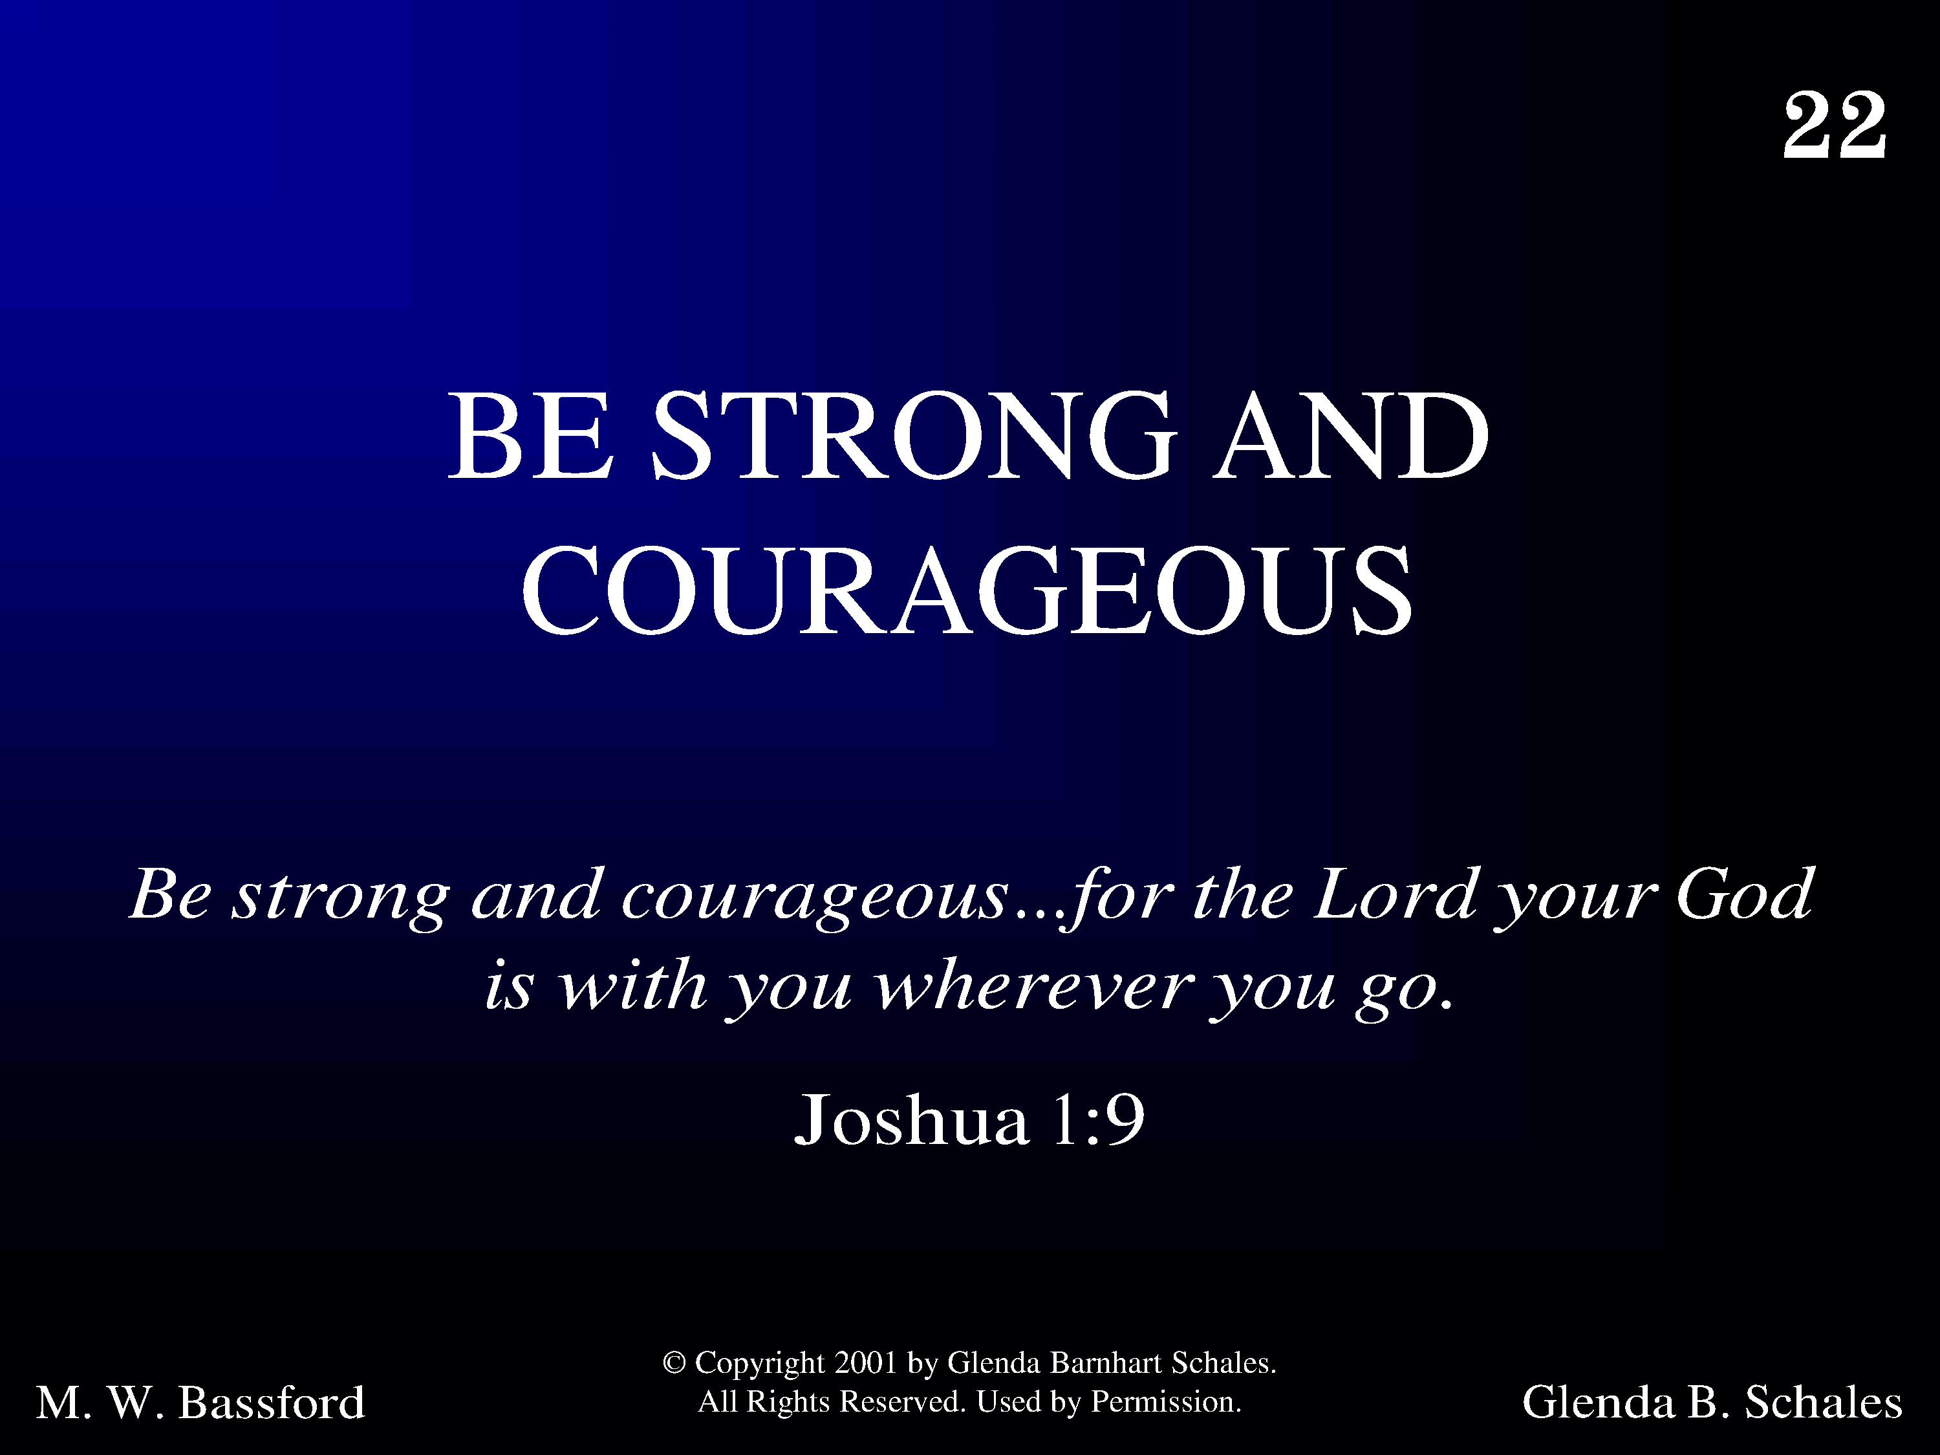
1022 - Be Strong And Courageous - Title

Slide 44
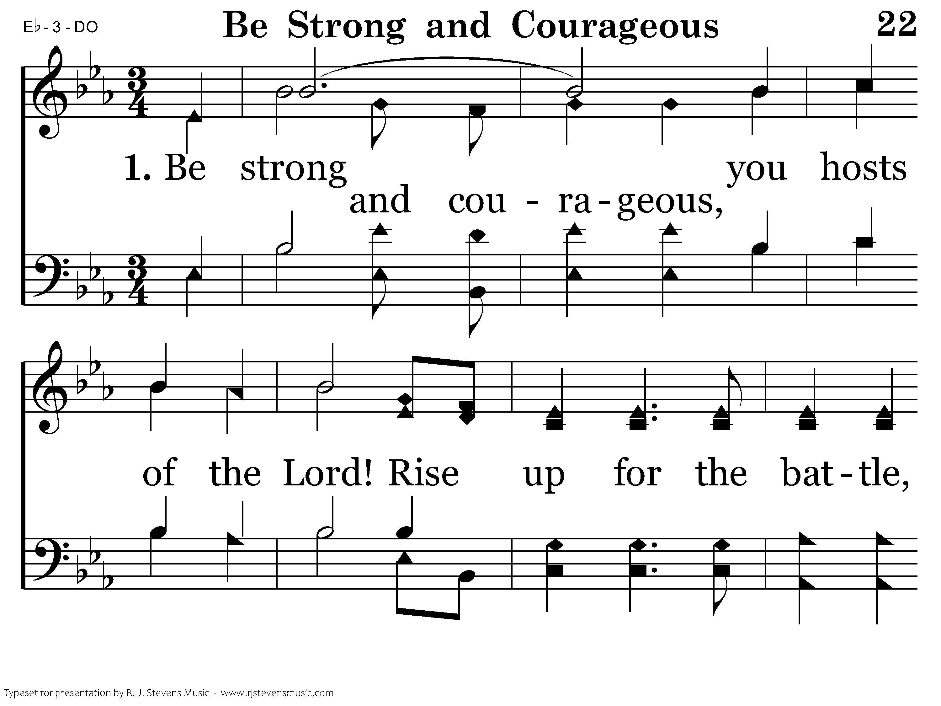
1022 - Be Strong And Courageous - 1.1

Slide 45
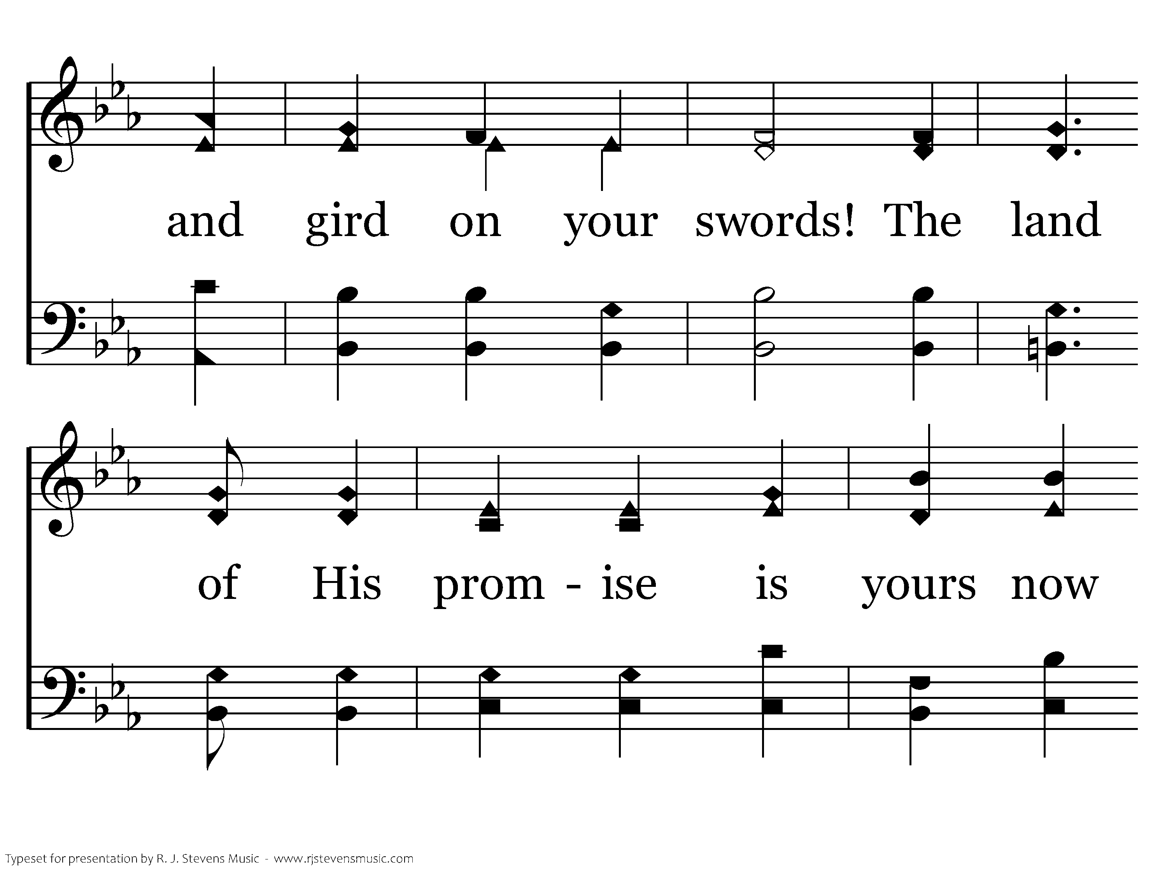
1022 - Be Strong And Courageous - 1.2

Slide 46
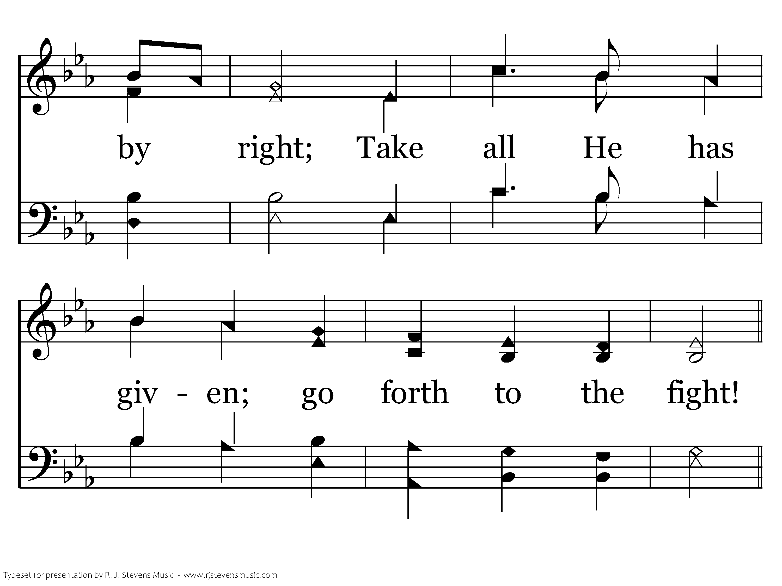
1022 - Be Strong And Courageous - 1.3

Slide 47
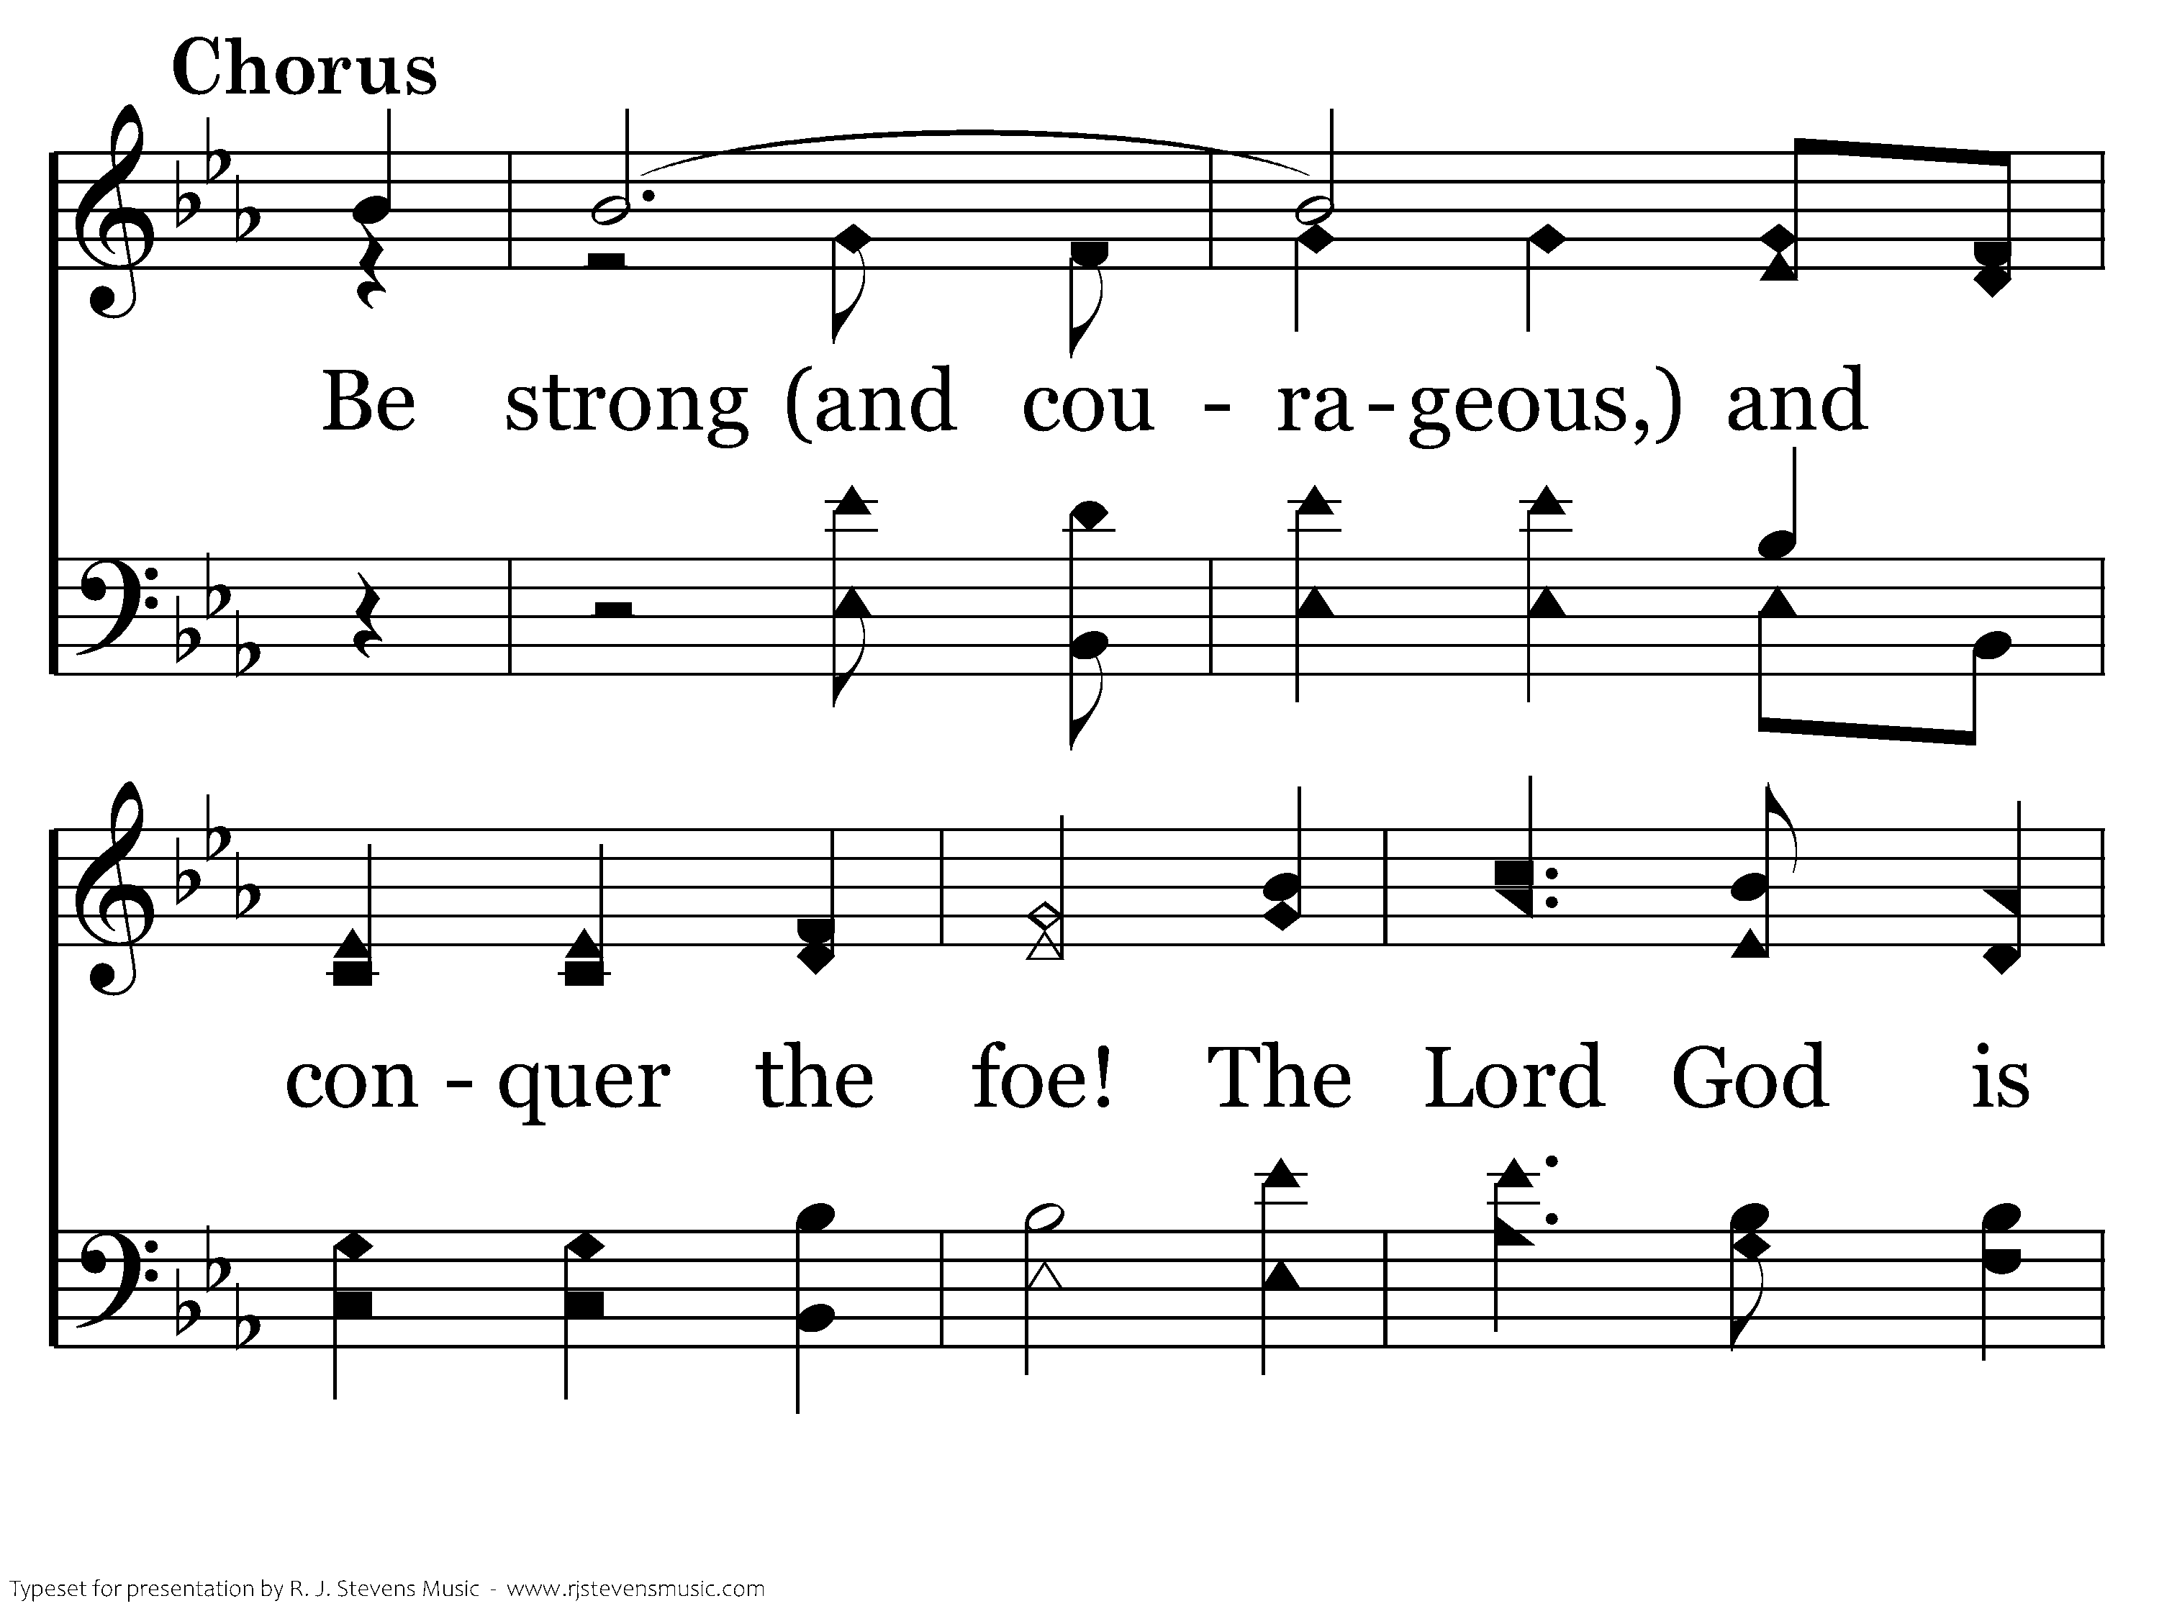
1022 - Be Strong And Courageous - C.1

Slide 48
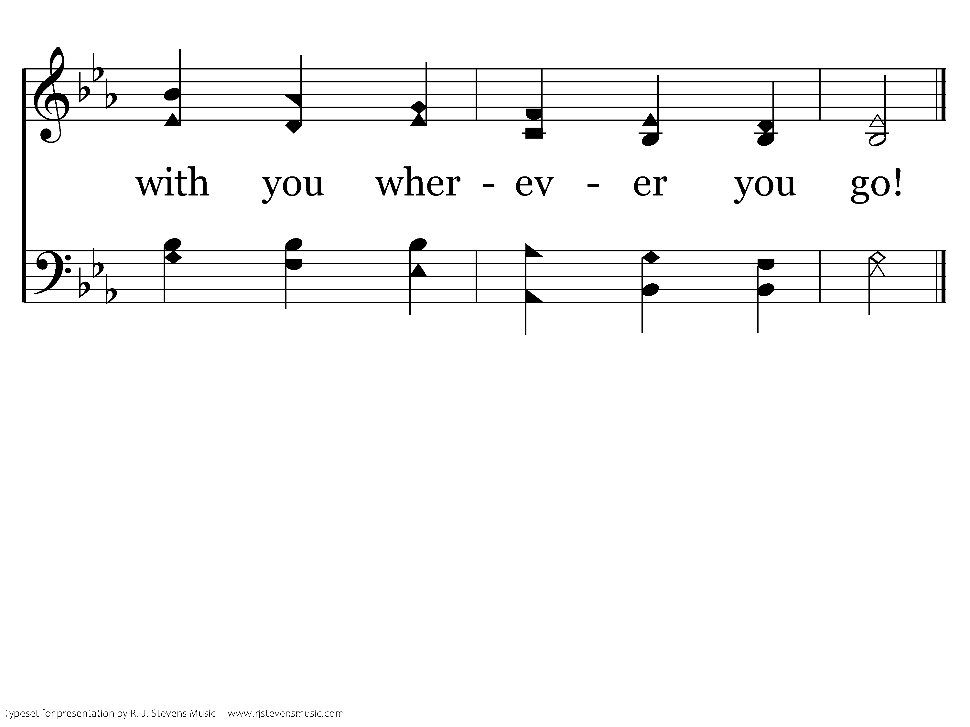
1022 - Be Strong And Courageous - C.2
End of Verse 1

Slide 49
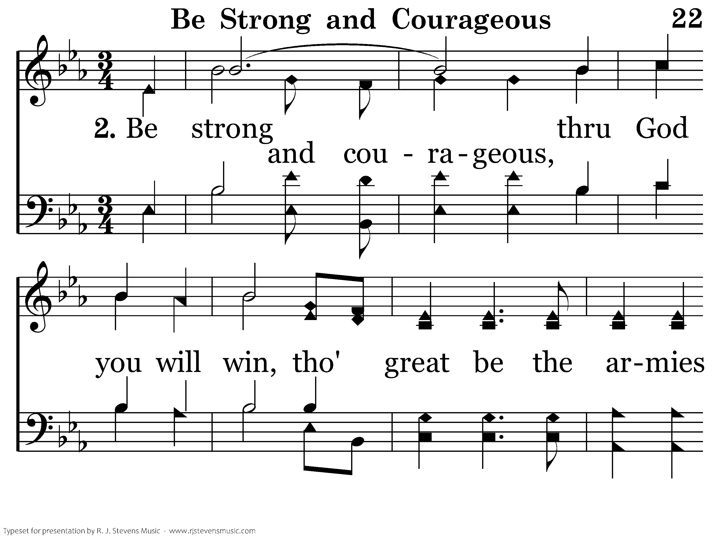
1022 - Be Strong And Courageous - 2.1

Slide 50
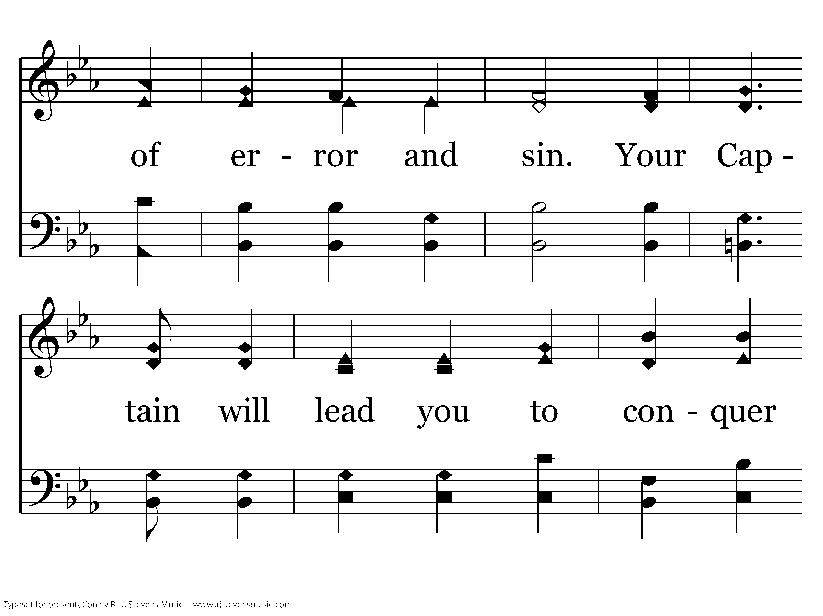
1022 - Be Strong And Courageous - 2.2

Slide 51
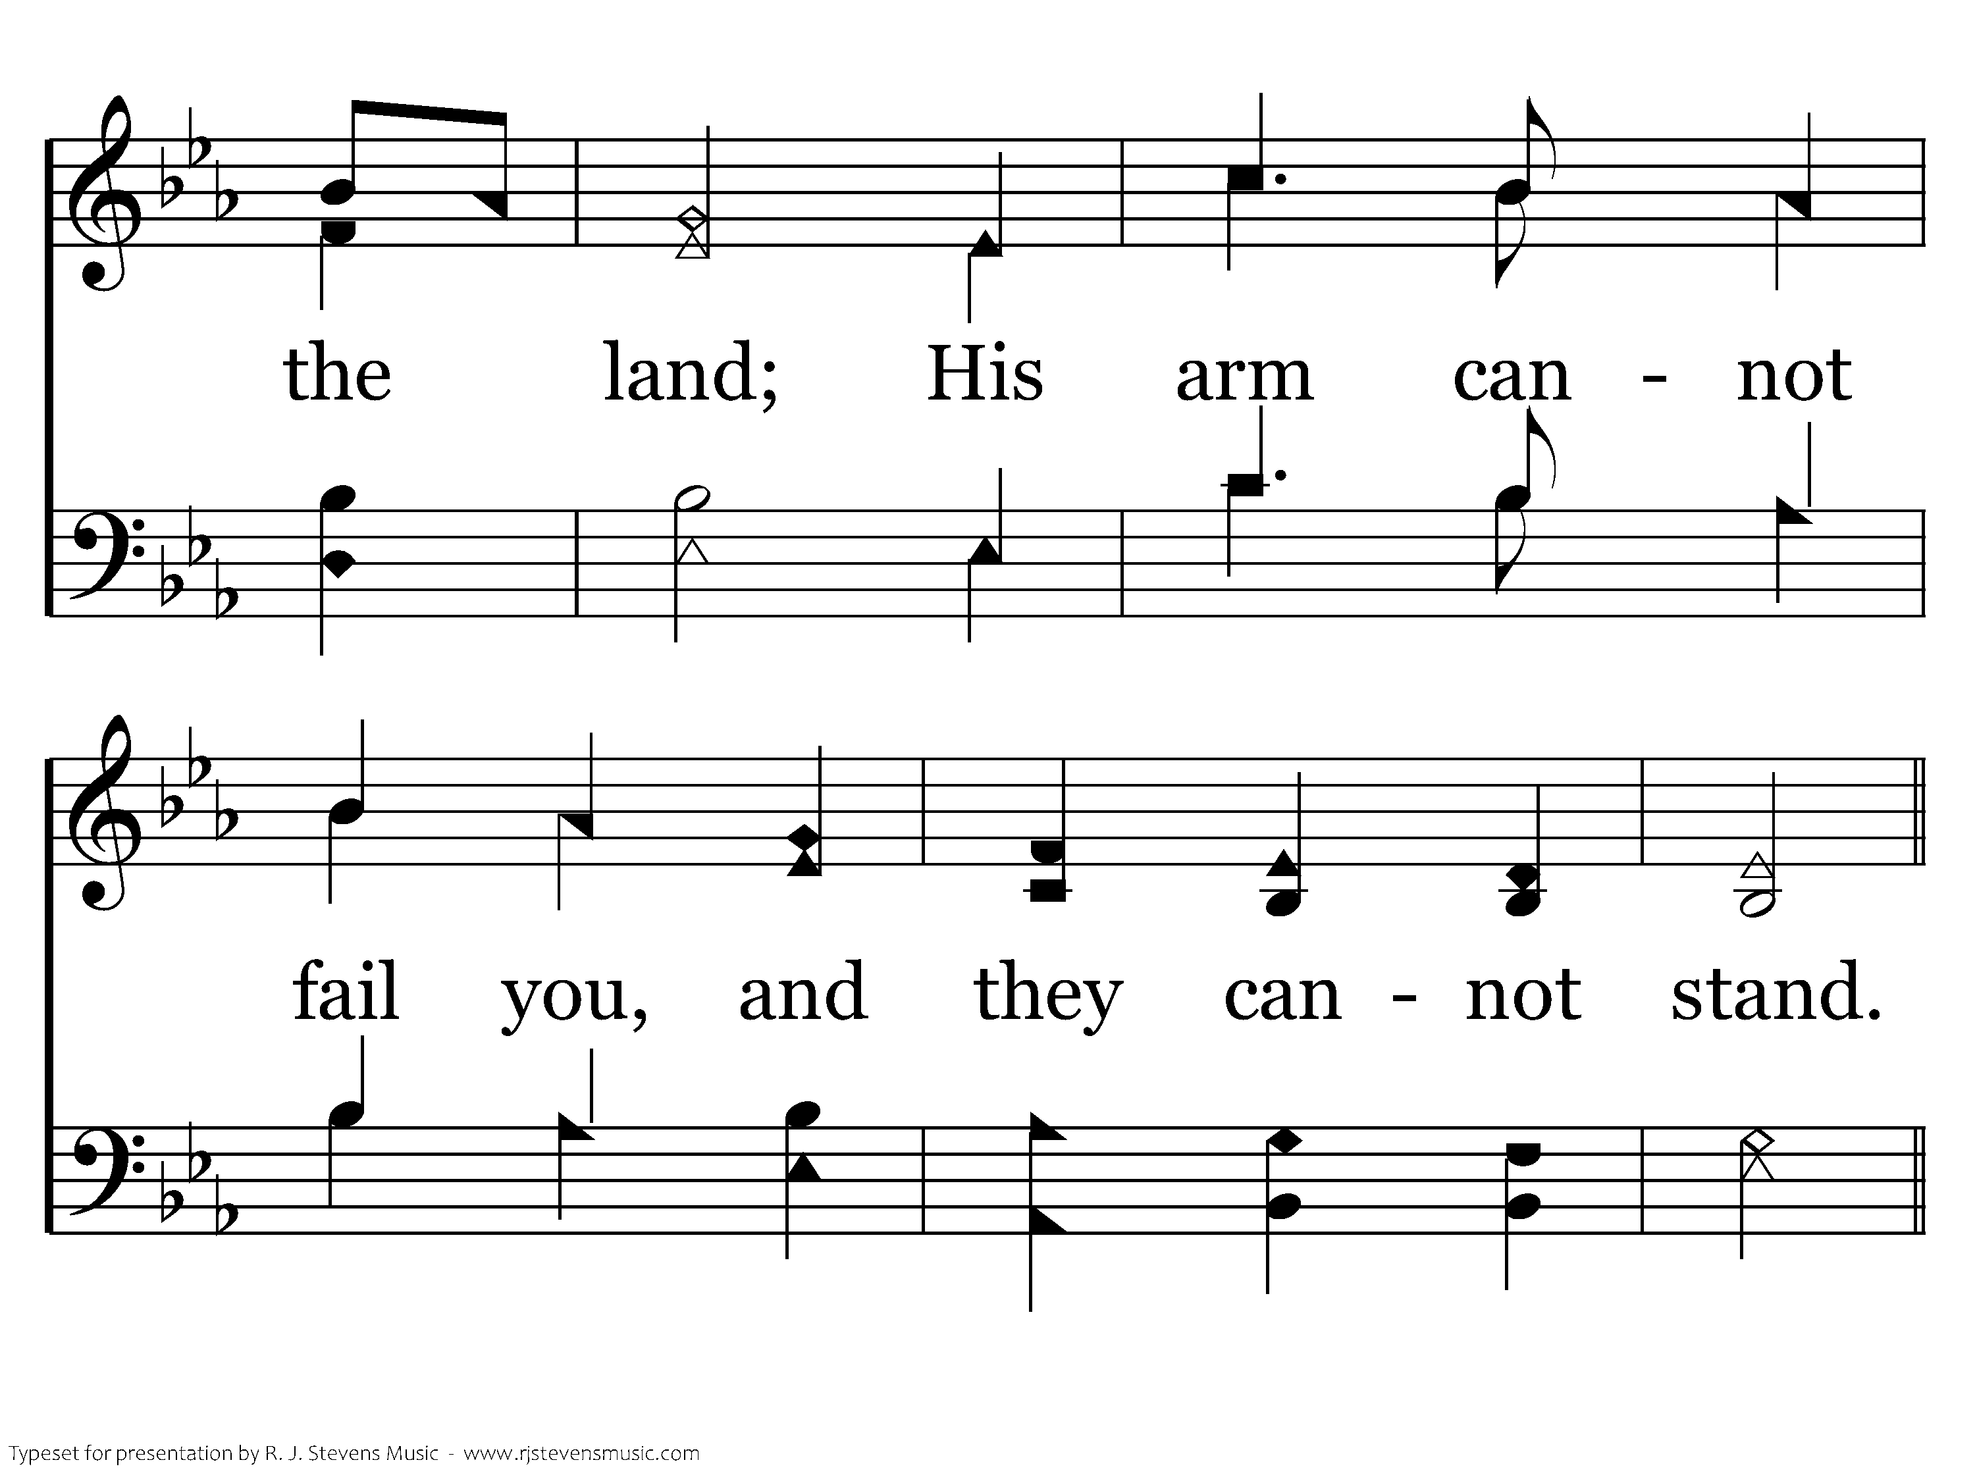
1022 - Be Strong And Courageous - 2.3

Slide 52
1022 - Be Strong And Courageous - C.1

Slide 53
1022 - Be Strong And Courageous - C.2
End of Verse 2

Slide 54
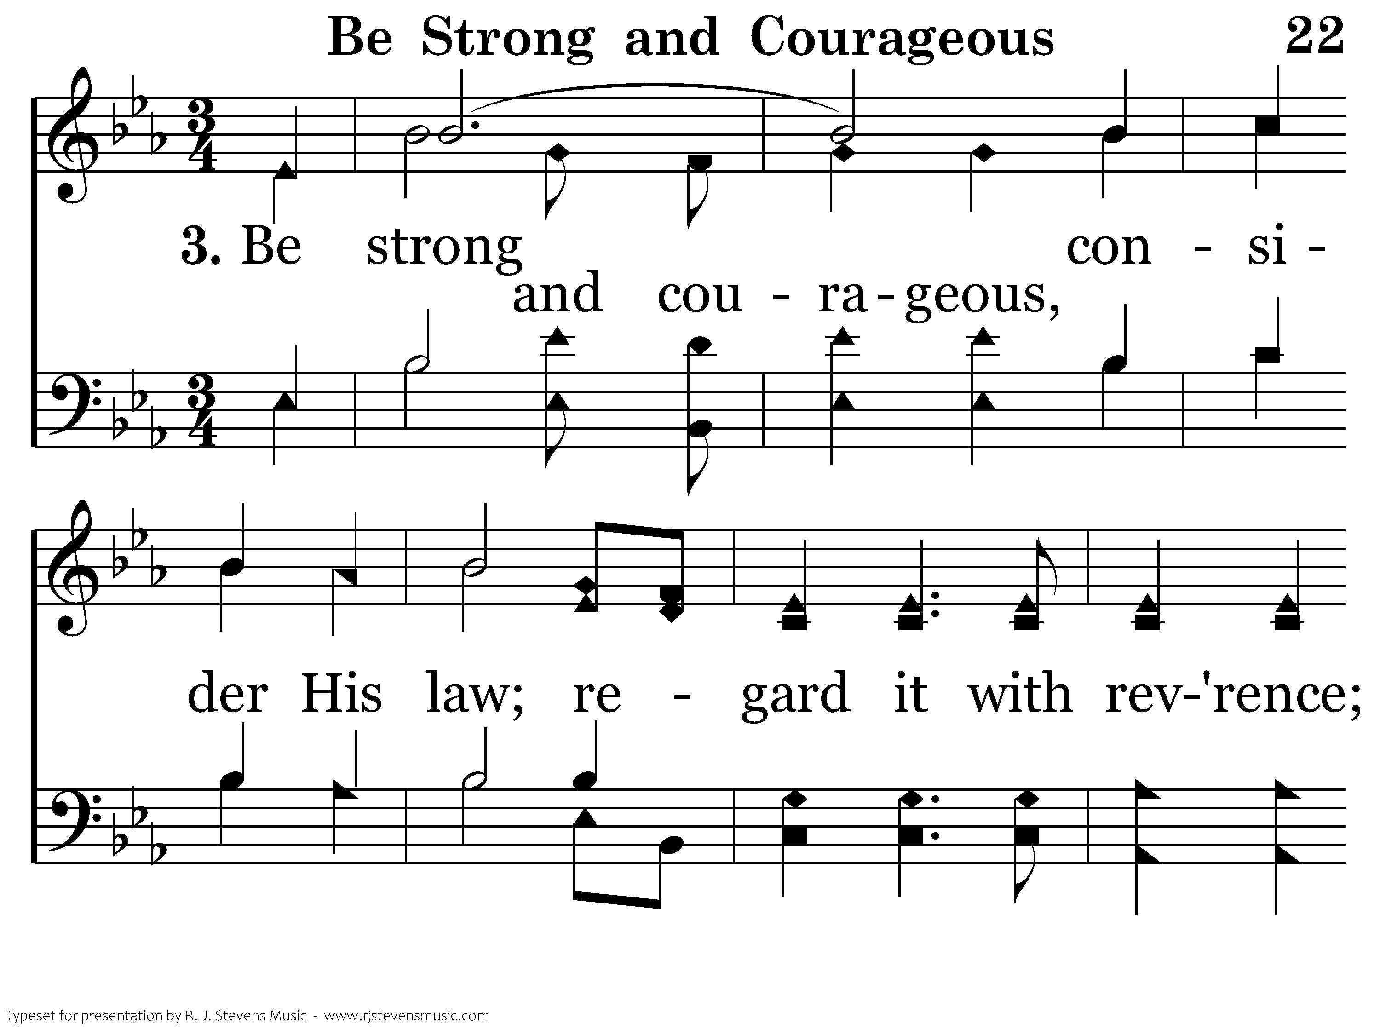
1022 - Be Strong And Courageous - 3.1

Slide 55
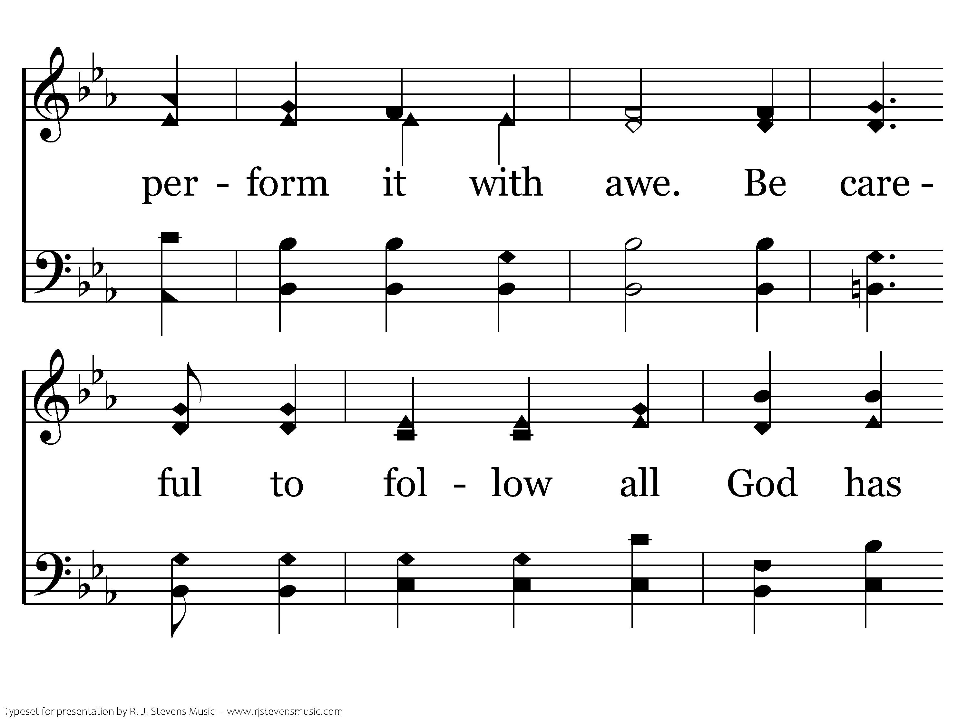
1022 - Be Strong And Courageous - 3.2

Slide 56
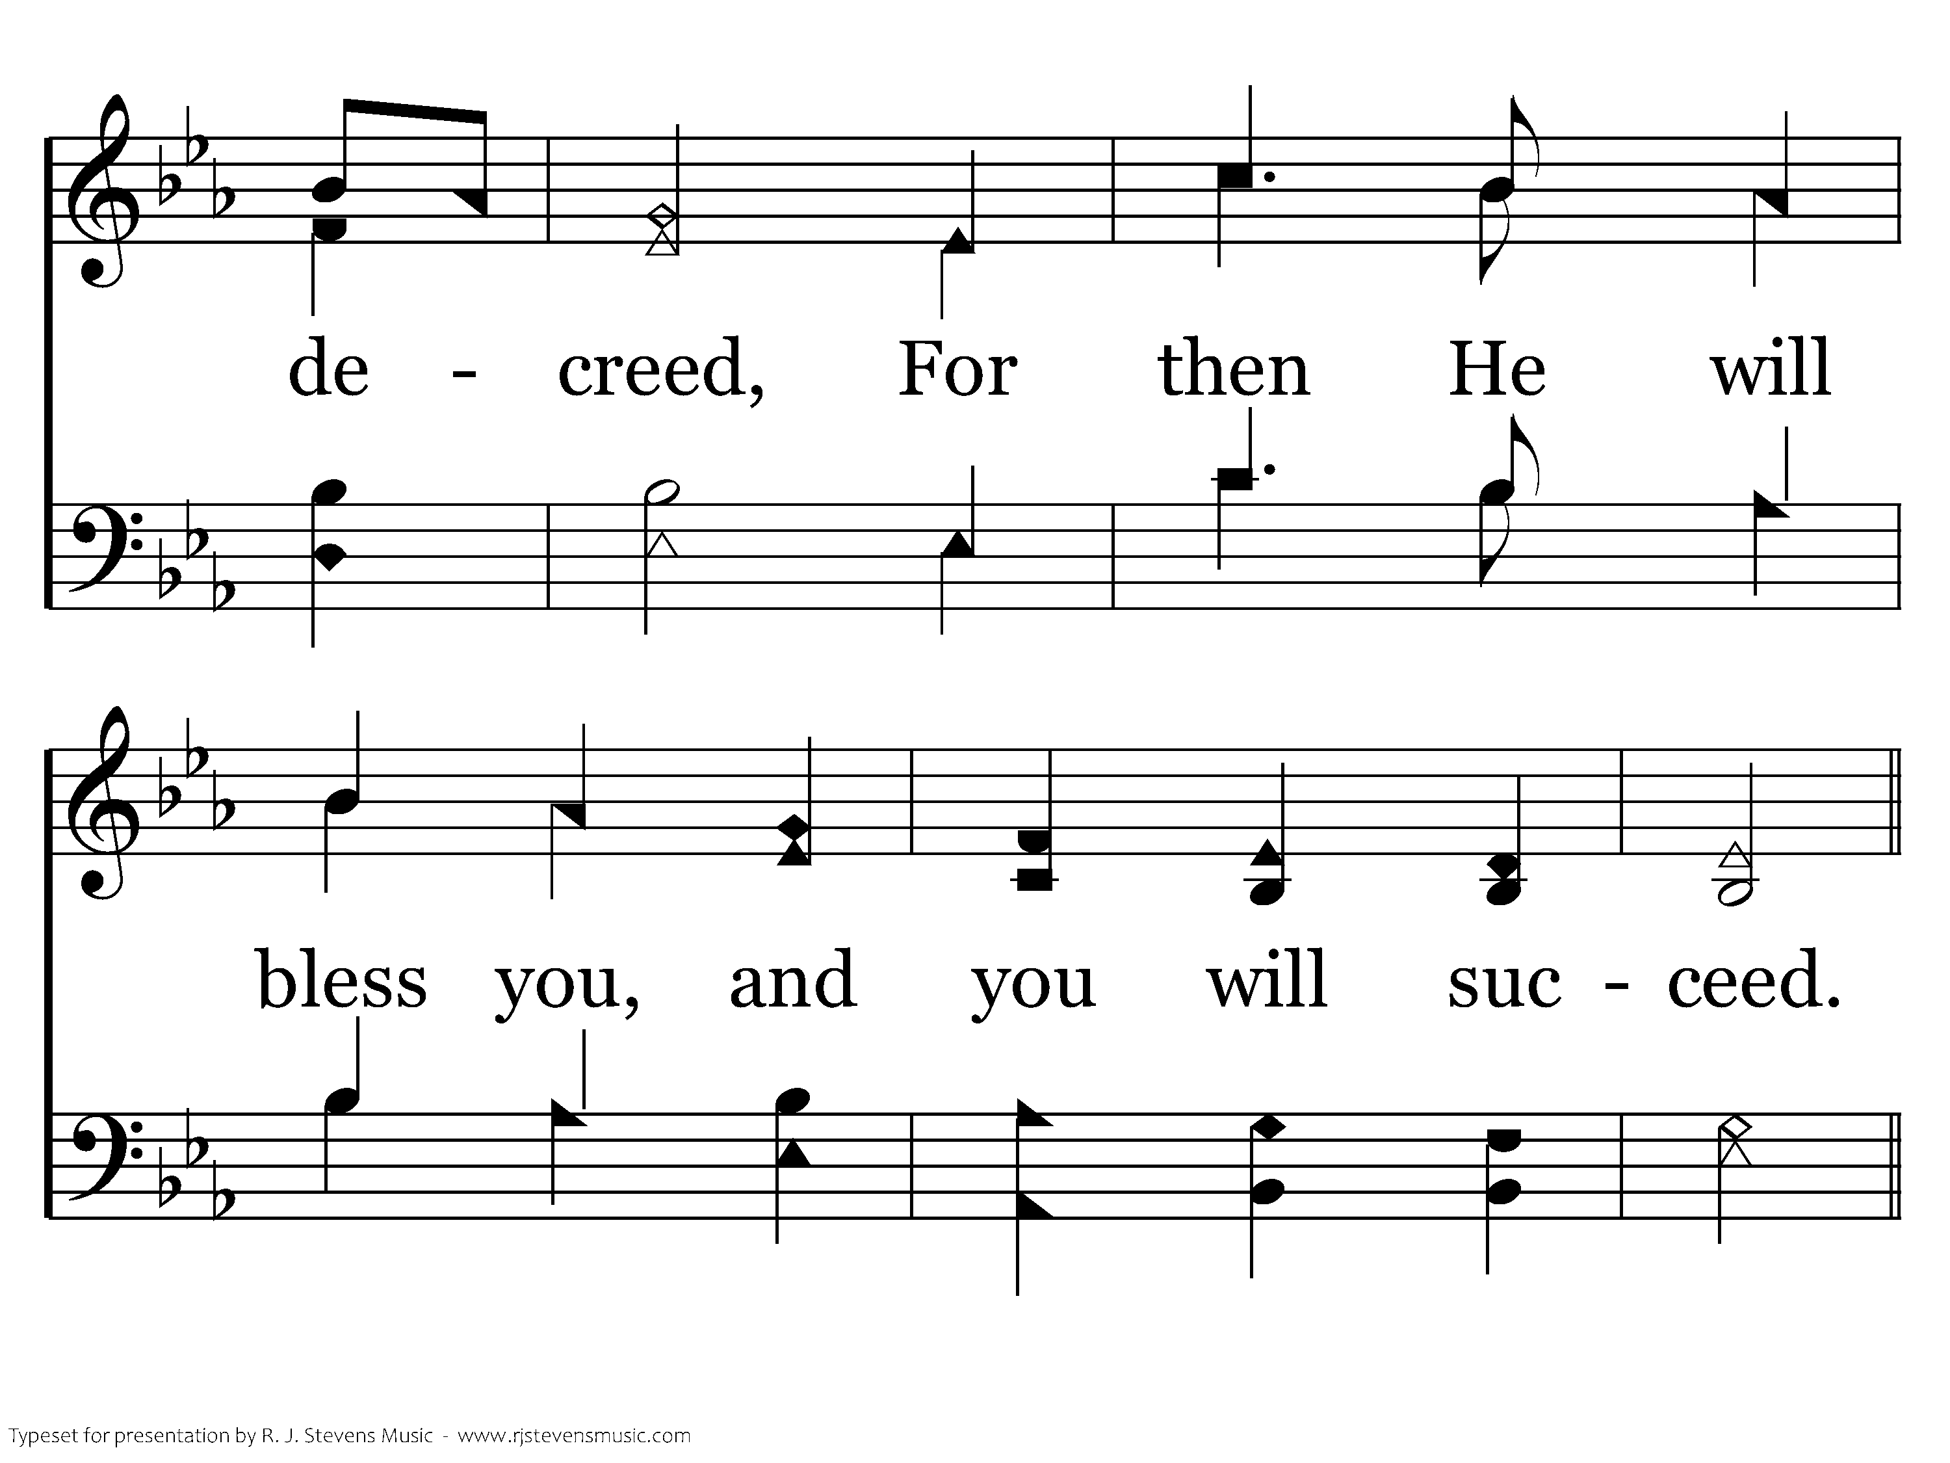
1022 - Be Strong And Courageous - 3.3

Slide 57
1022 - Be Strong And Courageous - C.1

Slide 58
1022 - Be Strong And Courageous - C.2

Slide 59
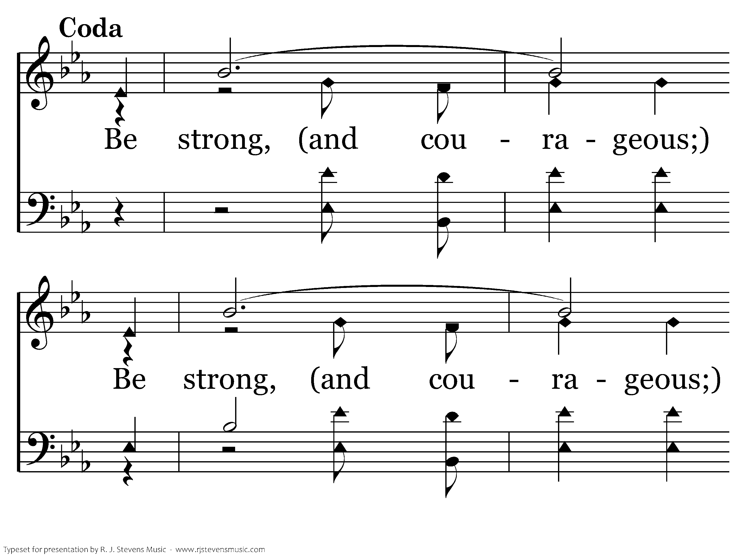
1022 - Be Strong And Courageous - D.1

Slide 60
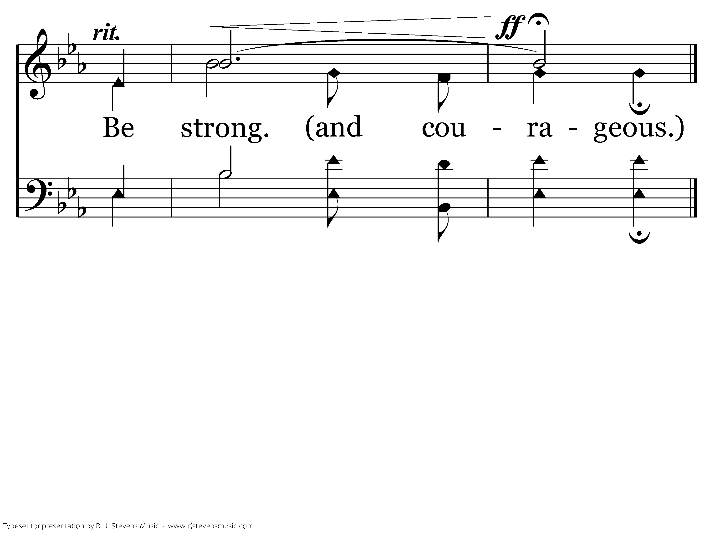
1022 - Be Strong And Courageous - D.2
End of Song

Slide 62
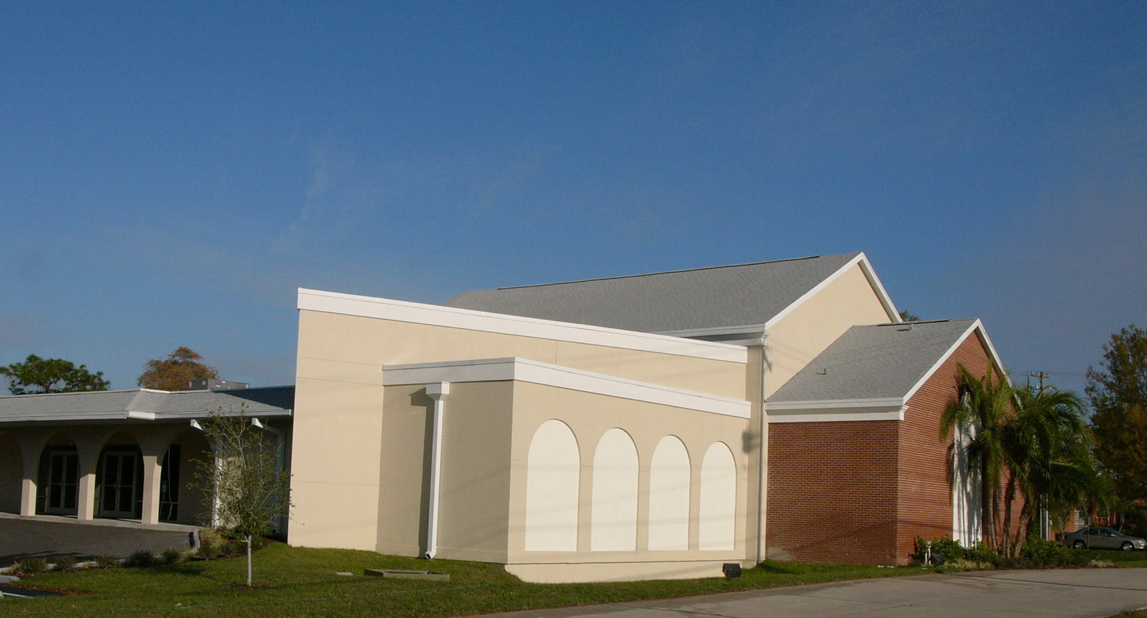
LOVE
HAPPENS
HERE

Slide 63
GOD’S LOVE
HAPPENS
HERE
¹⁸ may be able to comprehend with all the saints what is the breadth and length and height and depth, ¹⁹ and to know the love of Christ which surpasses knowledge, that you may be filled up to all the fullness of God.
Ephesians 3:18–19 (NASB95)

Slide 64
OUR LOVE
HAPPENS
HERE
¹⁸ may be able to comprehend with all the saints what is the breadth and length and height and depth, ¹⁹ and to know the love of Christ which surpasses knowledge, that you may be filled up to all the fullness of God.
Ephesians 3:18–19 (NASB95)

Slide 65
OUR LOVE
HAPPENS
HERE
Our love should be broad enough toward “outsiders” that we refrain from judging (Matthew 7.1-5)

Slide 66
OUR LOVE
HAPPENS
HERE
“The command to judge not is not a requirement to be blind, but rather a plea to be generous. Jesus does not tell us to cease to be men… but to renounce the presumptuous ambition to be God.” (John Stott)

Slide 67
OUR LOVE
HAPPENS
HERE
Our love should be broad enough toward “outsiders” that we refrain from judging (Matthew 7.1-5)
Our love should be broad enough that it would encompass those who have wronged us (Matthew 18.15)

Slide 68
OUR LOVE
HAPPENS
HERE
¹⁸ may be able to comprehend with all the saints what is the breadth and length and height and depth, ¹⁹ and to know the love of Christ which surpasses knowledge, that you may be filled up to all the fullness of God.
Ephesians 3:18–19 (NASB95)

Slide 69
OUR LOVE
HAPPENS
HERE
Our love must be long enough to reach brethren who are like us… and those who aren’t (James 2.1-7; Romans 14)
Our love needs to be long enough to reach the community around us (John 4)

Slide 70
LOVE
HAPPENS
HERE

Slide 72
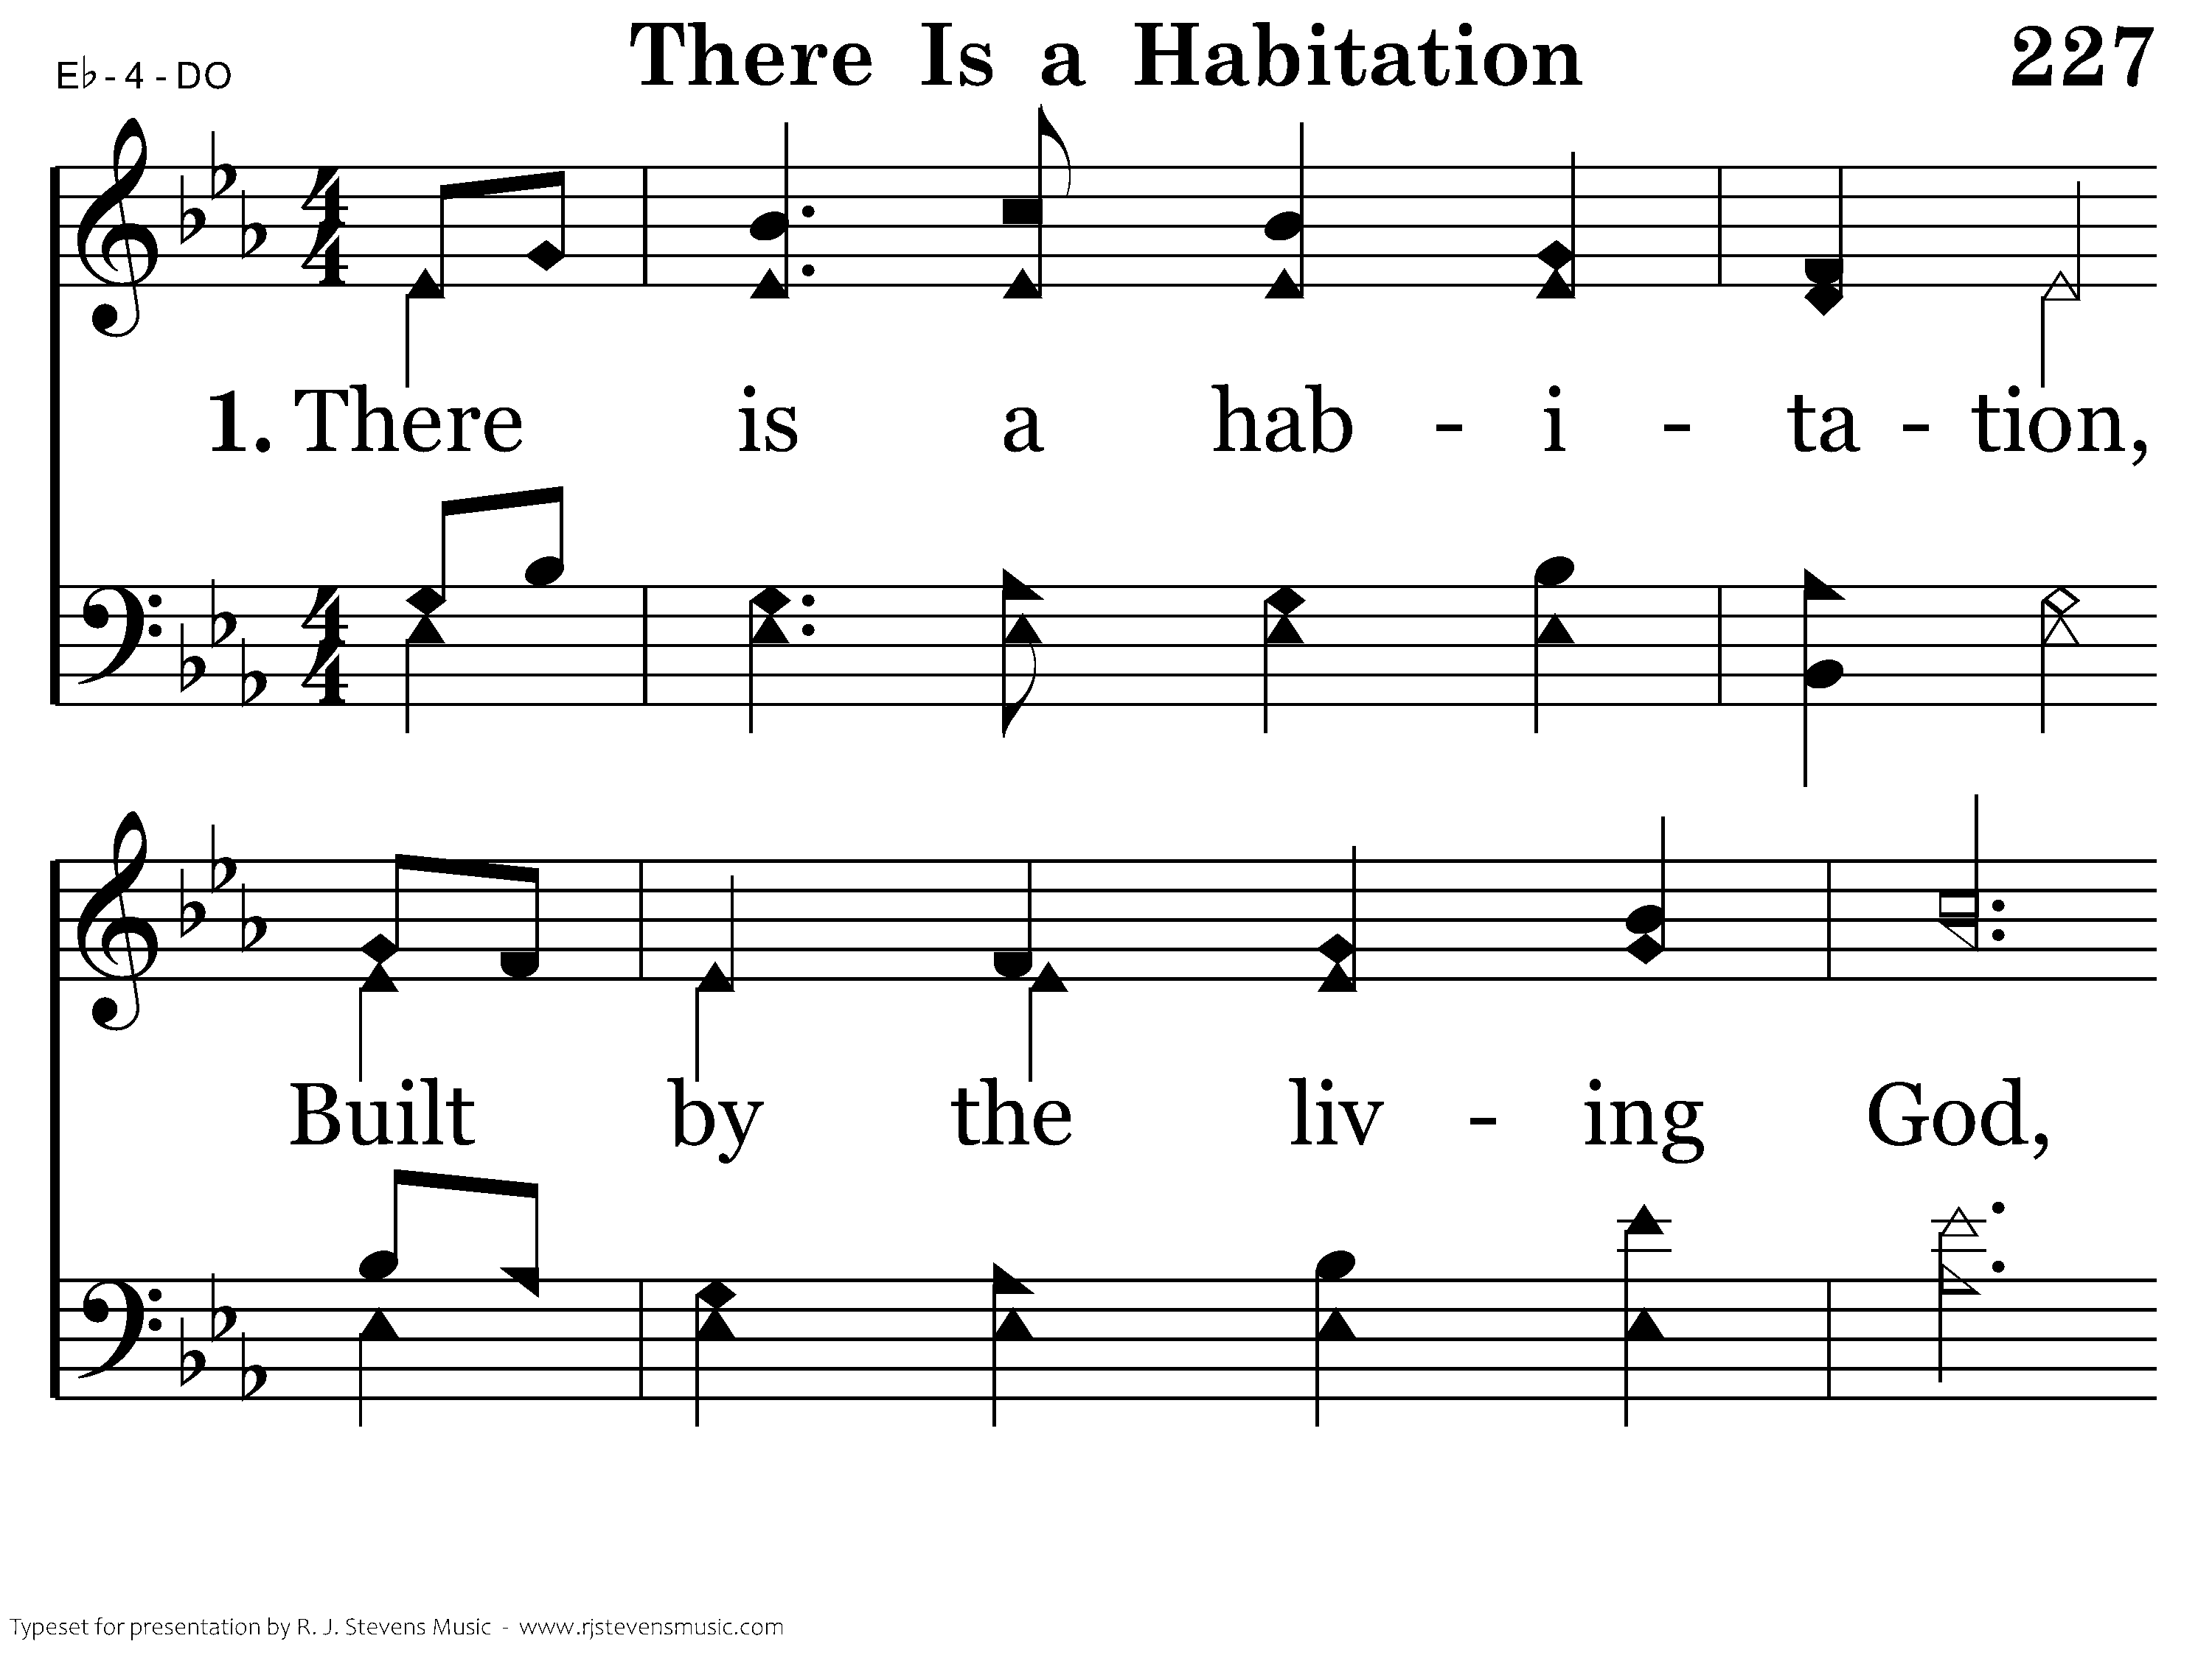
227 - There Is A Habitation - 1.1

Slide 73
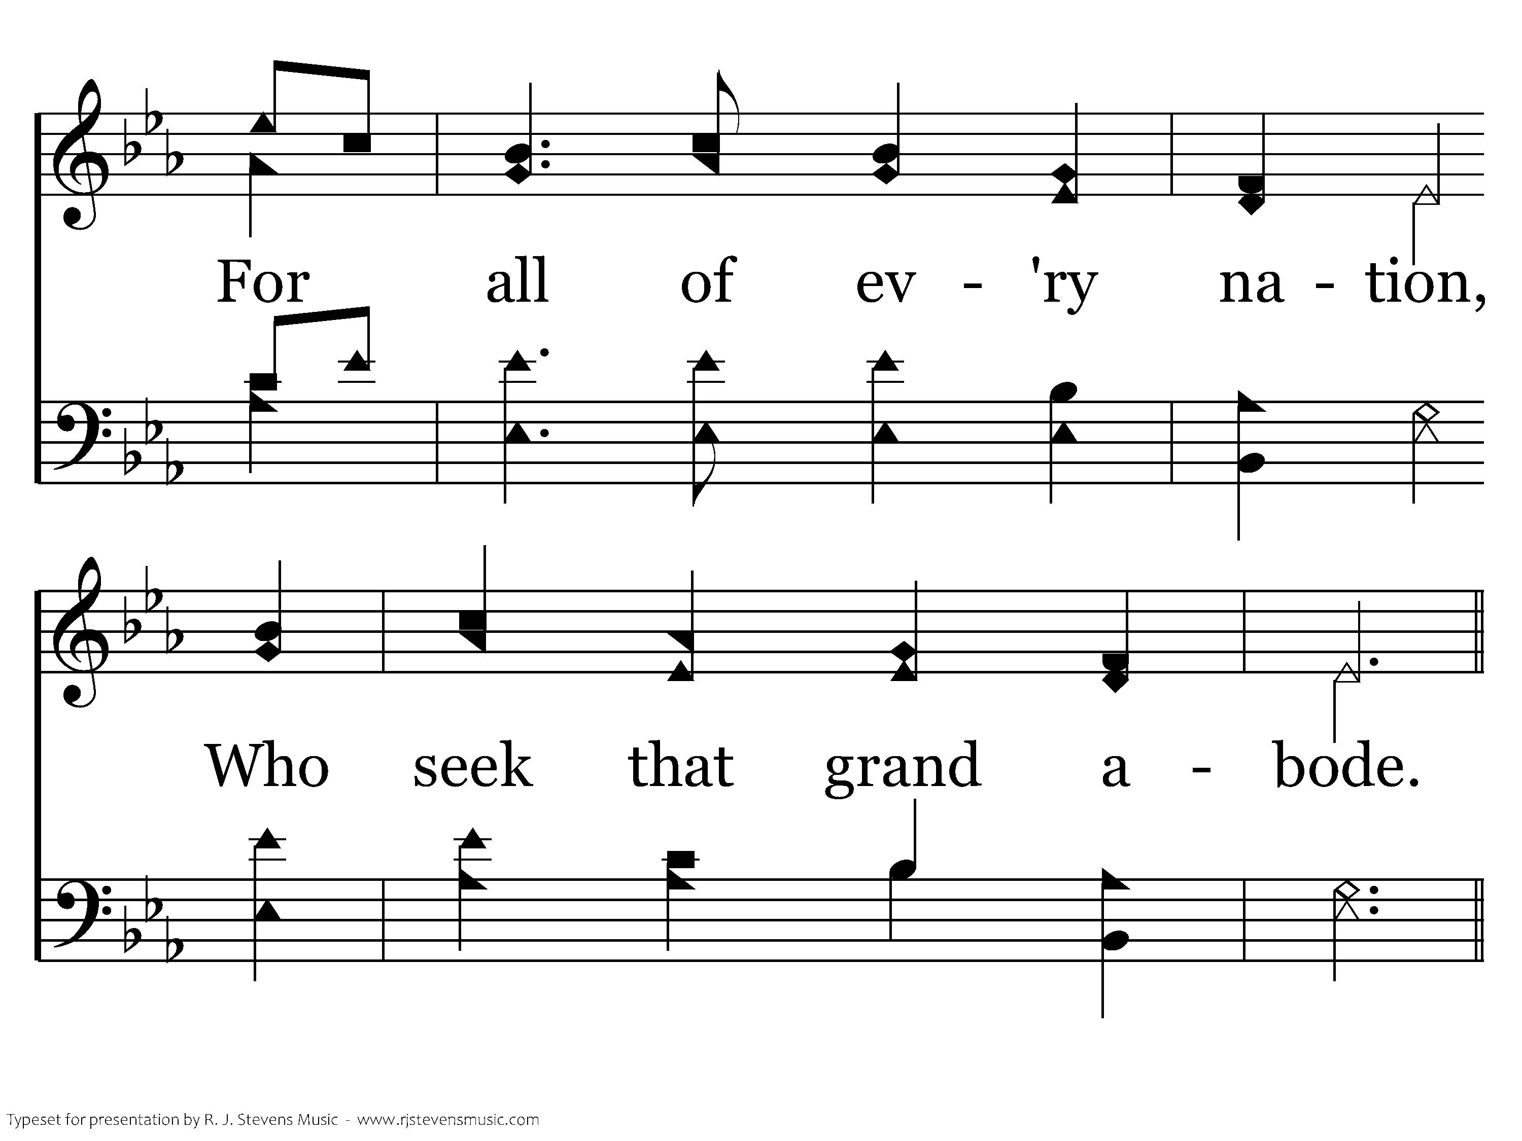
227 - There Is A Habitation - 1.2

Slide 74
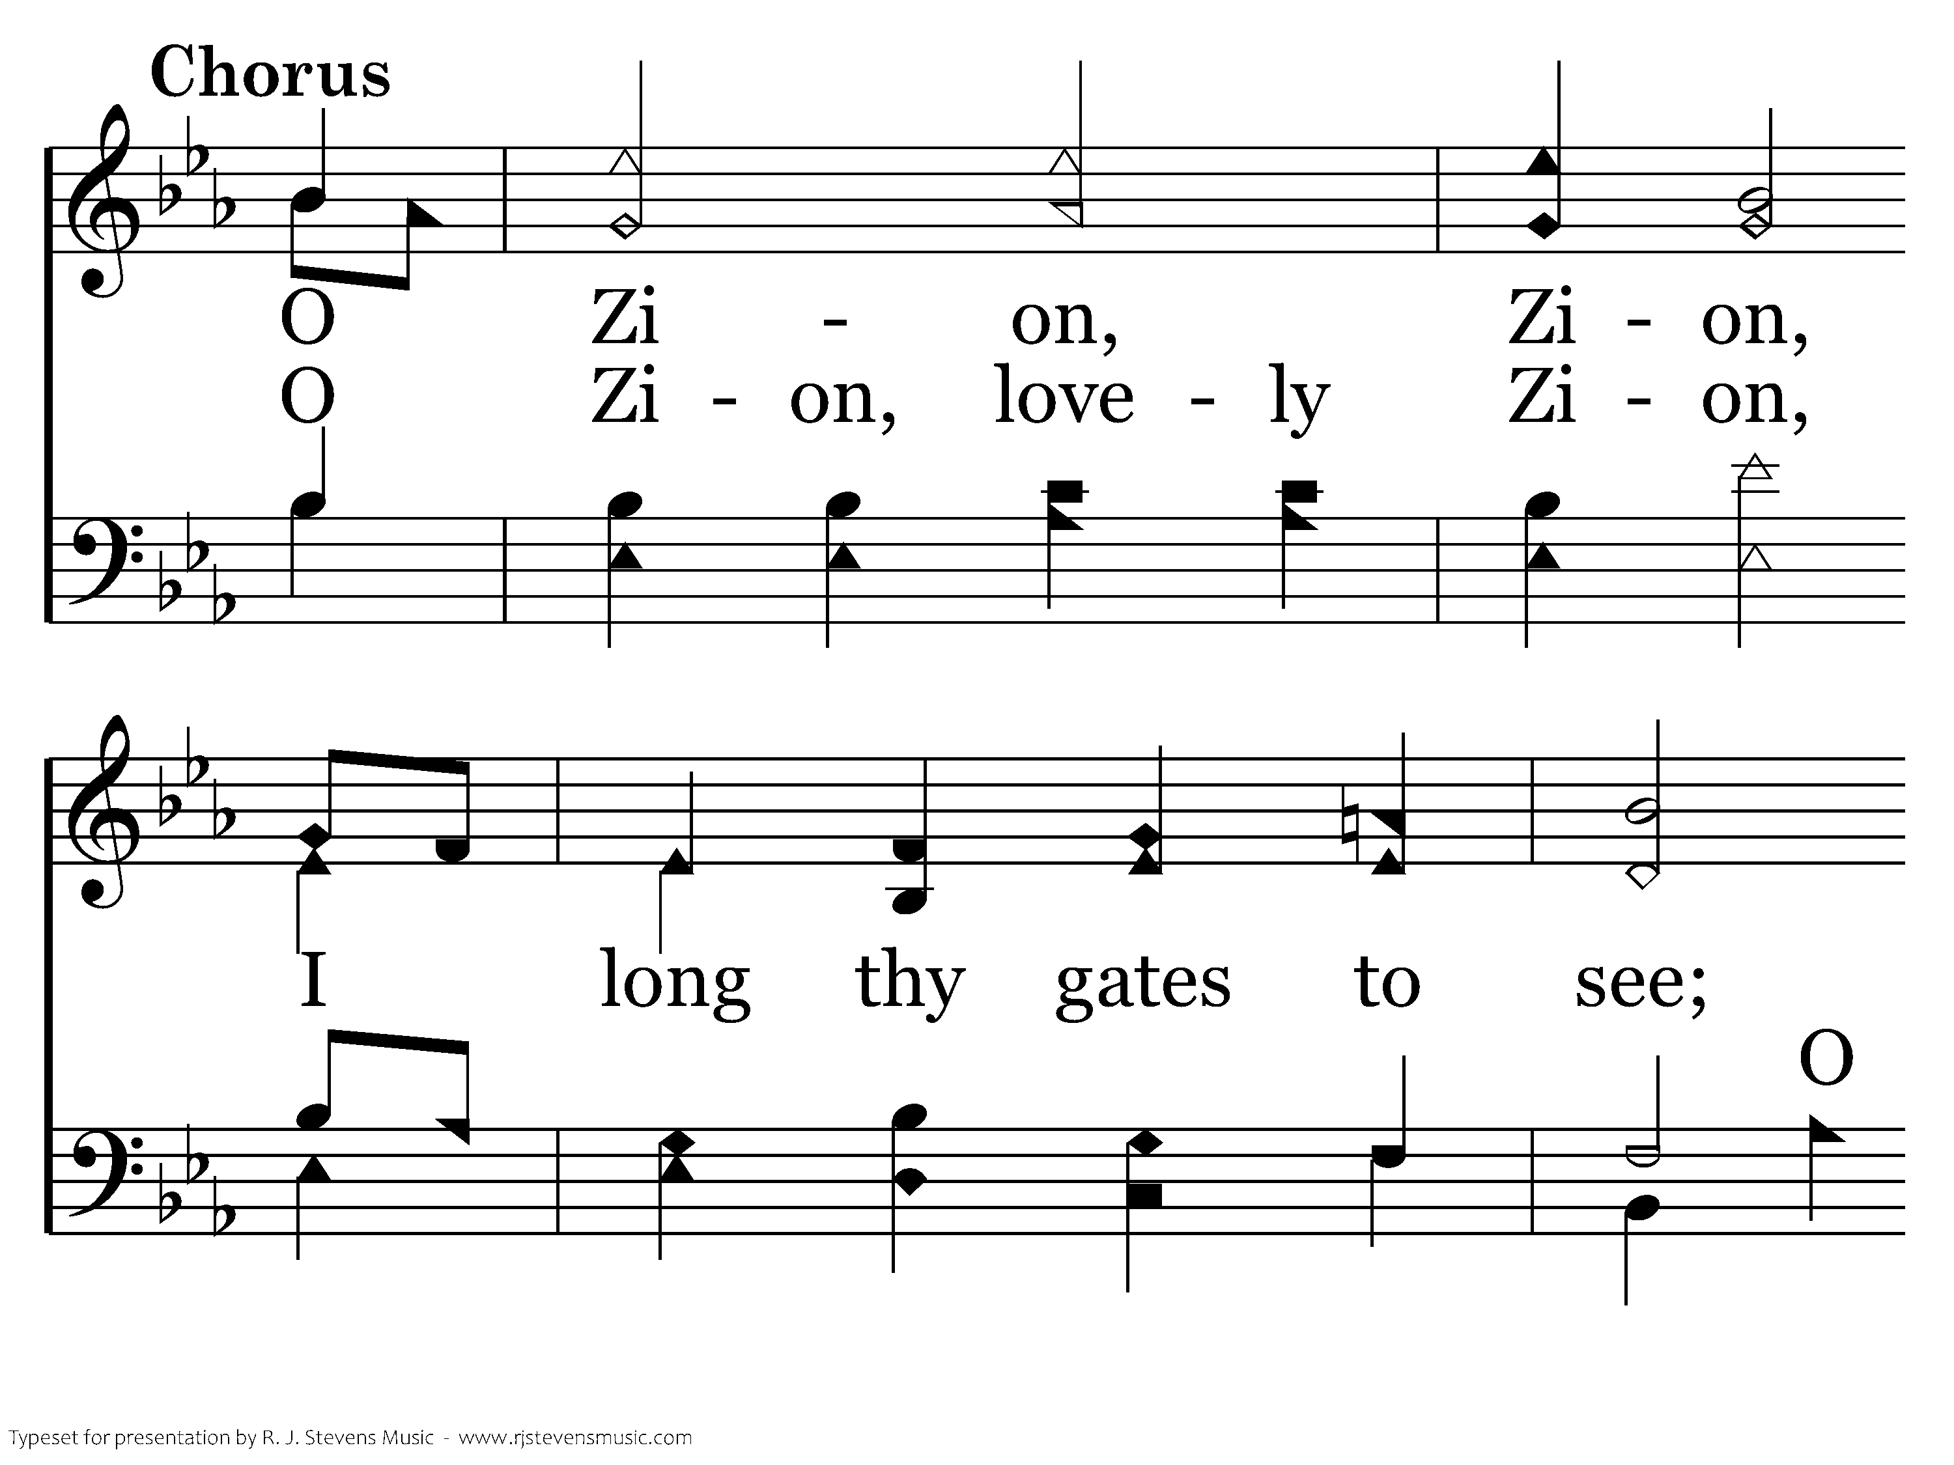
227 - There Is A Habitation - C.1

Slide 75
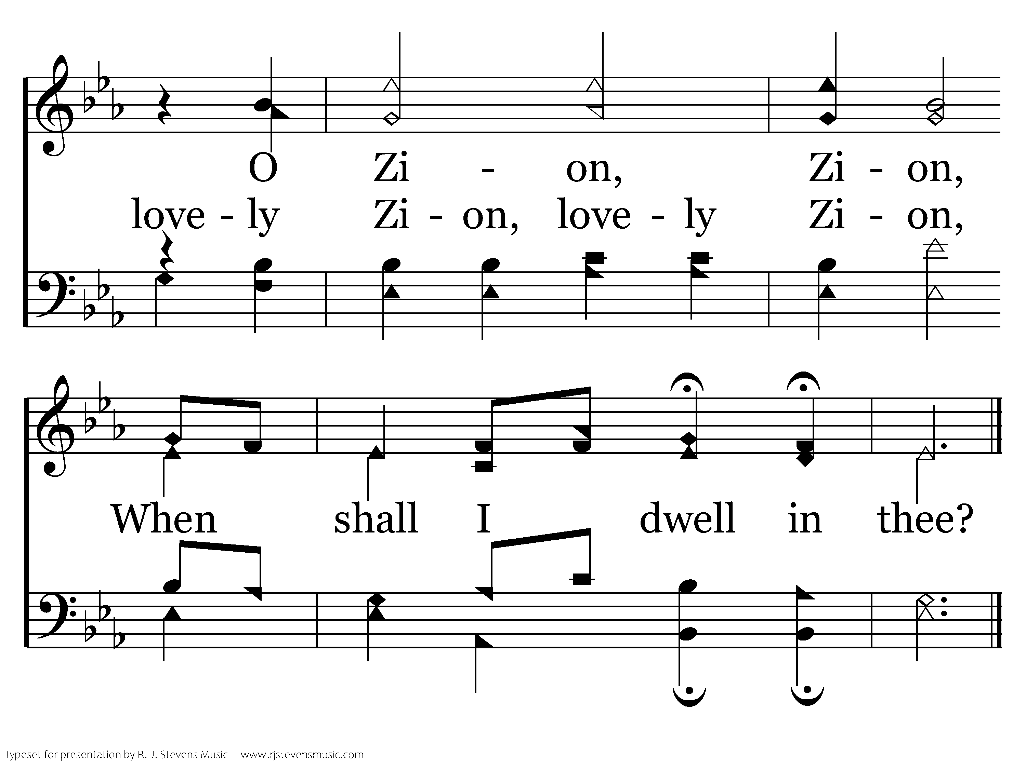
227 - There Is A Habitation - C.2
End of Verse 1

Slide 76
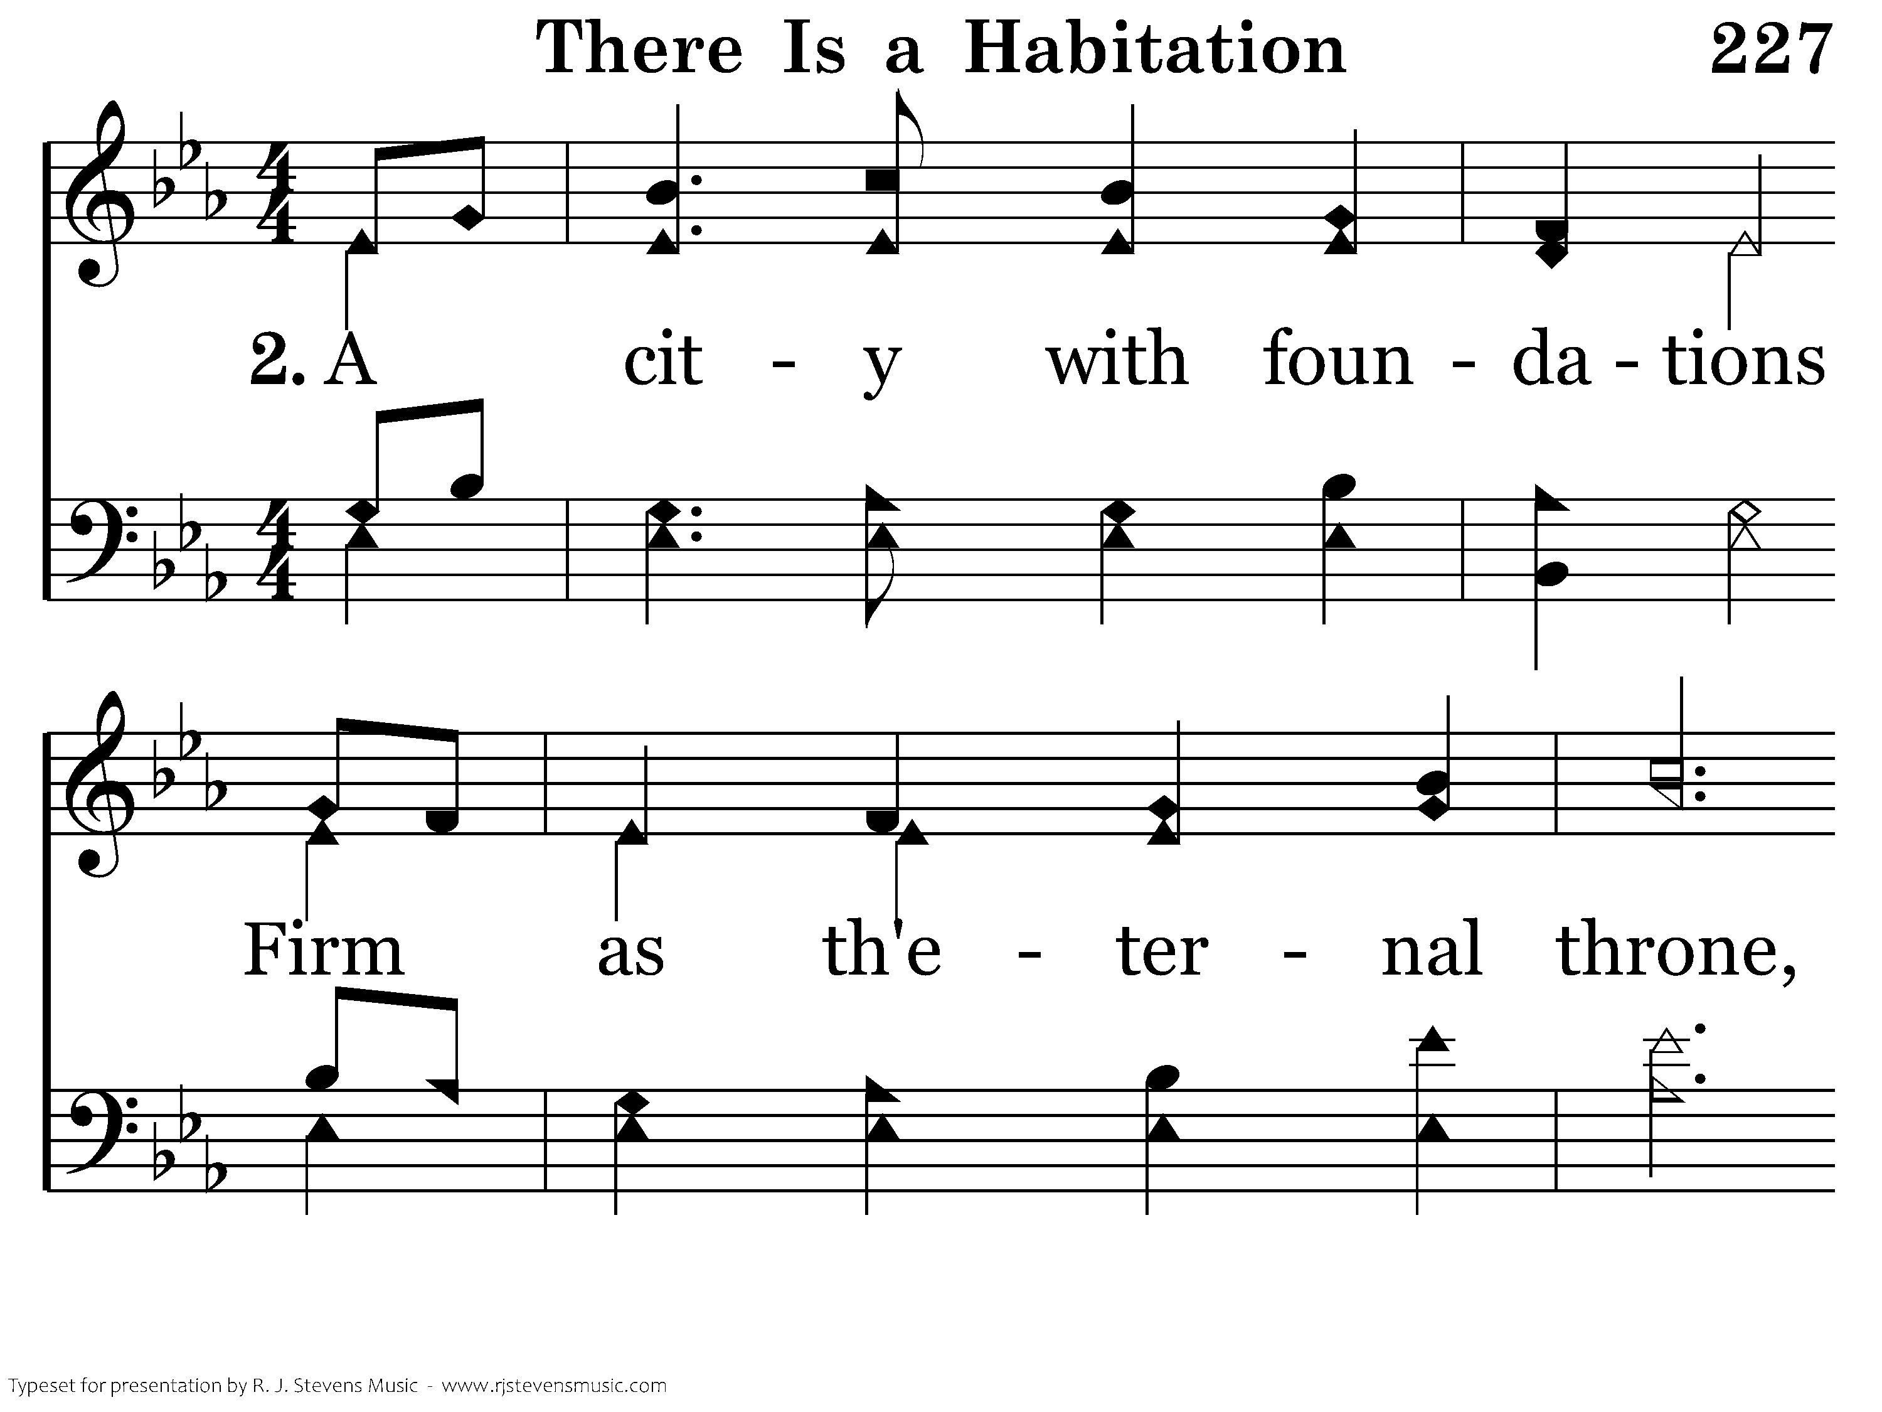
227 - There Is A Habitation - 2.1

Slide 77
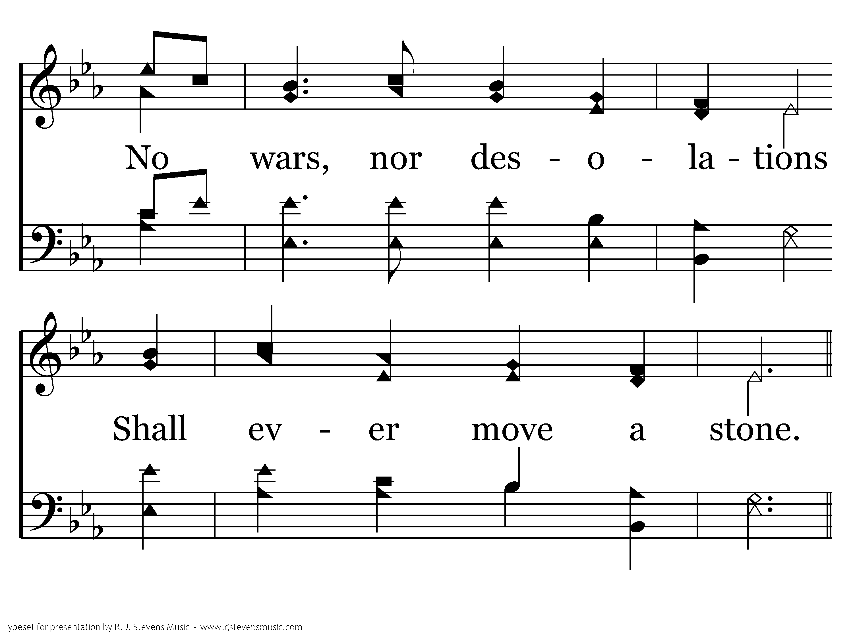
227 - There Is A Habitation - 2.2

Slide 78
227 - There Is A Habitation - C.1

Slide 79
227 - There Is A Habitation - C.2
End of Verse 2

Slide 80
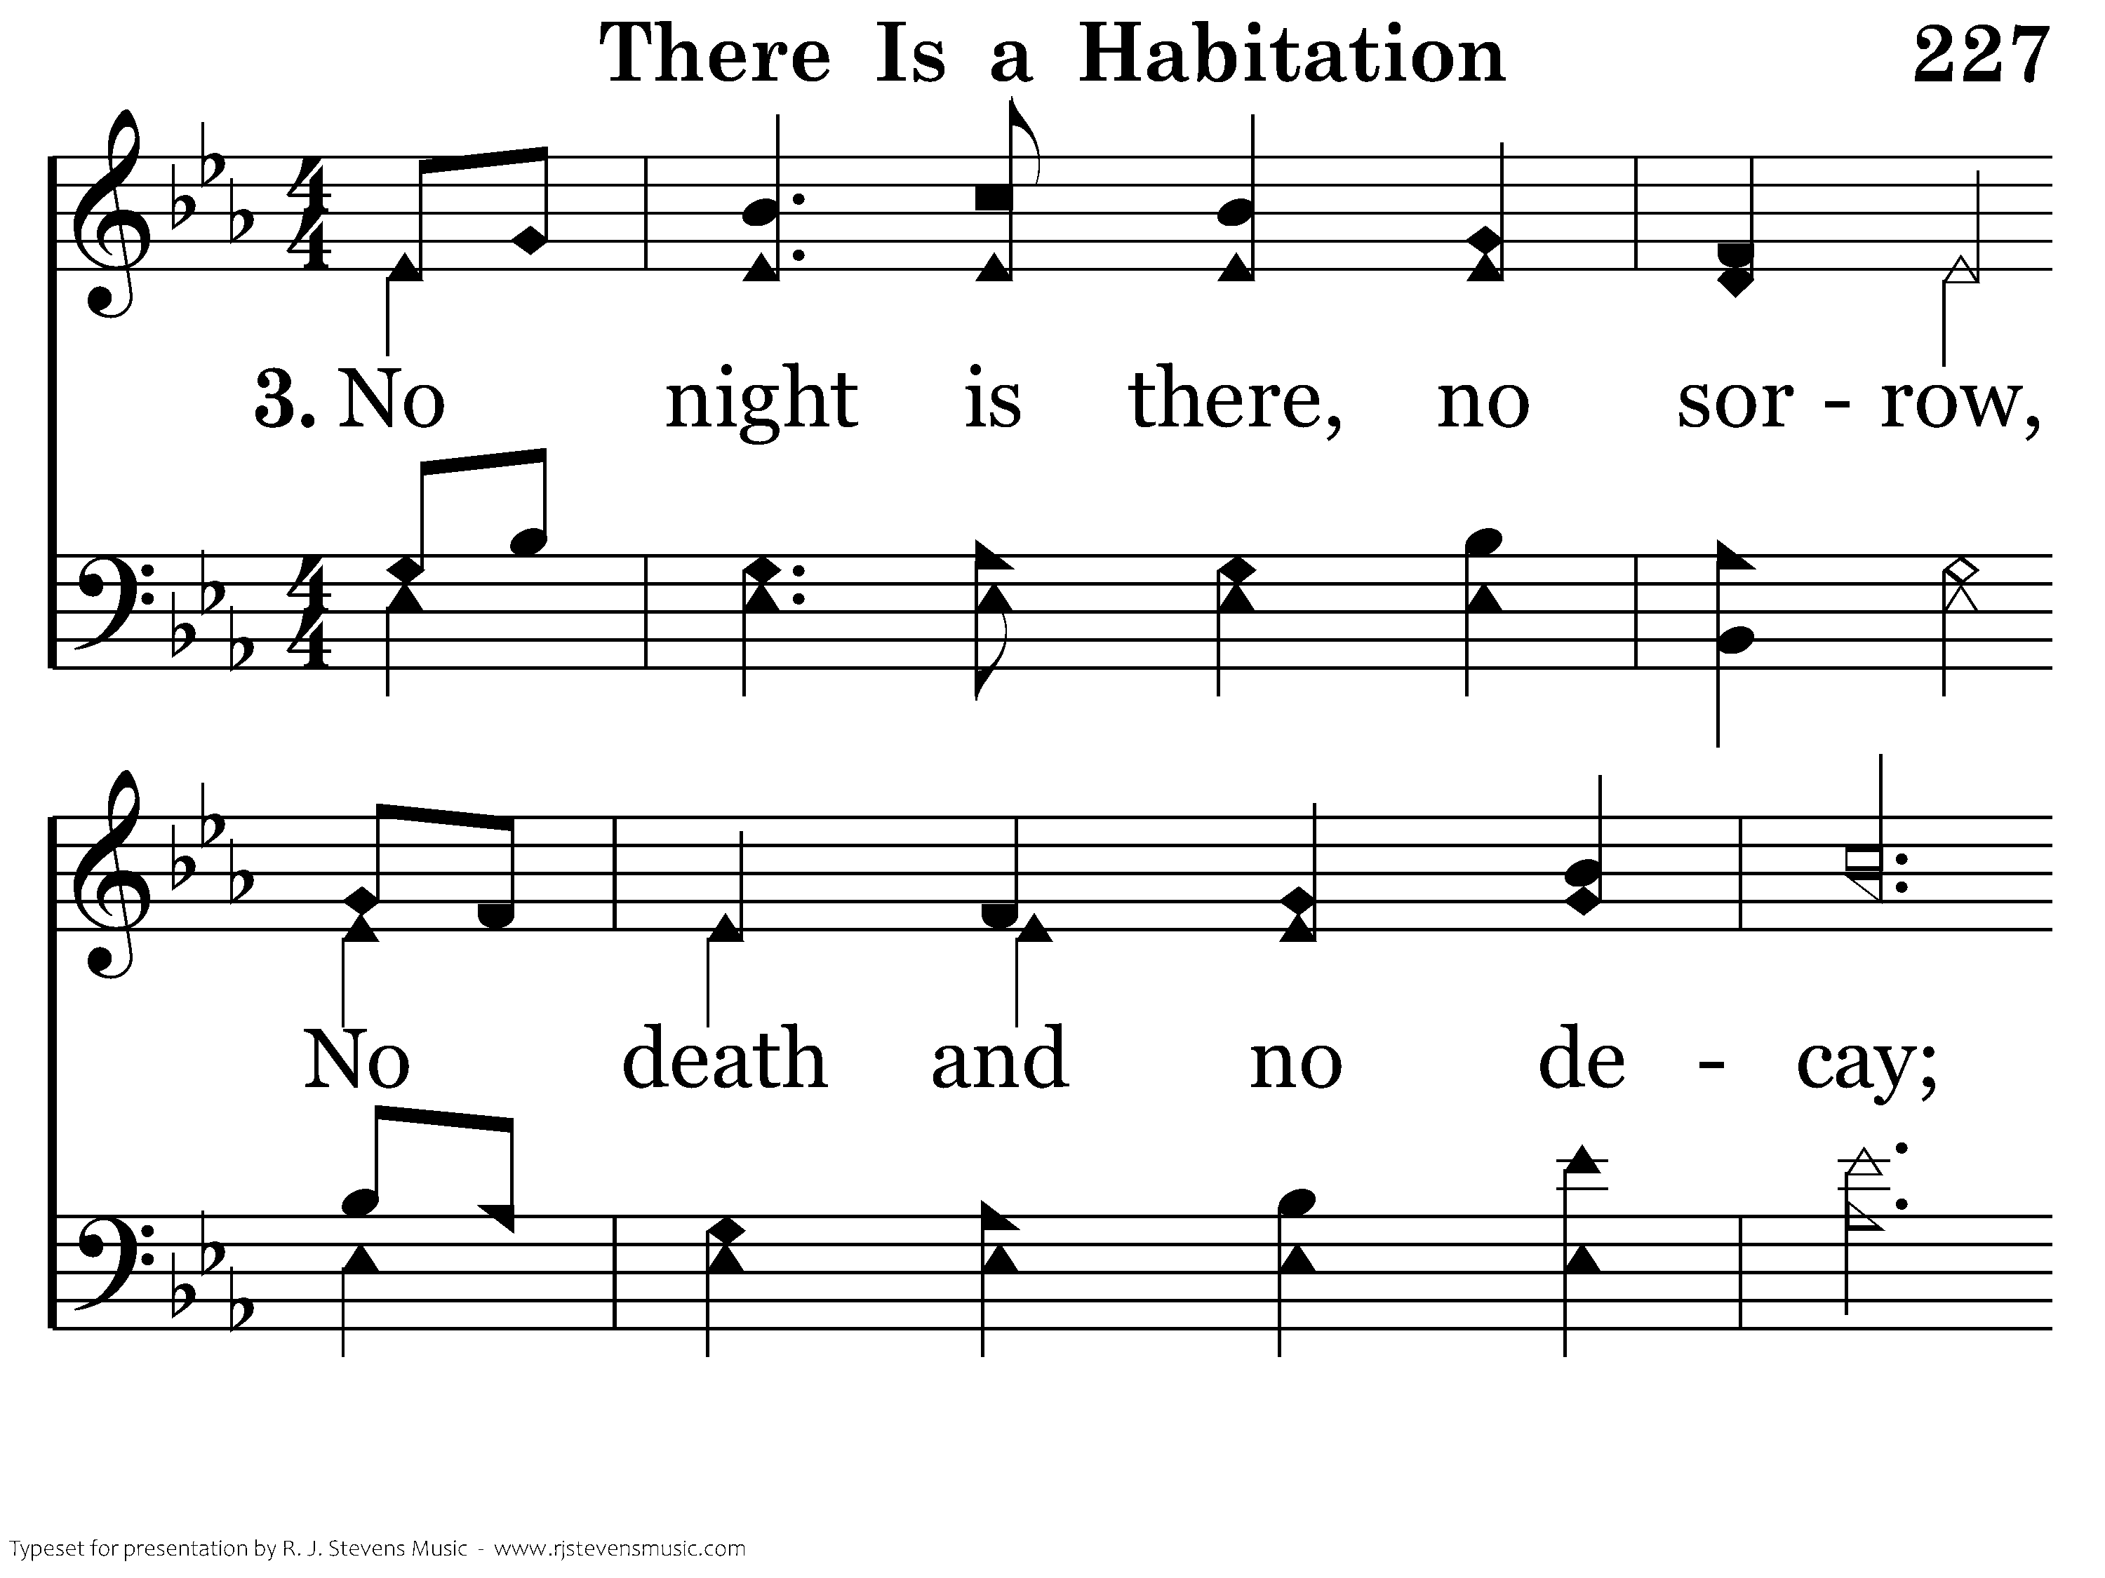
227 - There Is A Habitation - 3.1

Slide 81

227 - There Is A Habitation - 3.2

Slide 82
227 - There Is A Habitation - C.1

Slide 83
227 - There Is A Habitation - C.2
End of Verse 3

Slide 84

227 - There Is A Habitation - 4.1

Slide 85

227 - There Is A Habitation - 4.2

Slide 86
227 - There Is A Habitation - C.1

Slide 87
227 - There Is A Habitation - C.2
End of Song

Slide 89
Closing Prayer
Micah Richeson

