Slide 2
LOVE
HAPPENS
HERE

Slide 3
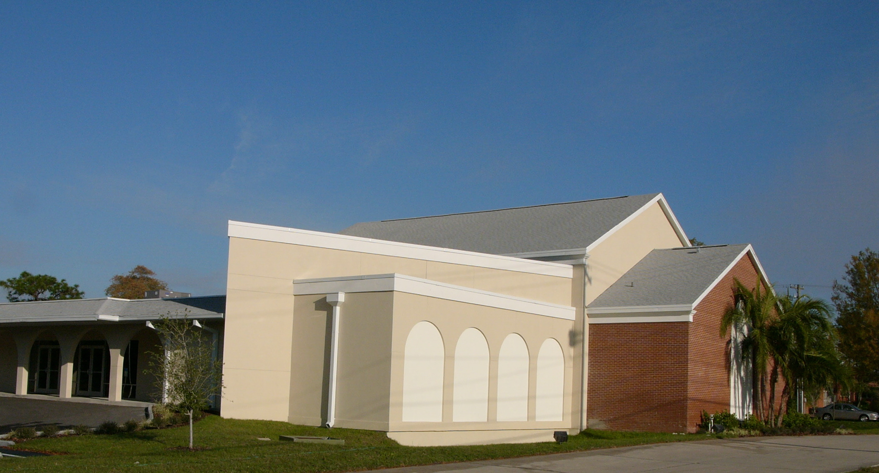
LOVE
HAPPENS
HERE

Slide 4
GOD’S LOVE
HAPPENS
HERE
¹⁸ may be able to comprehend with all the saints what is the breadth and length and height and depth, ¹⁹ and to know the love of Christ which surpasses knowledge, that you may be filled up to all the fullness of God.
Ephesians 3:18–19 (NASB95)

Slide 5
GOD’S LOVE
HAPPENS
HERE
¹⁸ may be able to comprehend with all the saints what is the breadth and length and height and depth, ¹⁹ and to know the love of Christ which surpasses knowledge, that you may be filled up to all the fullness of God.
Ephesians 3:18–19 (NASB95)

Slide 6
GOD’S LOVE
HAPPENS
HERE
¹⁸ may be able to comprehend with all the saints what is the breadth and length and height and depth, ¹⁹ and to know the love of Christ which surpasses knowledge, that you may be filled up to all the fullness of God.
Ephesians 3:18–19 (NASB95)

Slide 7
GOD’S LOVE
HAPPENS
HERE
¹⁸ may be able to comprehend with all the saints what is the breadth and length and height and depth, ¹⁹ and to know the love of Christ which surpasses knowledge, that you may be filled up to all the fullness of God.
Ephesians 3:18–19 (NASB95)

Slide 8
GOD’S LOVE
HAPPENS
HERE
¹⁸ may be able to comprehend with all the saints what is the breadth and length and height and depth, ¹⁹ and to know the love of Christ which surpasses knowledge, that you may be filled up to all the fullness of God.
Ephesians 3:18–19 (NASB95)

Slide 9
GOD’S LOVE
HAPPENS
HERE
¹⁸ may be able to comprehend with all the saints what is the breadth and length and height and depth, ¹⁹ and to know the love of Christ which surpasses knowledge, that you may be filled up to all the fullness of God.
Ephesians 3:18–19 (NASB95)

Slide 10
LOVE
HAPPENS
HERE

