Slide 4
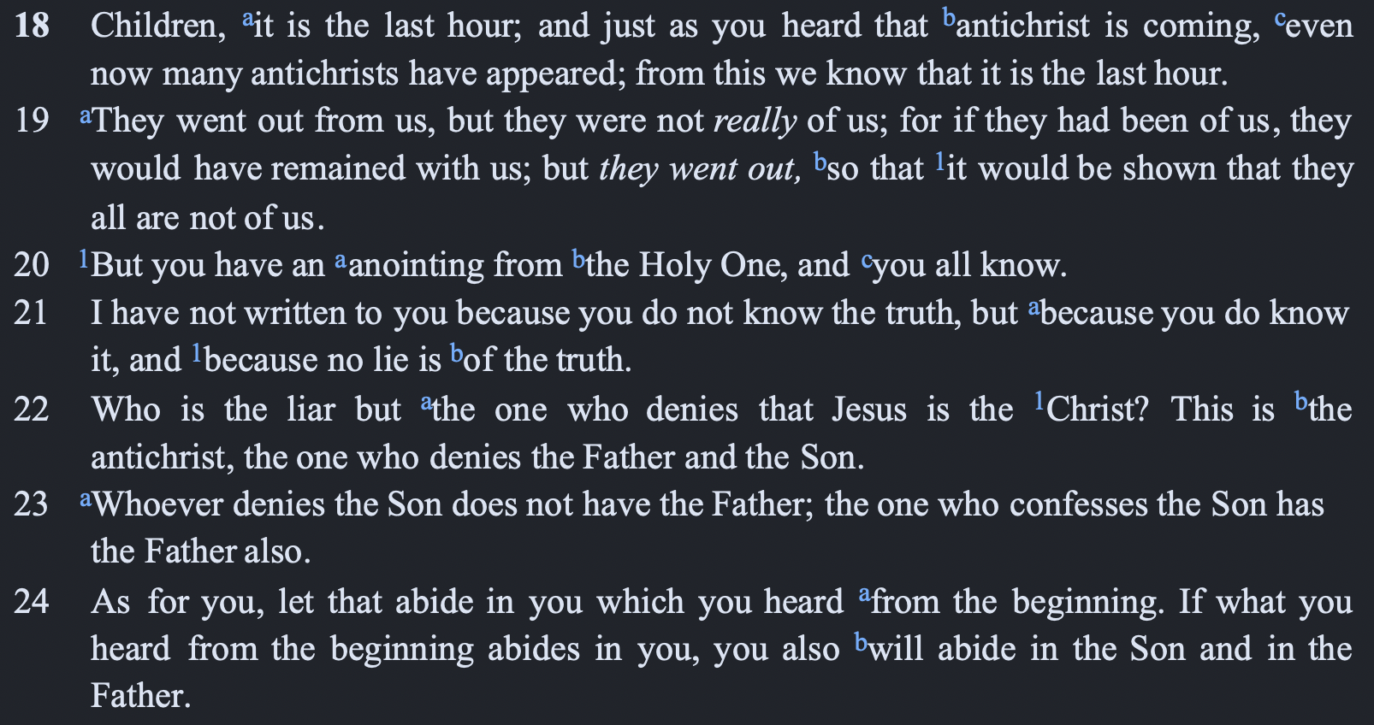

Slide 5
Deuteronomy 18:18–22 (NASB95)
¹⁸‘I will raise up a prophet from among their countrymen like you, and I will put My words in his mouth, and he shall speak to them all that I command him.
¹⁹‘It shall come about that whoever will not listen to My words which he shall speak in My name, I Myself will require it of him.
²⁰‘But the prophet who speaks a word presumptuously in My name which I have not commanded him to speak, or which he speaks in the name of other gods, that prophet shall die.’
²¹“You may say in your heart, ‘How will we know the word which the Lord has not spoken?’
²²“When a prophet speaks in the name of the Lord, if the thing does not come about or come true, that is the thing which the Lord has not spoken. The prophet has spoken it presumptuously; you shall not be afraid of him.

Slide 6
Daniel 11:36 (NASB95)
³⁶“Then the king will do as he pleases, and he will exalt and magnify himself above every god and will speak monstrous things against the God of gods; and he will prosper until the indignation is finished, for that which is decreed will be done.

Slide 7
Matthew 24 (NASB95)
⁵“For many will come in My name, saying, ‘I am the Christ,’ and will mislead many.
¹¹“Many false prophets will arise and will mislead many.
²⁴“For false Christs and false prophets will arise and will show great signs and wonders, so as to mislead, if possible, even the elect.

Slide 8
2 Thessalonians 2:1–4 (NASB95)
¹Now we request you, brethren, with regard to the coming of our Lord Jesus Christ and our gathering together to Him,
²that you not be quickly shaken from your composure or be disturbed either by a spirit or a message or a letter as if from us, to the effect that the day of the Lord has come.
³Let no one in any way deceive you, for it will not come unless the apostasy comes first, and the man of lawlessness is revealed, the son of destruction,
⁴who opposes and exalts himself above every so-called god or object of worship, so that he takes his seat in the temple of God, displaying himself as being God.

Slide 10
Christ (christos)
Antichrist (antichristos)
Anointing (chrisma)

