Slide 2
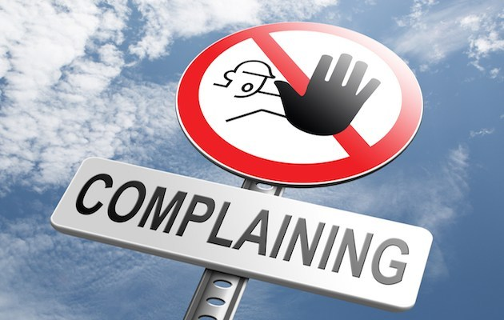
“Grumble, Grumble, Grumble” Philippians 2:1-18

Slide 3
Philippians 2:14-16
“Do all things without grumbling or disputing, that you may be blameless and innocent, children of God without blemish in the midst of a crooked and twisted generation, among whom you shine as lights in the world, holding fast to the word of life, so that in the day of Christ I may be proud that I did not run in vain or labor in vain”

Slide 4
Why Does God Hate Complaining?
It destroys the complainer
It discourages other people
It drains leaders
It discredits the gospel of Jesus Christ

Slide 5
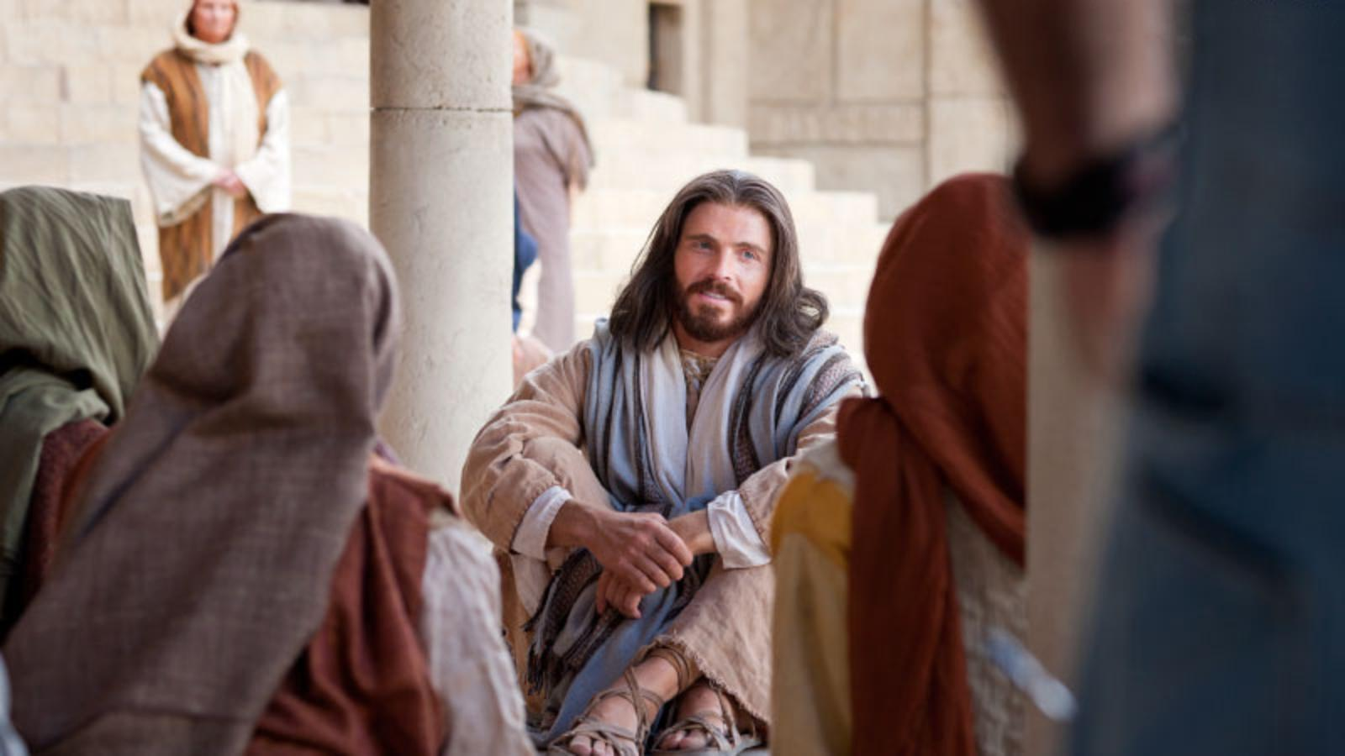
“Have the Mind of Christ” Philippians 2:1-18

Slide 6
Complainer
- “One who is discontented with his/her lot in life”
- Grumbler (ESV)
- Murmuring (KJV)
Disputing
- “Inward reasoning”
- Arguing (NIV)
- Continuous critic

Slide 7
Why We Refuse to Complain?
We are children of God
- Remember who you are
- Blameless “free from fault”
- Innocent (harmless) “free from impurities”
- Without blemish (God approved sacrifices)

Slide 8
Why We Refuse to Complain?
We are children of God
We are lights to this world
- Remember your calling
- Matt 5:14-16; Isa 46:9
- God is using us to enlightened a dark world

Slide 9
Why We Refuse to Complain?
We are children of God
We are lights to this world
We are clinging to His promises
- Remember the source of your strength
- Word of life (1 Jn 1:1)

Slide 10
Take Home
Remind, Shine, & Bind
Take it to the Lord
Commit to a complaining fast
Humble yourself

