Slide 2
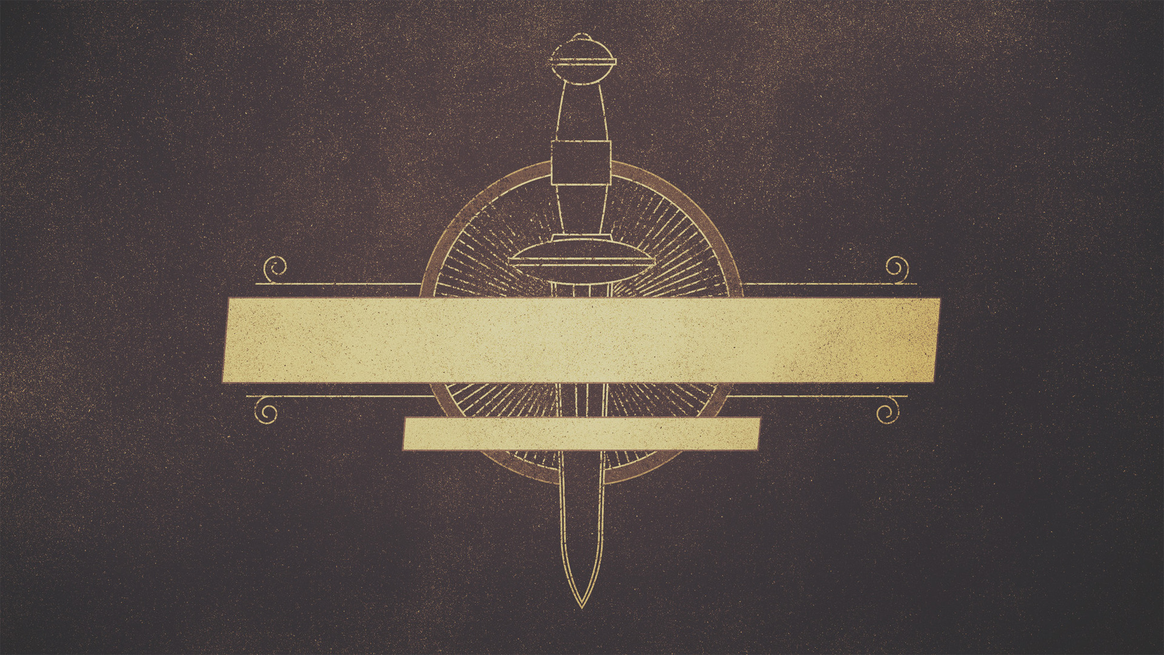
Timothy’s Sacrifice
Acts 16.1-3

Slide 3
Culture War At Home
Acts 16.1

Slide 4
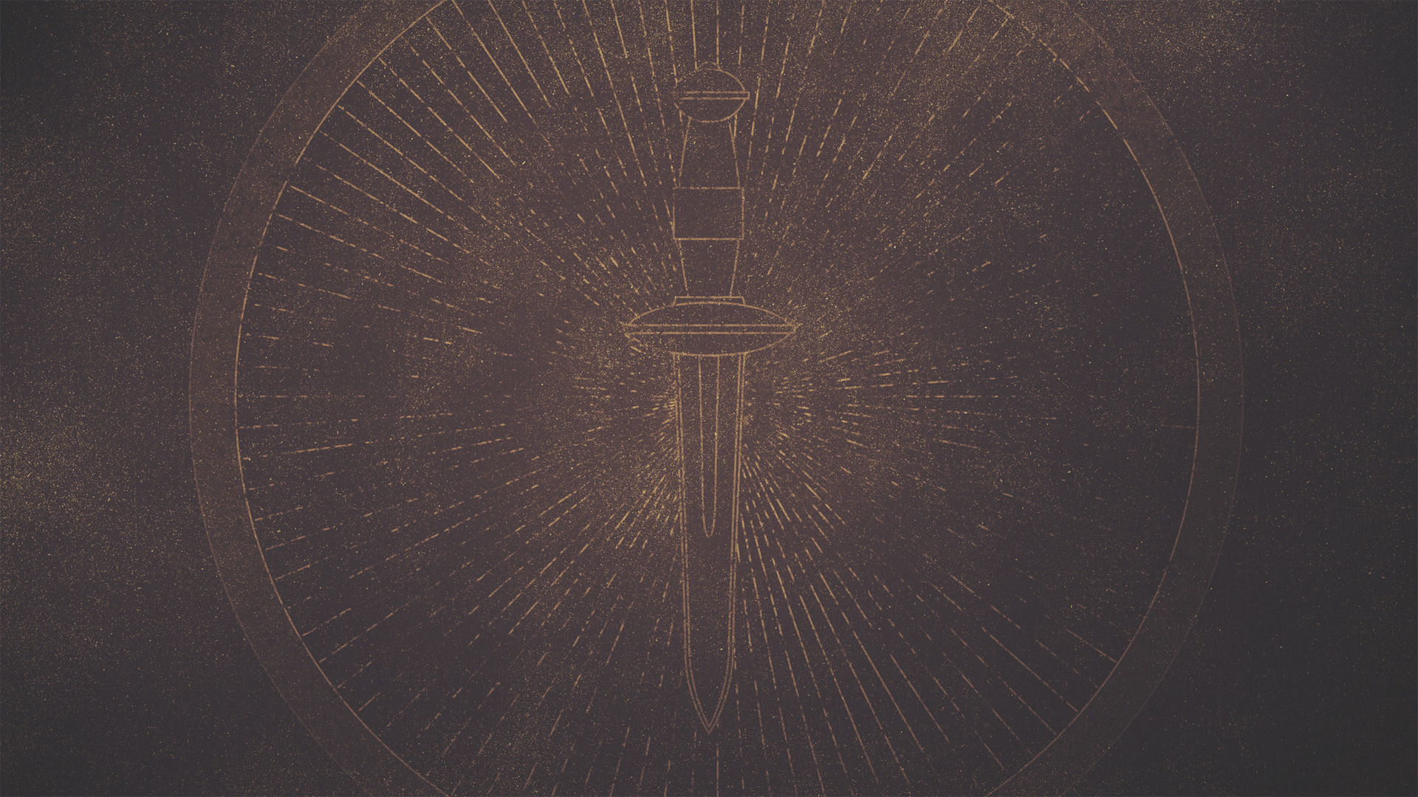
“And every one that is born, the flesh of whose foreskin is not circumcised on the eighth day, belongs not to the children of the covenant which the Lord made with Abraham, but to the children of destruction; nor is there, moreover, any sign on him that he is the Lord’s, but (he is destined) to be destroyed and slain from the earth, and to be rooted out of the earth, for he has broken the covenant of the Lord our God. For all the angels of the presence and all the angels of sanctification have been so created from the day of their creation, and before the angels of the presence and the angels of sanctification He hath sanctified Israel, that they should be with Him and with His holy angels.” (Jubilees 15.26-27)

Slide 5
“Then Mattathias and his friends went round about, and pulled down the altars: And what children soever they found within the coast of Israel uncircumcised, those they circumcised valiantly.” (1Macc 2.45-46)

Slide 6
“All of these works counter the Greek threat against circumcision by reasserting its necessity or explaining its significance. Circumcision atones for guilt as a sacrifice, transfers one from the realm of the deceiving, destroying angels to the realm of blessing, and sanctifies one for participation in heavenly worship in God’s presence. It is folly to neglect it, folly inspired by the demonic rulers of the uncircumcised.” (AYBD)

Slide 7
Culture War At Home
Acts 16.1

Slide 8
Timothy Had Already Sacrificed
Acts 16.2

Slide 9
Circumcision Wasn’t His Idea
Acts 16.3

Slide 10
“So circumcise your heart, and stiffen your neck no longer.”
(Deuteronomy 10:16)

