Slide 2
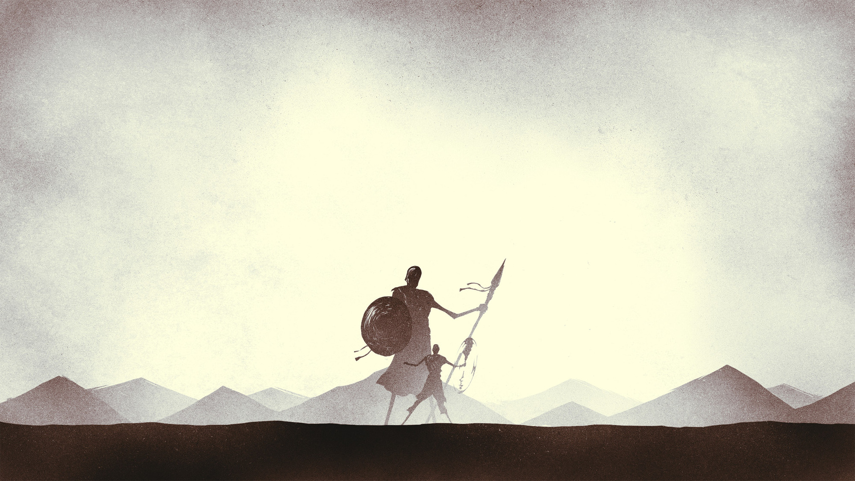
“Let no man’s heart fail…”

Slide 3
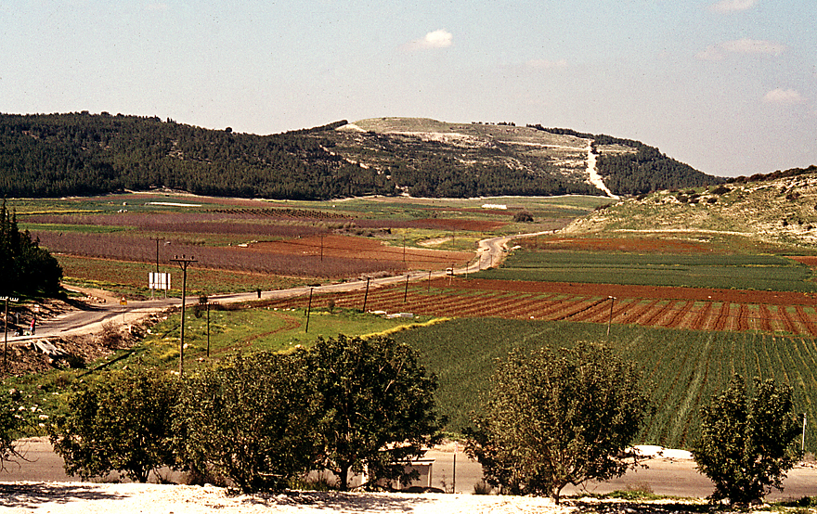
Courtesy of Ferrell Jenkins

Slide 4
FEAR Israel’s response to the Philistine champion
DOUBT how Israel felt about David

Slide 5
“Let no man’s heart fail…”

Slide 6
FEAR Israel’s response to the Philistine champion
DOUBT how Israel felt about David
COURAGE the result of David’s confidence in the Lord

Slide 7
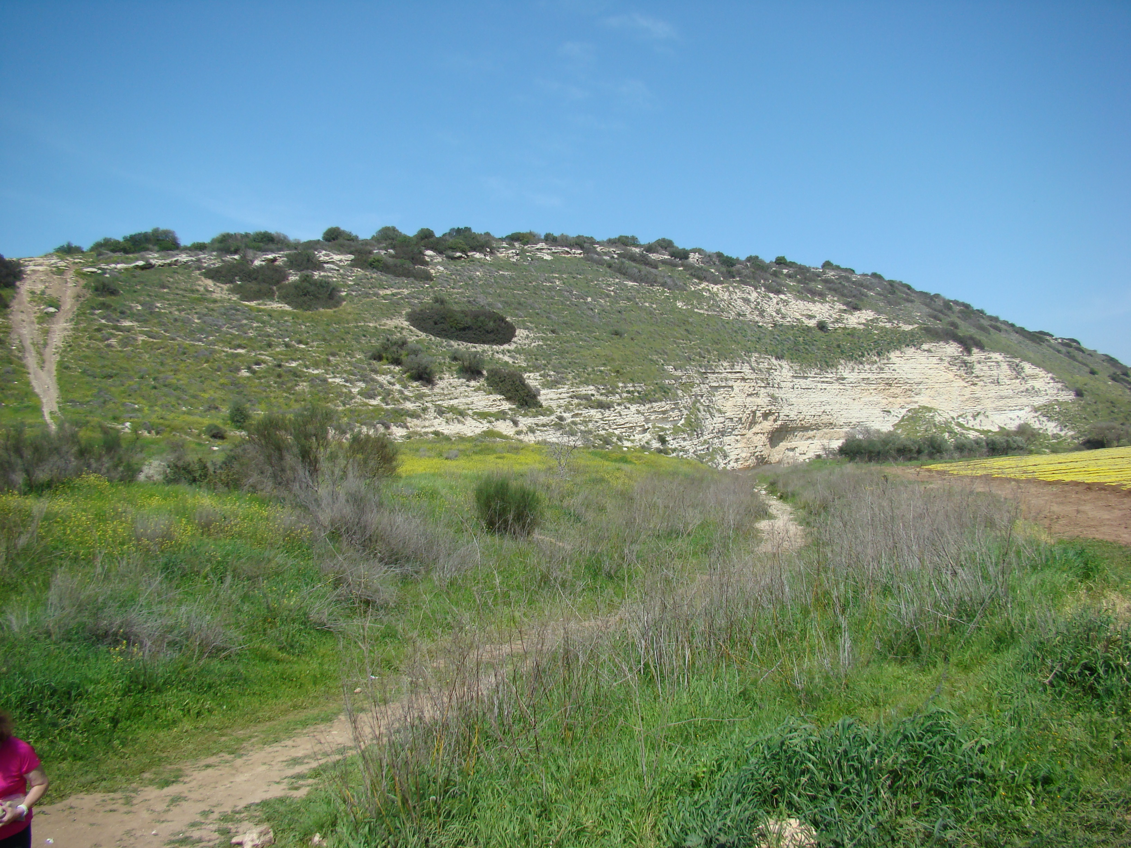
Courtesy of Leon Mauldin

Slide 8
“go and fight”

