Slide 2
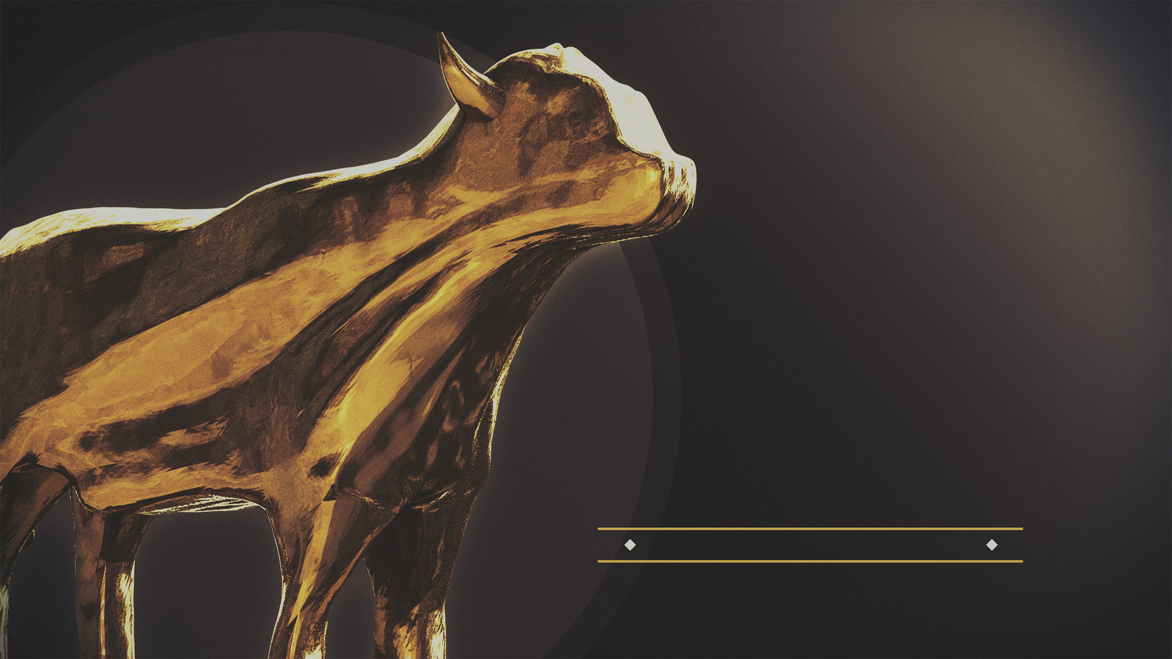
IDOLATRY
is the
PROBLEM

Slide 3
³ “You shall have no other gods before Me. ⁴ “You shall not make for yourself an idol, or any likeness of what is in heaven above or on the earth beneath or in the water under the earth. ⁵ “You shall not worship them or serve them; for I, the Lord your God, am a jealous God, visiting the iniquity of the fathers on the children, on the third and the fourth generations of those who hate Me, ⁶ but showing lovingkindness to thousands, to those who love Me and keep My commandments.
(Exodus 20.3-6 NASB95)
Idolatry is the Problem

Slide 4
it invites competition when none should exist (Exodus 20.3)
it seeks to bring God down to our level (Exodus 20.4-6)
Idolatry is the Problem

Slide 5
IDOLATRY
is OUR
PROBLEM

