Slide 1
Joined Together
Ephesians 4:11-16

Slide 2
What causes the growth of the body?
Eph. 4:11-16- As a result, we are no longer to be children, tossed here and there by waves and carried about by every wind of doctrine, by the trickery of men, by craftiness in deceitful scheming; 15 but speaking the truth in love, we are to grow up in all aspects into Him who is the head, even Christ, 16 from whom the whole body, being fitted and held together by what every joint supplies, according to the proper working of each individual part, causes the growth of the body for the building up of itself in love.

Slide 3
What is a joint?
A place where two things or parts are joined; an area at which two ends, surfaces, or edges are attached
A joint is NOT an individual but two members working together

Slide 4
God’s design for His family
Gen. 2:18 – “not good to be alone”
God’s pattern of joining-
Mark 6:7/Luke 10:1 – “in pairs”
Mark 11:1-3/Mark 14:12-13- “sent two disciples”

Slide 5
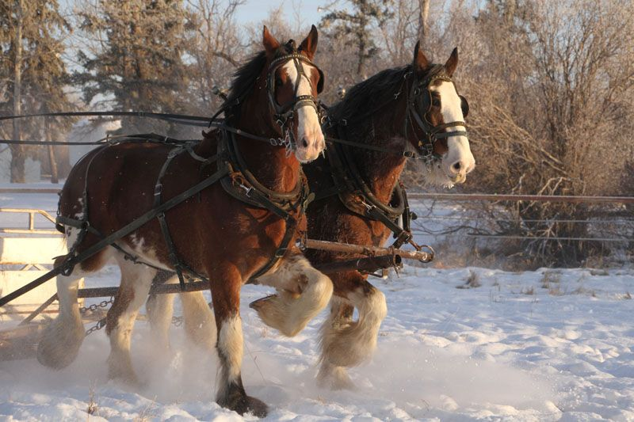

Slide 6
The plurality of togetherness
Heb.10:22-25- let us draw near with a sincere heart in full assurance of faith, having our hearts sprinkled clean from an evil conscience and our bodies washed with pure water. 23 Let us hold fast the confession of our hope without wavering, for He who promised is faithful;

Slide 7
The plurality of togetherness
Heb. 10:22-25- and let us consider how to stimulate one another to love and good deeds, 25 not forsaking our own assembling together, as is the habit of some, but encouraging one another; and all the more as you see the day drawing near.
“us, our, together, one another”

Slide 8
Luke 8:19-21
And His mother and brothers came to Him, and they were unable to get to Him because of the crowd. 20 And it was reported to Him, “Your mother and Your brothers are standing outside, wishing to see You.” 21 But He answered and said to them, “My mother and My brothers are these who hear the word of God and do it.”

Slide 9
What If I don’t feel connected?
PLUG IN
You get out what you put in.

Slide 10
What if I don’t feel connected?
1 Corinthians 12:25-26- so that there may be no division in the body, but that the members may have the same care for one another. [26] And if one member suffers, all the members suffer with it; if one member is honored, all the members rejoice with it.

Slide 11
Ecclesiastes 4:9-12- Two are better than one because they have a good return for their labor. [10] For if either of them falls, the one will lift up his companion. But woe to the one who falls when there is not another to lift him up. [11] Furthermore, if two lie down together they keep warm, but how can one be warm alone? [12] And if one can overpower him who is alone, two can resist him. A cord of three strands is not quickly torn apart.

Slide 12
Joined Together
Ephesians 4:11-16

