Slide 2
Welcome and Announcements
Luke Heard

Slide 3
Song Leader
Nathan Shepard

Slide 4
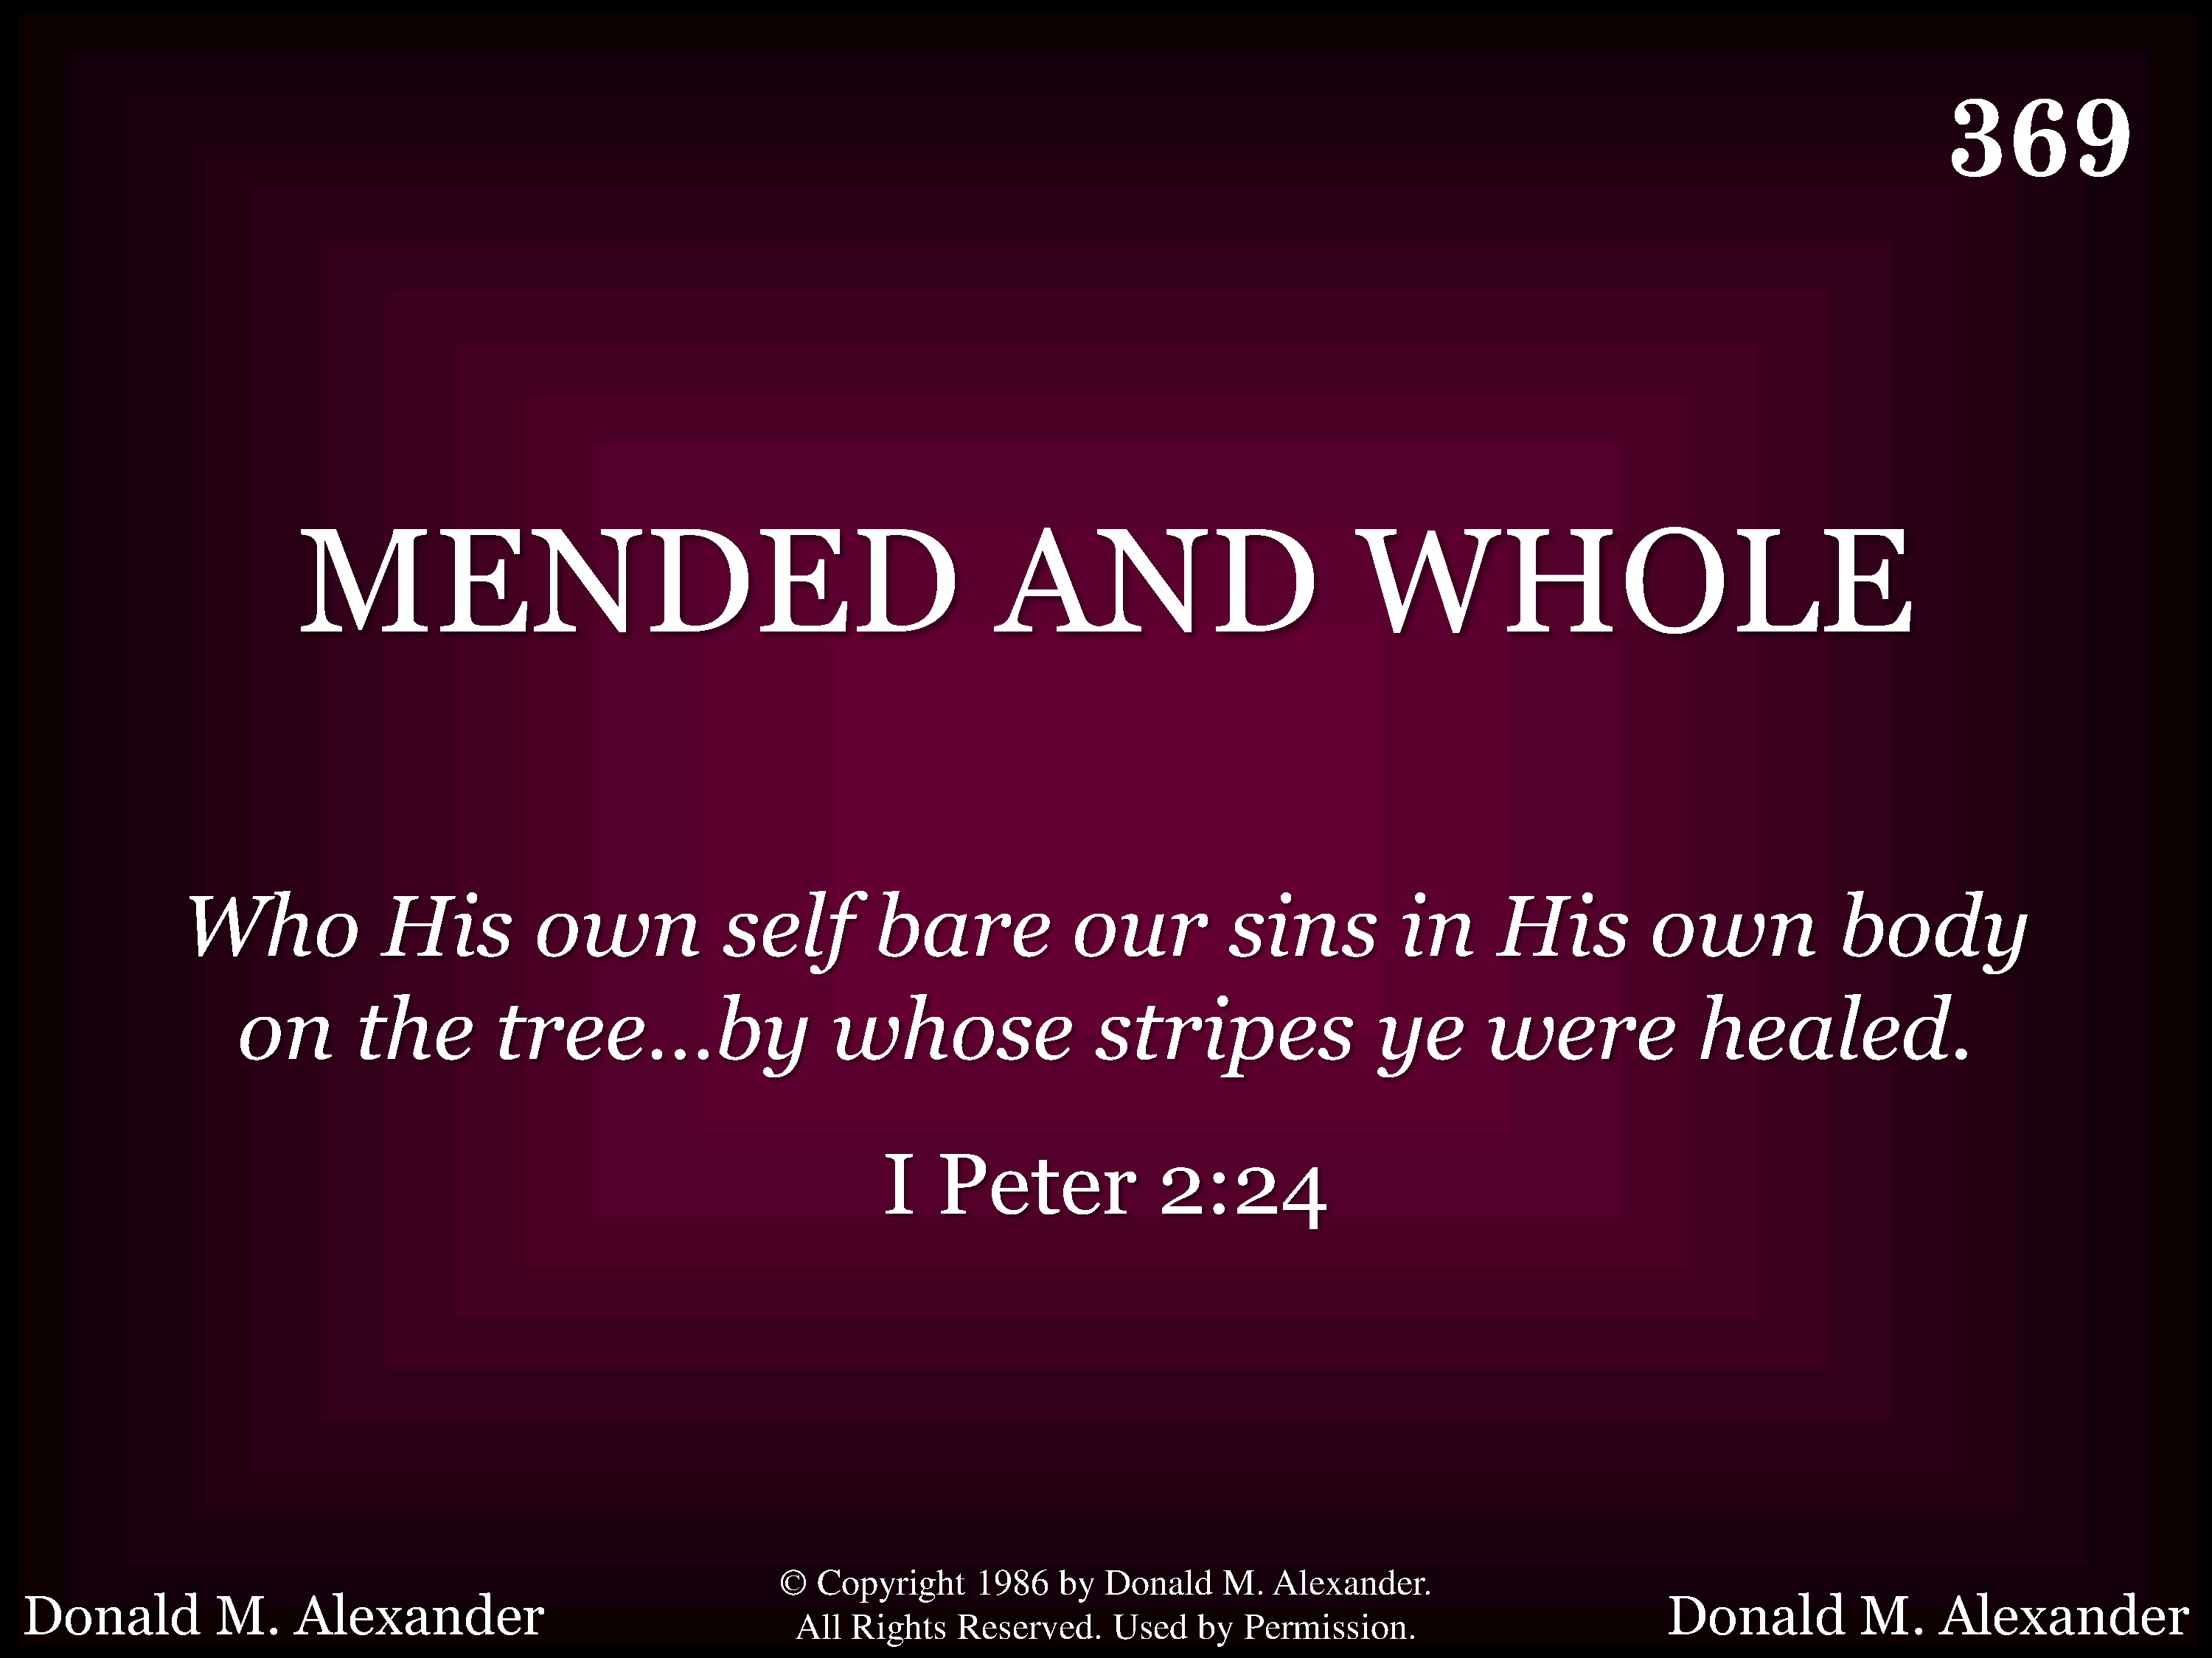
369 - Mended And Whole - Title

Slide 5
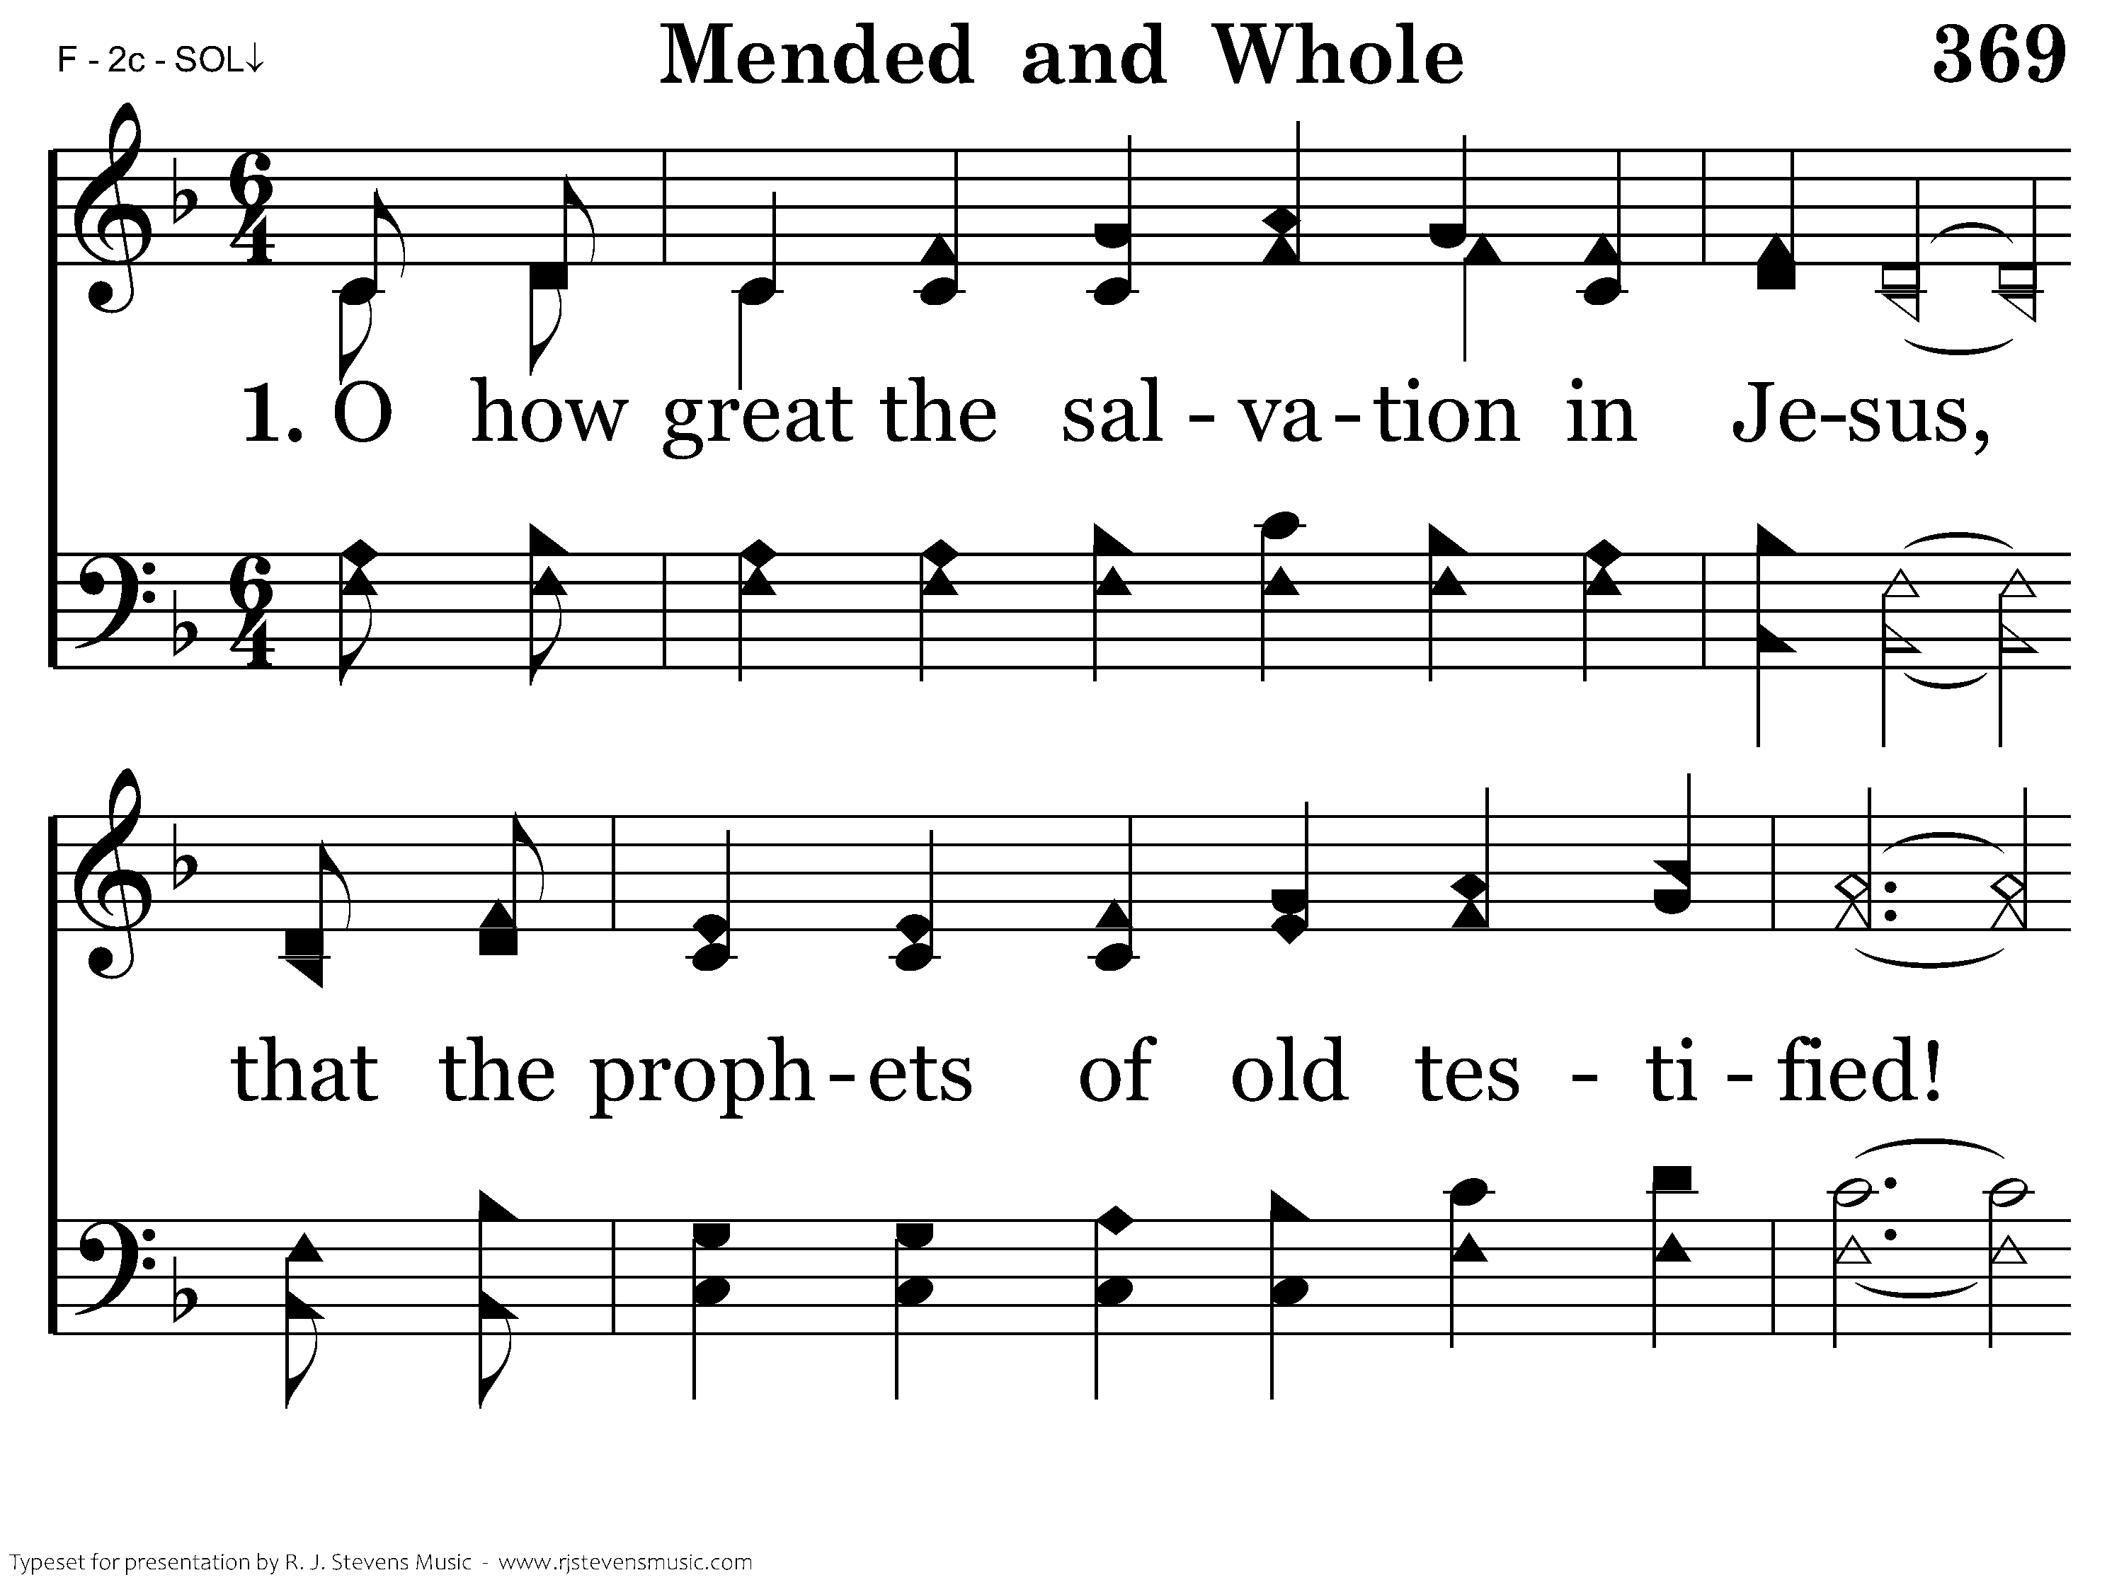
369 - Mended And Whole - 1.1

Slide 6
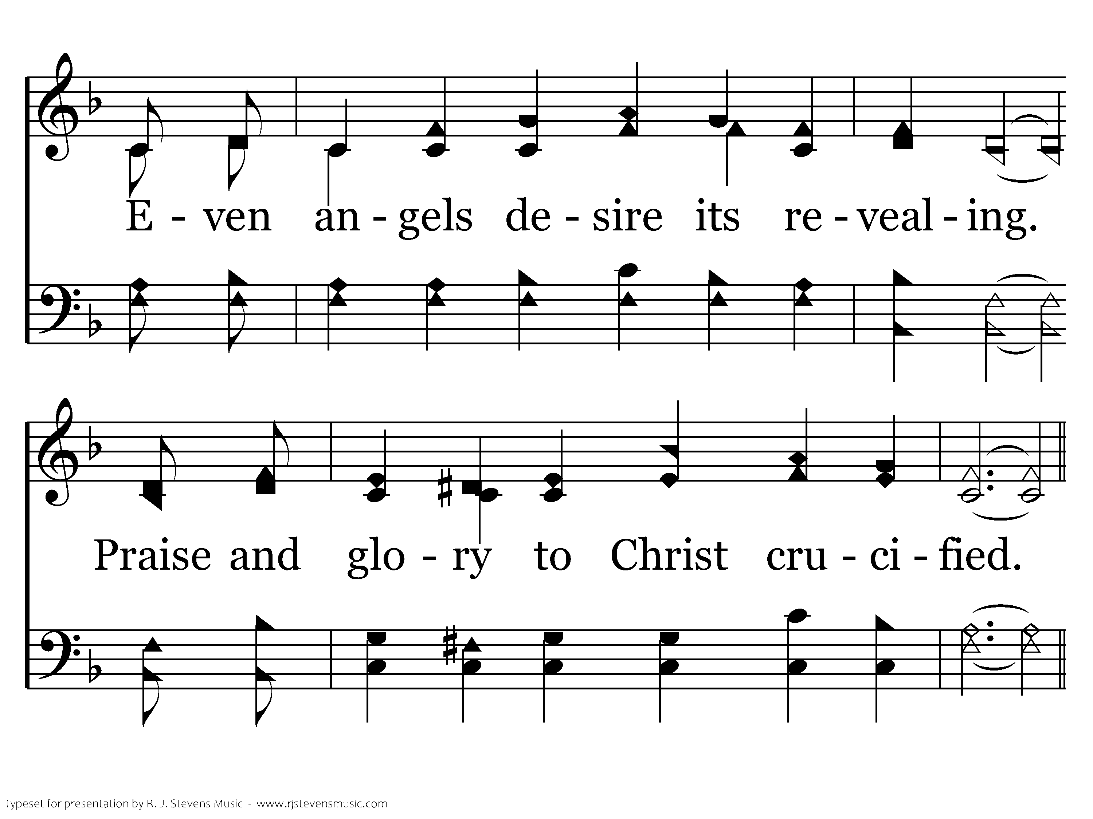
369 - Mended And Whole - 1.2

Slide 7
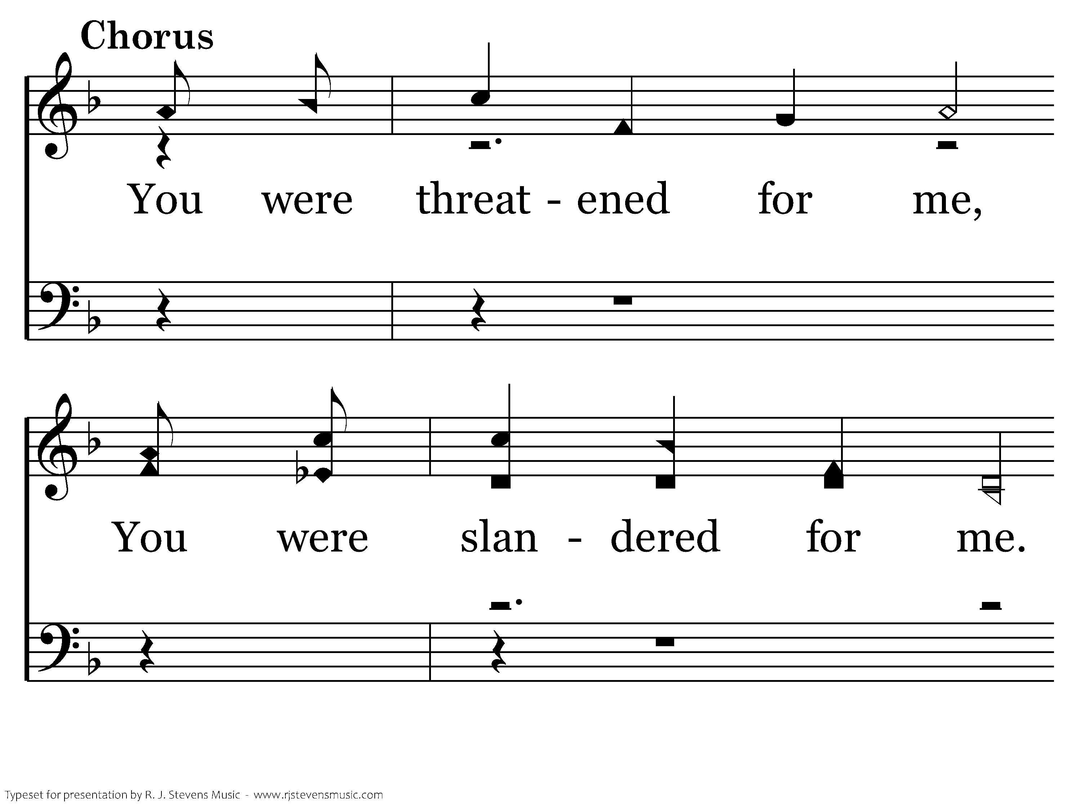
369 - Mended And Whole - C.1

Slide 8
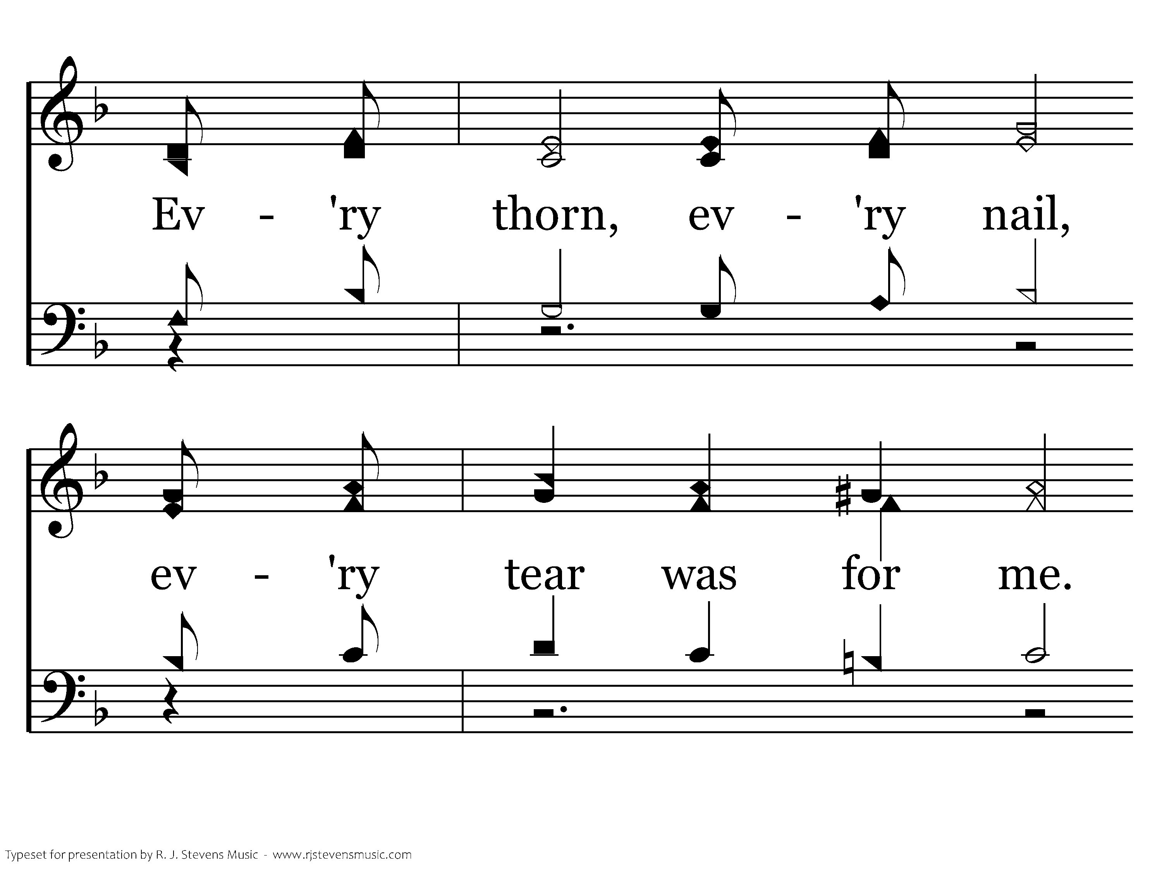
369 - Mended And Whole - C.2

Slide 9
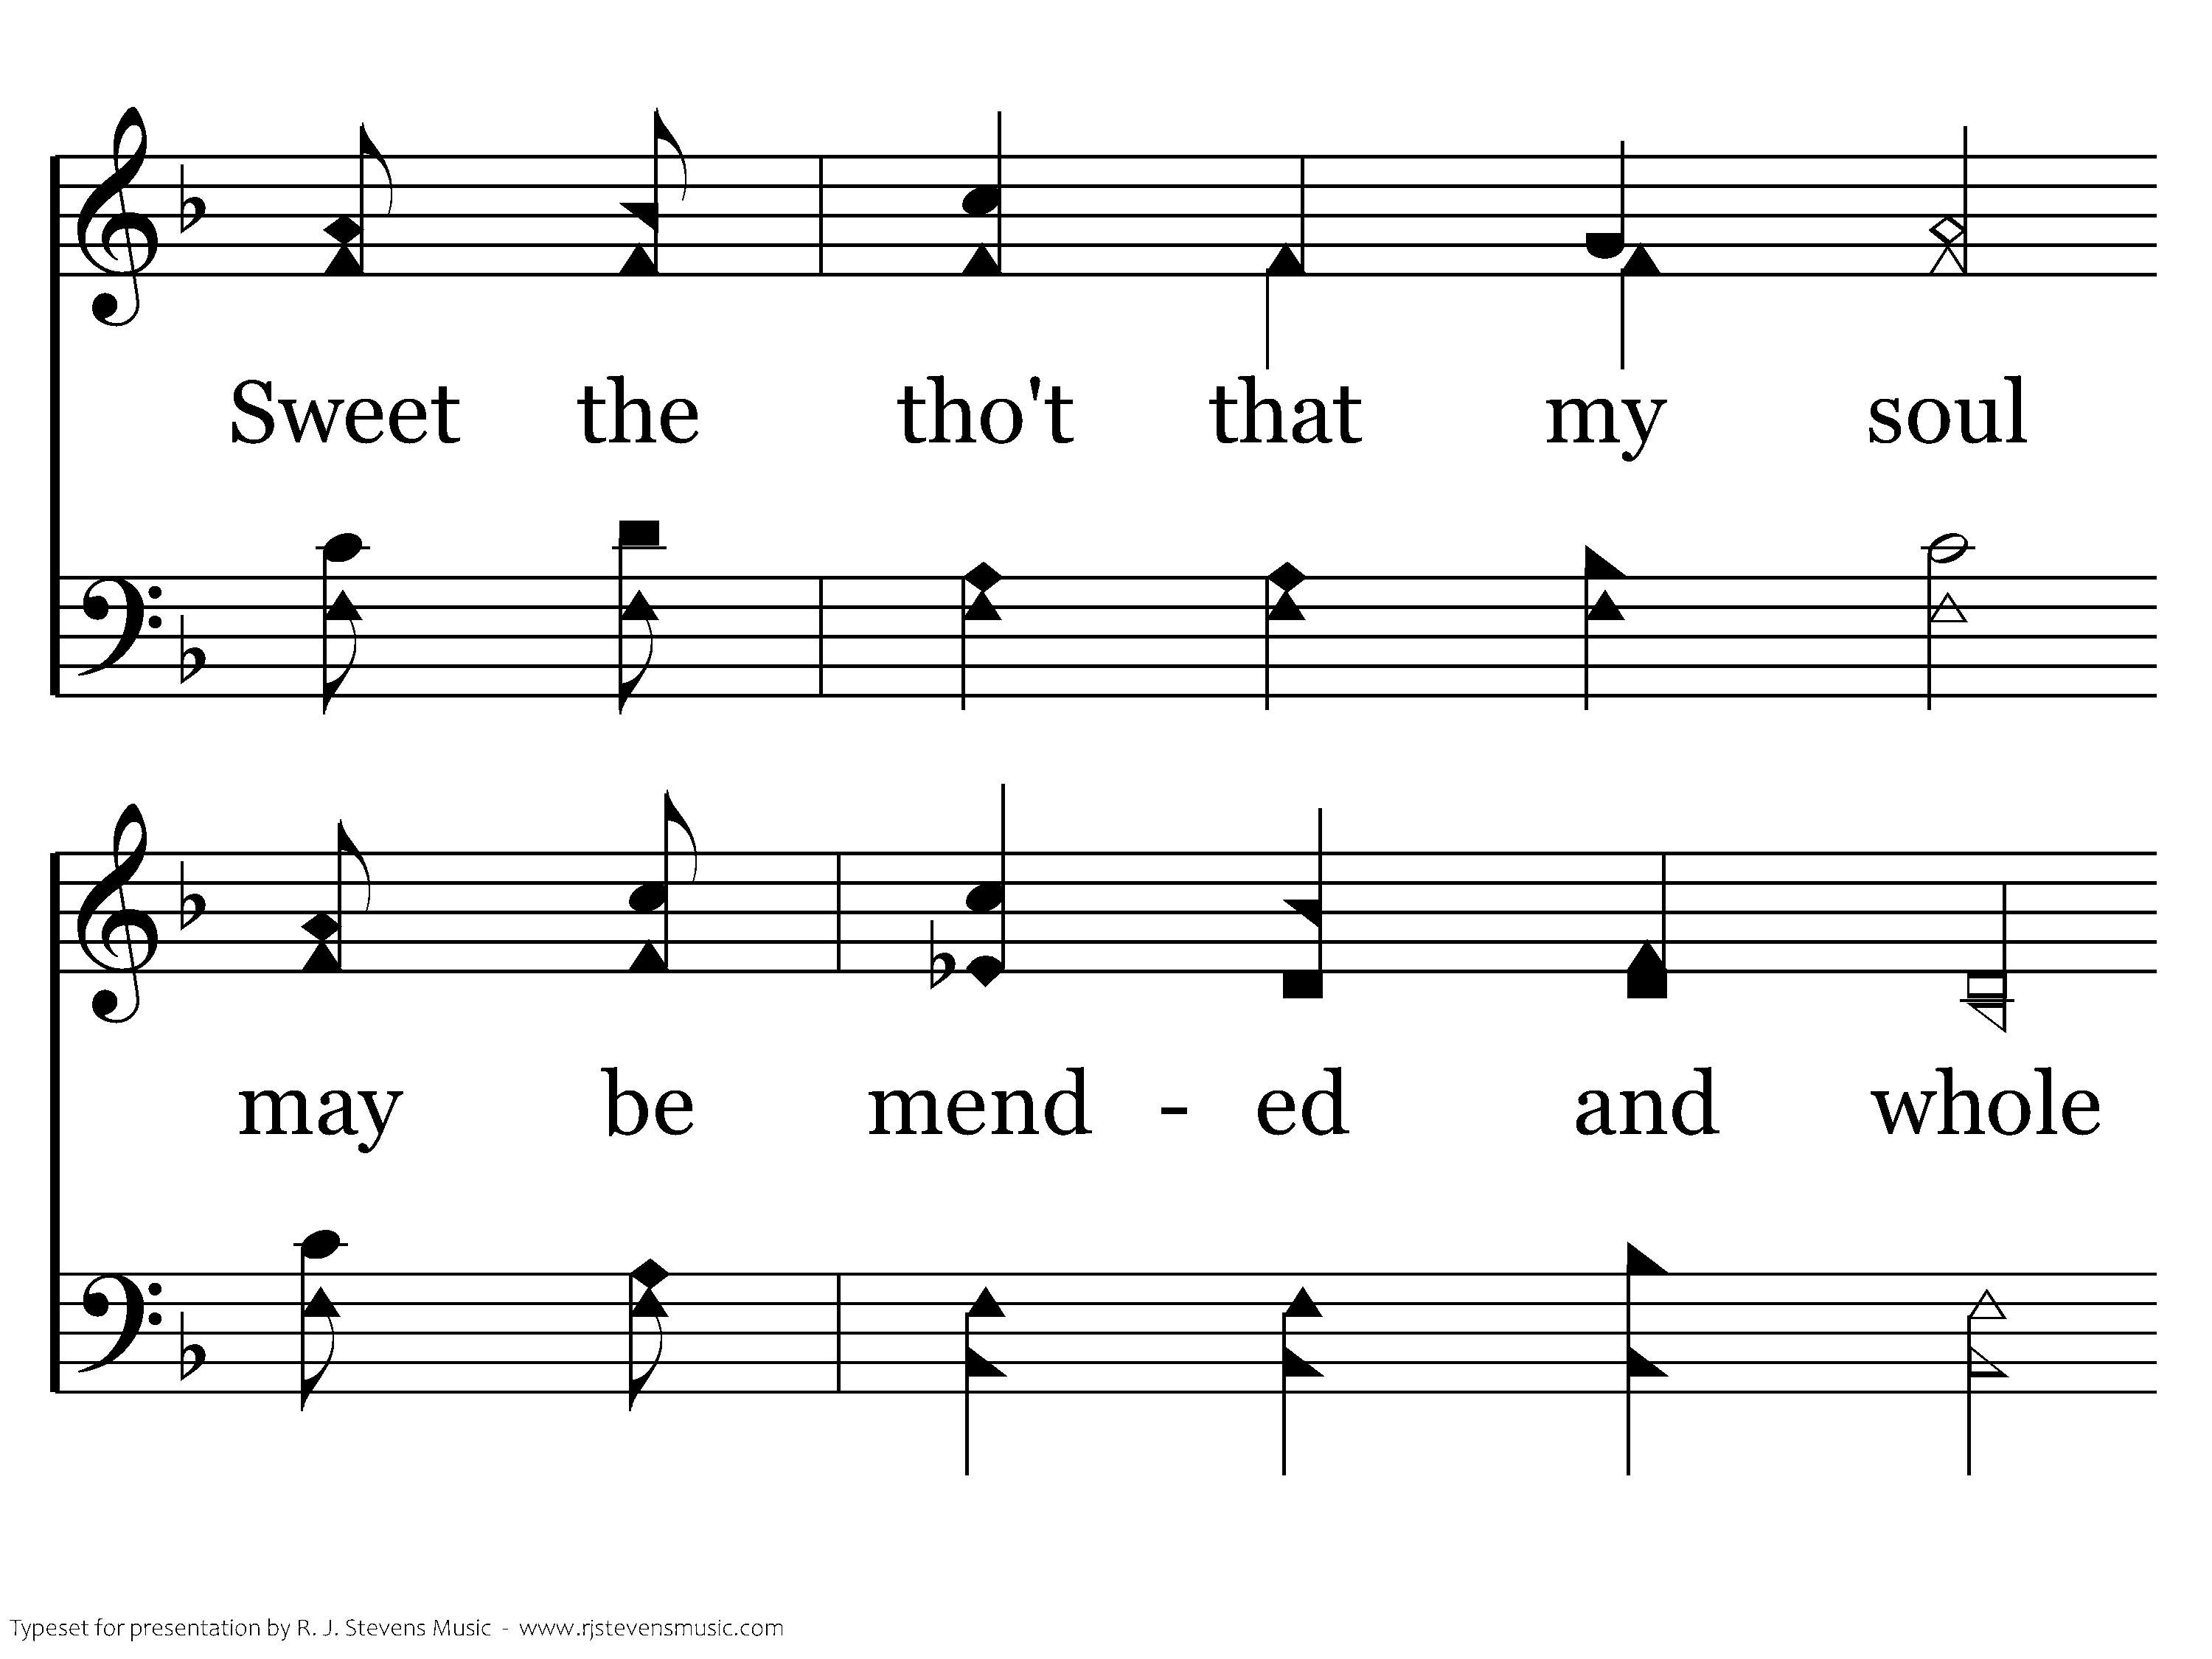
369 - Mended And Whole - C.3

Slide 10
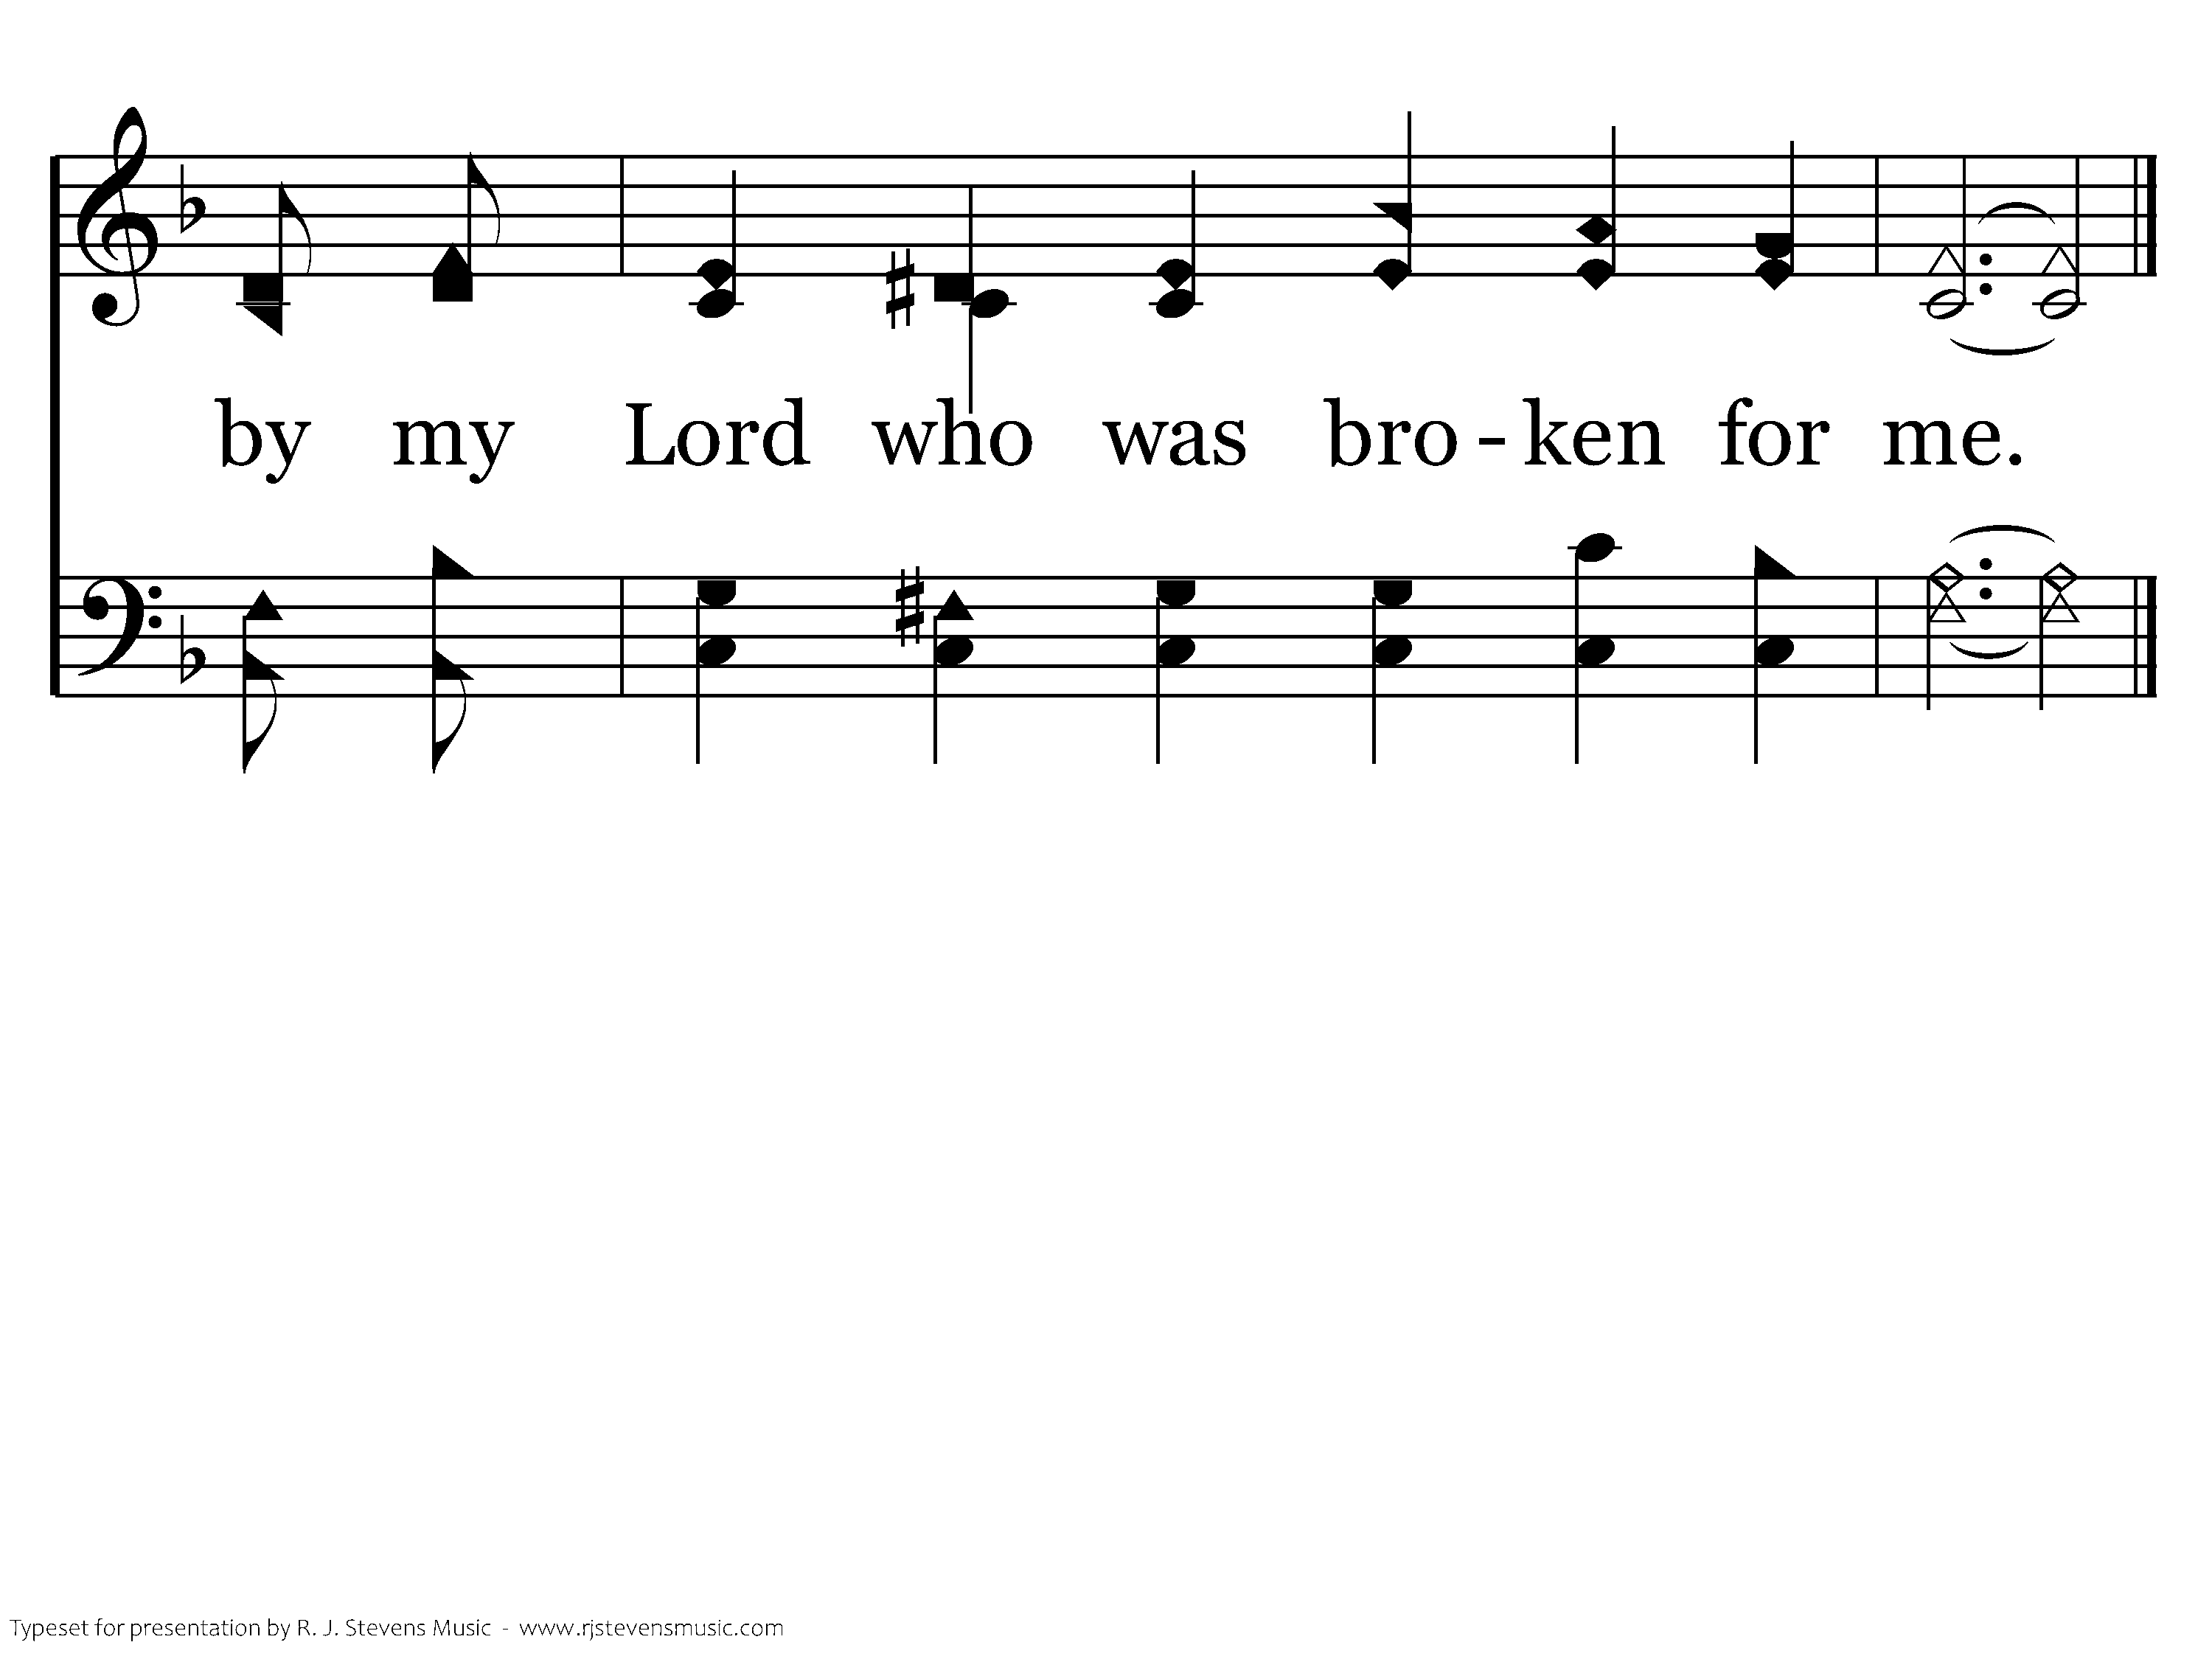
369 - Mended And Whole - C.4
End of Verse 1

Slide 11
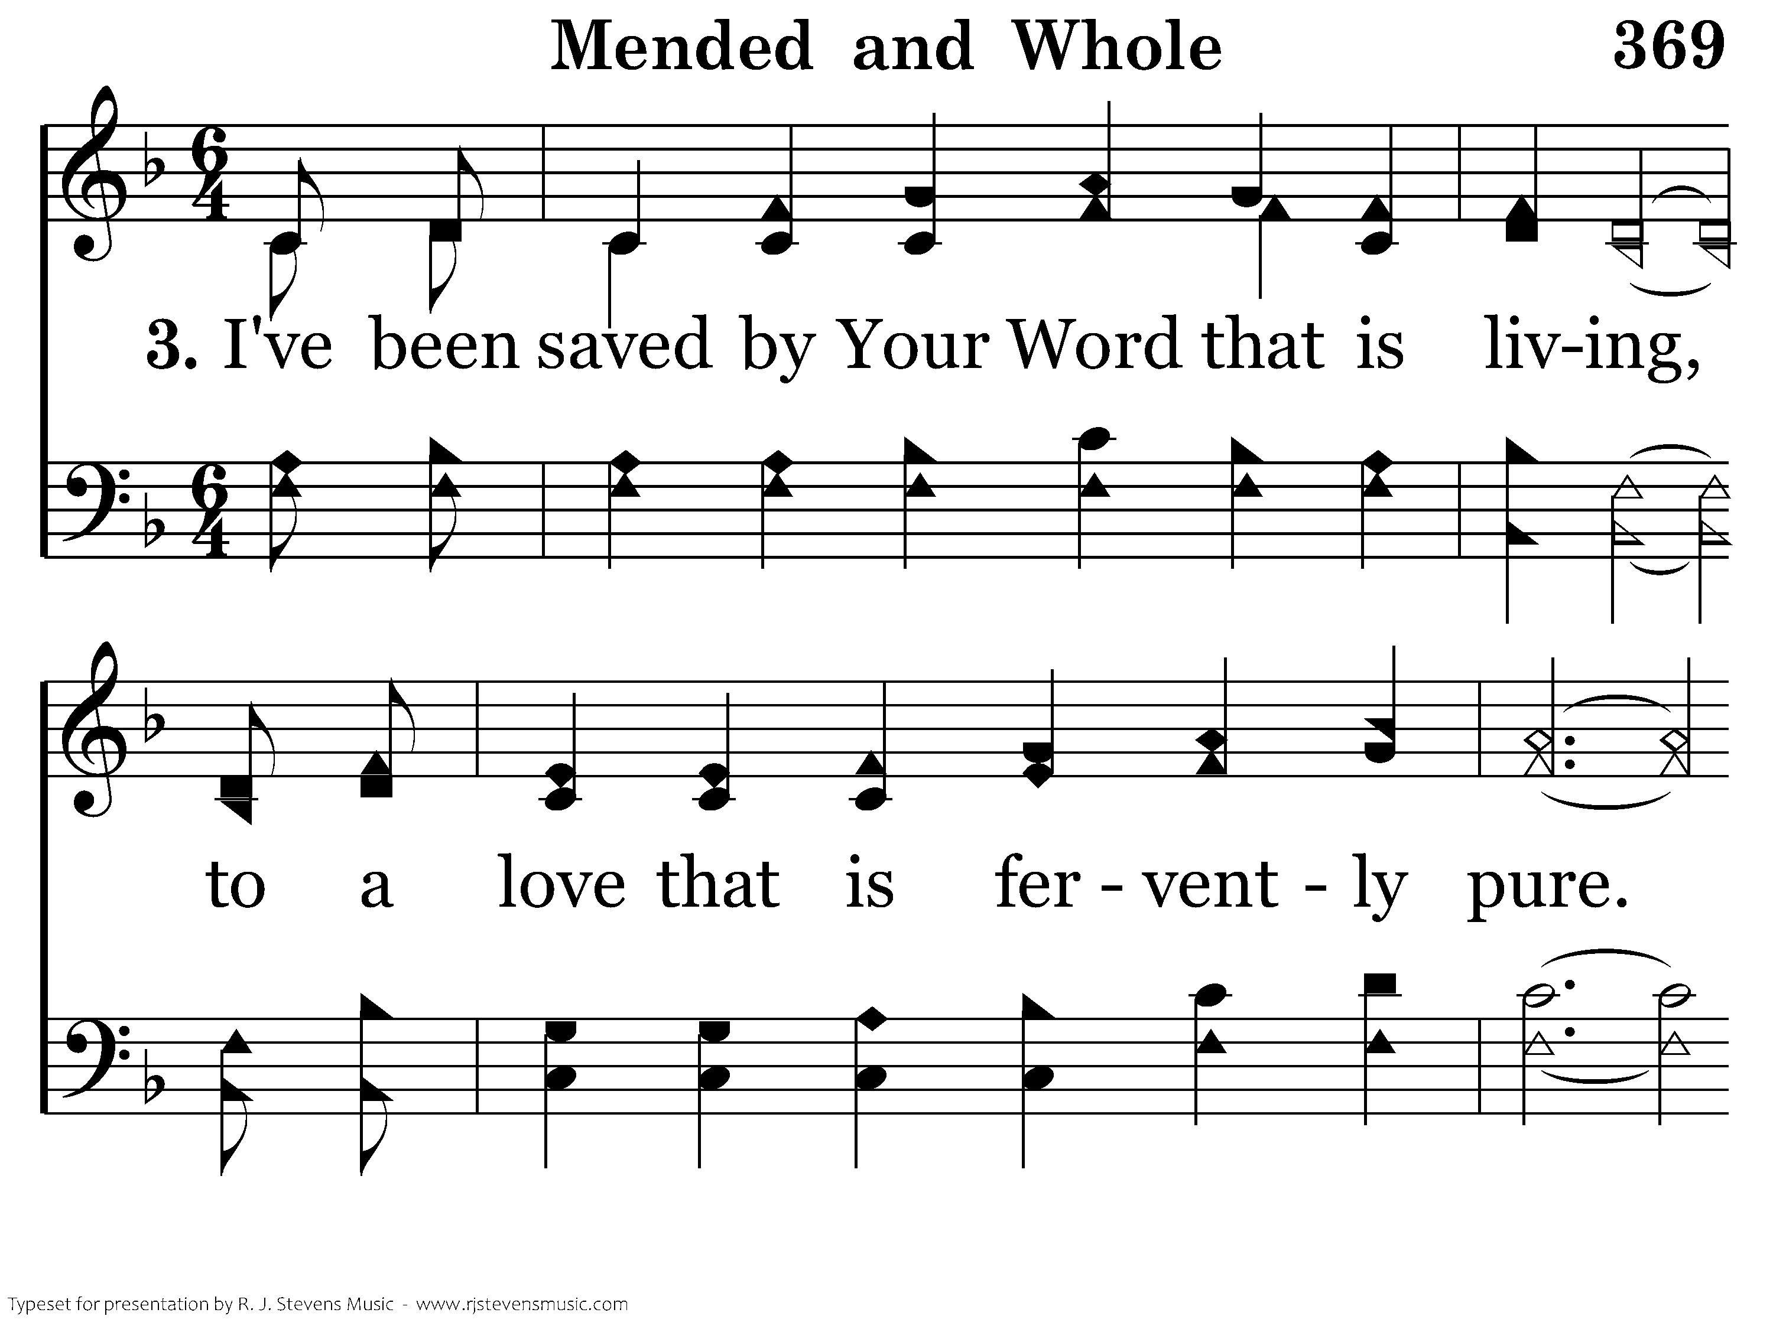
369 - Mended And Whole - 3.1

Slide 12
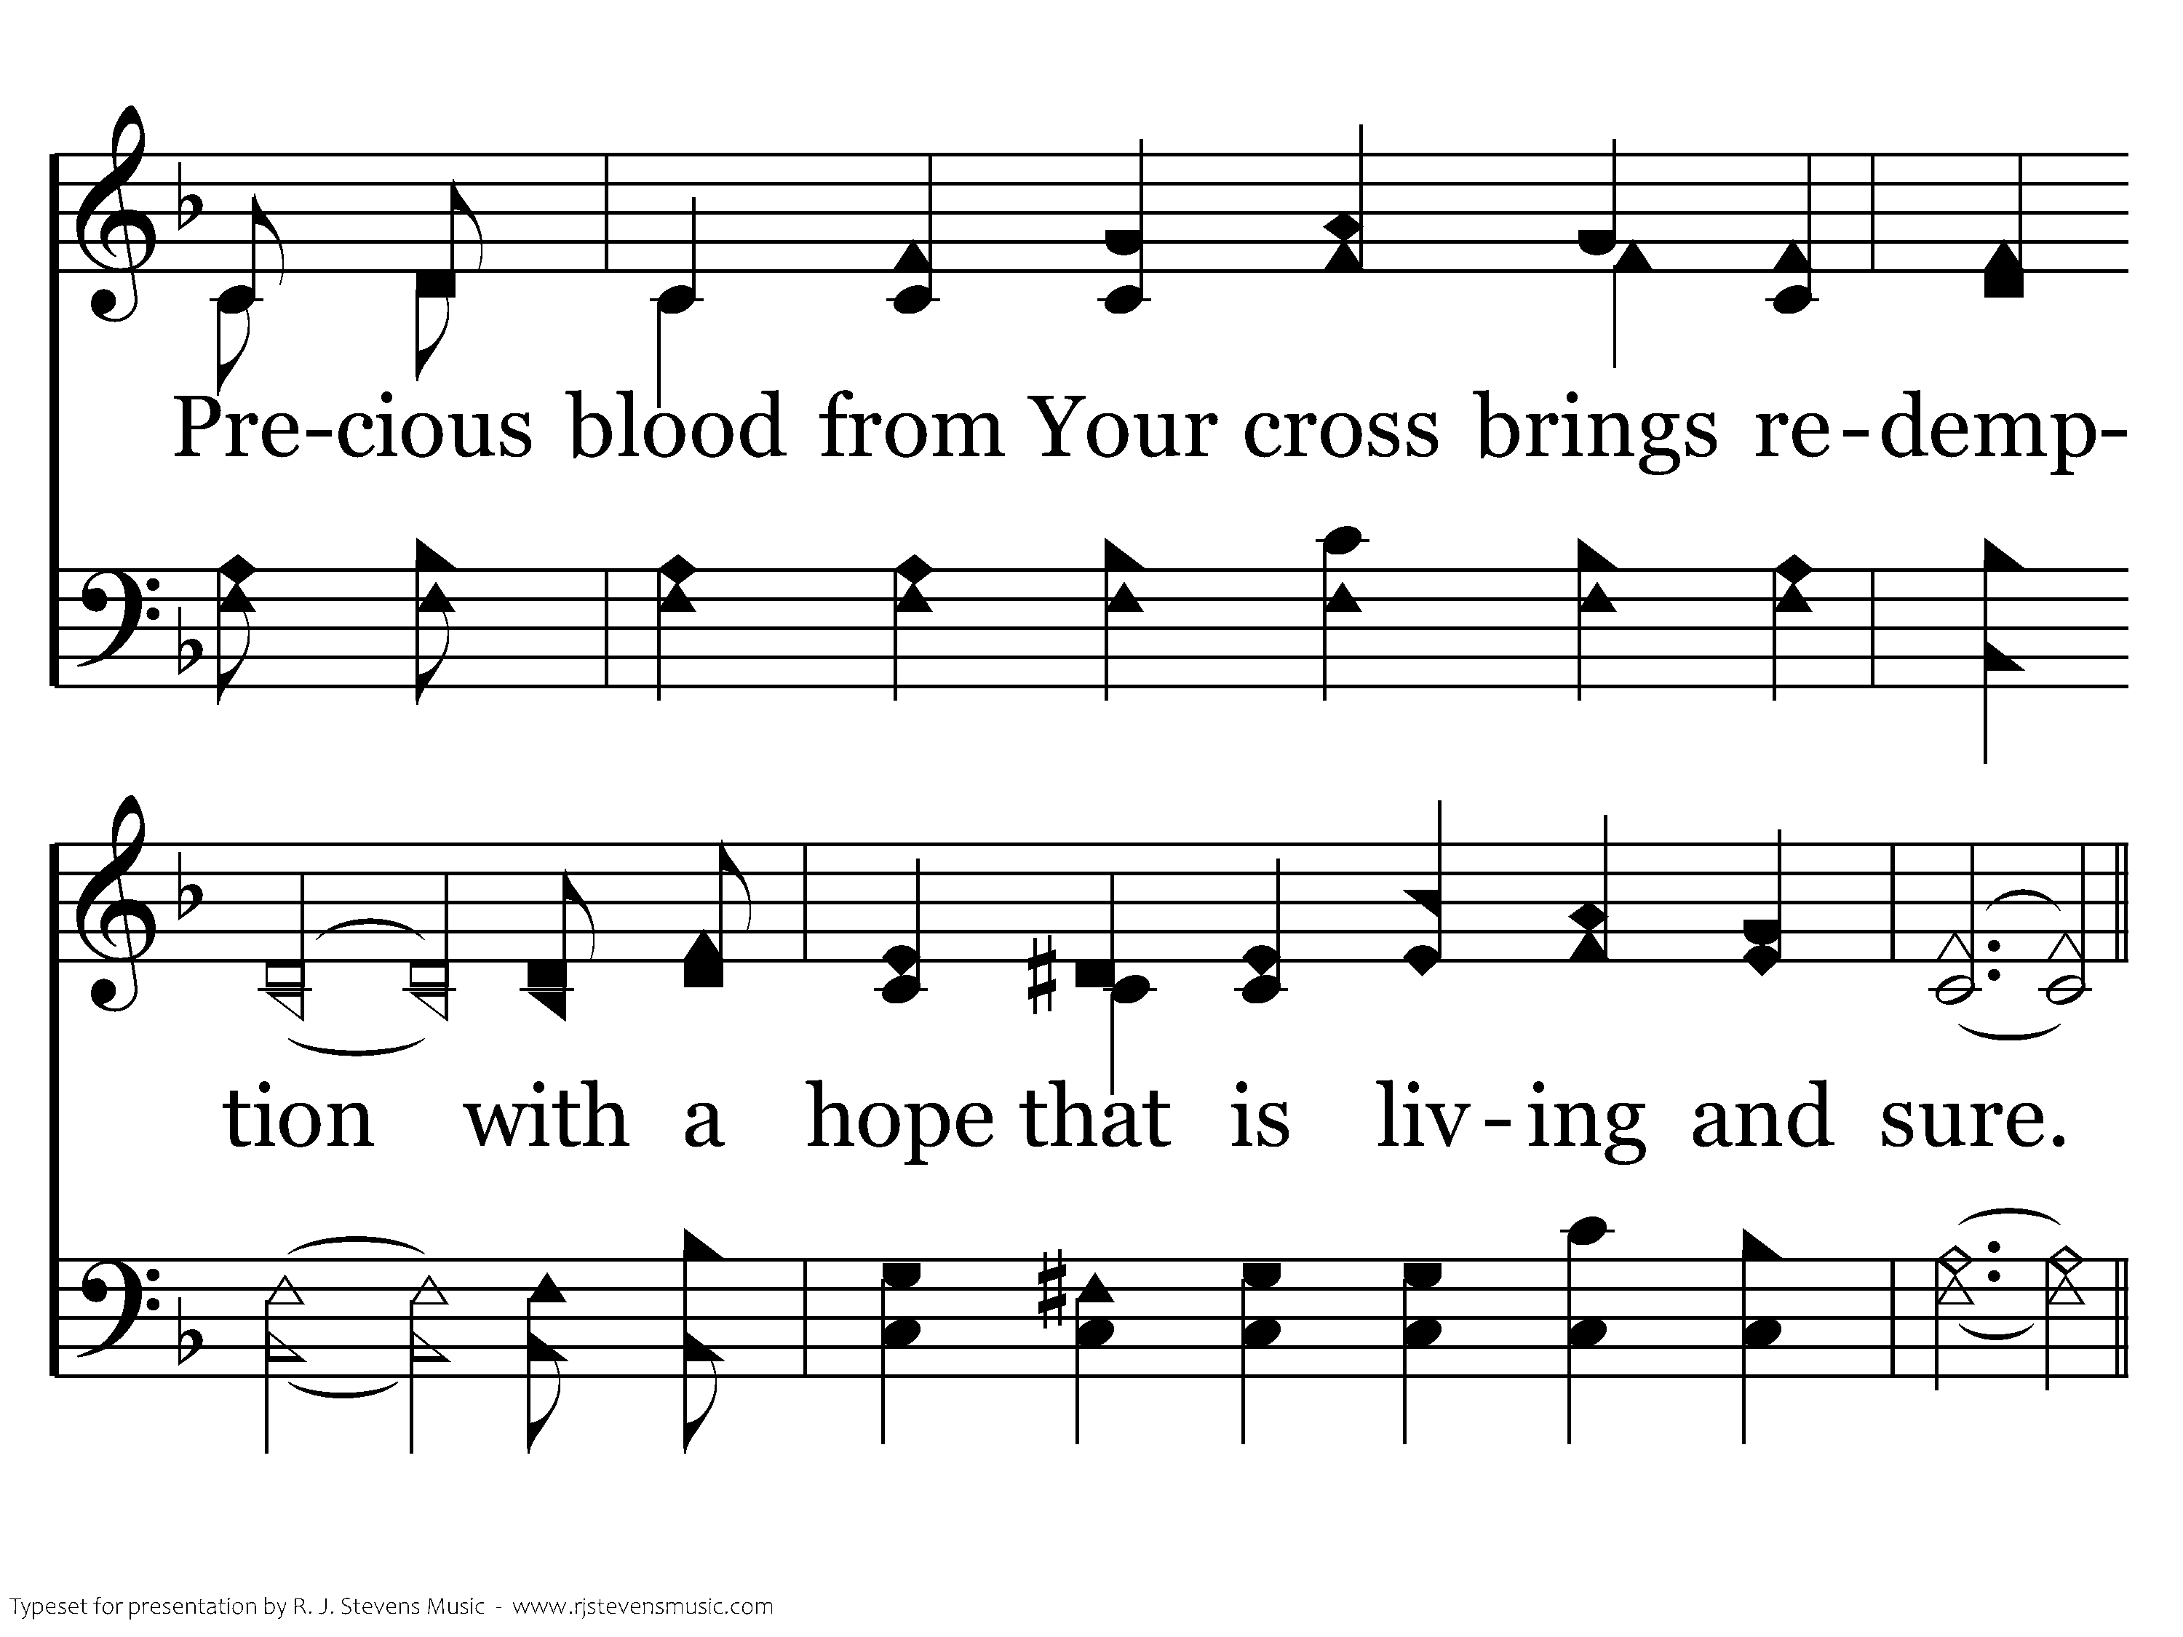
369 - Mended And Whole - 3.2

Slide 13
369 - Mended And Whole - C.1

Slide 14
369 - Mended And Whole - C.2

Slide 15
369 - Mended And Whole - C.3

Slide 16
369 - Mended And Whole - C.4
End of Song

Slide 18
Opening Prayer
Aaron Schmidt

Slide 20
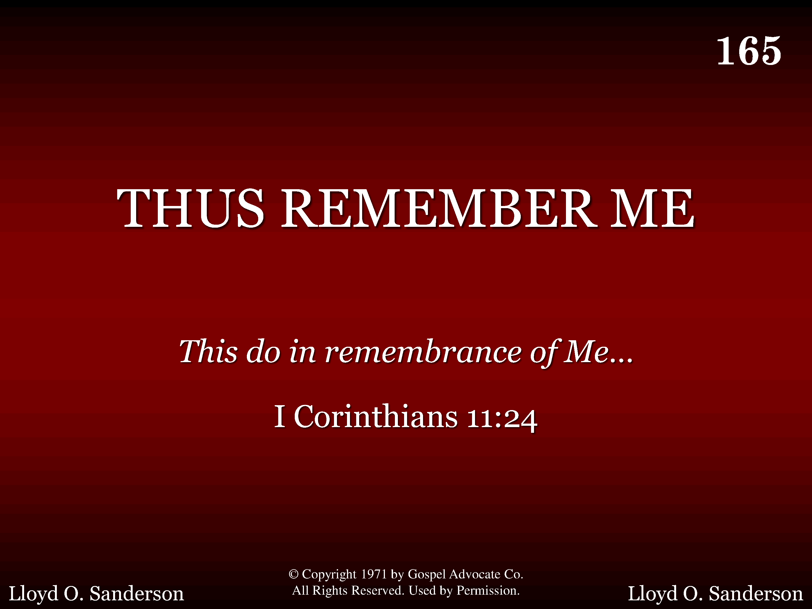
165 - Thus Remember Me - Title

Slide 21
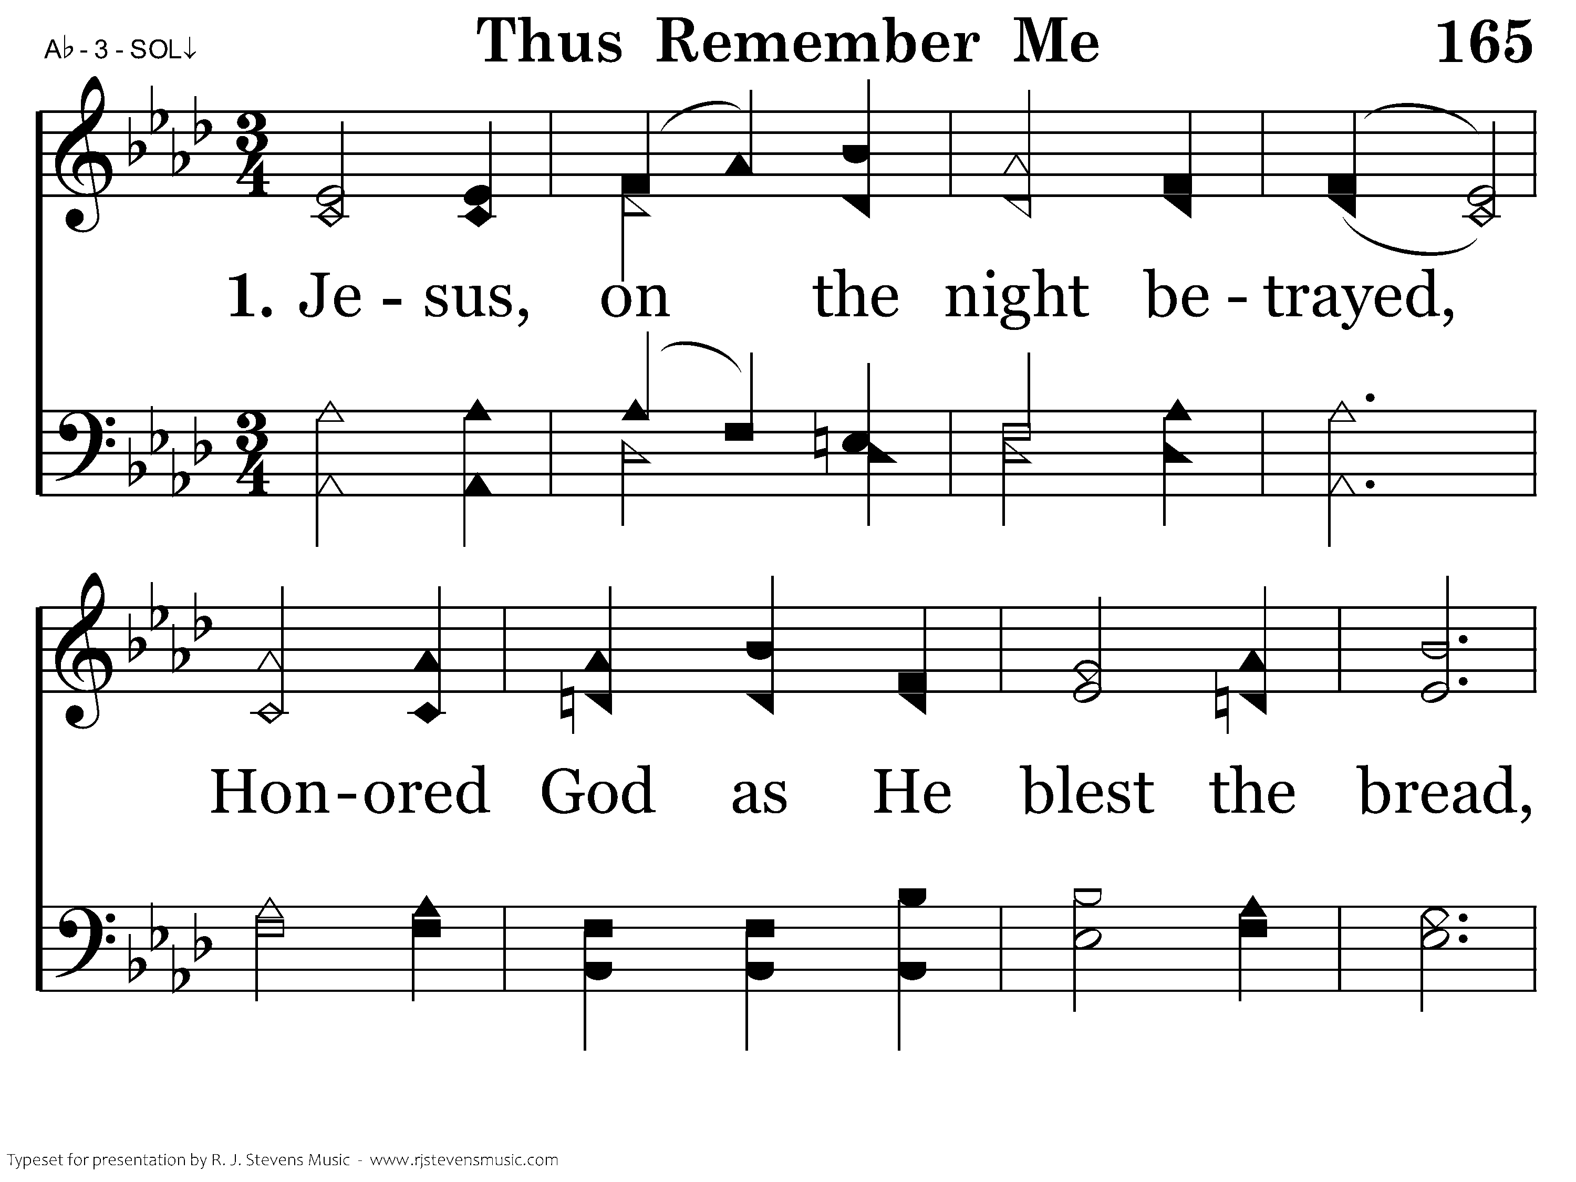
165 - Thus Remember Me - 1.1

Slide 22
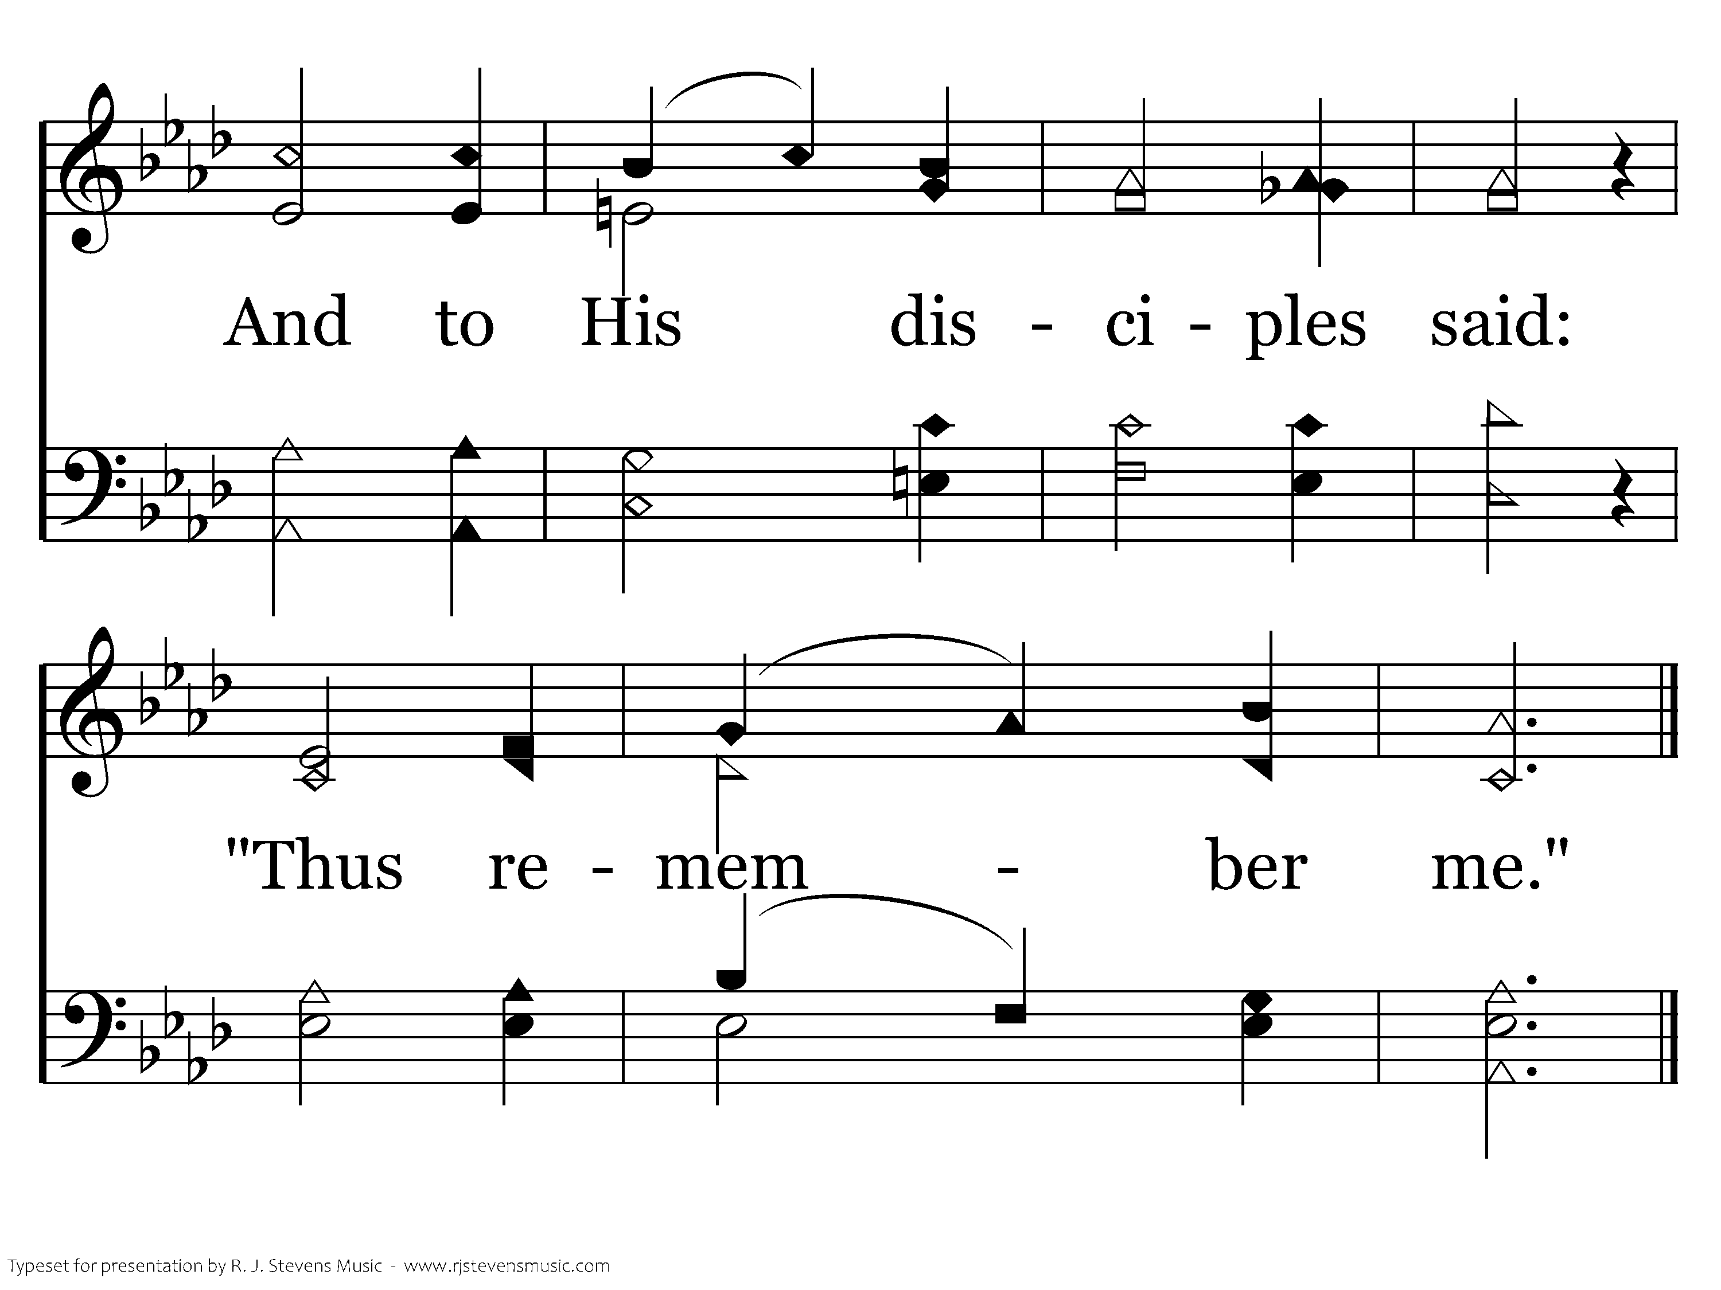
165 - Thus Remember Me - 1.2
End of Verse 1

Slide 23
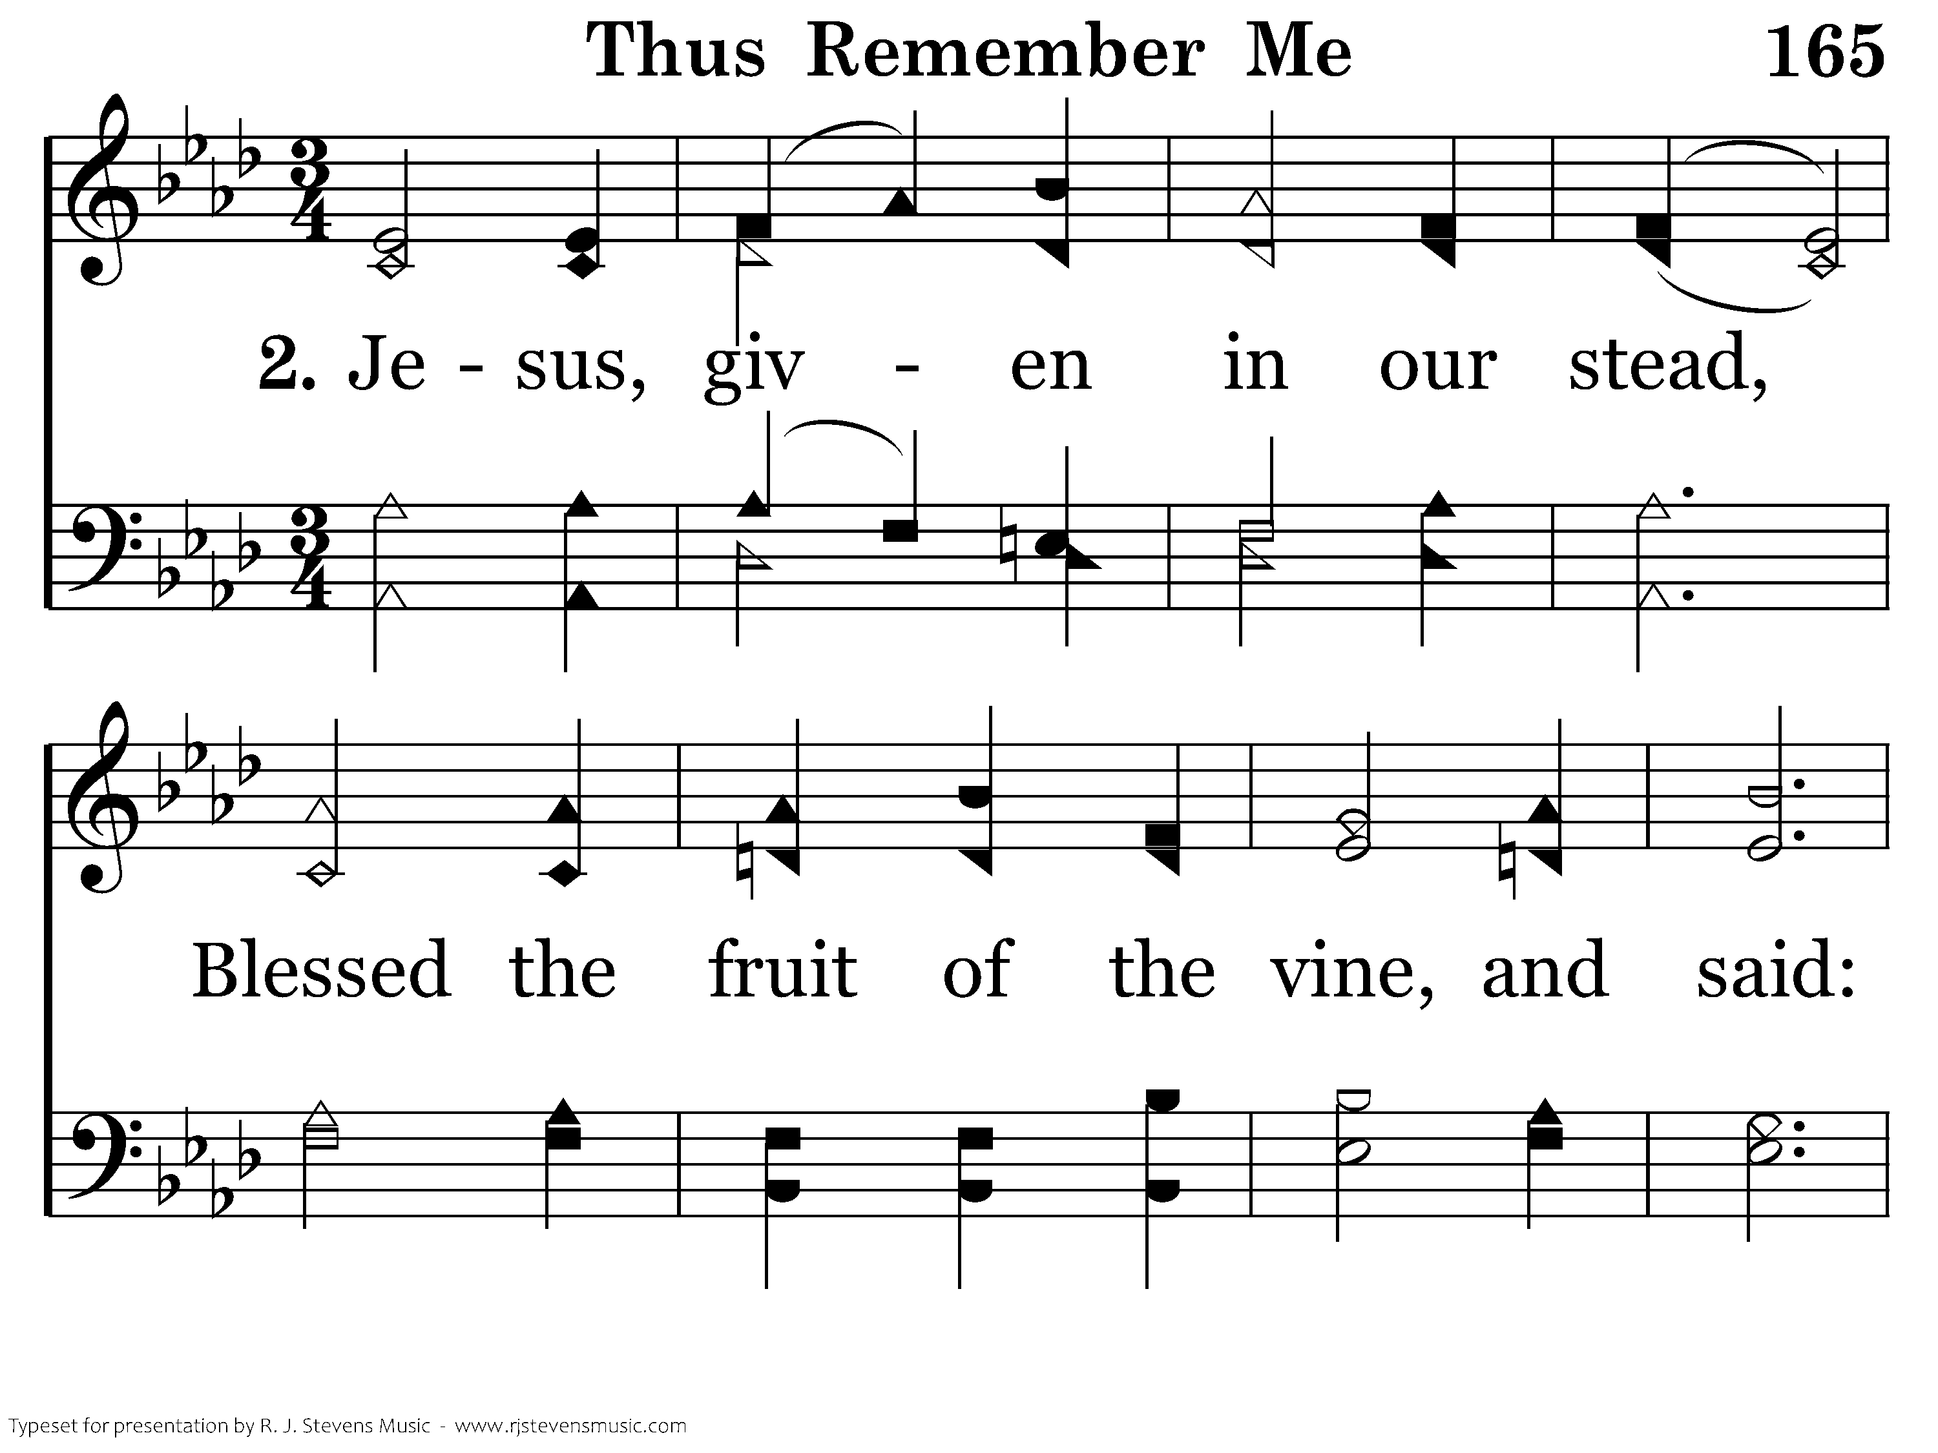
165 - Thus Remember Me - 2.1

Slide 24
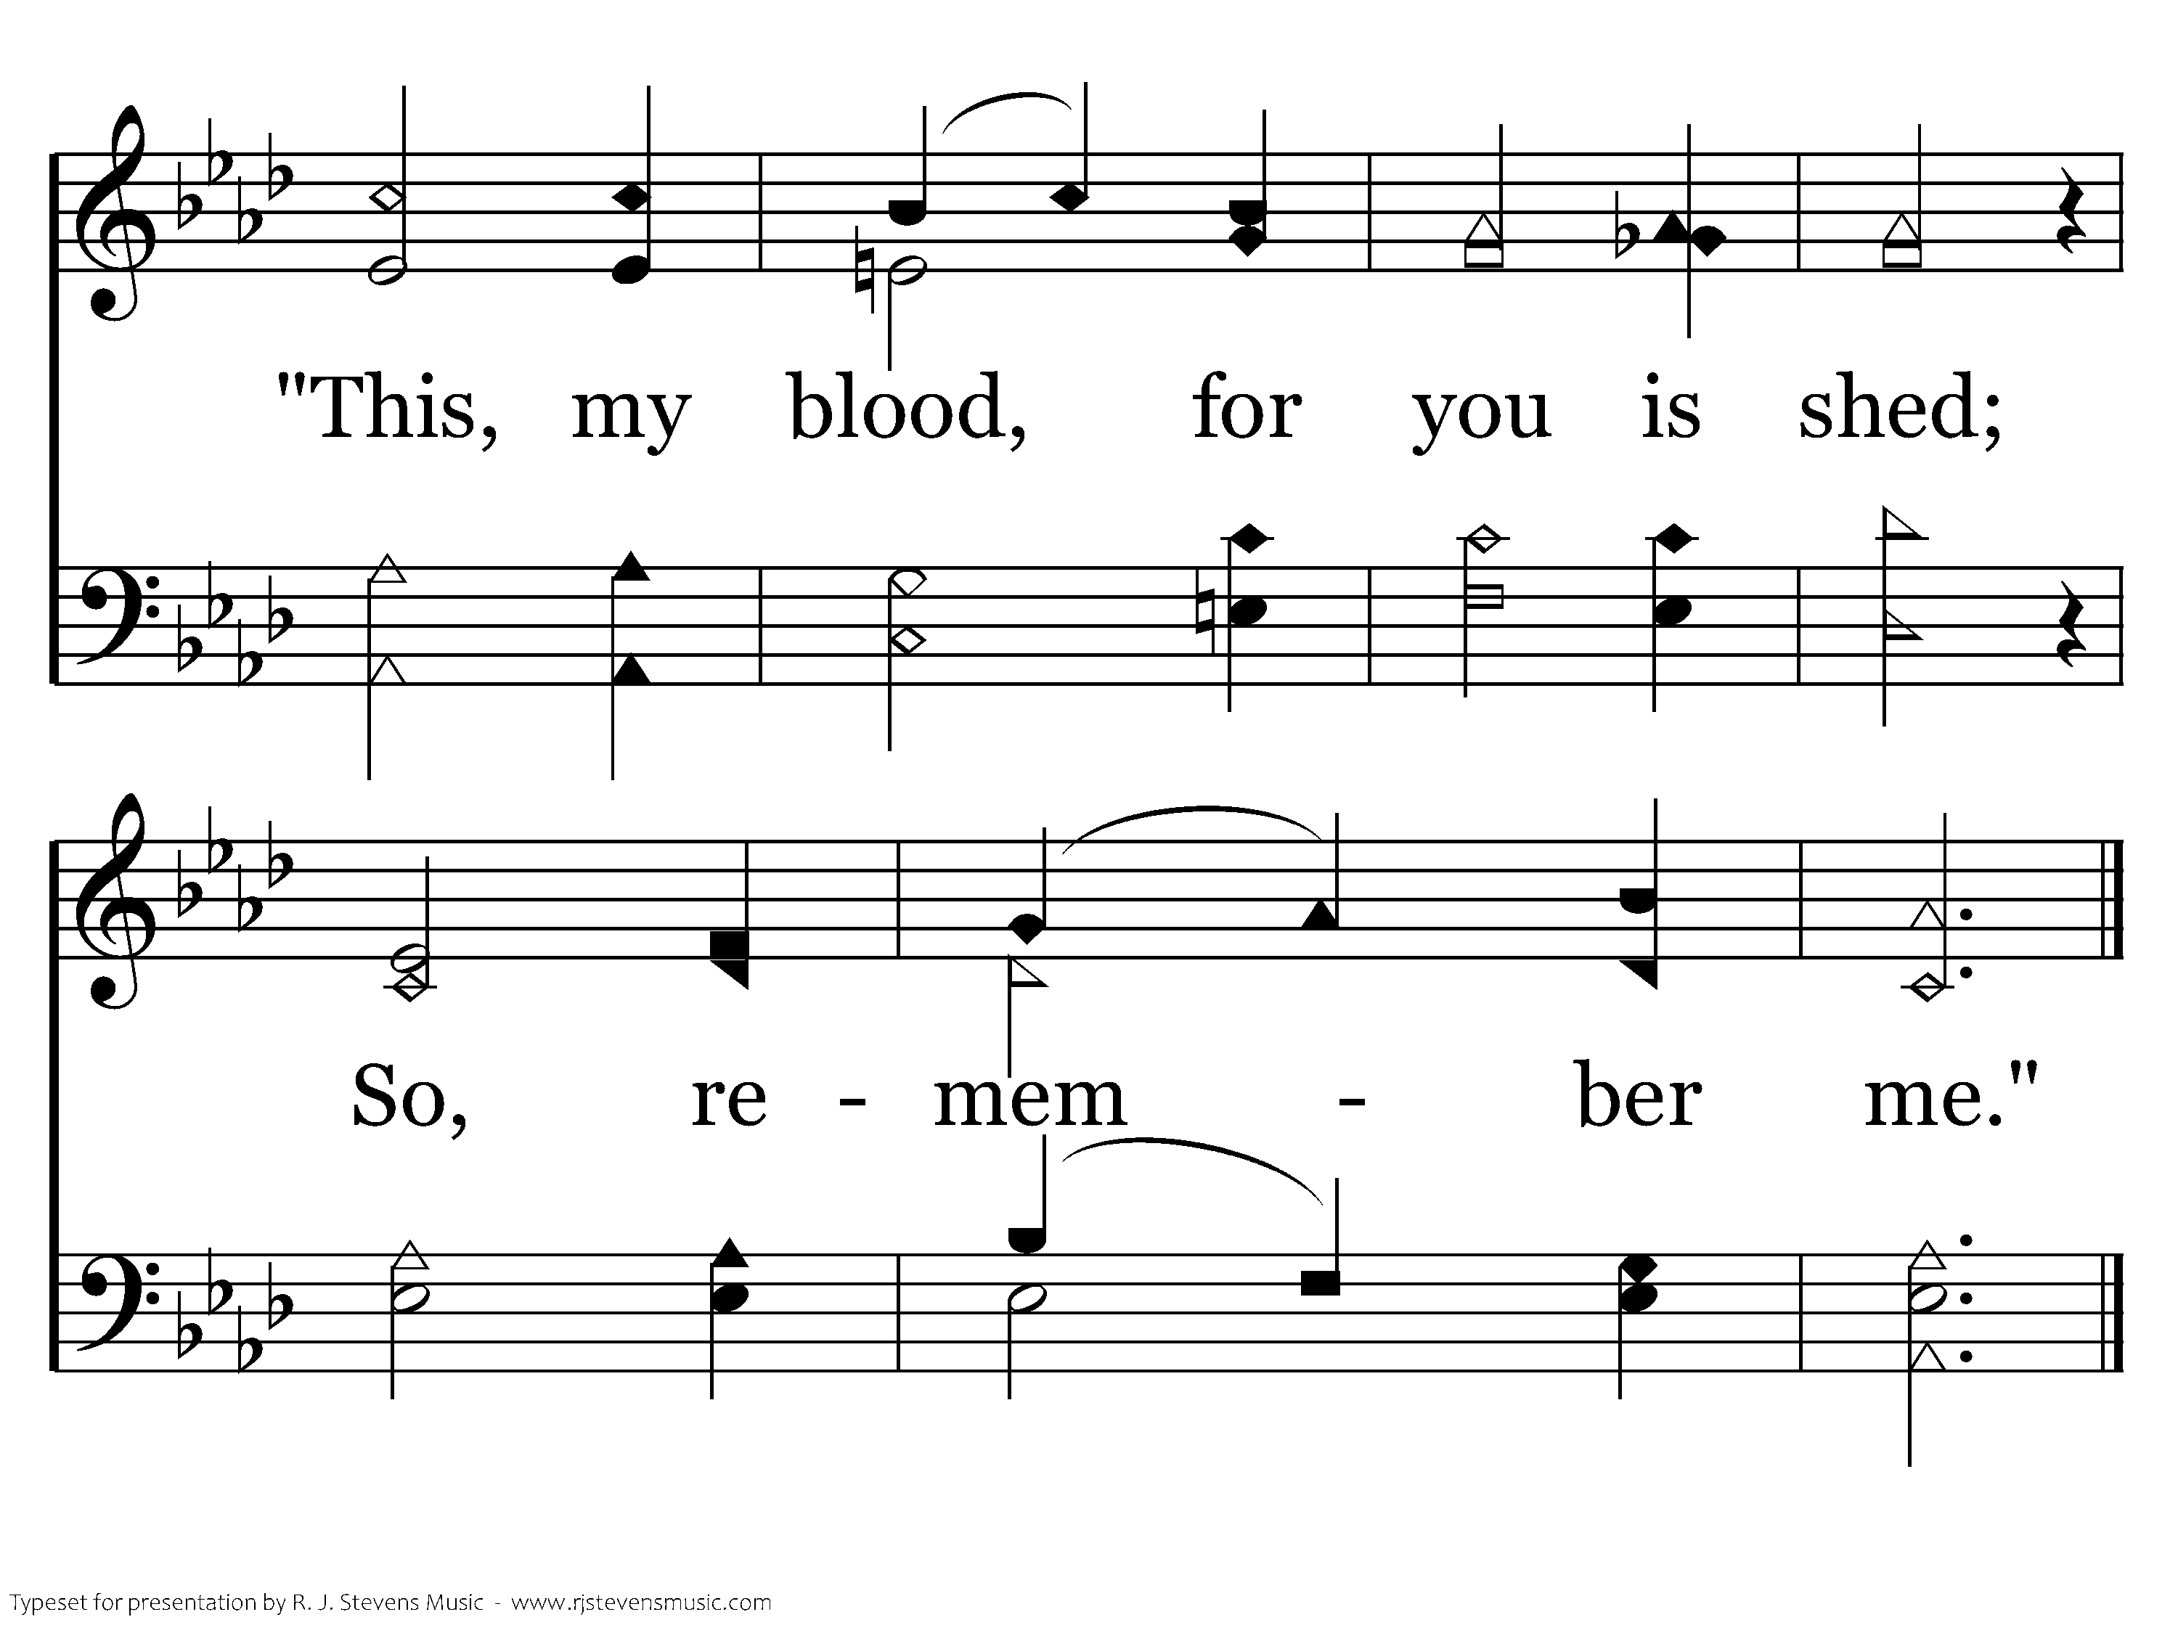
165 - Thus Remember Me - 2.2
End of Verse 2

Slide 25
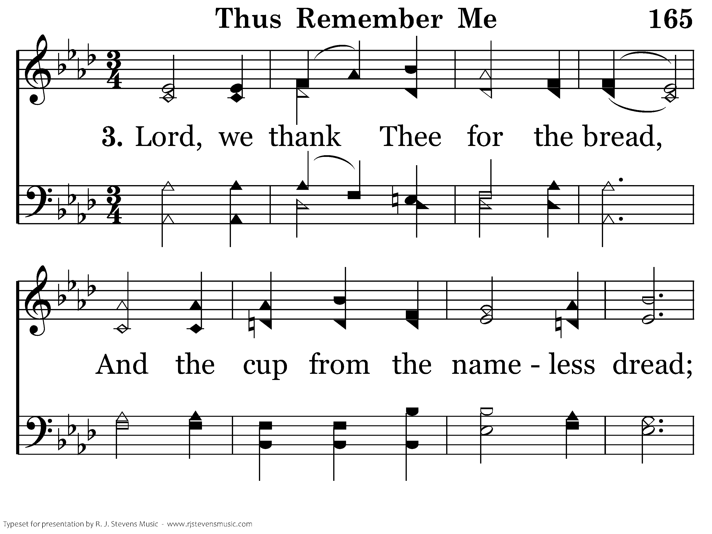
165 - Thus Remember Me - 3.1

Slide 26
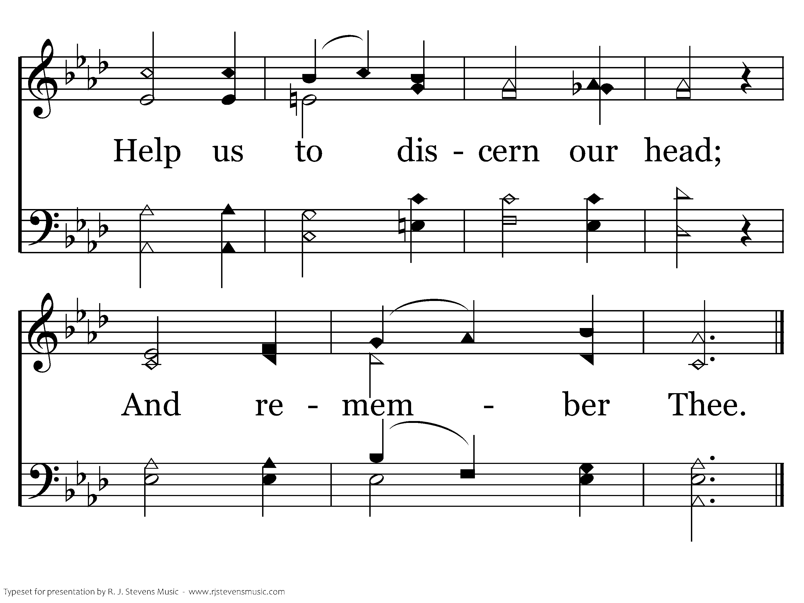
165 - Thus Remember Me - 3.2
End of Song

Slide 28
Lord’s Supper
Evan Rude

Slide 30

²³ For I received from the Lord what I also delivered to you, that the Lord Jesus on the night when he was betrayed took bread, ²⁴ and when he had given thanks, he broke it, and said, “This is my body, which is for you. Do this in remembrance of me.” ²⁵ In the same way also he took the cup, after supper, saying, “This cup is the new covenant in my blood. Do this, as often as you drink it, in remembrance of me.” ²⁶ For as often as you eat this bread and drink the cup, you proclaim the Lord's death until he comes.
1 Corinthians 11:23-26

Slide 32

While they were eating, Jesus took bread, and when he had given thanks, he broke it and gave it to his disciples, saying, “Take and eat; this is my body.” Then he took a cup, and when he had given thanks, he gave it to them, saying, “Drink from it, all of you. This is my blood of the covenant, which is poured out for many for the forgiveness of sins.
Mathew 26:26-28

Slide 34
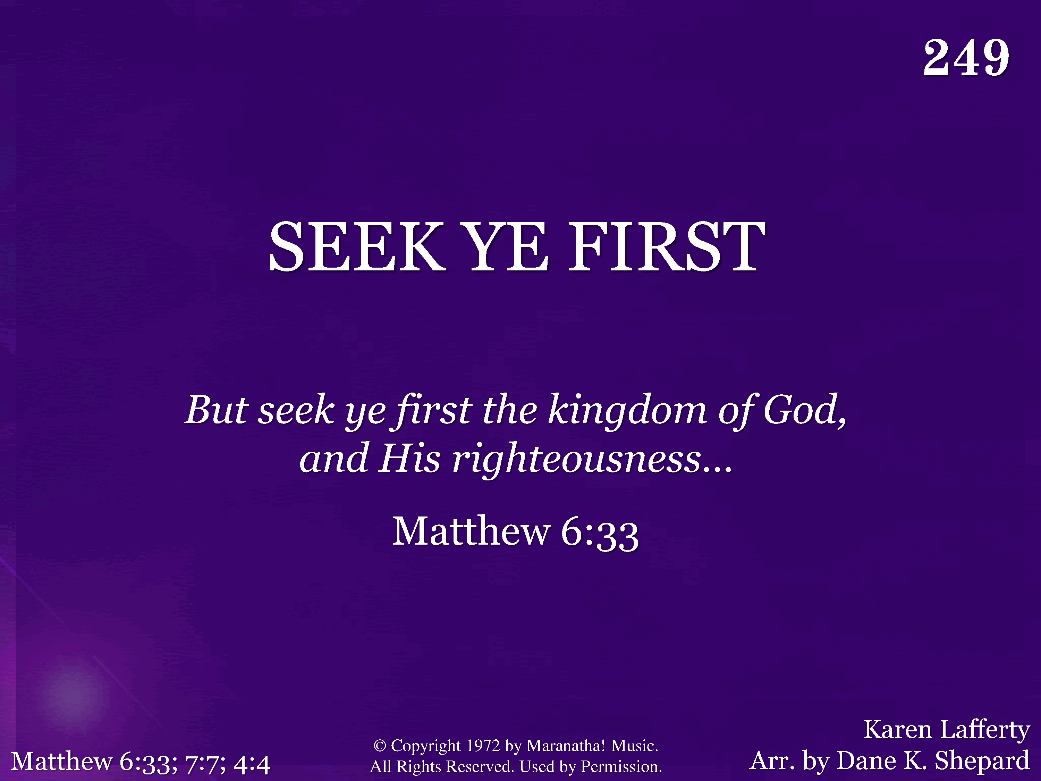
249 - Seek Ye First - Title

Slide 35
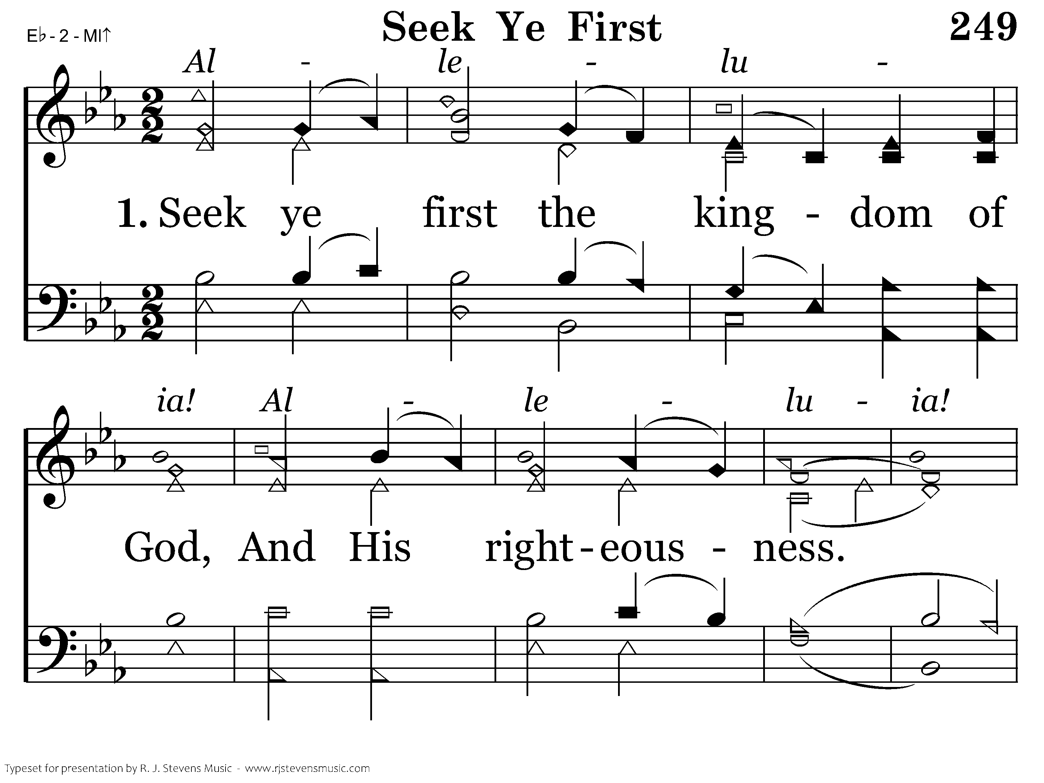
249 - Seek Ye First - 1.1

Slide 36
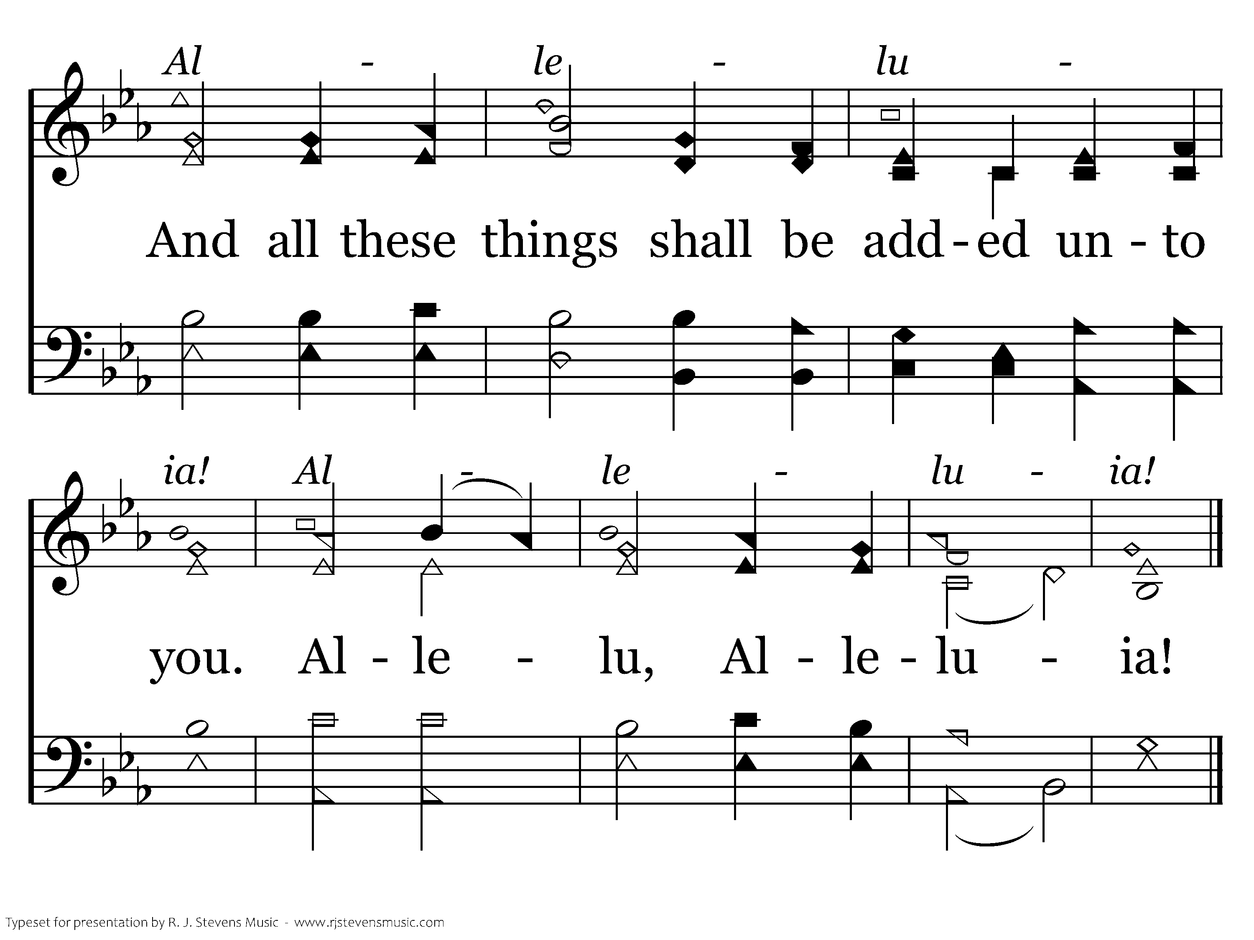
249 - Seek Ye First - 1.2
End of Verse 1

Slide 37
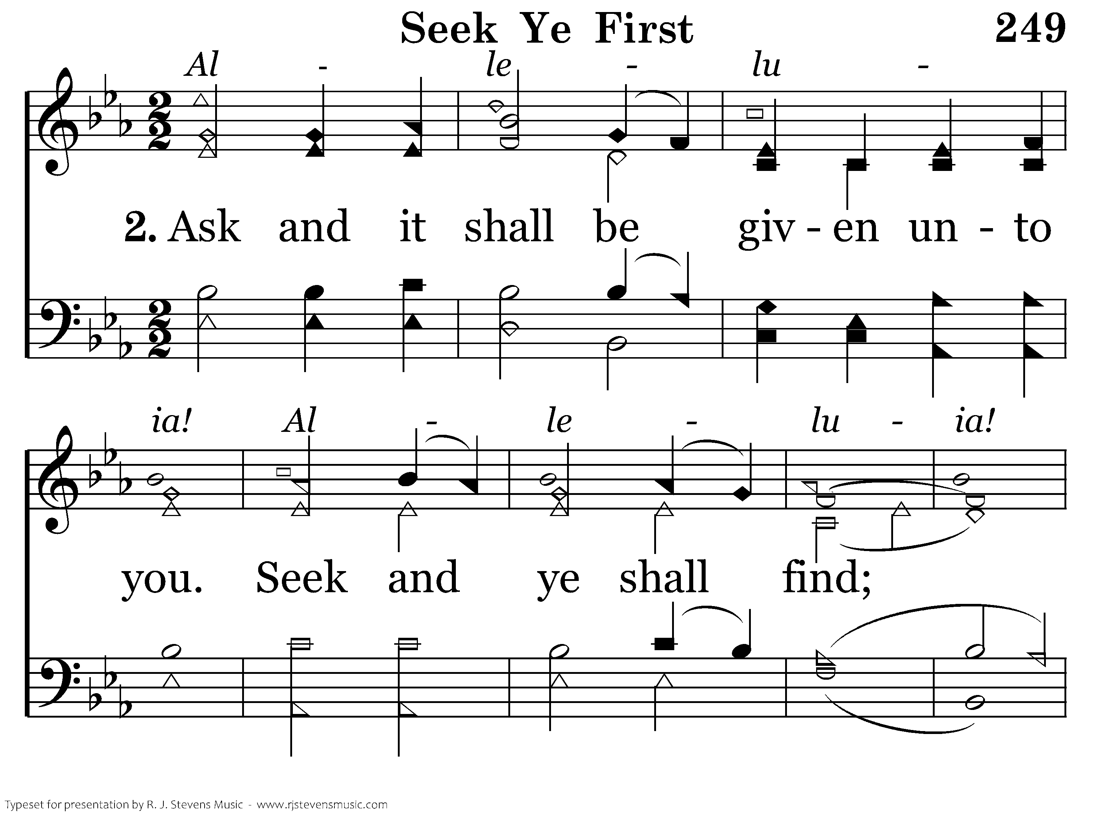
249 - Seek Ye First - 2.1

Slide 38
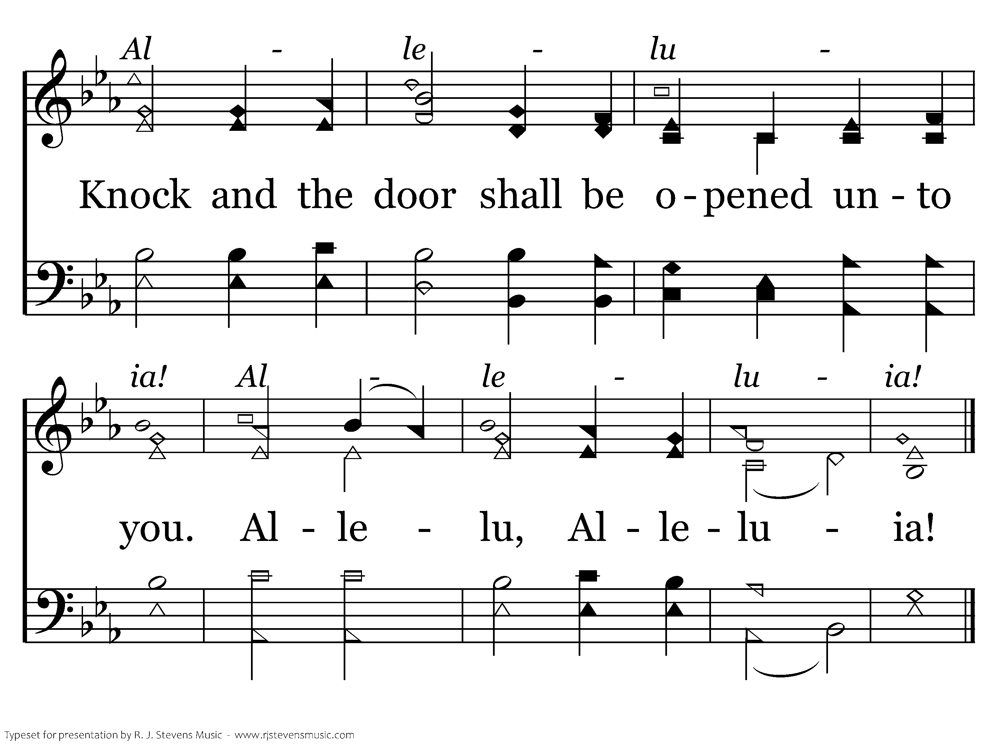
249 - Seek Ye First - 2.2
End of Verse 2

Slide 39
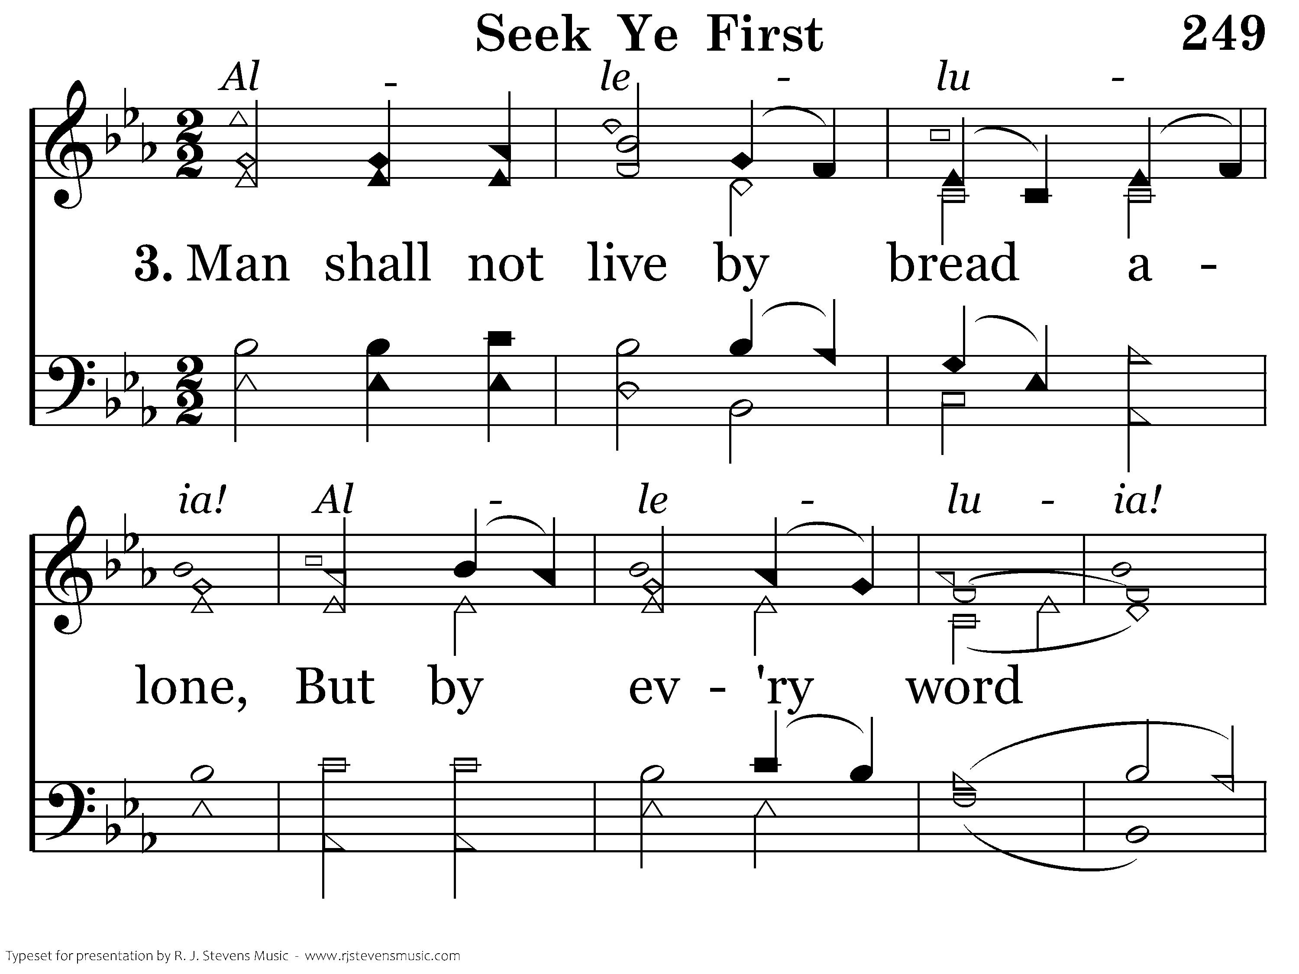
249 - Seek Ye First - 3.1

Slide 40
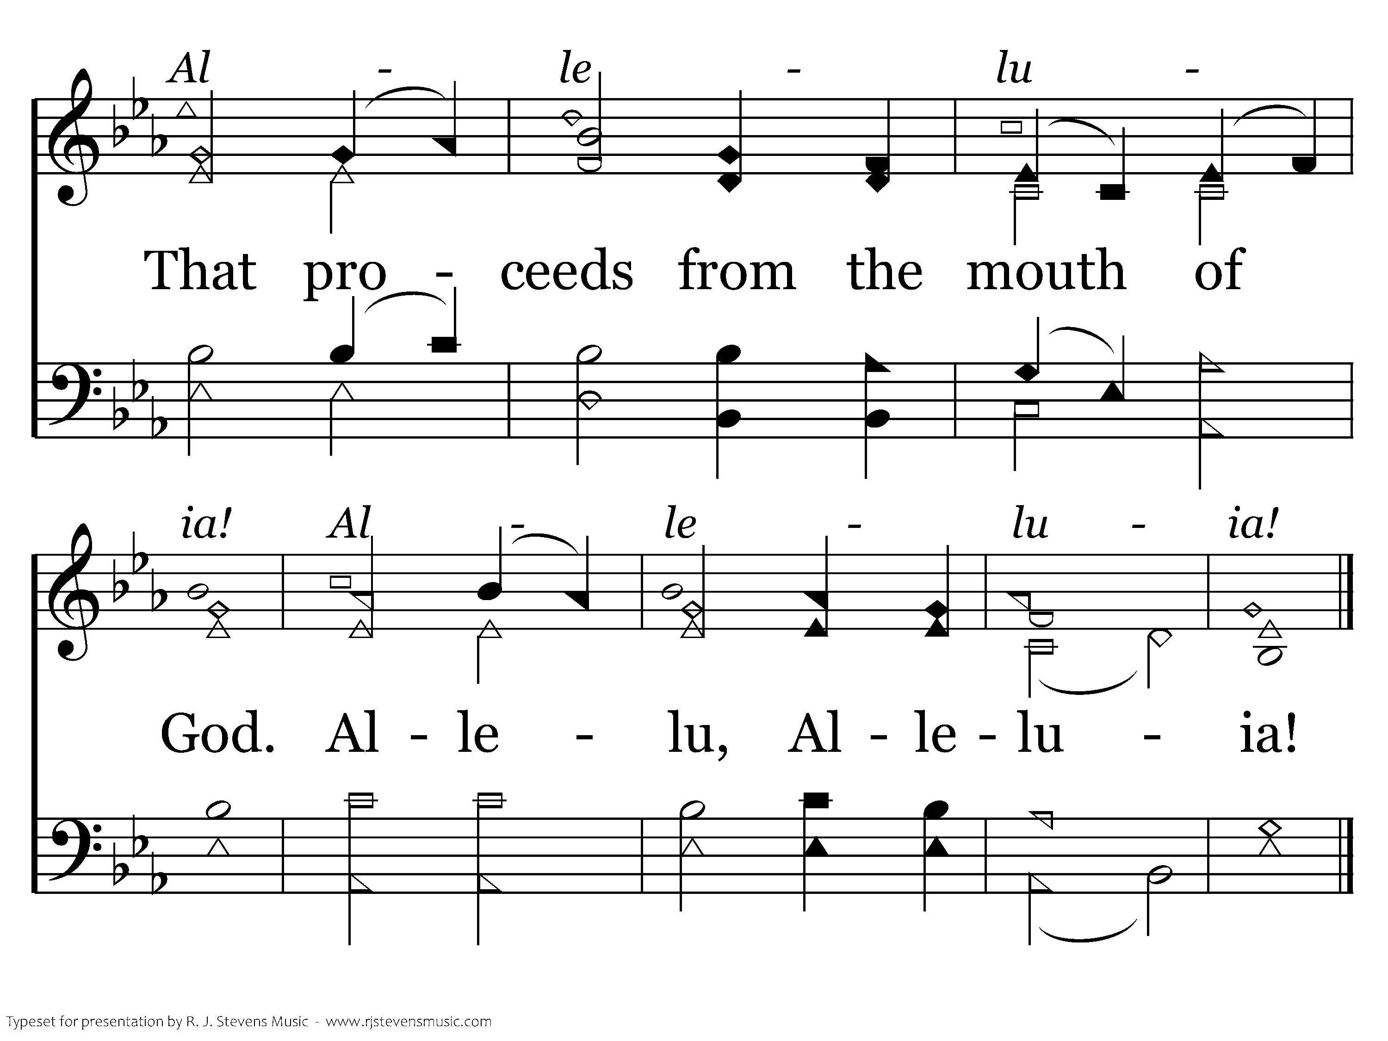
249 - Seek Ye First - 3.2
End of Song

Slide 41
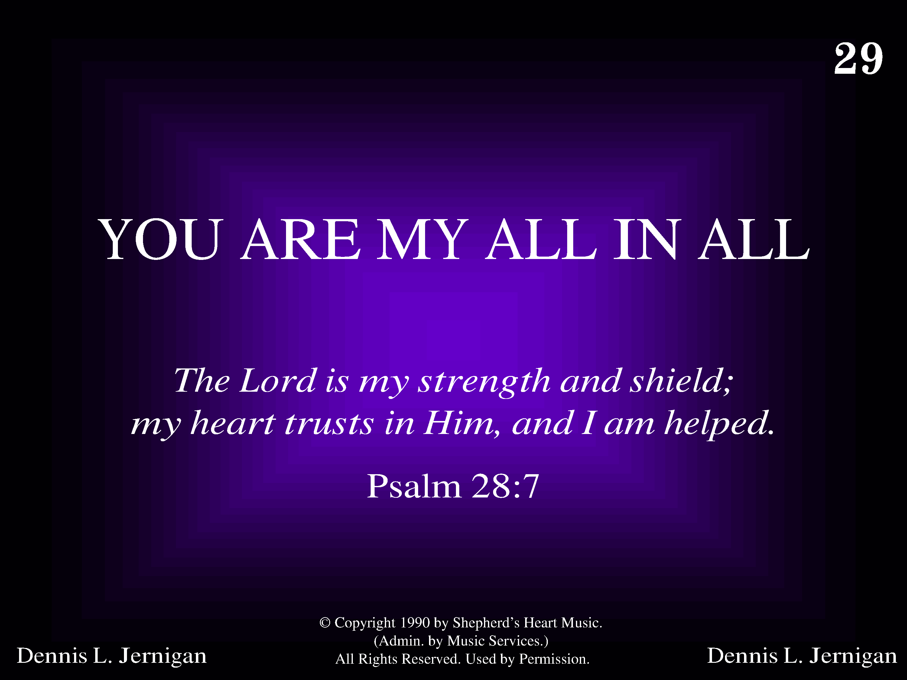
1029 - You Are My All In All - Title

Slide 42
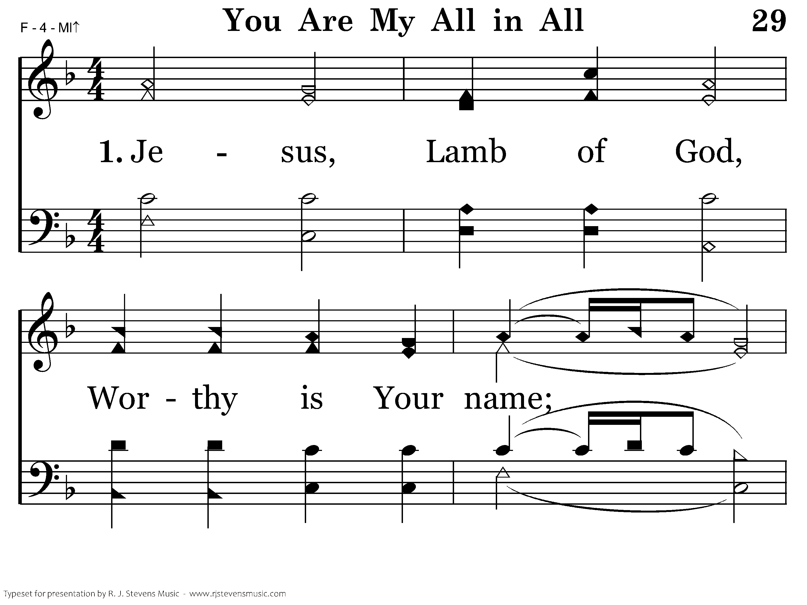
1029 - You Are My All In All - 1.1

Slide 43
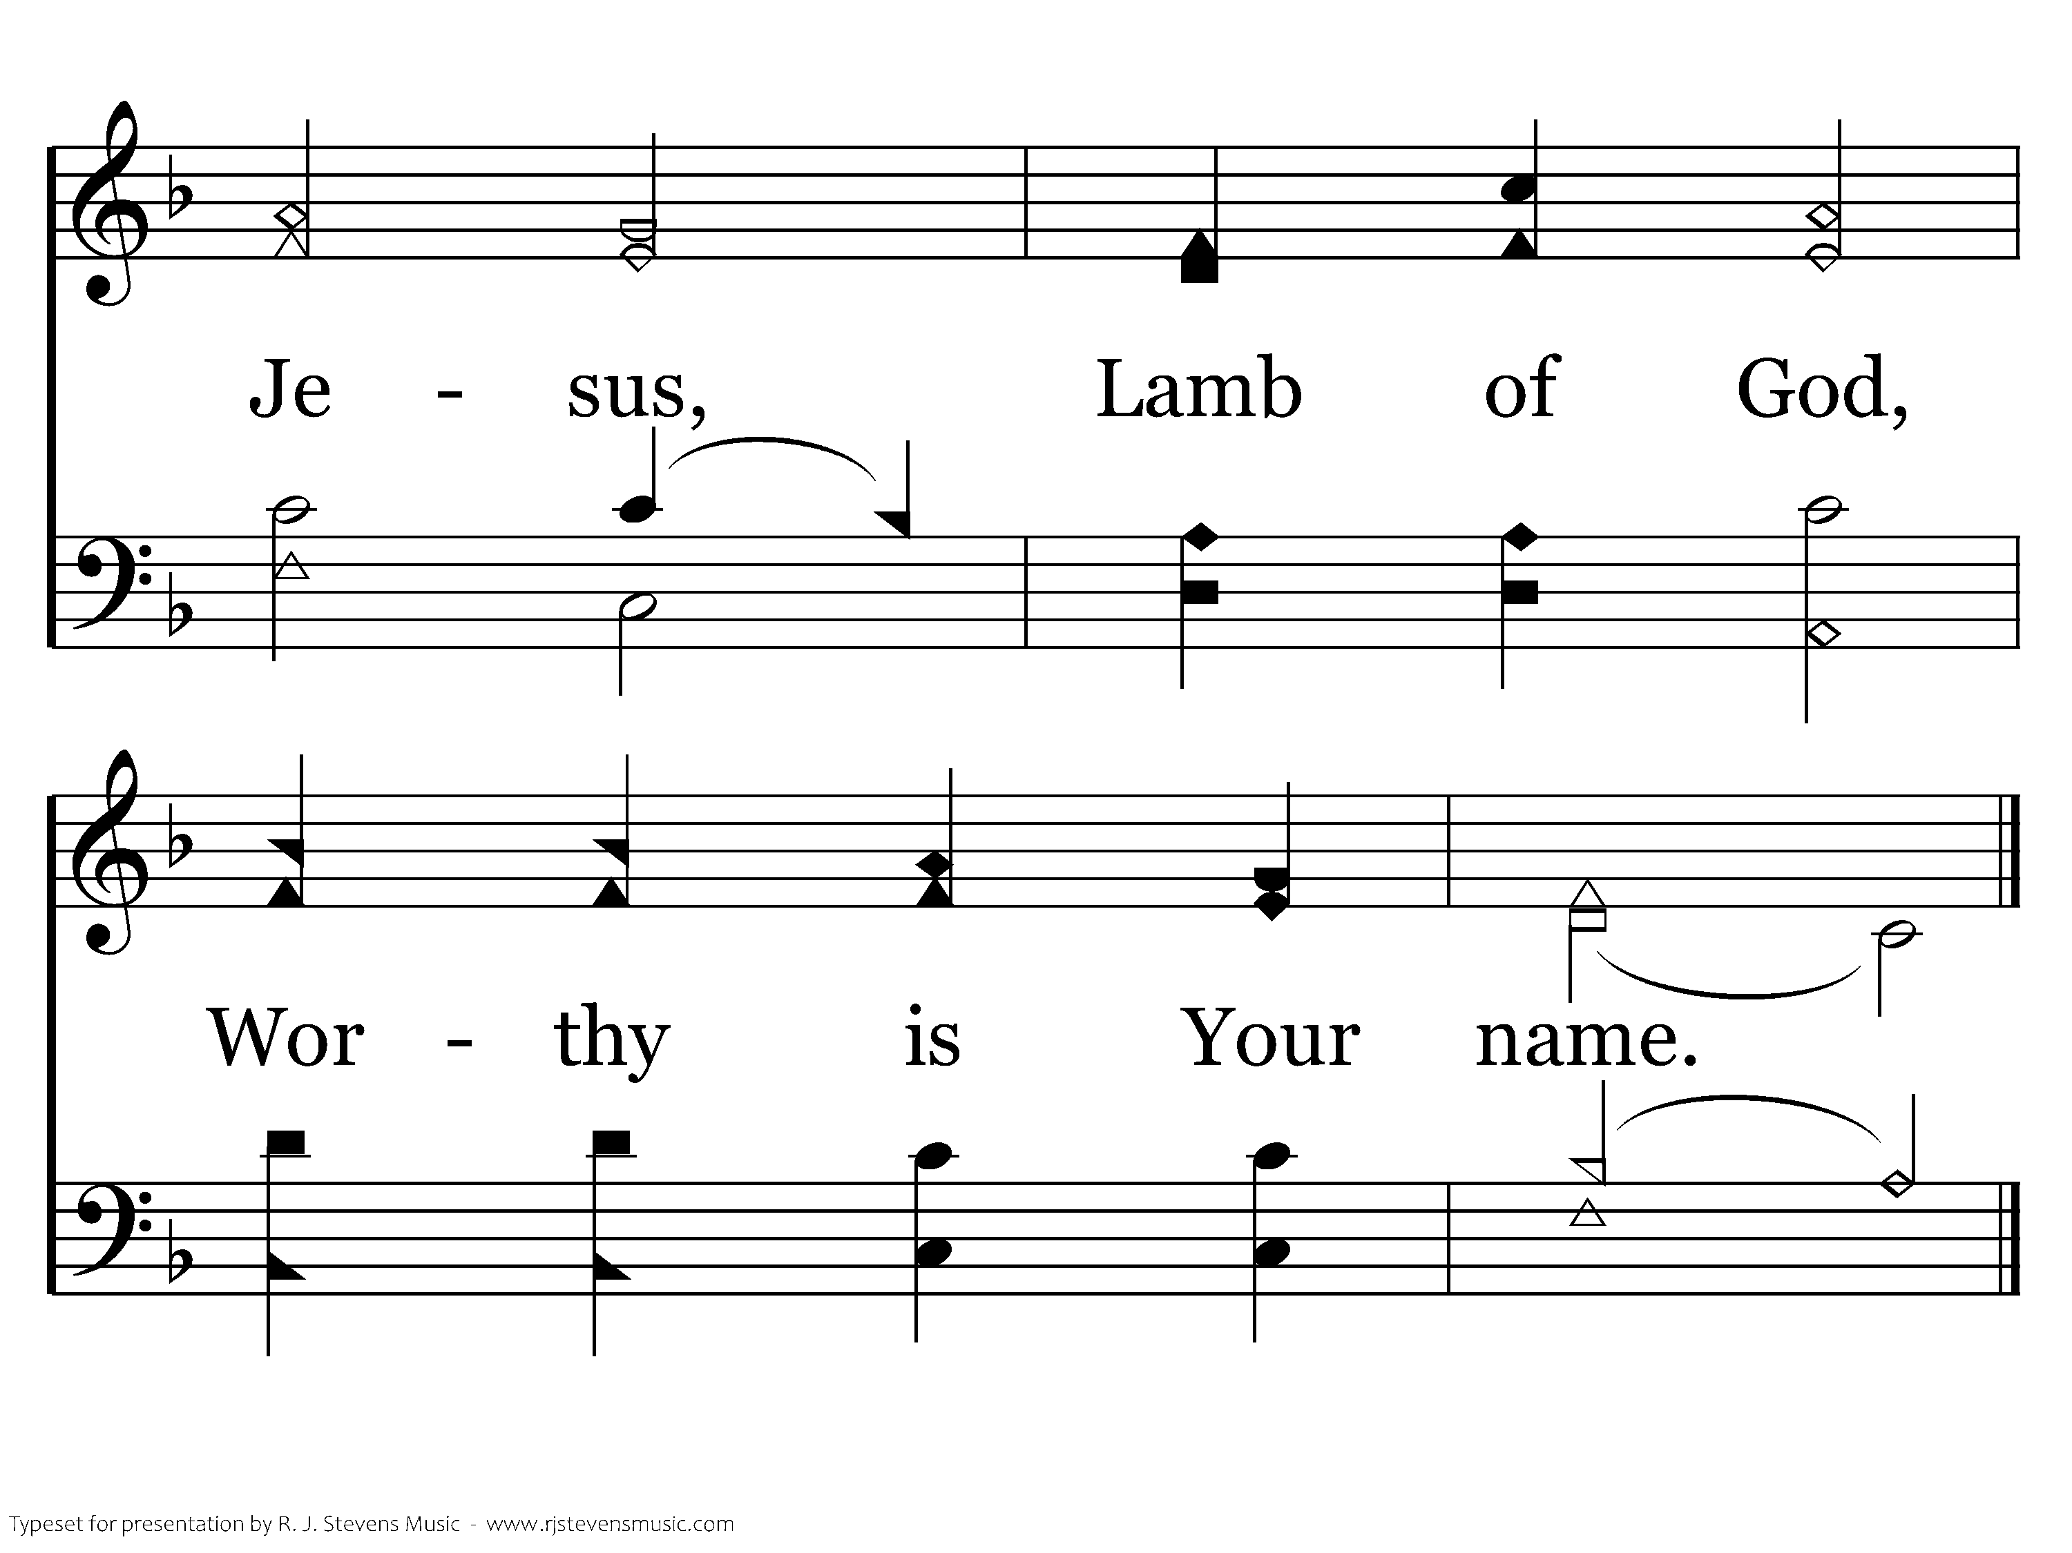
1029 - You Are My All In All - 1.2
End of Verse 1

Slide 44
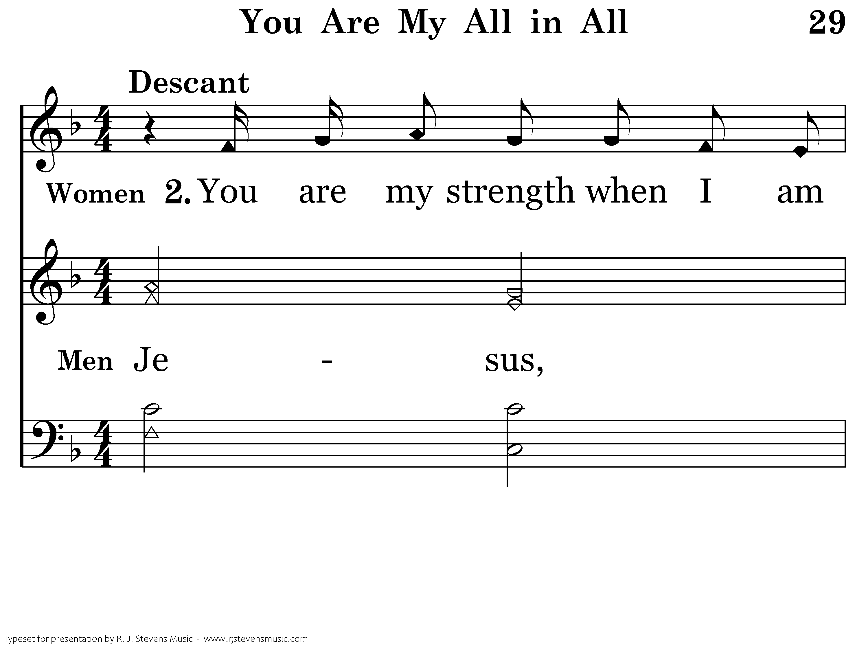
1029 - You Are My All In All - 2.1

Slide 45
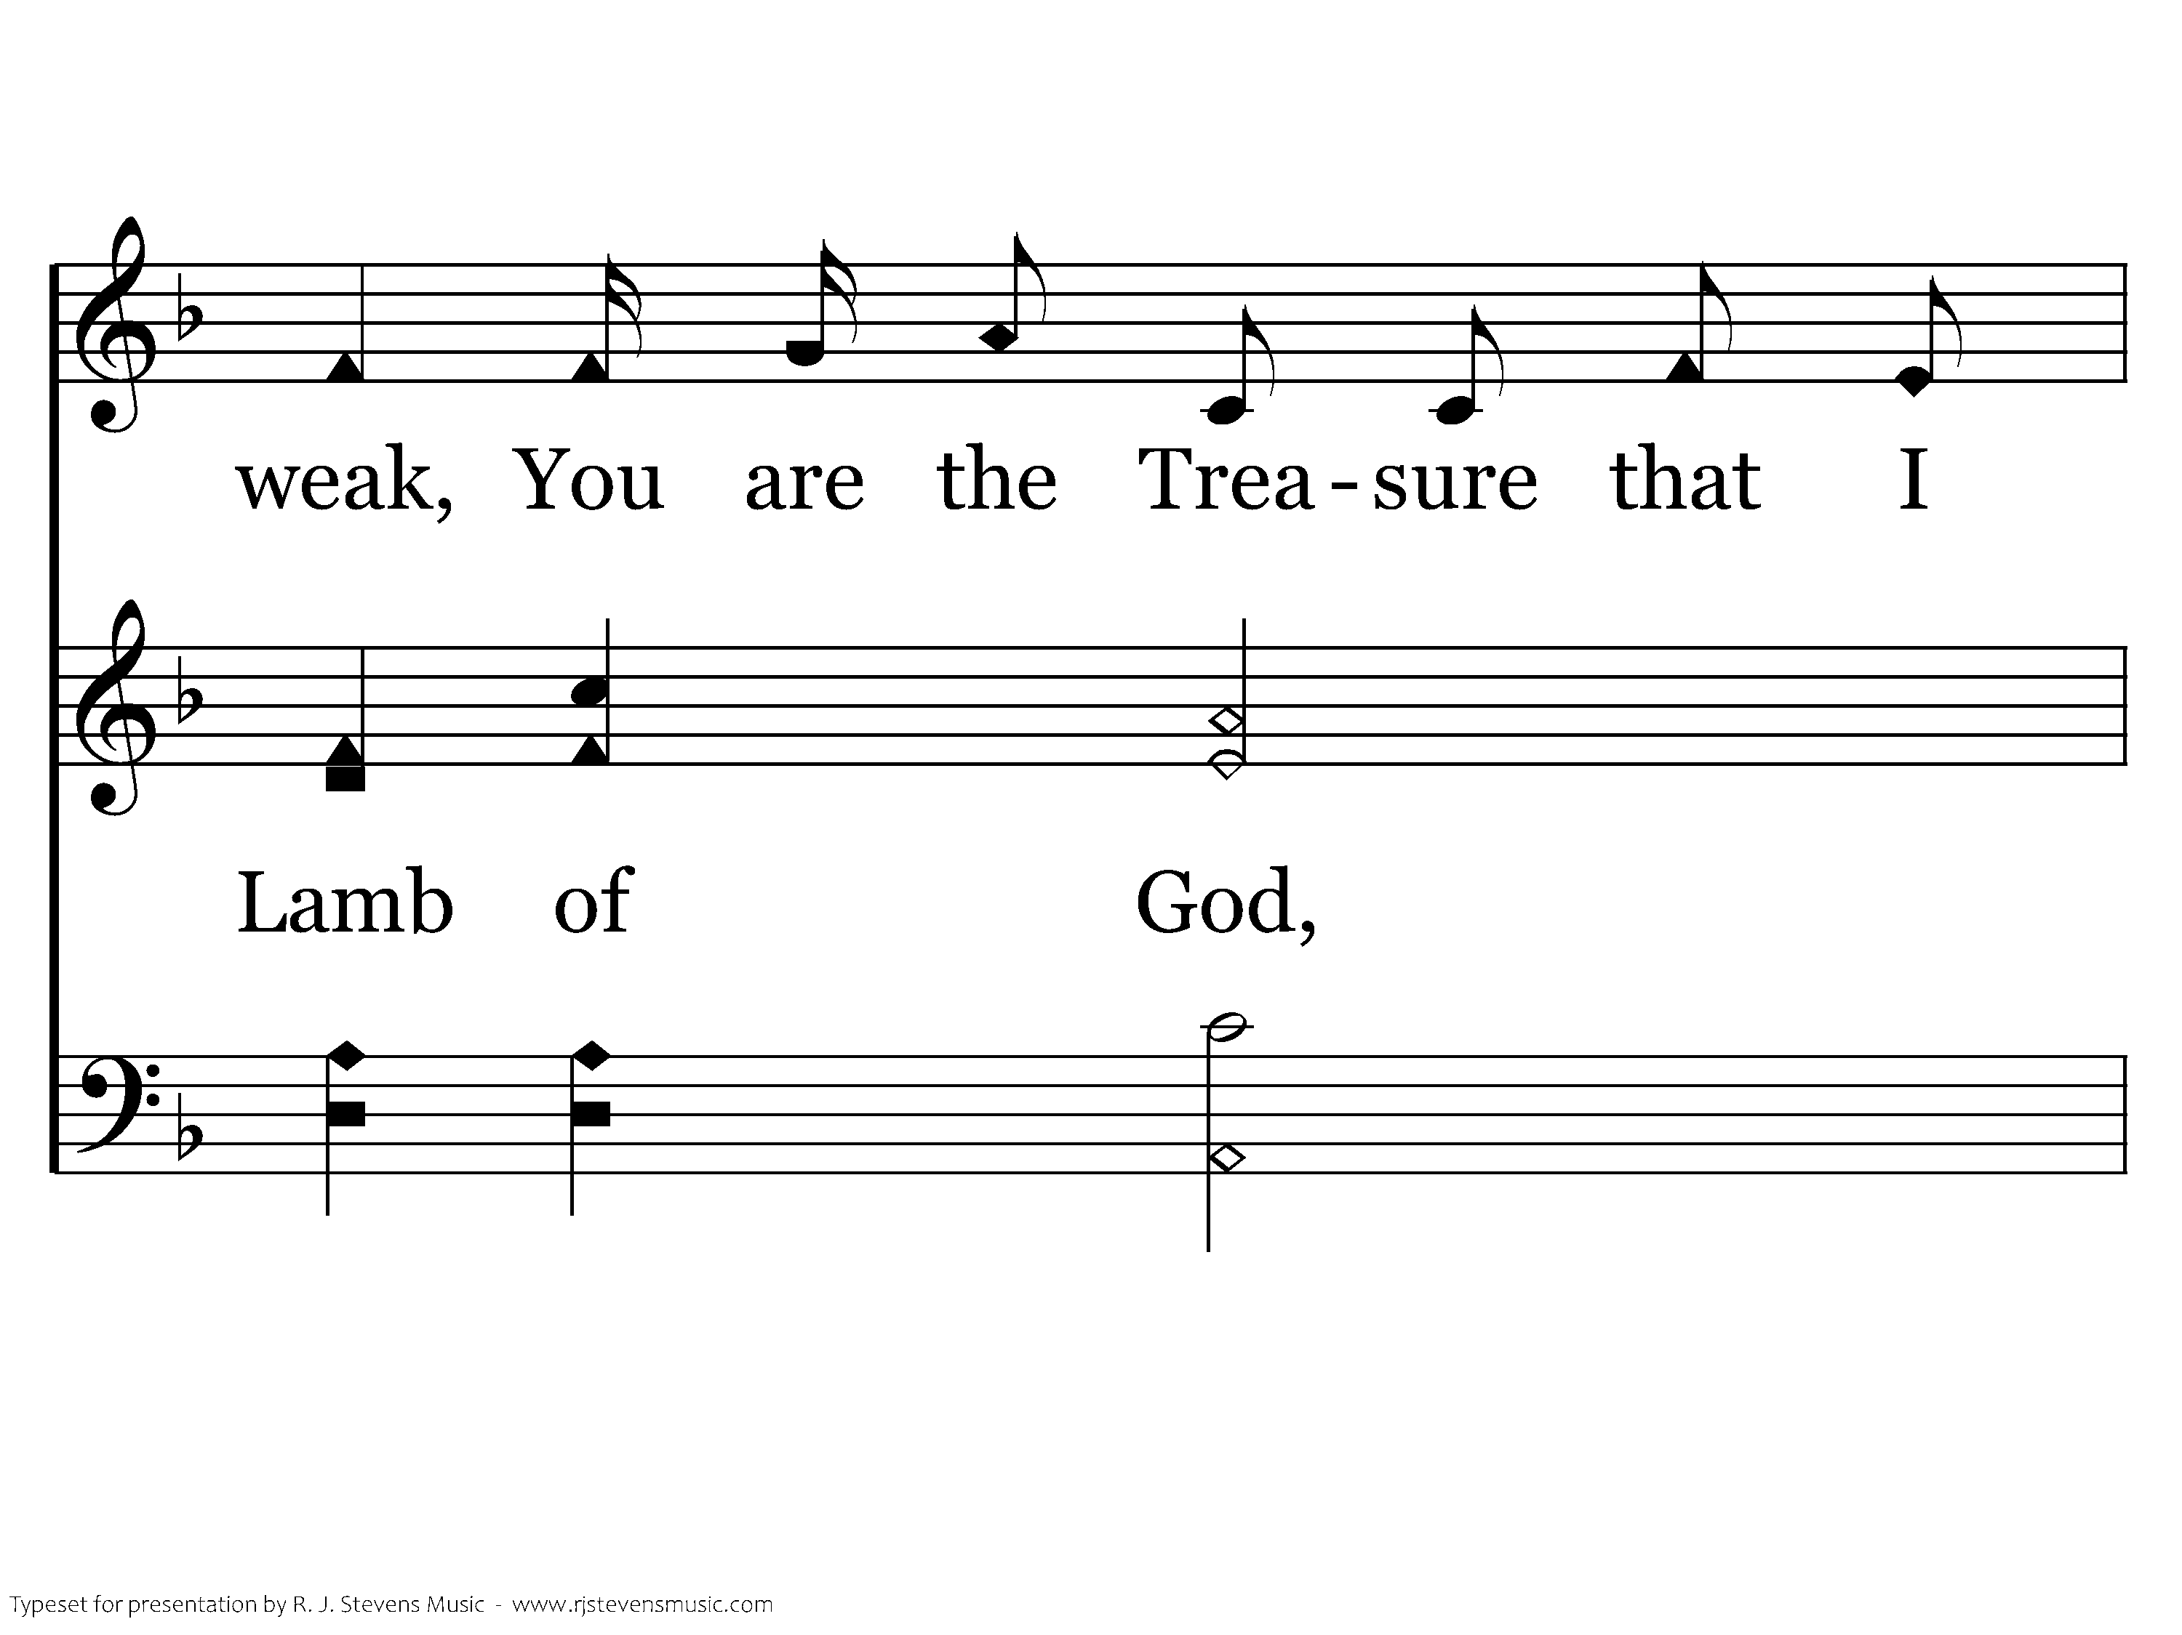
1029 - You Are My All In All - 2.2

Slide 46
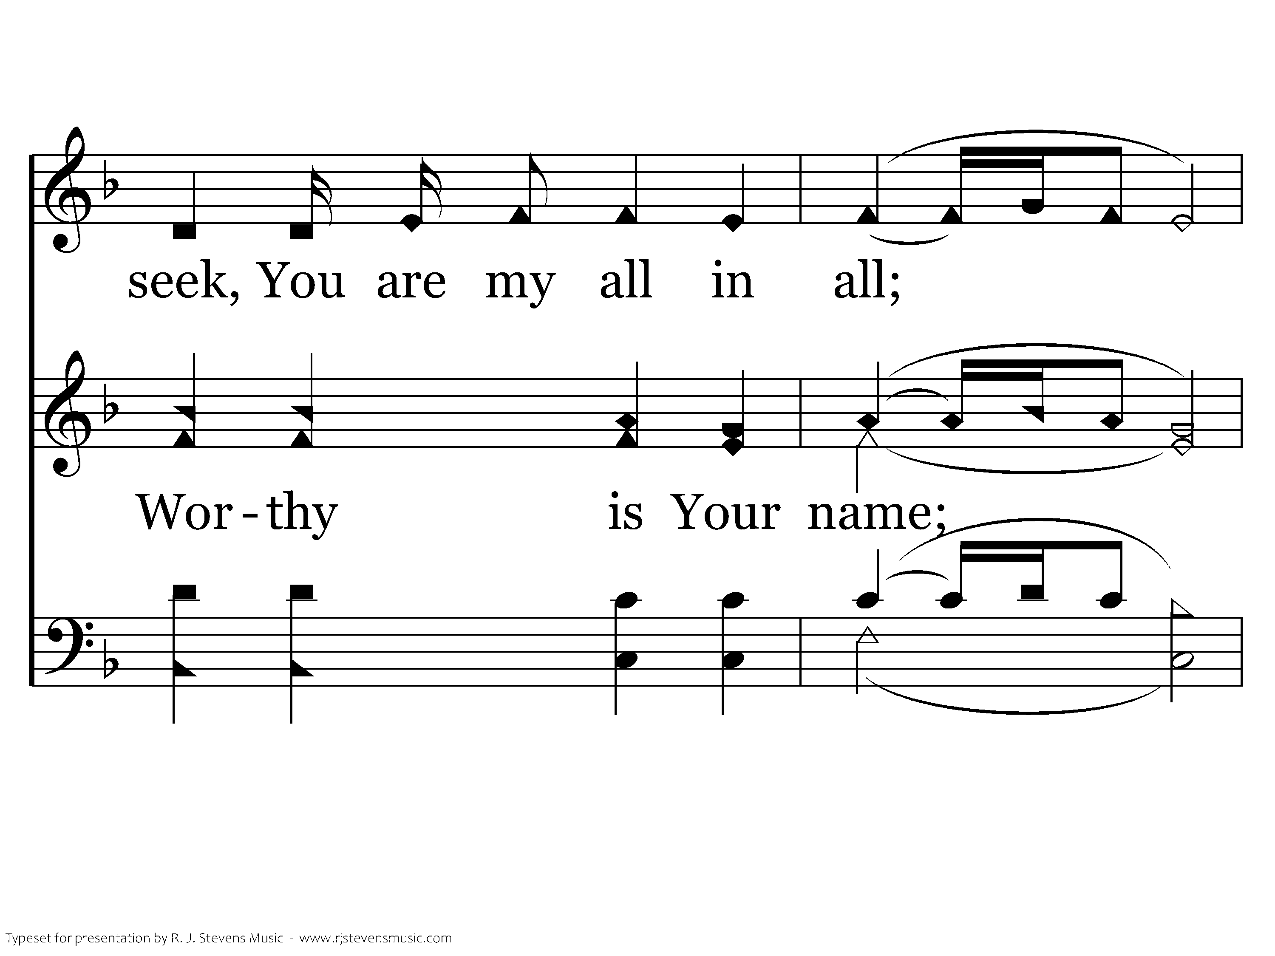
1029 - You Are My All In All - 2.3

Slide 47
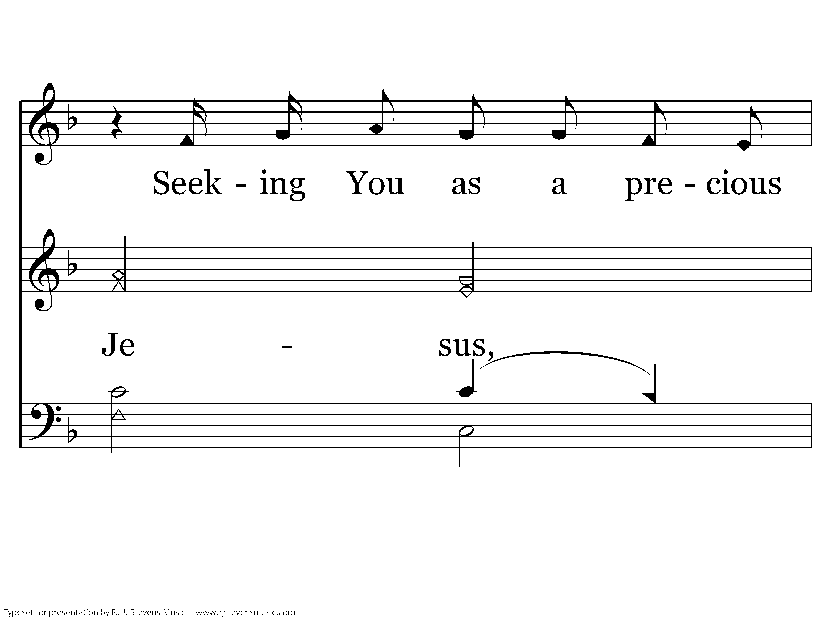
1029 - You Are My All In All - 2.4

Slide 48
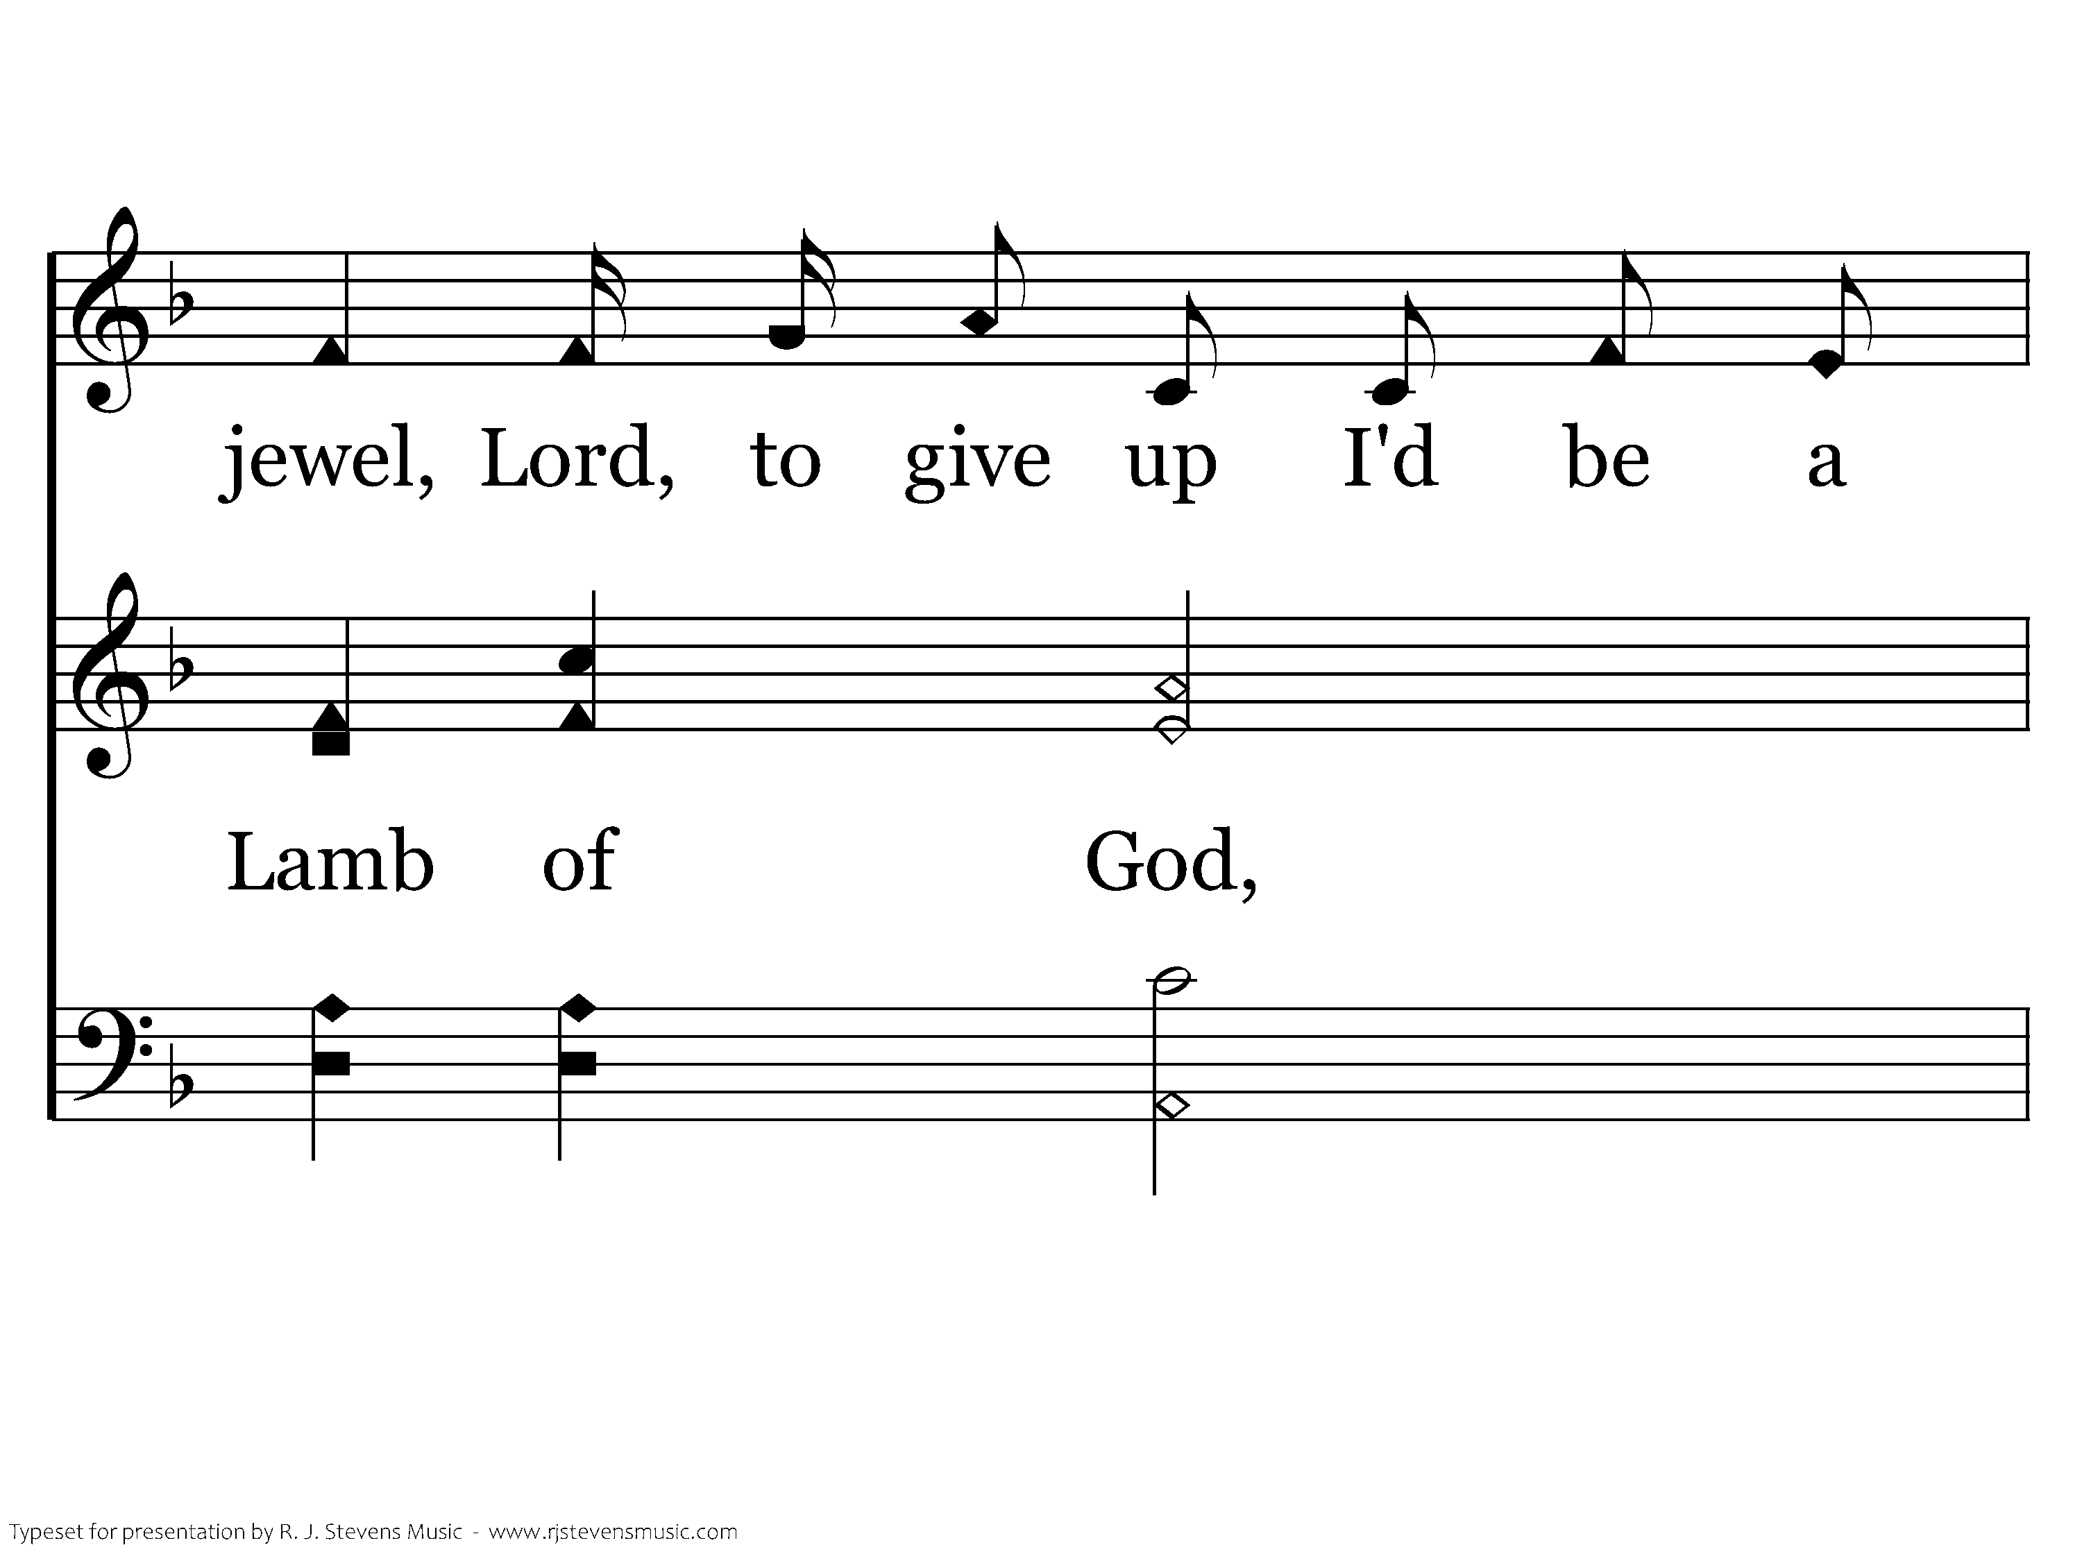
1029 - You Are My All In All - 2.5

Slide 49
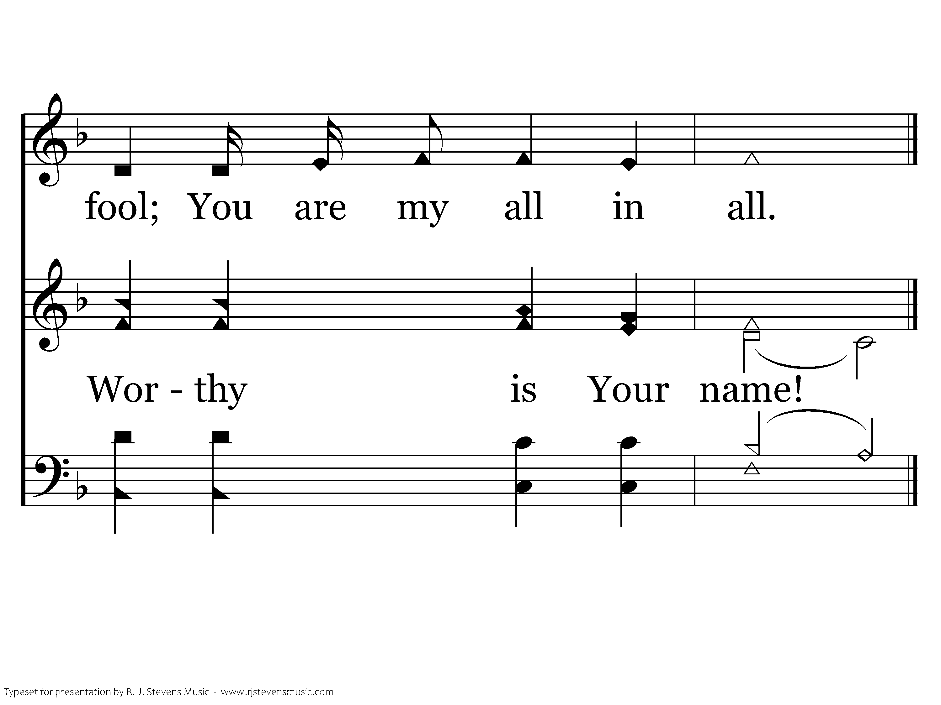
1029 - You Are My All In All - 2.6
End of Verse 2

Slide 50
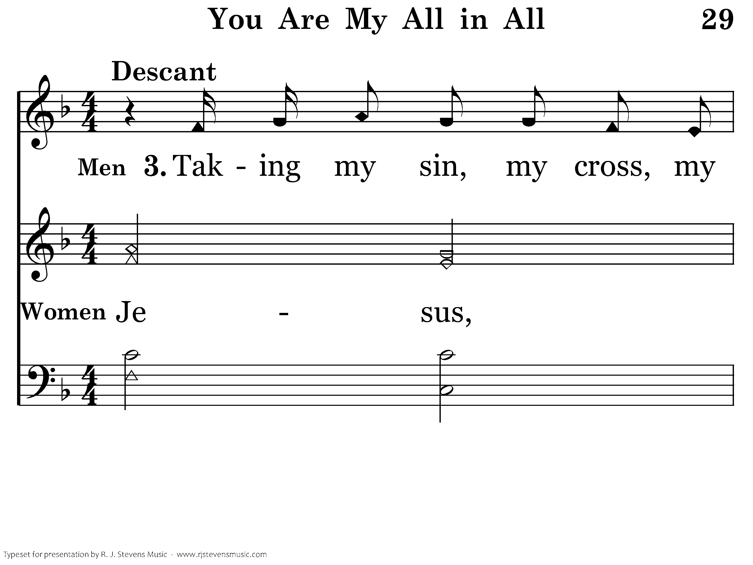
1029 - You Are My All In All - 3.1

Slide 51
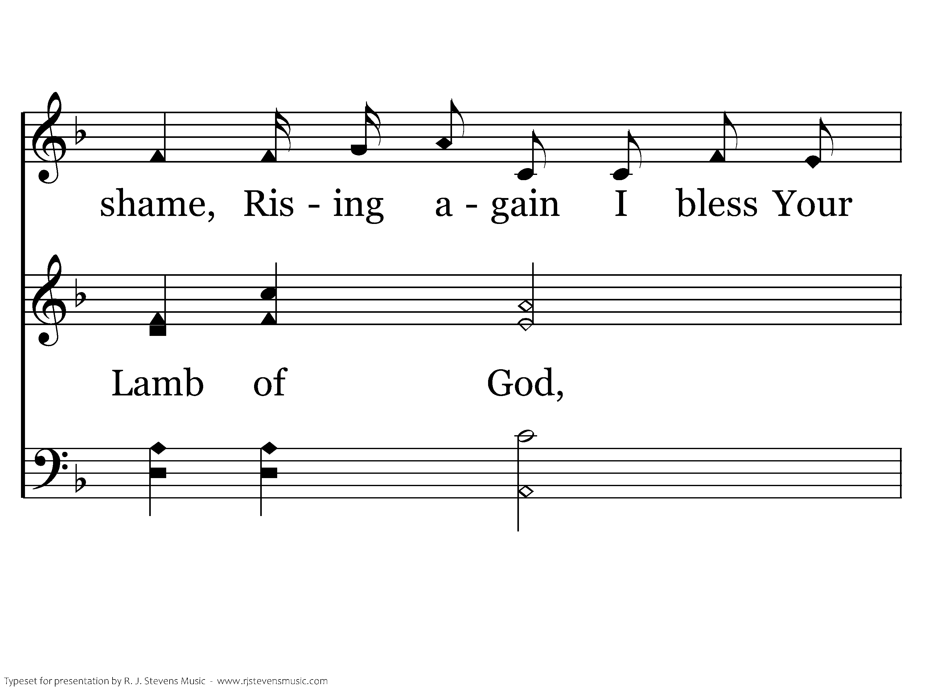
1029 - You Are My All In All - 3.2

Slide 52
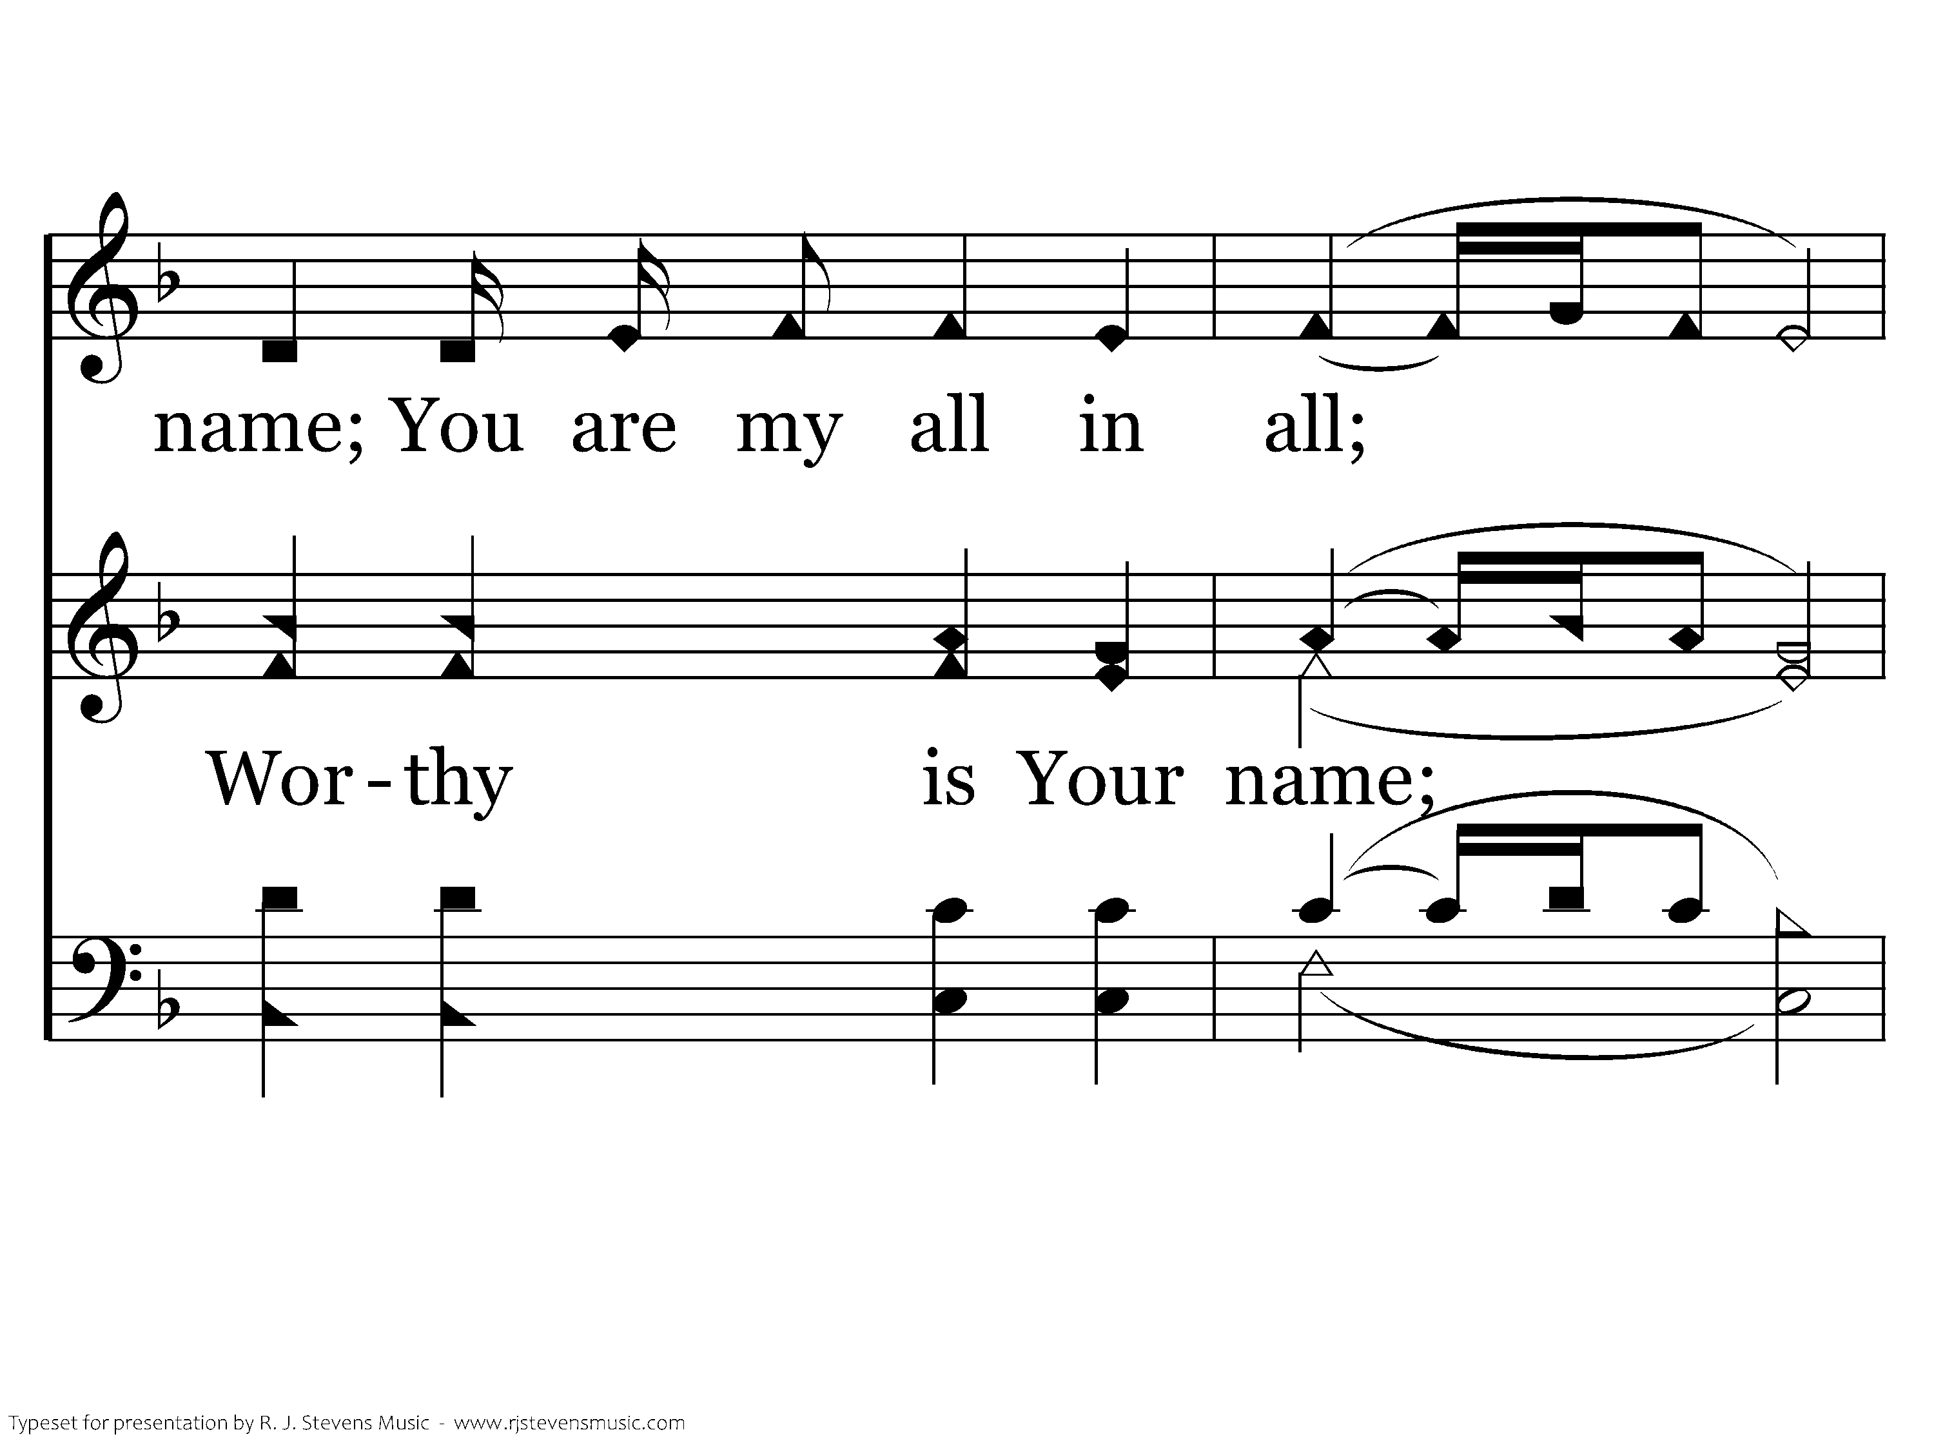
1029 - You Are My All In All - 3.3

Slide 53
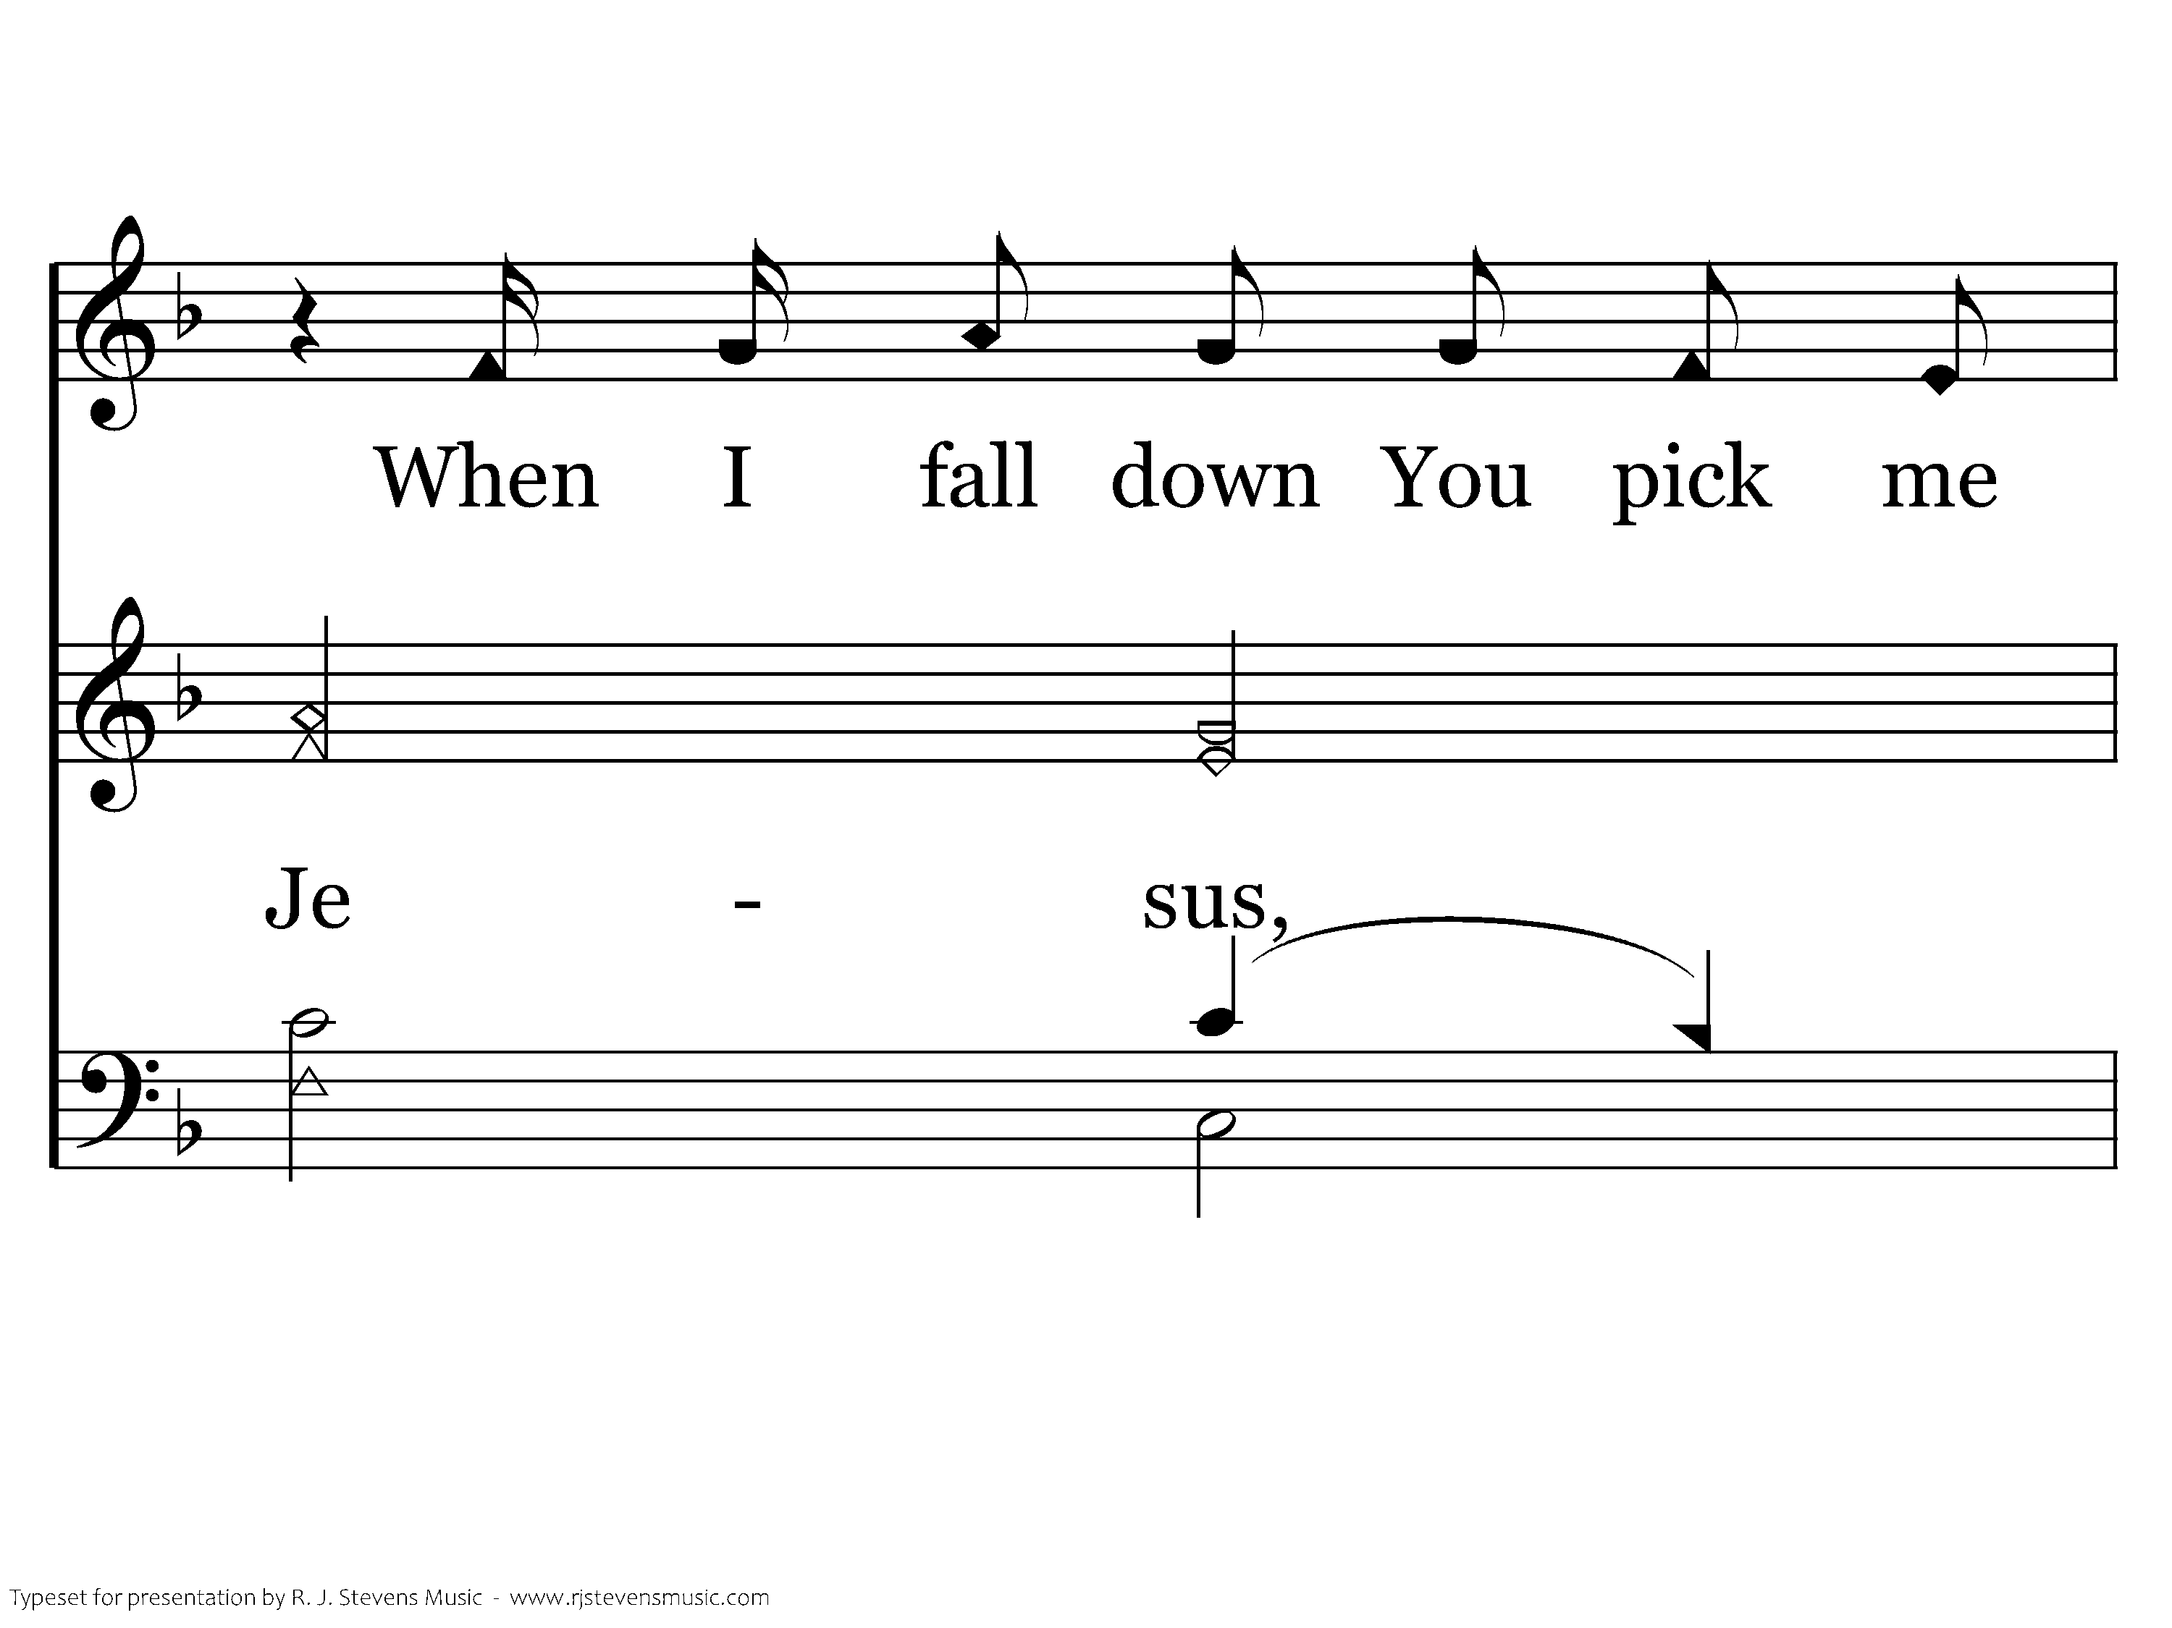
1029 - You Are My All In All - 3.4

Slide 54
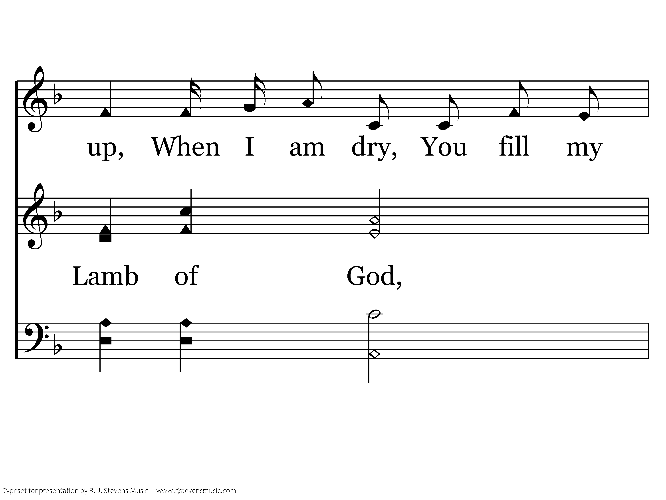
1029 - You Are My All In All - 3.5

Slide 55
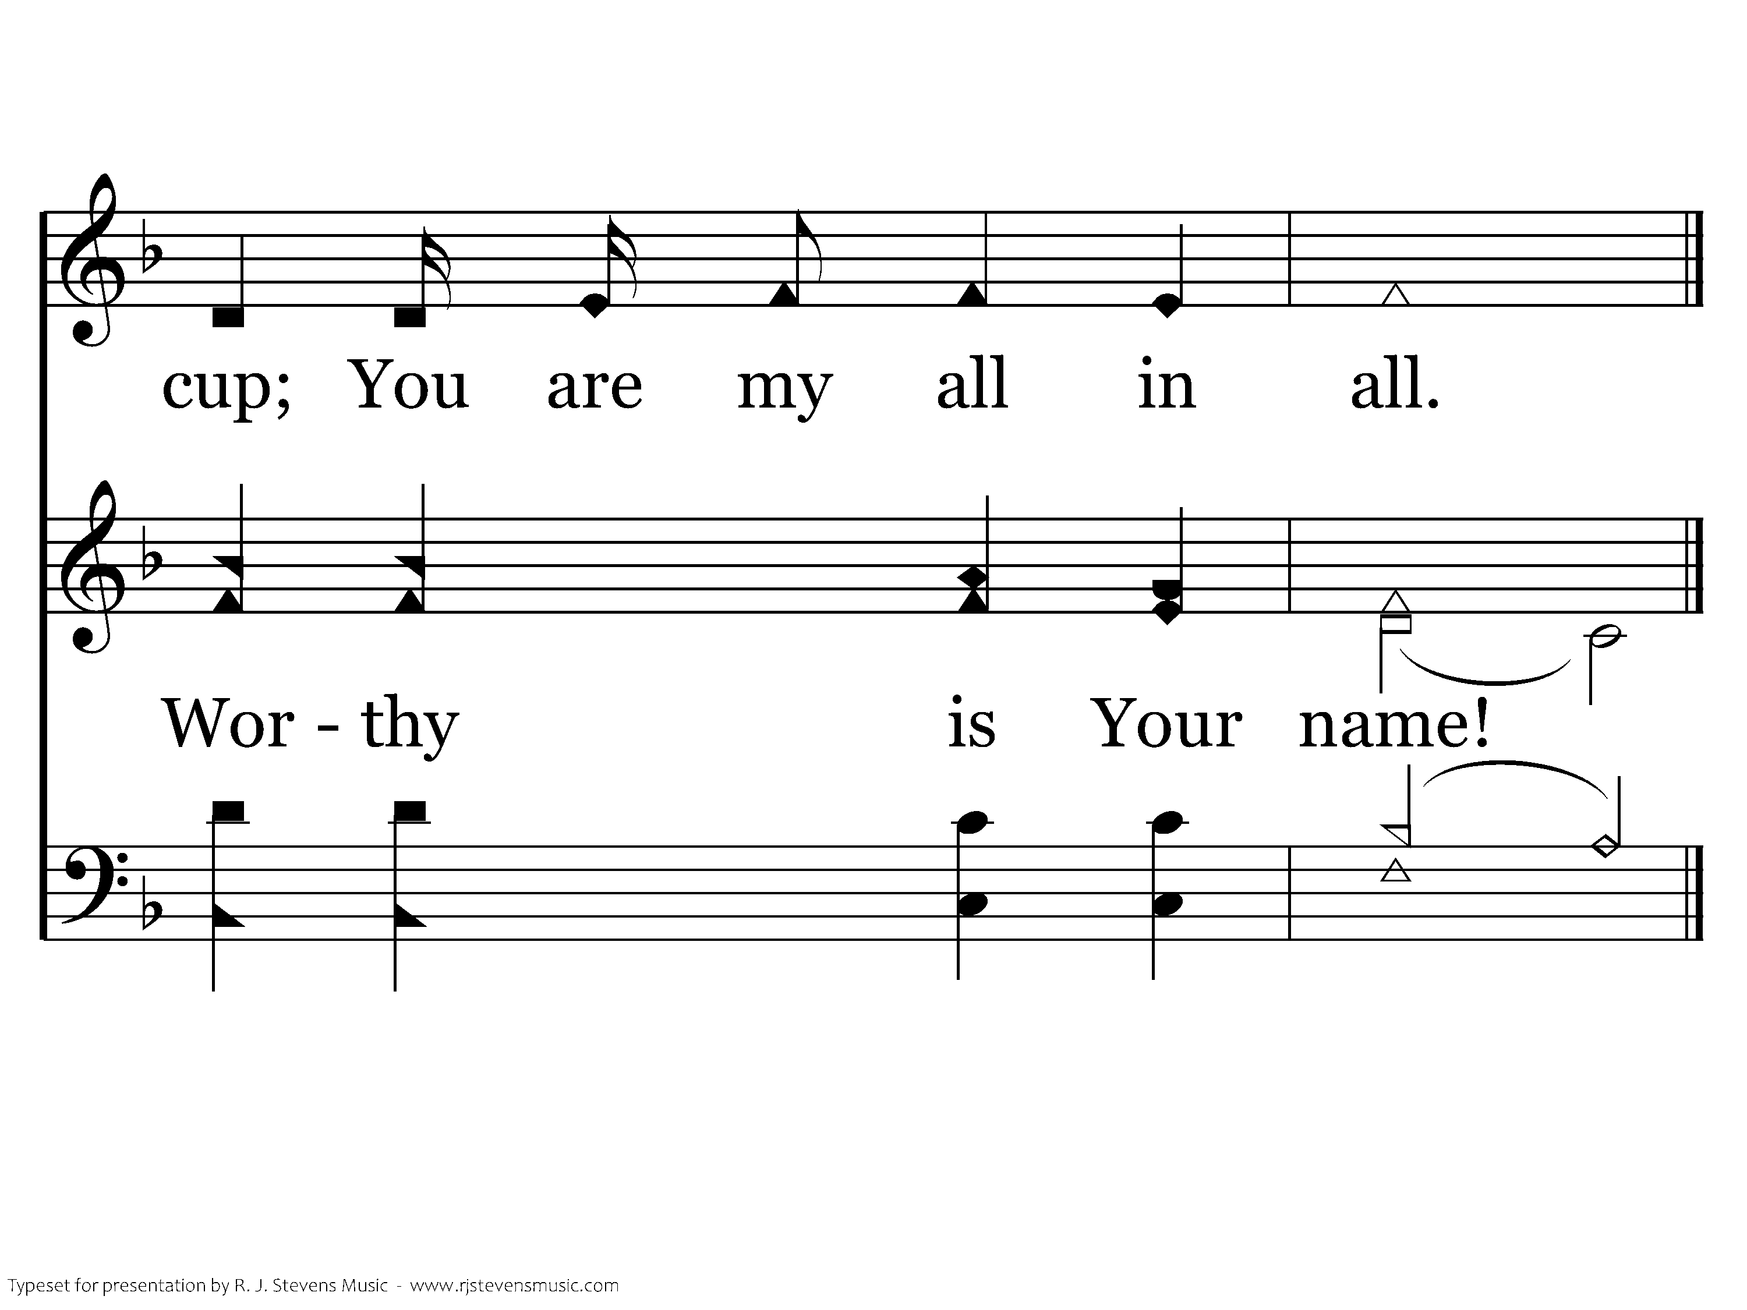
1029 - You Are My All In All - 3.6
End of Verse 3

Slide 56
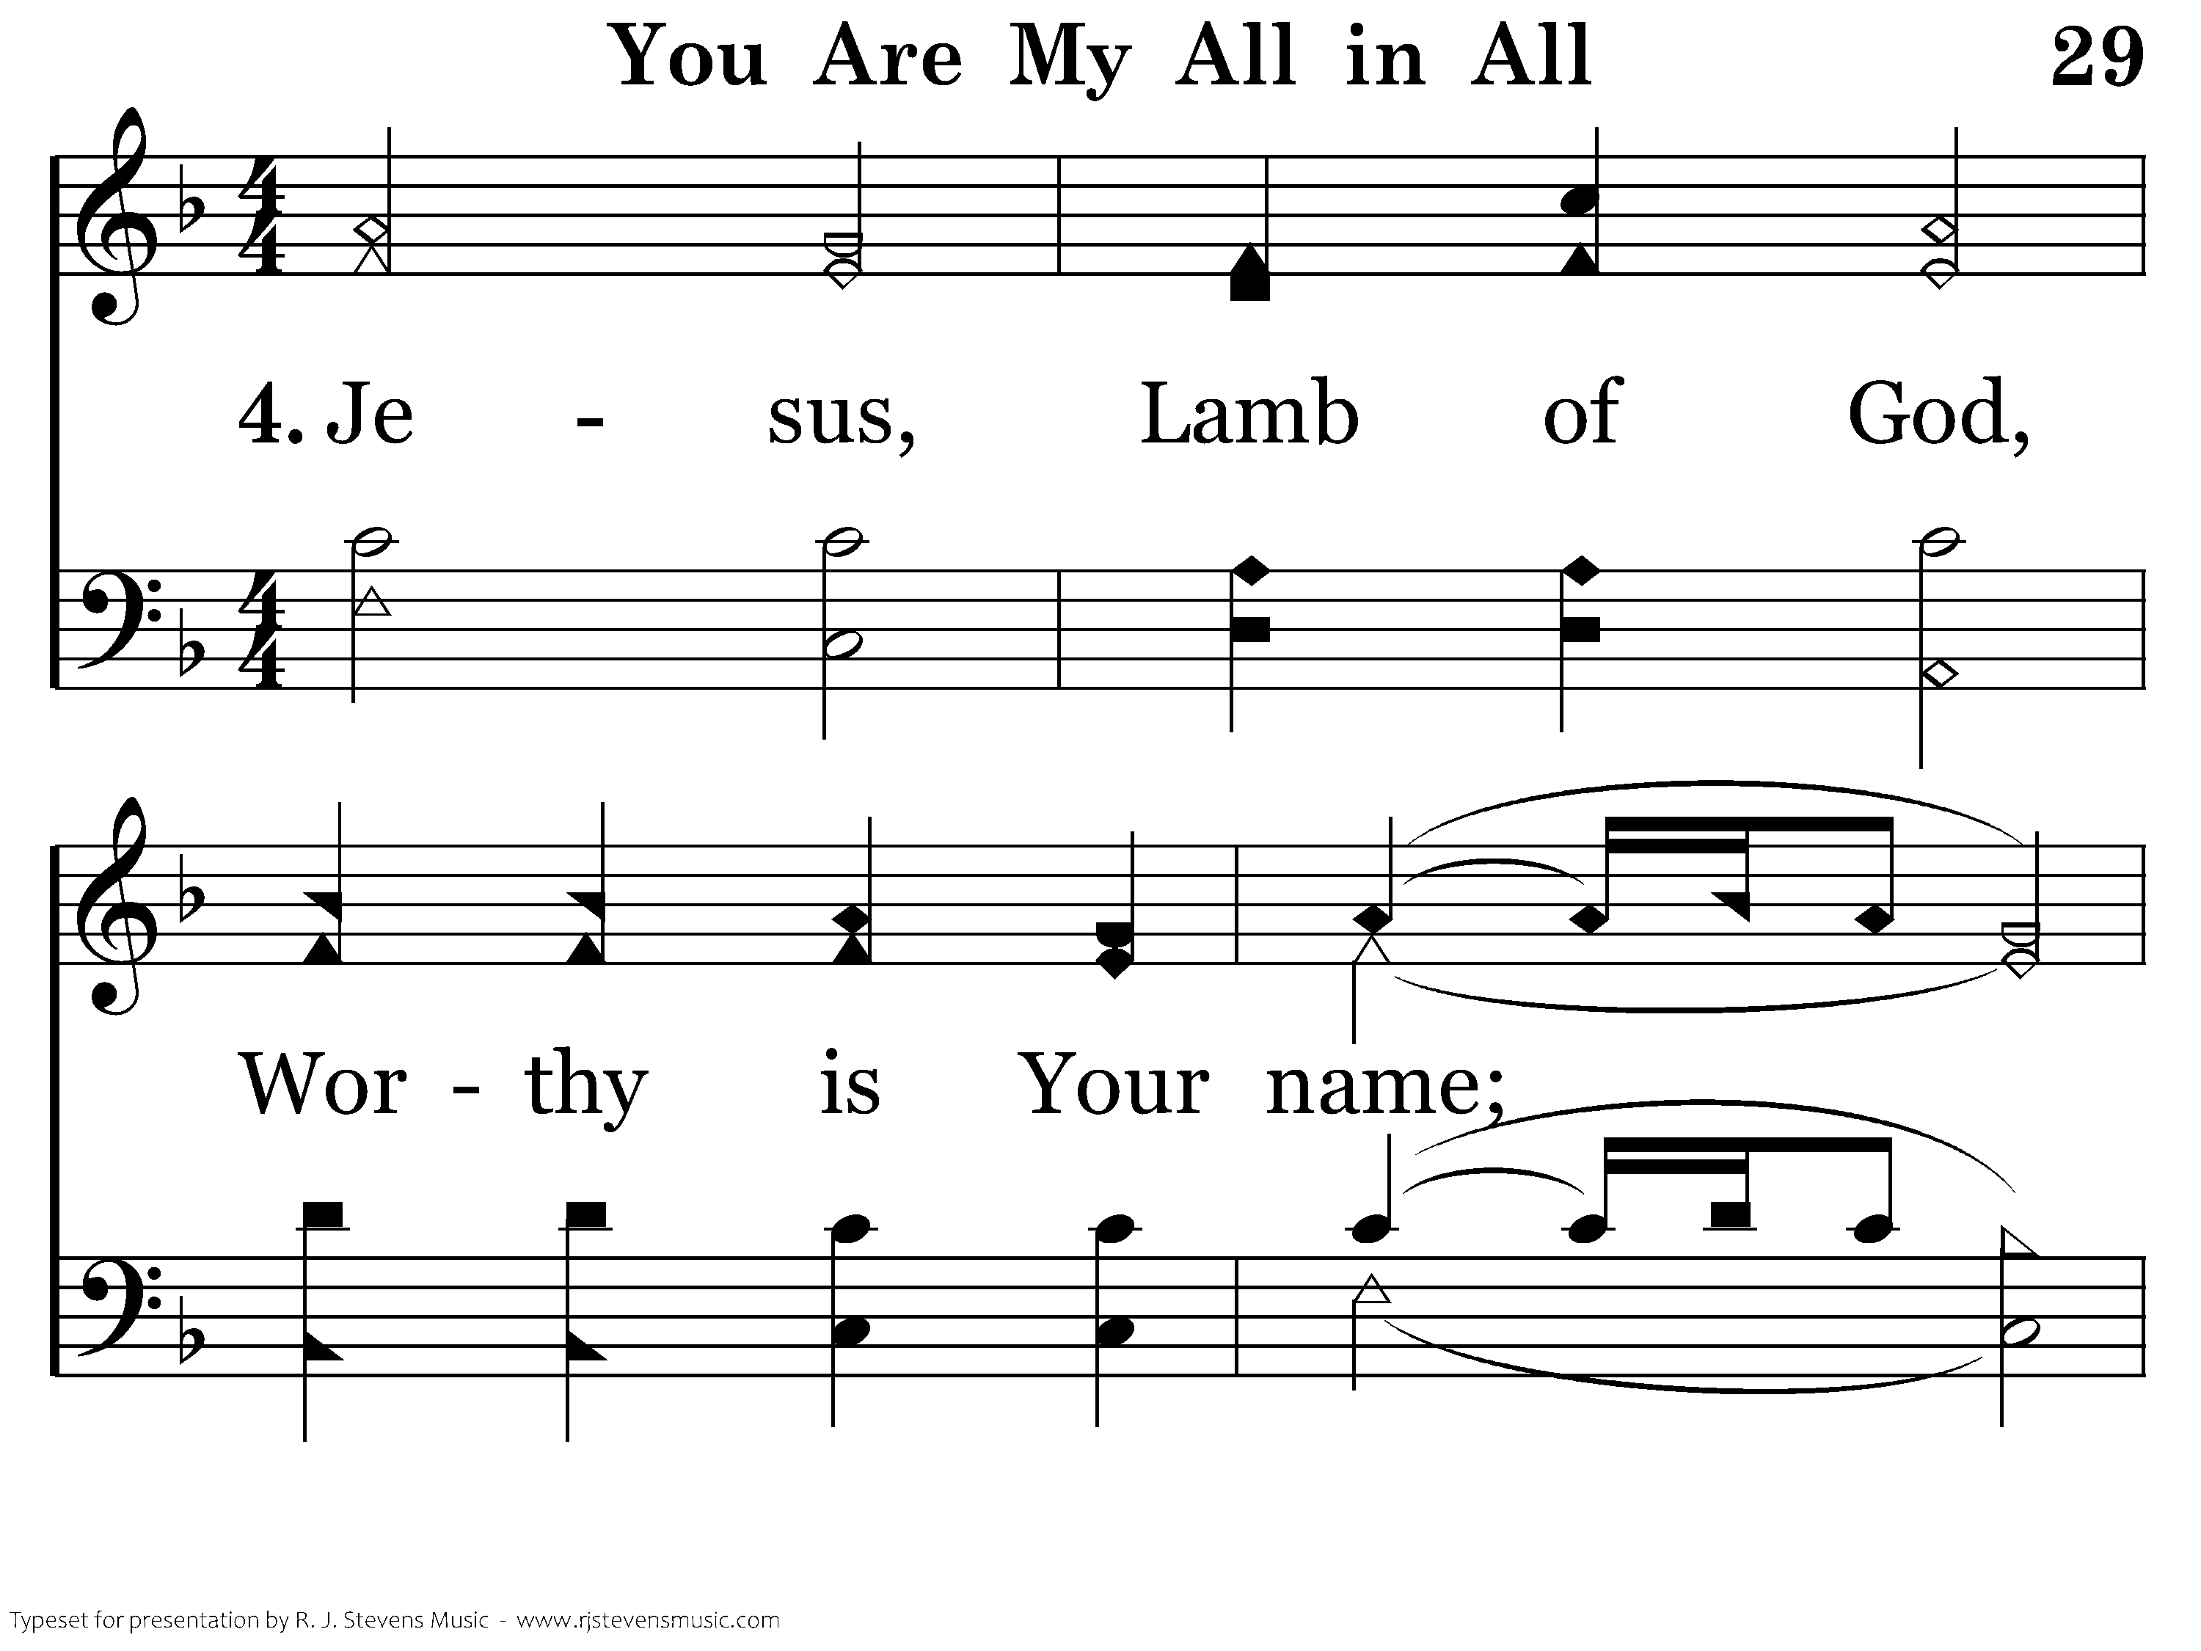
1029 - You Are My All In All - 4.1

Slide 57
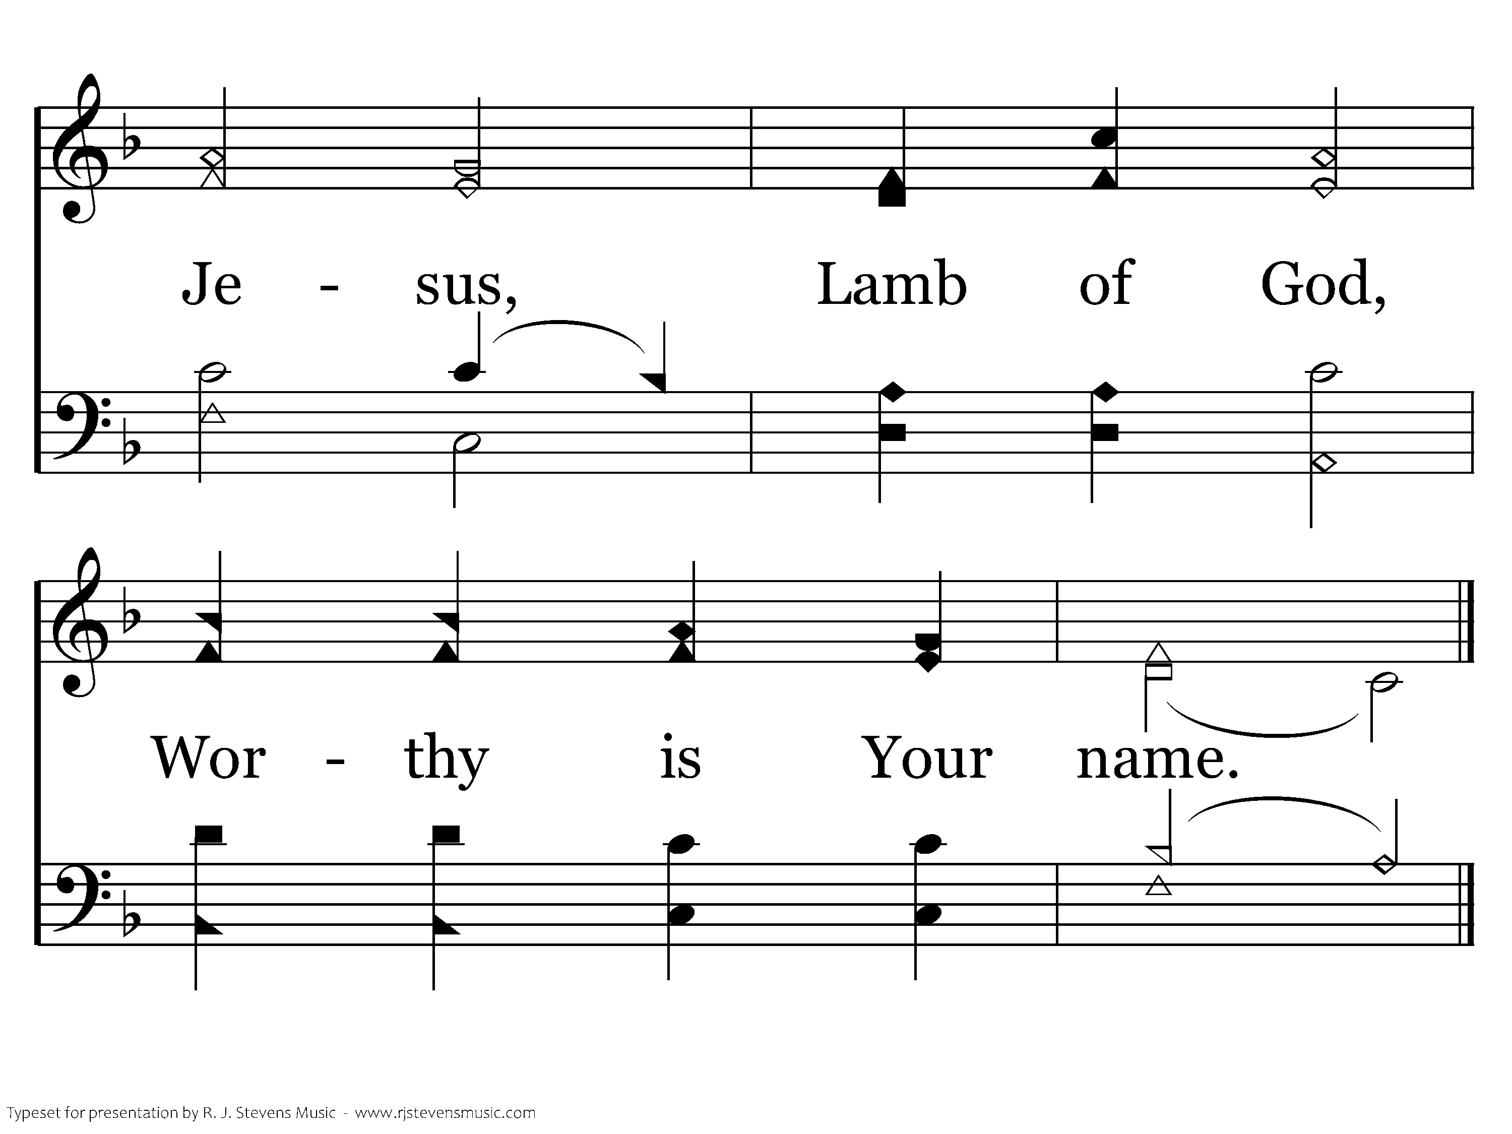
1029 - You Are My All In All - 4.2
End of Song

Slide 58
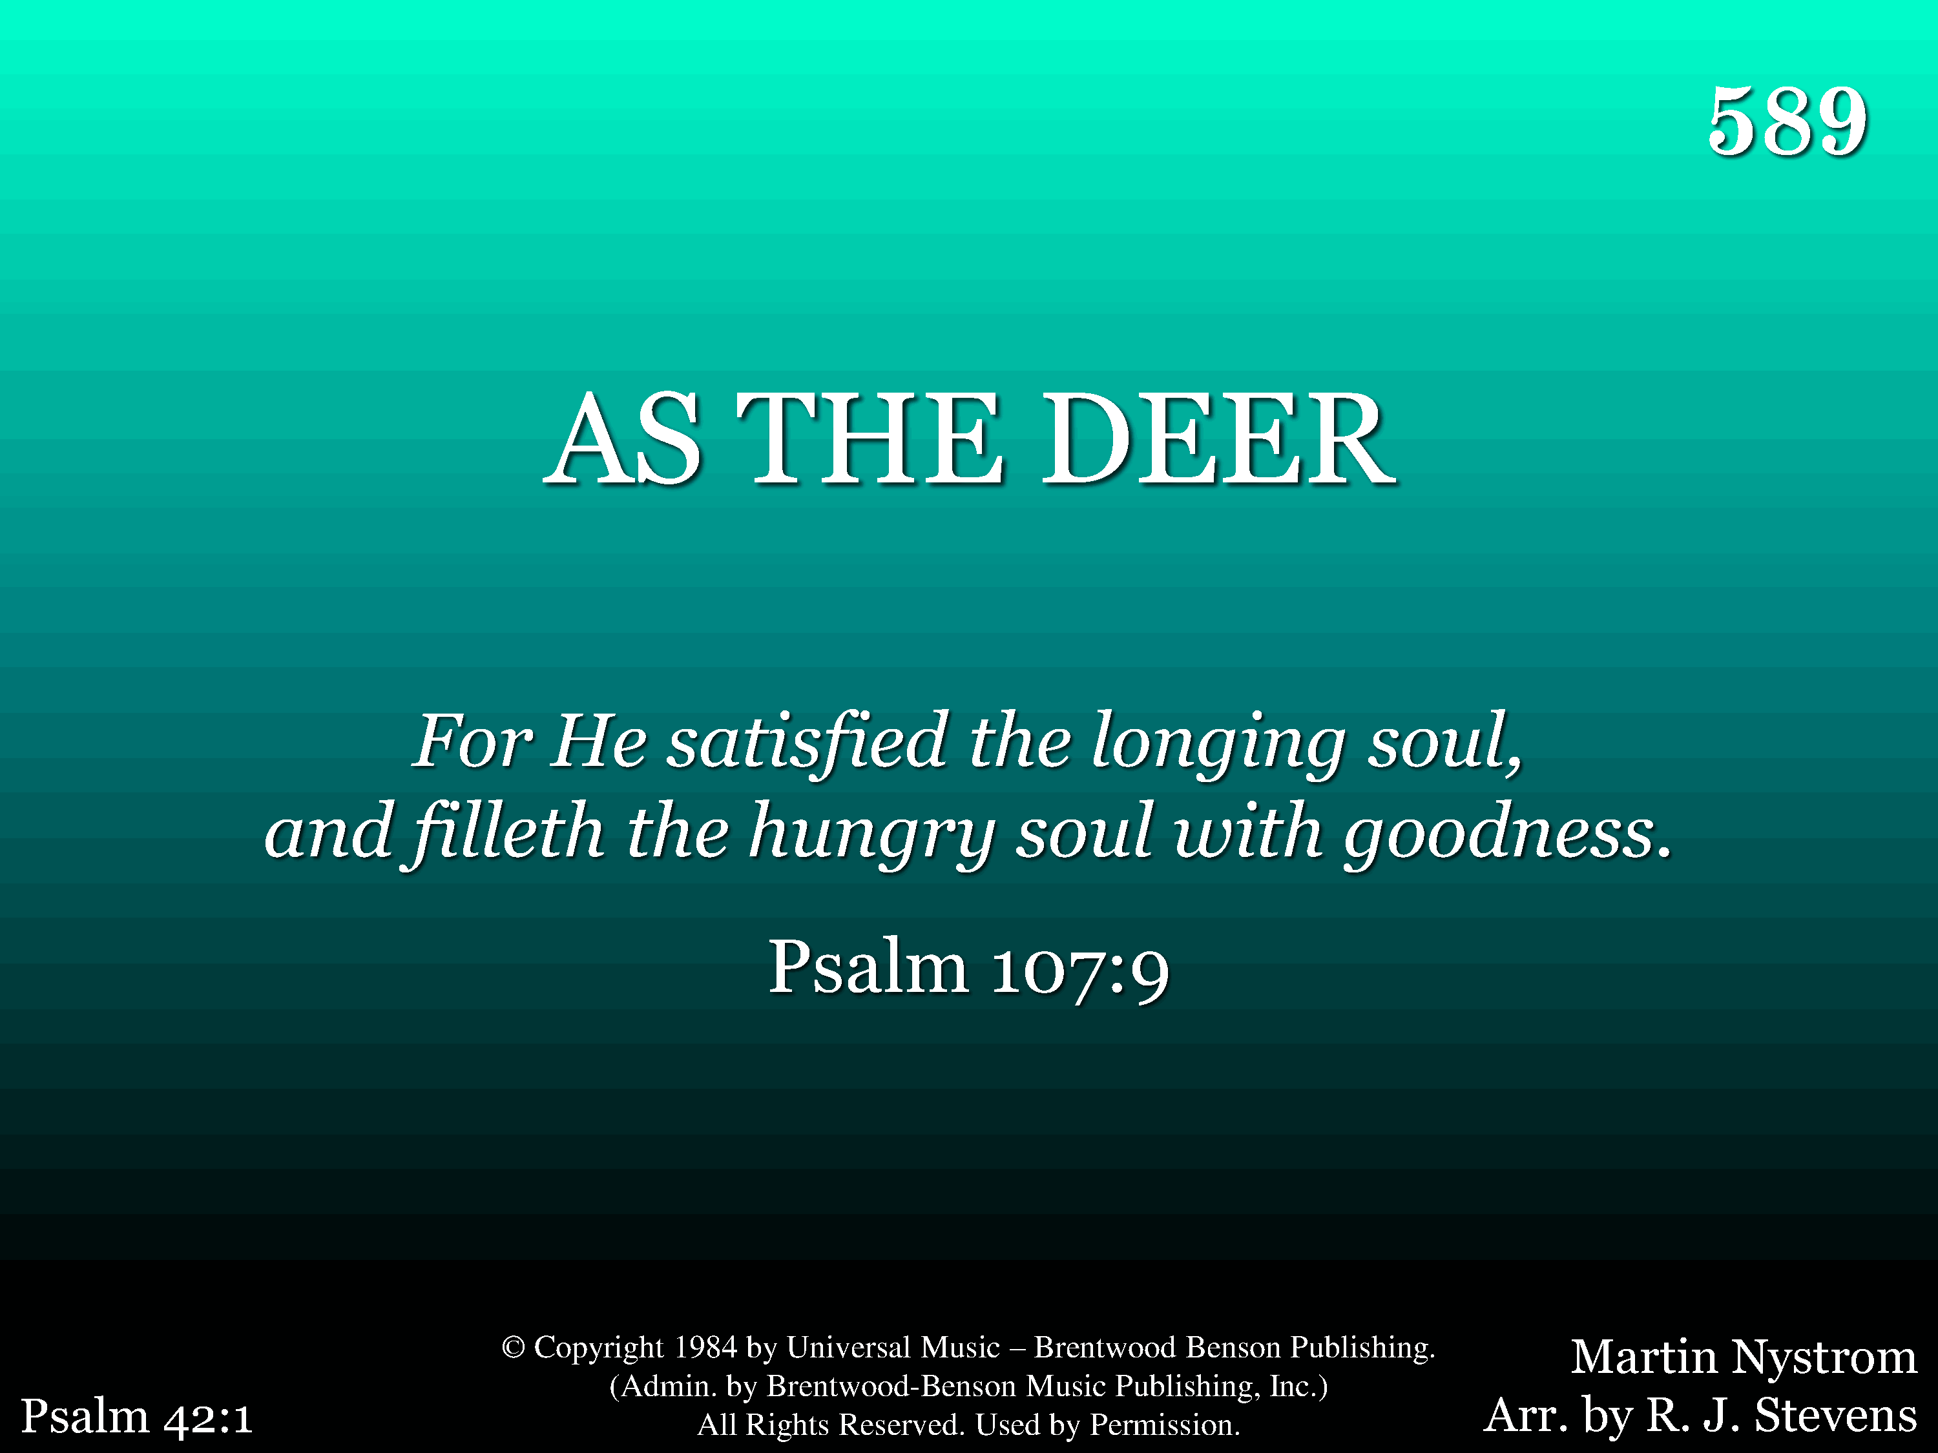
589 - As The Deer - Title

Slide 59
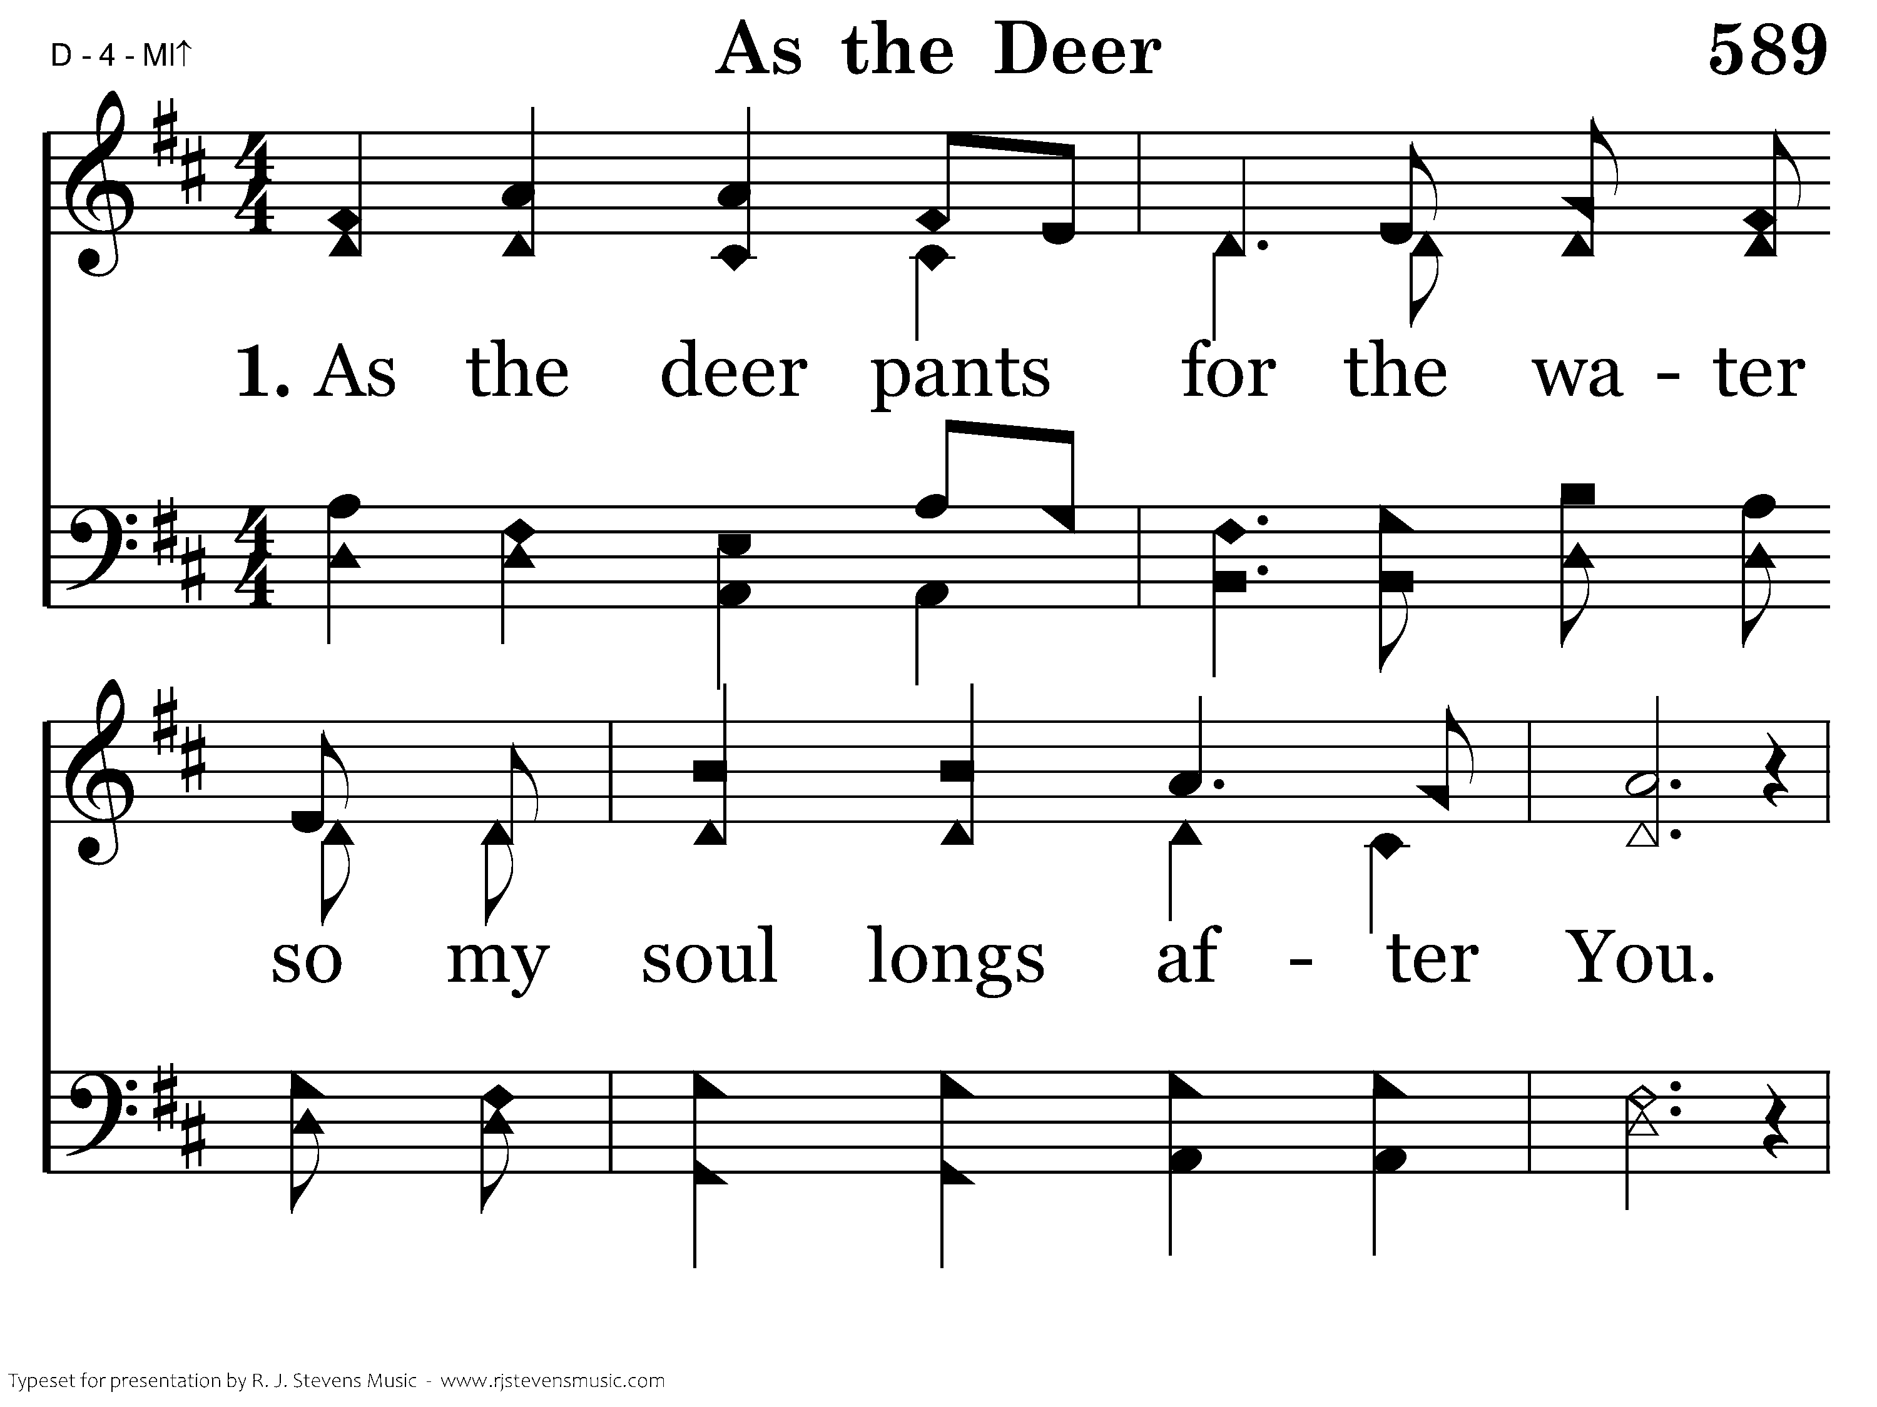
589 - As The Deer - 1.1

Slide 60
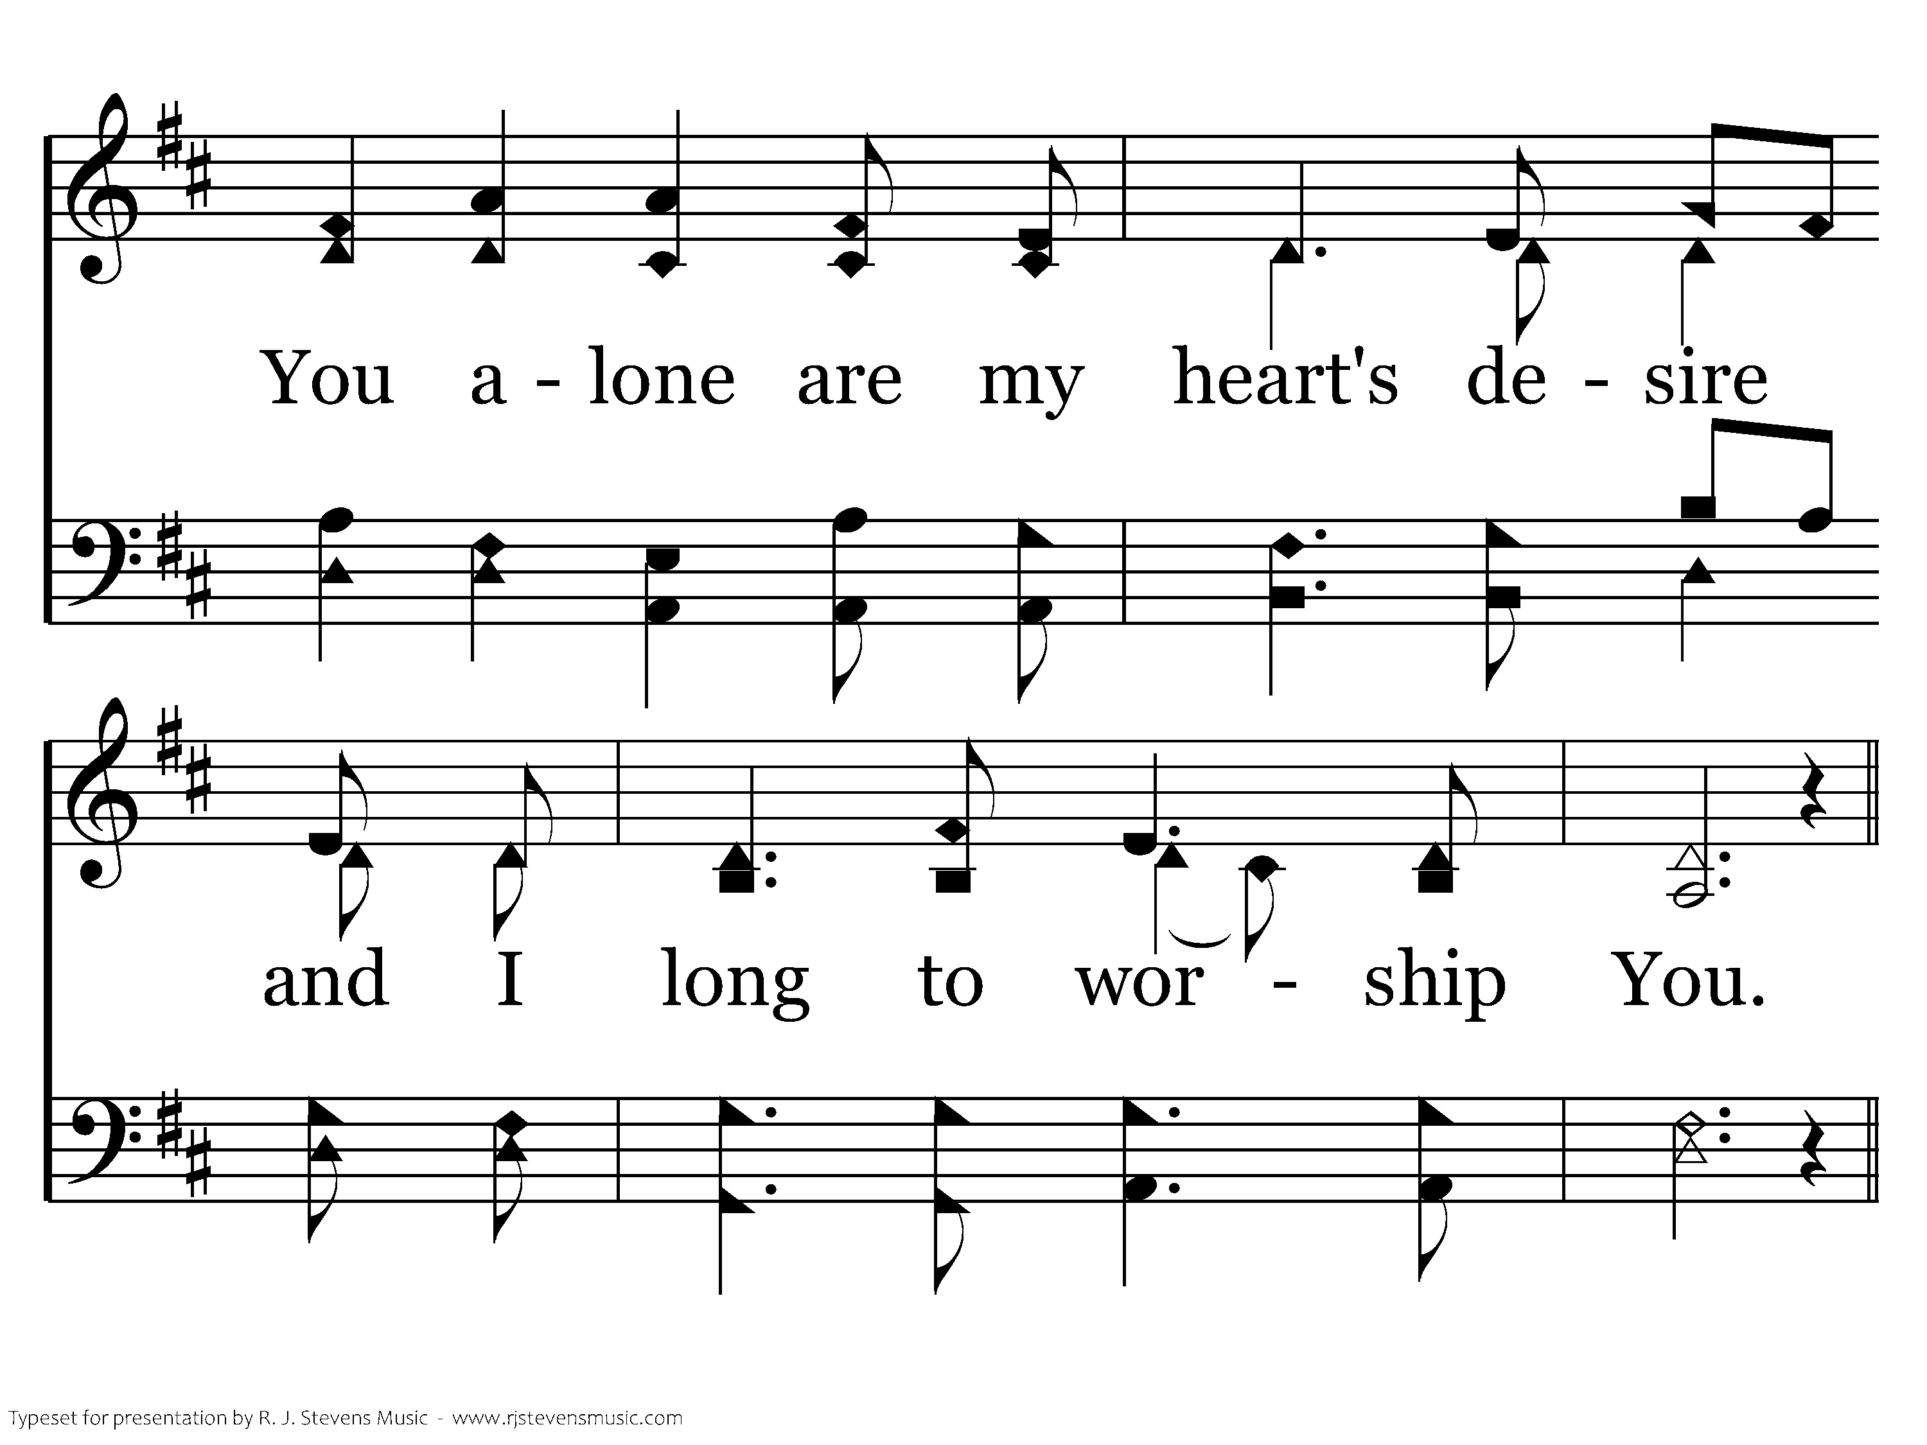
589 - As The Deer - 1.2

Slide 61
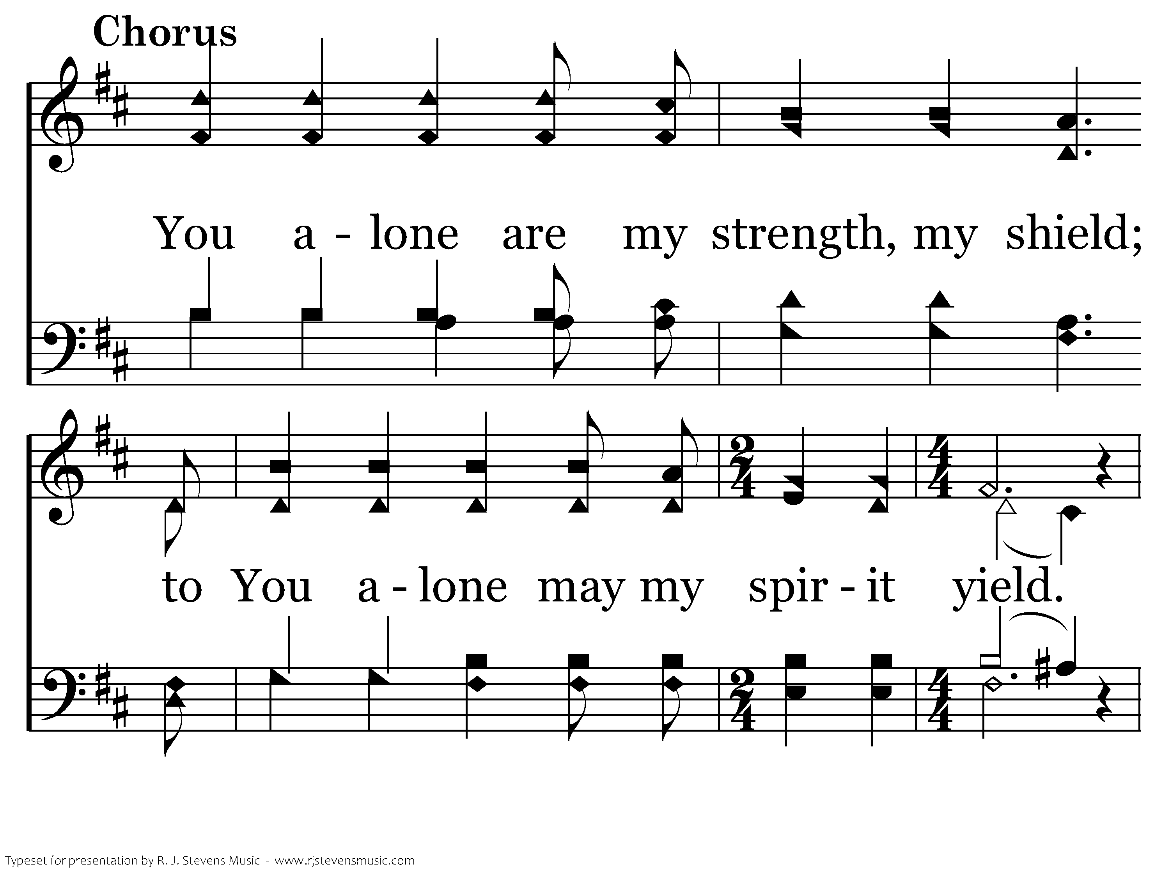
589 - As The Deer - C.1

Slide 62
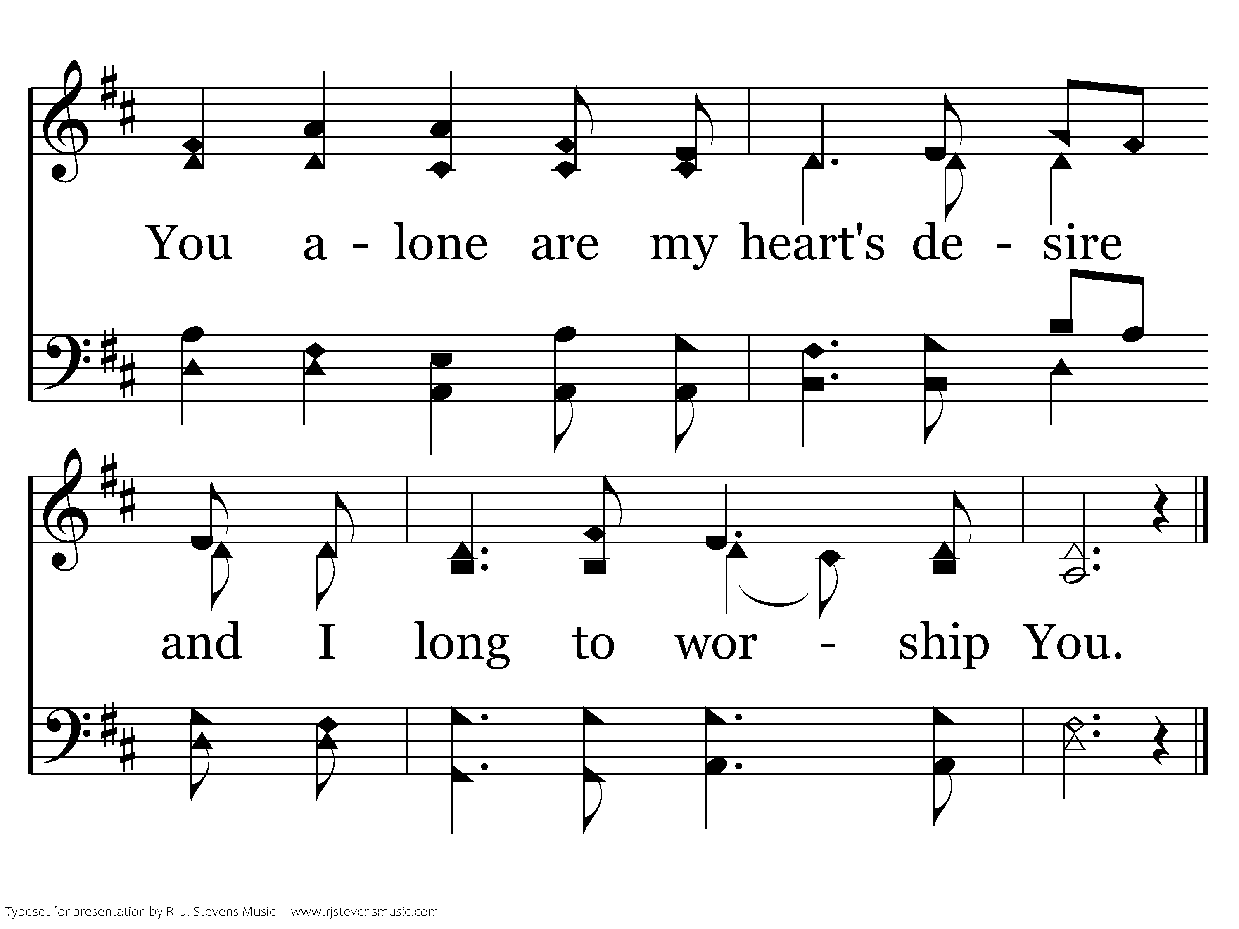
589 - As The Deer - C.2
End of Verse 1

Slide 63
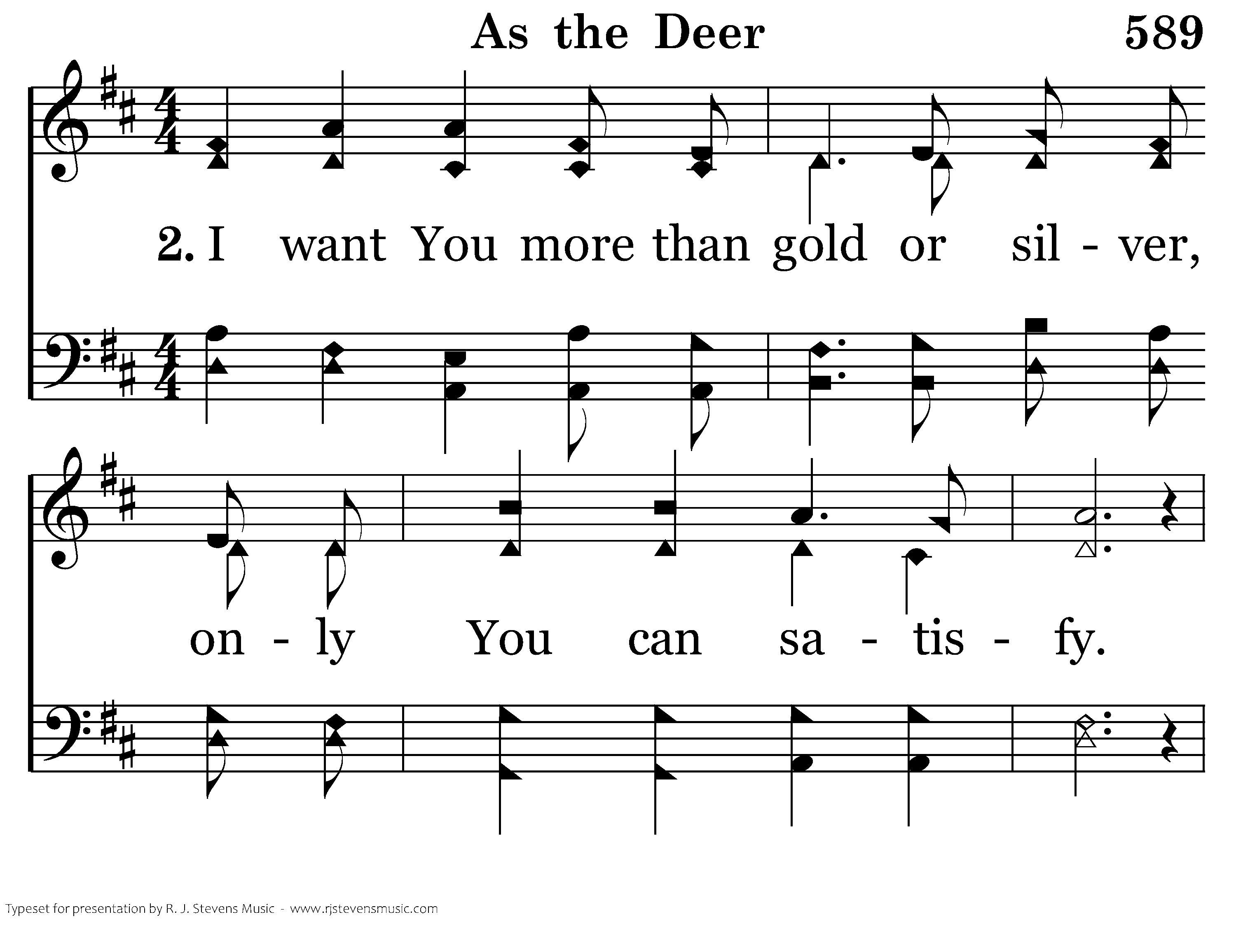
589 - As The Deer - 2.1

Slide 64
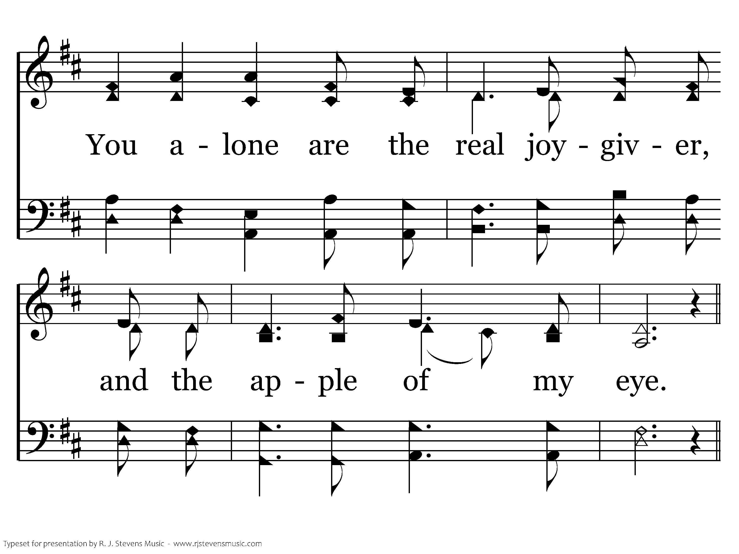
589 - As The Deer - 2.2

Slide 65
589 - As The Deer - C.1

Slide 66
589 - As The Deer - C.2
End of Song

Slide 68
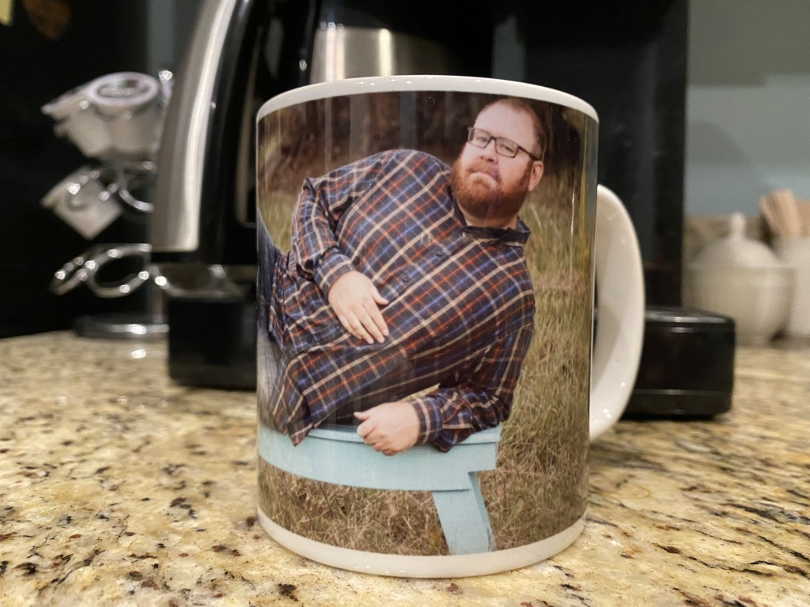

Slide 69

IDOLATRY
is the
PROBLEM

Slide 70
gods
of
pleasure

Slide 71

When there is competition, God withholds His blessings
When we worship pleasure, the result
is pain
exposing the gods of pleasure

Slide 72
As a gift it brings connection; as a god it causes loneliness.
As a gift it brings pleasure; as a god it leads to emptiness.
As a gift it brings satisfaction; but as a god it demands slavery.
As a gift it brings intimacy; as a god, separation.
As a gift it brings unity; as a god it often causes divorce.
It’s a beautiful gift and a tyrant of a god.
Kyle Idelman
Gods at War

Slide 73
When there is competition, God withholds His blessings
When we worship pleasure, the result
is pain
Satisfaction should be sought in Jehovah
exposing the gods of pleasure

Slide 75
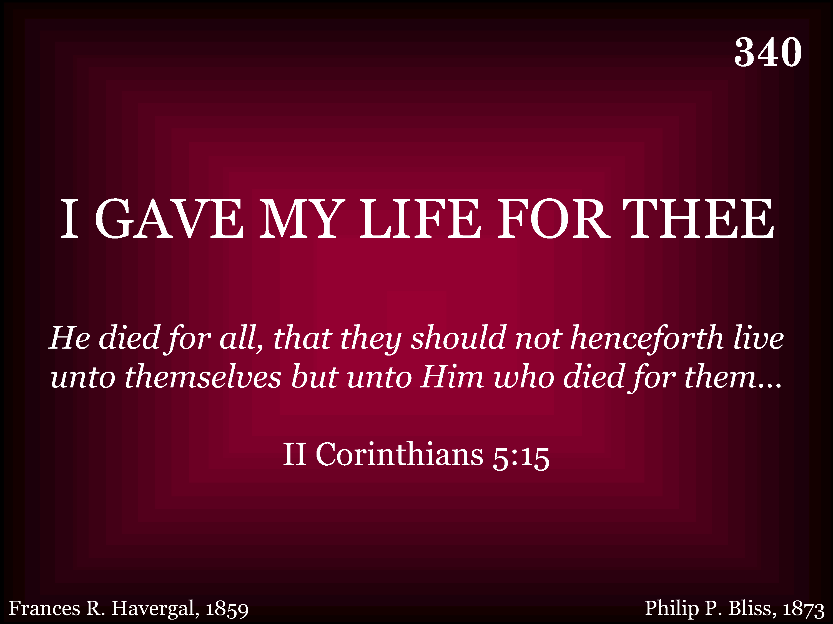
340 - I Gave My Life For Thee - Title

Slide 76
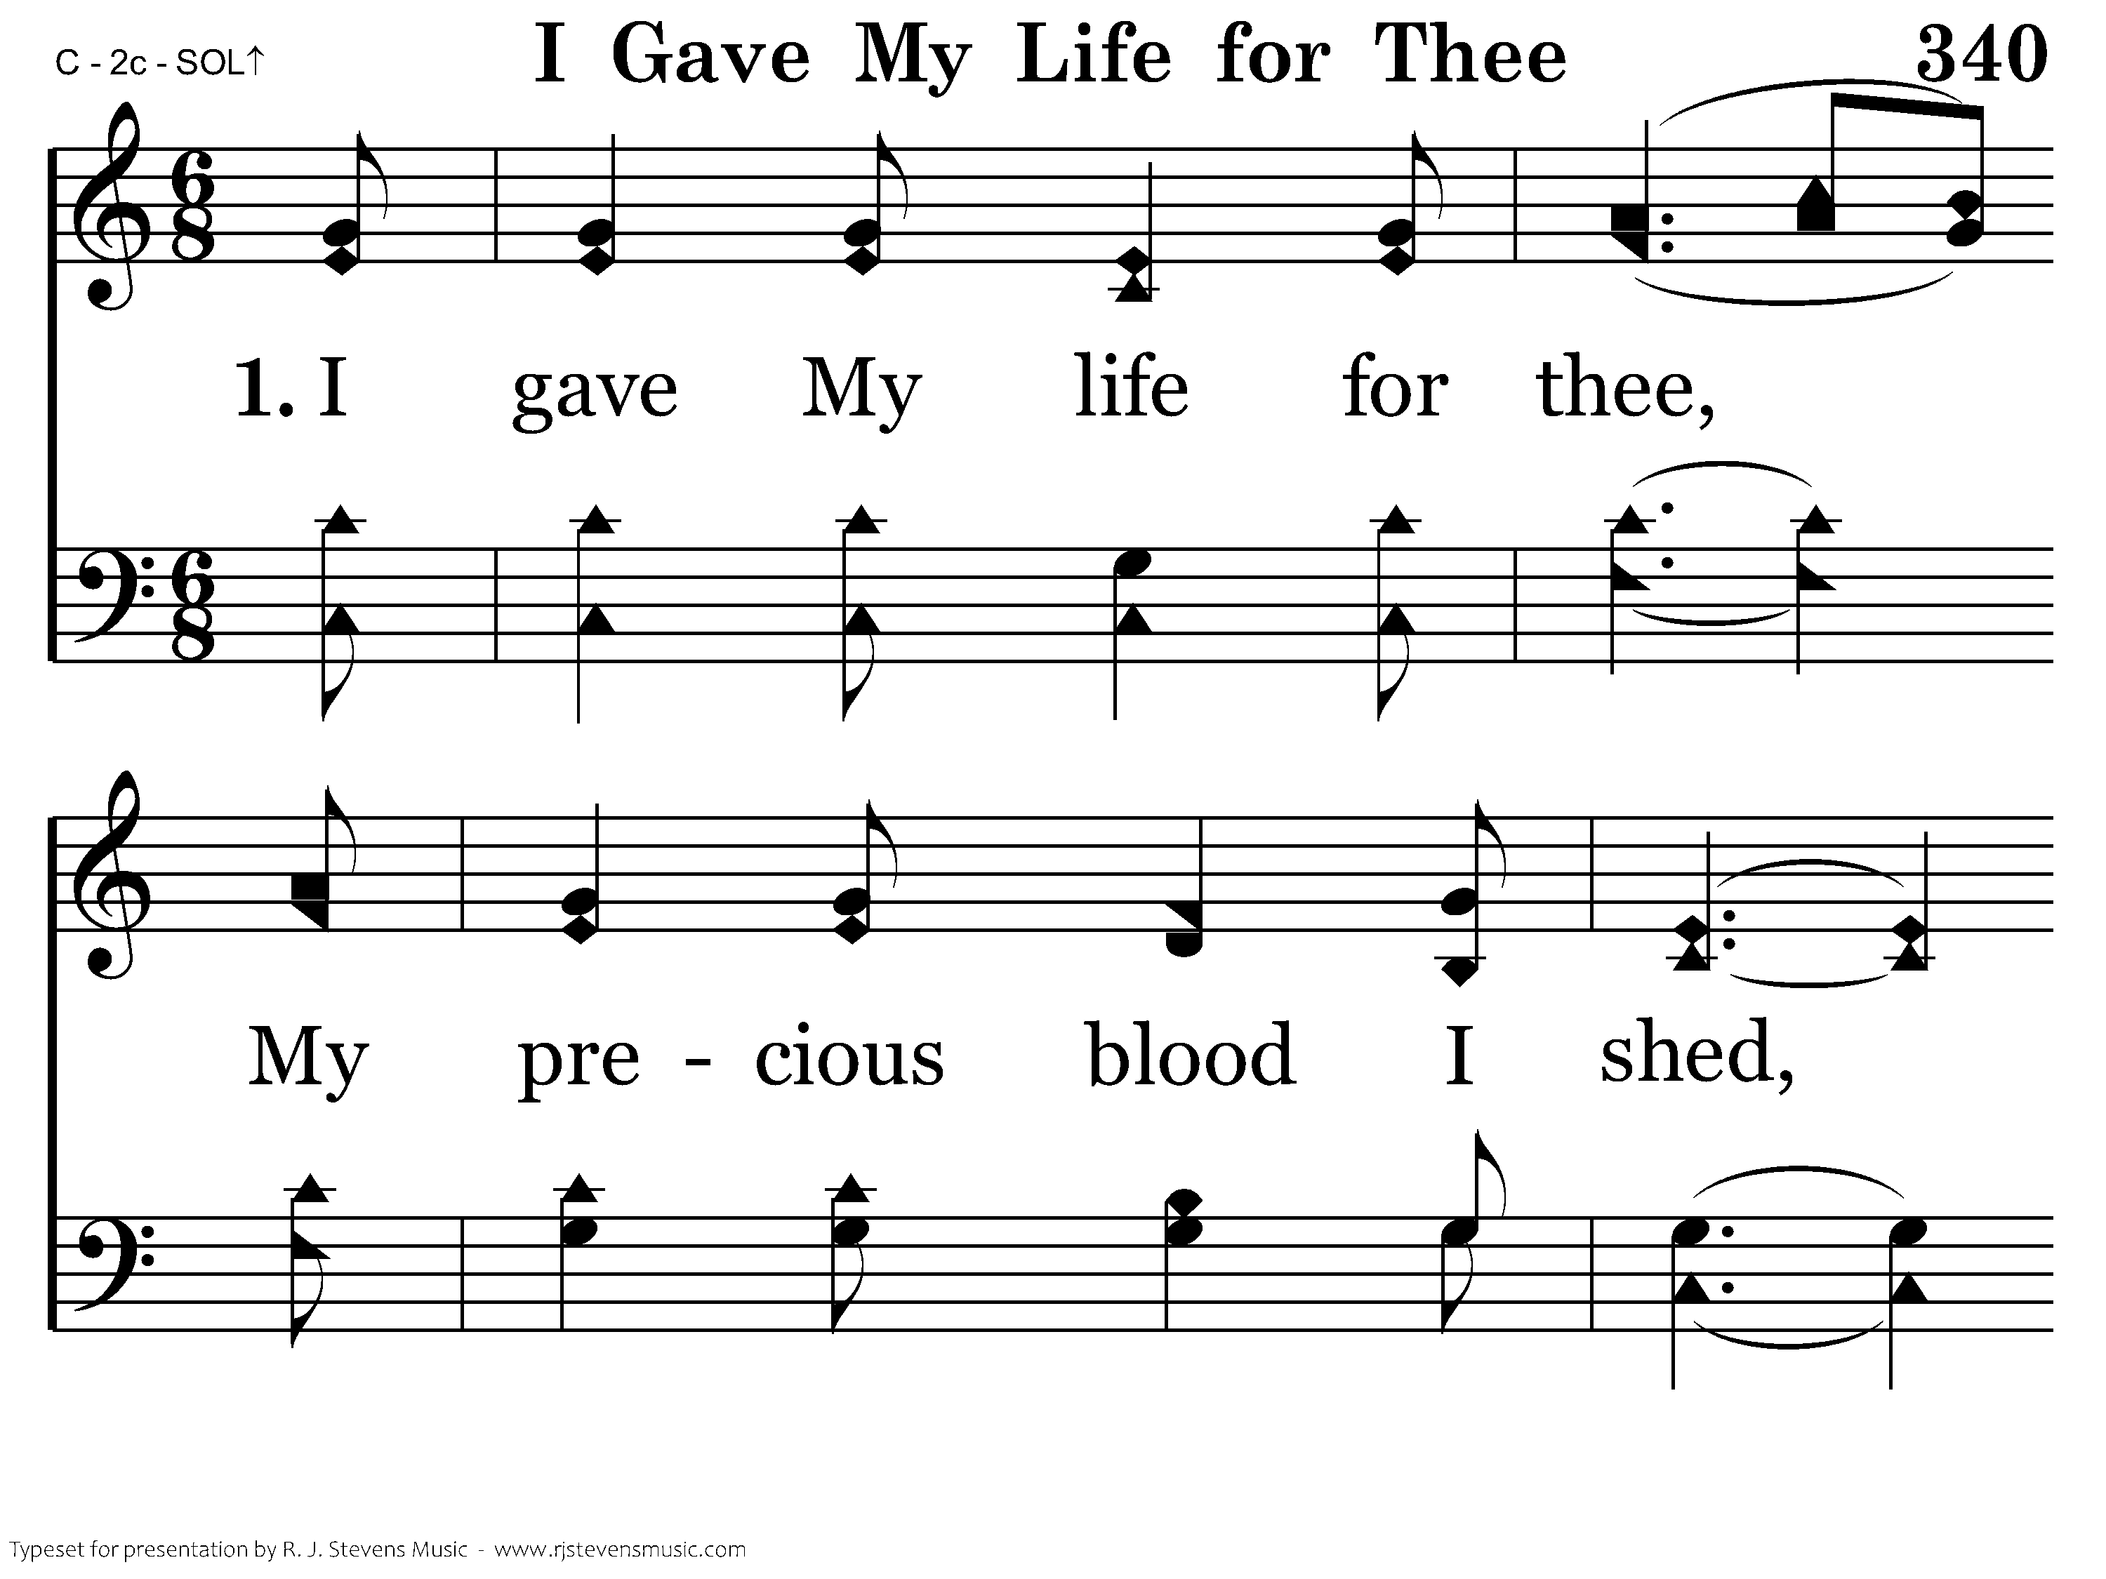
340 - I Gave My Life For Thee - 1.1

Slide 77

340 - I Gave My Life For Thee - 1.2

Slide 78

340 - I Gave My Life For Thee - 1.3

Slide 79

340 - I Gave My Life For Thee - 1.4
End of Verse 1

Slide 80

340 - I Gave My Life For Thee - 3.1

Slide 81

340 - I Gave My Life For Thee - 3.2

Slide 82

340 - I Gave My Life For Thee - 3.3

Slide 83

340 - I Gave My Life For Thee - 3.4
End of Song

Slide 85
Closing Prayer
Kevin Floyd

