Slide 2
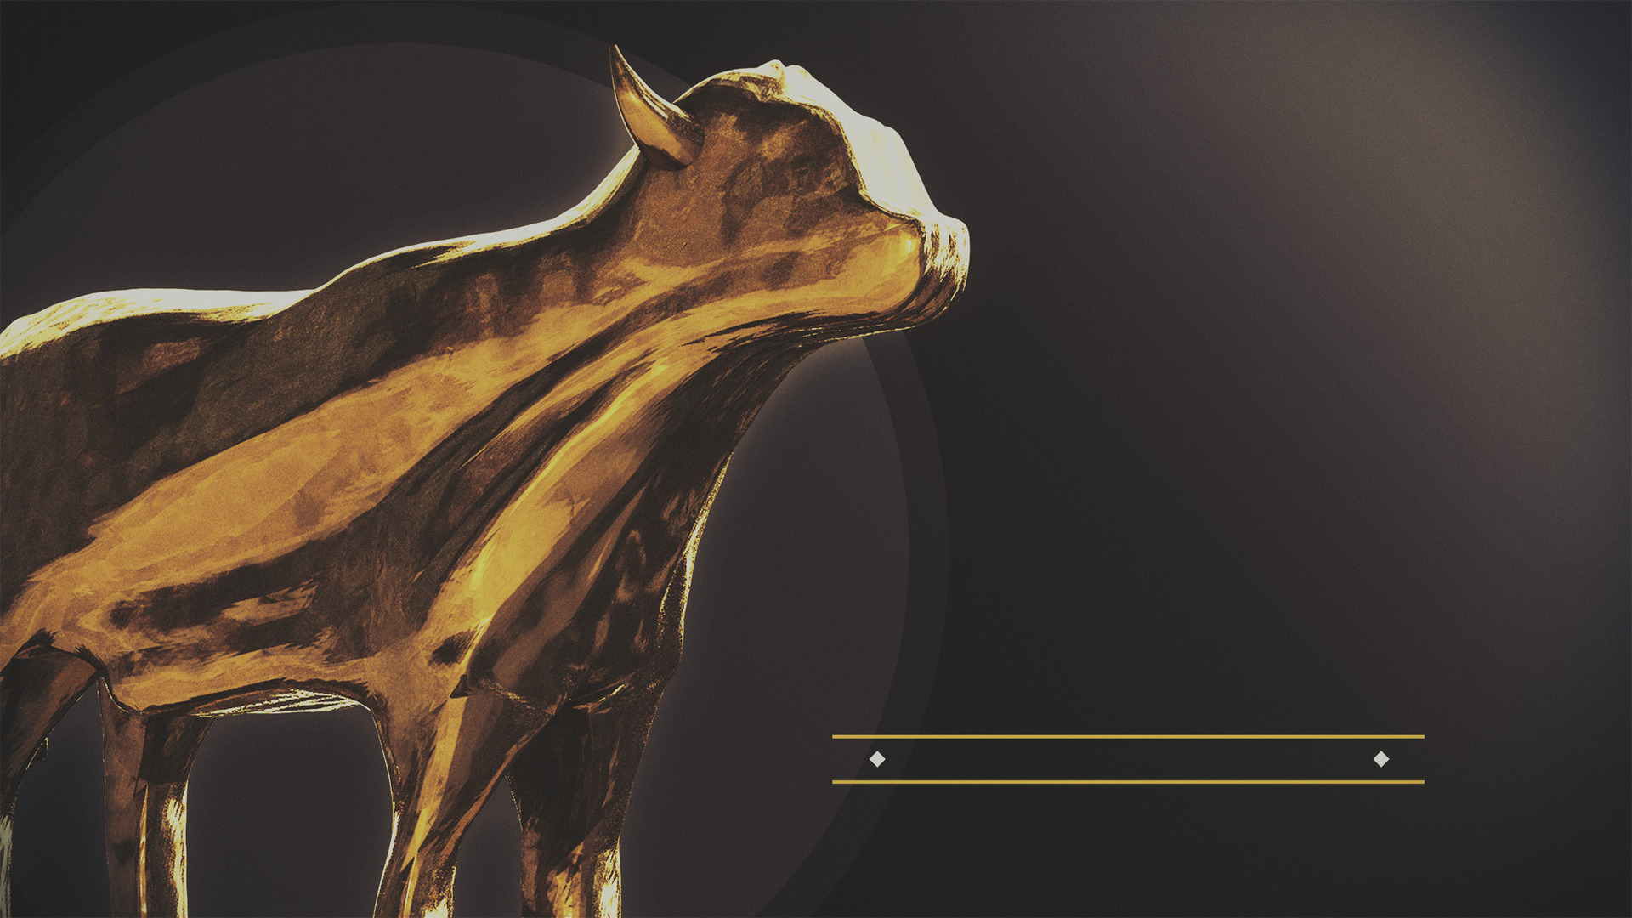
IDOLATRY
is the
PROBLEM

Slide 3
our jealous
GOD

Slide 4
“Now when the people saw that Moses delayed to come down from the mountain, the people assembled about Aaron and said to him, ‘Come, make us a god who will go before us; as for this Moses, the man who brought us up from the land of Egypt, we do not know what has become of him.’”
(Exodus 32:1, NASB95)
Israel’s god wasn’t Jehovah, or the golden calf

Slide 5
“If anyone wishes to come after Me, he must deny himself, and take up his cross and follow Me.”
(Matthew 16:24, NASB95)
Our complaints reveal our god

Slide 6
God was making plans to dwell among the people (Exodus 25.8)
He gave instructions for the construction of the tabernacle (Exodus 25.10-27.21) and the ordination of priests (Exodus 29).
He required a contribution of gold from the people (Exodus 25.3)
Idolatry threatened to derail God’s plan

Slide 7
God was making plans to dwell among the people (Exodus 25.8) Exodus 32.1
He gave instructions for the construction of the tabernacle (Exodus 25.10-27.21) and the ordination of priests (Exodus 29) Exodus 32.1
He required a contribution of gold from the people (Exodus 25.3) Exodus 32.2-3
Idolatry threatened to derail God’s plan

Slide 8
⁹ The Lord said to Moses, “I have seen this people, and behold, they are an obstinate people. ¹⁰ “Now then let Me alone, that My anger may burn against them and that I may destroy them; and I will make of you a great nation.”
(Exodus 32:9–10 NASB95)
Idolatry threatened to derail God’s plan

Slide 9
¹ See how great a love the Father has bestowed on us, that we would be called children of God; and such we are. For this reason the world does not know us, because it did not know Him. ² Beloved, now we are children of God, and it has not appeared as yet what we will be. We know that when He appears, we will be like Him, because we will see Him just as He is.
(1 John 3:1–2 NASB95)
Idolatry threatens to derail God’s plan

Slide 10
Little children, guard yourselves from idols.
(1 John 5:21 NASB95)
Idolatry threatens to derail God’s plan

Slide 11
People ask Aaron to make a god for them (Exodus 32.1)
Aaron gathers gold from the people (Exodus 32.3)
Aaron fashions the calf with a graving tool (Exodus 32.4)
Aaron finishes the calf in fire (Exodus 32.24)
Moses asks Aaron why he did this (Exodus 32.21)
Moses makes the people drink it (Exodus 32.20)
Moses grinds the calf (Exodus 32.20)
Moses burns the calf (Exodus 32.20)
Israel’s idolatry was undone

Slide 12
⁵ “You shall not worship them or serve them; for I, the Lord your God, am a jealous God, visiting the iniquity of the fathers on the children, on the third and the fourth generations of those who hate Me, ⁶ but showing lovingkindness to thousands, to those who love Me and keep My commandments.
(Exodus 20:5–6 NASB95)
Israel’s idolatry was undone. Why?

Slide 13
“for you shall not worship any other god, for the Lord, whose name is Jealous, is a jealous God”
(Exodus 34:14 NASB95)
Israel’s idolatry was undone. Why?

Slide 14
“for you shall not worship any other god, for the Lord, whose name is Jealous, is a jealous God”
(Exodus 34:14 NASB95)
God’s jealousy is a good thing for us

Slide 15
our jealous
GOD

