Slide 1
You shall be holy for I am holy
A study of Leviticus

Slide 2
Outline
Chap
1-7
Chap
8-10
Chap
11-15
Chap
16
Chap
17-20
Chap
20-22
Chap
23-25
Day of
Atonement
Ritual
Purity
Moral
Ordained
Priesthood
Qualifications
Sacrifices
Rituals
Feasts
Chap 26-27: Consequences of Obedience & Disobedience
Notes:
You’ll recall this outline from last week which will be the framework for out studies. We’re going to focus on the ritual sacrifices for 3 classes.

Slide 3
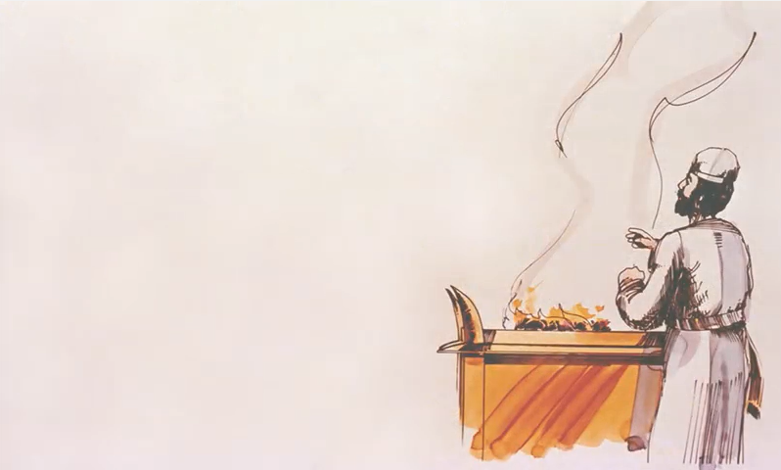
Voluntary Offerings
The Burnt Offering (ch.1)
The Grain Offering (ch.2)
The Peace Offering (ch.3)
Obligatory Offerings
The Sin Offering (ch.4)
The Guilt Offering (ch.5)
Notes:
Leviticus chapters 1 – 7 discusses 5 distinct sacrifices which can be divided up into 2 categories.
Chapters 1 – 3 deal exclusively with the voluntary offerings: the burnt offering, the grain offering, and the peace offering. Now, certain events would call for these sacrifices and so there were times where these voluntary offerings became obligatory. However, the language of the first 3 chapters, in summarizing these offerings, seems to suggest that individuals would offer these on a voluntary basis. These were devotional offerings toward God. And though they could not be offered before the obligatory offerings, they are mentioned first and so we will discuss them first.
Chapters 4 – 7 deal mostly with the obligatory offerings: the sin offering and the guilt offering. There is some information pertaining to the voluntary offerings given, but the majority deal with sacrifices that must be offered when sin was committed if that individual was to receive atonement for that sin.

Slide 4
Grain Offering (ch.2)
This offering is a sacrifice of thanksgiving to God that is consumed by the priests.
It might be difficult to give our first fruit to God. However, God gives us a great assurance. (Read Proverbs 3:9-10). With Proverbs three in mind what might we learn from the grain offering?
Proverbs 3:9-10 NASB95- Honor the LORD from your wealth And from the first of all your produce; [10] So your barns will be filled with plenty And your vats will overflow with new wine.
God deserves the fruit of of labor, because He is the source of our blessings. If I am willing to trust and be devoted to God, He will provide for me.

Slide 5
Grain Offering (ch.2)
Read Numbers 18:19 and 2 Chronicles 13:5. What does salt represent in terms of a covenant with God? (See Leviticus 2:13)
Num 18:19 – “All the heave offerings of the holy things, which the children of Israel offer to the Lord, I have given to you and your sons and daughters with you as an ordinance forever; it is a covenant of salt forever before the Lord with you and your descendants with you.”
2 Chron 13:5 – “Do you not know that the Lord God of Israel gave the rule over Israel forever to David and his sons by a covenant of salt?”
Salt represents something that is pure, enduring, and costly. In the context of Leviticus it also presents a relationship/friendship.

Slide 6
Peace offering (ch.3)
This offering isn’t to make peace with God but to enjoy peace with God. It is a sacrifice that is divided in three (Some for: God, the priest, & the offerer)
What word is the most repeated word in this chapter? What might this word represent? (i.e.- blood represents giving God your life)
Leviticus 17:14 NASB95- “For as for the life of all flesh, its blood is identified with its life. Therefore I said to the sons of Israel, ‘You are not to eat the blood of any flesh, for the life of all flesh is its blood; whoever eats it shall be cut off.’
Fat (3:3, 4, 9, 10, 14, 15, 16, 17)
Fat represents giving God our best.
We can truly enjoy peace with God by giving hime the best (the fat) and our life (the blood).

Slide 7
The Sin Offering in ch.4 is a unique offering:
A specific sin
A known sin
Unintentional sin (cf. 4:2, 13, 22, 27)
Made a different use of the blood and the body of the animal which was offered
Leviticus 17:14 NASB95- “For as for the life of all flesh, its blood is identified with its life. Therefore I said to the sons of Israel, ‘You are not to eat the blood of any flesh, for the life of all flesh is its blood; whoever eats it shall be cut off.’

Slide 8
Sin offering (ch.4)
Sin inhibits:
God’s holy presence in our lives: the veil (v.6)
Our prayers: the altar of incense (v.7)
Our atonement: the altar of burnt offering (v.10)
God in his mercy allows for one bull to cover and forgive the sin of the whole congregation of Israel (Ps. 32; 2 Sam. 12:13; Rom. 3:25; Rom. 4:5-8)

Slide 9
Sin offering (ch.4)
Chapter four has four clear divisions for an unintentional sin offering. What are those divisions?
Sin of the high priest (v.5)
Sin of the whole congregation (v.13)
Sin of the ruler (v.22)
Sin of the common person (v.27)

Slide 10
Purification/Guilt offering (ch.5)
How might a New Testament Christian apply verse one?
Verse one isn’t about avoiding lying but rather making the truth known, testifying, and being a witness. Christianity isn’t about not denying Jesus but rather telling the truth about Him.

Slide 11
Purification/Guilt offering (ch.5)
Joel 2:12-14 NASB95-“Yet even now,” declares the LORD, “Return to Me with all your heart, And with fasting, weeping and mourning; [13] And rend your heart and not your garments.” Now return to the LORD your God, For He is gracious and compassionate, Slow to anger, abounding in lovingkindness And relenting of evil. [14] Who knows whether He will not turn and relent And leave a blessing behind Him, Even a grain offering and a drink offering For the LORD your God?

Slide 12
Purification/Guilt offering (ch.5)
In Leviticus 19:9 and 23:22 what does God command His people to do? How does this verse apply to Leviticus 5:11? What does this verse teach us about God?
Leviticus 19:9-10 NASB95- ‘Now when you reap the harvest of your land, you shall not reap to the very corners of your field, nor shall you gather the gleanings of your harvest. [10] Nor shall you glean your vineyard, nor shall you gather the fallen fruit of your vineyard; you shall leave them for the needy and for the stranger. I am the LORD your God.
Leviticus 23:22 NASB95- ‘When you reap the harvest of your land, moreover, you shall not reap to the very corners of your field nor gather the gleaning of your harvest; you are to leave them for the needy and the alien. I am the LORD your God.’”
God isn’t interested in lavish sacrifice but He does want lavish forgiveness. He is so gracious and merciful that even the poorest person could offer a cup of flour for the forgiveness of sin and the salvation of their soul.

