Slide 1

You shall be holy for I am holy
A study of Leviticus

Slide 2
An overview of Leviticus
Leviticus 1:1-2 NASB95- Then the LORD called to Moses and spoke to him from the tent of meeting, saying, [2] “Speak to the sons of Israel and say to them, ‘When any man of you brings an offering to the LORD, you shall bring your offering of animals from the herd or the flock.
“You shall be holy for I am holy”- Lev. 11:44; 19:2; 20:7, 26
ch.1-17- The way to God (How we come before God)
ch.18-27- The walk with God (What holiness looks like in my daily life)
Who is the book of Leviticus for?
  Everyone! (Not just the priests)
  Leviticus 27:34 NASB95- These are the commandments which the LORD commanded Moses for the sons of Israel at Mount Sinai.

Slide 3
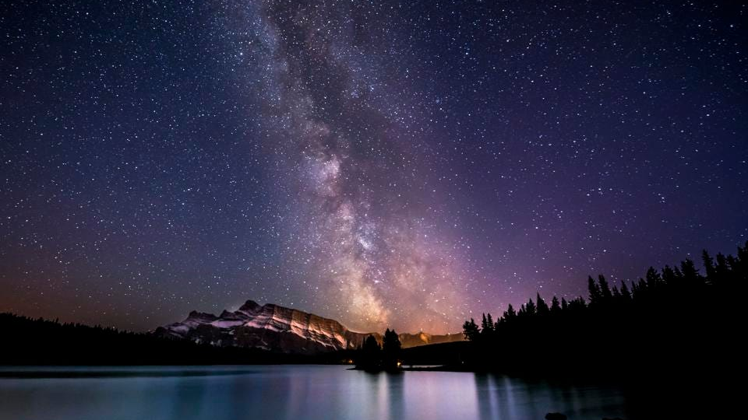

Slide 4
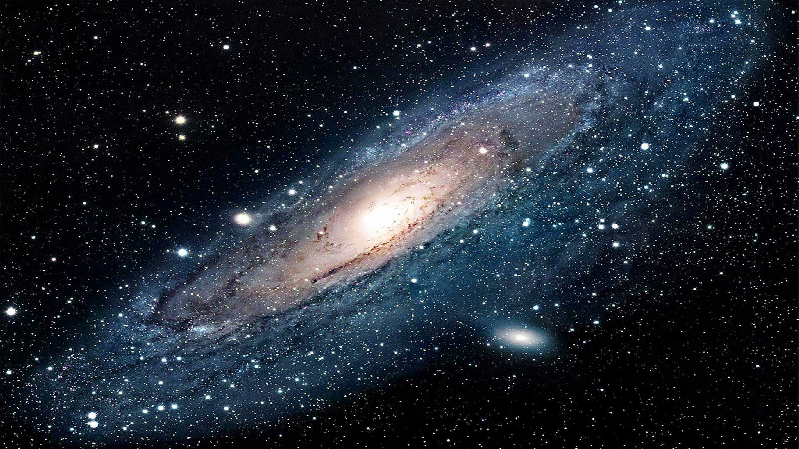

Slide 5
Moses meets God
Exodus 3:1-6 NASB95- Now Moses was pasturing the flock of Jethro his father-in-law, the priest of Midian; and he led the flock to the west side of the wilderness and came to Horeb, the mountain of God. [2] The angel of the LORD appeared to him in a blazing fire from the midst of a bush; and he looked, and behold, the bush was burning with fire, yet the bush was not consumed. [3] So Moses said, “ I must turn aside now and see this marvelous sight, why the bush is not burned up.” [4] When the LORD saw that he turned aside to look, God called to him from the midst of the bush and said, “Moses, Moses!” And he said, “Here I am.” [5] Then He said, “Do not come near here; remove your sandals from your feet, for the place on which you are standing is holy ground.” [6] He said also, “ I am the God of your father, the God of Abraham, the God of Isaac, and the God of Jacob.” Then Moses hid his face, for he was afraid to look at God.
“Kadosh”- unique, one of a kind, set apart for a specific purpose
When something is associated with God’s “kadosh” it also becomes “kadosh”

Slide 6
Israel meets God
Exodus 19:3-6 NASB95- Moses went up to God, and the LORD called to him from the mountain, saying, “Thus you shall say to the house of Jacob and tell the sons of Israel: [4] ‘You yourselves have seen what I did to the Egyptians, and how I bore you on eagles’ wings, and brought you to Myself. [5] Now then, if you will indeed obey My voice and keep My covenant, then you shall be My own possession among all the peoples, for all the earth is Mine; [6] and you shall be to Me a kingdom of priests and a holy nation.’ These are the words that you shall speak to the sons of Israel.”
God’s goal for Israel is to make them a holy people by planting His holy presence right in the middle of them.
A unique person (High priest), goes into a one of a kind space (Holy of Holies), that is set a part for a specific purpose (Representing God’s people).

Slide 7
God meets us
Leviticus 11:44-45 NASB95- For I am the LORD your God. Consecrate yourselves therefore, and be holy, for I am holy. And you shall not make yourselves unclean with any of the swarming things that swarm on the earth. [45] For I am the LORD who brought you up from the land of Egypt to be your God; thus you shall be holy, for I am holy.’”
God invites us to share in these divine qualities and characteristics and become sharers/partakers of His divine nature, His holiness
Is God waiting for you to come and be holy like Him?
            or…
Did He first move towards you, in His holiness, to heal and transform you?

