Slide 1
You shall be holy for I am holy
A study of Leviticus

Slide 2
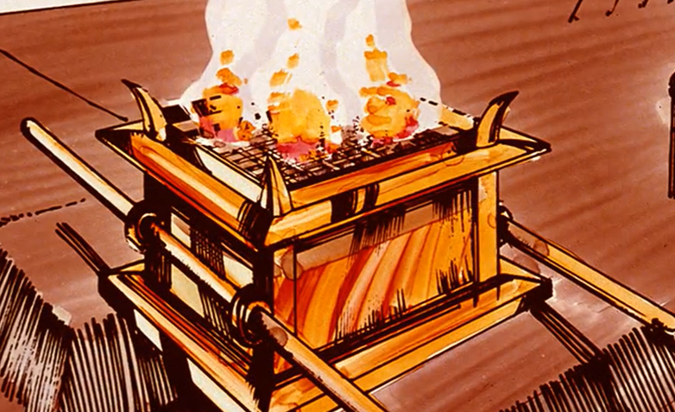
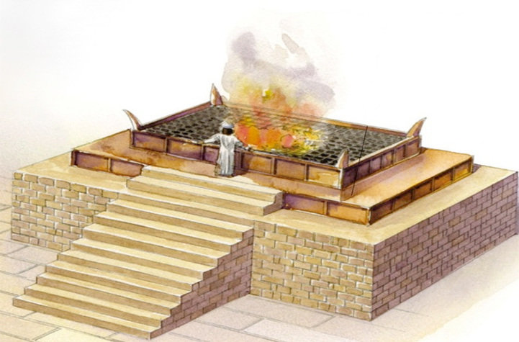
An Altar
Ex. 29:42-46- It shall be a continual burnt offering throughout your generations at the doorway of the tent of meeting before the LORD, where I will meet with you, to speak to you there. [43] I will meet there with the sons of Israel, and it shall be consecrated by My glory. [44] I will consecrate the tent of meeting and the altar; I will also consecrate Aaron and his sons to minister as priests to Me. [45] I will dwell among the sons of Israel and will be their God. [46] They shall know that I am the LORD their God who brought them out of the land of Egypt, that I might dwell among them; I am the LORD their God.
Lev. 1:7-9 - The sons of Aaron the priest shall put fire on the altar and arrange wood on the fire. [8] Then Aaron’s sons the priests shall arrange the pieces, the head and the suet over the wood which is on the fire that is on the altar. [9] Its entrails, however, and its legs he shall wash with water. And the priest shall offer up in smoke all of it on the altar for a burnt offering, an offering by fire of a soothing aroma to the LORD.
Notes:
Now the general location where these sacrifices would be made were at the tabernacle/temple. Scripture does not explicitly spell this out, to my recollection, but we believe the altar was an elevated place, suggesting man’s approach to heaven, the realm of deity. In fact the Latin word for “altar” means “high”. So it would either be placed upon a mound of dirt, which is what we believe they did for the tabernacle, or built upon a structure which we know they did in Solomon’s temple.
More pertinent, though, is that this is where God designated that the sacrifices would be made – at the brazen altar right at the entrance to the courtyard. And this in Ex 29, it was at this altar that God said He would meet with Israel, speak to them, and reconcile them. Ex 29:42-43
So think about it. You’re approaching the tabernacle/temple where God’s presence dwells and boy would it be something to be there in His presence. But as soon as you entered through the courtyard gate of that tabernacle, the first thing you would see standing right before your eyes was this brazen altar with that massive fire upon it and blood is everywhere; its a perpetual reminder that you were not worthy to approach a holy God without first offering a blood sacrifice for your sins. This was to leave an impression on Israel

Slide 3
Moses meets God
Where does the offerer get their offering? (vs.1-2)
From their herd or flock
Chapter one has three clear divisions for the burnt offering sacrifices. What are those divisions? (vs.3-17)
A burnt offering from the herd
A burnt offering from the flock
A burnt offering from the birds
Read verse 3 in the King James Version. Leviticus 1:3 KJV- If his offering be a burnt sacrifice of the herd, let him offer a male without blemish: he shall offer it of his own voluntary will at the door of the tabernacle of the congregation before the LORD. What is significant about the burnt offering that is being brought by the individual?

Slide 4
Moses meets God
Read verse 3 in the King James Version. Leviticus 1:3 KJV- If his offering be a burnt sacrifice of the herd, let him offer a male without blemish: he shall offer it of his own voluntary will at the door of the tabernacle of the congregation before the LORD. What is significant about the burnt offering that is being brought by the individual?
It is suppose to be a voluntary, willing, surrendered sacrifice.

Slide 5
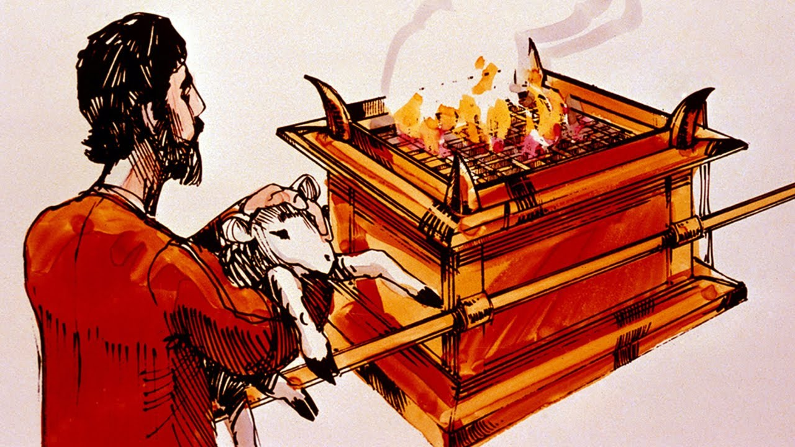
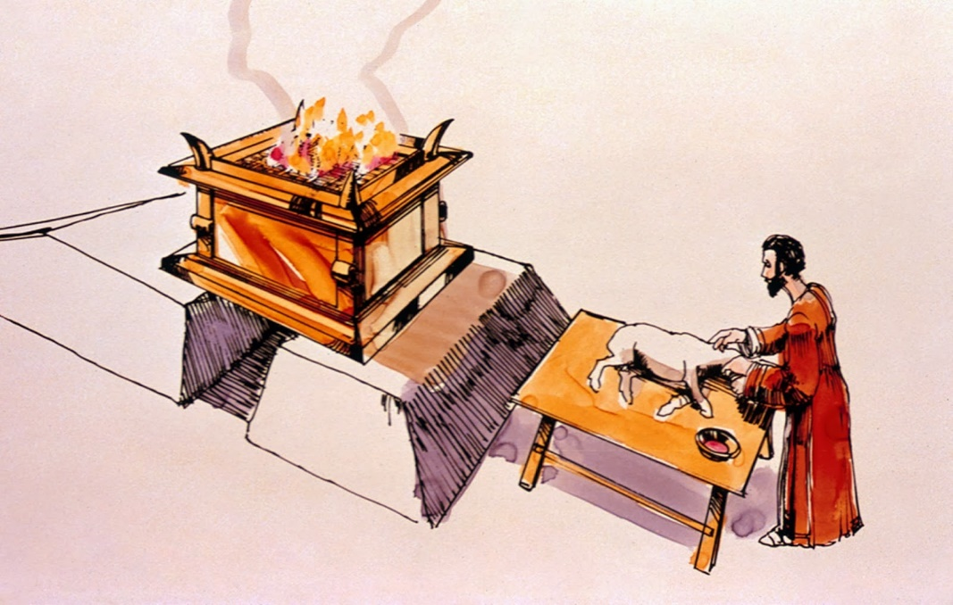
An Offerer
Psa 51:16-17 – “For You do not delight in sacrifice, otherwise I would give it; You are not pleased with burnt offering. The sacrifices of God are a broken spirit; a broken and a contrite heart, O God, You will not despise.”
Amos 5:22-24 – “Even though you offer up to Me burnt offerings and your grain offerings, I will not accept them; and I will not even look at the peace offerings of your fatlings. Take away from Me the noise of your songs; I will not even listen to the sound of your harps. But let justice roll down like waters and righteousness like an ever-flowing stream.”
Notes:
Second, there was an offerer. Now, we typically look at these sacrifices as a type of Jesus and the sacrifice He made on the cross. And that is true assessment to a large degree. But, at this point in time they were ideally designed to teach the one making the offering what kind of spirit God expected of them as they draw near to Him soliciting atonement.
So, for example, regarding the sin offering, since this is one of the ones we more easily understand, when they sinned, they had to take an animal from their flock, take it to the tabernacle, and bring it before the altar where the priest would be. Then, the offerer had to put his hand on the head of that animal, and he killed the animal, not the priest. The offerer would take a knife, cut the animal’s throat, and stand there watching the animal die. And what was supposed to be going through his mind is, “I’ve sinned. And this animal is dying for me”. The animal didn’t do anything. Whatever sin was committed by the person, priest, congregation, or ruler, the animal didn’t participate in it. The animal was out there in the field minding its own business, doing what animals do and now all of the sudden he’s being dragged into the tabernacle w/o any understanding of what’s happening and having his throat slit by the man standing there, and the man is holding this animal’s head while it undergoes a slow, agonizing death. Do you think those people should have been impacted by the image of what was going on in front of them? “This animal didn’t do it; I did. I’m guilty”
King David understood this about the Levitical offerings. Psa 51:16-17 – “For You do not delight in sacrifice, otherwise I would give it; You are not pleased with burnt offering. The sacrifices of God are a broken spirit; a broken and a contrite heart, O God, You will not despise.”
In other words, God never wanted the animals. He wanted the broken heart and broken spirit of the man offering the animal.
Amos 5:22-24 – “Even though you offer up to Me burnt offerings and your grain offerings, I will not accept them; and I will not even look at the peace offerings of your fatlings. Take away from Me the noise of your songs; I will not even listen to the sound of your harps. But let justice roll down like waters and righteousness like an ever-flowing stream.”
In other words, God didn’t merely want these people to make sacrifices; He wanted those sacrifice to change their hearts. And if you brought your sacrifice and your heart wasn’t any different, your sacrifice didn’t do any good at all. And this is where Jesus comes into the picture. He fully represented all the sacrifices in both his life and death because Israel either couldn’t ever do it (such as the case with the sin and guilt offering) or they insufficiently lived up to the standard of them (in the case of the burnt, grain, and peace offerings).

Slide 6
A Sacrifice
Mal 3:10 – “‘Bring the whole tithe into the storehouse, so that there may be food in My house, and test Me now in this,’ says the Lord of hosts, ‘if I will not open for you the windows of heaven and pour out for you a blessing until it overflows.”
2 Sam 24:24 – “However, the king said to Araunah, ‘No, but I will surely buy it from you for a price, for I will not offer burnt offerings to the Lord my God which cost me nothing.’ So David bought the threshing floor and the oxen for fifty shekels of silver.”
Notes:
And this is why its called a sacrifice. The idea behind sacrifice is giving up something that you want for something that you want more. If you want God, truly want Him for what He offers undeserving men, you’ll give up anything, including things of material and temporal value. And so, in this system, in order for the offering to truly be a sacrifice, it had to be a product of the offerer’s own labor. It couldn’t be a wild animal or something given to him or something that he steals. You’ll remember from Mal 1:13 that one of the reasons God was no longer accepting their offerings is because they were bringing that which had been acquired through robbery. The sacrifice had to be a product of the offerer’s labor, something that he depended on to sustain his life. Because when the offerer gives up something that came from the toil of his hands, which is indicative of his labor and time, and also gave of something that he needed to sustain his physical life, the offerer is representing and symbolizing the surrender of his soul to God and his absolute dependence on God to sustain him. This is what made it a sacrifice which then made it acceptable to God because it became something that you did by faith. And as this same individual continued to yield and serve His Creator, He would find that God could easily replace in abundance what was being offered.
Mal 3:10 – “‘Bring the whole tithe into the storehouse, so that there may be food in My house, and test Me now in this,’ says the Lord of hosts, ‘if I will not open for you the windows of heaven and pour out for you a blessing until it overflows.”
King David knew what a sacrifice truly was. In 2 Sam 24, when David took the census and sinned against God, he was commanded to build an altar at the threshing floor of Araunah where the angel of the Lord stood near. When he told Araunah that he needed to purchase the threshing floor from him, Araunah offered to just give it to him along with the oxen and the wood. Notice David’s response – 2 Sam 24:24 – “However, the king said to Araunah, ‘No, but I will surely buy it from you for a price, for I will not offer burnt offerings to the Lord my God which cost me nothing.’ So David bought the threshing floor and the oxen for fifty shekels of silver.”
Did David understand the concept of sacrifice? Absolutely he did. But this culture does not, including the Christian culture we live in. I’ve wondered if the reason why we’re losing so many young people is because it is costing some of them way too little to serve God. I’ve wondered about this of all brethren, but especially our young people. I wonder if the thinking doesn’t exist that being a Christian and going to church is just one of those things you do that doesn’t require much effort or cost us very much. Go to church just enough to keep the elders from withdrawing from you. Sin all you want as long as just before you eat or go to bed you say a prayer for forgiveness. Brethren, that is cheap grace and there is no such thing as cheap grace because of what it cost the Lord. There is no acceptable worship to God, whether it is private or public worship, that doesn’t demand real, genuine sacrifice on our part. That was the case in Leviticus and it is still the case today. It must cost us something for it to be of real value to the Lord.

Slide 7
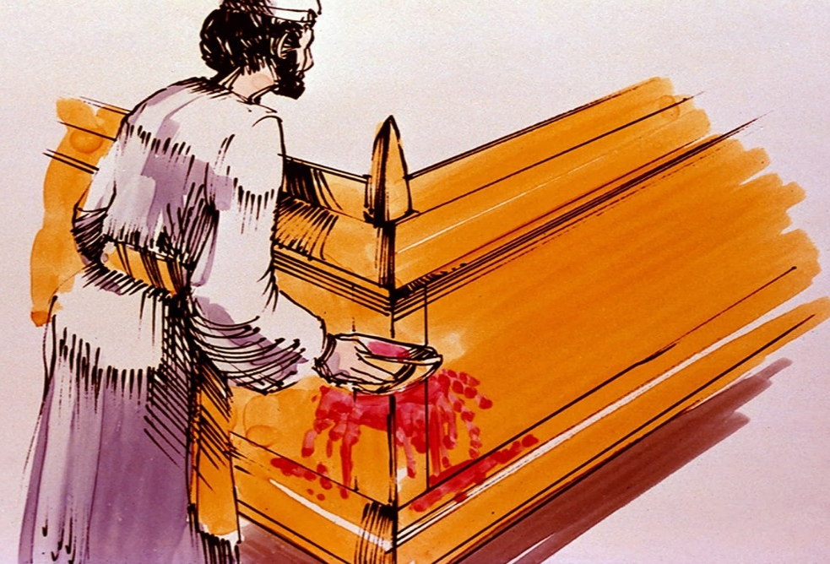
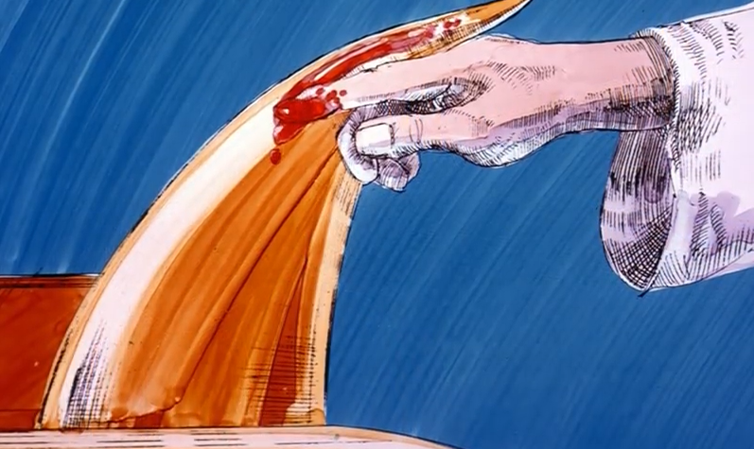
The Blood
Lev 17:11 – “For the life of the flesh is in the blood, and I have given it to you on the altar to make atonement for your souls; for it is the blood by reason of the life that makes atonement.”
Heb 9:22 – “And according to the Law, one may almost say, all things are cleansed with blood, and without shedding of blood there is no forgiveness.”
Notes:
Nothing played a more prominent role in the sacrifices than the blood of the offering, and the manner in which it was used was minutely specified by the Lord. Depending on the offering, the blood might be dabbed upon the horns that were on the four corners of the golden altar of incense, splashed/sprinkled on all four the sides of the brazen altar, or dumped out at the base of the altar, or sprinkled seven times on the veil. Why blood? Lev 17:11 – “For the life of the flesh is in the blood, and I have given it to you on the altar to make atonement for your souls; for it is the blood by reason of the life that makes atonement.”
So there were two things the blood then symbolized. First, it dramatizes the consequences of sin, and secondly, the great pains involved in the process of forgiveness and reconciliation. And so the blood symbolized both life and the shedding of blood, or the giving of one’s life. Death is the consequence of sin and so the animal was slain to show what happens when man sins. And the blood “covered” sins which is the literal meaning of the word “atonement”.
Heb 9:22 – “And according to the Law, one may almost say, all things are cleansed with blood, and without shedding of blood there is no forgiveness.”

Slide 8
Moses meets God
Why is verse nine significant and how can we apply it to today?
When we do things God’s way it is pleasing to Him. The things that are pleasing to God might not be pleasing to us but He has shown us what He does delight in and take pleasure in.
Why does God allow different animals to be sacrificed? What does this reveal to us about God’s desire?
God is more interested in the heart than the animal being offered. The poor woman’s bird is equivalent to the rich man’s bull

Slide 9
God wants your heart
Psalm 50:7-15 MEV- “Hear, O My people, and I will speak, O Israel, and I will testify against you; I am God, even your God. [8] I will not reprove you for your sacrifices or for your burnt offerings that are continually before Me. [9] I will take no young bull out of your house, nor male goats out of your folds. [10] For every wild animal of the forest is Mine, and the cattle on a thousand hills. [11] I know every bird of the mountains, and the creatures that move in the field are Mine. [12] If I were hungry, I would not tell you; for the world is Mine, and all its fullness. [13] Will I eat the flesh of bulls, or drink the blood of goats? [14] Sacrifice a thank offering to God, and pay your vows to the Most High, [15] and call on Me in the day of trouble; I will deliver you, and you will glorify Me.”
God desires a relationship not a ritual. God wants a thankful heart, a life of obedience, and a living trust in Him.

