Slide 2
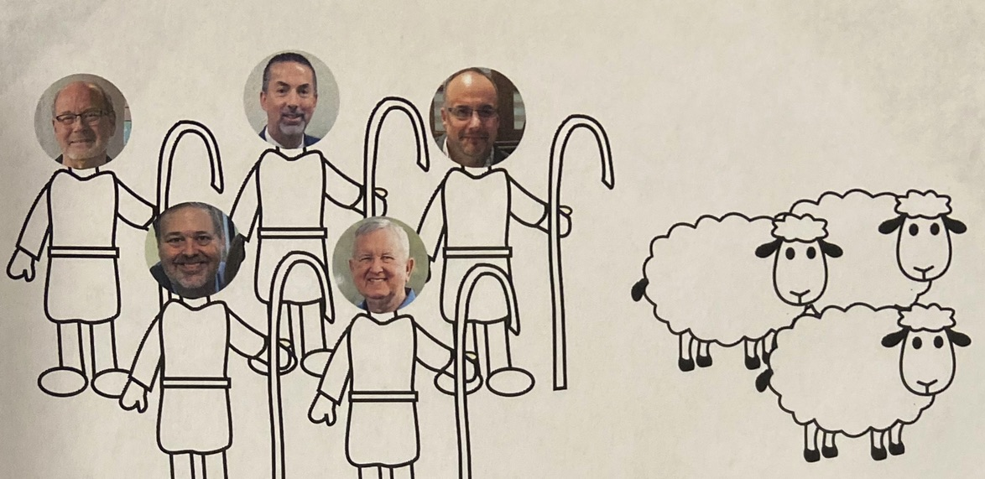

Slide 3
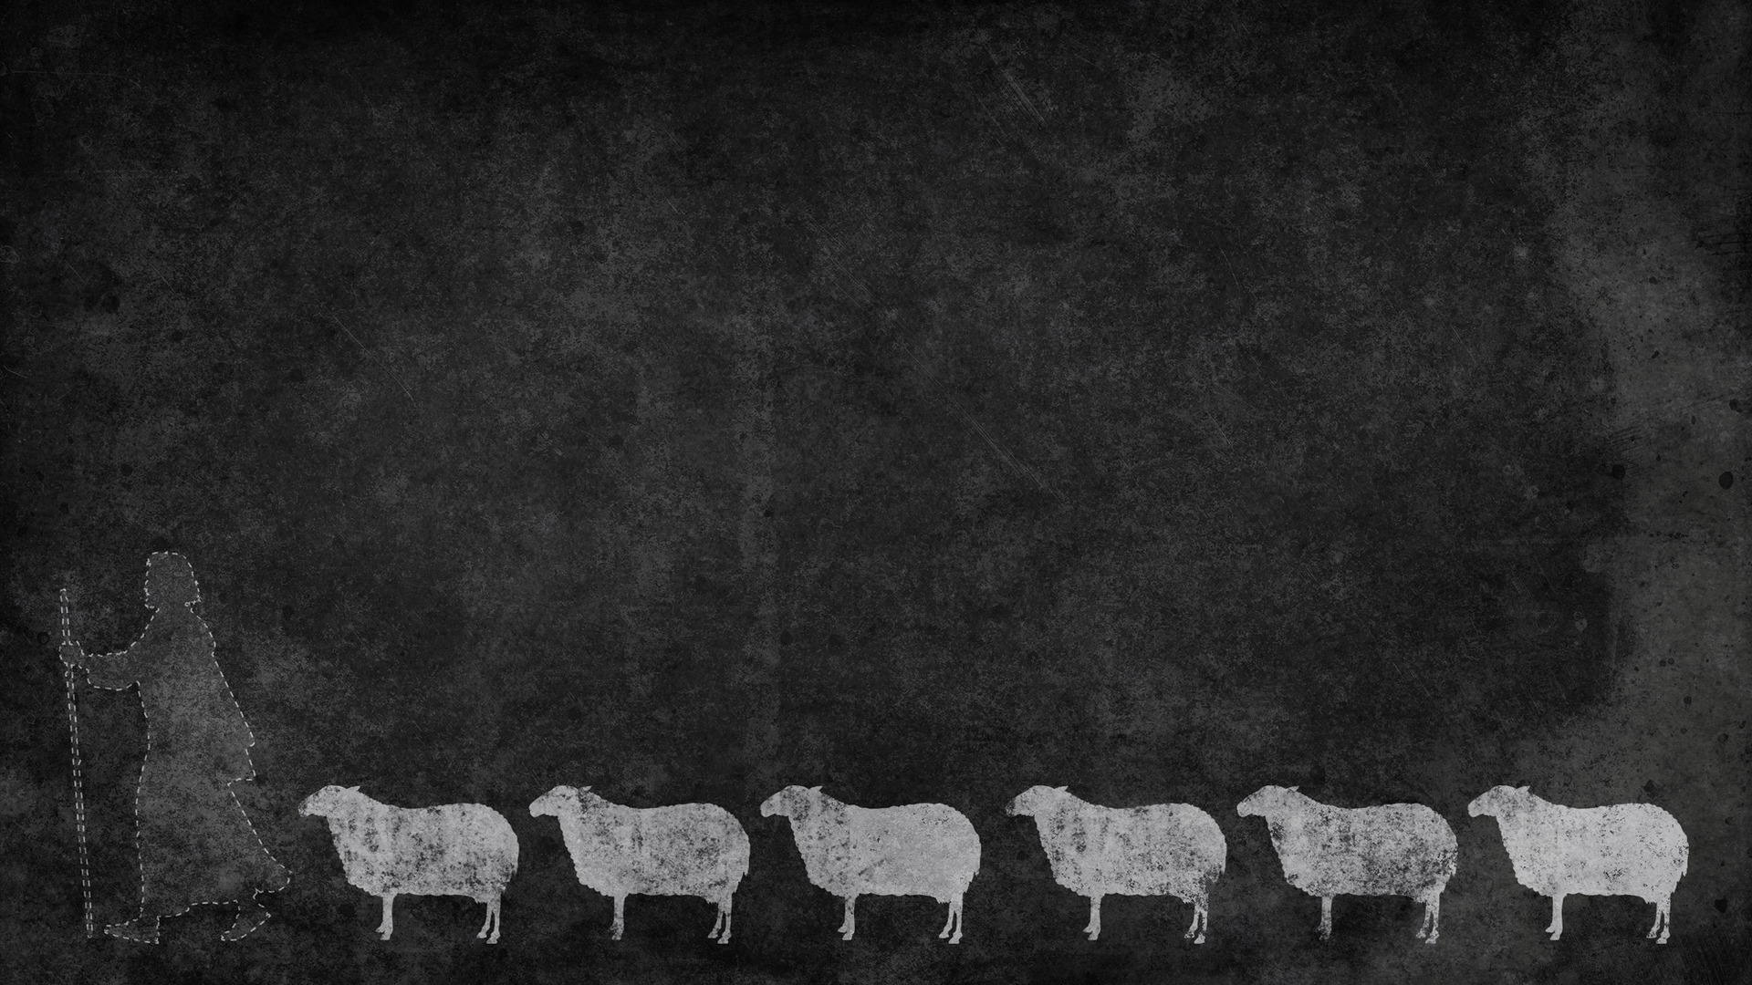
Shepherds watch over the souls of the ENTIRE flock (1Peter 5.2)
Shepherds don’t serve to please themselves (1Peter 5.3)
Shepherds need to know the sheep (John 10.14)
Sheep follow their shepherds because they know them (John 10.4-5)

