Slide 2
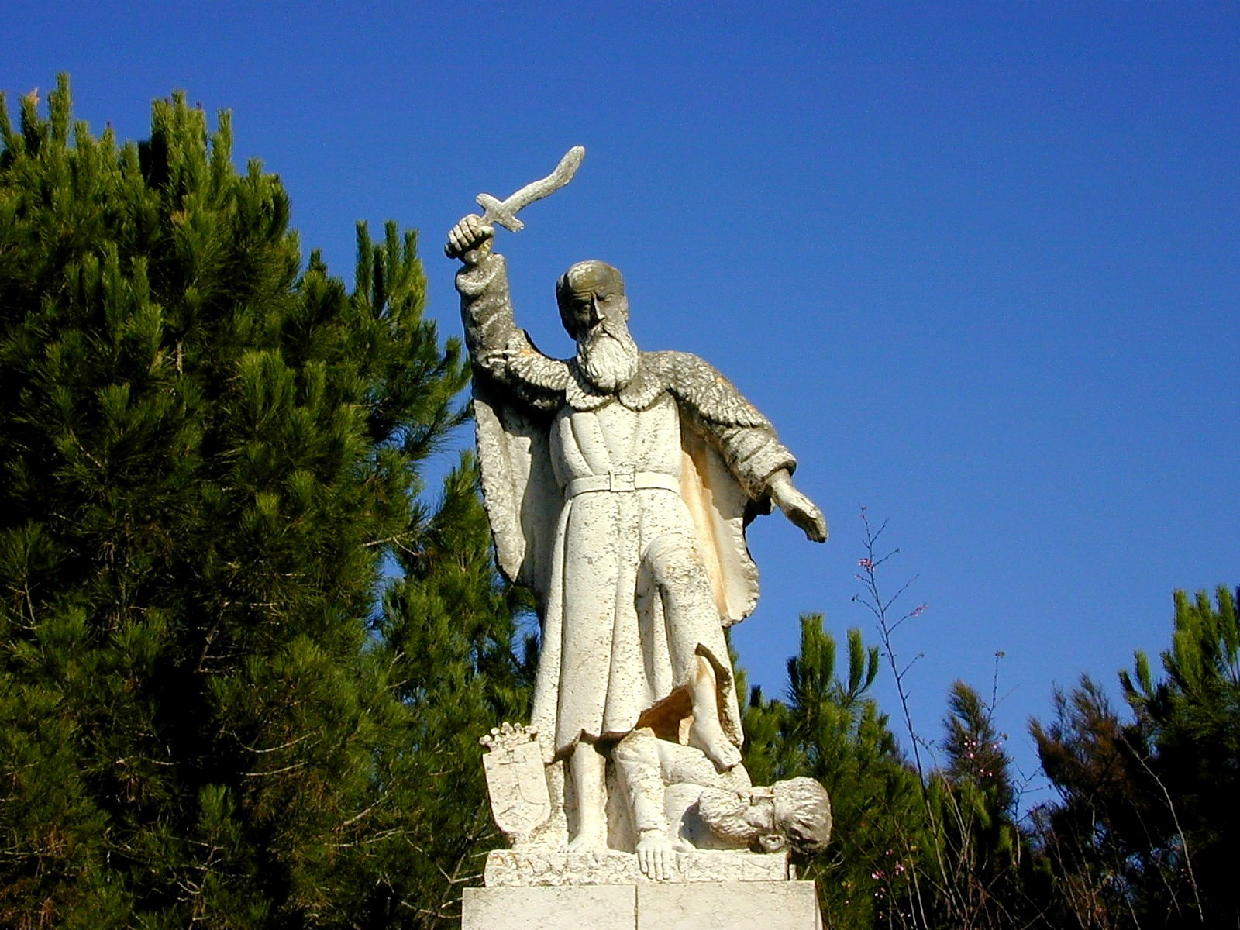

Slide 3
IDOLATRY
is the
PROBLEM

Slide 4
THREE LIES
of
IDOLATRY

Slide 5
You haven’t forsaken God
This will provide what you need
Three Lies of Idolatry

Slide 6
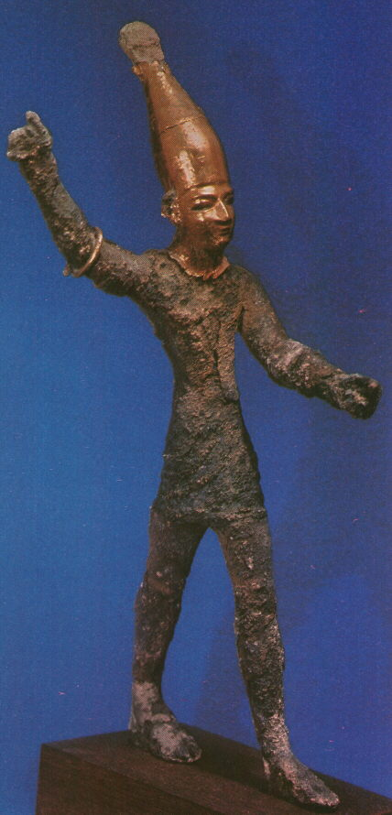

Slide 7
You haven’t forsaken God
This will provide what you need
Something / anything is greater than Jehovah
Three Lies of Idolatry

Slide 8
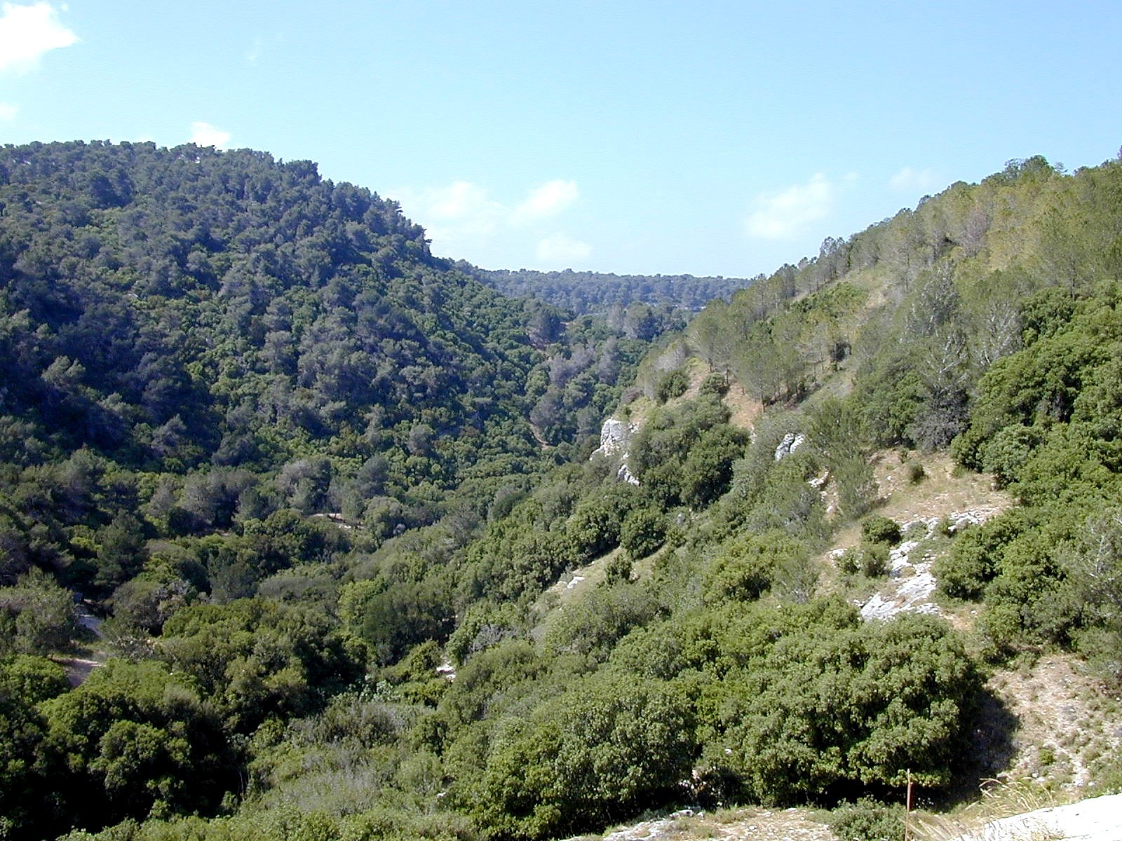

Slide 9
You haven’t forsaken God
This will provide what you need
Something / anything is greater than Jehovah
Three Lies of Idolatry

