Slide 2
Jesus and the Thirsty (John 4.1-42)
Notes:
7:30

Slide 3
Imitate your teacher
Matthew 10:24-25 NASB95
“ A disciple is not above his teacher, nor a slave above his master. [25] It is enough for the disciple that he become like his teacher, and the slave like his master. If they have called the head of the house Beelzebul, how much more will they malign the members of his household!
Notes:
7:30

Slide 4
Profile of the Samaritan Woman
What details does the text reveal about this Woman? (lifestyle, character, personality, relationships, worldviews, etc.)
Notes:
7:44
Small group discuss

Slide 5
Profile of the Samaritan Woman
Woman, socially viewed as inferior
Samaritan, group despised by Jews
Came mid-day (not usual time, apart from other women)
Unafraid to engage in potentially combative conversation
Willing to ask questions, seek answers
Seeking satisfaction (water, men, religious concepts)
Unsatisfied with human (spec. marriage) relationships
Ashamed (?) of marriage history
Uncomfortable with discussing personal matters
Open to believing in “a Prophet”
Thoughtful (or at least curious) about religious questions
Worshipper of God, believer in (at least parts of) the Scriptures
Waiting on salvation (or answers) from the “Messiah” (or “Taheb”)
Outsider
Seeking
Empty
Spiritual
Notes:
7:48
Share out and discuss as class

Slide 6
How Jesus Spoke with the Thirsty
He “had to go” into the (uncomfortable) place where she was (4)
Disregarded racial and social barriers (9)
Used ordinary object to talk about spiritual & Scriptural concepts (10)
Discerned natural desires and appealed to their deeper reality (10-15)
Kindly yet directly exposed personal sins (16-18)
Allowed her to (somewhat) dictate the conversation (19-26)
Unafraid to openly discuss matters of religious debate (21-24)
Answered dichotomous religious propositions with independent truth (21)
Directly pointed out and corrected religious failure and false doctrine (22)
Focus on the Father and genuine relationship with him (23-24)
Notes:
8:05
Teacher lecture + open for comments / applications
Most likely only cover #1-3 possibly 4
What are some ‘places’ that create discomfort for us? (geographically, socially, relationally) What does it mean that Jesus ‘had to’ go and what does that mean for us?
__________________________
What racial and social barriers are most challenging to overcome? Why are these barriers so difficult to deal with like Christ did? What can we learn from him for our own ministry?
What are some of the most common, ordinary, daily conversation topics? How can we turn those into spiritual-Scriptural conversations?
What are some of the ways that people search for happiness? What are some of the most important desires to most people you know? How do these desires point down to deeper needs that the Gospel fulfills? How might you appeal to the deeper realities of the desires of those whom you know and meet?
What are the sins with which most of your friends and neighbors are engaged? What makes it complicated to discuss these things? (some too timid to point out sin, others too harsh and condemnatory)
______________________
What religious debates are some of the most likely / common for you to face in your conversations with people? Why is it sometimes difficult to discuss these things?
______________________
______________________
What are some other things we might fall into the trap of pointing people to instead of a life devoted to worshipping the Father in Spirit and Truth? (“Church Of Christ”, Embry Hills, doctrinal concepts in isolation, moralism, etc.)
What are some wrong goals we might have in our discussions with people? (get credit for myself, baptize them)

Slide 7
Our Prayer List
People: Who are some outsiders I can and should influence with the Gospel?
Knowledge: What information am I missing to be able to influence outsiders?
Wisdom: What complications might arise for me in reaching outsiders?
Courage: What fears do I have in connecting with outsiders?
Love: Who do I struggle to care about?

Slide 9
Facing a Task Unfinished
(Digital Only)
Hymn: Frank Houghton (1930)
Tune: AURELIA • Samuel S. Wesley (1864)

Slide 10
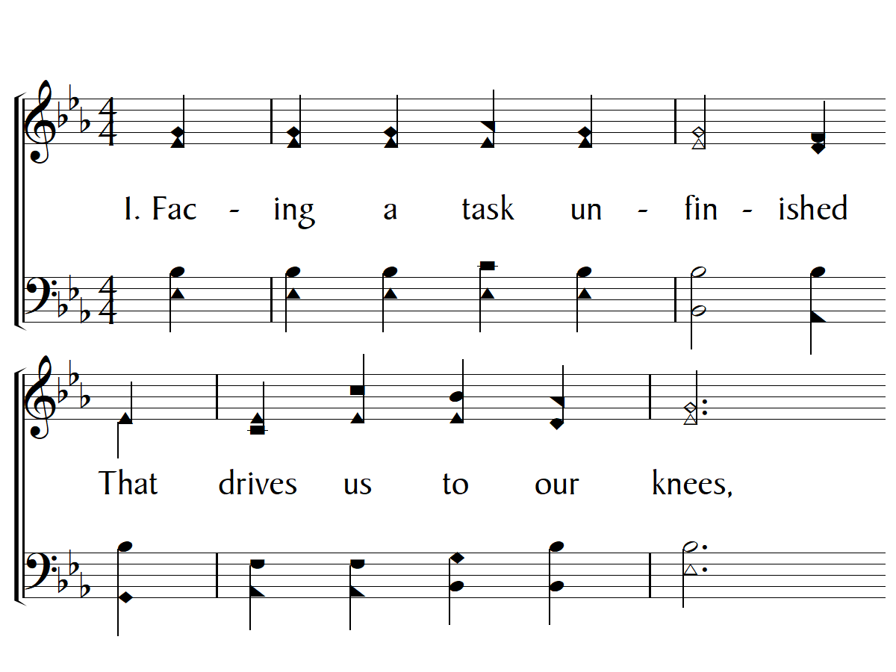

Slide 11
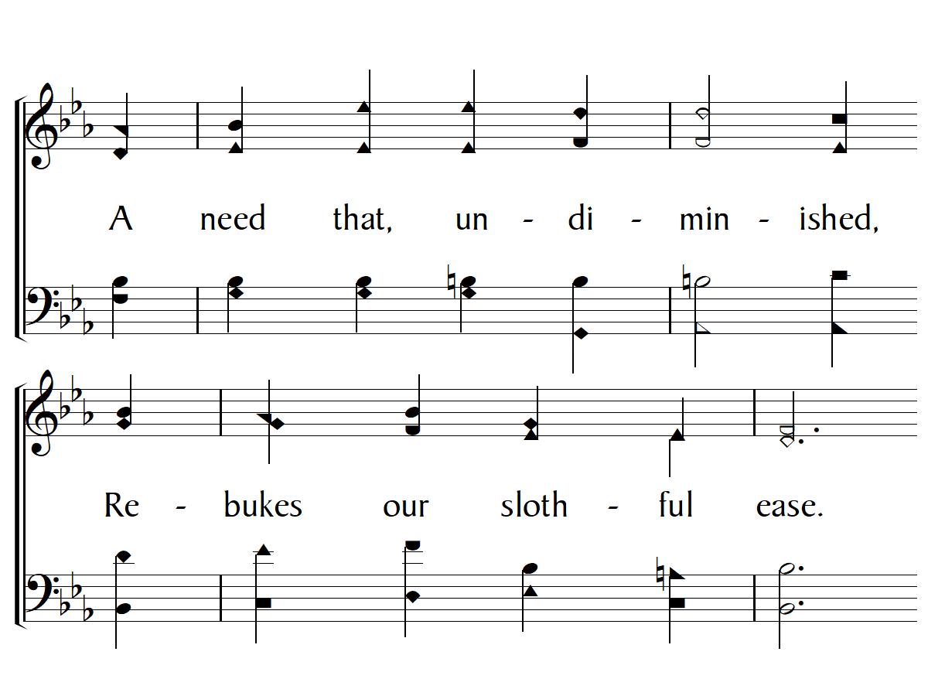

Slide 12
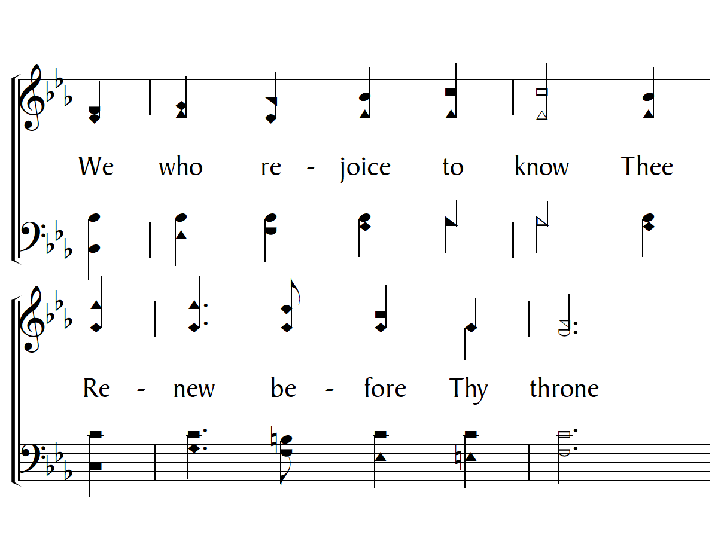

Slide 13
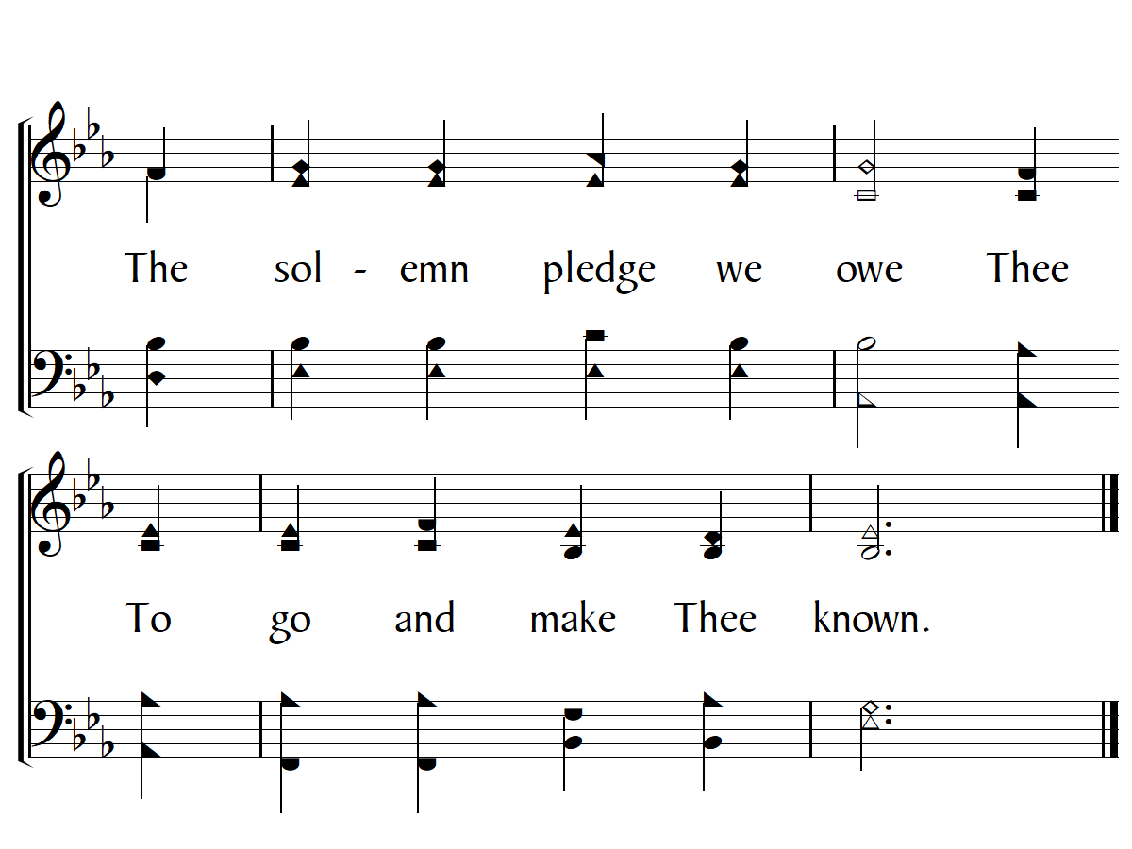

Slide 14
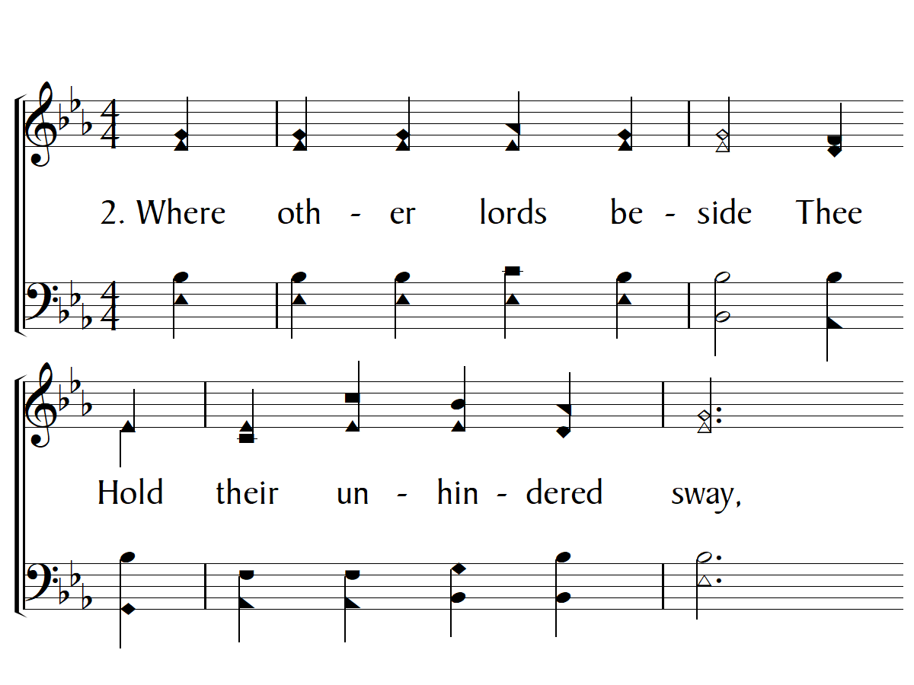

Slide 15
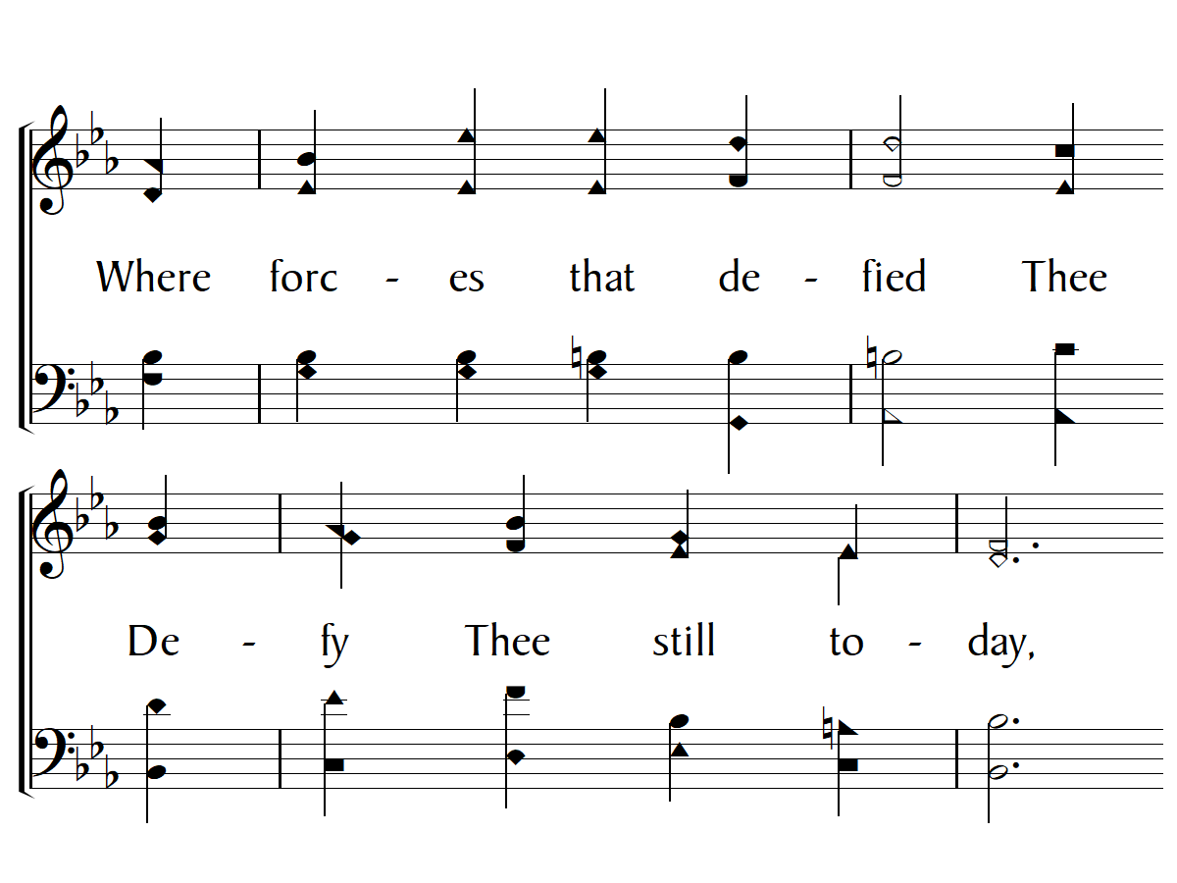

Slide 16
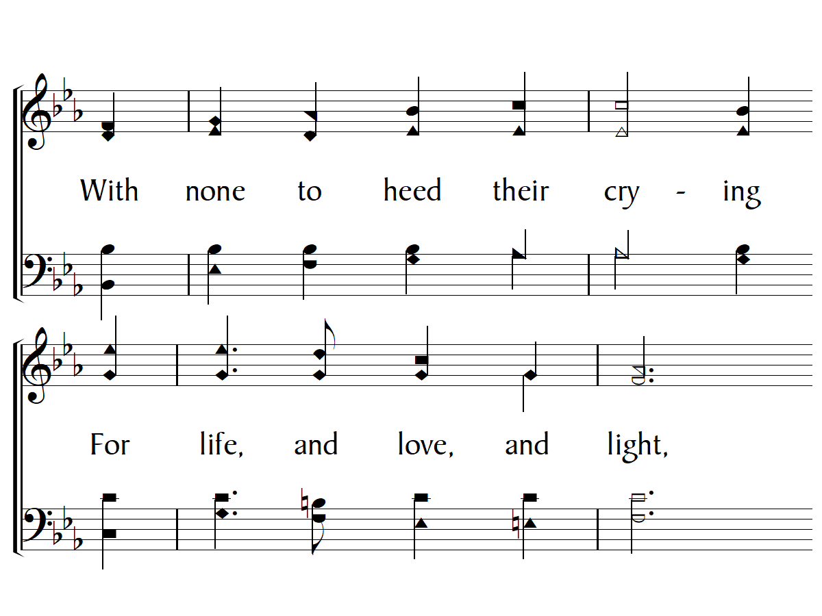

Slide 17
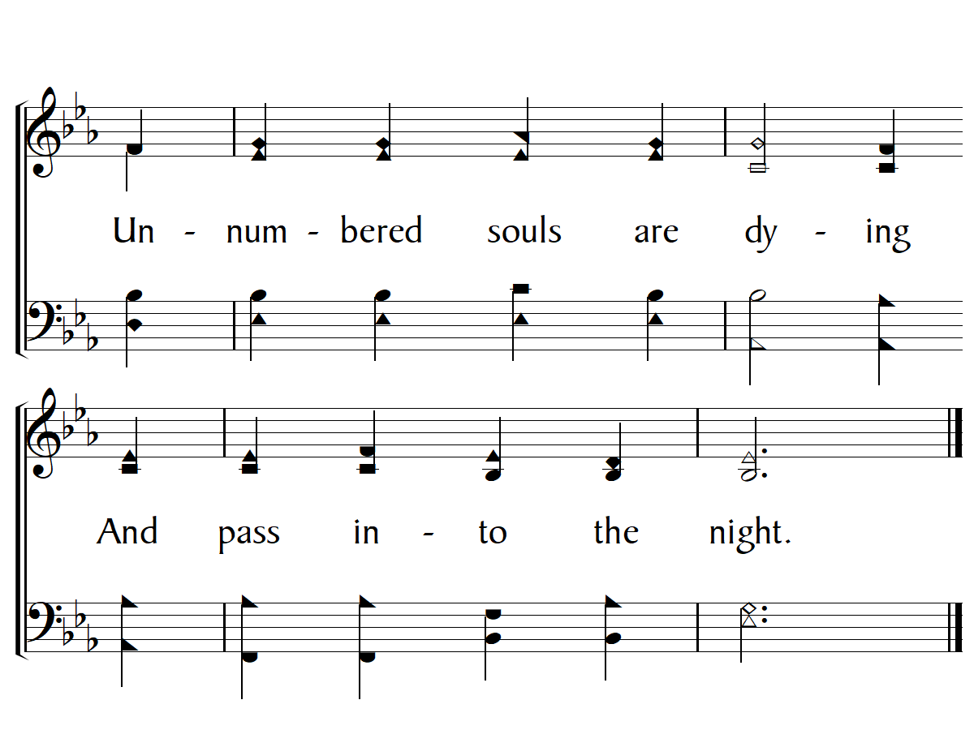

Slide 18
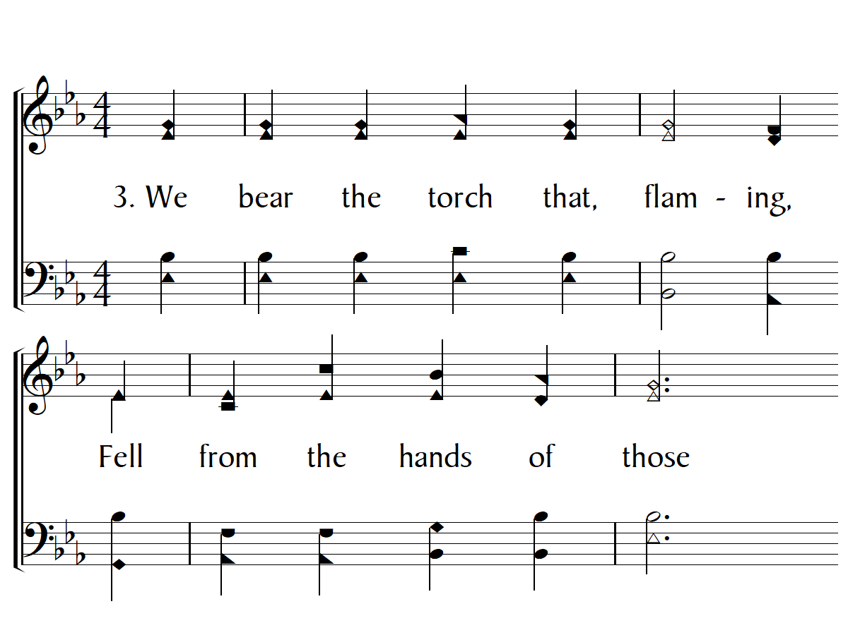

Slide 19
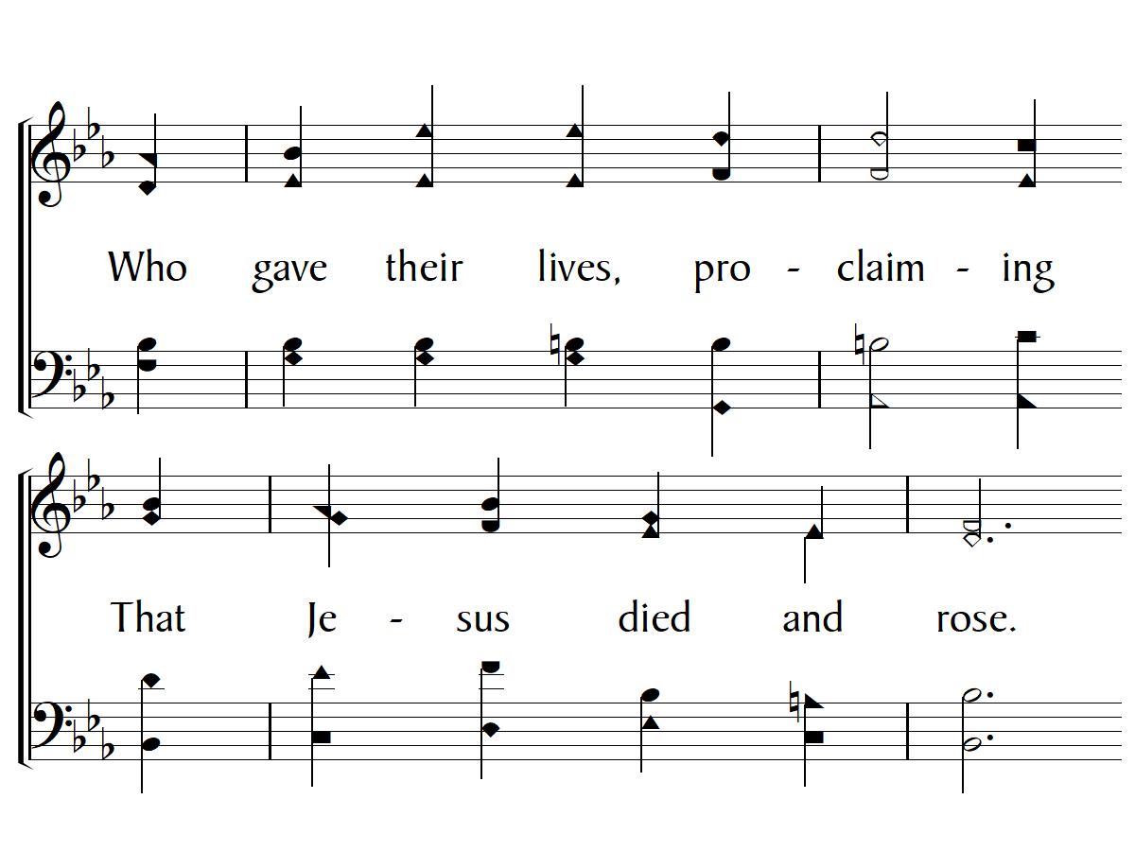

Slide 20
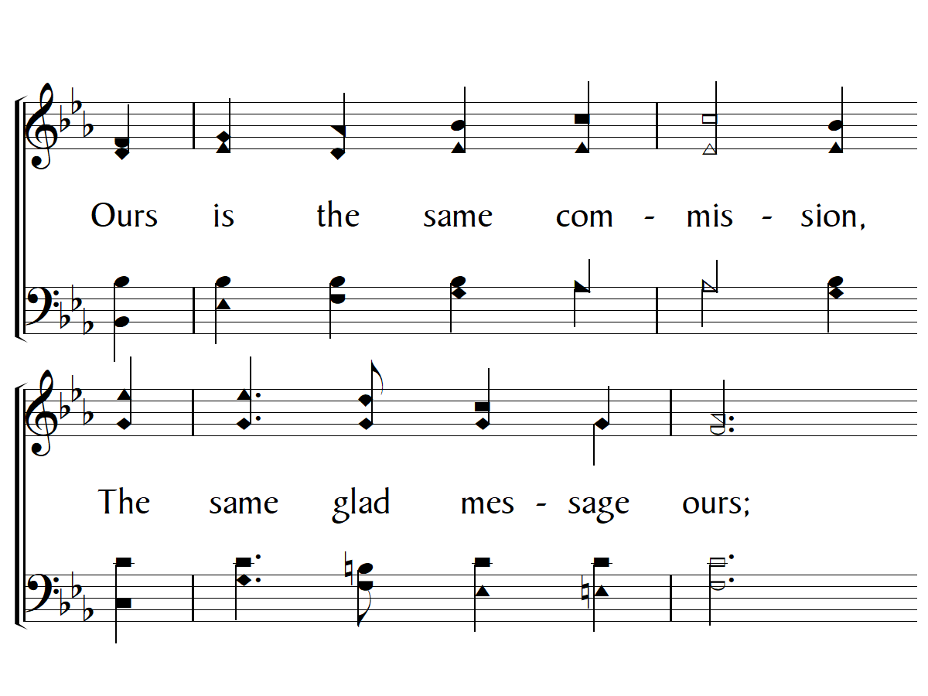

Slide 21
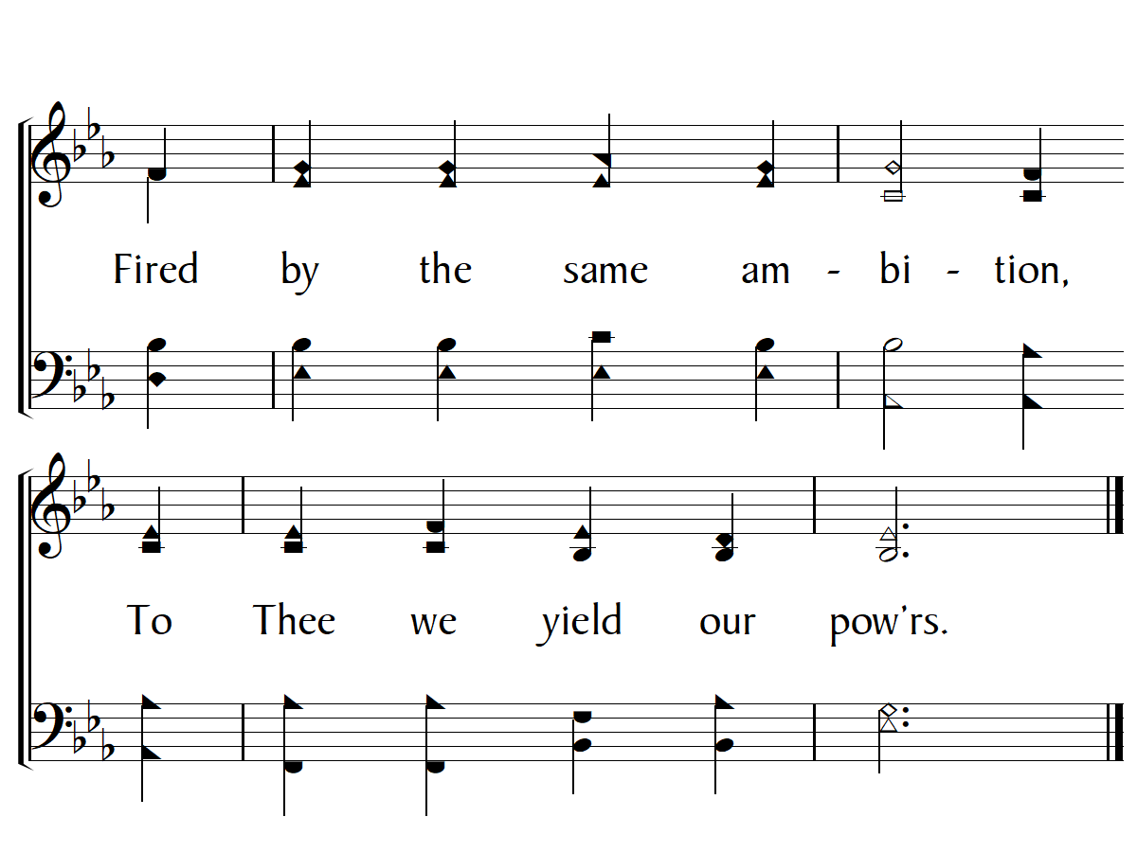

Slide 22
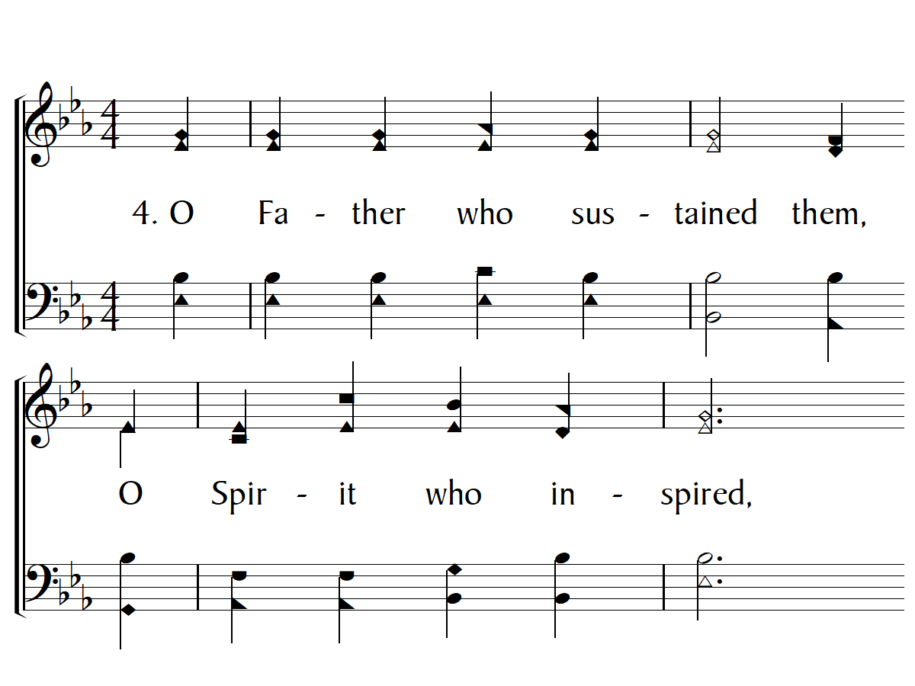

Slide 23
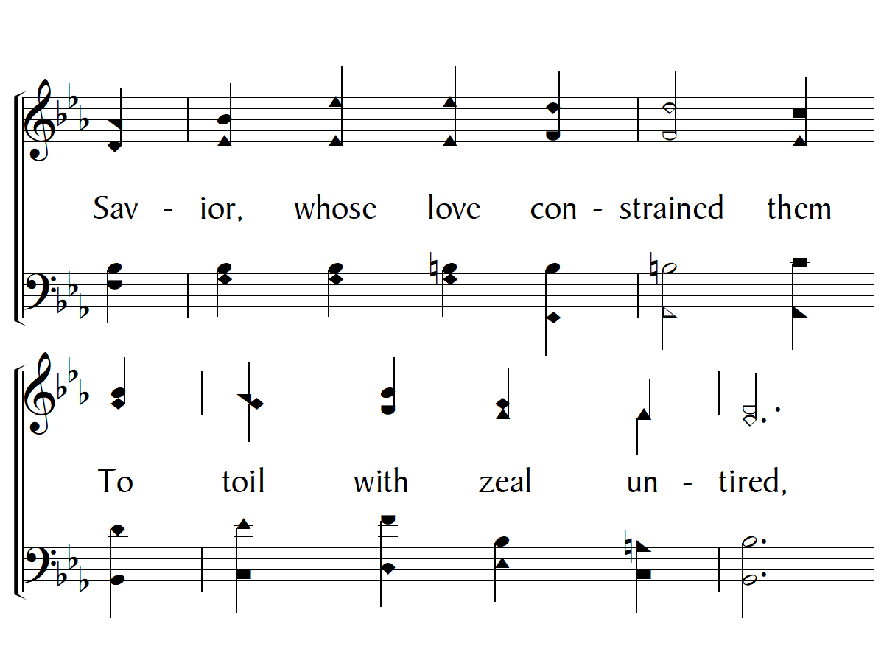

Slide 24
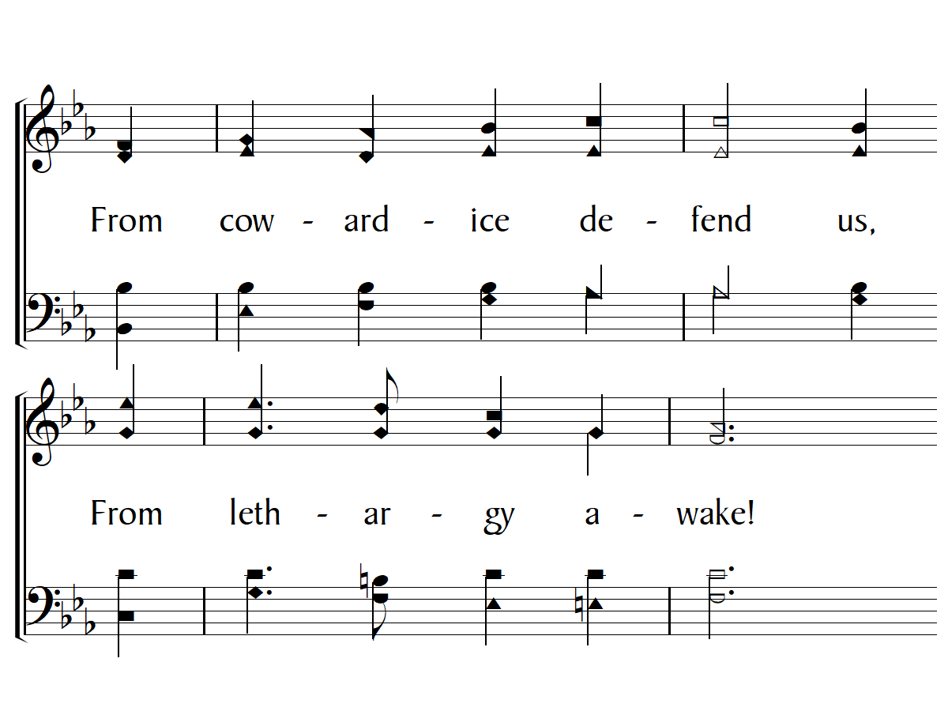

Slide 25
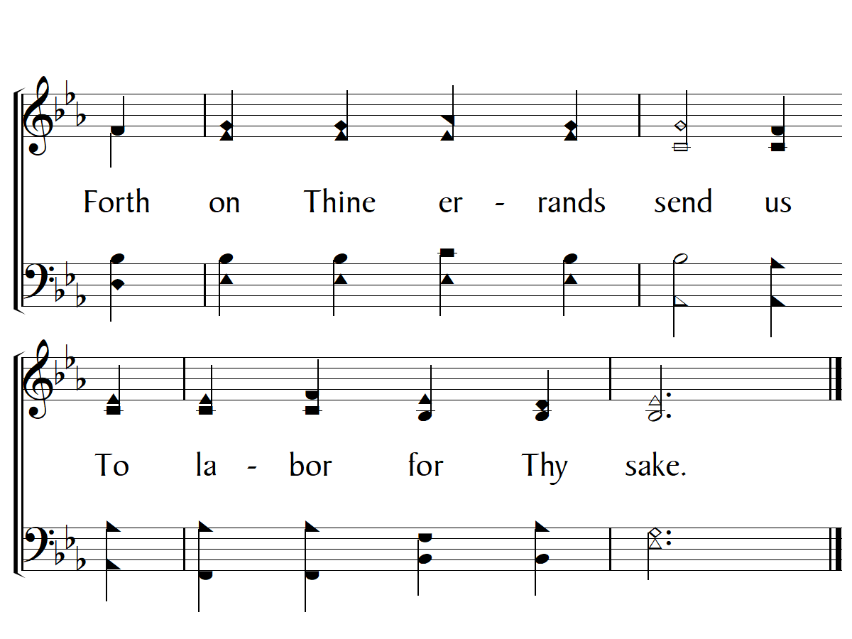
End

