Slide 1

You shall be holy for I am holy
A study of Leviticus

Slide 2
The Pattern of 7 (ch.23)
  3
  6
  8
  15-16
  18
  24
  27
  34
  36
  39
  40
  41
  42
  Leviticus 23:32 NASB95- It is to be a sabbath of complete rest to you, and you shall humble your souls; on the ninth of the month at evening, from evening until evening you shall keep your sabbath.”

Slide 3
The Pattern of 7 (ch.23)
  Leviticus 23:5 NASB95- In the first month, on the fourteenth day of the month at twilight is the LORD’S Passover.
  Leviticus 23:6 NASB95- Then on the fifteenth day of the same month there is the Feast of Unleavened Bread to the LORD; for seven days you shall eat unleavened bread.
  Leviticus 23:15 NASB95- ‘You shall also count for yourselves from the day after the sabbath, from the day when you brought in the sheaf of the wave offering; there shall be seven complete sabbaths.
  Leviticus 23:24 NASB95- Speak to the sons of Israel, saying, ‘In the seventh month on the first of the month you shall have a rest, a reminder by blowing of trumpets, a holy convocation.
  Leviticus 23:27 NASB95- On exactly the tenth day of this seventh month is the day of atonement; it shall be a holy convocation for you, and you shall humble your souls and present an offering by fire to the LORD.
  Leviticus 23:34 NASB95- Speak to the sons of Israel, saying, ‘On the fifteenth of this seventh month is the Feast of Booths for seven days to the LORD.

Slide 4
The Pattern of 7 (ch.23)
  v.5- Passover- Start of the ritual calendar (from evening until evening)
  vs.4-8- Unleaved bread (7 day feast)
  vs.15-23- Pentecost (7 x 7 weeks feast)
  vs.23-25- Rosh Hashanah- Feast of trumpets (1st day of the 7th month feast)
  vs.26-32- Day of atonement (10th day of the 7th month feast)
  vs.33-44- Tabernacles (7 day feast in the 7th month
  In Genesis (1:14) on the fourth day, God appoints the sun, moon and stars to rule over day and night, and they are to mark the moadim (מועד) ("festive season"), the sacred feasts, the annual sacred feasts. So the whole sacred calendar of Israel that you’ll meet in Exodus and Leviticus is already woven into the story at the beginning of Genesis. This is sacred time.

Slide 5
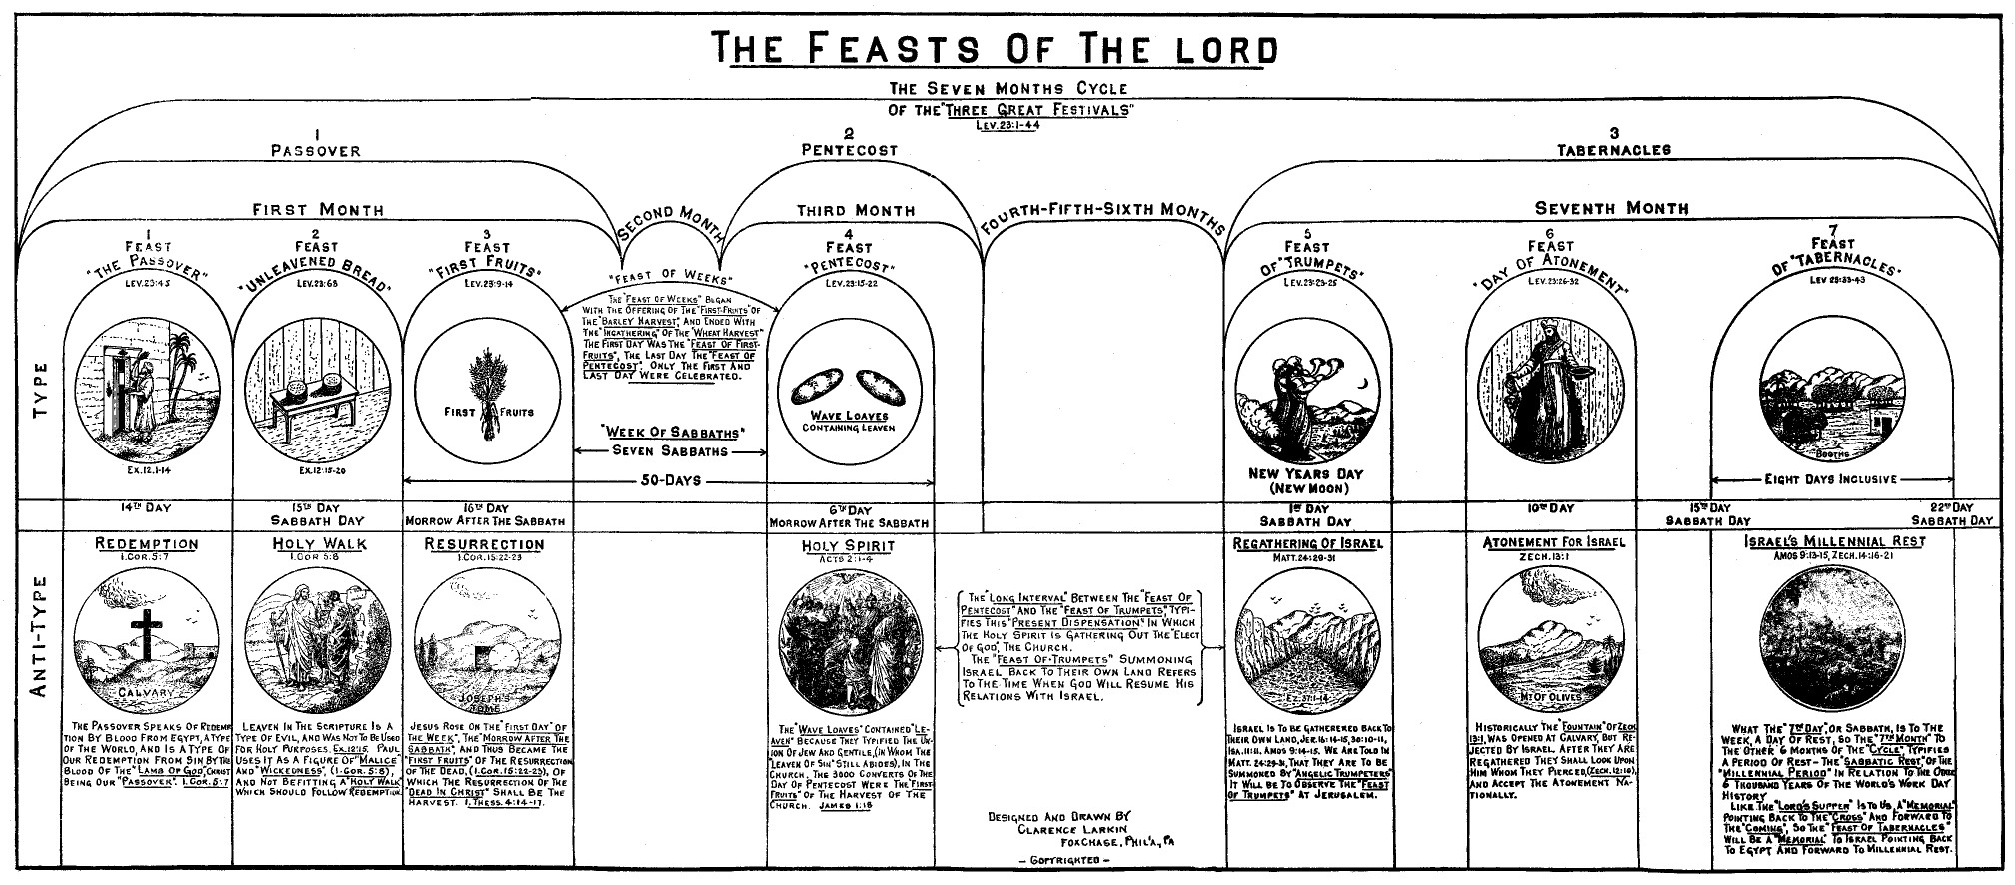

Slide 6
The Pattern of 7 (ch.23)
  These feasts celebrate God’s provision of food, rescue, bread, forgiveness, etc.
  They are all divine interruptions because of what God has done and is doing.

Slide 7
Keeping the Sabbath
  Exodus 20:8-11 NASB95- Remember the sabbath day, to keep it holy. [9] Six days you shall labor and do all your work, [10] but the seventh day is a sabbath of the LORD your God; in it you shall not do any work, you or your son or your daughter, your male or your female servant or your cattle or your sojourner who stays with you. [11] For in six days the LORD made the heavens and the earth, the sea and all that is in them, and rested on the seventh day; therefore the LORD blessed the sabbath day and made it holy.
  Deuteronomy 5:12-15 NASB95- ‘Observe the sabbath day to keep it holy, as the LORD your God commanded you. [13] Six days you shall labor and do all your work, [14] but the seventh day is a sabbath of the LORD your God; in it you shall not do any work, you or your son or your daughter or your male servant or your female servant or your ox or your donkey or any of your cattle or your sojourner who stays with you, so that your male servant and your female servant may rest as well as you. [15] You shall remember that you were a slave in the land of Egypt, and the LORD your God brought you out of there by a mighty hand and by an outstretched arm; therefore the LORD your God commanded you to observe the sabbath day.

Slide 8
Keeping the Sabbath
  Exodus 12:1-2, 14-16,34,39 NASB95- Now the LORD said to Moses and Aaron in the land of Egypt, [2] “This month shall be the beginning of months for you; it is to be the first month of the year to you. [14] Now this day will be a memorial to you, and you shall celebrate it as a feast to the LORD; throughout your generations you are to celebrate it as a permanent ordinance. [15] Seven days you shall eat unleavened bread, but on the first day you shall remove leaven from your houses; for whoever eats anything leavened from the first day until the seventh day, that person shall be cut off from Israel. [16] On the first day you shall have a holy assembly, and another holy assembly on the seventh day; no work at all shall be done on them, except what must be eaten by every person, that alone may be prepared by you. [34] So the people took their dough before it was leavened, with their kneading bowls bound up in the clothes on their shoulders. [39] They baked the dough which they had brought out of Egypt into cakes of unleavened bread. For it had not become leavened, since they were driven out of Egypt and could not delay, nor had they prepared any provisions for themselves.

Slide 9
Keeping the Sabbath
  Passover and the Exodus are a kind of “new creation” as enslaved humanity is liberated from the realm of exile, death, and darkness and led through the waters of death into the new Eden of the promised land, marked by the celebration of a seven-day ritual (in the month of Abib on the 14th-21st).
  The liberation brought about at Passover is a new creation.
  The liberation requires that humans not try to provide their own security or provision (bread) but eat only what God allows and provides.

Slide 10
Keeping the Sabbath
  “The seventh day is like a multifaceted gem. One of the main facets is the fabric of creation as leading toward a great goal where humans imitate God and join him in ceasing from work and labor. But there’s going to be another facet that’s all about being a slave to our labor. And so the seventh day is a time to celebrate our liberation from slavery so that we can rest with God.”
  KEY TAKEAWAYS
    The theme of the sabbath or seventh-day rest is a key theme in the Bible that starts on page one and goes all the way through to the end.
    The word sabbath comes from the Hebrew word shabot, which means most simply “to stop” or “to cease from.”
    Keeping/observing/remembering the sabbath is one of the Ten Commandments. It sticks out as being a uniquely Jewish practice at the time in history when the commandments were given. (See Heb. 4: Col. 2:16-17)

