Slide 1
You shall be holy for I am holy
A study of Leviticus

Slide 2
Keeping the Sabbath
Leviticus 23:32 NASB95- It is to be a sabbath of complete rest to you, and you shall humble your souls; on the ninth of the month at evening, from evening until evening you shall keep your sabbath.
These feasts celebrate God’s provision of food, rescue, bread, forgiveness, etc.
They are all divine interruptions because of what God has done and is doing.

Slide 3
Keeping the Sabbath
Exodus 20:8-11 NASB95- Remember the sabbath day, to keep it holy. [9] Six days you shall labor and do all your work, [10] but the seventh day is a sabbath of the LORD your God; in it you shall not do any work, you or your son or your daughter, your male or your female servant or your cattle or your sojourner who stays with you. [11] For in six days the LORD made the heavens and the earth, the sea and all that is in them, and rested on the seventh day; therefore the LORD blessed the sabbath day and made it holy.
Deuteronomy 5:12-15 NASB95- ‘Observe the sabbath day to keep it holy, as the LORD your God commanded you. [13] Six days you shall labor and do all your work, [14] but the seventh day is a sabbath of the LORD your God; in it you shall not do any work, you or your son or your daughter or your male servant or your female servant or your ox or your donkey or any of your cattle or your sojourner who stays with you, so that your male servant and your female servant may rest as well as you. [15] You shall remember that you were a slave in the land of Egypt, and the LORD your God brought you out of there by a mighty hand and by an outstretched arm; therefore the LORD your God commanded you to observe the sabbath day.

Slide 4
Keeping the Sabbath
The idea of resting and the number seven are intimately connected in the Bible.
The word or number "seven" represents a full and complete world,
The rhythm of practicing sabbath or resting every seventh day is one way that humans can imitate God

Slide 5
Why the Sabbath is Important to Leviticus
“Set apart from all other days, the blessing of the seventh day establishes the seventh part of created time as a day when God grants his presence in the created world. It is then his presence that provides the blessing and the sanctification. The seventh day is blessed and established as the part of time that assures fruitfulness, future-orientation, continuity, and permanence for every aspect of life within the dimension of time. The seventh day is blessed by God’s presence for the sake of the created world, for all nature, and for all living beings.” (Mathilde Frey, The Sabbath in the Pentateuch, 45)

Slide 6
Different Kinds of Rest
Nuach:
Definition: to rest, settle down, remain, repose, be quiet, refreshed in, have rest: after labor
Like getting candy from people on October 31st.
Shabath:
Definition: to cease, desist, rest from labor

Slide 7
Different Kinds of Rest
“Man normally is master of his time. He is free to dispose of it as he sees fit or as necessity bids him. The Israelite is duty-bound, however, once every seven days to assert by word and deed that God is the master of time. One day out of seven the Israelite is to renounce dominion over his own time and recognize God's dominion over it. Simply: Every seventh day the Israelite renounces his autonomy and affirms God's dominion over him in the conclusion that every seventh day the Israelite is to renounce dominion over time, thereby renounce autonomy, and recognize God's dominion over time and thus over himself. Keeping the sabbath is acceptance of the kingdom and sovereignty of God.” (Matitiahu Tsevat, The Basic Meaning of the Biblical Sabbath, 453-455.)
We preoccupy ourselves with work/working to feel some sense of purposeful control over our lives/time.
The structure of the sabbath is meant to be inconvenient. God is the master of all time, and He holds all the time that we think actually belongs to us.

Slide 8
So what?
After the fall, there was a change in the fundamental nature of humanity’s work. Before the fall, it was enjoyable by default.
After the fall, work becomes a task done for survival.
Genesis 2:15- Then the Lord God took the man and put (nuakh) him into the garden of Eden to cultivate it and keep it.
keyword is introduced to the story. That word is nuakh, “rested him” (וינחהו / nuakh) and it is meant to portray an act of full abiding residence.
Humanity was meant to be fully present and abide in the garden that God created.

Slide 9
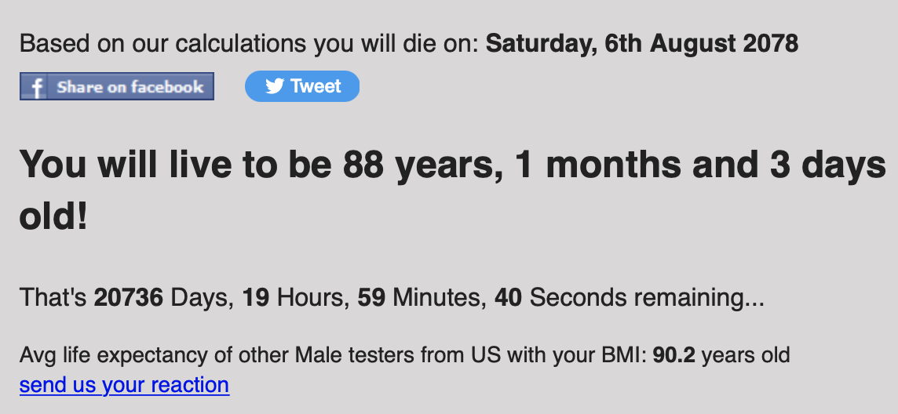

Slide 10
Psalm 90 NASB95
Lord, You have been our dwelling place [the place where God lives] in all generations. [2] Before the mountains were born Or You gave birth to the earth and the world [God labored], Even from everlasting to everlasting, You are God. [3] You turn man back into dust And say, “Return, O children of men.”[Genesis 3:19] [4] For a thousand years in Your sight Are like yesterday when it passes by, Or as a watch in the night. [5] You have swept them away like a flood [Genesis 1-11], they fall asleep; In the morning they are like grass which sprouts anew. [6] In the morning it flourishes and sprouts anew; Toward evening it fades and withers away. [7] For we have been consumed by Your anger And by Your wrath we have been dismayed. [8] You have placed our iniquities before You, Our secret sins in the light of Your presence. [9] For all our days have declined in Your fury; We have finished our years like a sigh [Exodus 6:5].

Slide 11
Psalm 90 NASB95
[10] As for the days of our life, they contain seventy years, Or if due to strength, eighty years, Yet their pride is but labor and sorrow; For soon it is gone and we fly away [James 4:14]. [11] Who understands the power of Your anger And Your fury, according to the fear that is due You? [12] So teach us to number our days, That we may present [offer] to You a heart of wisdom. [13] Do return, O LORD; how long will it be? And be sorry for Your servants. [Exodus 32:9-14] [14] O satisfy [saba or sabea: to be sated, satisfied; see Exodus 16:8, 12; a word play on seven- Shabath] us in the morning with Your lovingkindness, That we may sing for joy and be glad all our days. [15] Make us glad according to the days You have afflicted us, And the years we have seen evil.

Slide 12
Psalm 90 NASB95
[16] Let Your work [our work is for survival and just brings about death] appear to Your servants And Your majesty to their children. [17] Let the favor of the Lord our God be upon us; And confirm for us the work of our hands; Yes, confirm the work of our hands. [Make firm our work, turn our work into something that lasts]
Our work, like our lives, withers and dies
When God satisfies us with rest, in His new creation, His work does not fade
The Sabbath, the seventh day, is about a new creation/liberation and a completion of God’s labor/work

Slide 13
Jesus is Our Sabbath Rest
Matthew 12:8 NASB95- For the Son of Man is Lord of the Sabbath.”
When Jesus says he is “Lord of the Sabbath,” he is saying fundamentally the same thing as when he declares, “The Kingdom of God is here.” Both of these phrases are declarations by Jesus that He is beginning the restoration of creation.
Jesus seems to place a greater importance on the concept of the Sabbath. Jesus is effectually saying that what the Sabbath pointed to—a time of constant communion between God and man—is here because He is here.

