Slide 2
“He is possessed by Beelzebul… He casts out the demons by the ruler of the demons.”
(Mark 3.22)

Slide 3
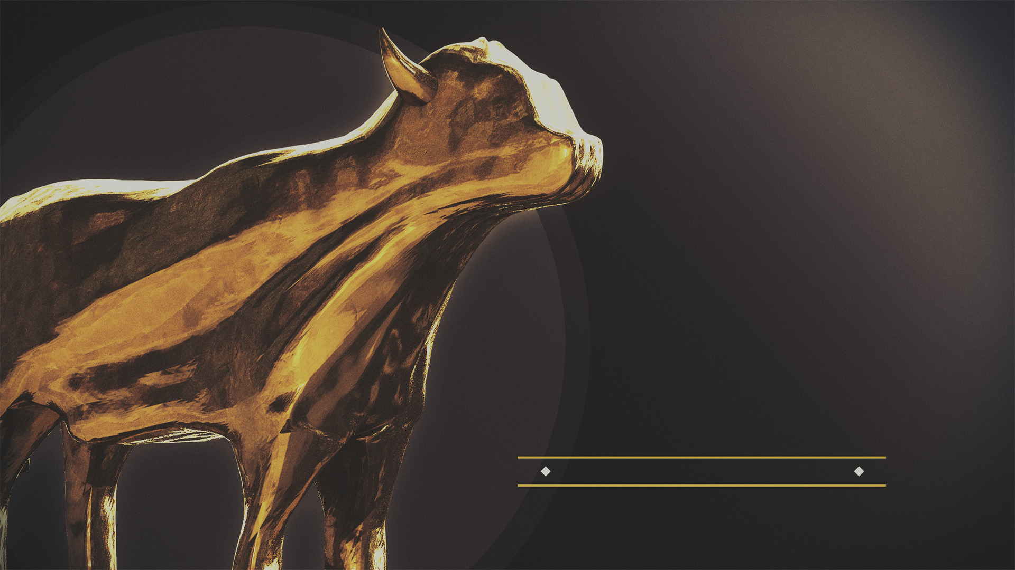
IDOLATRY
is the
PROBLEM

Slide 4
gods
of
viewpoint

Slide 5
“Forces from him will arise, desecrate the sanctuary fortress, and do away with the regular sacrifice. And they will set up the abomination of desolation.”
(Daniel 11:31, NASB95)
viewpoint becomes an idol

Slide 6
³² “By smooth words he will turn to godlessness those who act wickedly toward the covenant, but the people who know their God will display strength and take action. ³³ “Those who have insight among the people will give understanding to the many; yet they will fall by sword and by flame, by captivity and by plunder for many days.
(Daniel 11:32–33 NASB95)
viewpoint becomes an idol

Slide 7
Your vision can become so clouded that you can’t see what God is telling you
Your priorities get out of order
when viewpoint becomes an idol

Slide 8
IDOLATRY
removing the idol of viewpoint

Slide 9
For I determined to know nothing among you except Jesus Christ, and Him crucified.
(1 Corinthians 2:2 NASB95)
removing the idol of viewpoint

