Slide 2
“… and to keep the Lord’s commandments and His statutes which I am commanding you today for your good?” (Deuteronomy 10:13, NASB95)

Slide 3
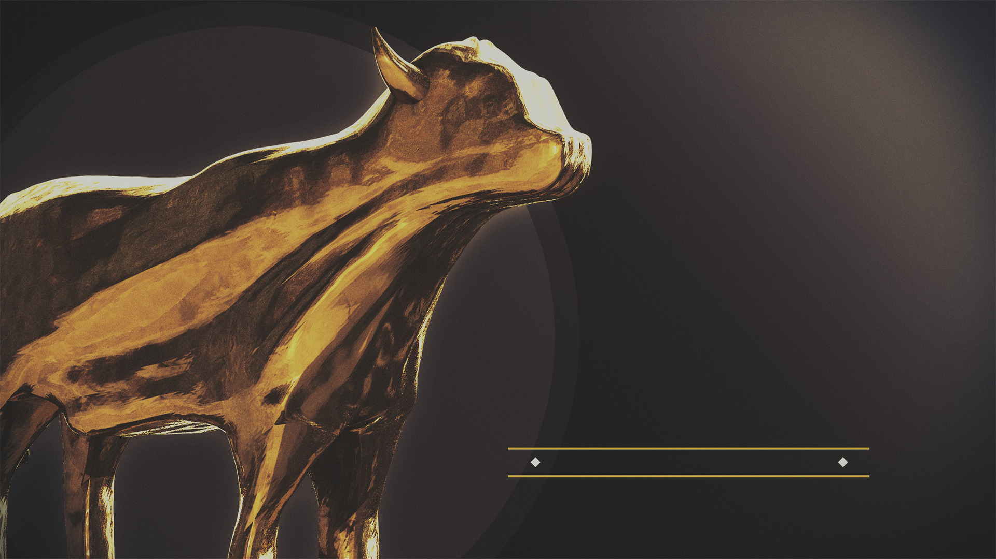
IDOLATRY
is the
PROBLEM

Slide 4
you become
what you
worship

Slide 5
⁹ He said, “Go, and tell this people: ‘Keep on listening, but do not perceive; Keep on looking, but do not understand.’ ¹⁰ “Render the hearts of this people insensitive, Their ears dull, And their eyes dim, Otherwise they might see with their eyes, Hear with their ears, Understand with their hearts, And return and be healed.”
(Isaiah 6:9–10 NASB95)
the blind, deaf & dumb

Slide 6
⁴ Their idols are silver and gold, The work of man’s hands. ⁵ They have mouths, but they cannot speak; They have eyes, but they cannot see; ⁶ They have ears, but they cannot hear; They have noses, but they cannot smell; ⁷ They have hands, but they cannot feel; They have feet, but they cannot walk; They cannot make a sound with their throat. ⁸ Those who make them will become like them, Everyone who trusts in them.
(Psalm 115:4–8 NASB95)
the blind, deaf & dumb

Slide 7
¹⁷ They will be turned back and be utterly put to shame, Who trust in idols, Who say to molten images, “You are our gods.” ¹⁸ Hear, you deaf! And look, you blind, that you may see. ¹⁹ Who is blind but My servant, Or so deaf as My messenger whom I send? Who is so blind as he that is at peace with Me, Or so blind as the servant of the Lord? ²⁰ You have seen many things, but you do not observe them; Your ears are open, but none hears.
(Isaiah 42:17–20 NASB95)
the blind, deaf & dumb

Slide 8
¹⁹ They made a calf in Horeb And worshiped a molten image. ²⁰ Thus they exchanged their glory For the image of an ox that eats grass. ²¹ They forgot God their Savior, Who had done great things in Egypt
(Psalm 106:19–21 NASB95)
exchanging glory for vanity

Slide 9
⁷ The more they multiplied, the more they sinned against Me; I will change their glory into shame.
¹⁶ Since Israel is stubborn Like a stubborn heifer, Can the Lord now pasture them Like a lamb in a large field? ¹⁷ Ephraim is joined to idols; Let him alone.
(Hosea 4:7,16-17 NASB95)
exchanging glory for vanity

Slide 10
⁵ Thus says the Lord, “What injustice did your fathers find in Me, That they went far from Me And walked after emptiness and became empty?
¹¹ “Has a nation changed gods When they were not gods? But My people have changed their glory For that which does not profit.
(Jeremiah 2:5,11 NASB95)
exchanging glory for vanity

Slide 11
“They rejected His statutes and His covenant which He made with their fathers and His warnings with which He warned them. And they followed vanity and became vain, and went after the nations which surrounded them, concerning which the Lord had commanded them not to do like them.”
(2 Kings 17:15, NASB95)
exchanging glory for vanity

Slide 12
“and exchanged the glory of the incorruptible God for an image in the form of corruptible man and of birds and four-footed animals and crawling creatures.”
(Romans 1:23, NASB95)
exchanging glory for vanity

Slide 13
“But we all, with unveiled face, beholding as in a mirror the glory of the Lord, are being transformed into the same image from glory to glory, just as from the Lord, the Spirit.”
(2 Corinthians 3:18, NASB95)
reverencing glory

Slide 14
you become
what you
worship

