Slide 2
¹⁴ “Now, therefore, fear the Lord and serve Him in sincerity and truth; and put away the gods which your fathers served beyond the River and in Egypt, and serve the Lord. ¹⁵ If it is disagreeable in your sight to serve the Lord, choose for yourselves today whom you will serve: whether the gods which your fathers served which were beyond the River, or the gods of the Amorites in whose land you are living; but as for me and my house, we will serve the Lord.” (Joshua 24:14–15 NASB95)

Slide 3
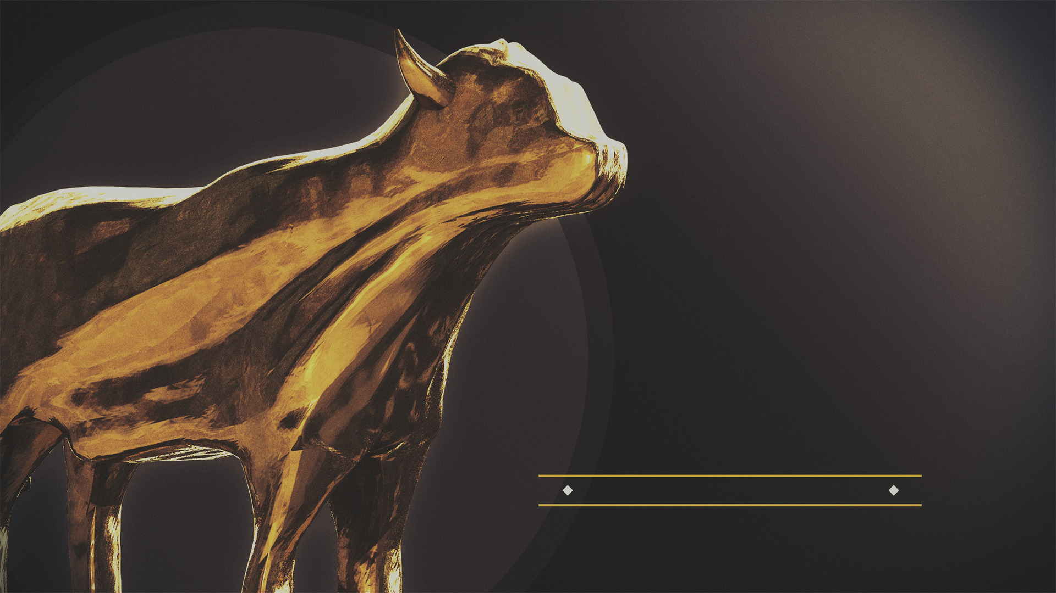
IDOLATRY
is the
PROBLEM

Slide 4
Jehovah had blessed their ancestors in ways their gods had not (vss. 2-4)
Jehovah had proven stronger than the gods of Egypt (vss. 5-7)
Jehovah had given His people the land of Canaan, and the gods of the land had been unable to stop Him (vss. 8-13)
the choice seems obvious

Slide 5
¹ Therefore, putting aside all malice and all deceit and hypocrisy and envy and all slander, ² like newborn babies, long for the pure milk of the word, so that by it you may grow in respect to salvation, ³ if you have tasted the kindness of the Lord. (1 Peter 2:1–3 NASB95)
the choice seems obvious

Slide 6
¹ See how great a love the Father has bestowed on us, that we would be called children of God; and such we are. For this reason the world does not know us, because it did not know Him. ² Beloved, now we are children of God, and it has not appeared as yet what we will be. We know that when He appears, we will be like Him, because we will see Him just as He is. ³ And everyone who has this hope fixed on Him purifies himself, just as He is pure. (1 John 3:1–3 NASB95)
the choice seems obvious

Slide 7
¹³ “Enter through the narrow gate; for the gate is wide and the way is broad that leads to destruction, and there are many who enter through it. ¹⁴ “For the gate is small and the way is narrow that leads to life, and there are few who find it. (Matthew 7:13–14 NASB95)
the choice seems obvious

Slide 8
¹⁴ “Now, therefore, fear the Lord and serve Him in sincerity and truth; and put away the gods which your fathers served beyond the River and in Egypt, and serve the Lord. ¹⁵ If it is disagreeable in your sight to serve the Lord, choose for yourselves today whom you will serve: whether the gods which your fathers served which were beyond the River, or the gods of the Amorites in whose land you are living; but as for me and my house, we will serve the Lord.” (Joshua 24:14–15 NASB95)
serving the Lord is disagreeable to some

Slide 9
¹⁴ “Now, therefore, fear the Lord and serve Him in sincerity and truth; and put away the gods which your fathers served beyond the River and in Egypt, and serve the Lord. ¹⁵ If it is disagreeable in your sight to serve the Lord, choose for yourselves today whom you will serve: whether the gods which your fathers served which were beyond the River, or the gods of the Amorites in whose land you are living; but as for me and my house, we will serve the Lord.” (Joshua 24:14–15 NASB95)
serving the Lord is disagreeable to some

Slide 10
¹⁴ “Now, therefore, fear the Lord and serve Him in sincerity and truth; and put away the gods which your fathers served beyond the River and in Egypt, and serve the Lord. ¹⁵ If it is disagreeable in your sight to serve the Lord, choose for yourselves today whom you will serve: whether the gods which your fathers served which were beyond the River, or the gods of the Amorites in whose land you are living; but as for me and my house, we will serve the Lord.” (Joshua 24:14–15 NASB95)
serving the Lord is disagreeable to some

Slide 11
¹⁴ “Now, therefore, fear the Lord and serve Him in sincerity and truth; and put away the gods which your fathers served beyond the River and in Egypt, and serve the Lord. ¹⁵ If it is disagreeable in your sight to serve the Lord, choose for yourselves today whom you will serve: whether the gods which your fathers served which were beyond the River, or the gods of the Amorites in whose land you are living; but as for me and my house, we will serve the Lord.” (Joshua 24:14–15 NASB95)
serving the Lord is disagreeable to some

Slide 12
¹⁴ “Now, therefore, fear the Lord and serve Him in sincerity and truth; and put away the gods which your fathers served beyond the River and in Egypt, and serve the Lord. ¹⁵ If it is disagreeable in your sight to serve the Lord, choose for yourselves today whom you will serve: whether the gods which your fathers served which were beyond the River, or the gods of the Amorites in whose land you are living; but as for me and my house, we will serve the Lord.” (Joshua 24:14–15 NASB95)
the choice is made today & everyday

Slide 13
¹⁴ “Now, therefore, fear the Lord and serve Him in sincerity and truth; and put away the gods which your fathers served beyond the River and in Egypt, and serve the Lord. ¹⁵ If it is disagreeable in your sight to serve the Lord, choose for yourselves today whom you will serve: whether the gods which your fathers served which were beyond the River, or the gods of the Amorites in whose land you are living; but as for me and my house, we will serve the Lord.” (Joshua 24:14–15 NASB95)
the choice is made today & everyday

Slide 14
¹⁴ “Now, therefore, fear the Lord and serve Him in sincerity and truth; and put away the gods which your fathers served beyond the River and in Egypt, and serve the Lord. ¹⁵ If it is disagreeable in your sight to serve the Lord, choose for yourselves today whom you will serve: whether the gods which your fathers served which were beyond the River, or the gods of the Amorites in whose land you are living; but as for me and my house, we will serve the Lord.” (Joshua 24:14–15 NASB95)
the choice is made today & everyday

Slide 15
¹⁴ “Now, therefore, fear the Lord and serve Him in sincerity and truth; and put away the gods which your fathers served beyond the River and in Egypt, and serve the Lord. ¹⁵ If it is disagreeable in your sight to serve the Lord, choose for yourselves today whom you will serve: whether the gods which your fathers served which were beyond the River, or the gods of the Amorites in whose land you are living; but as for me and my house, we will serve the Lord.” (Joshua 24:14–15 NASB95)
the choice is made today & everyday

Slide 16
¹⁴ “Now, therefore, fear the Lord and serve Him in sincerity and truth; and put away the gods which your fathers served beyond the River and in Egypt, and serve the Lord. ¹⁵ If it is disagreeable in your sight to serve the Lord, choose for yourselves today whom you will serve: whether the gods which your fathers served which were beyond the River, or the gods of the Amorites in whose land you are living; but as for me and my house, we will serve the Lord.” (Joshua 24:14–15 NASB95)
make your choice regardless of what others choose

