Slide 1
Exodus 1:15-17 NASB95- Then the king of Egypt spoke to the Hebrew midwives, one of whom was named Shiphrah and the other was named Puah; [16] and he said, “When you are helping the Hebrew women to give birth and see them upon the birthstool, if it is a son, then you shall put him to death; but if it is a daughter, then she shall live.” [17] But the midwives feared God, and did not do as the king of Egypt had commanded them, but let the boys live.

Slide 2
Acts 8:1-3 NASB95- Saul was in hearty agreement with putting him to death. And on that day a great persecution began against the church in Jerusalem, and they were all scattered throughout the regions of Judea and Samaria, except the apostles. [2] Some devout men buried Stephen, and made loud lamentation over him. [3] But Saul began ravaging the church, entering house after house, and dragging off men and women, he would put them in prison.

Slide 3
God’s People Will Volunteer
Psalm 110

Slide 4
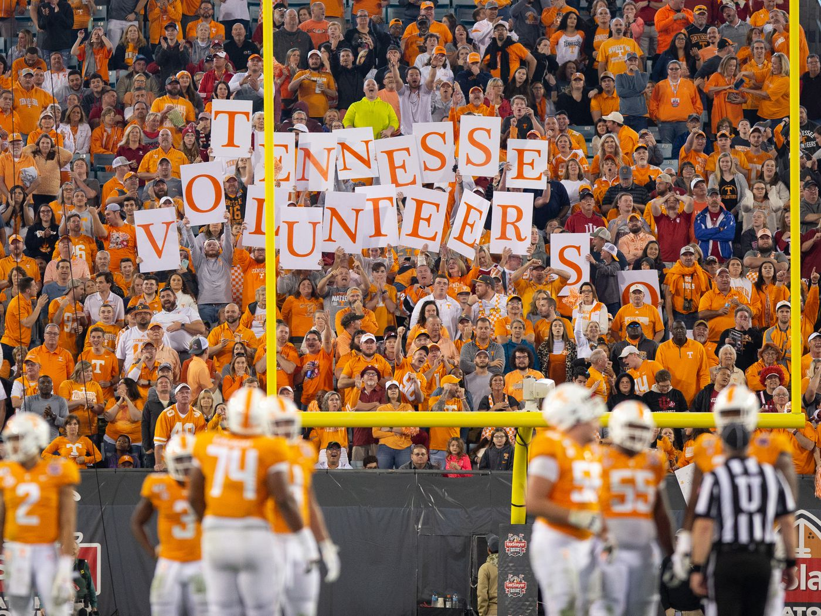

Slide 5
Psalm 110:1-7 NASB95- The LORD says to my Lord: “Sit at My right hand Until I make Your enemies a footstool for Your feet.” [2] The LORD will stretch forth Your strong scepter from Zion, saying, “Rule in the midst of Your enemies.” [3] Your people will volunteer freely in the day of Your power; In holy array, from the womb of the dawn, Your youth are to You as the dew.

Slide 6
Psalm 110:1-7 NASB95- [4] The LORD has sworn and will not change His mind, “You are a priest forever According to the order of Melchizedek.” [5] The Lord is at Your right hand; He will shatter kings in the day of His wrath. [6] He will judge among the nations, He will fill them with corpses, He will shatter the chief men over a broad country. [7] He will drink from the brook by the wayside; Therefore He will lift up His head.

Slide 7
Matthew 22:41-46 NASB95- Now while the Pharisees were gathered together, Jesus asked them a question: [42] “What do you think about the Christ, whose son is He?” They said to Him, “The son of David.” [43] He said to them, “Then how does David in the Spirit call Him ‘Lord,’ saying, [44] ‘THE LORD SAID TO MY LORD, “SIT AT MY RIGHT HAND, UNTIL I PUT YOUR ENEMIES BENEATH YOUR FEET”’? [45] If David then calls Him ‘Lord,’ how is He his son?” [46] No one was able to answer Him a word, nor did anyone dare from that day on to ask Him another question.

Slide 8
Psalm 110: 3 NASB95- [3] Your people will volunteer freely in the day of Your power; In holy array, from the womb of the dawn, Your youth are to You as the dew.

Slide 9
”In holy array”- Isaiah 61:10 NASB95
I will rejoice greatly in the LORD, My soul will exult in my God; For He has clothed me with garments of salvation, He has wrapped me with a robe of righteousness, As a bridegroom decks himself with a garland, And as a bride adorns herself with her jewels.

Slide 10
”womb of the dawn”- Isaiah 60:1-4 ERV-“Jerusalem, get up and shine! Your Light is coming! The Glory of the LORD will shine on you. [2] Darkness now covers the earth, and the people are in darkness. But the LORD will shine on you, and his Glory will appear over you. [3] Then the nations will come to your light. Kings will come to your bright sunrise. [4] Look around you! See all the people gathering around. Those are your sons coming from far away, and your daughters are there beside them

Slide 11
”womb of the dawn”- 1 Peter 2:9 NASB95 But you are A CHOSEN RACE, A royal PRIESTHOOD, A HOLY NATION, A PEOPLE FOR God’s OWN POSSESSION, so that you may proclaim the excellencies of Him who has called you out of darkness into His marvelous light;

Slide 12
”as the dew”- Isaiah 61:11 NASB95- For as the earth brings forth its sprouts, And as a garden causes the things sown in it to spring up, So the Lord GOD will cause righteousness and praise To spring up before all the nations.

Slide 13
Recognizing serving God is voluntary
  Appreciate one another
  Solves the, “Do I have to?” questions
  Are you acting like a volunteer?

