Slide 2

044 - To God Be The Glory - Title

Slide 3
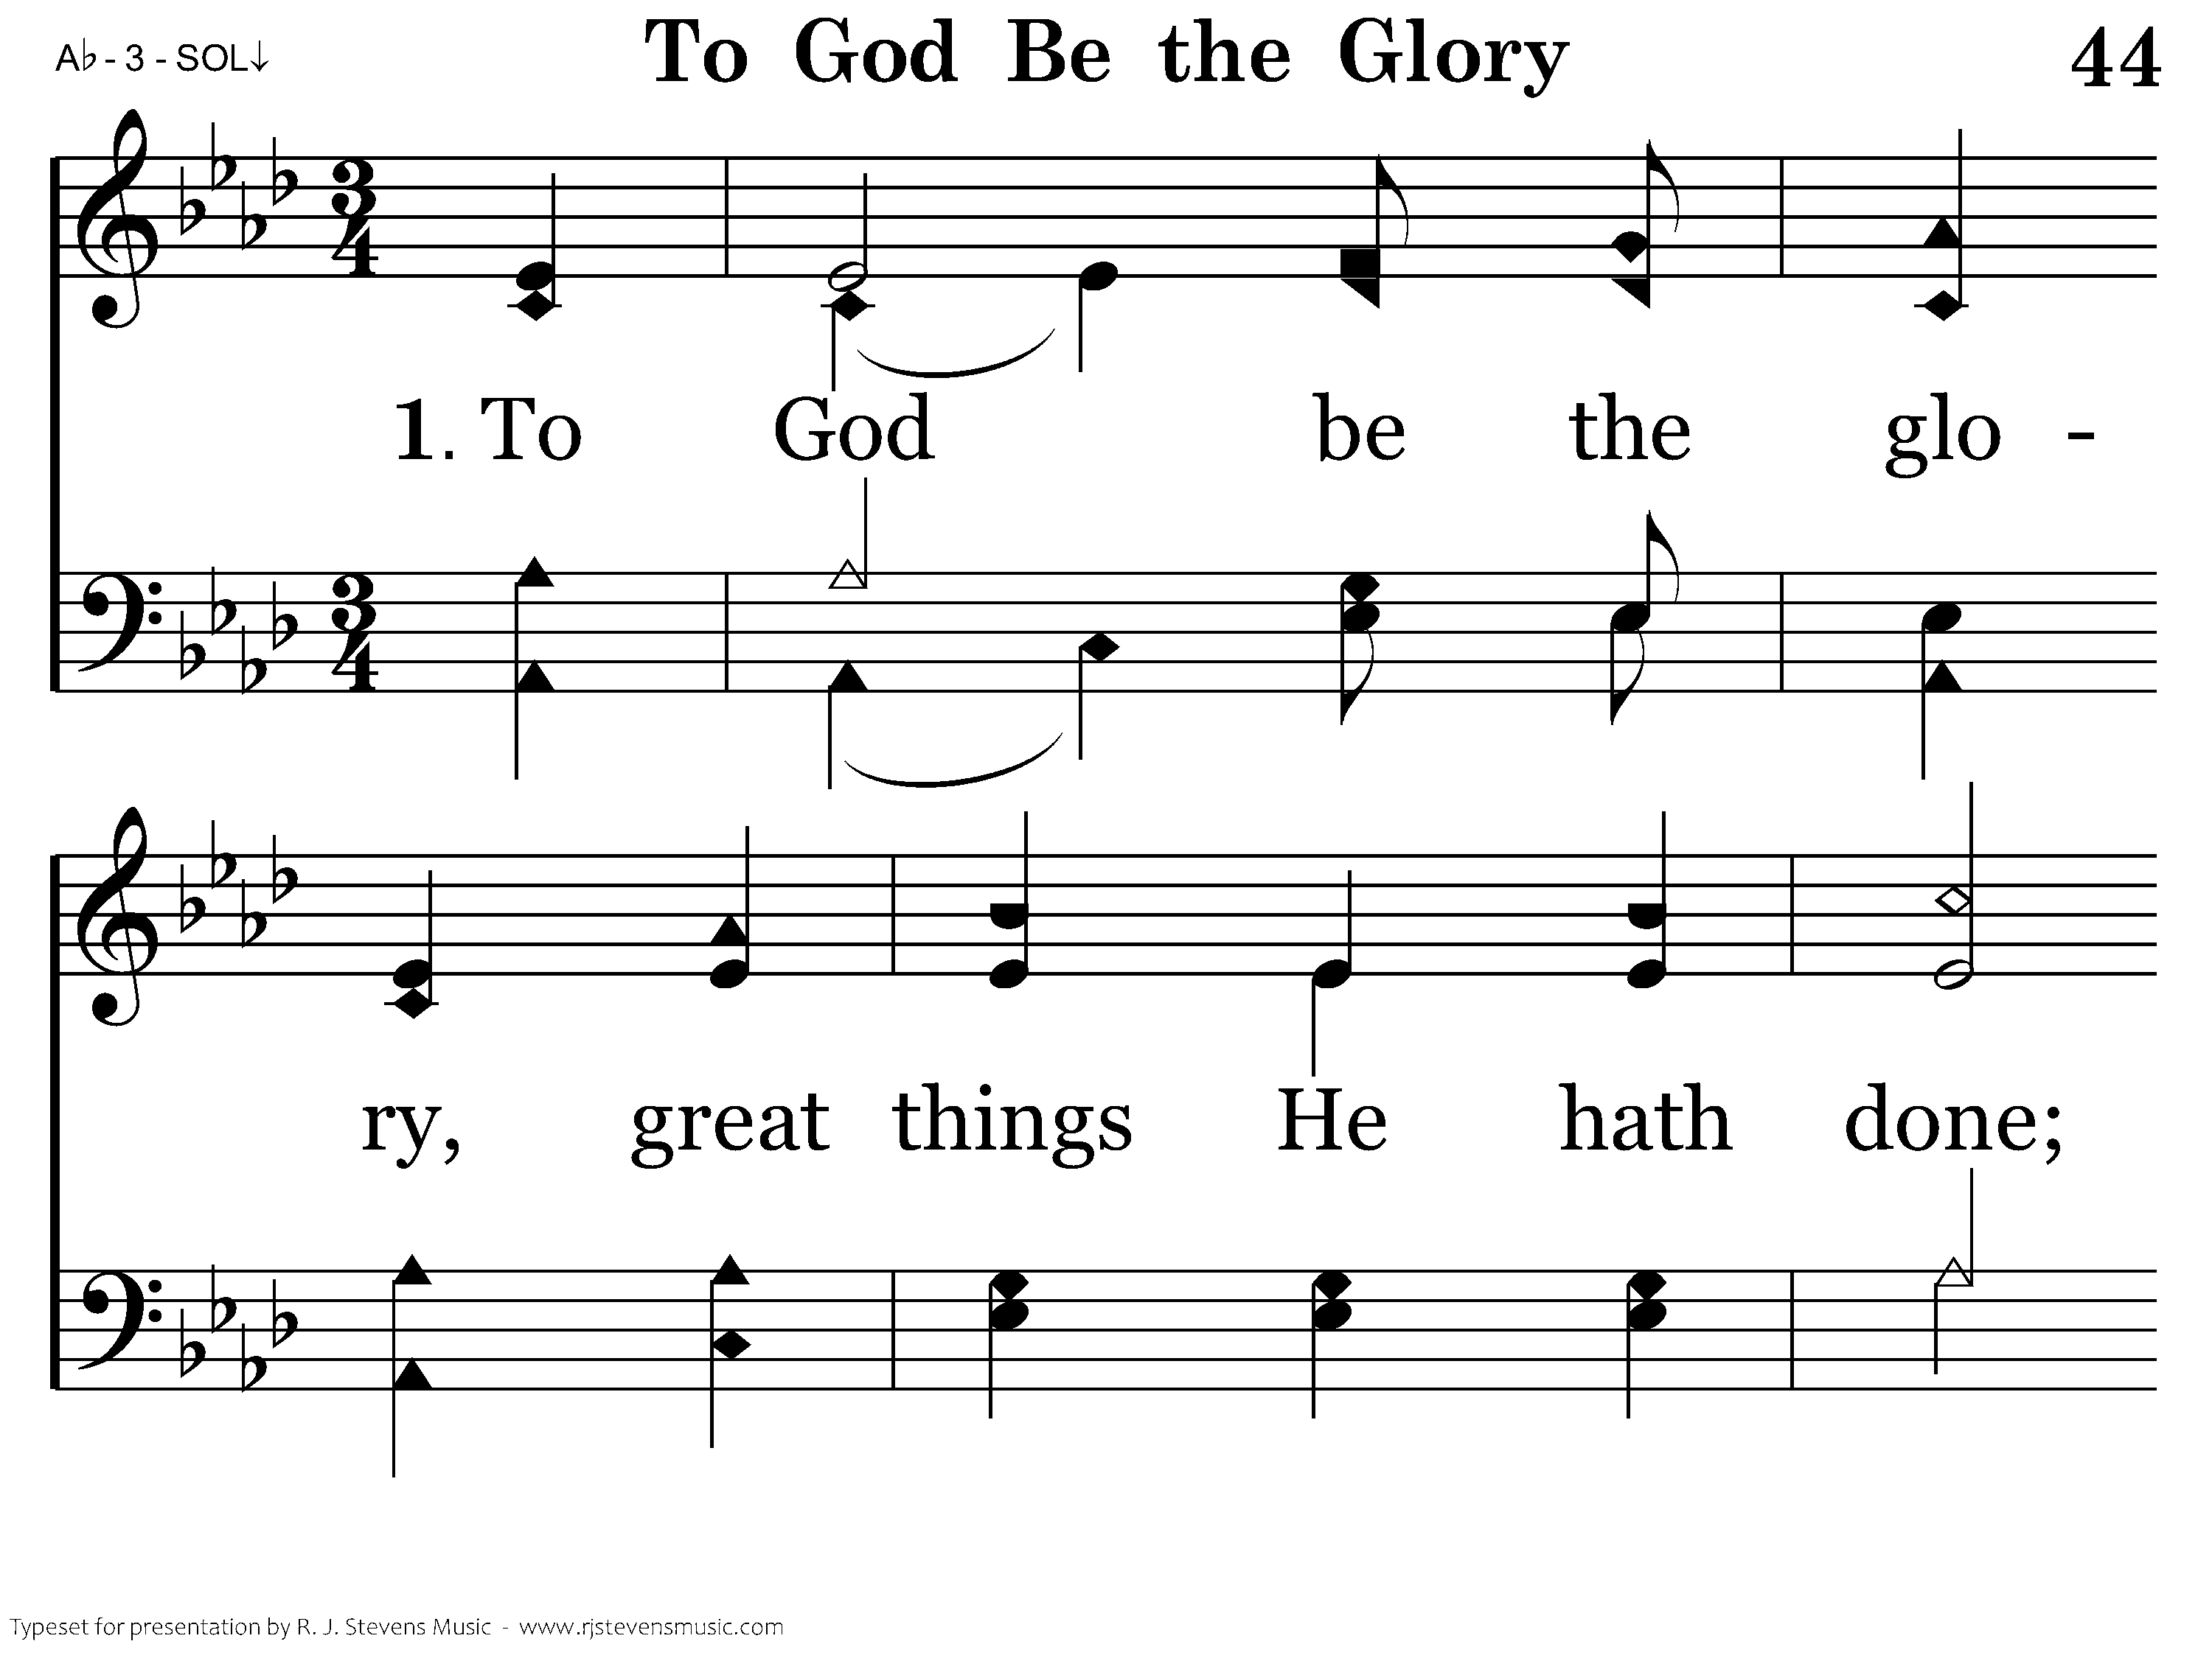
044 - To God Be The Glory - 1.1

Slide 4
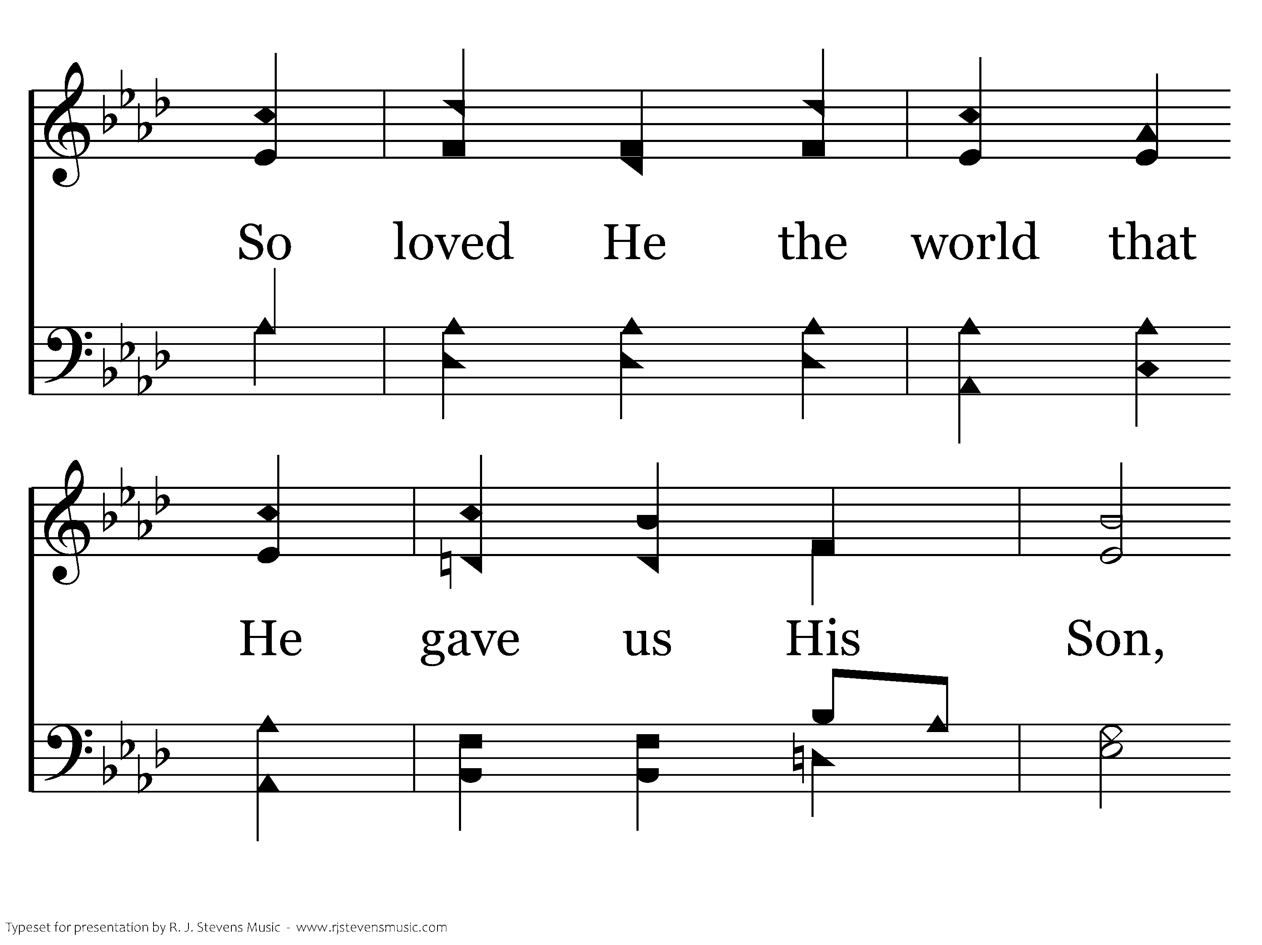
044 - To God Be The Glory - 1.2

Slide 5
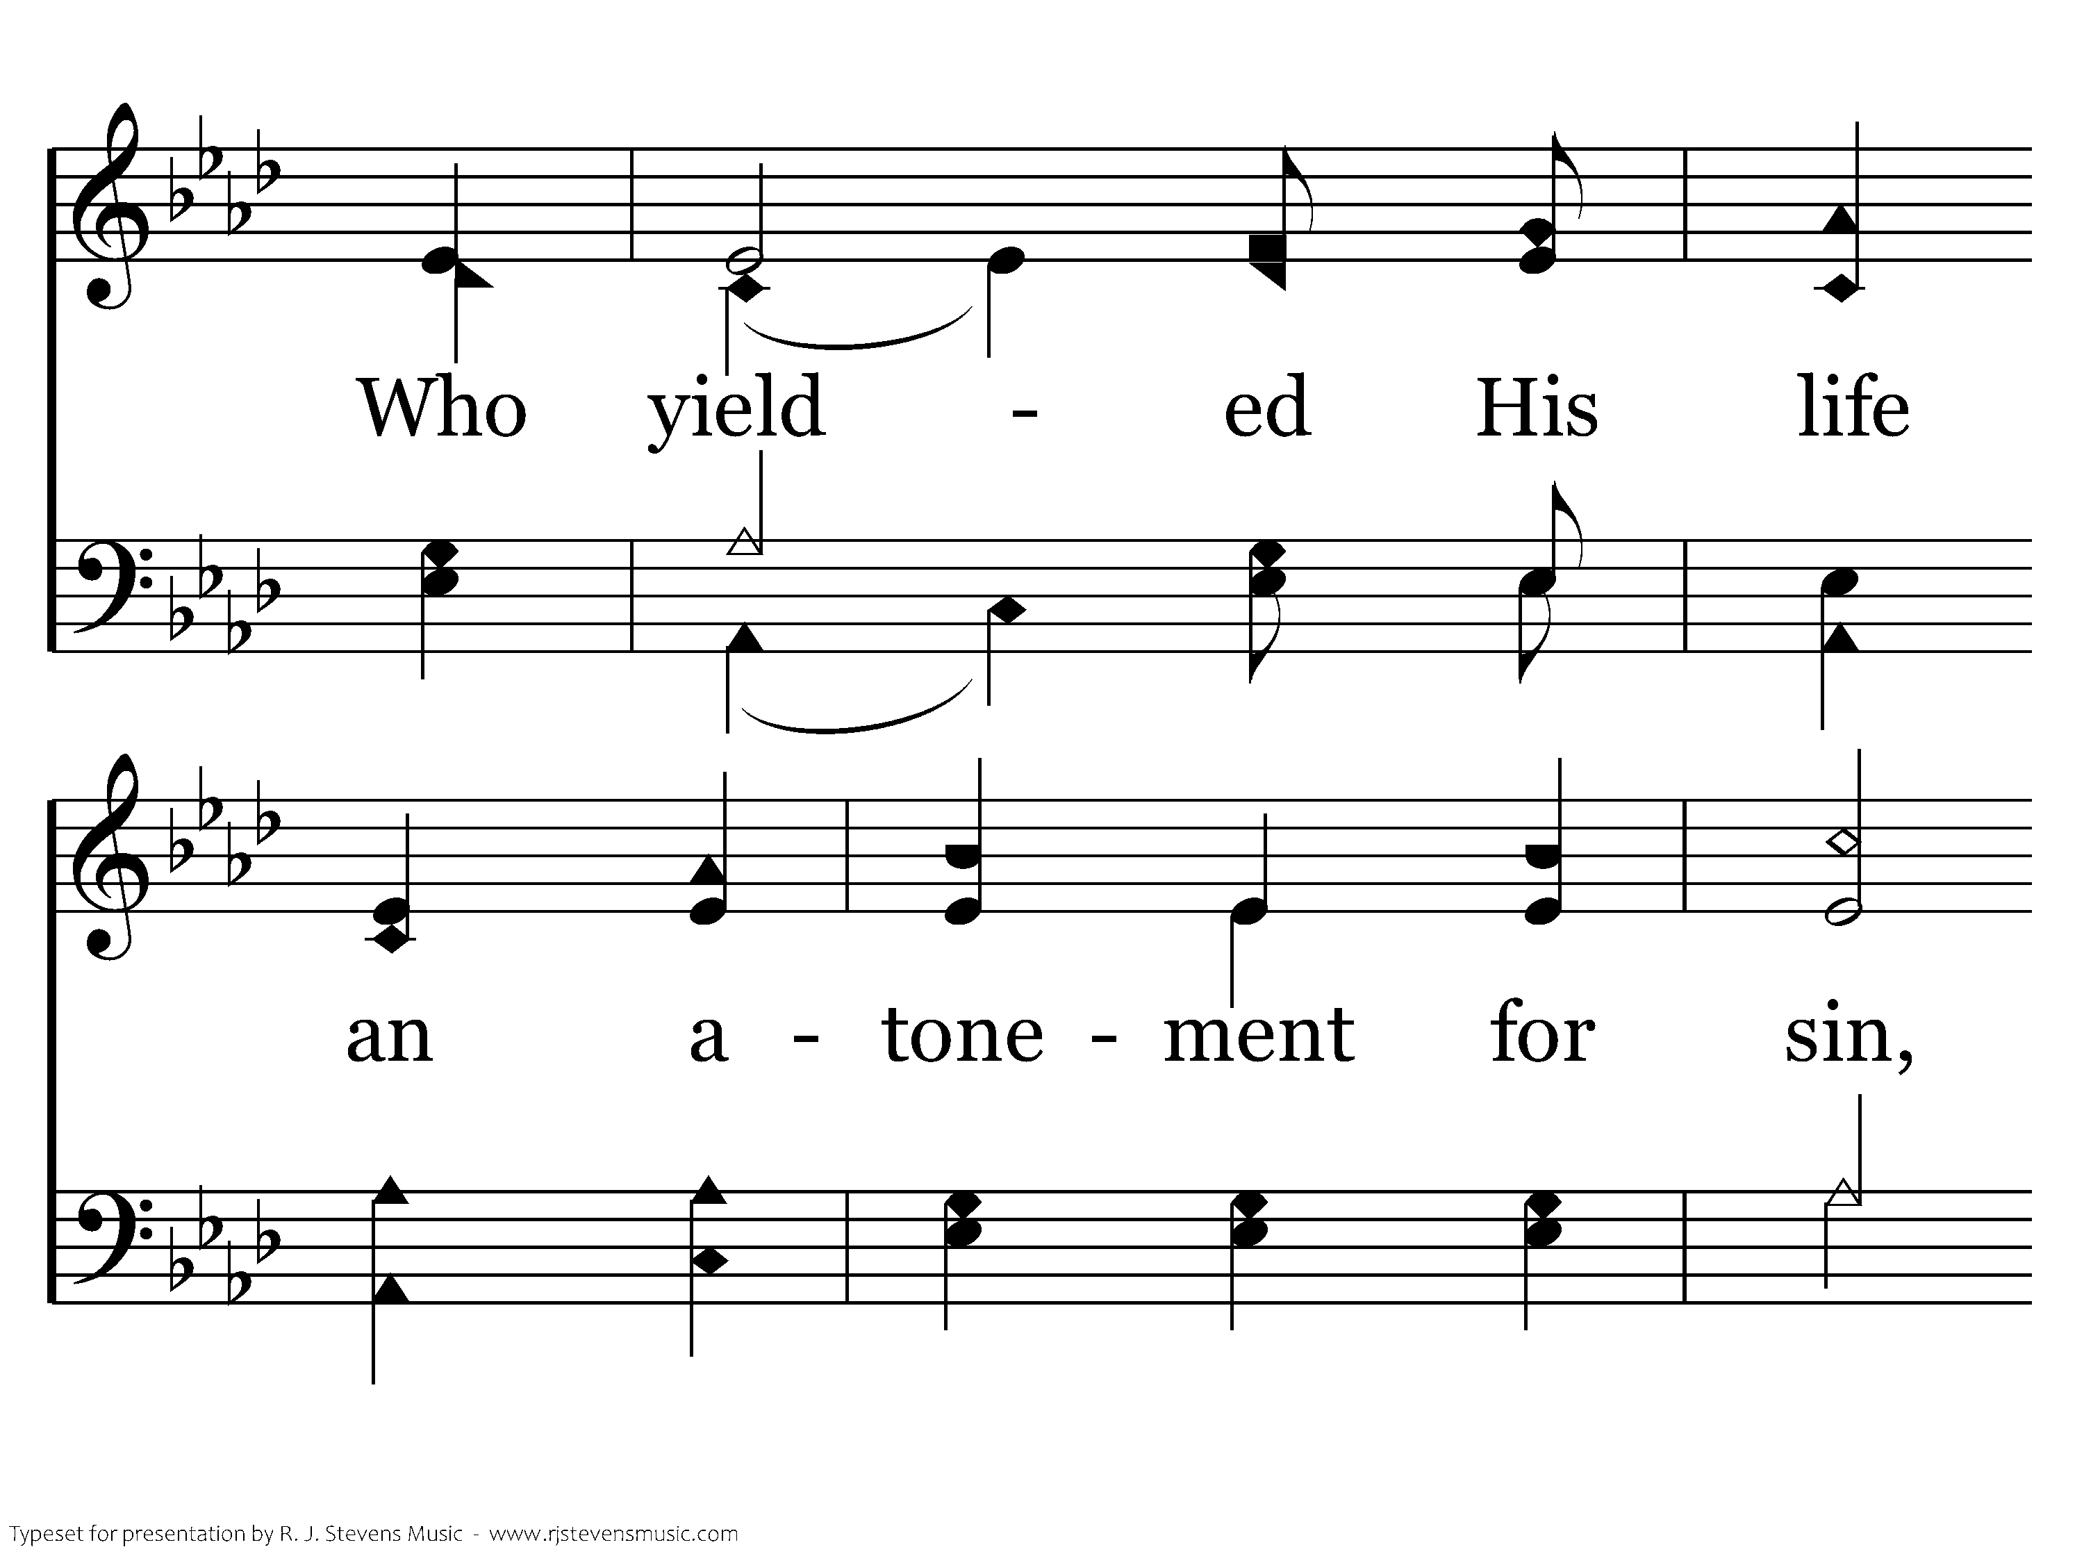
044 - To God Be The Glory - 1.3

Slide 6
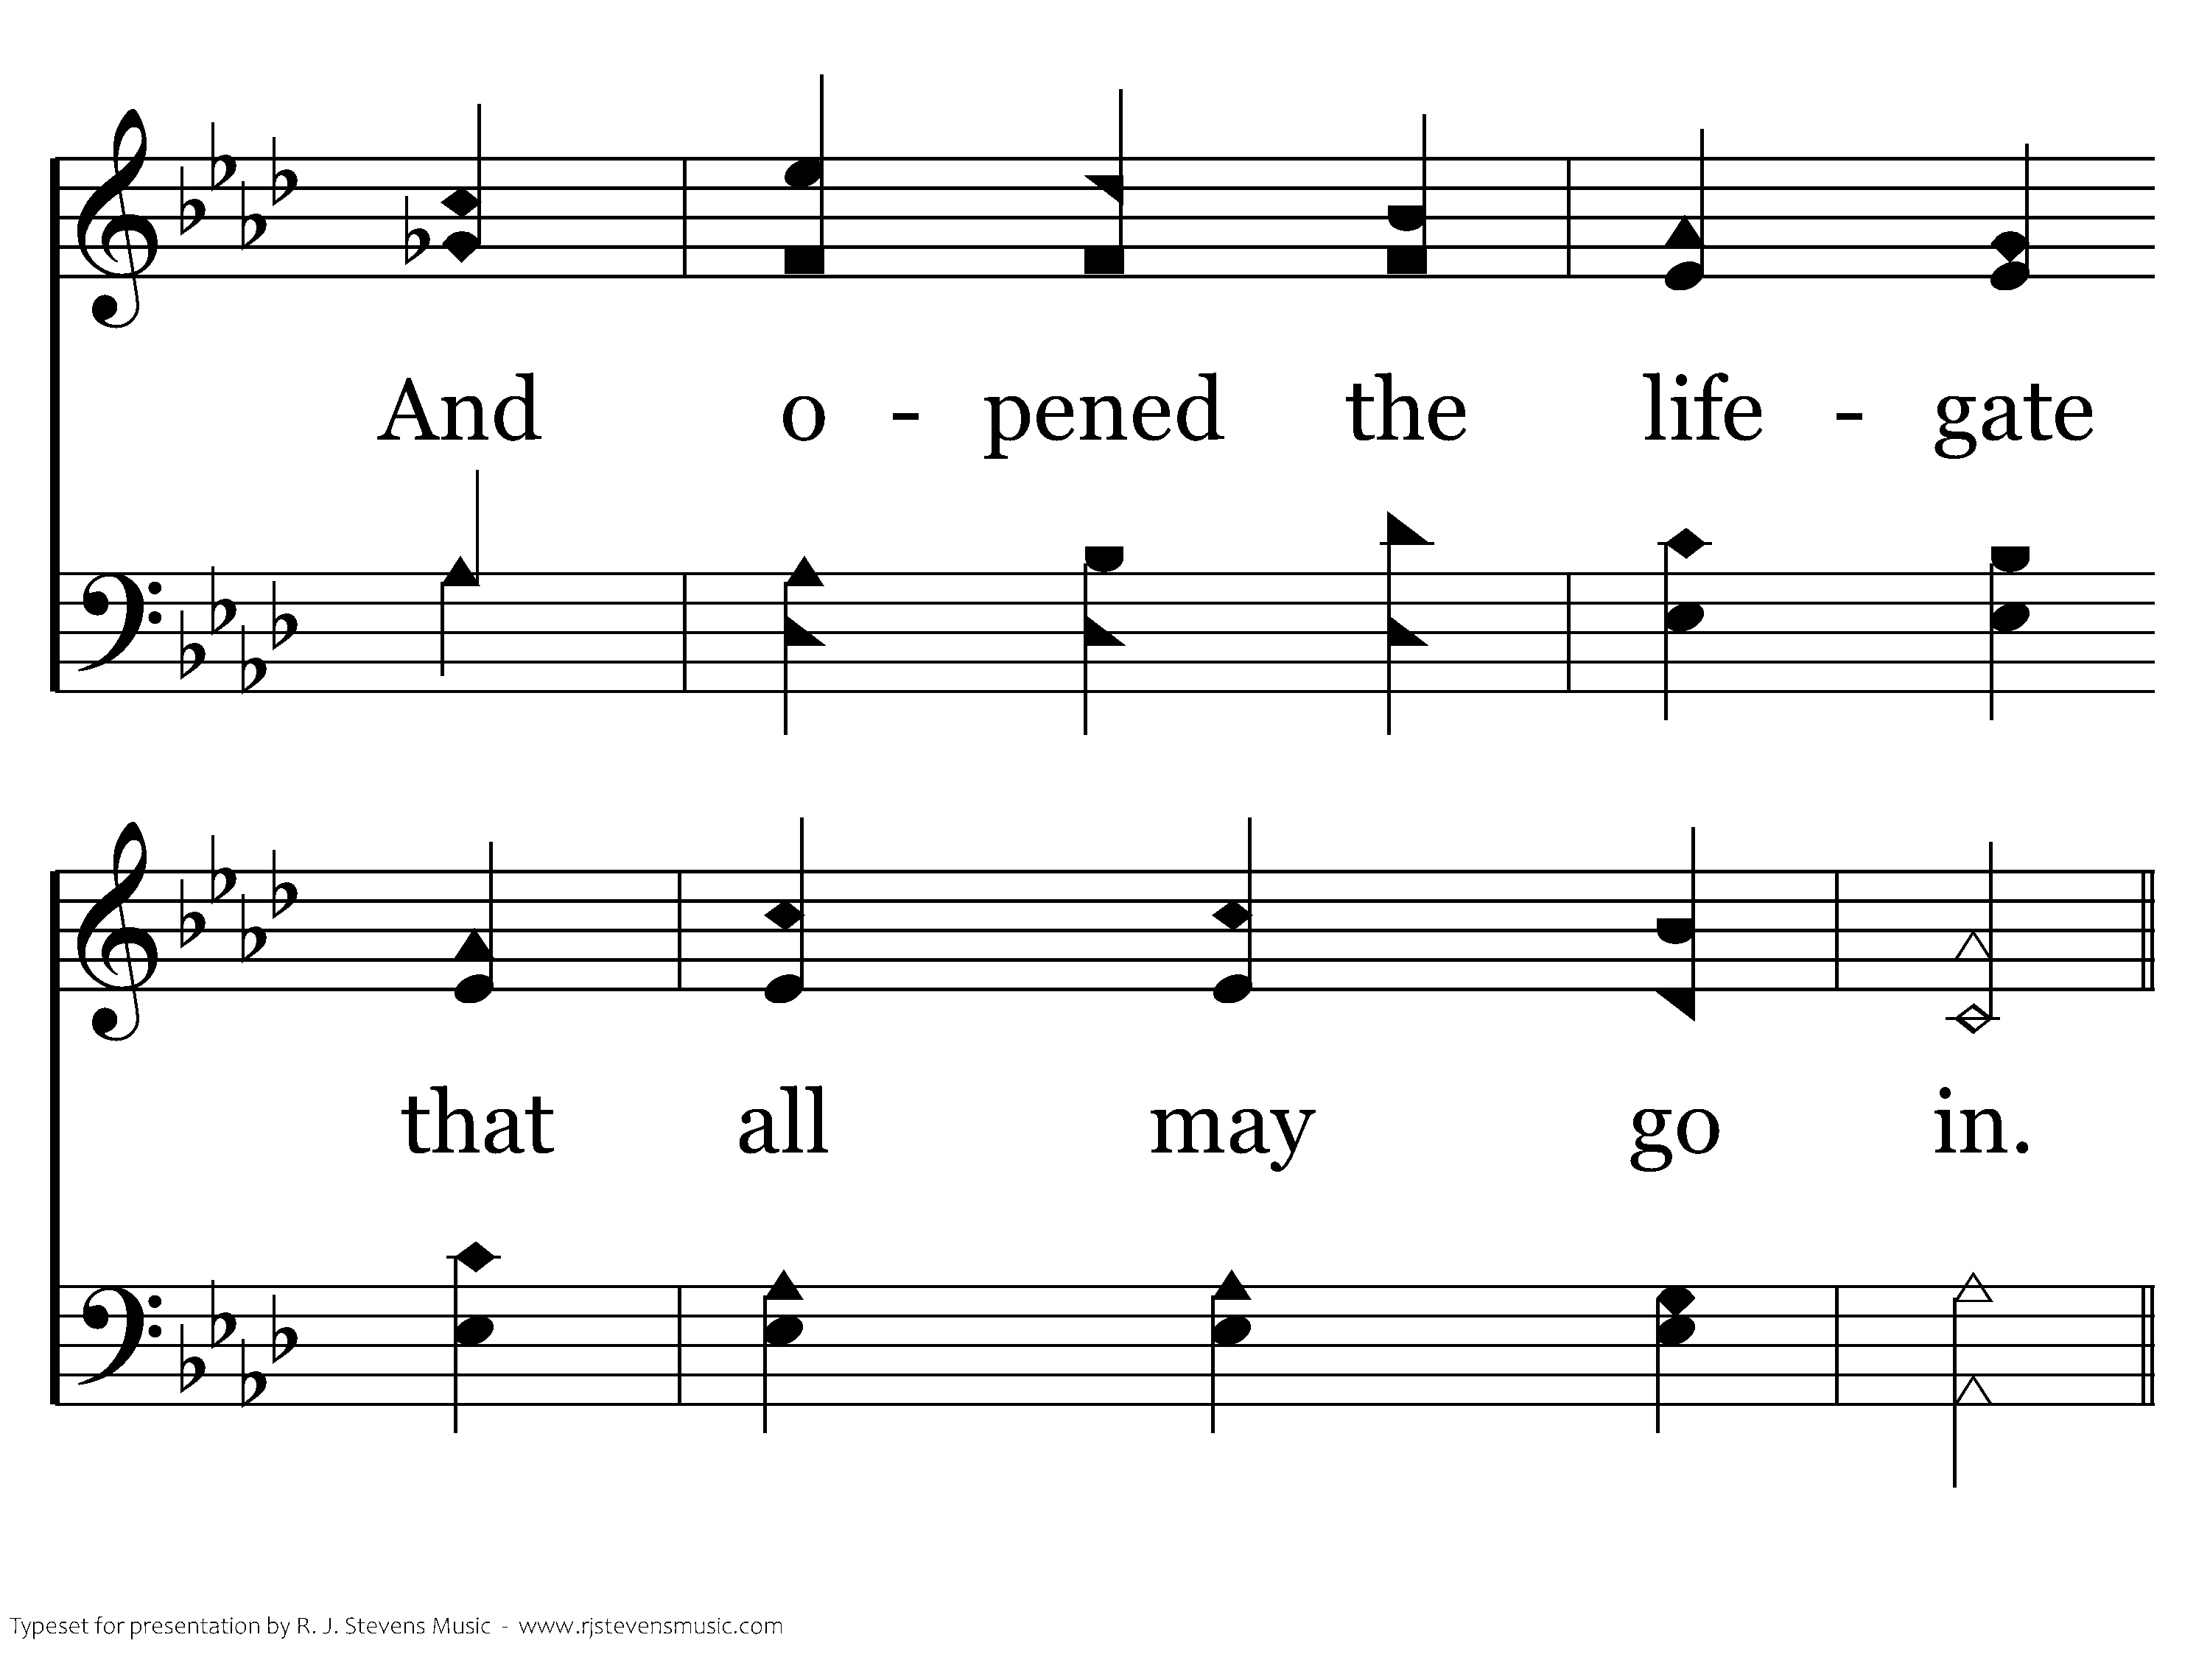
044 - To God Be The Glory - 1.4

Slide 7
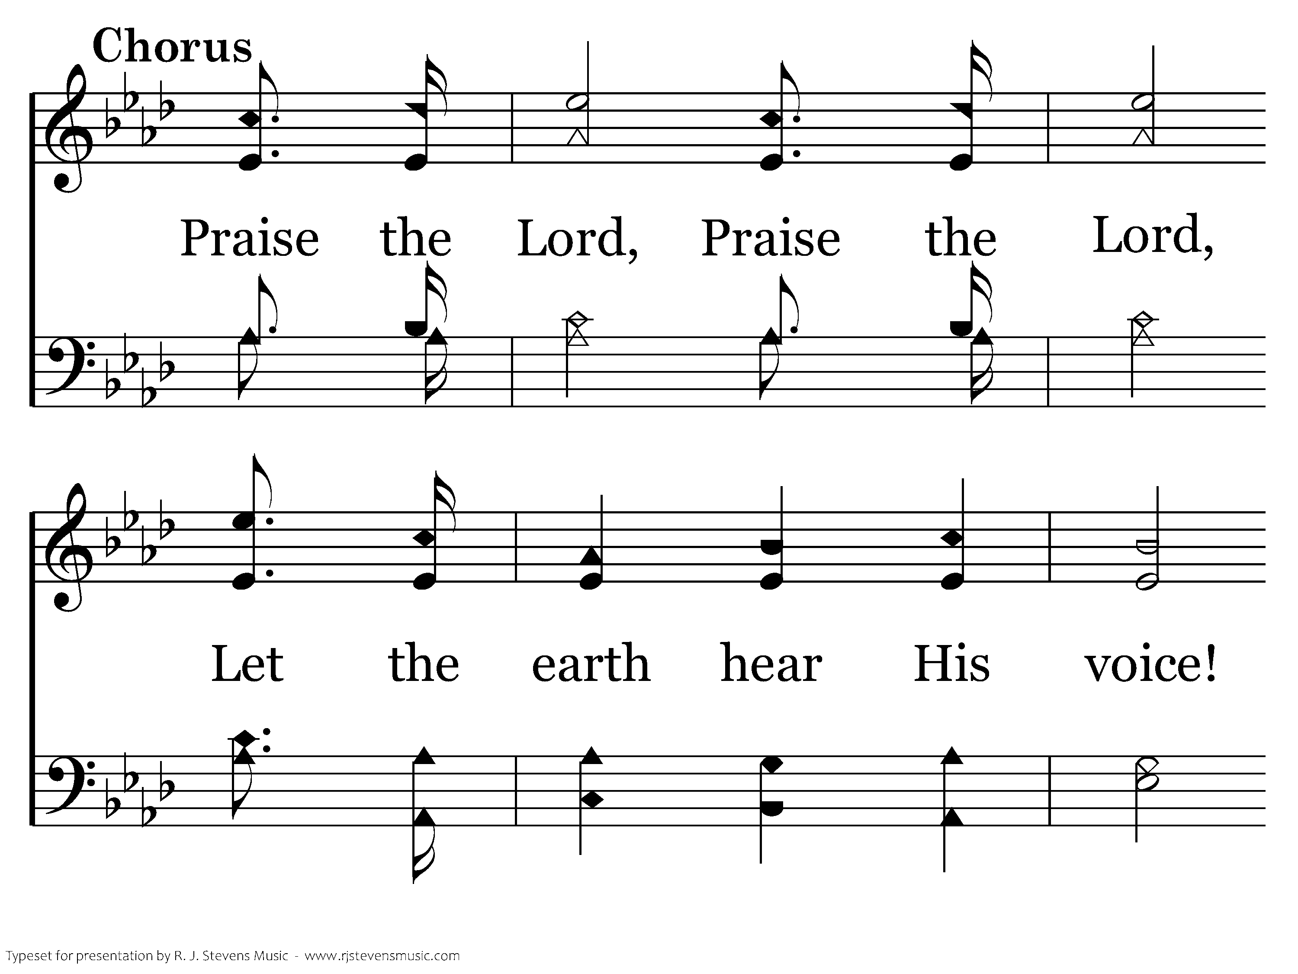
044 - To God Be The Glory - C.1

Slide 8
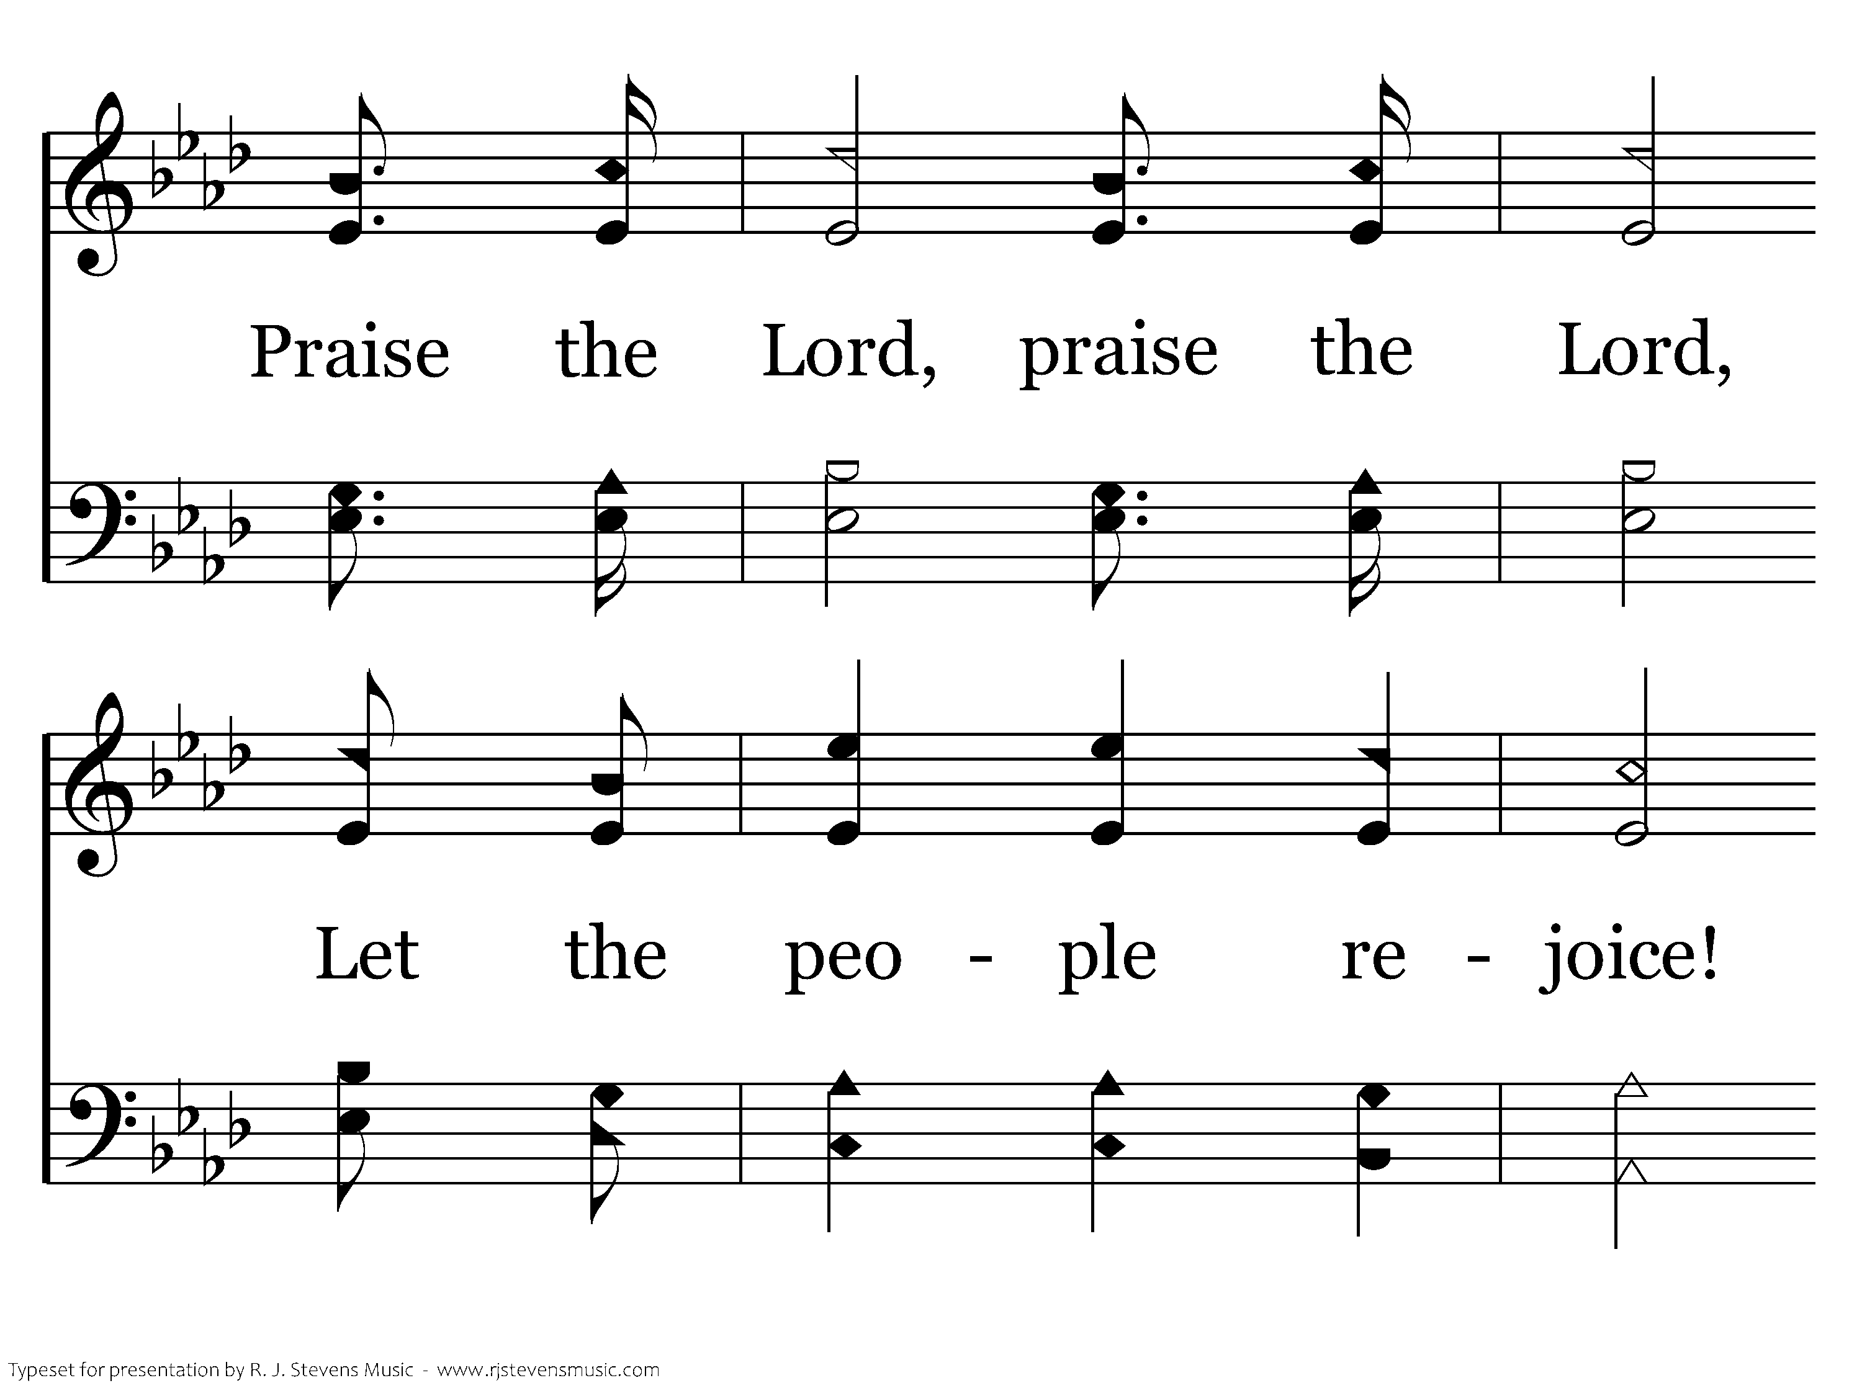
044 - To God Be The Glory - C.2

Slide 9
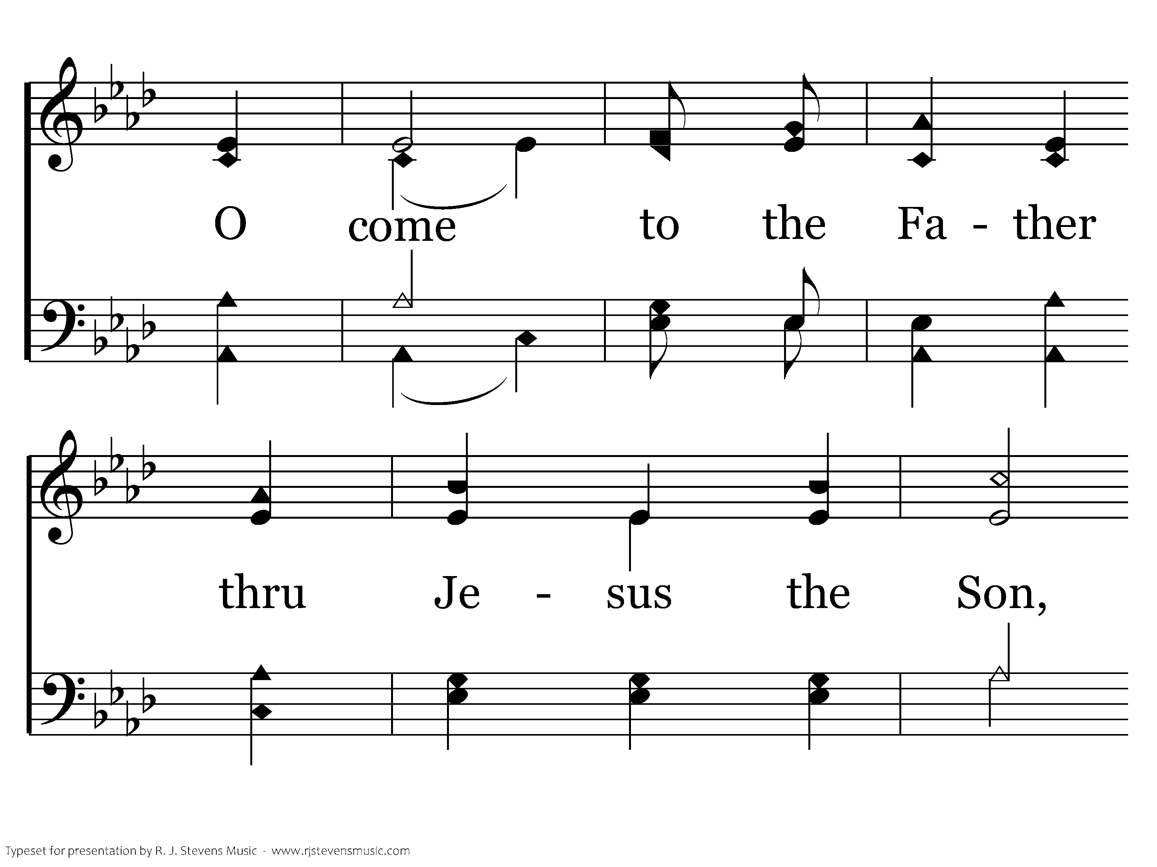
044 - To God Be The Glory - C.3

Slide 10
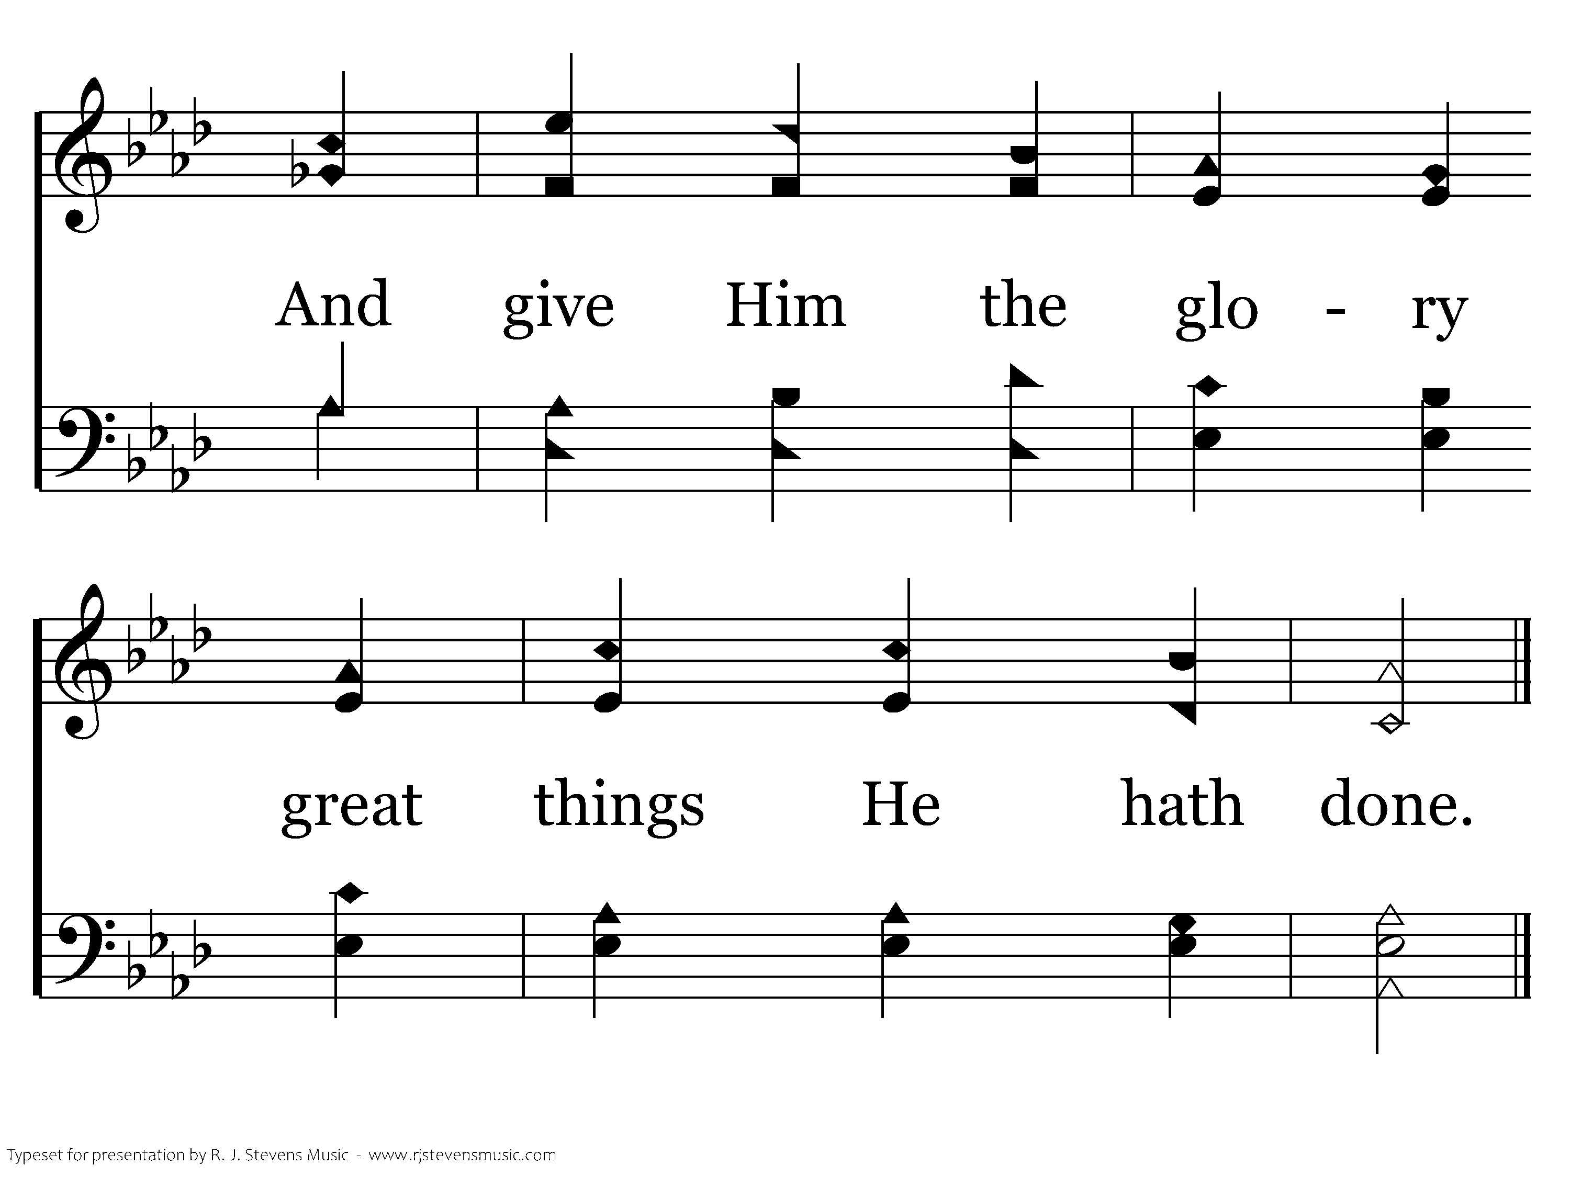
044 - To God Be The Glory - C.4
End of Verse 1

Slide 11
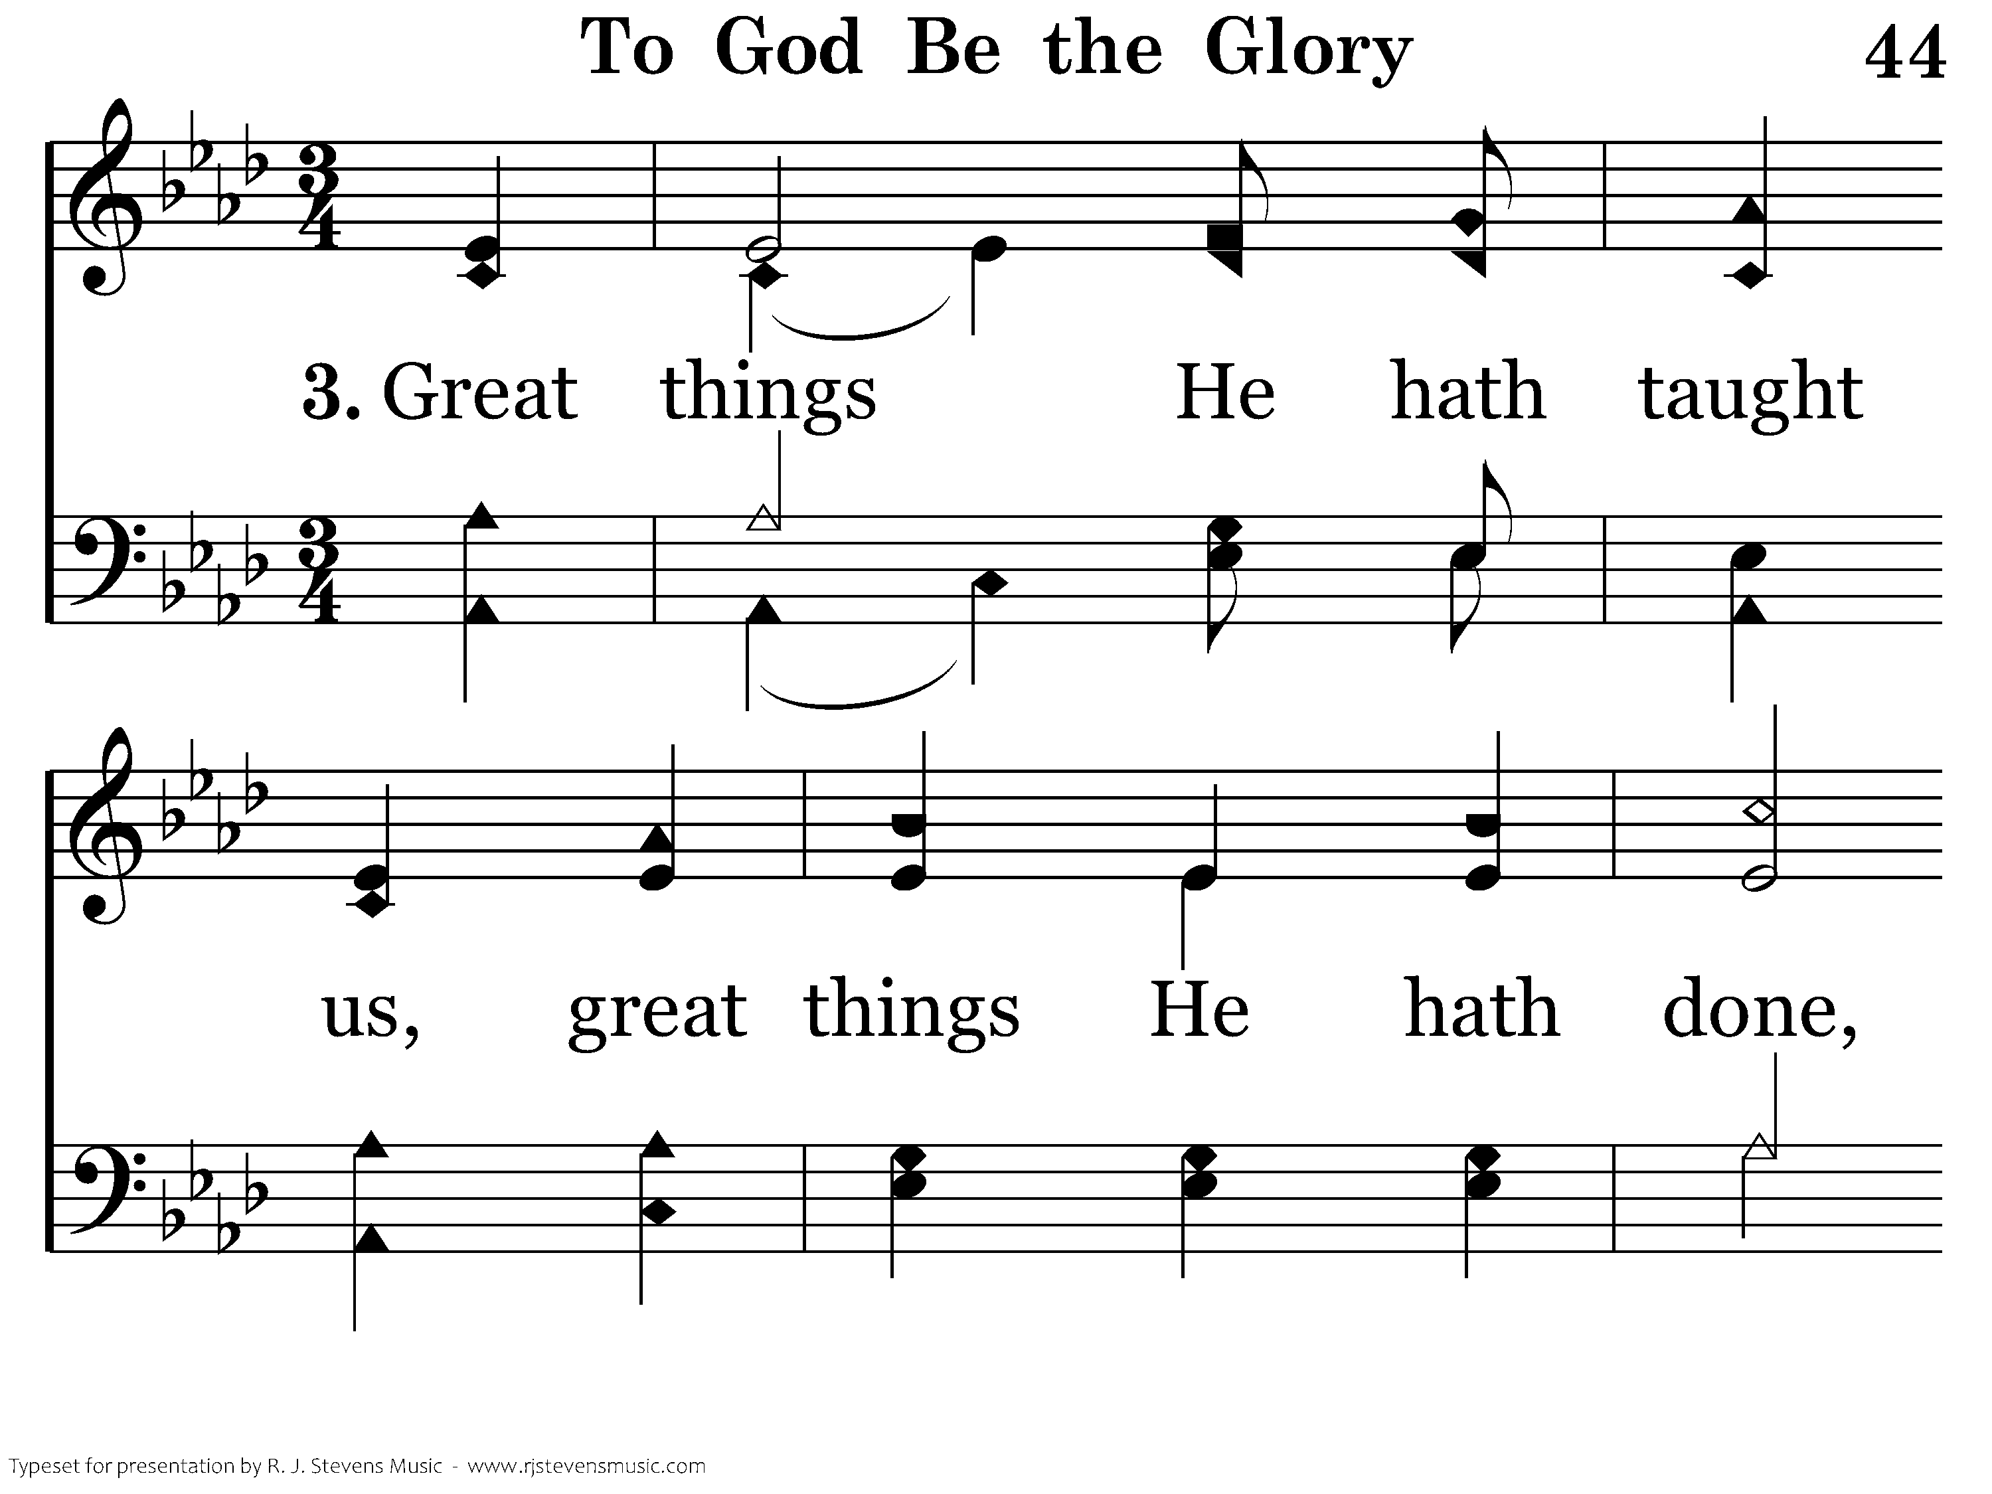
044 - To God Be The Glory - 3.1

Slide 12
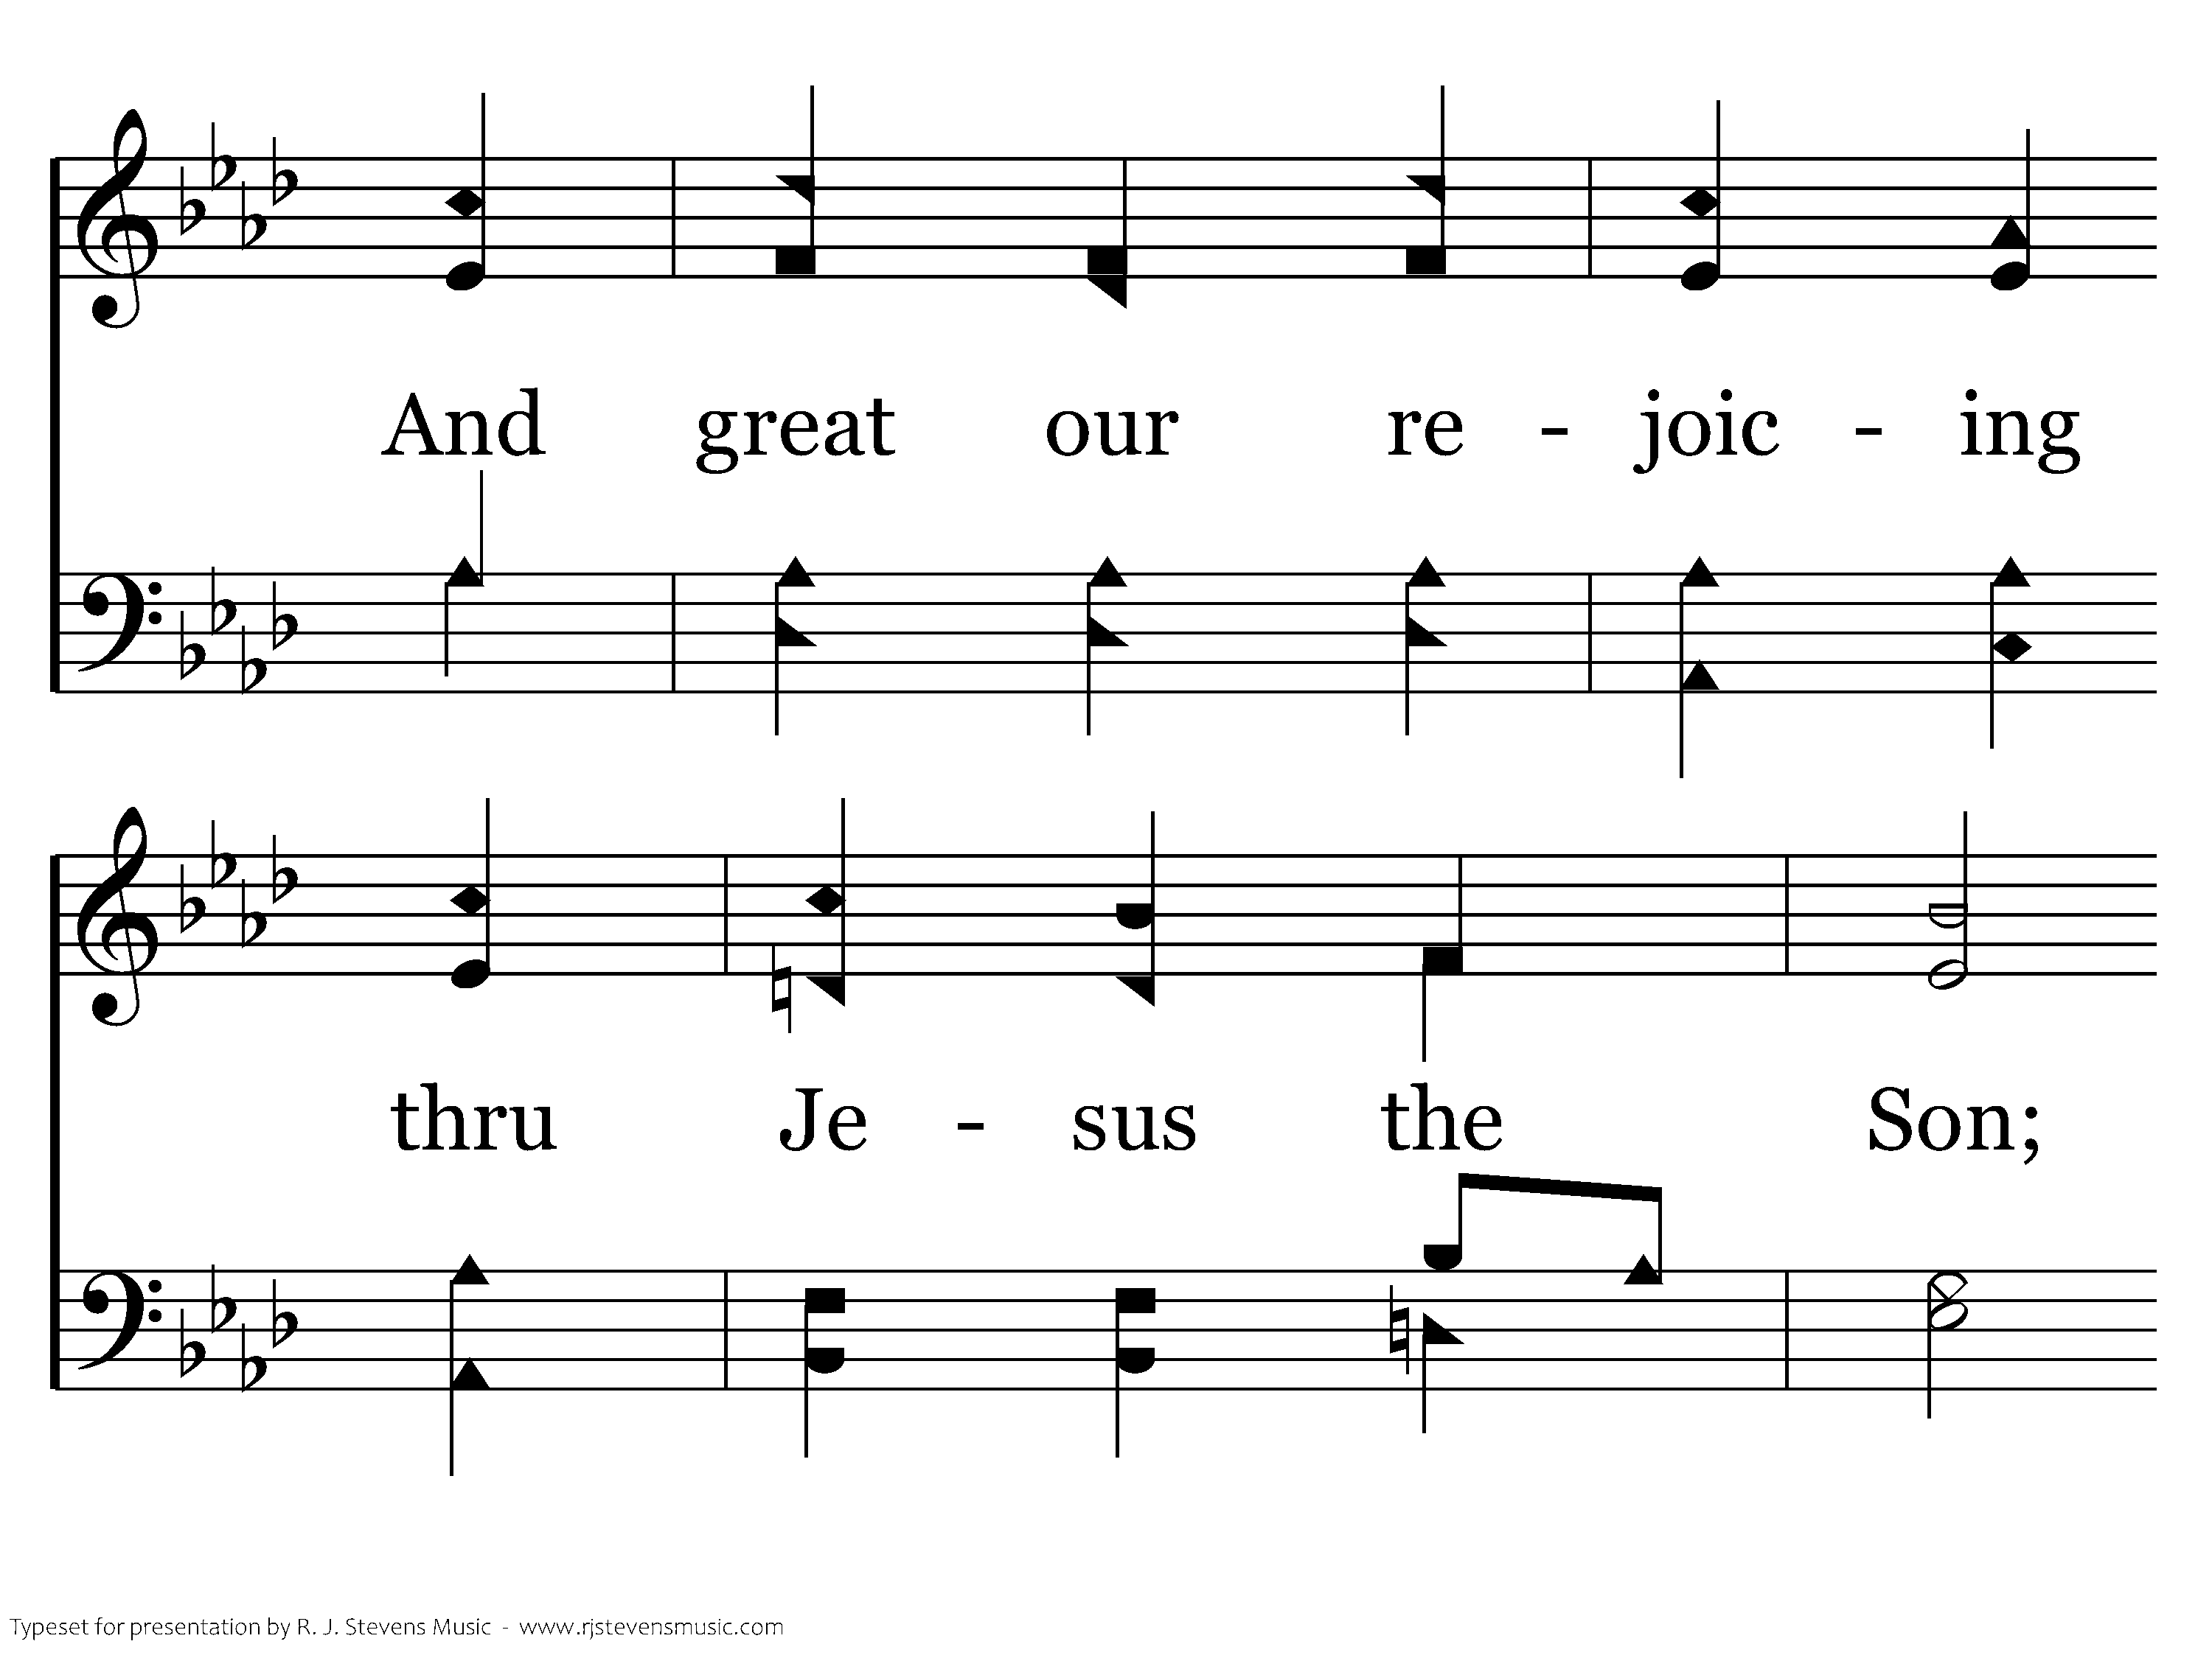
044 - To God Be The Glory - 3.2

Slide 13
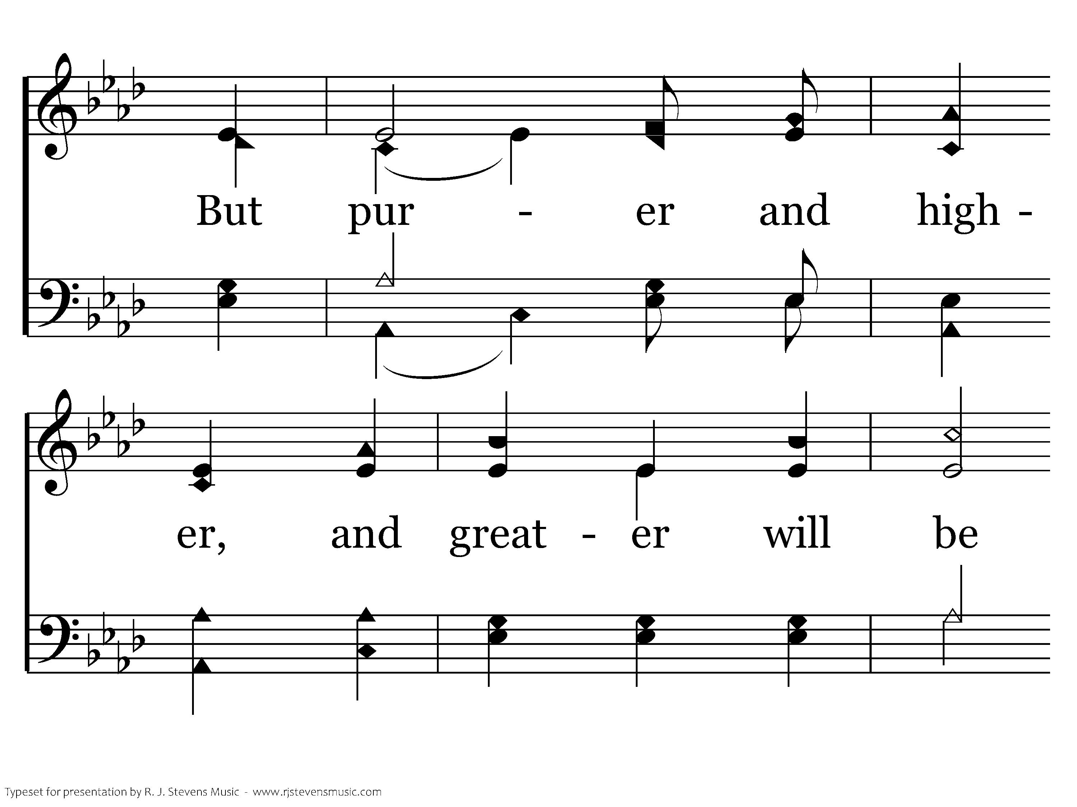
044 - To God Be The Glory - 3.3

Slide 14
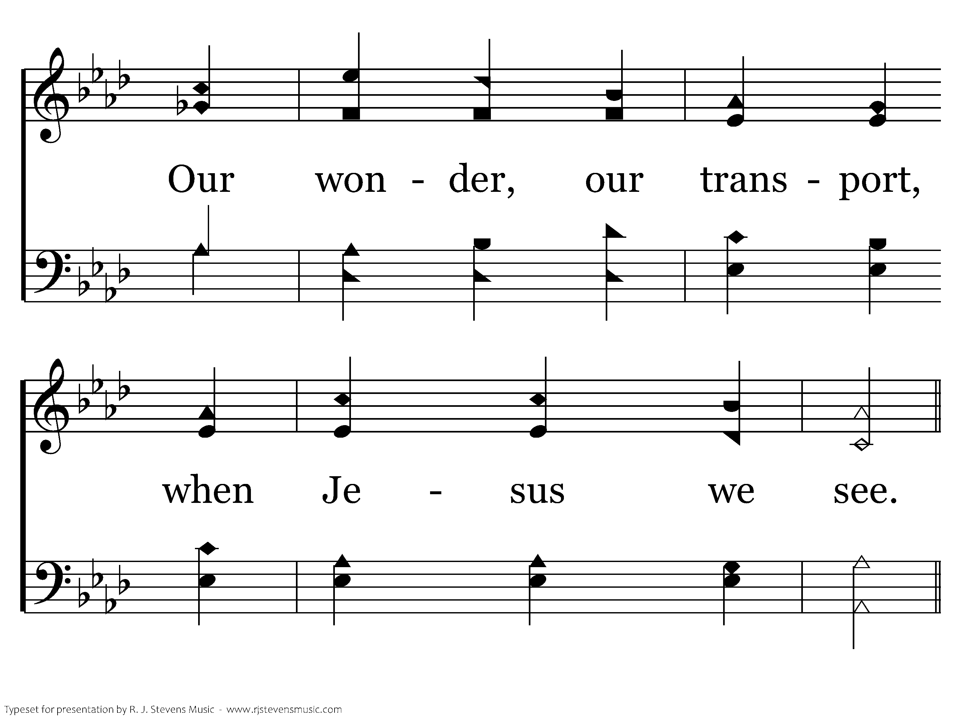
044 - To God Be The Glory - 3.4

Slide 15
044 - To God Be The Glory - C.1

Slide 16
044 - To God Be The Glory - C.2

Slide 17
044 - To God Be The Glory - C.3

Slide 18
044 - To God Be The Glory - C.4
End of Song

Slide 20
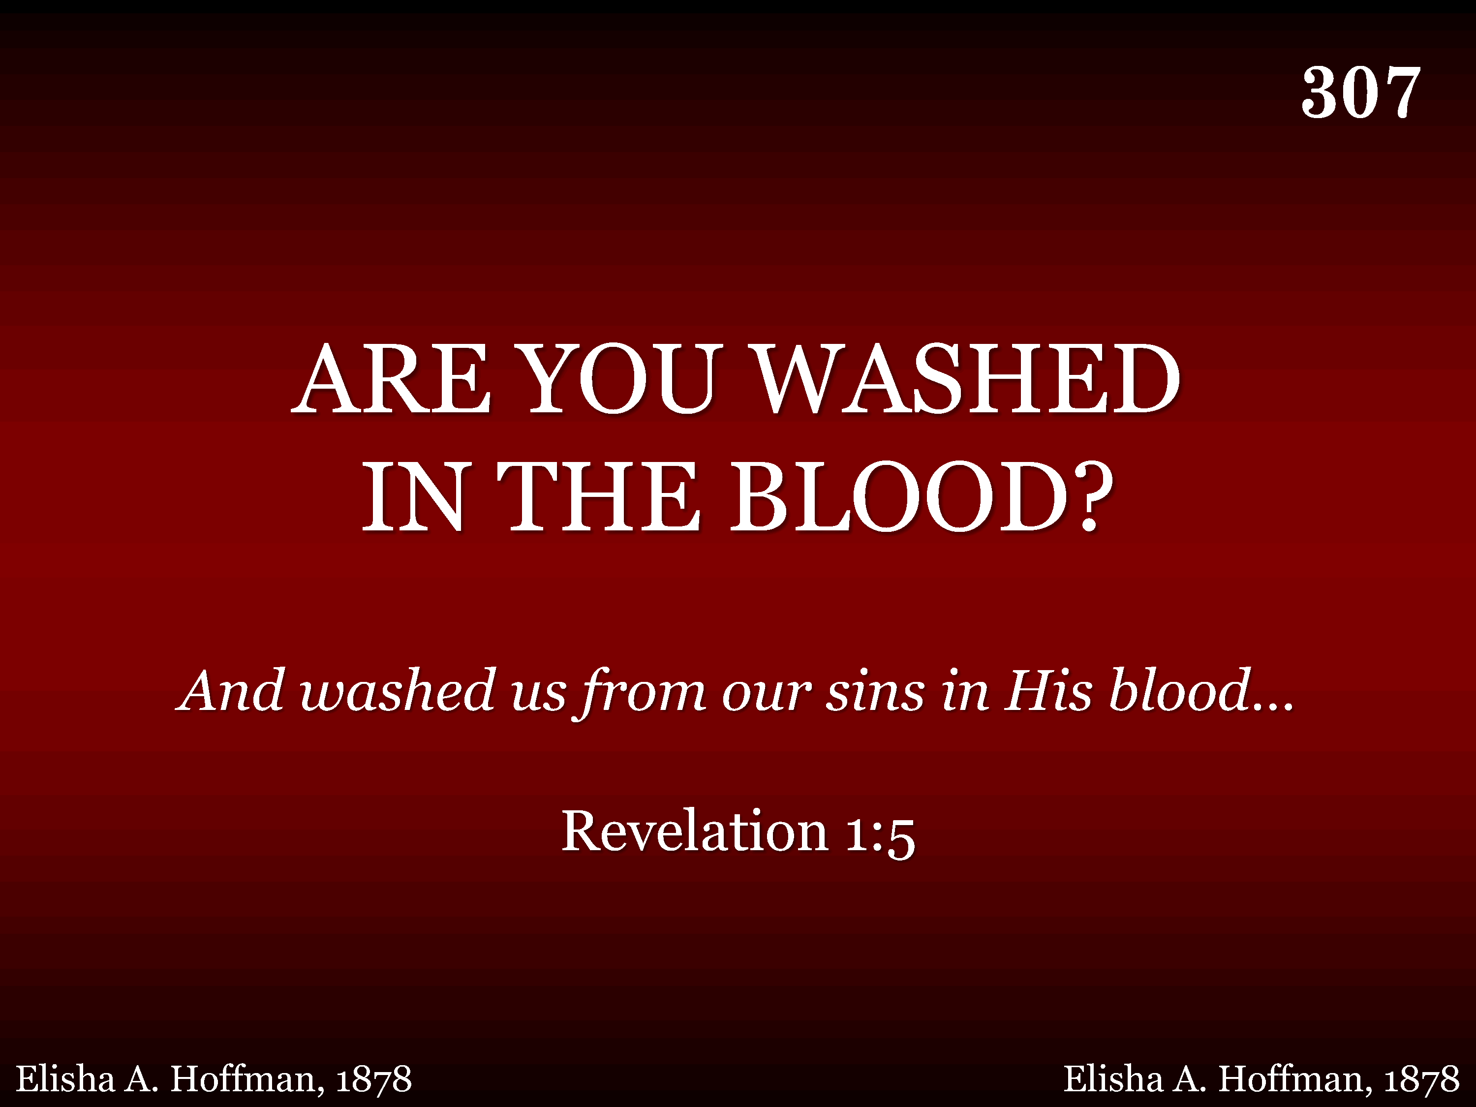
307 - Are You Washed In The Blood - Title

Slide 21

439 - Psalm 19 - Title

Slide 22
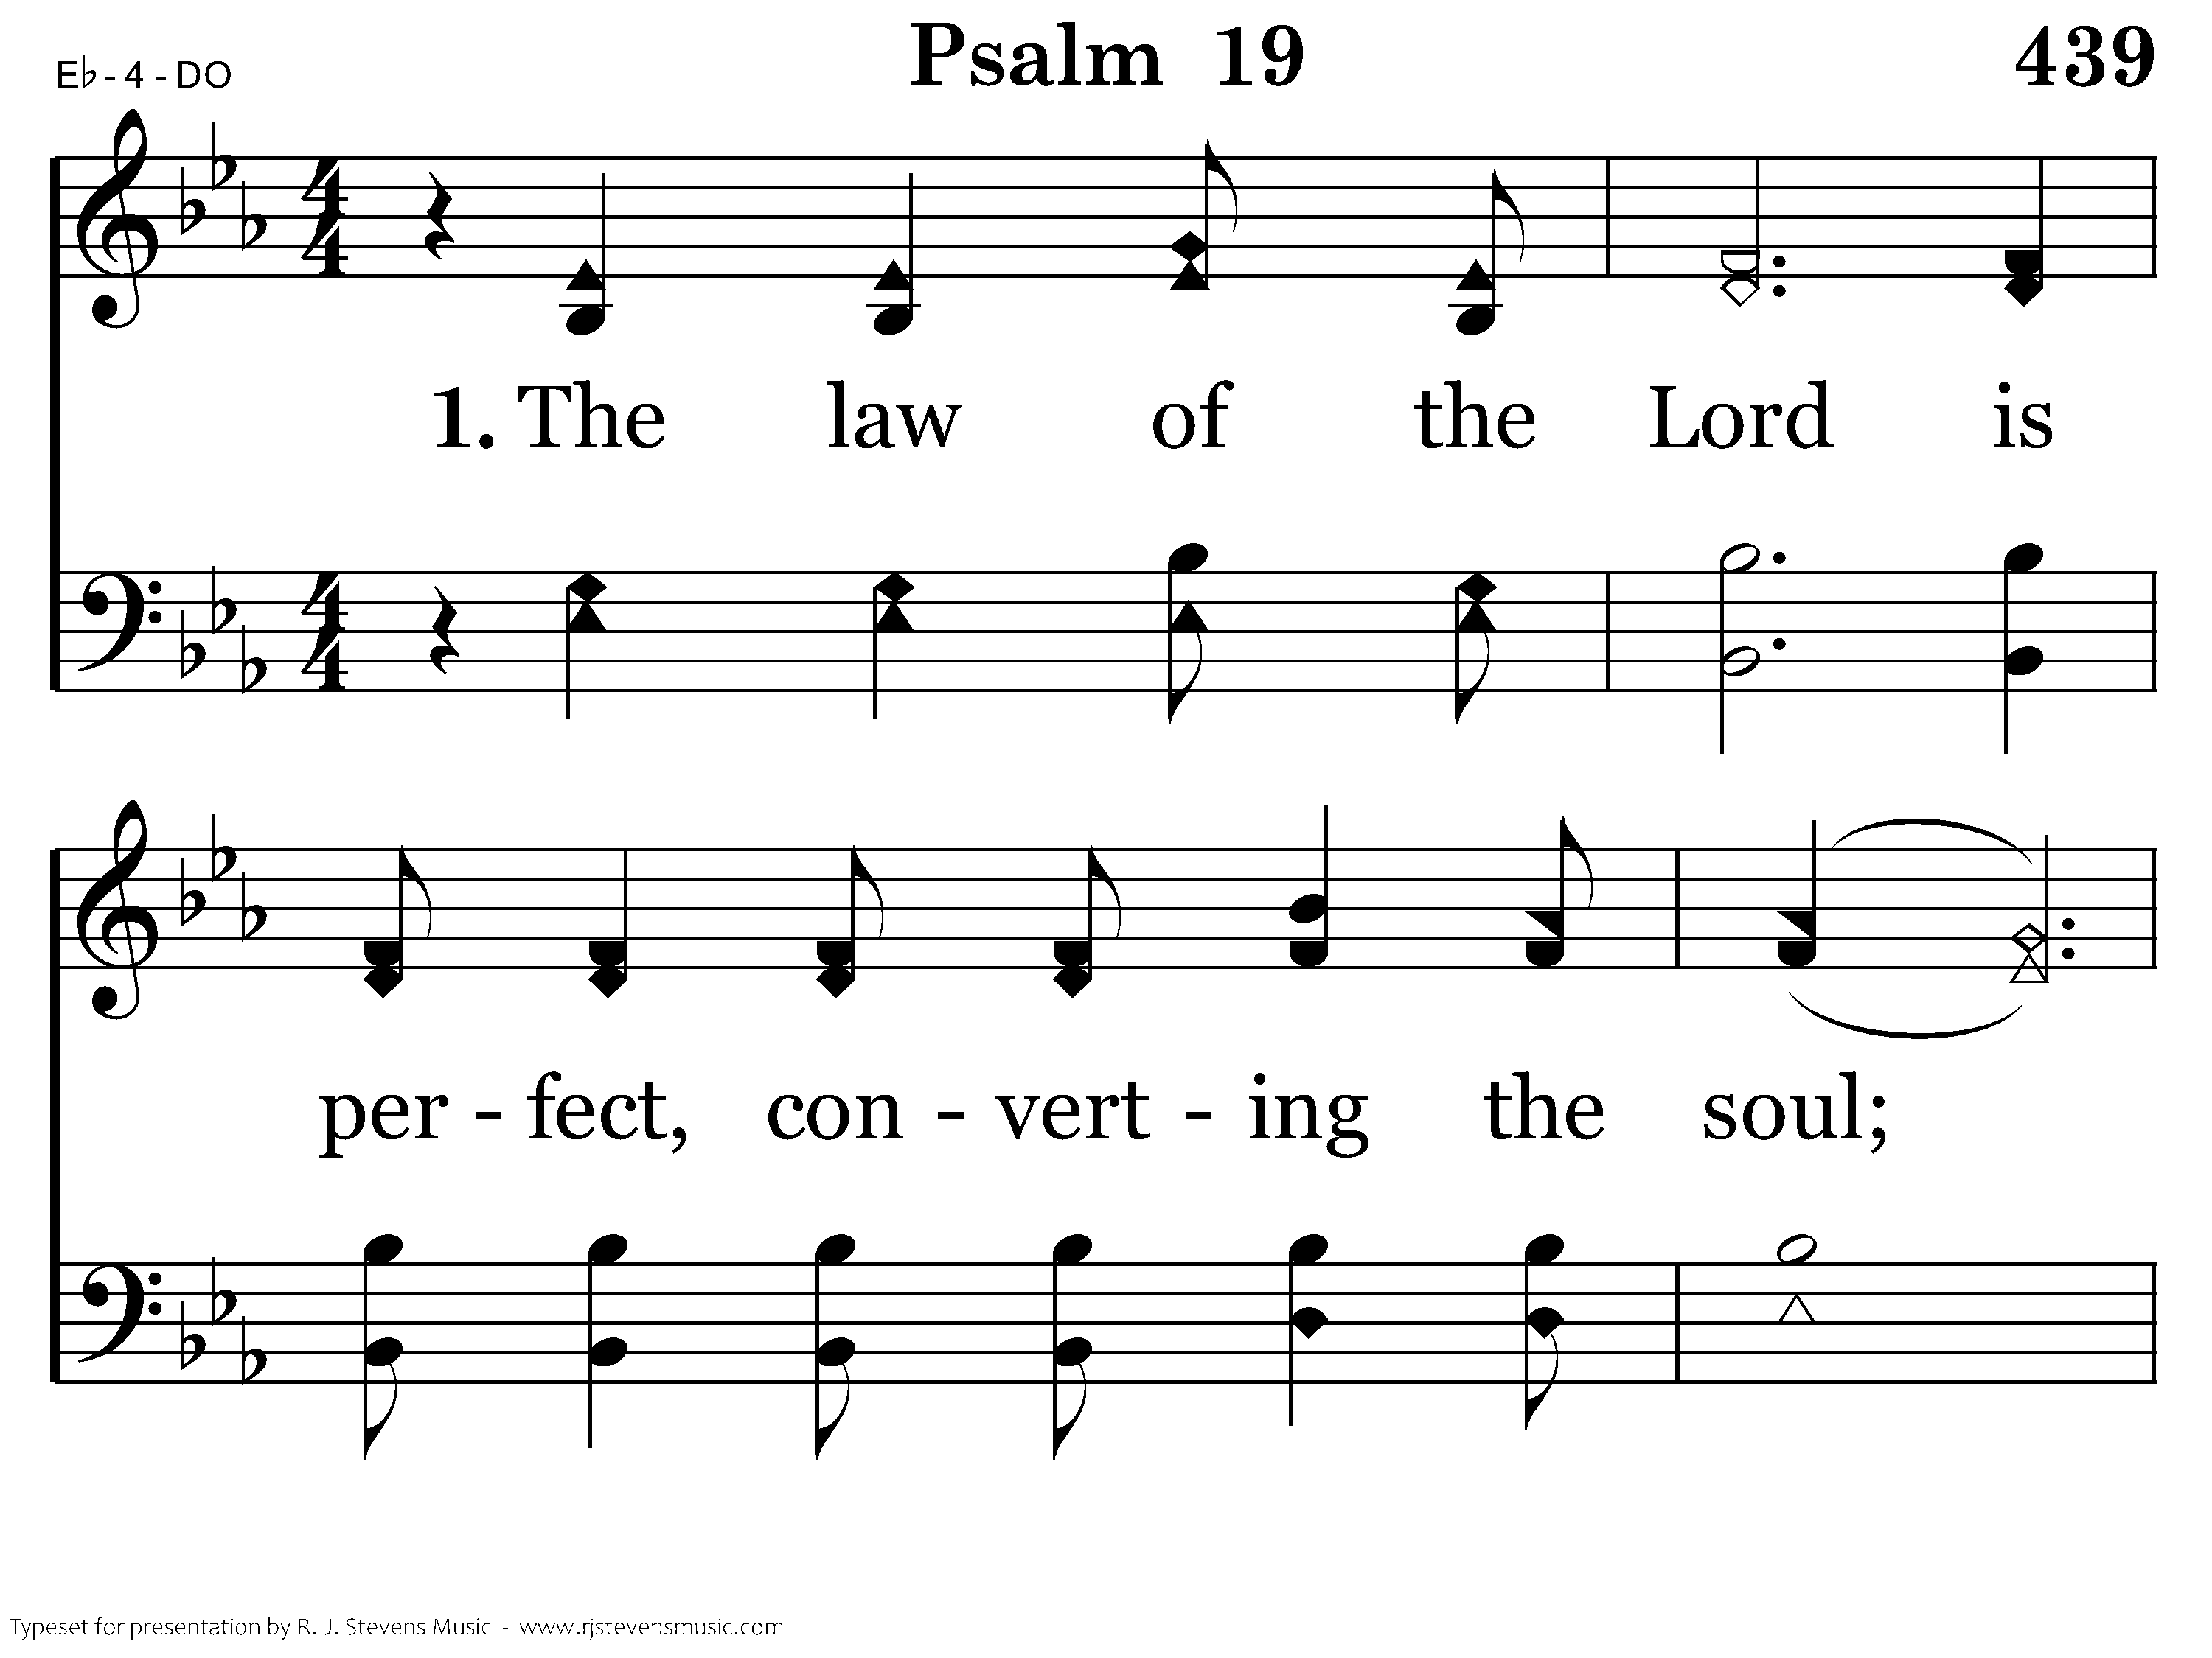
439 - Psalm 19 - 1.1

Slide 23
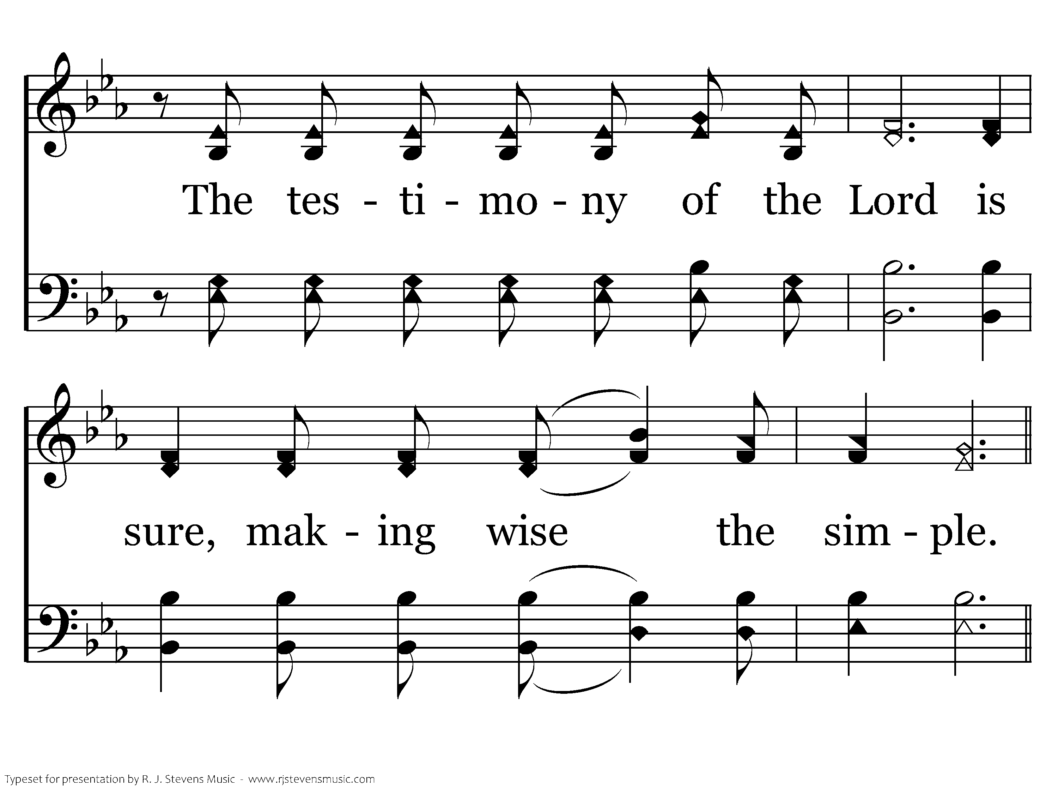
439 - Psalm 19 - 1.2

Slide 24
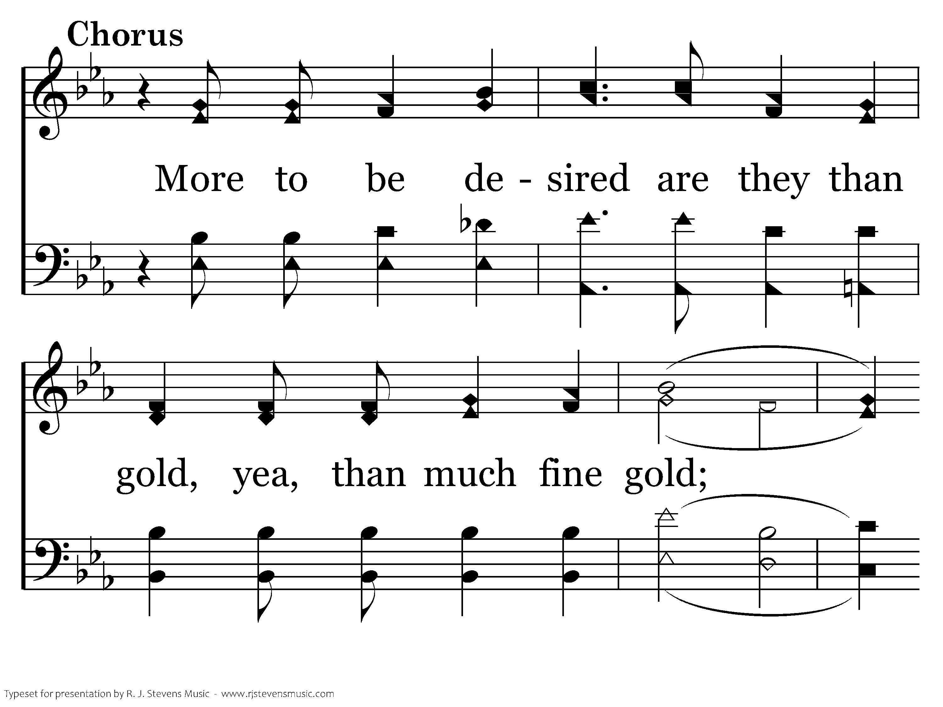
439 - Psalm 19 - C.1

Slide 25
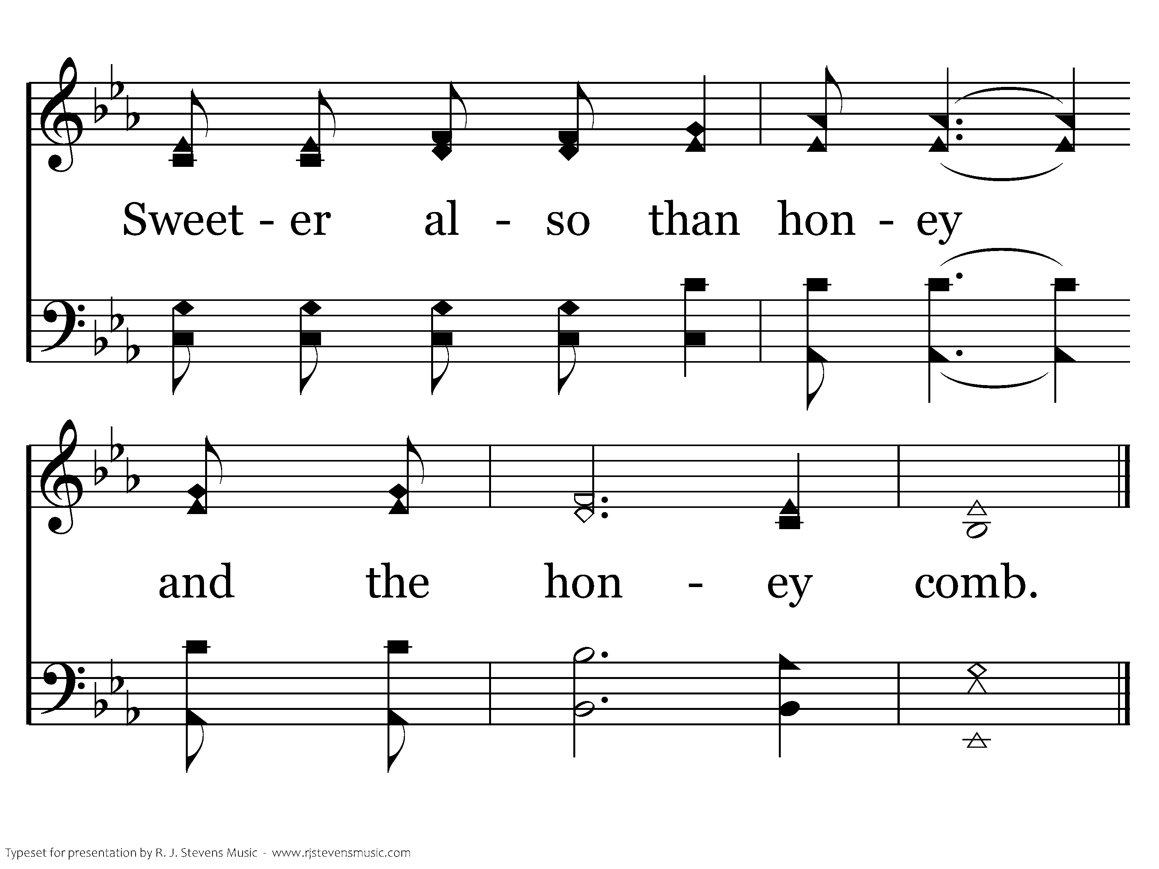
439 - Psalm 19 - C.2
End of Verse 1

Slide 26
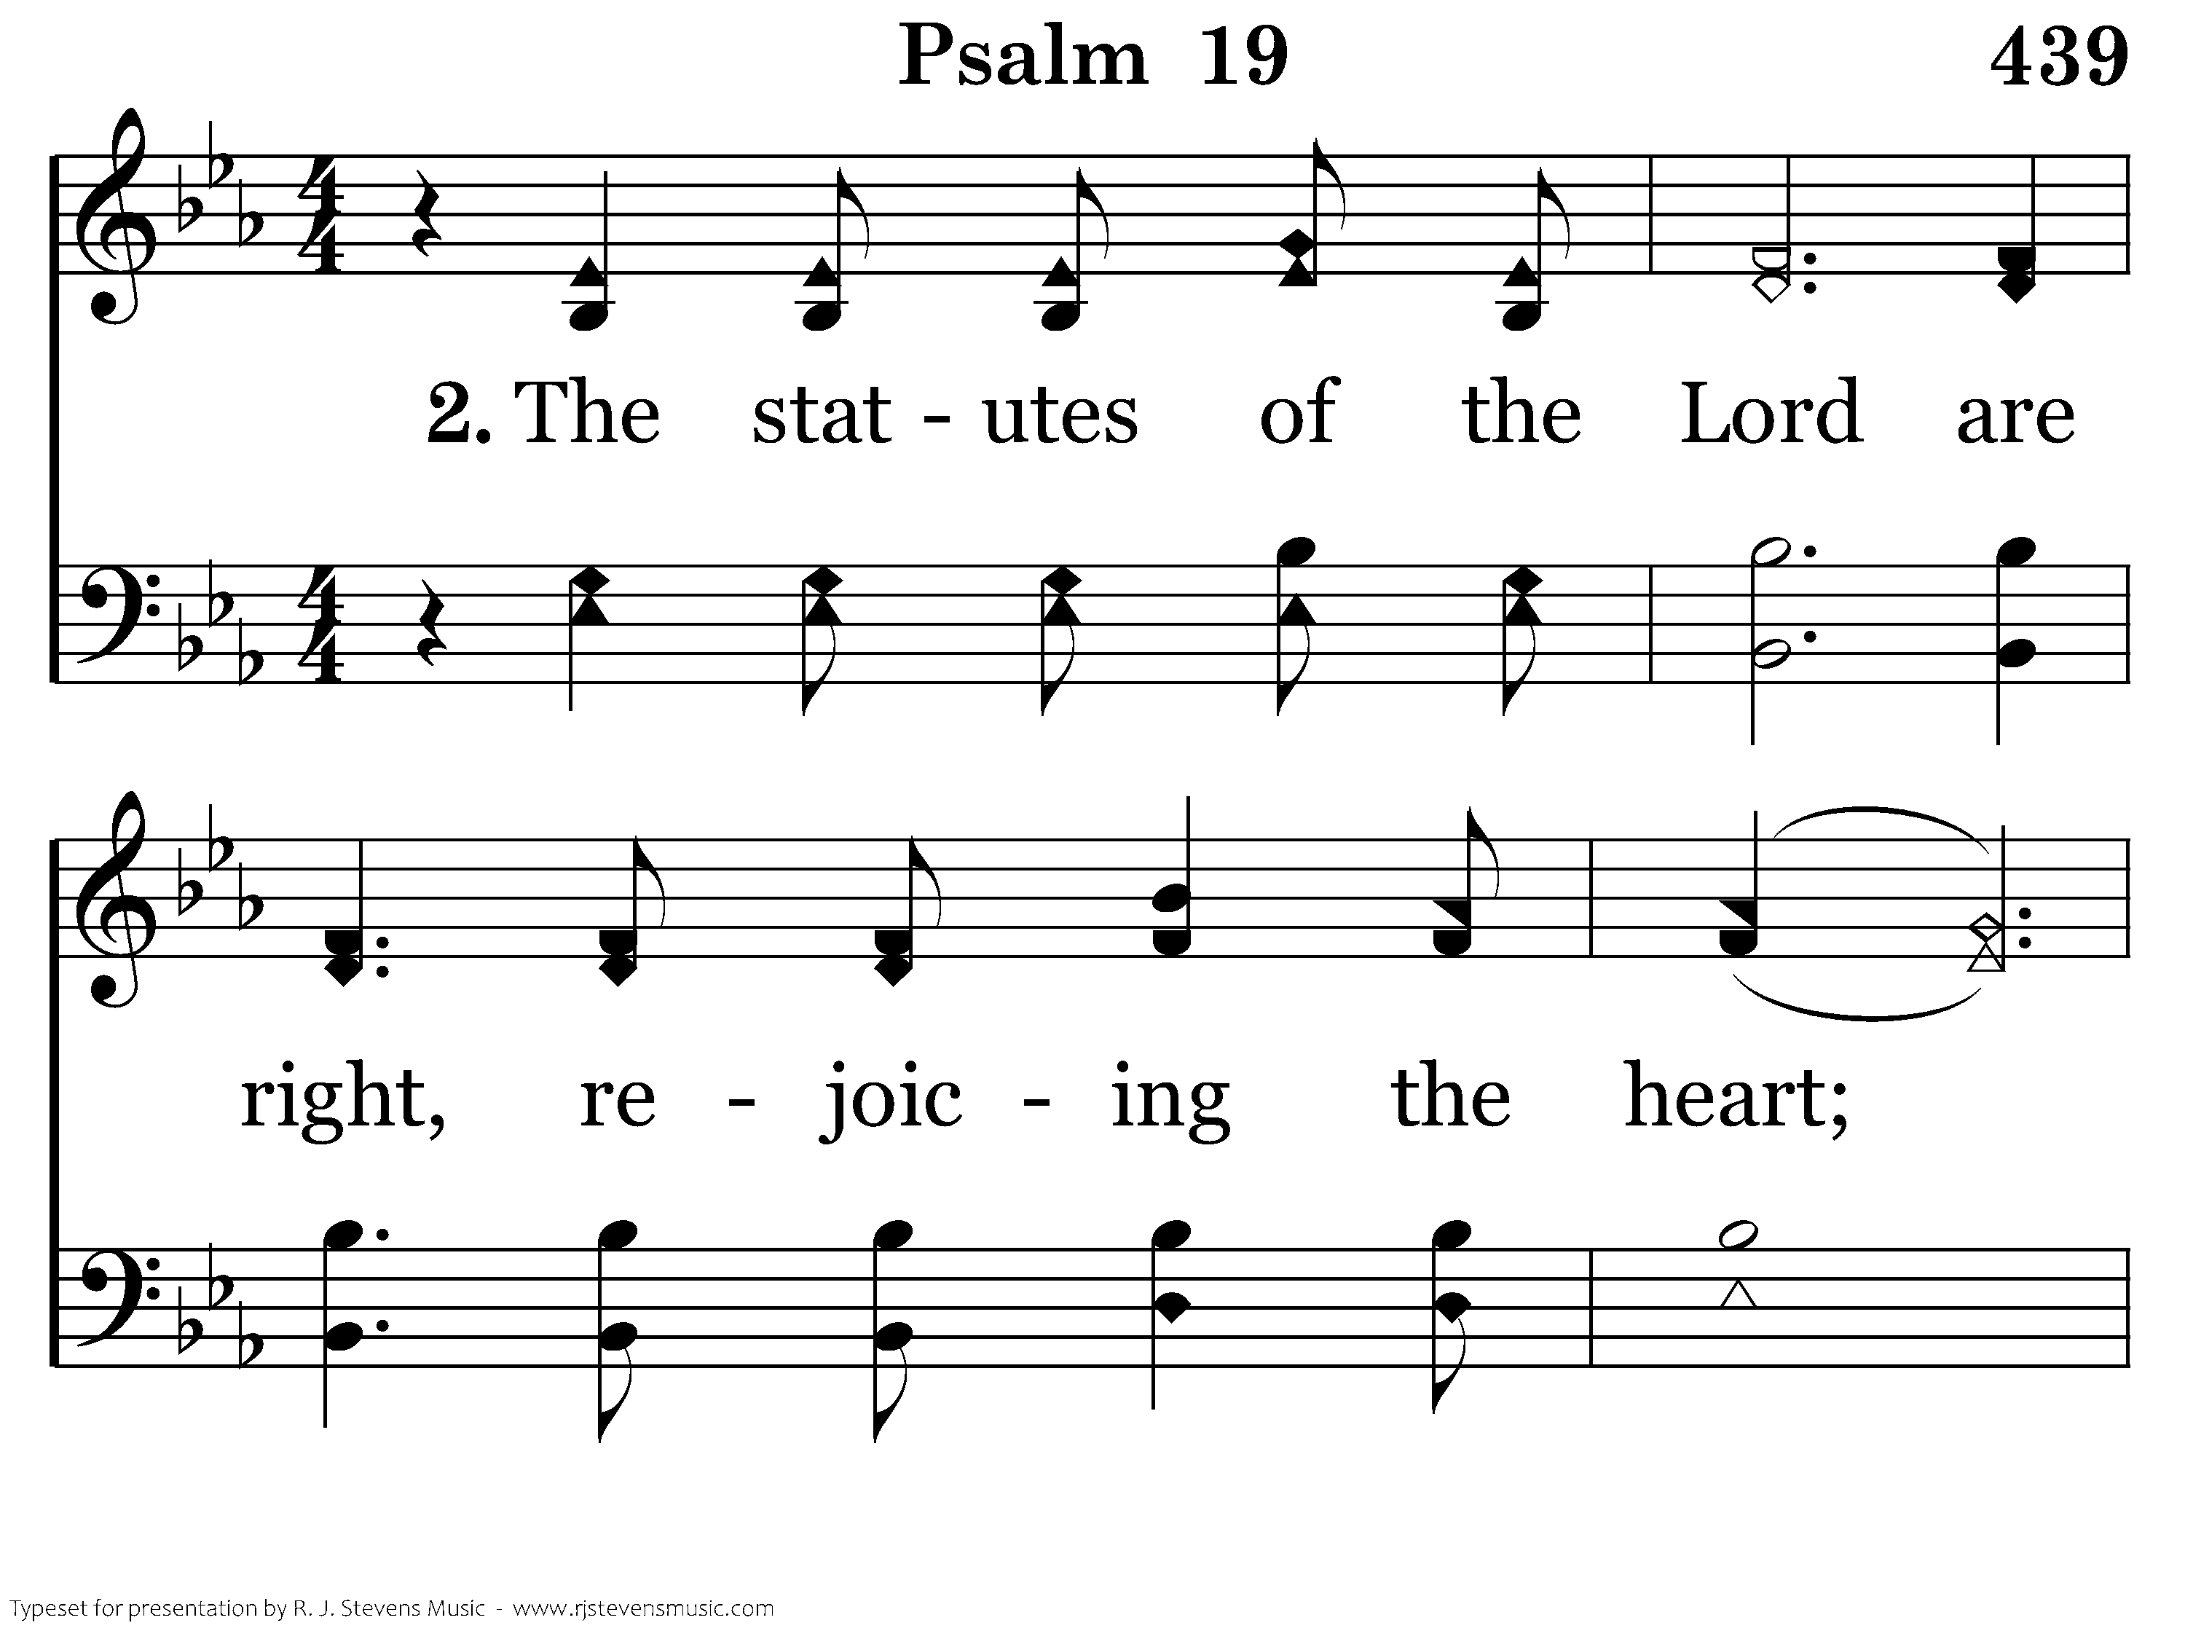
439 - Psalm 19 - 2.1

Slide 27
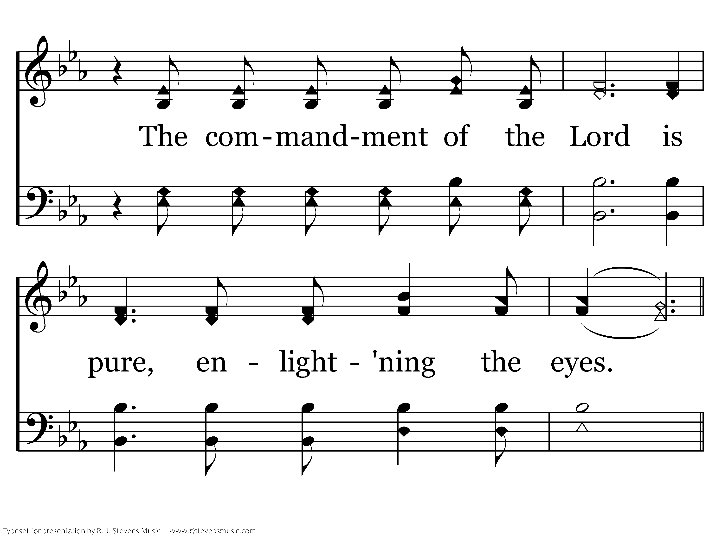
439 - Psalm 19 - 2.2

Slide 28
439 - Psalm 19 - C.1

Slide 29
439 - Psalm 19 - C.2
End of Verse 2

Slide 30
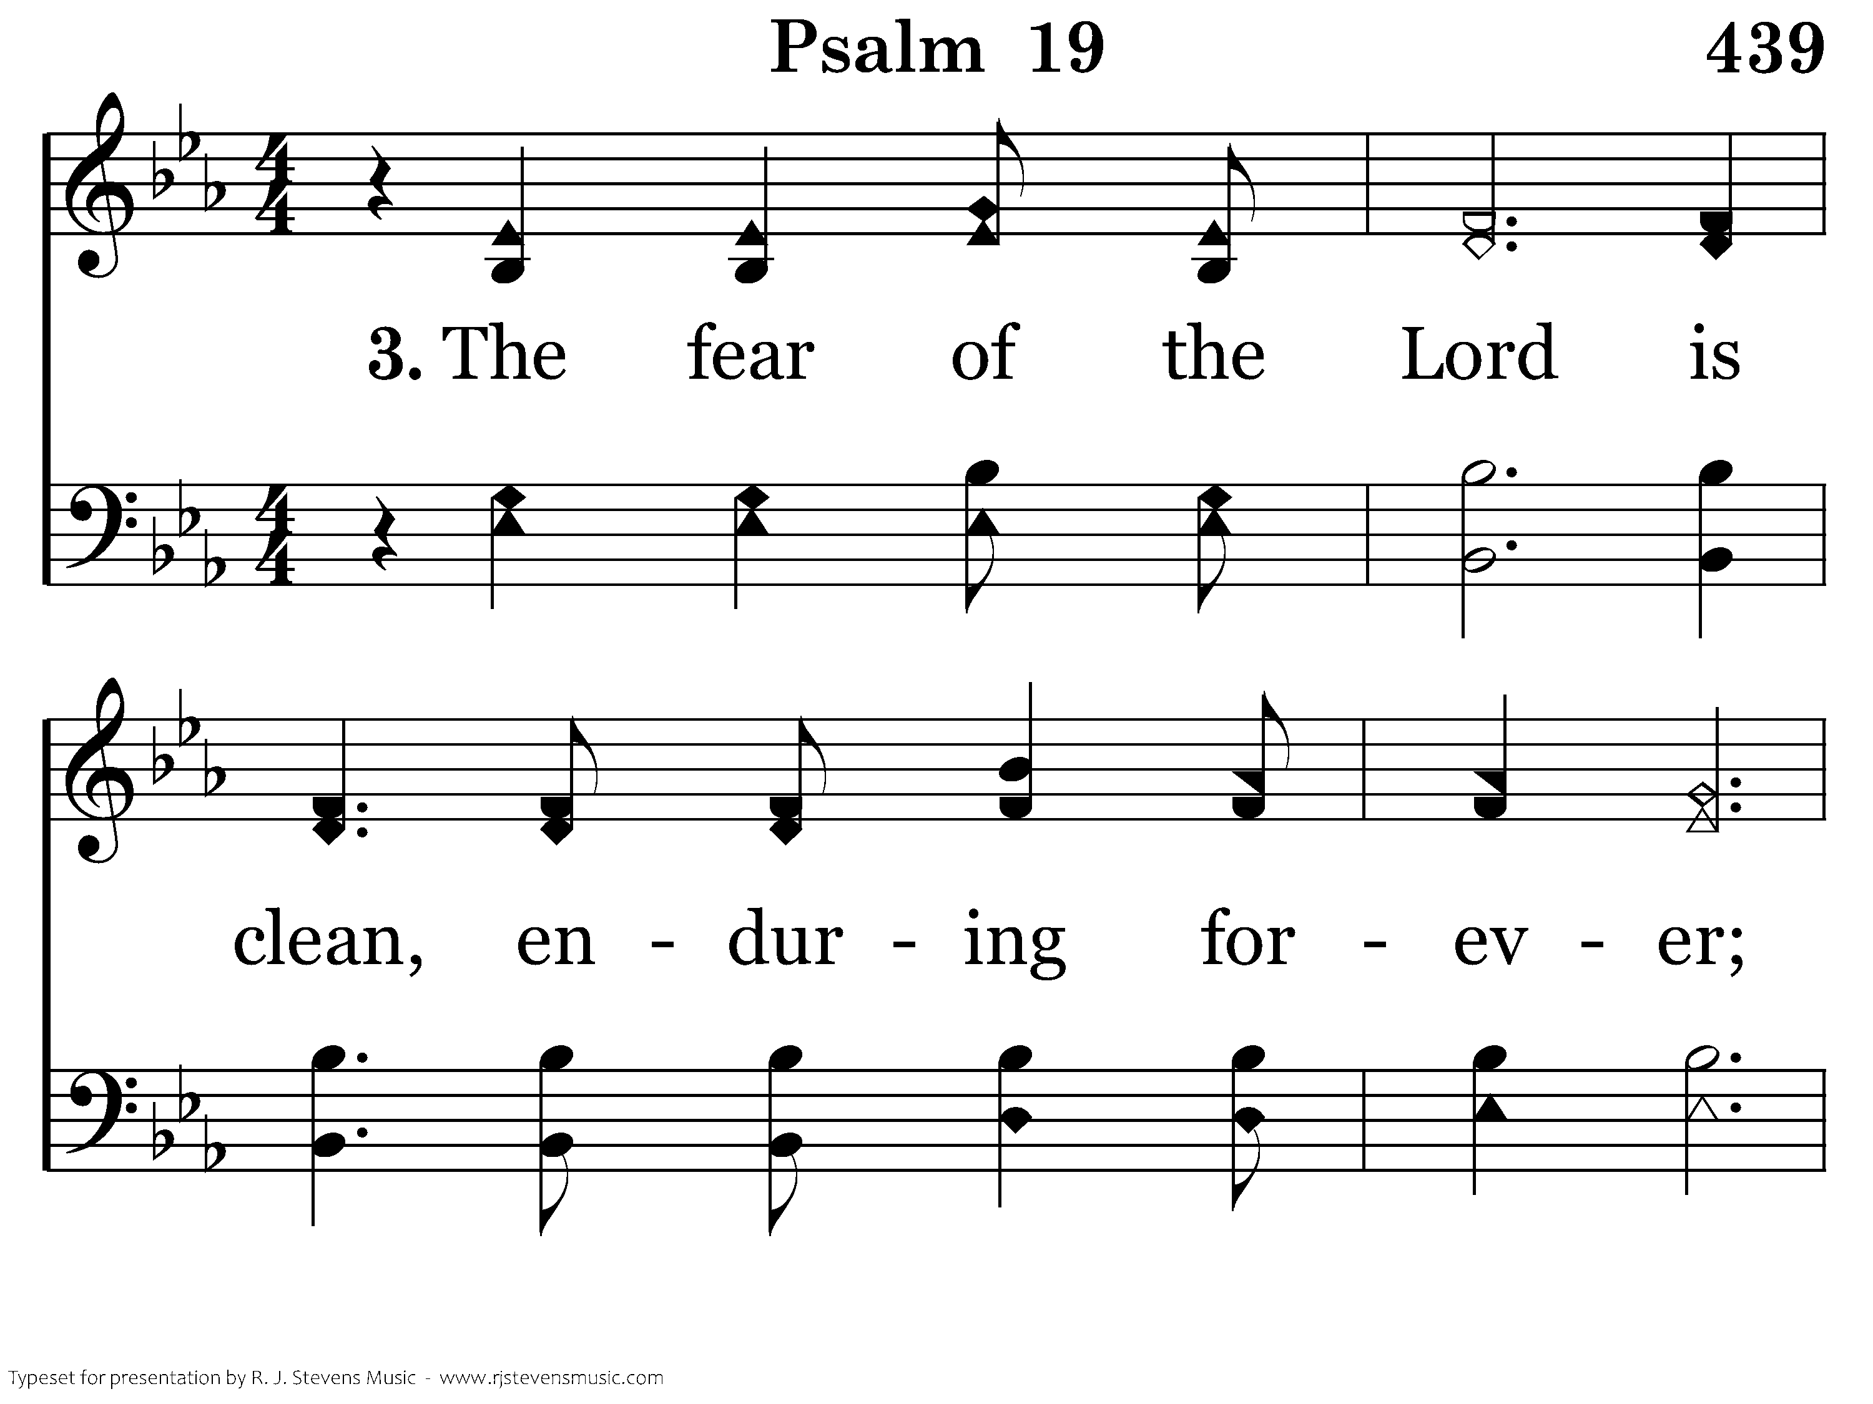
439 - Psalm 19 - 3.1

Slide 31
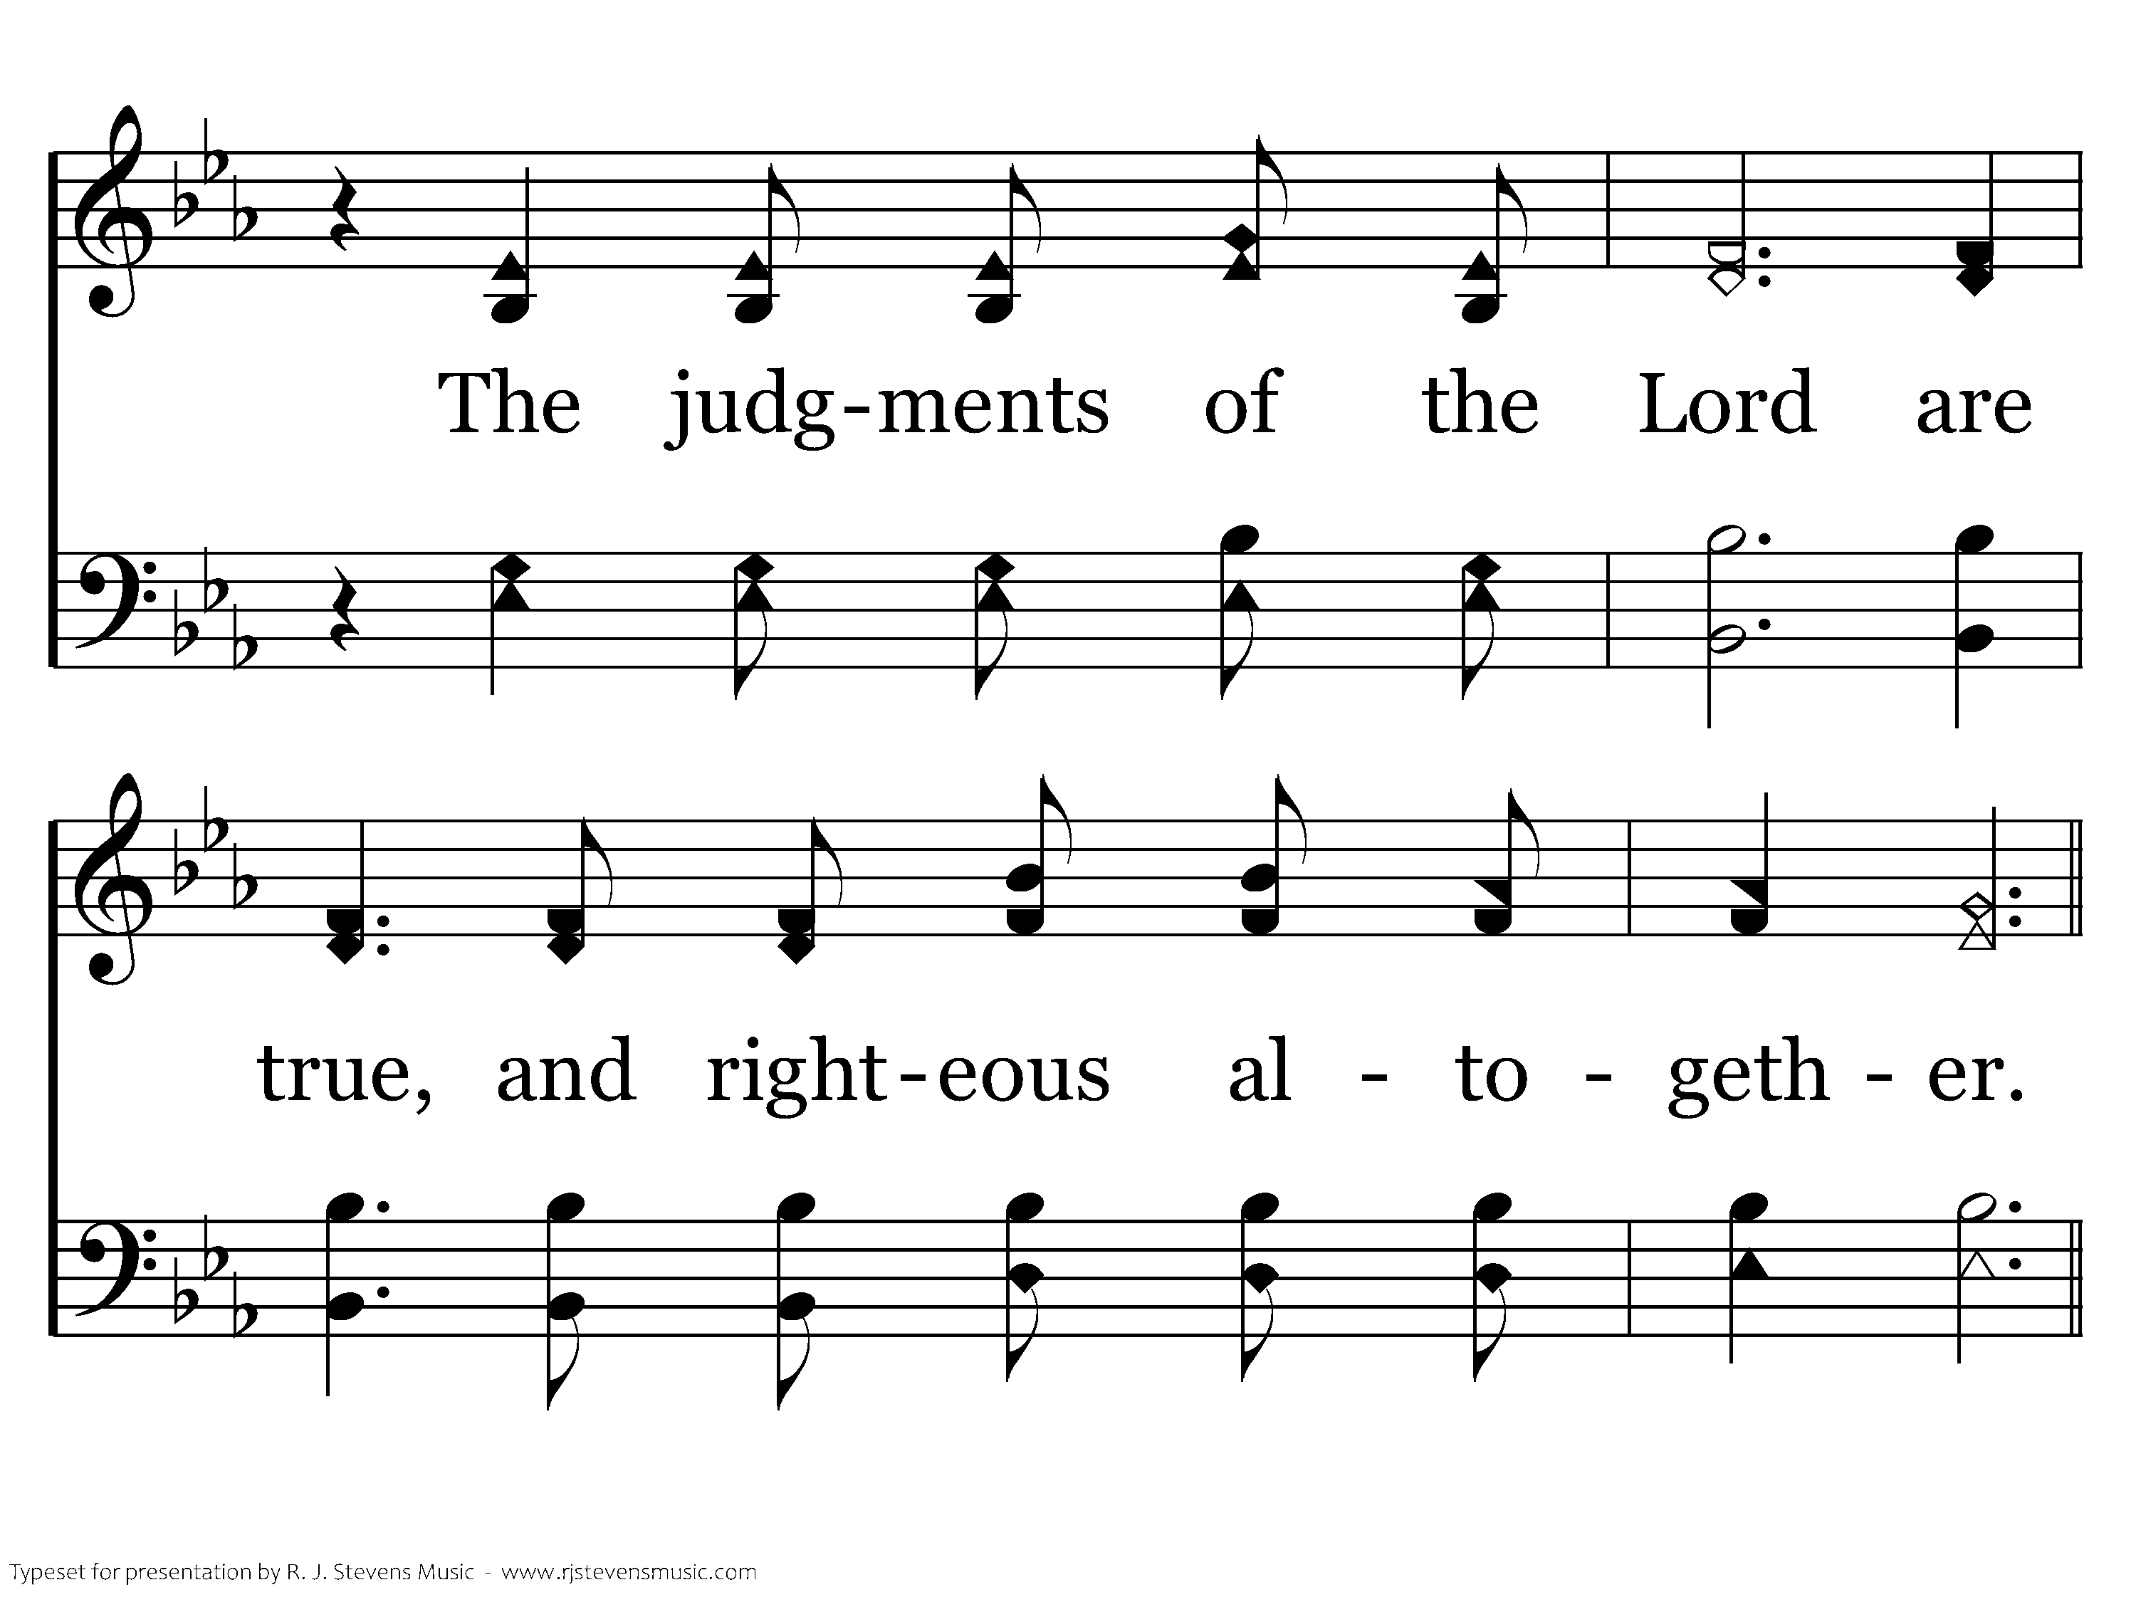
439 - Psalm 19 - 3.2

Slide 32
439 - Psalm 19 - C.1

Slide 33
439 - Psalm 19 - C.2
End of Song

Slide 35
rhetorical question
^{3.13} Who is going to harm you if you are eager to do good?

Slide 36
possible
^{3.14} But even if you should suffer for what is right, you are blessed. “Do not fear their threats; do not be frightened.”

Slide 37
probable
^{3.15} But sanctify the Lord God in your hearts, and always be ready to give a defense to everyone who
asks you a reason for the hope that is in you, with meekness and fear;

Slide 38
certain
^{1.21} who through Him believe in God, who raised Him from the dead and gave Him glory, so that your faith and hope are in God

Slide 40
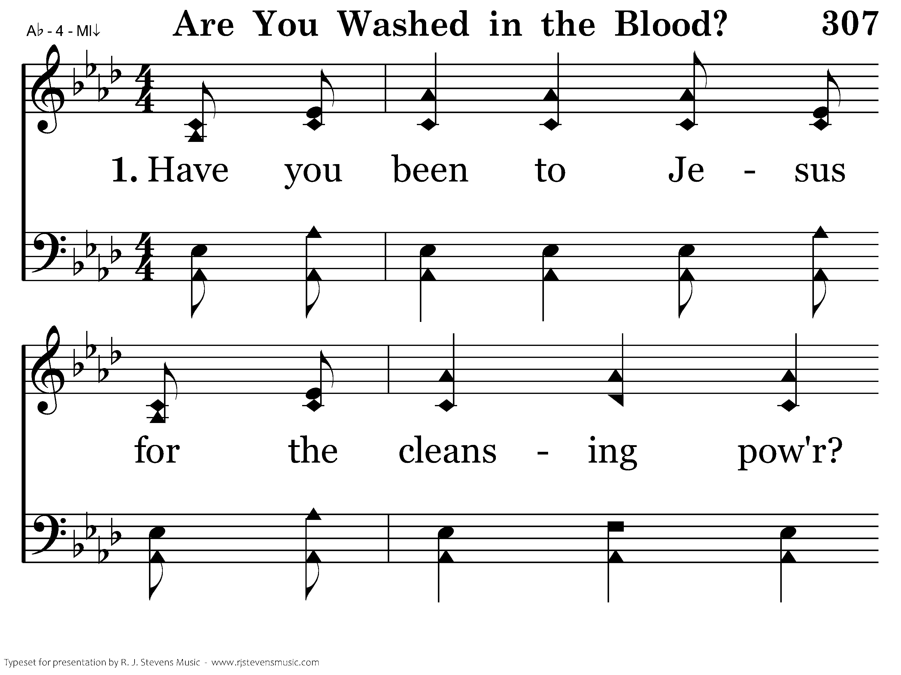
307 - Are You Washed In The Blood - 1.1

Slide 41
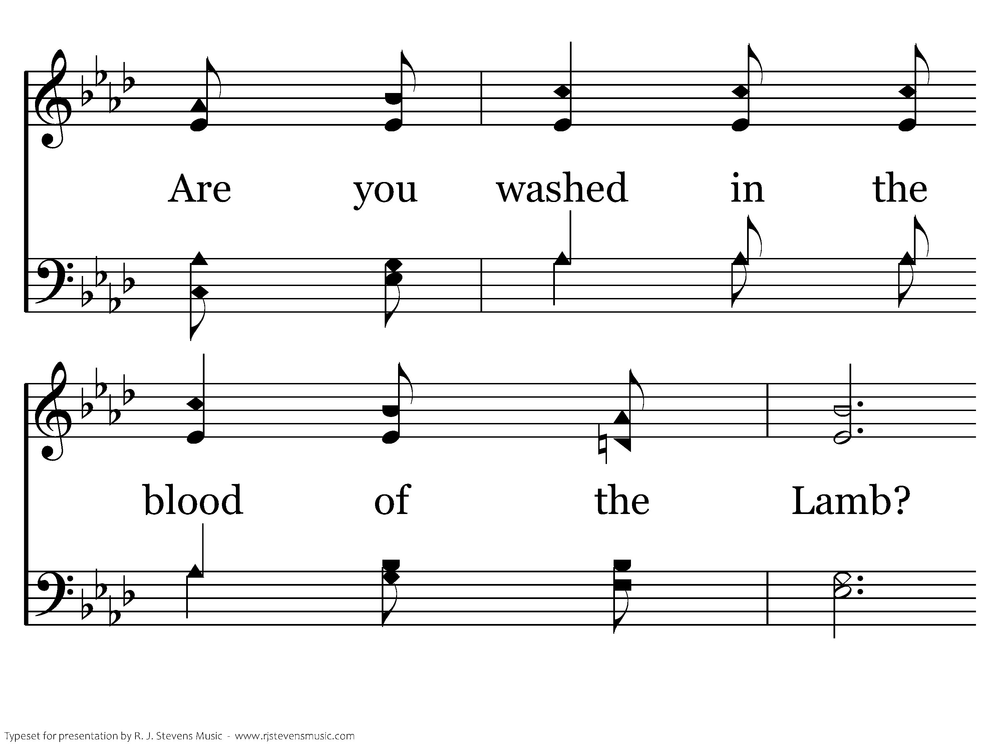
307 - Are You Washed In The Blood - 1.2

Slide 42
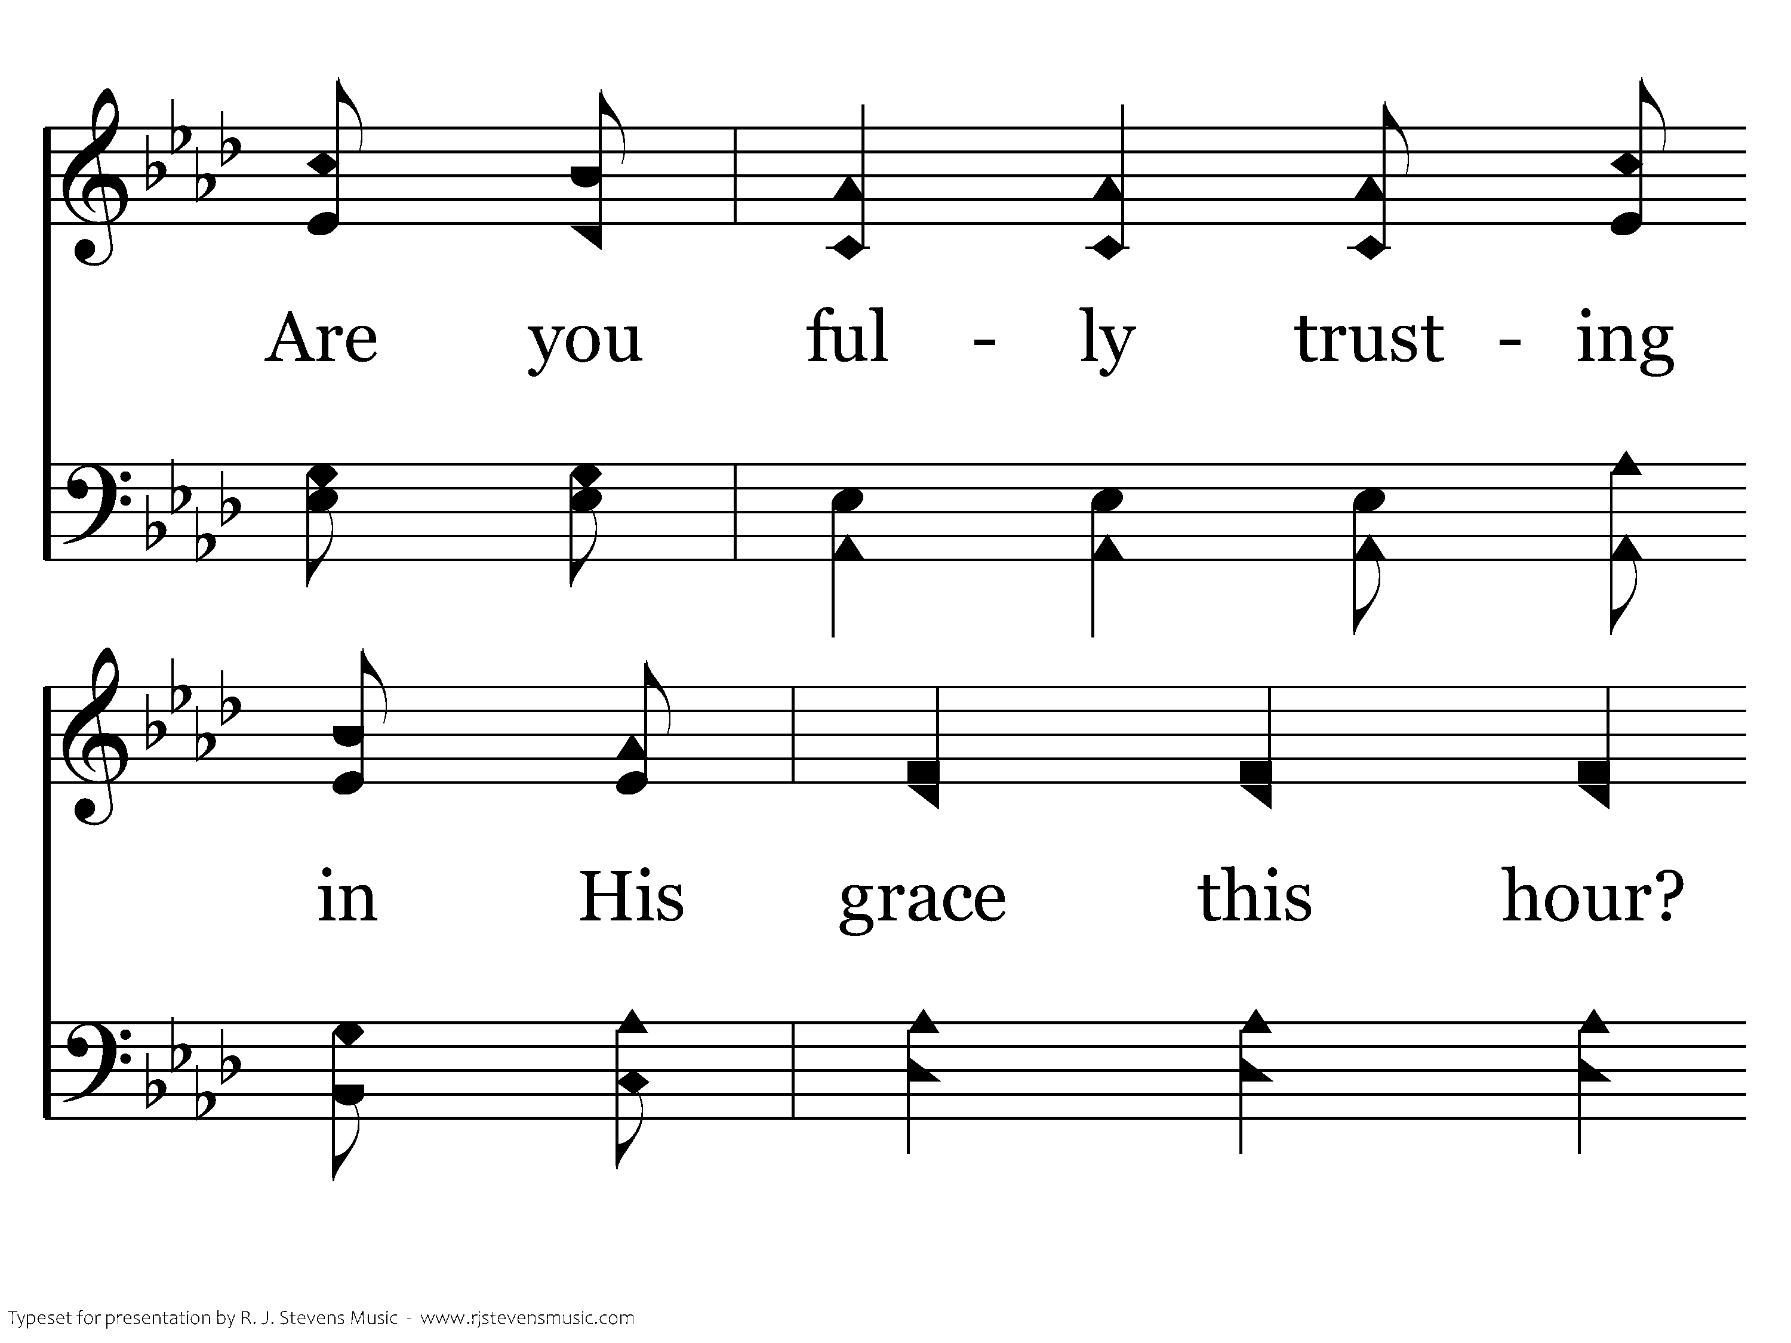
307 - Are You Washed In The Blood - 1.3

Slide 43
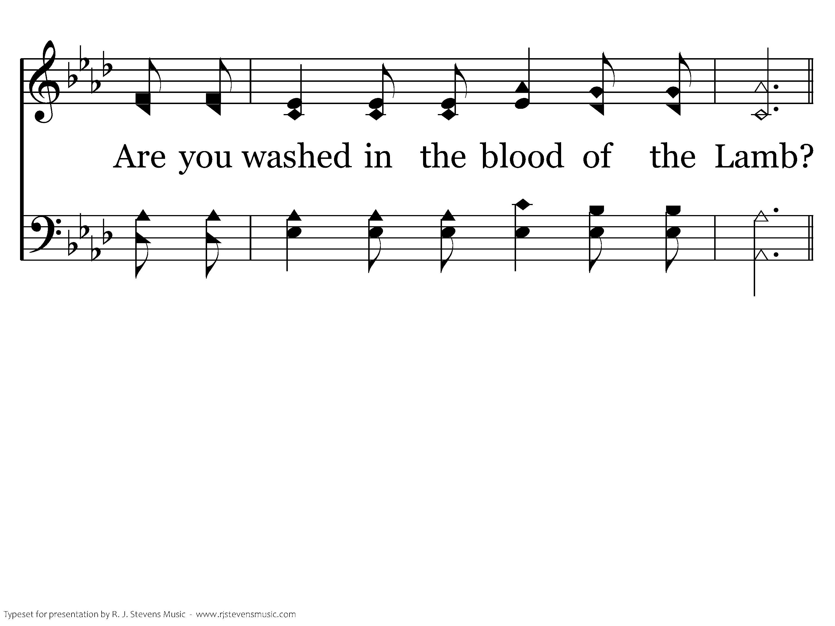
307 - Are You Washed In The Blood - 1.4

Slide 44
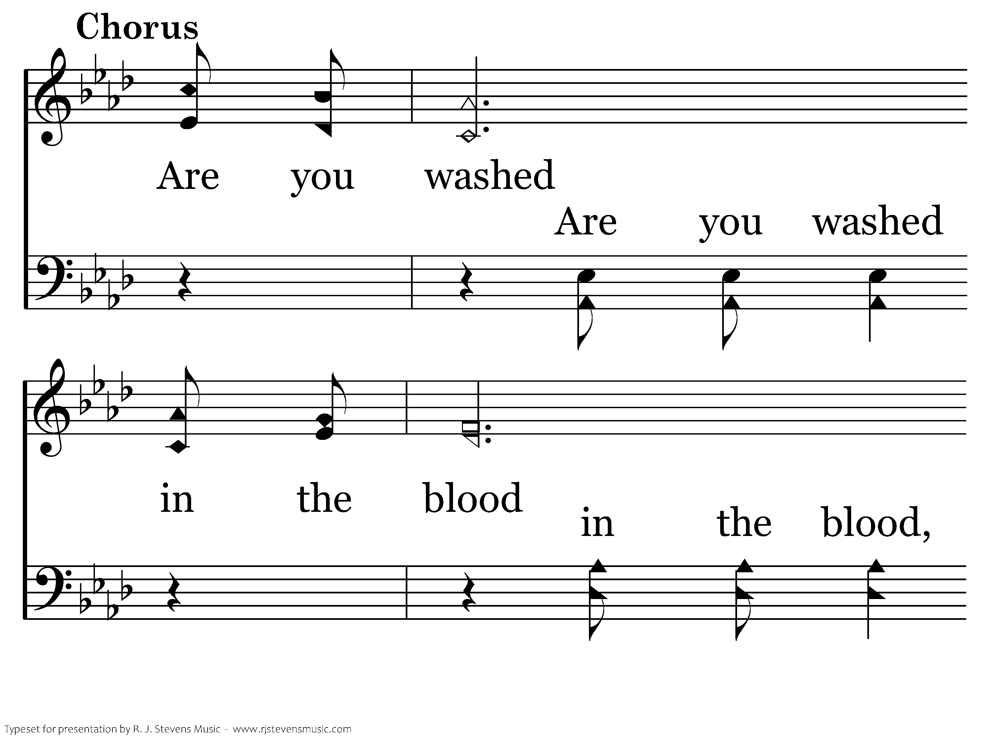
307 - Are You Washed In The Blood - C.1

Slide 45
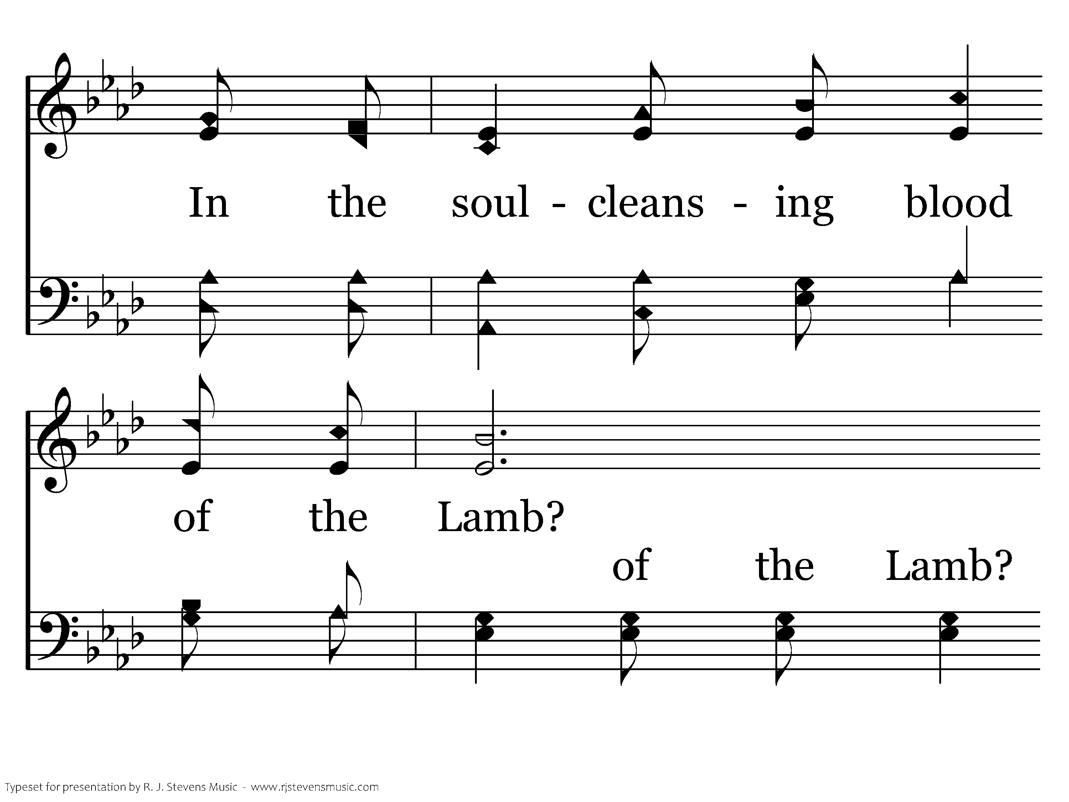
307 - Are You Washed In The Blood - C.2

Slide 46
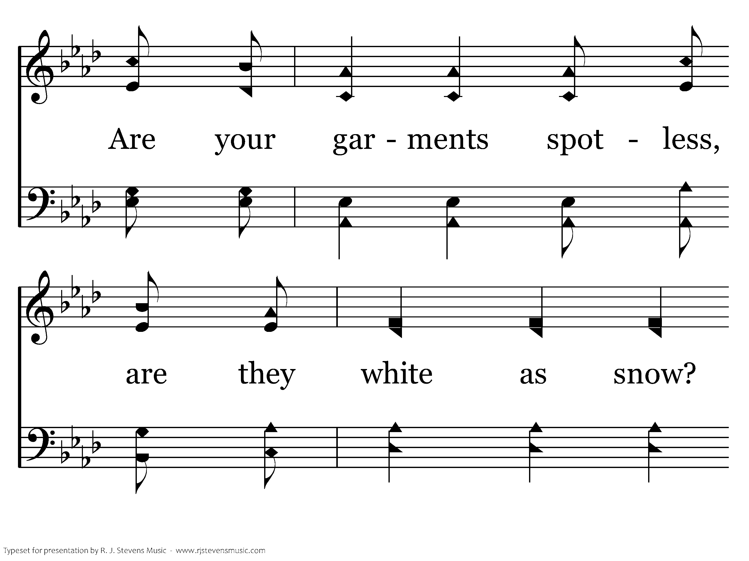
307 - Are You Washed In The Blood - C.3

Slide 47
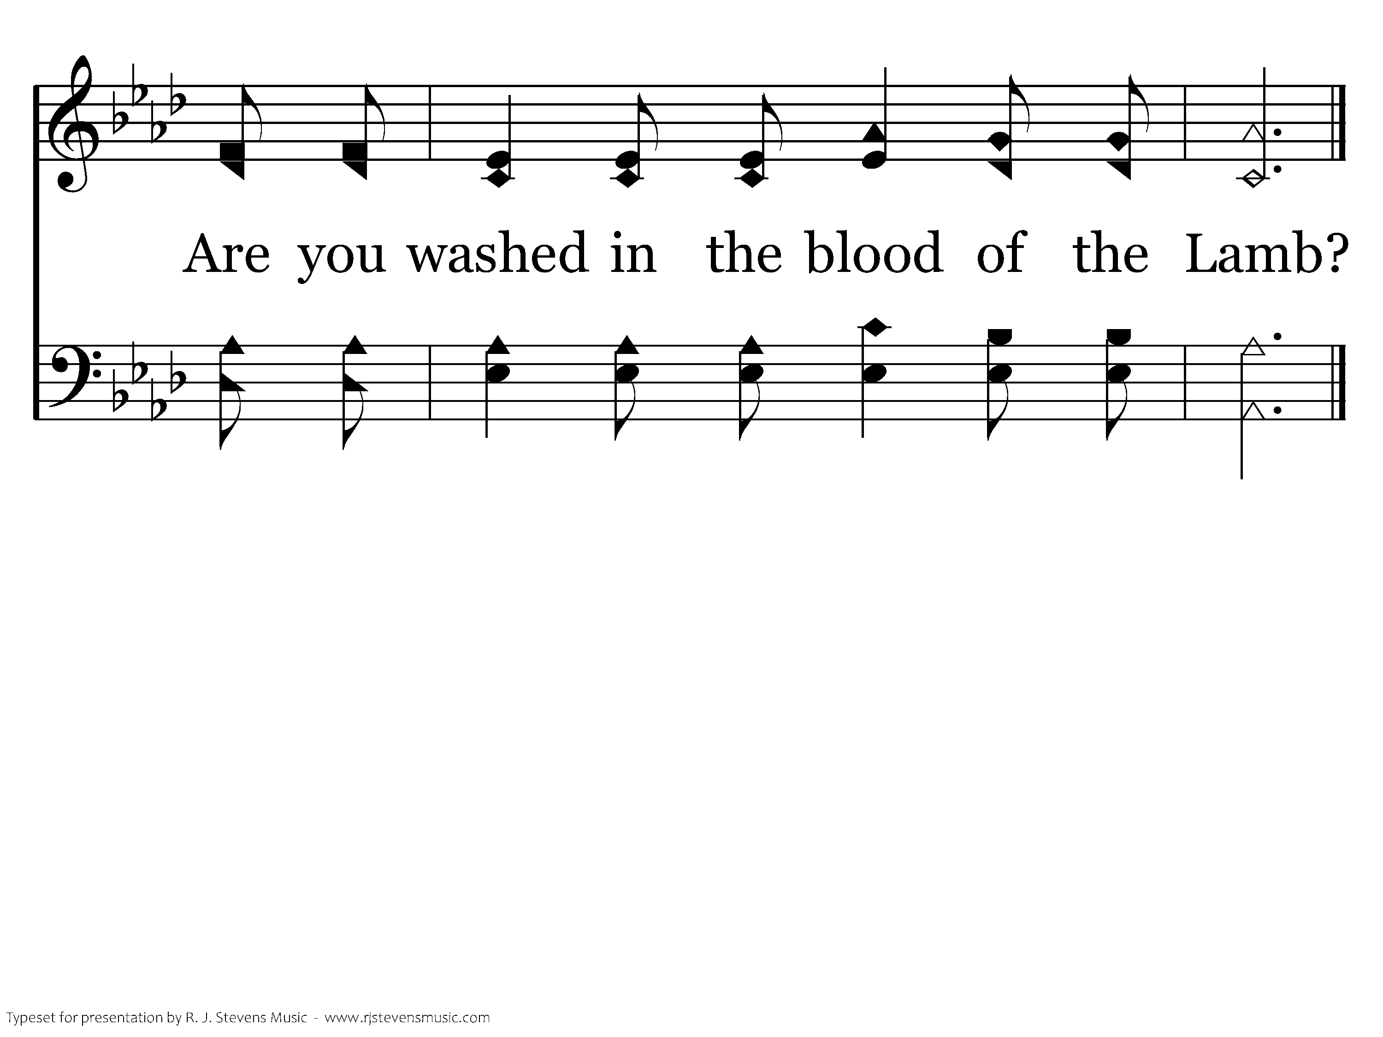
307 - Are You Washed In The Blood - C.4
End of Verse 1

Slide 48
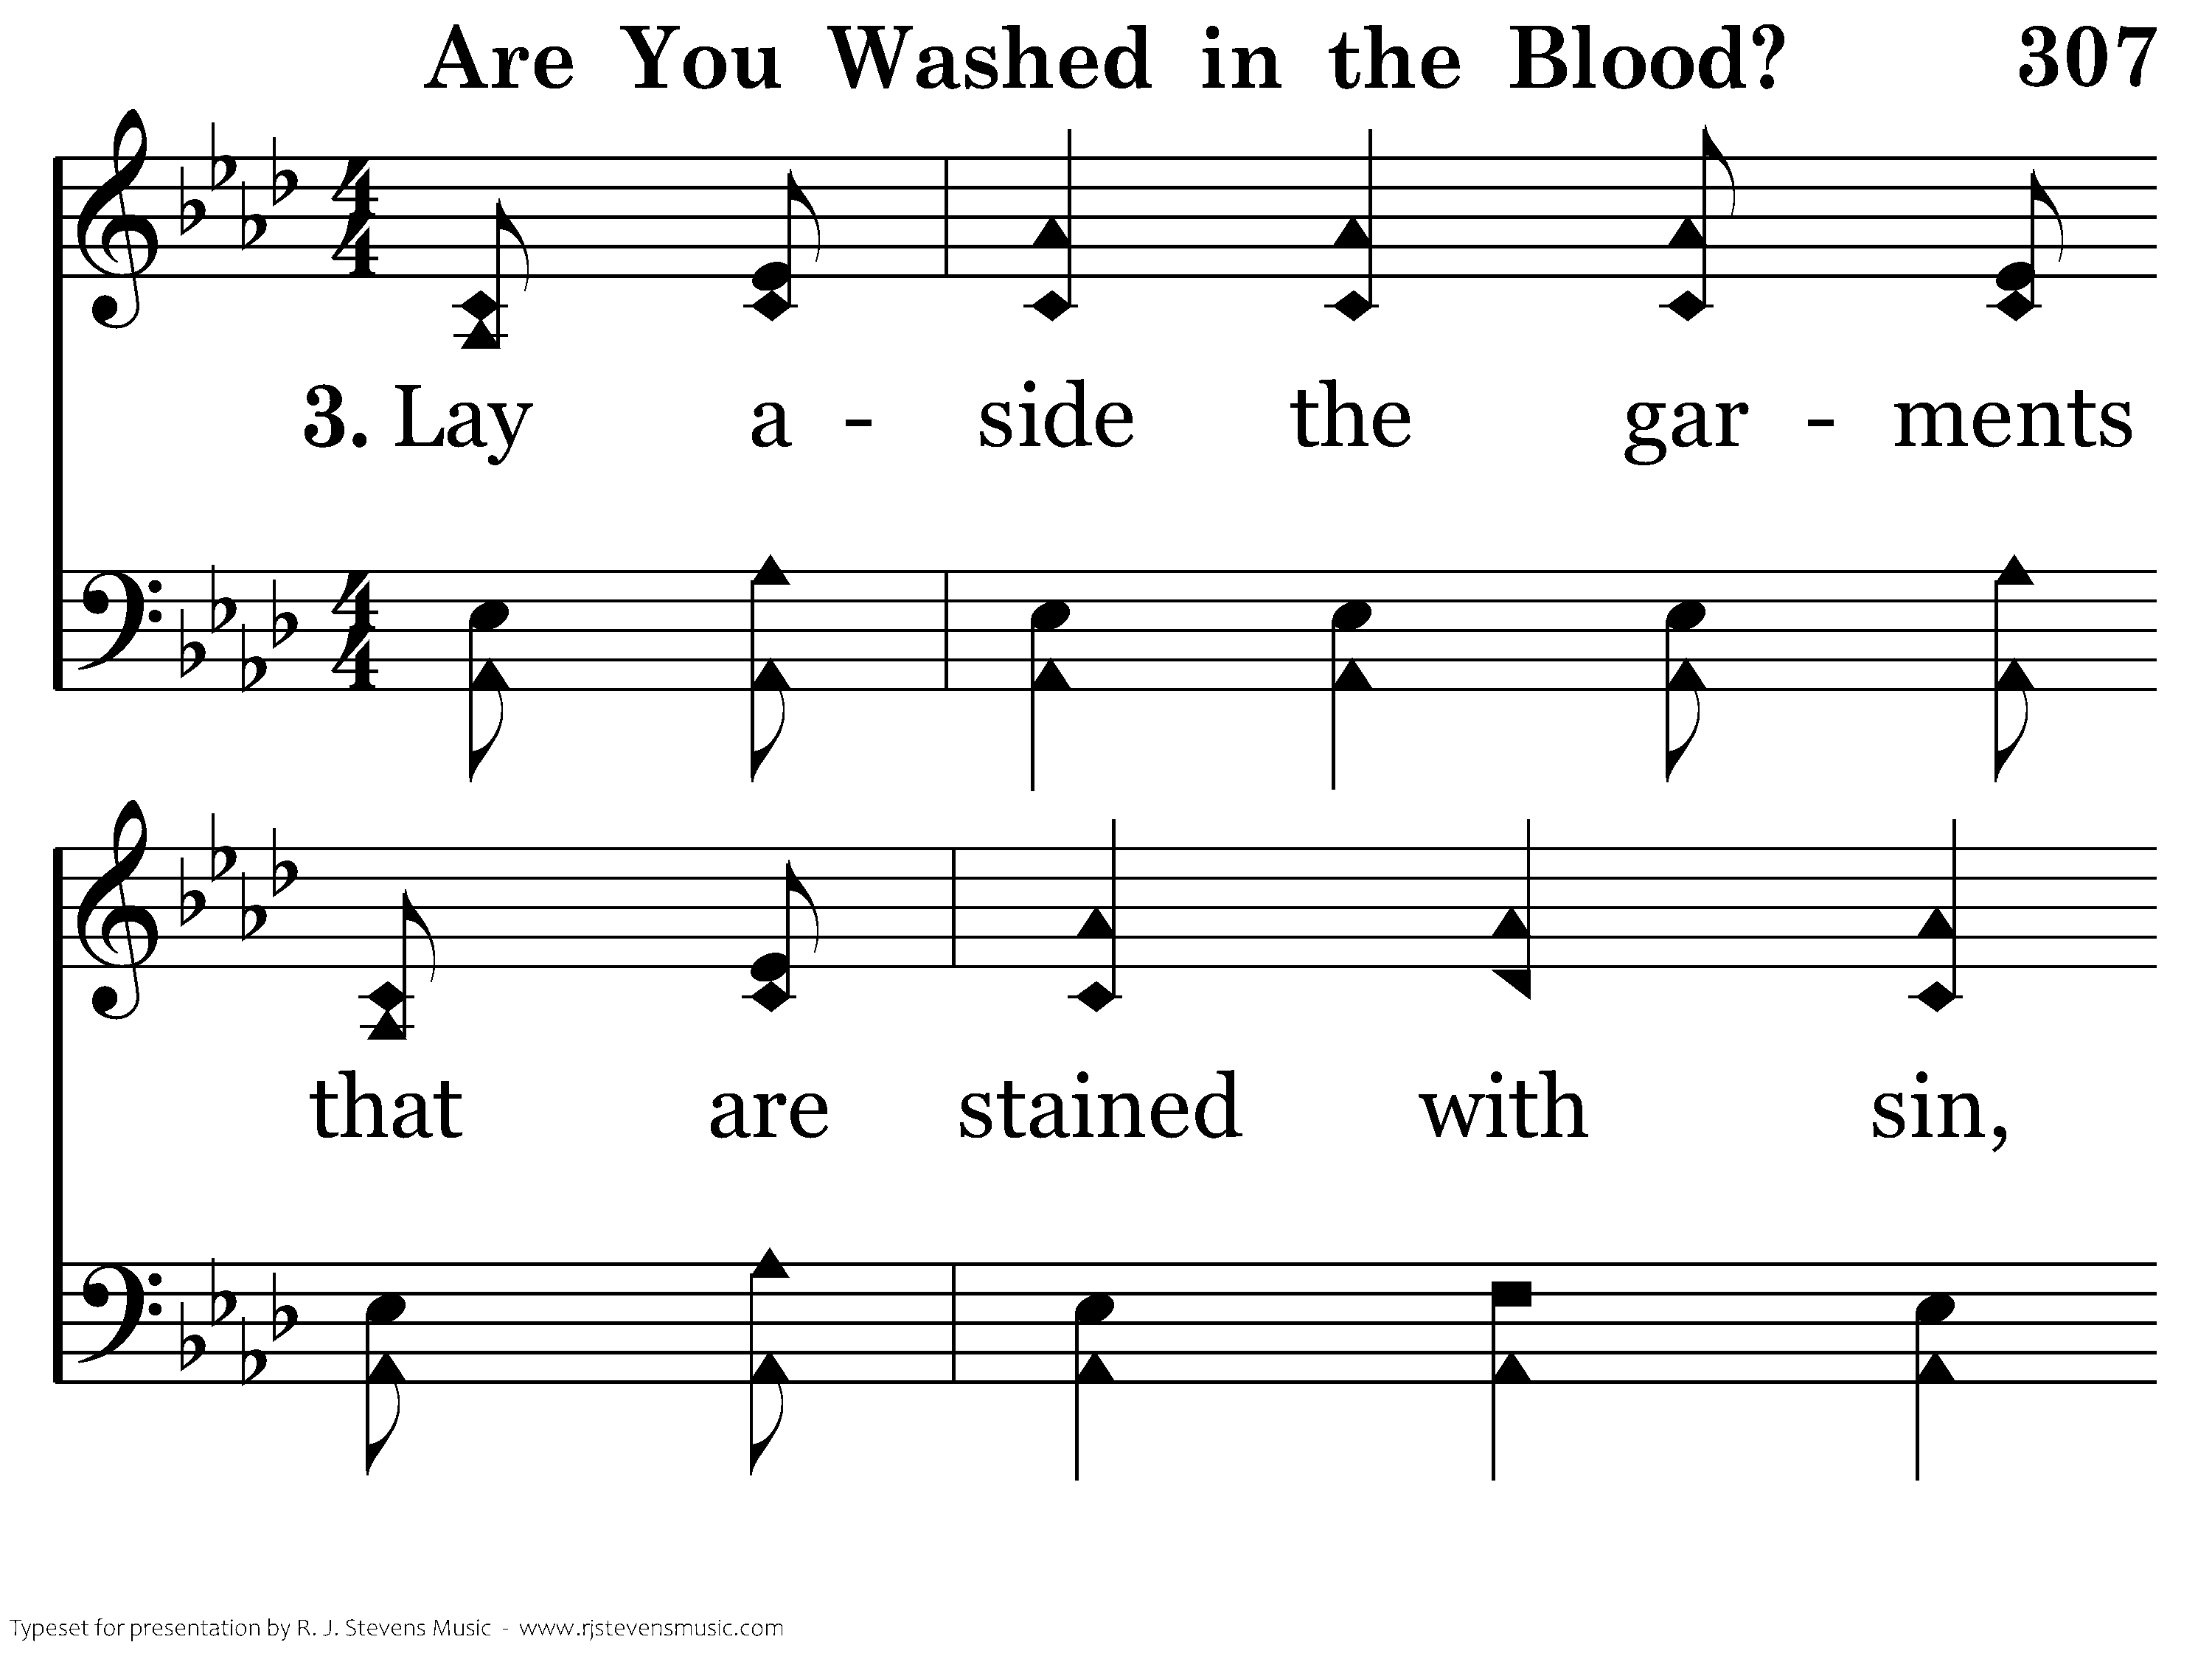
307 - Are You Washed In The Blood - 3.1

Slide 49
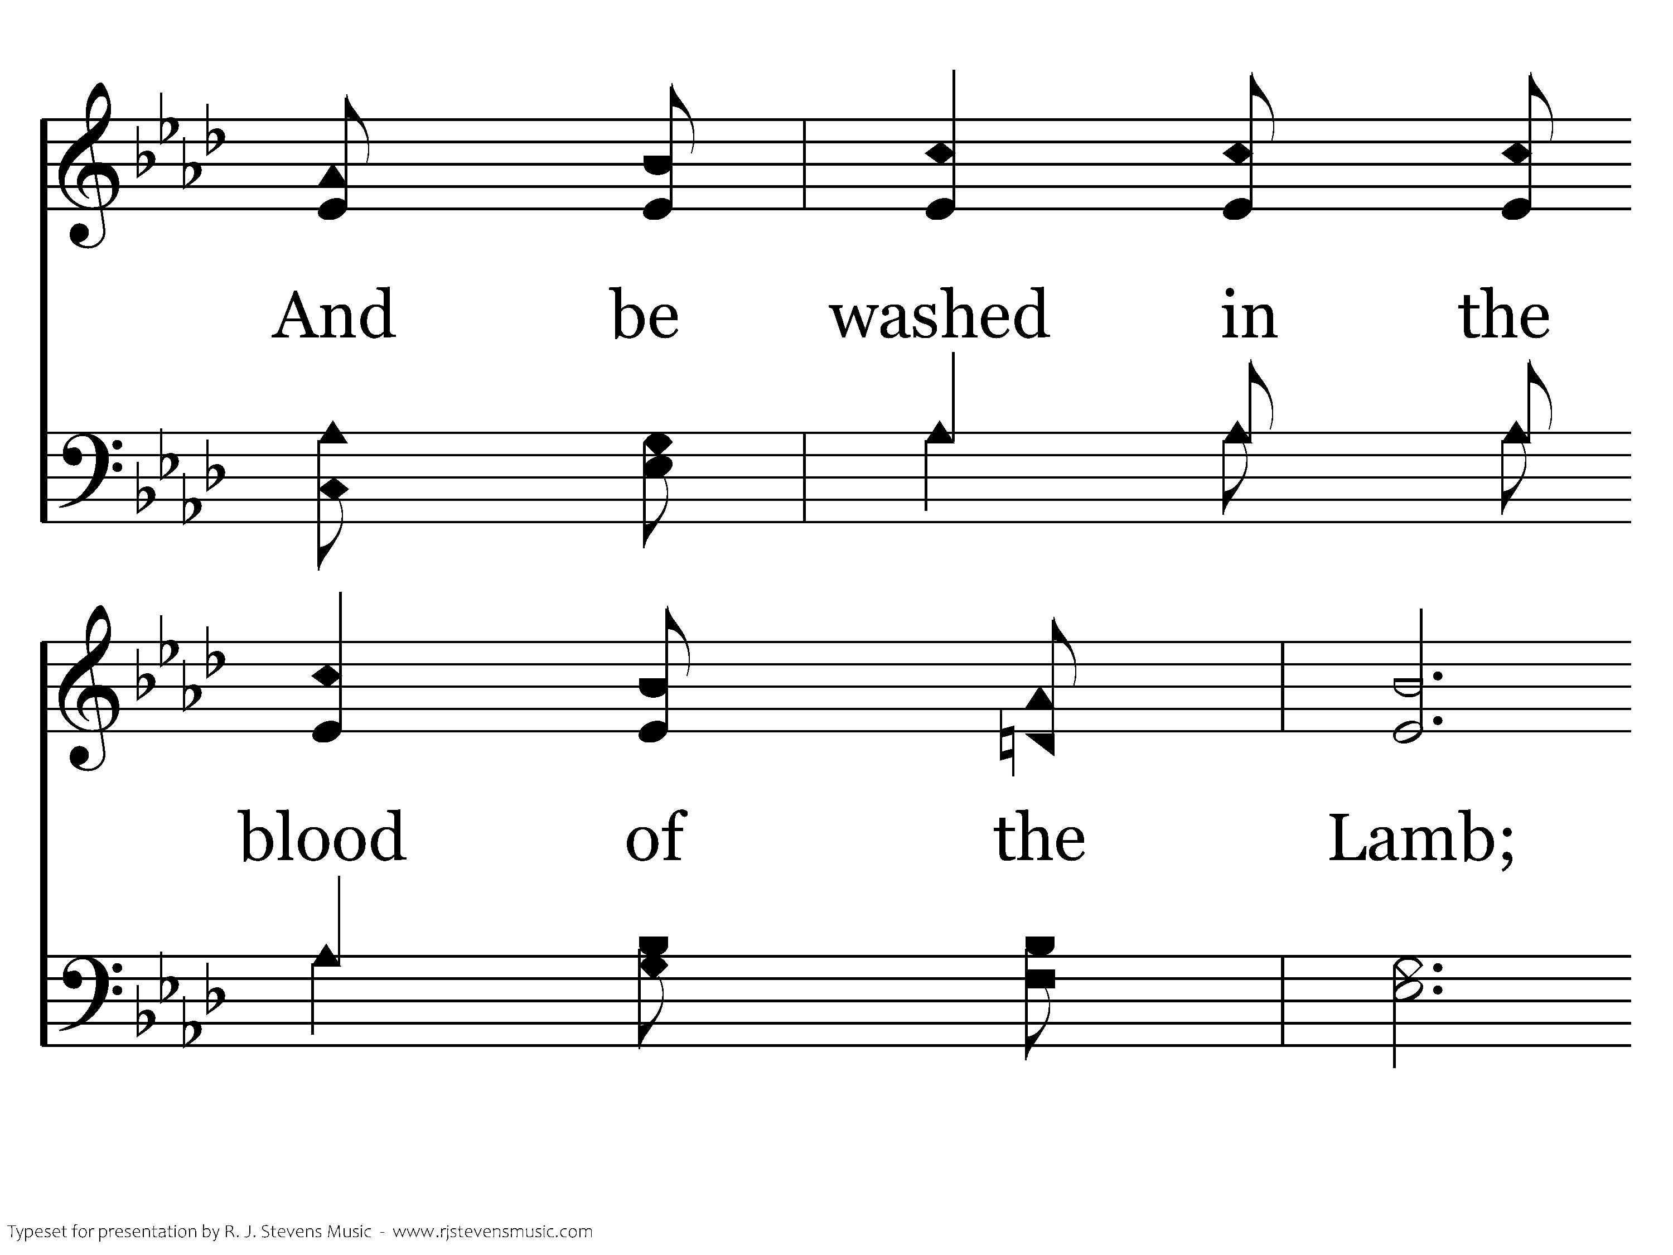
307 - Are You Washed In The Blood - 3.2

Slide 50
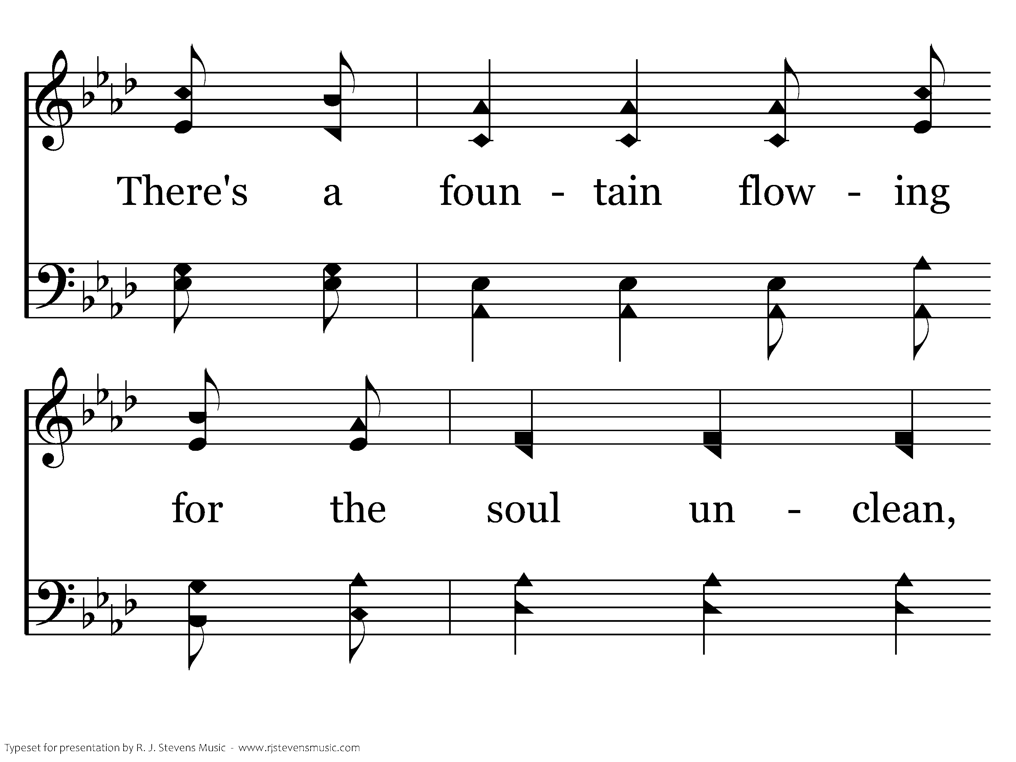
307 - Are You Washed In The Blood - 3.3

Slide 51
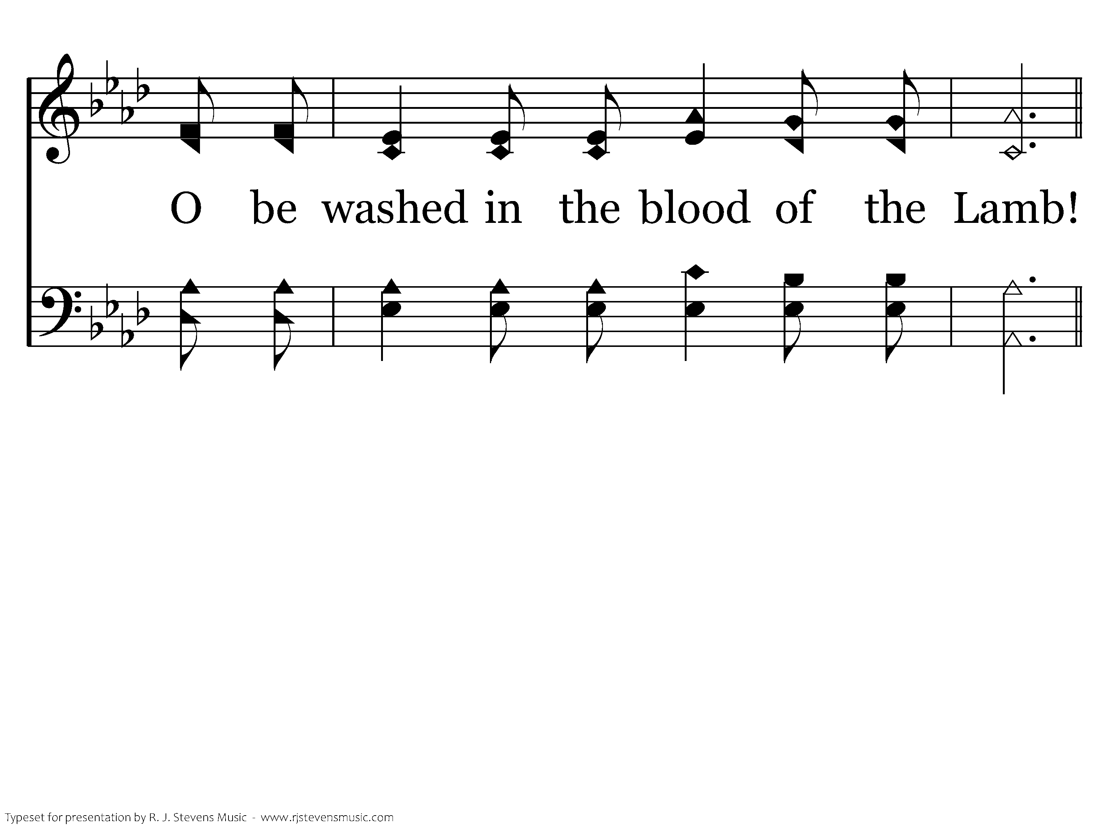
307 - Are You Washed In The Blood - 3.4

Slide 52
307 - Are You Washed In The Blood - C.1

Slide 53
307 - Are You Washed In The Blood - C.2

Slide 54
307 - Are You Washed In The Blood - C.3

Slide 55
307 - Are You Washed In The Blood - C.4
End of Song

