Slide 2
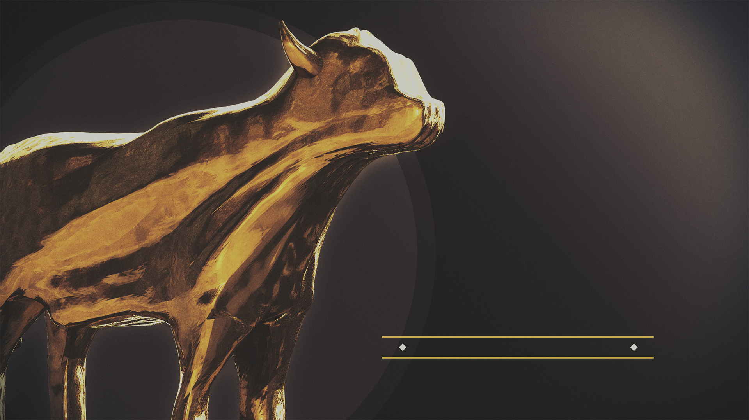
you become
what you
worship

Slide 3
Follow Me

Slide 4
Not Everyone Is A Disciple
“A pupil is not above his teacher; but everyone, after he has been fully trained, will be like his teacher.”
(Luke 6:40, NASB95)

Slide 5
What Makes A Disciple?
Disciples are not all alike (Mark 3.16-19)

Slide 6
What Makes A Disciple?
“And He went up on the mountain and summoned those whom He Himself wanted, and they came to Him.” (Mark 3:13, NASB95)

Slide 7
What Makes A Disciple?
Disciples are not all alike (Mark 3.16-19)
Disciples are with Him (Mark 3.14)
Disciples are sent out by Him (Mark 3.14-15)

