Slide 2
External source of temptation (Genesis 3.1)
The external temptation appeals to some personal desire or lust (Genesis 3.6)
A choice is made (Genesis 3.6)
SIN & TEMPTATION

Slide 3
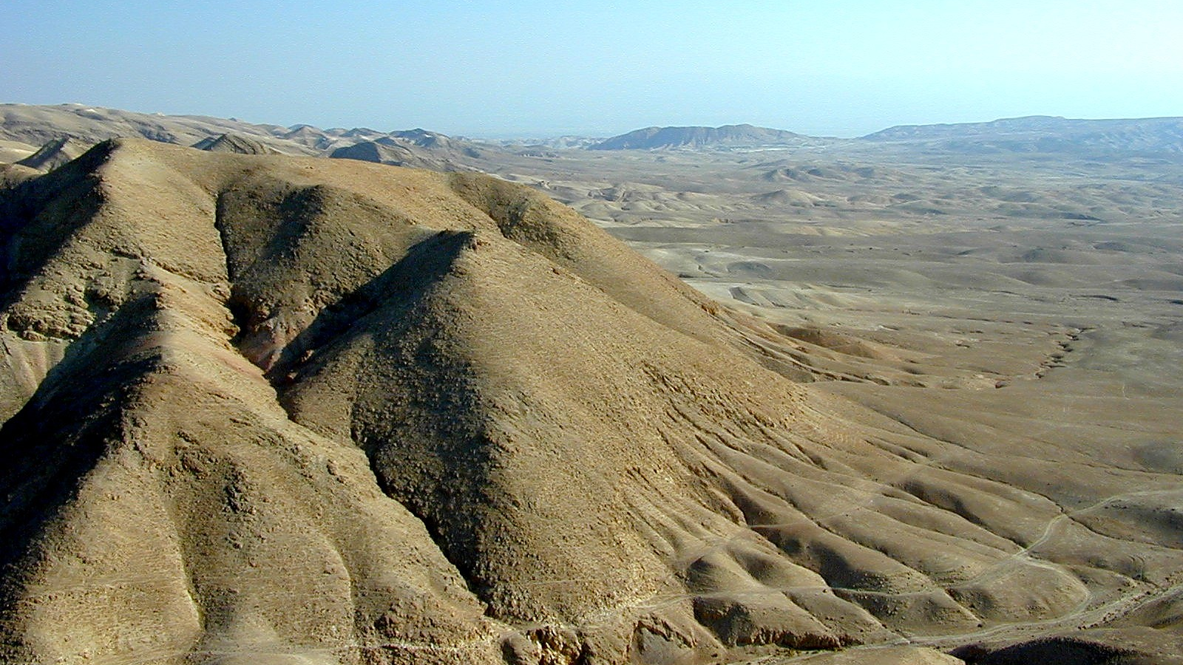
Choose to trust God (Luke 4.1-4)
Choose to forsake temporary rewards (Luke 4.5-8)

Slide 4
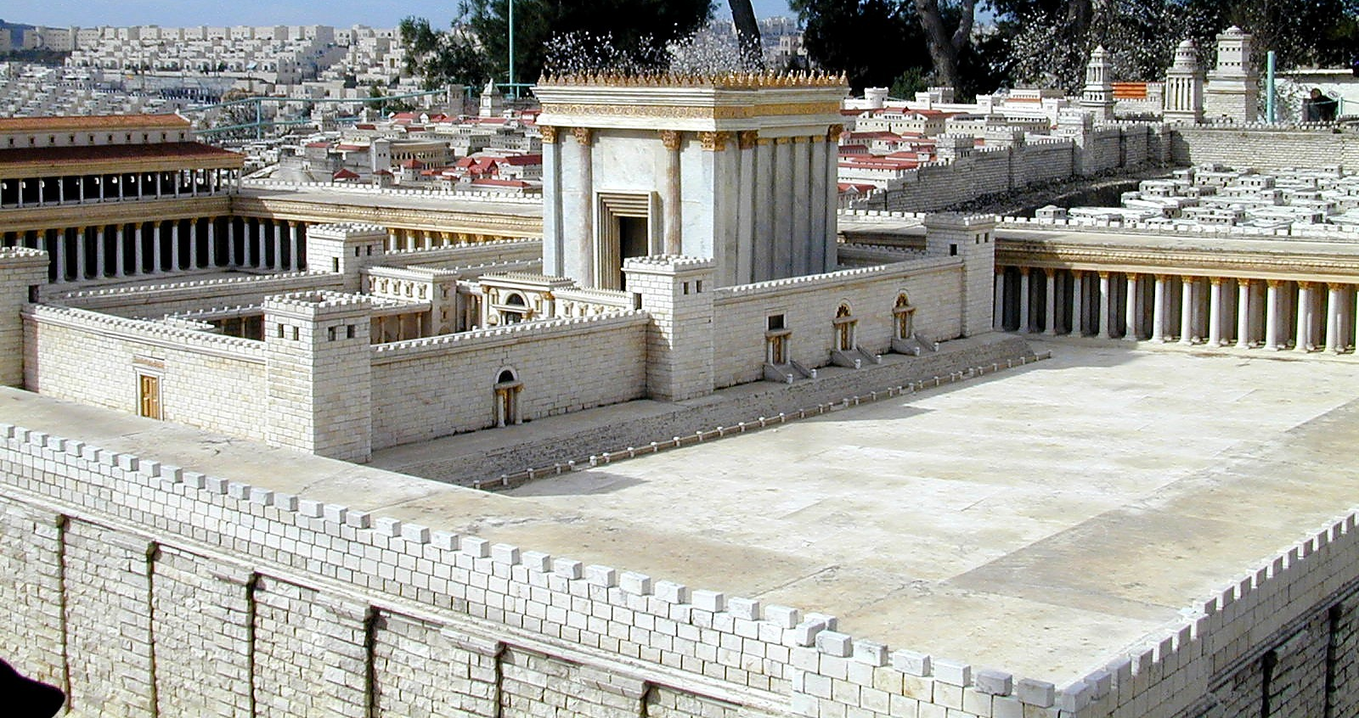
Choose to trust God (Luke 4.1-4)
Choose to forsake temporary rewards (Luke 4.5-8)
Choose to not test God (Luke 4.9-12)

