Slide 1
Jesus Heals the Lame Man
John 5

Slide 2
Jesus and the Samaritan woman
Three boundaries crossed:
  Socio-ethnic
  Gender
  Moral
Potential for shame (4:27)
But the hour is coming, and is now here, when the true worshipers will worship the Father in spirit and truth, for the Father seeks such as these to worship him. ²⁴ God is spirit, and those who worship him must worship in spirit and truth.”

Slide 3
Jesus in Samaria
A Samaritan woman came to draw water, and Jesus said to her, “Give me a drink.” ⁸ (His disciples had gone to the city to buy food.) ⁹ The Samaritan woman said to him, “How is it that you, a Jew, ask a drink of me, a woman of Samaria?” (Jews do not share things in common with Samaritans.) ¹⁰ Jesus answered her, “If you knew the gift of God, and who it is that is saying to you, ‘Give me a drink,’ you would have asked him, and he would have given you living water.” ¹¹ The woman said to him, “Sir, you have no bucket, and the well is deep. Where do you get that living water? ¹² Are you greater than our ancestor Jacob, who gave us the well, and with his sons and his flocks drank from it?”

Slide 4
Jesus in Samaria
Jesus said to her, “Everyone who drinks of this water will be thirsty again, ¹⁴ but those who drink of the water that I will give them will never be thirsty. The water that I will give will become in them a spring of water gushing up to eternal life.” ¹⁵ The woman said to him, “Sir, give me this water, so that I may never be thirsty or have to keep coming here to draw water.”

Slide 5
Jesus in Samaria
Jesus said to her, “Woman, believe me, the hour is coming when you will worship the Father neither on this mountain nor in Jerusalem. ²² You worship what you do not know; we worship what we know, for salvation is from the Jews. ²³ But the hour is coming, and is now here, when the true worshipers will worship the Father in spirit and truth, for the Father seeks such as these to worship him. ²⁴ God is spirit, and those who worship him must worship in spirit and truth.” ²⁵ The woman said to him, “I know that Messiah is coming” (who is called Christ). “When he comes, he will proclaim all things to us.” ²⁶ Jesus said to her, “I am he, the one who is speaking to you.”

Slide 6
Jesus in Samaria
Jesus said to her, “Go, call your husband, and come back.” ¹⁷ The woman answered him, “I have no husband.” Jesus said to her, “You are right in saying, ‘I have no husband’; ¹⁸ for you have had five husbands, and the one you have now is not your husband. What you have said is true!” ¹⁹ The woman said to him, “Sir, I see that you are a prophet. ²⁰ Our ancestors worshiped on this mountain, but you say that the place where people must worship is in Jerusalem.”

Slide 7
Jesus in Samaria
Just then his disciples came. They were astonished that he was speaking with a woman, but no one said, “What do you want?” or, “Why are you speaking with her?” ²⁸ Then the woman left her water jar and went back to the city. She said to the people, ²⁹ “Come and see a man who told me everything I have ever done! He cannot be the Messiah, can he?” ³⁰ They left the city and were on their way to him.

Slide 8
Sabbath Controversies
Jesus heals people on the Sabbath
His contemporaries had debates about what could or could not be done on the Sabbath
Why?
“Laws concerning shabbat and festival-offering and stealing from holy-designated things, these are like mountains hung from a hair: they have few verses and many laws. Judgment and service and purity and impurity and improper sexual relations, they have plenty to be based on. They themselves are the body of Torah,” m. Hagigah 1.7.

Slide 9
Jesus Heals the Lame Man
Now in Jerusalem by the Sheep Gate there is a pool, called in Hebrew Beth-zatha, which has five porticoes. ³ In these lay many invalids—blind, lame, and paralyzed. ⁵ One man was there who had been ill for thirty-eight years. ⁶ When Jesus saw him lying there and knew that he had been there a long time, he said to him, “Do you want to be made well?” ⁷ The sick man answered him, “Sir, I have no one to put me into the pool when the water is stirred up; and while I am making my way, someone else steps down ahead of me.” ⁸ Jesus said to him, “Stand up, take your mat and walk.” ⁹ At once the man was made well, and he took up his mat and began to walk.

Slide 10
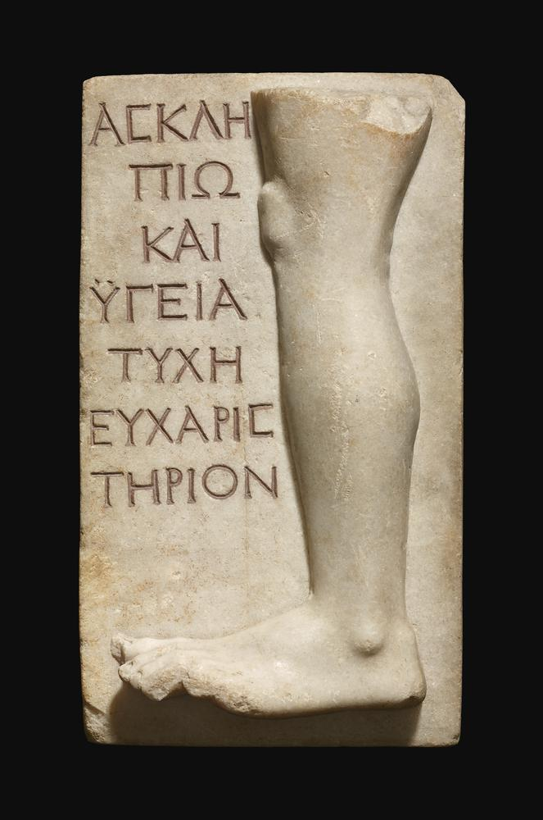
Jesus Heals the Lame Man
But Vespasian removed from Emmaus, where he had last pitched his camp before the city Tiberias, (now Emmaus, if it be interpreted, may be rendered "a warm bath," for therein is a spring of warm water, useful for healing,) and came to Gamala, Josephus, War 4.11.

Slide 11
Jesus Heals on the Sabbath
Now that day was a sabbath. ¹⁰ So the Jews said to the man who had been cured, “It is the sabbath; it is not lawful for you to carry your mat.” ¹¹ But he answered them, “The man who made me well said to me, ‘Take up your mat and walk.’” ¹² They asked him, “Who is the man who said to you, ‘Take it up and walk’?” ¹³ Now the man who had been healed did not know who it was, for Jesus had disappeared in the crowd that was there. ¹⁴ Later Jesus found him in the temple and said to him, “See, you have been made well! Do not sin any more, so that nothing worse happens to you.” ¹⁵ The man went away and told the Jews that it was Jesus who had made him well.

Slide 12
Jesus Heals on the Sabbath
Therefore the Jews started persecuting Jesus, because he was doing such things on the sabbath. ¹⁷ But Jesus answered them, “My Father is still working, and I also am working.” ¹⁸ For this reason the Jews were seeking all the more to kill him, because he was not only breaking the sabbath, but was also calling God his own Father, thereby making himself equal to God

Slide 13
God Worked and Works on the Sabbath
And on the seventh day God finished the work that he had done, and he rested on the seventh day from all the work that he had done. ³ So God blessed the seventh day and hallowed it, because on it God rested from all the work that he had done in creation.
And on the sixth day God finished the work he had done...(LXX)

Slide 14
God Worked and Works on the Sabbath
And on the seventh day God finished the work that he had done, and he rested on the seventh day from all the work that he had done. ³ So God blessed the seventh day and hallowed it, because on it God rested from all the work that he had done in creation.
And on the sixth day God finished the work he had done...(LXX)

Slide 15
Jesus, Equal to God?
Jesus said to them, “Very truly, I tell you, the Son can do nothing on his own, but only what he sees the Father doing; for whatever the Father does, the Son does likewise. ²⁰ The Father loves the Son and shows him all that he himself is doing; and he will show him greater works than these, so that you will be astonished. ²¹ Indeed, just as the Father raises the dead and gives them life, so also the Son gives life to whomever he wishes.

Slide 16
The Resurrection
“Very truly, I tell you, the hour is coming, and is now here, when the dead will hear the voice of the Son of God, and those who hear will live. ²⁶ For just as the Father has life in himself, so he has granted the Son also to have life in himself; ²⁷ and he has given him authority to execute judgment, because he is the Son of Man. ²⁸ Do not be astonished at this; for the hour is coming when all who are in their graves will hear his voice ²⁹ and will come out—those who have done good, to the resurrection of life, and those who have done evil, to the resurrection of condemnation.

