Slide 1
Jesus' Discussion with Nicodemus
John 3

Slide 2
Turning Water to Wine
Jewish weddings lasted several days
Wine was an integral part of the feast
Shame if wine ran out
What is the point of this sign?
2:6 "Now standing there were six stone water jars for the Jewish rites of purification, each holding twenty or thirty gallons."

Slide 3
Turning Water to Wine
When the wine gave out, the mother of Jesus said to him, “They have no wine.” ⁴ And Jesus said to her, “Woman, what concern is that to you and to me? My hour has not yet come.”

Slide 4
Turning Water to Wine
Jesus said to them, “Fill the jars with water.” And they filled them up to the brim. ⁸ He said to them, “Now draw some out, and take it to the chief steward.” So they took it. ⁹ When the steward tasted the water that had become wine, and did not know where it came from (though the servants who had drawn the water knew), the steward called the bridegroom ¹⁰ and said to him, “Everyone serves the good wine first, and then the inferior wine after the guests have become drunk. But you have kept the good wine until now.”

Slide 5
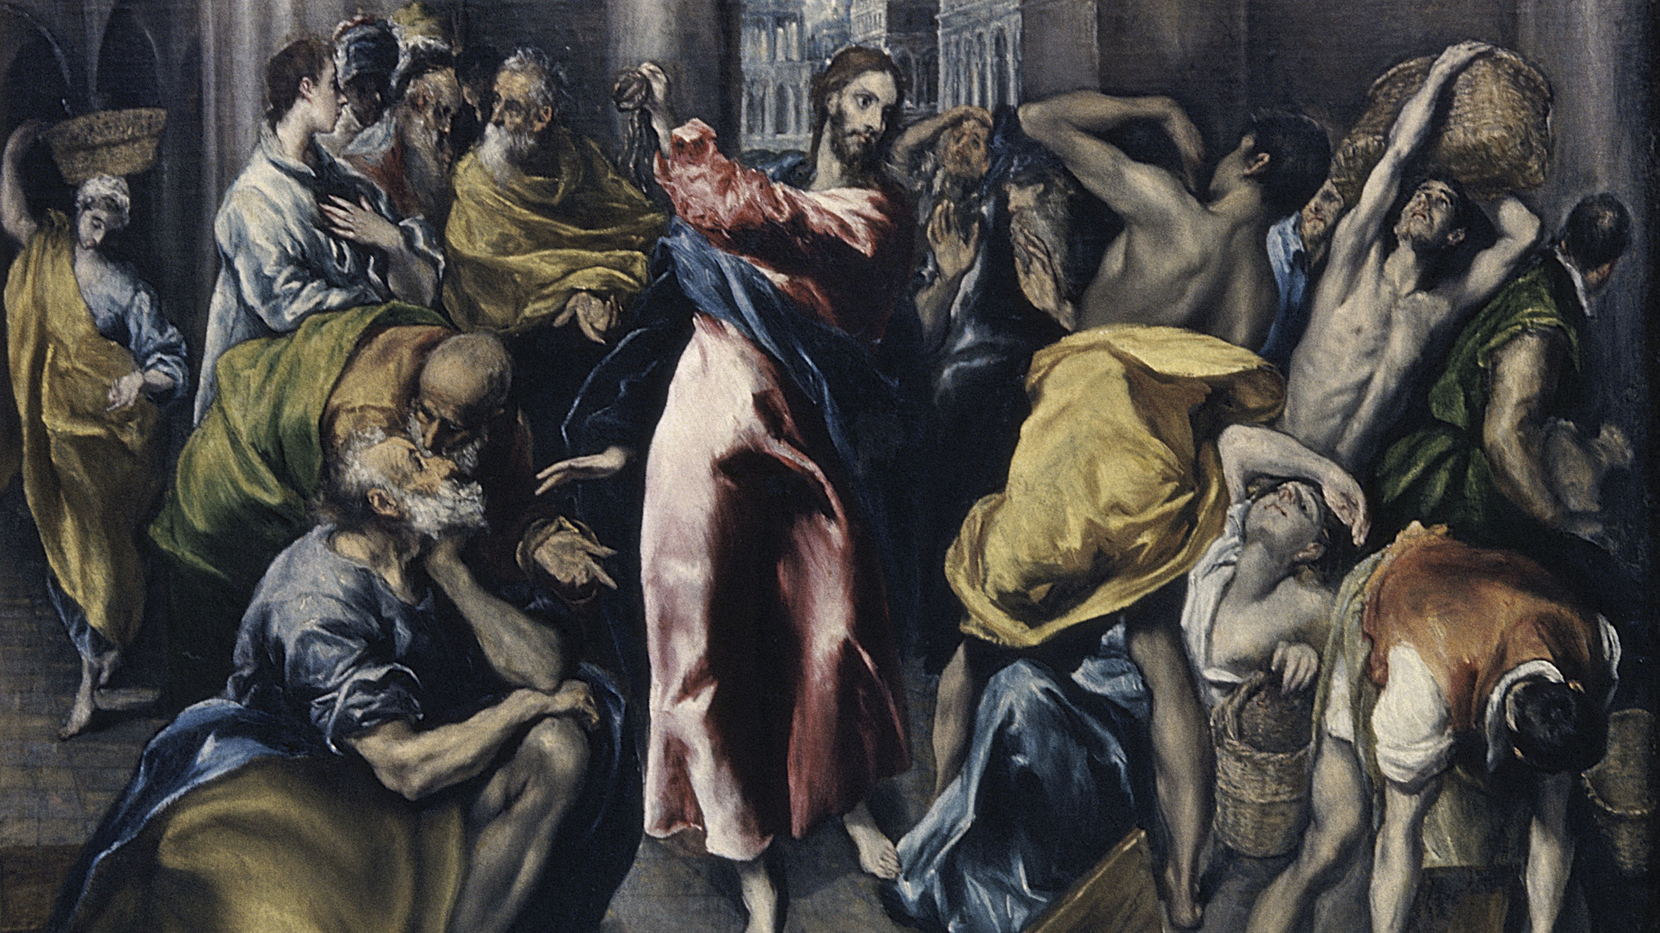
The Cleansing of the Temple
Occurs in all three synoptics
But it occurs at the end of his ministry
Two cleansings?
More likely this episode is not chronological

Slide 6
The Cleansing of the Temple
The Passover of the Jews was near, and Jesus went up to Jerusalem. ¹⁴ In the temple he found people selling cattle, sheep, and doves, and the money changers seated at their tables. ¹⁵ Making a whip of cords, he drove all of them out of the temple, both the sheep and the cattle. He also poured out the coins of the money changers and overturned their tables. ¹⁶ He told those who were selling the doves, “Take these things out of here! Stop making my Father’s house a marketplace!” ¹⁷ His disciples remembered that it was written, “Zeal for your house will consume me.” ¹⁸ The Jews then said to him, “What sign can you show us for doing this?” ¹⁹ Jesus answered them, “Destroy this temple, and in three days I will raise it up.” ²⁰ The Jews then said, “This temple has been under construction for forty-six years, and will you raise it up in three days?” ²¹ But he was speaking of the temple of his body. ²² After he was raised from the dead, his disciples remembered that he had said this; and they believed the scripture and the word that Jesus had spoken.

Slide 7
He needed no testimony
When he was in Jerusalem during the Passover festival, many believed in his name because they saw the signs that he was doing. ²⁴ But Jesus on his part would not entrust himself to them, because he knew all people ²⁵ and needed no one to testify about anyone; for he himself knew what was in everyone.

Slide 8
How does one have a relationship with God?
Not through Jewish purification ritual
Nor through the temple
But through the true water ritual of Jesus and through him as the true temple

Slide 9
Nicodemus
Comes at night (3:1)
But eventually comes into the light (19:39)
For all who do evil hate the light and do not come to the light, so that their deeds may not be exposed. ²¹ But those who do what is true come to the light, so that it may be clearly seen that their deeds have been done in God.

Slide 10
A Second Birth
Now there was a Pharisee named Nicodemus, a leader of the Jews. ² He came to Jesus by night and said to him, “Rabbi, we know that you are a teacher who has come from God; for no one can do these signs that you do apart from the presence of God.” ³ Jesus answered him, “Very truly, I tell you, no one can see the kingdom of God without being born from above (or again).” ⁴ Nicodemus said to him, “How can anyone be born after having grown old? Can one enter a second time into the mother’s womb and be born?” ⁵ Jesus answered, “Very truly, I tell you, no one can enter the kingdom of God without being born of water and Spirit.

Slide 11
Clean water and a new spirit
Ezekiel 36:24 I will take you from the nations, and gather you from all the countries, and bring you into your own land. ²⁵ I will sprinkle clean water upon you, and you shall be clean from all your uncleannesses, and from all your idols I will cleanse you. ²⁶ A new heart I will give you, and a new spirit I will put within you; and I will remove from your body the heart of stone and give you a heart of flesh. ²⁷ I will put my spirit within you, and make you follow my statutes and be careful to observe my ordinances.

Slide 12
Born Again
As to the words (or the poets), they are these: consider now, if you think that they speak the truth. They say that the soul of man is immortal, and at one time comes to an end, which is called dying, and at another is born again, but never perishes...Seeing then that the soul is immortal and has been born many times, and has beheld all things both in this world and in the nether realms, she has acquired knowledge of all and everything; so that it is no wonder that she should be able to recollect all that she knew before about virtue and other things, Plato, Meno 81BC.

Slide 13
How do you misunderstand?
What is born of the flesh is flesh, and what is born of the Spirit (pneumatos-pneuma) is spirit (pneuma). ⁷ Do not be astonished that I said to you, ‘You must be born from above.’ ⁸ The wind (pneuma) blows (pnei-pnew) where it chooses, and you hear the sound of it, but you do not know where it comes from or where it goes. So it is with everyone who is born of the Spirit (pneumatos).” ⁹ Nicodemus said to him, “How can these things be?” ¹⁰ Jesus answered him, “Are you a teacher of Israel, and yet you do not understand these things?

Slide 14
How much did God love the world?
“Very truly, I tell you, we speak of what we know and testify to what we have seen; yet you do not receive our testimony. ¹² If I have told you about earthly things and you do not believe, how can you believe if I tell you about heavenly things? ¹³ No one has ascended into heaven except the one who descended from heaven, the Son of Man. ¹⁴ And just as Moses lifted up the serpent in the wilderness, so must the Son of Man be lifted up, ¹⁵ that whoever believes in him may have eternal life.¹⁶ “For God so loved the world that he gave his only Son, so that everyone who believes in him may not perish but may have eternal life.¹⁷ “Indeed, God did not send the Son into the world to condemn the world, but in order that the world might be saved through him.

