Slide 1
The Wedding at Cana and the Cleansing of the Temple
John 2:1-25

Slide 2
The First Disciples
The next day John again was standing with two of his disciples, ³⁶ and as he watched Jesus walk by, he exclaimed, “Look, here is the Lamb of God!” ³⁷ The two disciples heard him say this, and they followed Jesus. ³⁸ When Jesus turned and saw them following, he said to them, “What are you looking for?” They said to him, “Rabbi” (which translated means Teacher), “where are you staying?” ³⁹ He said to them, “Come and see.” They came and saw where he was staying, and they remained with him that day. It was about four o’clock in the afternoon. ⁴⁰ One of the two who heard John speak and followed him was Andrew, Simon Peter’s brother. ⁴¹ He first found his brother Simon and said to him, “We have found the Messiah” (which is translated Anointed). ⁴² He brought Simon to Jesus, who looked at him and said, “You are Simon son of John. You are to be called Cephas” (which is translated Peter).

Slide 3
The First Disciples
The next day Jesus decided to go to Galilee. He found Philip and said to him, “Follow me.” ⁴⁴ Now Philip was from Bethsaida, the city of Andrew and Peter. ⁴⁵ Philip found Nathanael and said to him, “We have found him about whom Moses in the law and also the prophets wrote, Jesus son of Joseph from Nazareth.” ⁴⁶ Nathanael said to him, “Can anything good come out of Nazareth?” Philip said to him, “Come and see.” ⁴⁷ When Jesus saw Nathanael coming toward him, he said of him, “Here is truly an Israelite in whom there is no deceit!” ⁴⁸ Nathanael asked him, “Where did you get to know me?” Jesus answered, “I saw you under the fig tree before Philip called you.” ⁴⁹ Nathanael replied, “Rabbi, you are the Son of God! You are the King of Israel!” ⁵⁰ Jesus answered, “Do you believe because I told you that I saw you under the fig tree? You will see greater things than these.” ⁵¹ And he said to him, “Very truly, I tell you, you will see heaven opened and the angels of God ascending and descending upon the Son of Man.”

Slide 4
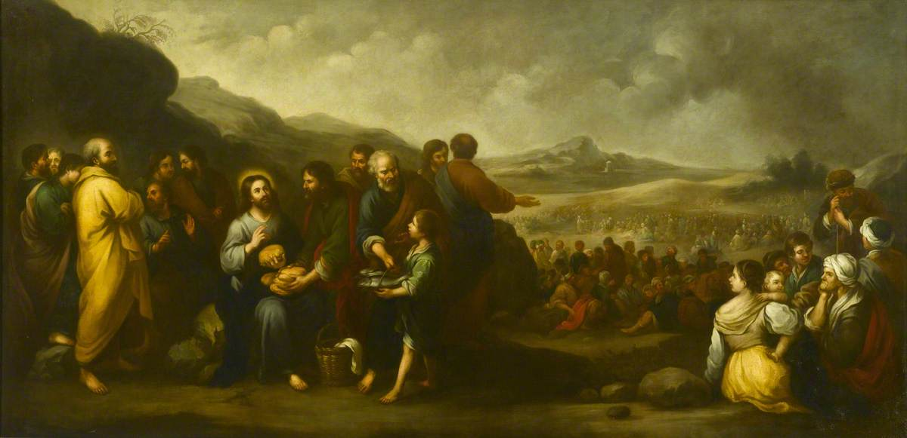
The Seven Signs of John's Gospel (1:19-12)
Water to wine
Healing of an official's son
Healing of the paraletic
Feeding of the 5000
Walking on water
Healing the blind man
Raising of Lazarus

Slide 5
The Water Motif in the Gospel of John
Jesus walks on water (6)
Jesus as the water of life (7)
Jesus washes the feet of his disciples (13)
Blood and water flow from Jesus' side (19)
Witness of John (1)
The Wedding at Cana (2)
Nicodemus (3)
Samaritan woman (4)
Jesus heals a lame man (5)

Slide 6
Turning Water to Wine
Jewish weddings lasted several days
Wine was an integral part of the feast
Shame if wine ran out
What is the point of this sign?
2:6 "Now standing there were six stone water jars for the Jewish rites of purification, each holding twenty or thirty gallons."

Slide 7
Turning Water to Wine
When the wine gave out, the mother of Jesus said to him, “They have no wine.” ⁴ And Jesus said to her, “Woman, what concern is that to you and to me? My hour has not yet come.”

Slide 8
Turning Water to Wine
Jesus said to them, “Fill the jars with water.” And they filled them up to the brim. ⁸ He said to them, “Now draw some out, and take it to the chief steward.” So they took it. ⁹ When the steward tasted the water that had become wine, and did not know where it came from (though the servants who had drawn the water knew), the steward called the bridegroom ¹⁰ and said to him, “Everyone serves the good wine first, and then the inferior wine after the guests have become drunk. But you have kept the good wine until now.”

Slide 9
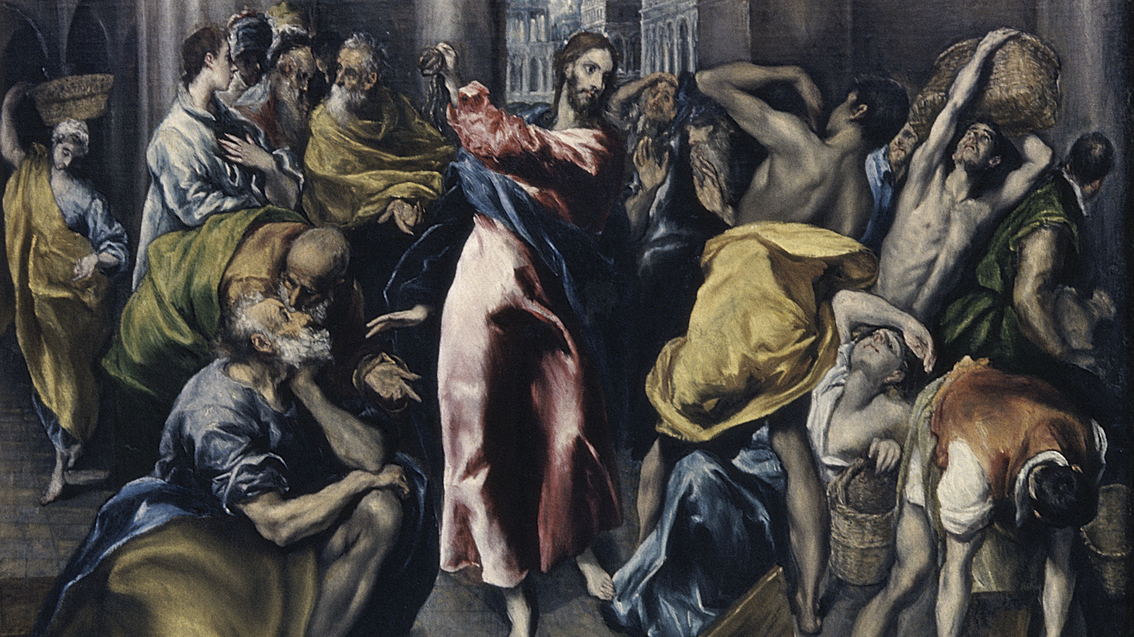
The Cleansing of the Temple
Occurs in all three synoptics
But it occurs at the end of his ministry
Two cleansings?
More likely this episode is not chronological

Slide 10
The Cleansing of the Temple
The Passover of the Jews was near, and Jesus went up to Jerusalem. ¹⁴ In the temple he found people selling cattle, sheep, and doves, and the money changers seated at their tables. ¹⁵ Making a whip of cords, he drove all of them out of the temple, both the sheep and the cattle. He also poured out the coins of the money changers and overturned their tables. ¹⁶ He told those who were selling the doves, “Take these things out of here! Stop making my Father’s house a marketplace!” ¹⁷ His disciples remembered that it was written, “Zeal for your house will consume me.” ¹⁸ The Jews then said to him, “What sign can you show us for doing this?” ¹⁹ Jesus answered them, “Destroy this temple, and in three days I will raise it up.” ²⁰ The Jews then said, “This temple has been under construction for forty-six years, and will you raise it up in three days?” ²¹ But he was speaking of the temple of his body. ²² After he was raised from the dead, his disciples remembered that he had said this; and they believed the scripture and the word that Jesus had spoken.

Slide 11
He needed no testimony
When he was in Jerusalem during the Passover festival, many believed in his name because they saw the signs that he was doing. ²⁴ But Jesus on his part would not entrust himself to them, because he knew all people ²⁵ and needed no one to testify about anyone; for he himself knew what was in everyone.

