Slide 1
John 10

Slide 2
Non-literal figures of speech- the Good Shepherd
Parable
Simile/metaphor
Allegory?
John 10:6 Jesus used this figure of speech with them, but they did not understand what he was saying to them.

Slide 3
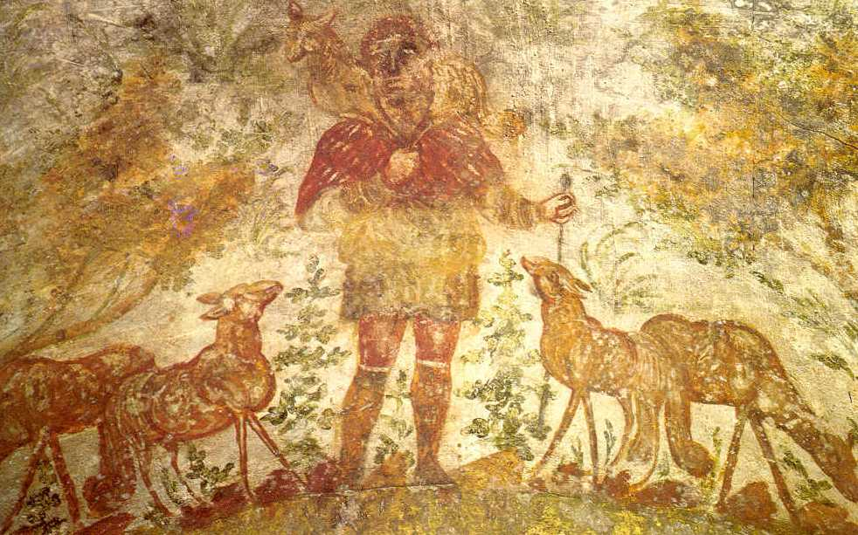
Shepherd imagery
Being a shepherd was often view as a despised profession
Yet it also represented leadership

Slide 4
Shepherd imagery
Ezekiel 34:2 Ah, you shepherds of Israel who have been feeding yourselves! Should not shepherds feed the sheep? ³ You eat the fat, you clothe yourselves with the wool, you slaughter the fatlings; but you do not feed the sheep. ⁴ You have not strengthened the weak, you have not healed the sick, you have not bound up the injured, you have not brought back the strayed, you have not sought the lost, but with force and harshness you have ruled them. ⁵ So they were scattered, because there was no shepherd; and scattered, they became food for all the wild animals.

Slide 5
Shepherd imagery
Ezekiel 34:7 Therefore, you shepherds, hear the word of the Lord: ⁸ As I live, says the Lord God, because my sheep have become a prey, and my sheep have become food for all the wild animals, since there was no shepherd; and because my shepherds have not searched for my sheep, but the shepherds have fed themselves, and have not fed my sheep; ⁹ therefore, you shepherds, hear the word of the Lord: ¹⁰ Thus says the Lord God, I am against the shepherds;

Slide 6
Shepherd imagery
Ezekiel 34:15 I myself will be the shepherd of my sheep, and I will make them lie down, says the Lord God. ¹⁶ I will seek the lost, and I will bring back the strayed, and I will bind up the injured, and I will strengthen the weak, but the fat and the strong I will destroy. I will feed them with justice.

Slide 7
Shepherd imagery
Ezekiel 34:23 I will set up over them one shepherd, my servant David, and he shall feed them: he shall feed them and be their shepherd. ²⁴ And I, the Lord, will be their God, and my servant David shall be prince among them; I, the Lord, have spoken.

Slide 8
Spiritual Blindness
John 9:39 Jesus said, “I came into this world for judgment so that those who do not see may see, and those who do see may become blind.” ⁴⁰ Some of the Pharisees near him heard this and said to him, “Surely we are not blind, are we?” ⁴¹ Jesus said to them, “If you were blind, you would not have sin. But now that you say, ‘We see,’ your sin remains.

Slide 9
"They drove him out"
The man answered, “Here is an astonishing thing! You do not know where he comes from, and yet he opened my eyes. ³¹ We know that God does not listen to sinners, but he does listen to one who worships him and obeys his will. ³² Never since the world began has it been heard that anyone opened the eyes of a person born blind. ³³ If this man were not from God, he could do nothing.” ³⁴ They answered him, “You were born entirely in sins, and are you trying to teach us?” And they drove him out.

Slide 10
The gate of the sheep
“Very truly, I tell you, anyone who does not enter the sheepfold by the gate but climbs in by another way is a thief and a bandit. ² The one who enters by the gate is the shepherd of the sheep. ³ The gatekeeper opens the gate for him, and the sheep hear his voice. He calls his own sheep by name and leads them out. ⁴ When he has brought out all his own, he goes ahead of them, and the sheep follow him because they know his voice. ⁵ They will not follow a stranger, but they will run from him because they do not know the voice of strangers.” ⁶ Jesus used this figure of speech with them, but they did not understand what he was saying to them.

Slide 11
The gate of the sheep
So again Jesus said to them, “Very truly, I tell you, I am the gate for the sheep. ⁸ All who came before me are thieves and bandits; but the sheep did not listen to them. ⁹ I am the gate. Whoever enters by me will be saved, and will come in and go out and find pasture. ¹⁰ The thief comes only to steal and kill and destroy. I came that they may have life, and have it abundantly.

Slide 12
The good shepherd
“I am the good shepherd. The good shepherd lays down his life for the sheep. ¹² The hired hand, who is not the shepherd and does not own the sheep, sees the wolf coming and leaves the sheep and runs away—and the wolf snatches them and scatters them. ¹³ The hired hand runs away because a hired hand does not care for the sheep. ¹⁴ I am the good shepherd. I know my own and my own know me, ¹⁵ just as the Father knows me and I know the Father. And I lay down my life for the sheep. ¹⁶ I have other sheep that do not belong to this fold. I must bring them also, and they will listen to my voice. So there will be one flock, one shepherd

Slide 13
Are you the Messiah?
At that time the festival of the Dedication took place in Jerusalem. It was winter, ²³ and Jesus was walking in the temple, in the portico of Solomon. ²⁴ So the Jews gathered around him and said to him, “How long will you keep us in suspense? If you are the Messiah, tell us plainly.” ²⁵ Jesus answered, “I have told you, and you do not believe. The works that I do in my Father’s name testify to me; ²⁶ but you do not believe, because you do not belong to my sheep. ²⁷ My sheep hear my voice. I know them, and they follow me. ²⁸ I give them eternal life, and they will never perish. No one will snatch them out of my hand. ²⁹ What my Father has given me is greater than all else, and no one can snatch it out of the Father’s hand. ³⁰ The Father and I are one.”

Slide 14
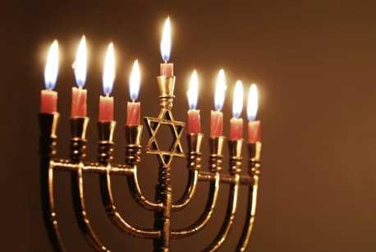
The Feast of Dedication= Hanukkah
Began as a celebration of national deliverance
Eight days in length

Slide 15
The Feast of Dedication= Hanukkah
1 Maccabees 4:52 Early in the morning on the twenty-fifth day of the ninth month, which is the month of Chislev, in the one hundred forty-eighth year, ⁵³ they rose and offered sacrifice, as the law directs, on the new altar of burnt offering that they had built. ⁵⁴ At the very season and on the very day that the Gentiles had profaned it, it was dedicated with songs and harps and lutes and cymbals. ⁵⁵ All the people fell on their faces and worshiped and blessed Heaven, who had prospered them. ⁵⁶ So they celebrated the dedication of the altar for eight days, and joyfully offered burnt offerings; they offered a sacrifice of well-being and a thanksgiving offering

Slide 16
Are you the Messiah?
At that time the festival of the Dedication took place in Jerusalem. It was winter, ²³ and Jesus was walking in the temple, in the portico of Solomon. ²⁴ So the Jews gathered around him and said to him, “How long will you keep us in suspense? If you are the Messiah, tell us plainly.” ²⁵ Jesus answered, “I have told you, and you do not believe. The works that I do in my Father’s name testify to me; ²⁶ but you do not believe, because you do not belong to my sheep. ²⁷ My sheep hear my voice. I know them, and they follow me. ²⁸ I give them eternal life, and they will never perish. No one will snatch them out of my hand. ²⁹ What my Father has given me is greater than all else, and no one can snatch it out of the Father’s hand. ³⁰ The Father and I are one.”

Slide 17
"You are gods"?
The Jews took up stones again to stone him. ³² Jesus replied, “I have shown you many good works from the Father. For which of these are you going to stone me?” ³³ The Jews answered, “It is not for a good work that we are going to stone you, but for blasphemy, because you, though only a human being, are making yourself God.” ³⁴ Jesus answered, “Is it not written in your law, ‘I said, you are gods’? ³⁵ If those to whom the word of God came were called ‘gods’—and the scripture cannot be annulled— ³⁶ can you say that the one whom the Father has sanctified and sent into the world is blaspheming because I said, ‘I am God’s Son’? ³⁷ If I am not doing the works of my Father, then do not believe me. ³⁸ But if I do them, even though you do not believe me, believe the works, so that you may know and understand that the Father is in me and I am in the Father.” ³⁹ Then they tried to arrest him again, but he escaped from their hands.

Slide 18
"You are gods"?
Psalm 82:6 I say, “You are gods,
children of the Most High, all of you;
7 nevertheless, you shall die like mortals,
and fall like any prince.”

