Slide 1
The Bread of Life
John 6

Slide 2
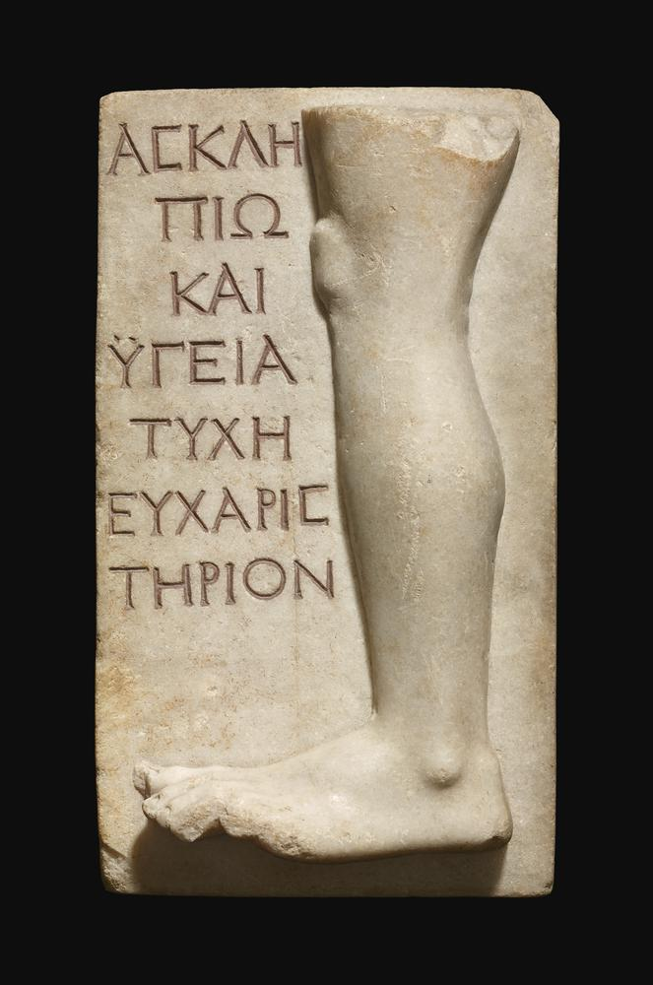
Jesus Heals the Lame Man
But Vespasian removed from Emmaus, where he had last pitched his camp before the city Tiberias, (now Emmaus, if it be interpreted, may be rendered "a warm bath," for therein is a spring of warm water, useful for healing,) and came to Gamala, Josephus, War 4.11.

Slide 3
Sabbath Controversies
Jesus heals people on the Sabbath
His contemporaries had debates about what could or could not be done on the Sabbath
Why?
“Laws concerning shabbat and festival-offering and stealing from holy-designated things, these are like mountains hung from a hair: they have few verses and many laws. Judgment and service and purity and impurity and improper sexual relations, they have plenty to be based on. They themselves are the body of Torah,” m. Hagigah 1.7.

Slide 4
Jesus Heals on the Sabbath
Therefore the Jews started persecuting Jesus, because he was doing such things on the sabbath. ¹⁷ But Jesus answered them, “My Father is still working, and I also am working.” ¹⁸ For this reason the Jews were seeking all the more to kill him, because he was not only breaking the sabbath, but was also calling God his own Father, thereby making himself equal to God

Slide 5
God Worked and Works on the Sabbath
And on the seventh day God finished the work that he had done, and he rested on the seventh day from all the work that he had done. ³ So God blessed the seventh day and hallowed it, because on it God rested from all the work that he had done in creation.
And on the sixth day God finished the work he had done...(LXX)

Slide 6
Jesus Heals on the Sabbath
Therefore the Jews started persecuting Jesus, because he was doing such things on the sabbath. ¹⁷ But Jesus answered them, “My Father is still working, and I also am working.” ¹⁸ For this reason the Jews were seeking all the more to kill him, because he was not only breaking the sabbath, but was also calling God his own Father, thereby making himself equal to God

Slide 7
Jesus, Equal to God?
Jesus said to them, “Very truly, I tell you, the Son can do nothing on his own, but only what he sees the Father doing; for whatever the Father does, the Son does likewise. ²⁰ The Father loves the Son and shows him all that he himself is doing; and he will show him greater works than these, so that you will be astonished. ²¹ Indeed, just as the Father raises the dead and gives them life, so also the Son gives life to whomever he wishes.

Slide 8
The Resurrection
“Very truly, I tell you, the hour is coming, and is now here, when the dead will hear the voice of the Son of God, and those who hear will live. ²⁶ For just as the Father has life in himself, so he has granted the Son also to have life in himself; ²⁷ and he has given him authority to execute judgment, because he is the Son of Man. ²⁸ Do not be astonished at this; for the hour is coming when all who are in their graves will hear his voice ²⁹ and will come out—those who have done good, to the resurrection of life, and those who have done evil, to the resurrection of condemnation.

Slide 9
Witnesses of Jesus
Not his own
Three witnesses
  John the Baptist
  God
  Scripture
On the evidence of two or three witnesses the death sentence shall be executed; a person must not be put to death on the evidence of only one witness, (Deuteronomy 17:6)

Slide 10
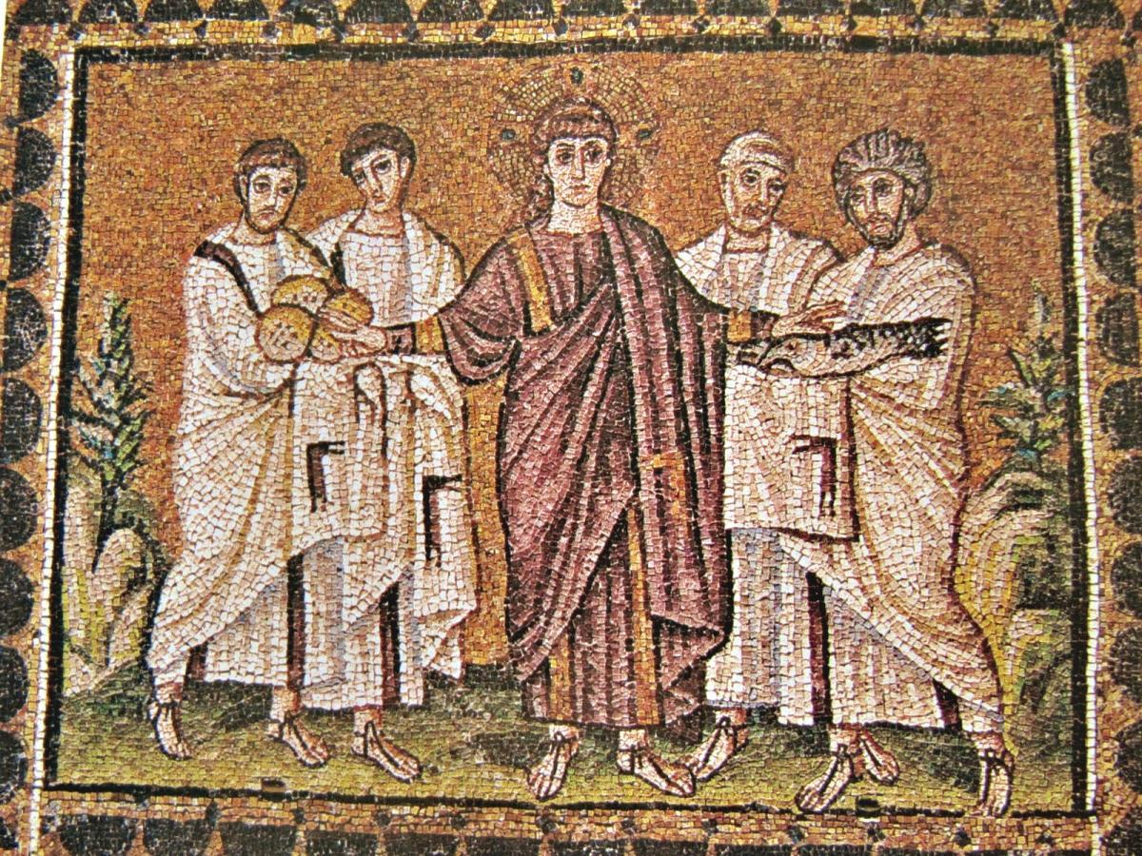
The True Manna from Heaven
Feeding of the 5000
Jesus walks on water

Slide 11
"Give us this bread"
³⁰ So they said to him, “What sign are you going to give us then, so that we may see it and believe you? What work are you performing? ³¹ Our ancestors ate the manna in the wilderness; as it is written, ‘He gave them bread from heaven to eat.’” ³² Then Jesus said to them, “Very truly, I tell you, it was not Moses who gave you the bread from heaven, but it is my Father who gives you the true bread from heaven. ³³ For the bread of God is that which comes down from heaven and gives life to the world.” ³⁴ They said to him, “Sir, give us this bread always.”

Slide 12
"I am the bread of life"
Jesus said to them, “I am the bread of life. Whoever comes to me will never be hungry, and whoever believes in me will never be thirsty. ³⁶ But I said to you that you have seen me and yet do not believe. ³⁷ Everything that the Father gives me will come to me, and anyone who comes to me I will never drive away; ³⁸ for I have come down from heaven, not to do my own will, but the will of him who sent me. ³⁹ And this is the will of him who sent me, that I should lose nothing of all that he has given me, but raise it up on the last day. ⁴⁰ This is indeed the will of my Father, that all who see the Son and believe in him may have eternal life; and I will raise them up on the last day.”

Slide 13
"I am the bread of life"
Very truly, I tell you, whoever believes has eternal life. ⁴⁸ I am the bread of life. ⁴⁹ Your ancestors ate the manna in the wilderness, and they died. ⁵⁰ This is the bread that comes down from heaven, so that one may eat of it and not die. ⁵¹ I am the living bread that came down from heaven. Whoever eats of this bread will live forever; and the bread that I will give for the life of the world is my flesh.”

Slide 14
Lord Supper imagery?
The Jews then disputed among themselves, saying, “How can this man give us his flesh to eat?” ⁵³ So Jesus said to them, “Very truly, I tell you, unless you eat the flesh of the Son of Man and drink his blood, you have no life in you. ⁵⁴ Those who eat my flesh and drink my blood have eternal life, and I will raise them up on the last day; ⁵⁵ for my flesh is true food and my blood is true drink. ⁵⁶ Those who eat my flesh and drink my blood abide in me, and I in them. ⁵⁷ Just as the living Father sent me, and I live because of the Father, so whoever eats me will live because of me. ⁵⁸ This is the bread that came down from heaven, not like that which your ancestors ate, and they died. But the one who eats this bread will live forever.”

