Slide 1
Jesus as the Feast of Tabernacles
John 7

Slide 2
"I am the bread of life"
Very truly, I tell you, whoever believes has eternal life. ⁴⁸ I am the bread of life. ⁴⁹ Your ancestors ate the manna in the wilderness, and they died. ⁵⁰ This is the bread that comes down from heaven, so that one may eat of it and not die. ⁵¹ I am the living bread that came down from heaven. Whoever eats of this bread will live forever; and the bread that I will give for the life of the world is my flesh.”

Slide 3
Lord Supper imagery?
The Jews then disputed among themselves, saying, “How can this man give us his flesh to eat?” ⁵³ So Jesus said to them, “Very truly, I tell you, unless you eat the flesh of the Son of Man and drink his blood, you have no life in you. ⁵⁴ Those who eat my flesh and drink my blood have eternal life, and I will raise them up on the last day; ⁵⁵ for my flesh is true food and my blood is true drink. ⁵⁶ Those who eat my flesh and drink my blood abide in me, and I in them. ⁵⁷ Just as the living Father sent me, and I live because of the Father, so whoever eats me will live because of me. ⁵⁸ This is the bread that came down from heaven, not like that which your ancestors ate, and they died. But the one who eats this bread will live forever.”

Slide 4
Jesus goes in secret
John 7:3 Jesus’ brothers said to him, “Leave Galilee and go to Judea, so that your disciples there may see the works you do. ⁴ No one who wants to become a public figure acts in secret. Since you are doing these things, show yourself to the world.” ⁵ For even his own brothers did not believe in him.⁶ Therefore Jesus told them, “My time is not yet here; for you any time will do. ⁷ The world cannot hate you, but it hates me because I testify that its works are evil. ⁸ You go to the festival. I am not going up to this festival, because my time has not yet fully come.” ⁹ After he had said this, he stayed in Galilee.¹⁰ However, after his brothers had left for the festival, he went also, not publicly, but in secret. ¹¹ Now at the festival the Jewish leaders were watching for Jesus and asking, “Where is he?”

Slide 5
The hidden Messiah
At that point some of the people of Jerusalem began to ask, “Isn’t this the man they are trying to kill? ²⁶ Here he is, speaking publicly, and they are not saying a word to him. Have the authorities really concluded that he is the Messiah? ²⁷ But we know where this man is from; when the Messiah comes, no one will know where he is from.”²⁸ Then Jesus, still teaching in the temple courts, cried out, “Yes, you know me, and you know where I am from. I am not here on my own authority, but he who sent me is true. You do not know him, ²⁹ but I know him because I am from him and he sent me.”

Slide 6
The hidden Messiah
4 Ezra 13:51 I said, "O sovereign Lord, explain this to me: Why did I see the man coming up from the heart of the sea?"52 He said to me, "Just as no one can explore or know what is in the depths of the sea, so no one on earth can see my Son or those who are with him, except in the time of his day.
Justin, Dialogue with Trypho 110- "Now I am aware that your teachers, sirs, admit the whole of the words of this passage to refer to Christ; and I am likewise aware that they maintain He has not yet come; or if they say that He has come, they assert that it is not known who He is; but when He shall become manifest and glorious, then it shall be known who He is"

Slide 7
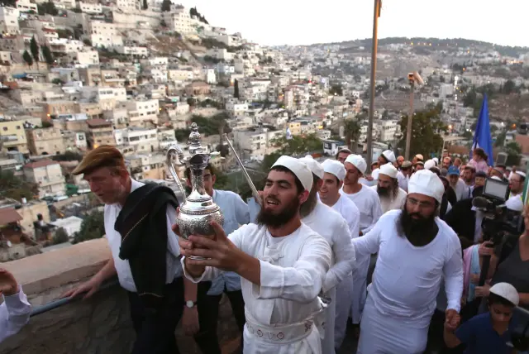
The Feast of Tabernacles
Signifies the end of the harvest (Ex. 34:22)
Also signifies a memorial to the exodus (Lev. 23:42-43)
A water drawing ceremony was added later

Slide 8
The water drawing ceremony
m. Sukkah 4:9 With regard to the rite of water libation performed in the Temple during the Festival, how was it performed? One would fill a golden jug with a capacity of three log with water from the Siloam pool...The high priest...poured the water into two silver basins

Slide 9
The living water
On the last and greatest day of the festival, Jesus stood and said in a loud voice, “Let anyone who is thirsty come to me and drink. ³⁸ Whoever believes in me, as Scripture has said, rivers of living water will flow from within them.” ³⁹ By this he meant the Spirit, whom those who believed in him were later to receive. Up to that time the Spirit had not been given, since Jesus had not yet been glorified.

Slide 10
"No one ever spoke like him"
Finally the temple guards went back to the chief priests and the Pharisees, who asked them, “Why didn’t you bring him in?”⁴⁶ “No one ever spoke the way this man does,” the guards replied.⁴⁷ “You mean he has deceived you also?” the Pharisees retorted. ⁴⁸ “Have any of the rulers or of the Pharisees believed in him? ⁴⁹ No! But this mob that knows nothing of the law—there is a curse on them.”⁵⁰ Nicodemus, who had gone to Jesus earlier and who was one of their own number, asked, ⁵¹ “Does our law condemn a man without first hearing him to find out what he has been doing?” ⁵² They replied, “Are you from Galilee, too? Look into it, and you will find that a prophet does not come out of Galilee.”

