Slide 1
The Light of the World
John 8

Slide 2
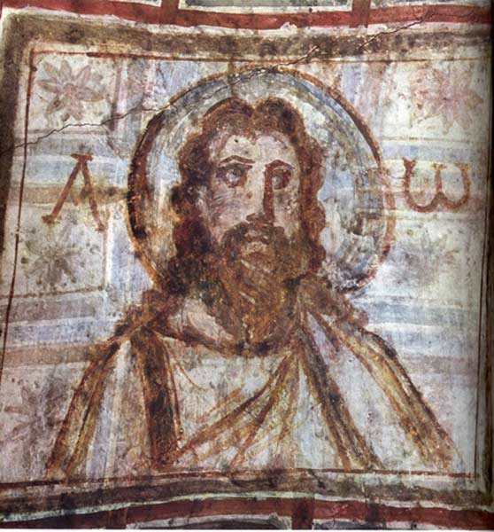
Claims so far
Jesus is the Logos
He is the Messiah
He is the bread of life
He is the light
He is the Son of God
He is the Son of Man
He has good testimony about his identity

Slide 3
Textual Criticism
We have copies of copies of copies, etc. and not the autographs.
We have texts from different eras and geographical locations.
How do we determine the “best “ reading?
John 5:3 In these lay many invalids—blind, lame, and paralyzed.^{[c]} ⁵ One man was there who had been ill for thirty-eight years
John 5:3 In these lay a great multitude of sick people, blind, lame, paralyzed, waiting for the moving of the water. ⁴ For an angel went down at a certain time into the pool and stirred up the water; then whoever stepped in first, after the stirring of the water, was made well of whatever disease he had. ⁵ Now a certain man was there who had an infirmity thirty-eight years.

Slide 4
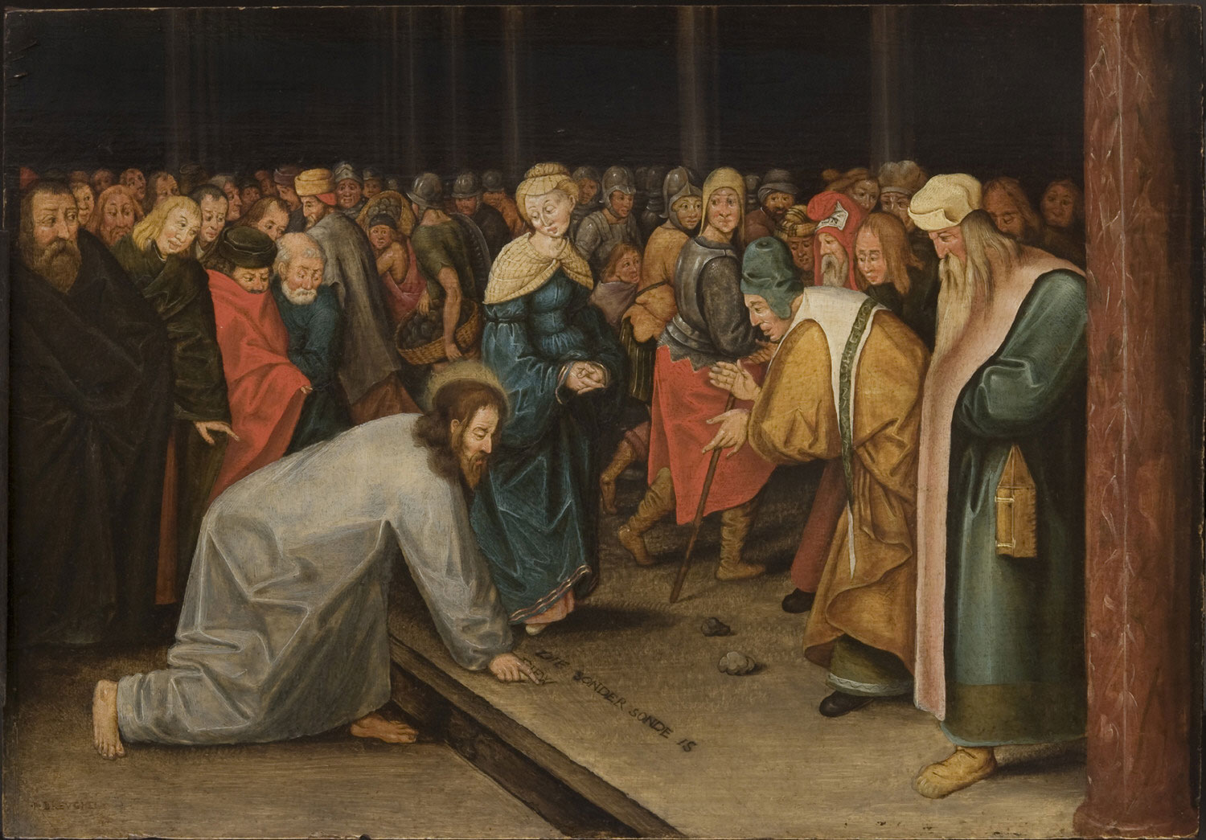
The Pericope Adulterae
John 7:53-8:11 is one of the biggest textual problems in the NT.
It is not found in any Greek text of the Gospel until circa 900 AD.
It does show up in the Latin West much earlier.
The language is more like Luke than John.
Why isn’t it in the early Greek manuscripts?

Slide 5
The Pericope Adulterae
John 8:1 Jesus went to the Mount of Olives. ² Early in the morning he came again to the temple. All the people came to him and he sat down and began to teach them. ³ The scribes and the Pharisees brought a woman who had been caught in adultery; and making her stand before all of them, ⁴ they said to him, “Teacher, this woman was caught in the very act of committing adultery. ⁵ Now in the law Moses commanded us to stone such women. Now what do you say?” ⁶ They said this to test him, so that they might have some charge to bring against him. Jesus bent down and wrote with his finger on the ground.

Slide 6
The Pericope Adulterae
John 8:7 When they kept on questioning him, he straightened up and said to them, “Let anyone among you who is without sin be the first to throw a stone at her.” ⁸ And once again he bent down and wrote on the ground. ⁹ When they heard it, they went away, one by one, beginning with the elders; and Jesus was left alone with the woman standing before him. ¹⁰ Jesus straightened up and said to her, “Woman, where are they? Has no one condemned you?” ¹¹ She said, “No one, sir.” And Jesus said, “Neither do I condemn you. Go your way, and from now on do not sin again.”

Slide 7
The Light of the World
You judge by human standards;I judge no one. ¹⁶ Yet even if I do judge, my judgment is valid; for it is not I alone who judge, but I and the Father who sent me. ¹⁷ In your law it is written that the testimony of two witnesses is valid. ¹⁸ I testify on my own behalf, and the Father who sent me testifies on my behalf.” ¹⁹ Then they said to him, “Where is your Father?” Jesus answered, “You know neither me nor my Father. If you knew me, you would know my Father also.” ²⁰ He spoke these words while he was teaching in the treasury of the temple, but no one arrested him, because his hour had not yet come.

Slide 8
“The truth will make you free”
Then Jesus said to the Jews who had believed in him, “If you continue in my word, you are truly my disciples; ³² and you will know the truth, and the truth will make you free.” ³³ They answered him, “We are descendants of Abraham and have never been slaves to anyone. What do you mean by saying, ‘You will be made free’?”³⁴ Jesus answered them, “Very truly, I tell you, everyone who commits sin is a slave to sin. ³⁵ The slave does not have a permanent place in the household; the son has a place there forever. ³⁶ So if the Son makes you free, you will be free indeed. ³⁷ I know that you are descendants of Abraham; yet you look for an opportunity to kill me, because there is no place in you for my word. ³⁸ I declare what I have seen in the Father’s presence; as for you, you should do what you have heard from the Father

Slide 9
“The truth will make you free”
"Rabbi Akiva said: Even with regard to the poor among the Jewish people, they are viewed as though they were freemen who lost their property and were impoverished. And their humiliation is calculated according to this status, as they are the children of Abraham, Isaac, and Jacob, and are all of prominent lineage," m. Baba Kamma 8.6.
"For, in actual fact, that person alone is free who has God for his/her leader; indeed, in my opinion, that person is even the ruler of all others, and has all the affairs of the earth committed to him, being, as it were, the viceroy of a great king, the mortal lieutenant of an immortal sovereign," Philo, Every Good Man is Free, 20.

Slide 10
Jesus and Abraham
They answered him, “Abraham is our father.” Jesus said to them, “If you were Abraham’s children, you would be doing what Abraham did, ⁴⁰ but now you are trying to kill me, a man who has told you the truth that I heard from God. This is not what Abraham did. ⁴¹ You are indeed doing what your father does.” They said to him, “We are not illegitimate children; we have one father, God himself.” ⁴² Jesus said to them, “If God were your Father, you would love me, for I came from God and now I am here. I did not come on my own, but he sent me. ⁴³ Why do you not understand what I say? It is because you cannot accept my word. ⁴⁴ You are from your father the devil, and you choose to do your father’s desires. He was a murderer from the beginning and does not stand in the truth, because there is no truth in him. When he lies, he speaks according to his own nature, for he is a liar and the father of lies.

Slide 11
Jesus and Abraham
The Jews answered him, “Are we not right in saying that you are a Samaritan and have a demon?” ⁴⁹ Jesus answered, “I do not have a demon; but I honor my Father, and you dishonor me. ⁵⁰ Yet I do not seek my own glory; there is one who seeks it and he is the judge. ⁵¹ Very truly, I tell you, whoever keeps my word will never see death.” ⁵² The Jews said to him, “Now we know that you have a demon. Abraham died, and so did the prophets; yet you say, ‘Whoever keeps my word will never taste death.’ ⁵³ Are you greater than our father Abraham, who died? The prophets also died. Who do you claim to be?”

Slide 12
Jesus and Abraham
Jesus answered, “If I glorify myself, my glory is nothing. It is my Father who glorifies me, he of whom you say, ‘He is our God,’ ⁵⁵ though you do not know him. But I know him; if I would say that I do not know him, I would be a liar like you. But I do know him and I keep his word. ⁵⁶ Your ancestor Abraham rejoiced that he would see my day; he saw it and was glad.” ⁵⁷ Then the Jews said to him, “You are not yet fifty years old, and have you seen Abraham?” ⁵⁸ Jesus said to them, “Very truly, I tell you, before Abraham was, I am.” ⁵⁹ So they picked up stones to throw at him, but Jesus hid himself and went out of the temple.

Slide 13
Jesus and Abraham
Exodus 3:13-14 Moses said to God, “Suppose I go to the Israelites and say to them, ‘The God of your fathers has sent me to you,’ and they ask me, ‘What is his name?’ Then what shall I tell them?”¹⁴ God said to Moses, “I am who I am. This is what you are to say to the Israelites: ‘I am has sent me to you.’”
Isaiah 43:10 “You are my witnesses,” declares the Lord,
“and my servant whom I have chosen,
so that you may know and believe me
and understand that I am he.
Before me no god was formed,
nor will there be one after me.
11 I, even I, am the Lord,
and apart from me there is no savior.

