Slide 3
Do I know anyone who I could invite to learn truths about God’s word?
Do I see the opportunities around me?

Slide 4
John 4:35 NASB95- Do you not say, ‘There are yet four months, and then comes the harvest’? Behold, I say to you, lift up your eyes and look on the fields, that they are white for harvest.

Slide 5
What is evangelism?
Evangelism: Moments where we speak God’s truths and announce the good news about God

Slide 6
What are we inviting other people to?
_________?
Ultimate goal is to invite them to join the kingdom of God NOT our local church.
Evangelism ISN’T about growing this congregation
If we can help someone get closer to God, that’s most important!

Slide 7
Seeing and Creating Opportunities
Carry and read your bible in public.
Pay attention to others. Consciousness
Create the opportunity.
Listen and share about life.
Become their go-to.

Slide 8
What are the invitations given? (notice the repeated words) What will God do for those who are invited?
Come!
vs.1- come drink
vs.2- listen to me and eat
vs.3- come to me, listen, and find life
vs.4- see the powerful leader
vs.6- seek the Lord and find Him.
vs.7- change and turn to God (repent)

Slide 9
Colossians 4:2-5 ERV- Never stop praying. Be ready for anything by praying and being thankful. [3] Also pray for us. Pray that God will give us an opportunity to tell people his message. I am in prison for doing this. But pray that we can continue to tell people the secret truth that God has made known about Christ. [4] Pray that I will say what is necessary to make this truth clear to everyone. [5] Be wise in the way you act with those who are not believers. Use your time in the best way you can.

Slide 10
Facing a Task Unfinished
(Digital Only)
Hymn: Frank Houghton (1930)
Tune: AURELIA • Samuel S. Wesley (1864)

Slide 11
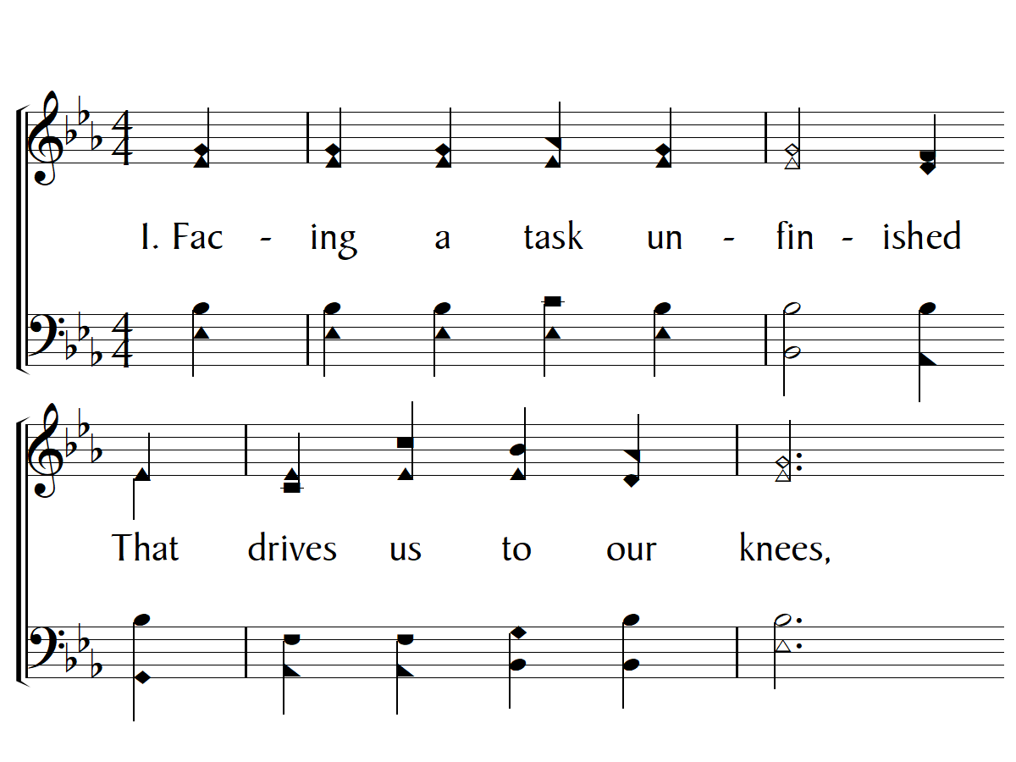

Slide 12
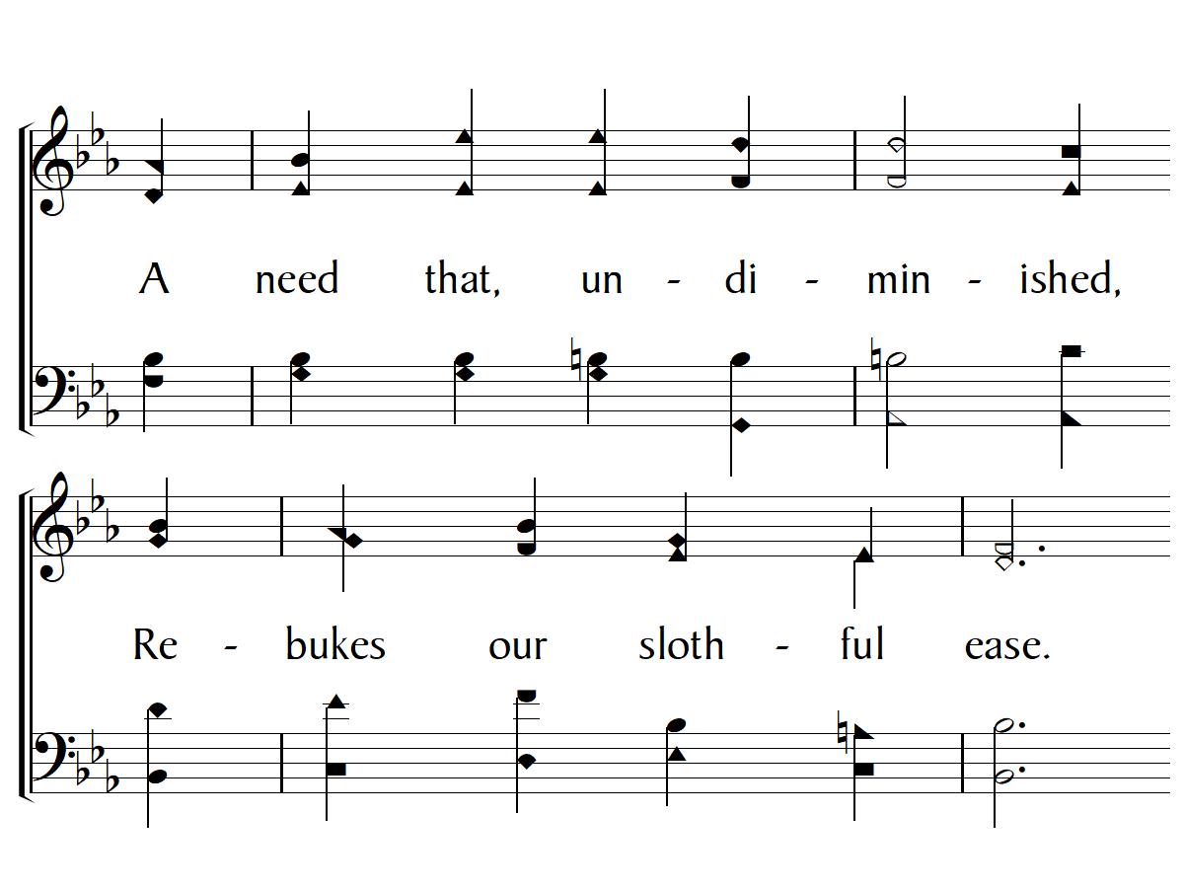

Slide 13
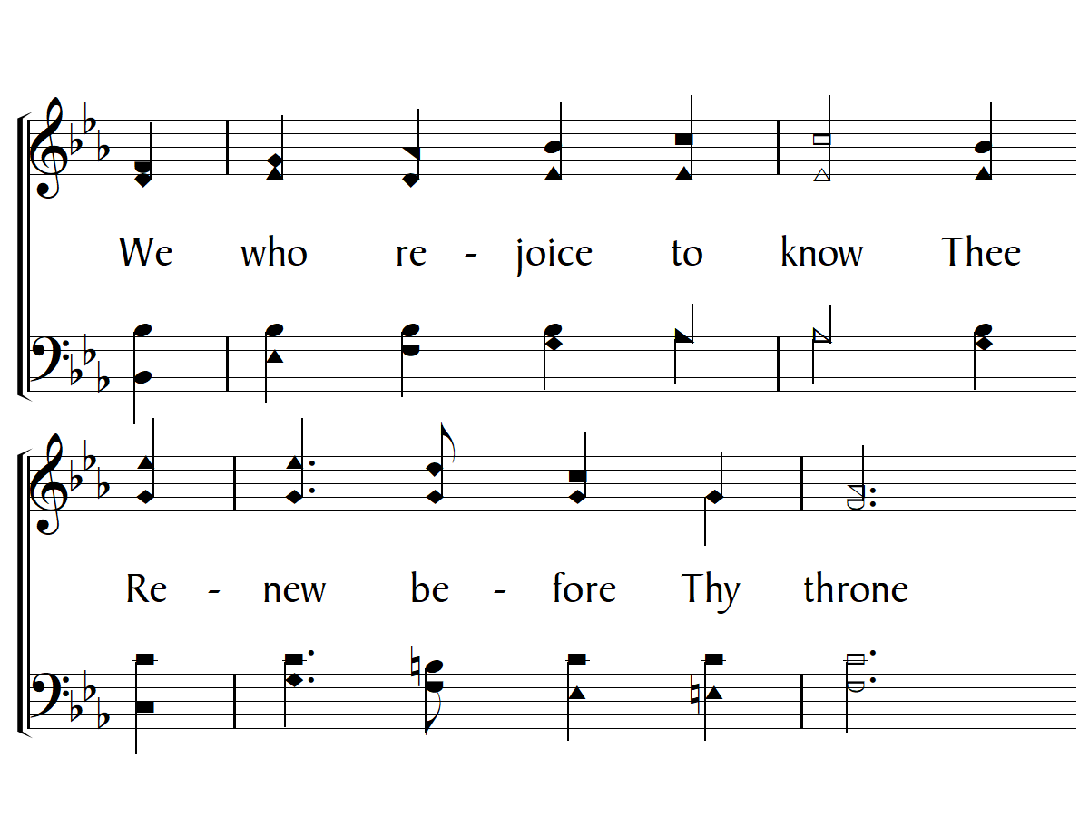

Slide 14
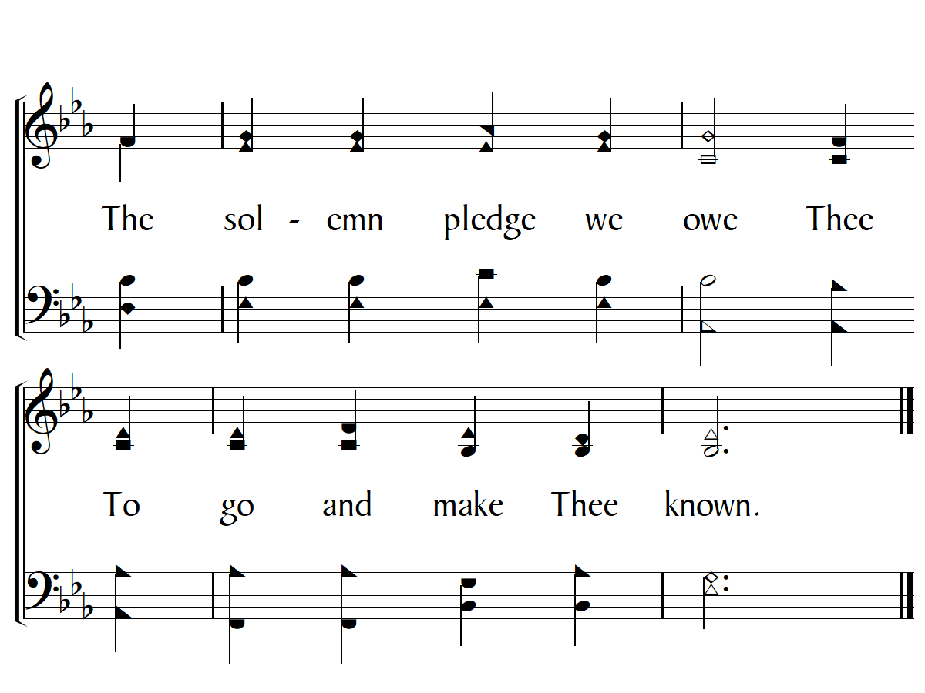

Slide 15
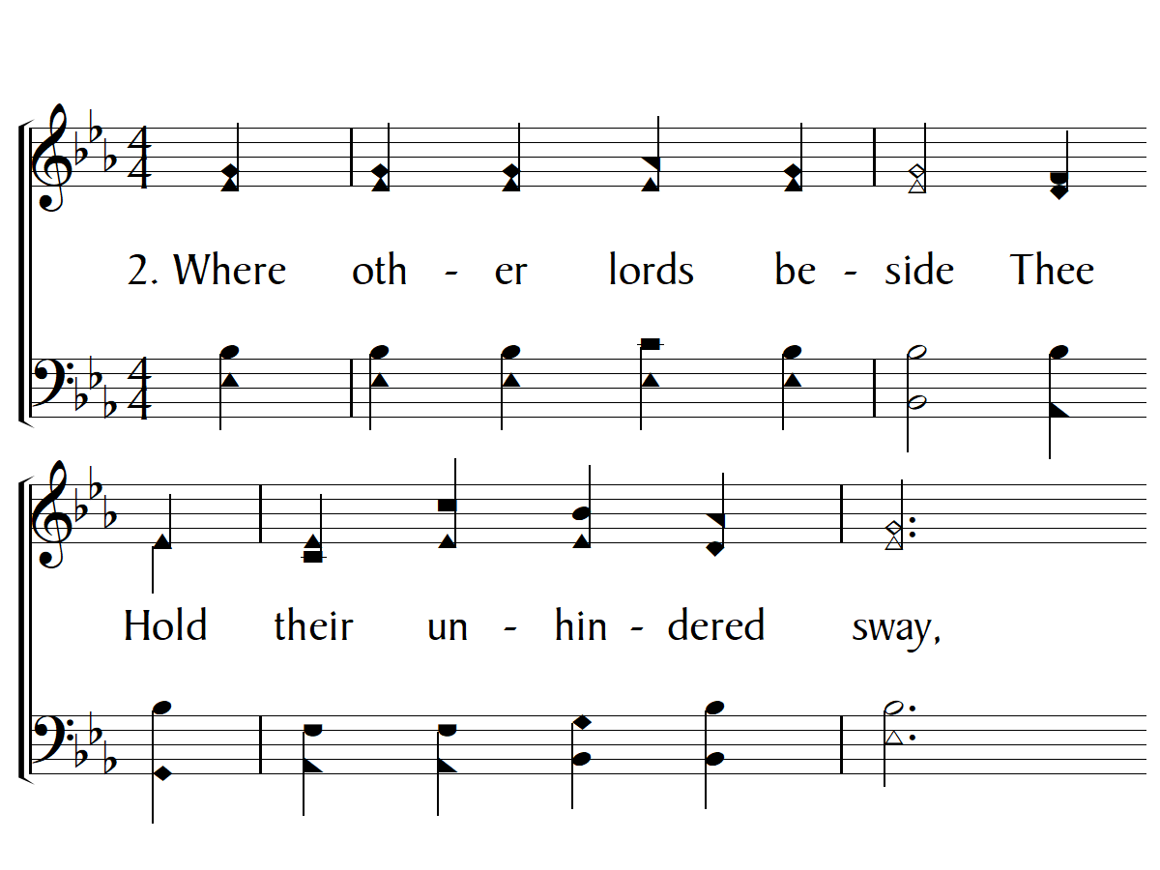

Slide 16
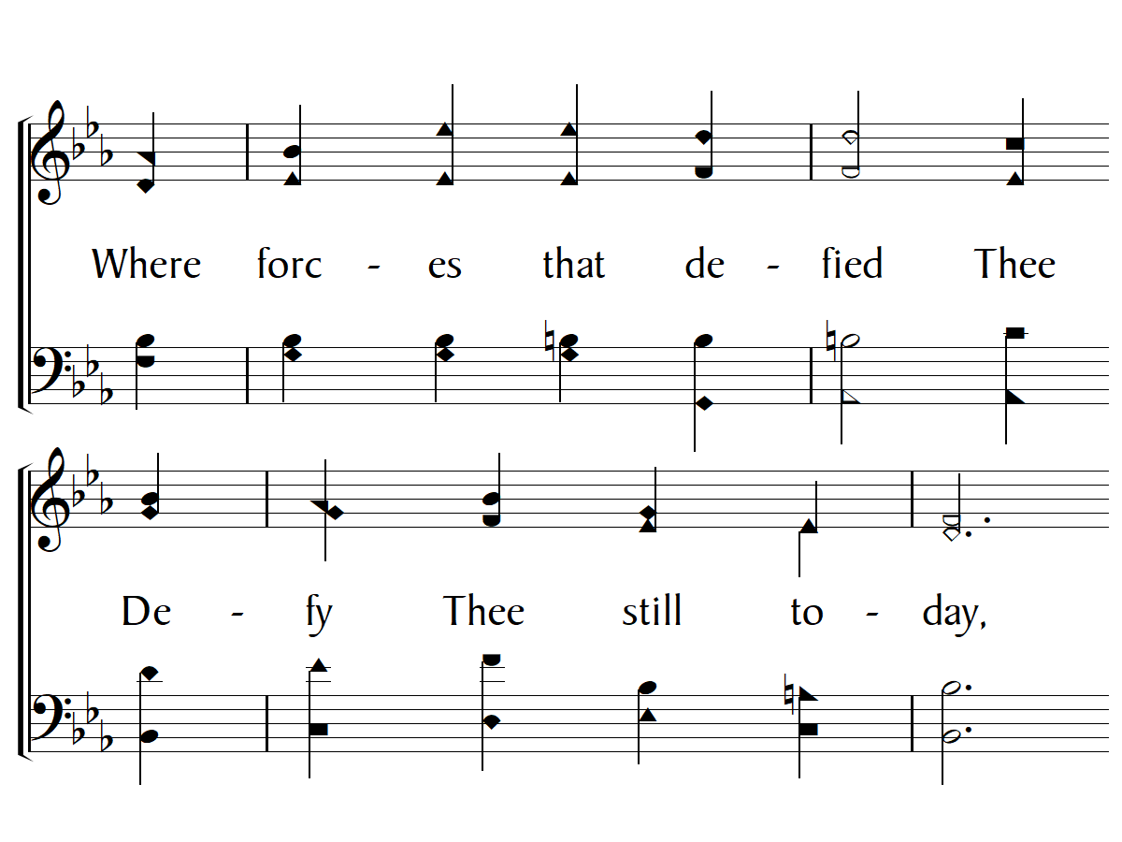

Slide 17
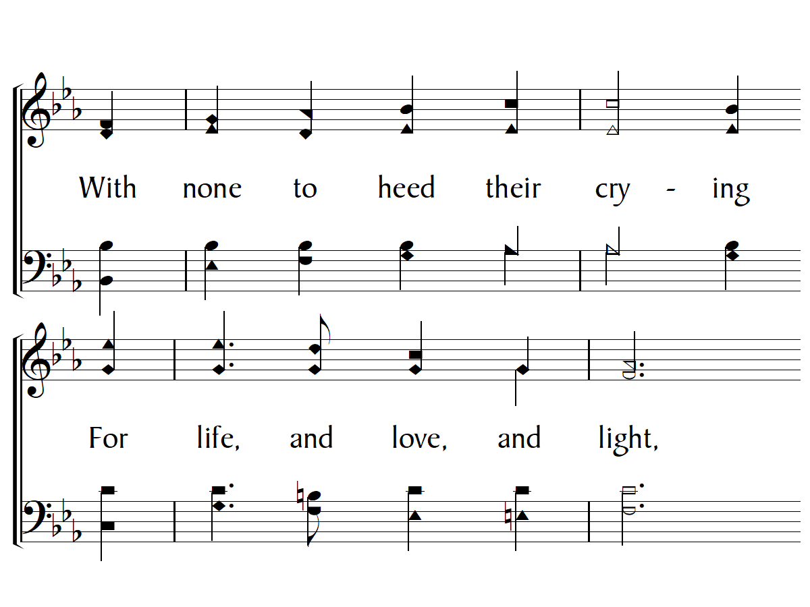

Slide 18
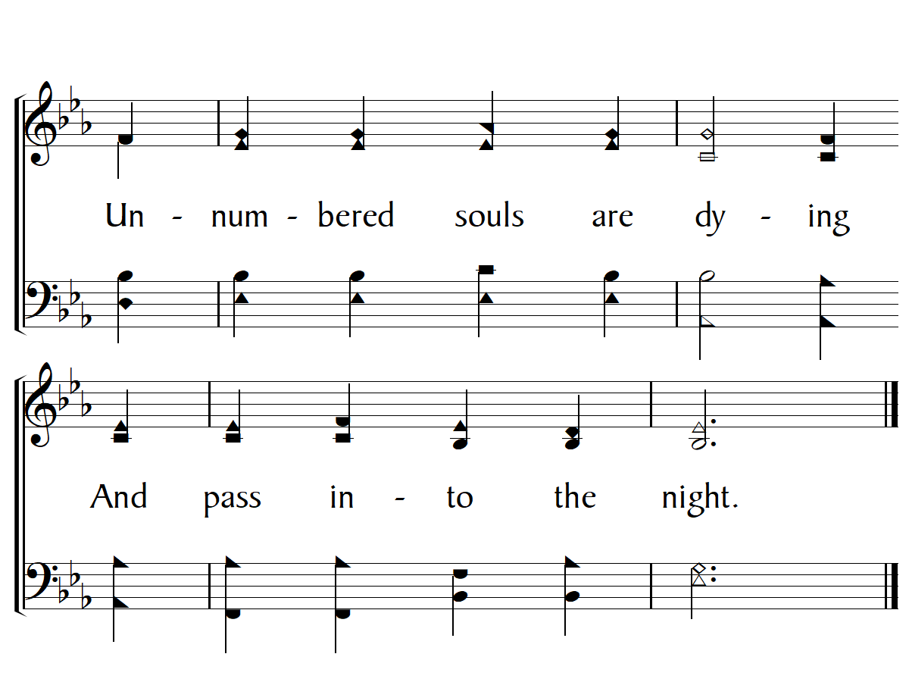

Slide 19
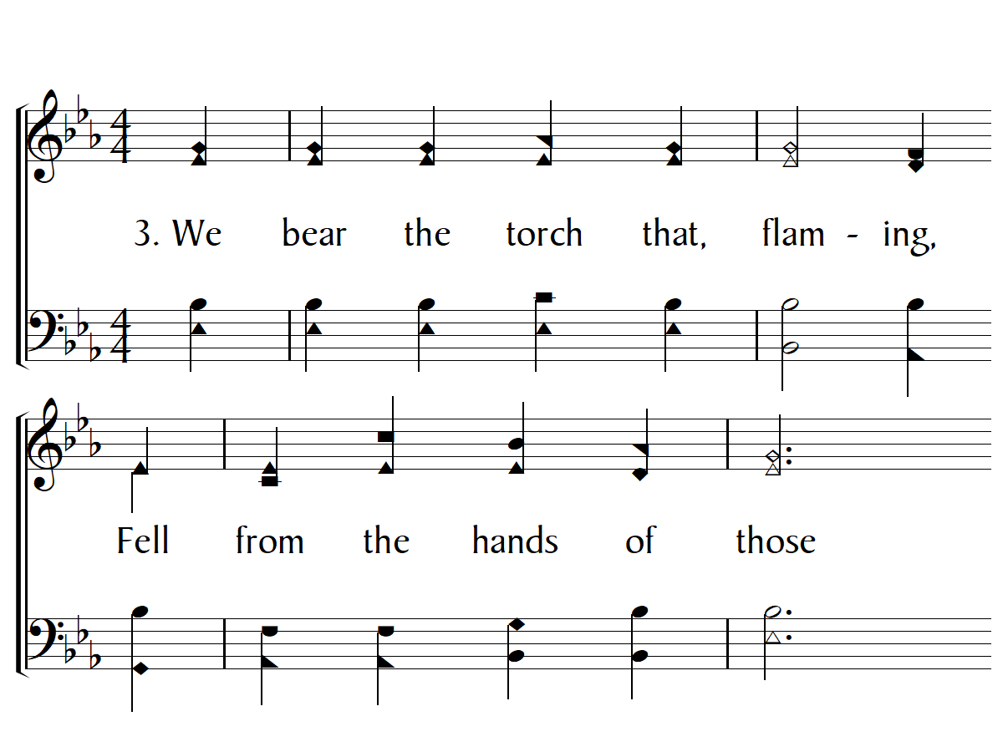

Slide 20
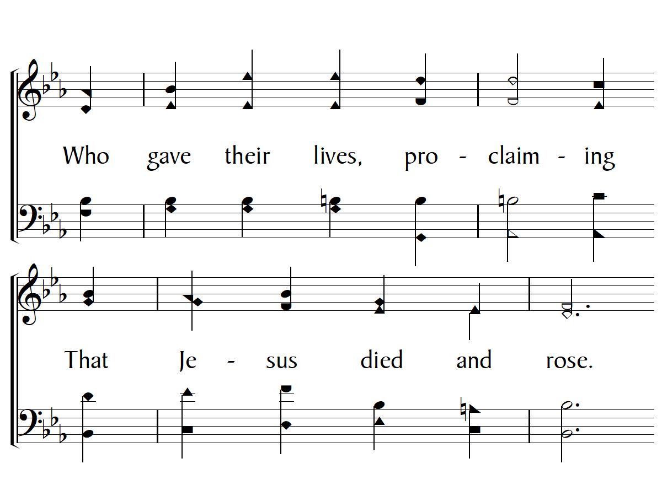

Slide 21
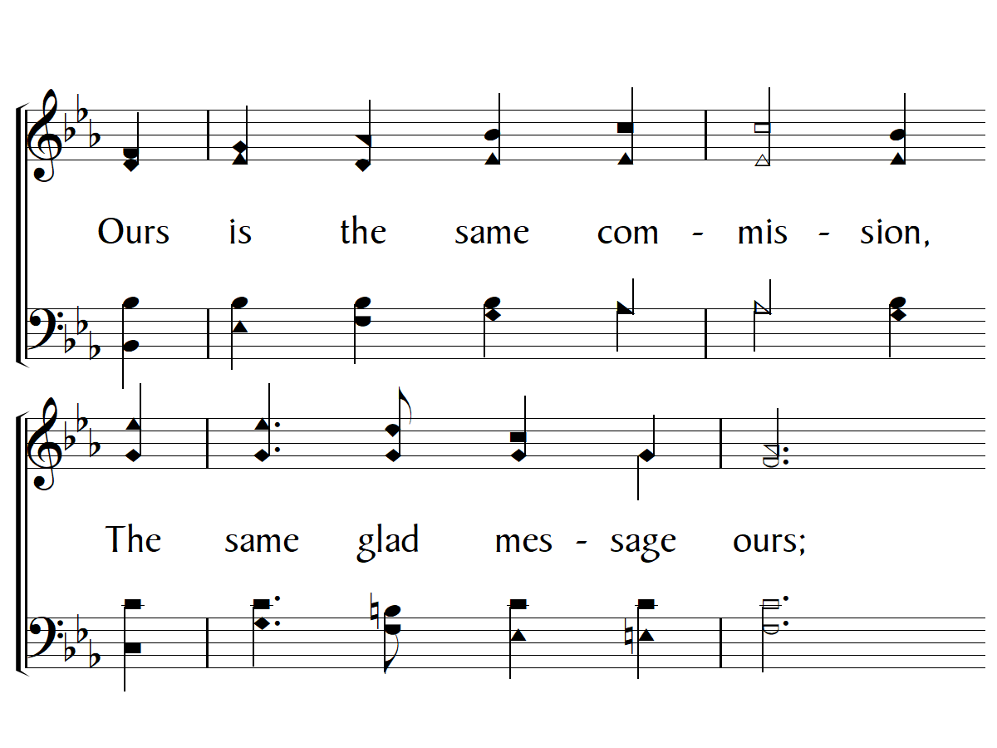

Slide 22
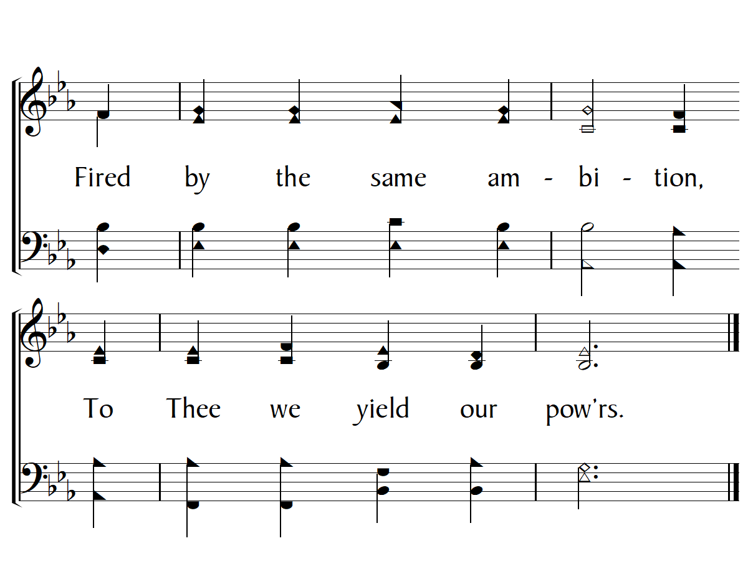

Slide 23
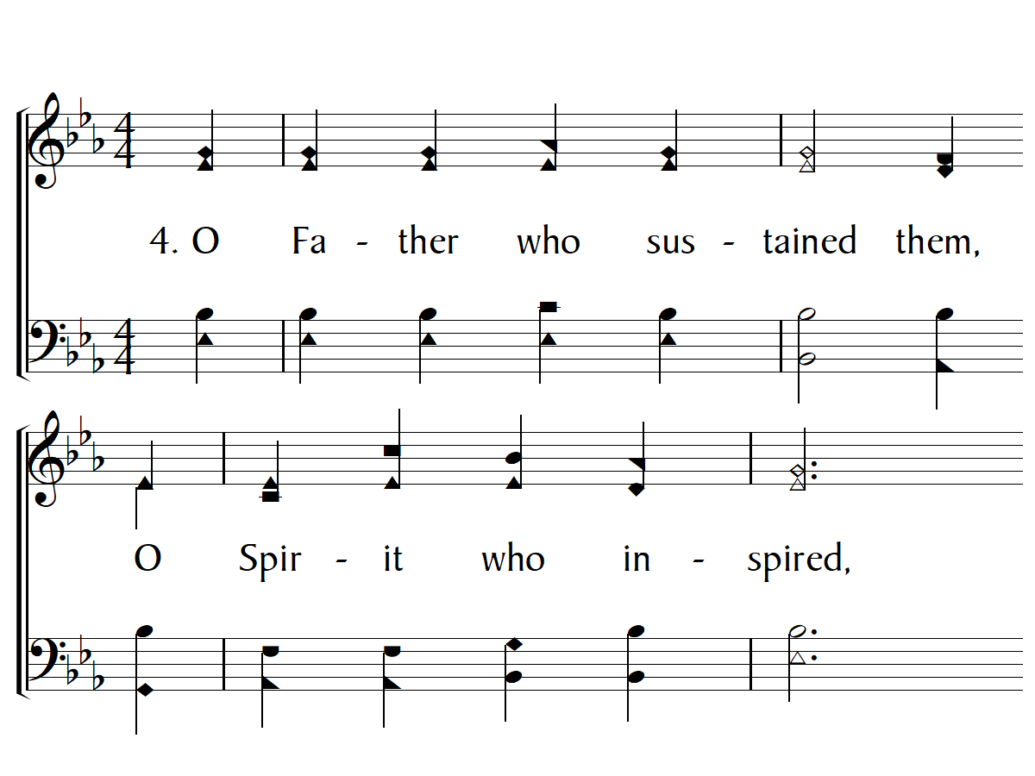

Slide 24
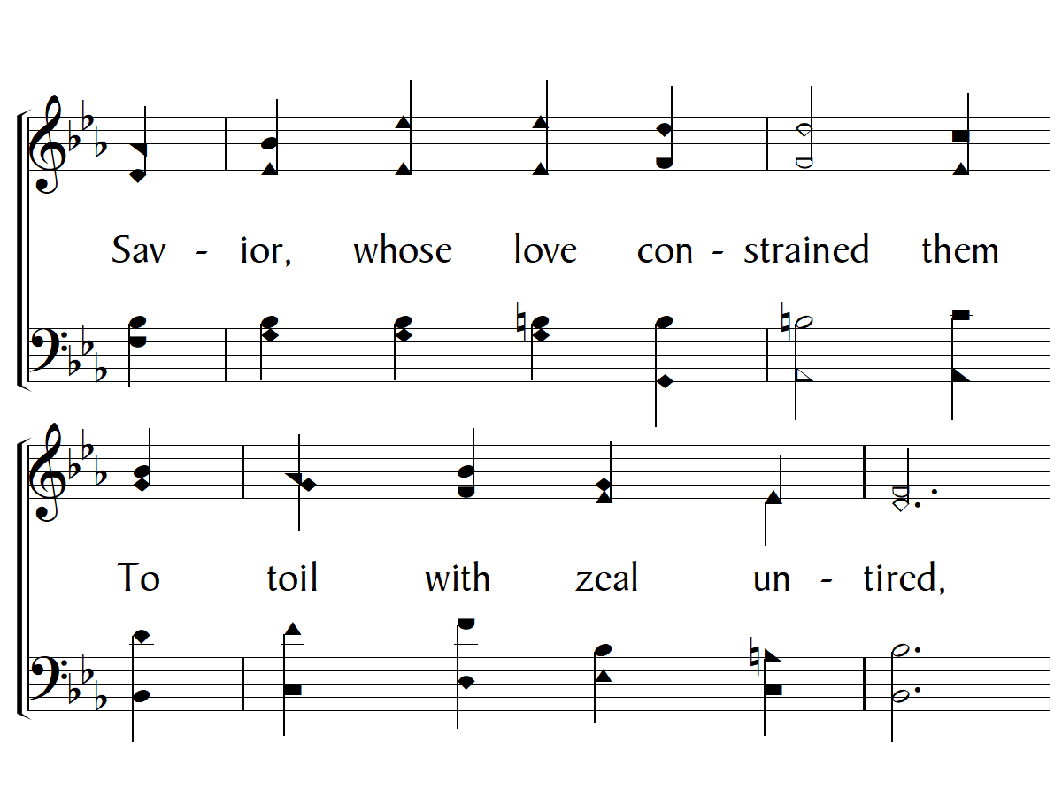

Slide 25
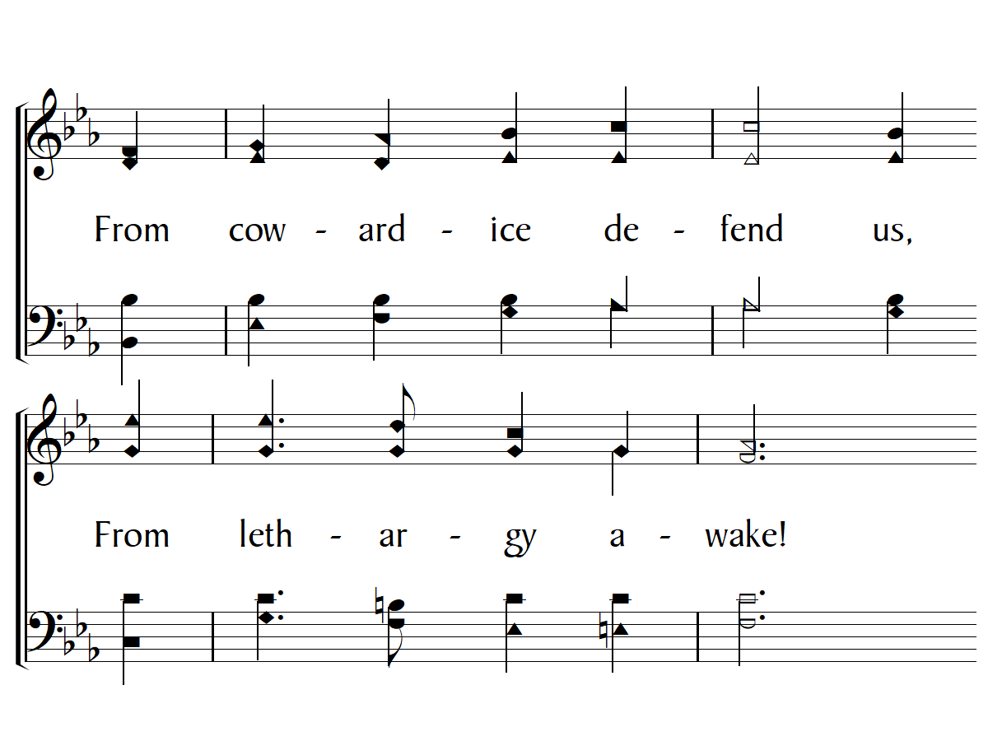

Slide 26
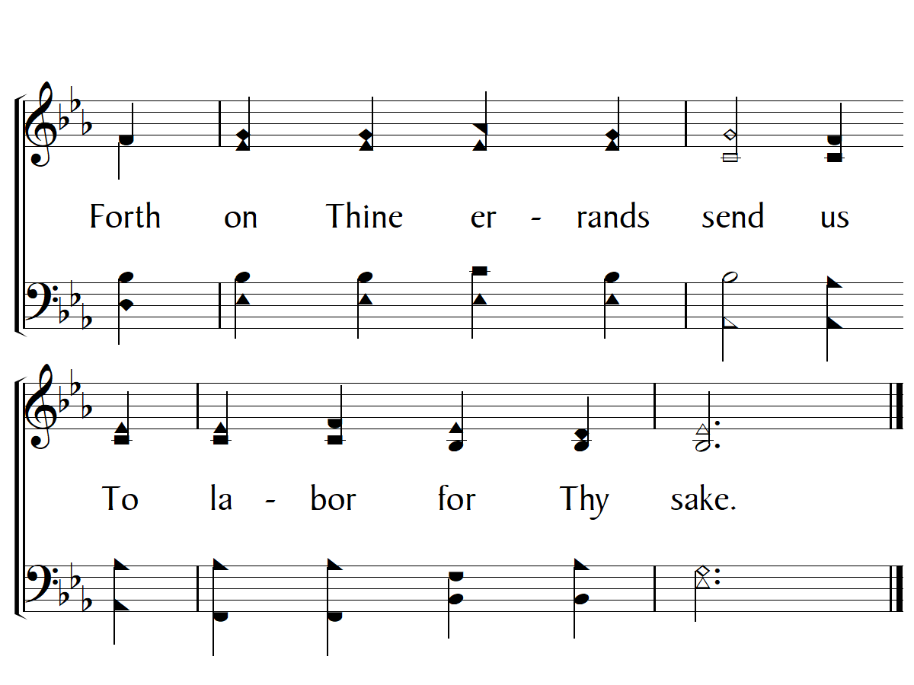
End

