Slide 3
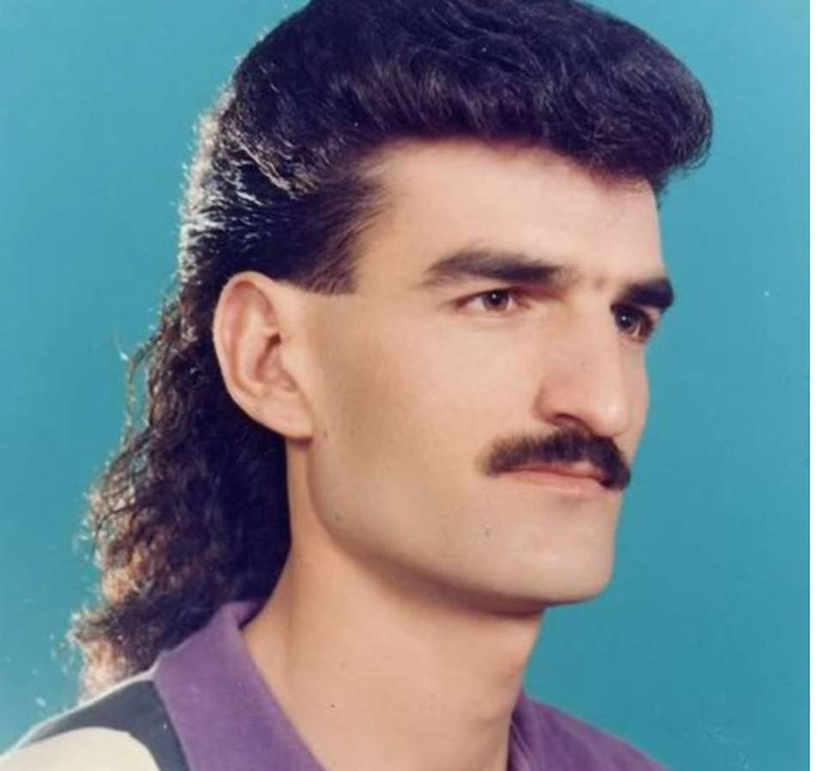
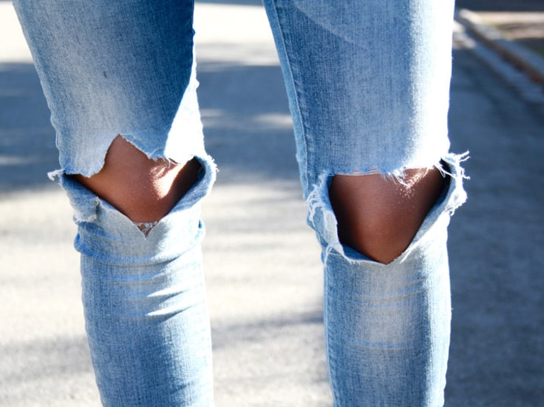
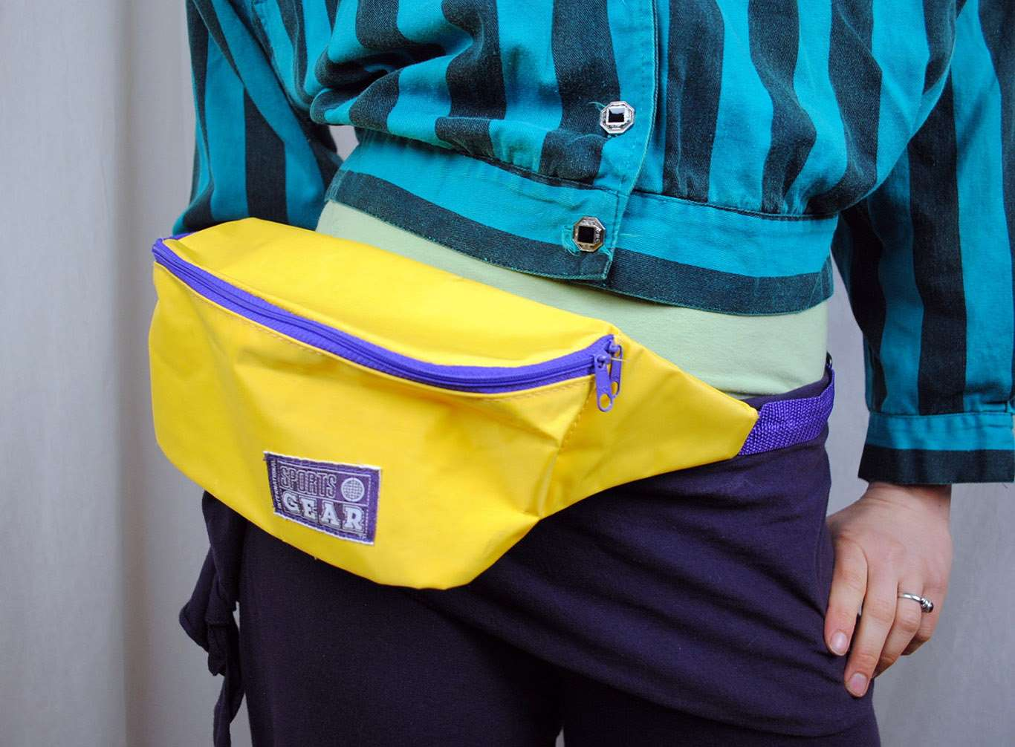

Slide 4
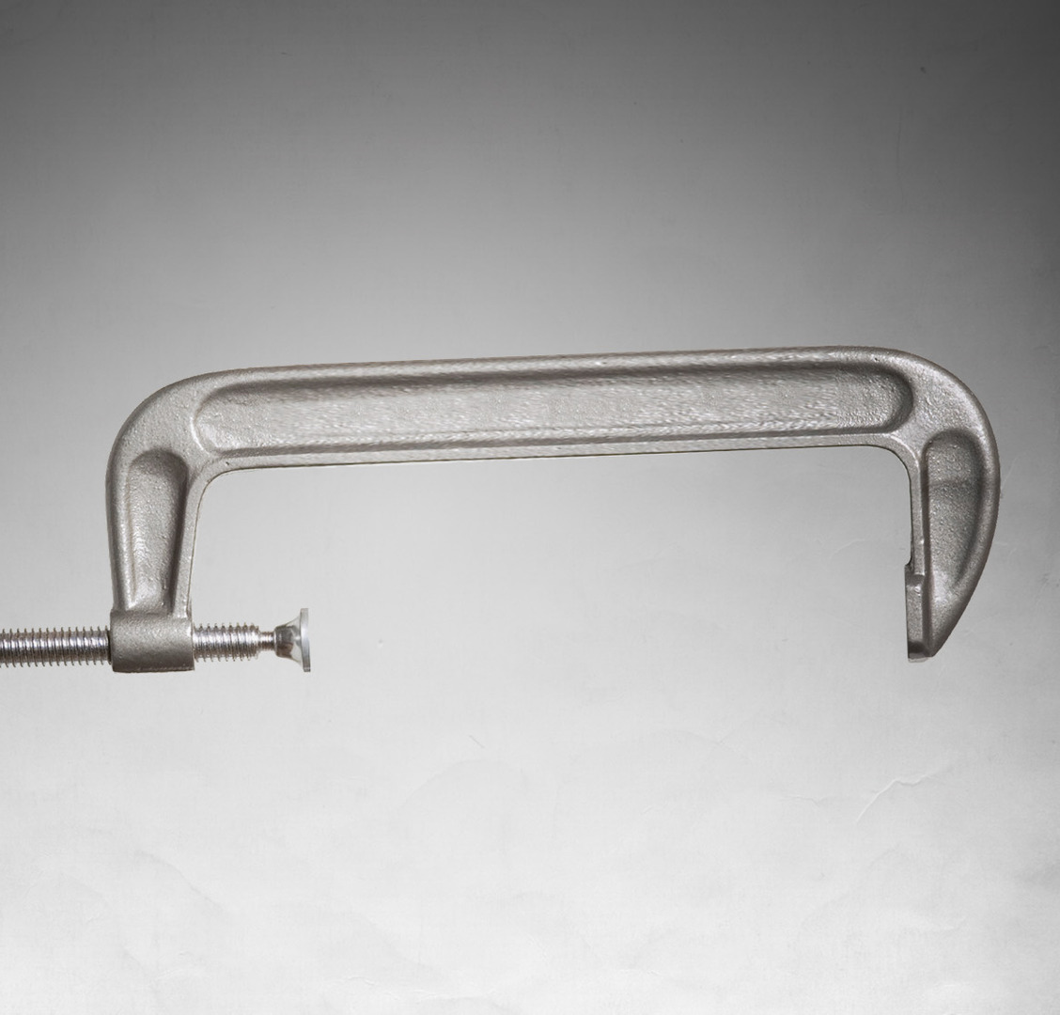
Know that peer-pressure is everyone’s reality
Defending Against Peer Pressure

Slide 5
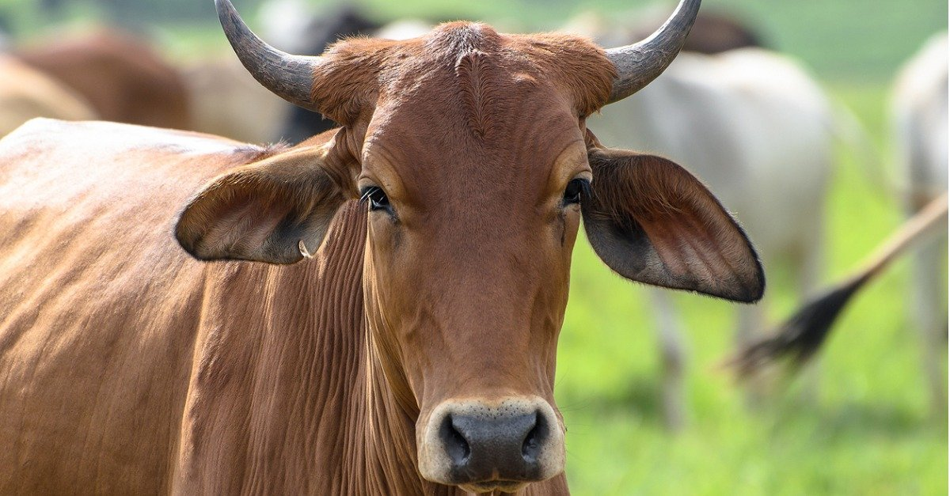
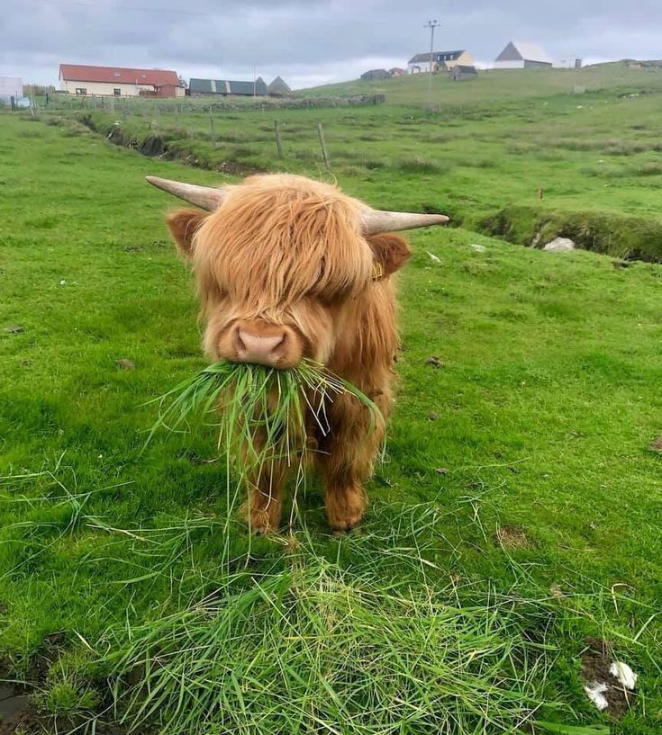

Slide 6
Know that peer-pressure is everyone’s reality
Consider the trade-offs
Defending Against Peer Pressure

Slide 7
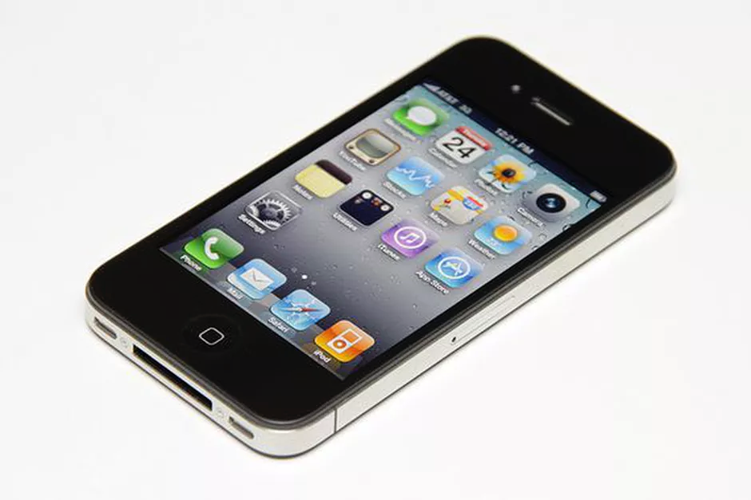

Slide 8
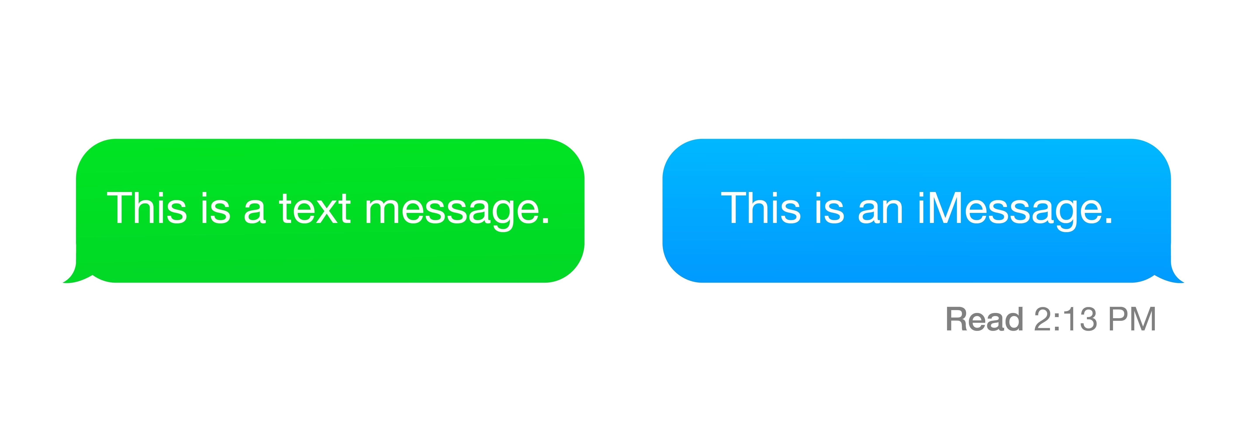

Slide 9
Know that peer-pressure is everyone’s reality
Consider the trade-offs
Utilize positive peer-pressure
Defending Against Peer Pressure

