Slide 2
1
Judges
9
Years of Silence
2
Establishment & Growth of Church
10
Life of Christ
3
Creation & Before The Flood
11
Exodus From Egypt
4
United Kingdom
12
Letters to the Churches
5
The Patriarchs
13
Wilderness Wanderings
6
Conquest of Canaan
14
Return from Captivity
7
Judah Alone
15
Babylonian Captivity
8
Divided Kingdom
16
The Flood

Slide 3
1
Creation & Before The Flood
9
Years of Silence
2
Establishment & Growth of Church
10
Life of Christ
3
Judges
11
Exodus From Egypt
4
United Kingdom
12
Letters to the Churches
5
The Patriarchs
13
Wilderness Wanderings
6
Conquest of Canaan
14
Return from Captivity
7
Judah Alone
15
Babylonian Captivity
8
Divided Kingdom
16
The Flood

Slide 4
1
Creation & Before The Flood
9
Years of Silence
2
The Flood
10
Life of Christ
3
Judges
11
Exodus From Egypt
4
United Kingdom
12
Letters to the Churches
5
The Patriarchs
13
Wilderness Wanderings
6
Conquest of Canaan
14
Return from Captivity
7
Judah Alone
15
Babylonian Captivity
8
Divided Kingdom
16
Establishment & Growth of Church

Slide 5
1
Creation & Before The Flood
9
Years of Silence
2
The Flood
10
Life of Christ
3
The Patriarchs
11
Exodus From Egypt
4
United Kingdom
12
Letters to the Churches
5
Judges
13
Wilderness Wanderings
6
Conquest of Canaan
14
Return from Captivity
7
Judah Alone
15
Babylonian Captivity
8
Divided Kingdom
16
Establishment & Growth of Church

Slide 6
1
Creation & Before The Flood
9
Years of Silence
2
The Flood
10
Life of Christ
3
The Patriarchs
11
United Kingdom
4
Exodus From Egypt
12
Letters to the Churches
5
Judges
13
Wilderness Wanderings
6
Conquest of Canaan
14
Return from Captivity
7
Judah Alone
15
Babylonian Captivity
8
Divided Kingdom
16
Establishment & Growth of Church

Slide 7
1
Creation & Before The Flood
9
Years of Silence
2
The Flood
10
Life of Christ
3
The Patriarchs
11
United Kingdom
4
Exodus From Egypt
12
Letters to the Churches
5
Wilderness Wanderings
13
Judges
6
Conquest of Canaan
14
Return from Captivity
7
Judah Alone
15
Babylonian Captivity
8
Divided Kingdom
16
Establishment & Growth of Church

Slide 8
1
Creation & Before The Flood
9
Years of Silence
2
The Flood
10
Life of Christ
3
The Patriarchs
11
United Kingdom
4
Exodus From Egypt
12
Letters to the Churches
5
Wilderness Wanderings
13
Judges
6
Conquest of Canaan
14
Return from Captivity
7
Judah Alone
15
Babylonian Captivity
8
Divided Kingdom
16
Establishment & Growth of Church

Slide 9
1
Creation & Before The Flood
9
Years of Silence
2
The Flood
10
Life of Christ
3
The Patriarchs
11
United Kingdom
4
Exodus From Egypt
12
Letters to the Churches
5
Wilderness Wanderings
13
Judah Alone
6
Conquest of Canaan
14
Return from Captivity
7
Judges
15
Babylonian Captivity
8
Divided Kingdom
16
Establishment & Growth of Church

Slide 10
1
Creation & Before The Flood
9
Years of Silence
2
The Flood
10
Life of Christ
3
The Patriarchs
11
Divided Kingdom
4
Exodus From Egypt
12
Letters to the Churches
5
Wilderness Wanderings
13
Judah Alone
6
Conquest of Canaan
14
Return from Captivity
7
Judges
15
Babylonian Captivity
8
United Kingdom
16
Establishment & Growth of Church

Slide 11
1
Creation & Before The Flood
9
Divided Kingdom
2
The Flood
10
Life of Christ
3
The Patriarchs
11
Years of Silence
4
Exodus From Egypt
12
Letters to the Churches
5
Wilderness Wanderings
13
Judah Alone
6
Conquest of Canaan
14
Return from Captivity
7
Judges
15
Babylonian Captivity
8
United Kingdom
16
Establishment & Growth of Church

Slide 12
1
Creation & Before The Flood
9
Divided Kingdom
2
The Flood
10
Judah Alone
3
The Patriarchs
11
Years of Silence
4
Exodus From Egypt
12
Letters to the Churches
5
Wilderness Wanderings
13
Life of Christ
6
Conquest of Canaan
14
Return from Captivity
7
Judges
15
Babylonian Captivity
8
United Kingdom
16
Establishment & Growth of Church

Slide 13
1
Creation & Before The Flood
9
Divided Kingdom
2
The Flood
10
Judah Alone
3
The Patriarchs
11
Babylonian Captivity
4
Exodus From Egypt
12
Letters to the Churches
5
Wilderness Wanderings
13
Life of Christ
6
Conquest of Canaan
14
Return from Captivity
7
Judges
15
Years of Silence
8
United Kingdom
16
Establishment & Growth of Church

Slide 14
1
Creation & Before The Flood
9
Divided Kingdom
2
The Flood
10
Judah Alone
3
The Patriarchs
11
Babylonian Captivity
4
Exodus From Egypt
12
Return from Captivity
5
Wilderness Wanderings
13
Life of Christ
6
Conquest of Canaan
14
Letters to the Churches
7
Judges
15
Years of Silence
8
United Kingdom
16
Establishment & Growth of Church

Slide 15
1
Creation & Before The Flood
9
Divided Kingdom
2
The Flood
10
Judah Alone
3
The Patriarchs
11
Babylonian Captivity
4
Exodus From Egypt
12
Return from Captivity
5
Wilderness Wanderings
13
Years of Silence
6
Conquest of Canaan
14
Letters to the Churches
7
Judges
15
Life of Christ
8
United Kingdom
16
Establishment & Growth of Church

Slide 16
1
Creation & Before The Flood
9
Divided Kingdom
2
The Flood
10
Judah Alone
3
The Patriarchs
11
Babylonian Captivity
4
Exodus From Egypt
12
Return from Captivity
5
Wilderness Wanderings
13
Years of Silence
6
Conquest of Canaan
14
Life of Christ
7
Judges
15
Letters to the Churches
8
United Kingdom
16
Establishment & Growth of Church

Slide 17
1
Creation & Before The Flood
9
Divided Kingdom
2
The Flood
10
Judah Alone
3
The Patriarchs
11
Babylonian Captivity
4
Exodus From Egypt
12
Return from Captivity
5
Wilderness Wanderings
13
Years of Silence
6
Conquest of Canaan
14
Life of Christ
7
Judges
15
Establishment & Growth of Church
8
United Kingdom
16
Letters to the Churches

Slide 18
“but you will receive power when the Holy Spirit has come upon you; and you shall be My witnesses both in Jerusalem, and in all Judea and Samaria, and even to the remotest part of the earth.” (Acts 1:8)

Slide 19
“but you will receive power when the Holy Spirit has come upon you; and you shall be My witnesses both in Jerusalem, and in all Judea and Samaria, and even to the remotest part of the earth.” (Acts 1:8)

Slide 20
“but you will receive power when the Holy Spirit has come upon you; and you shall be My witnesses both in Jerusalem, and in all Judea and Samaria, and even to the remotest part of the earth.” (Acts 1:8)

Slide 21
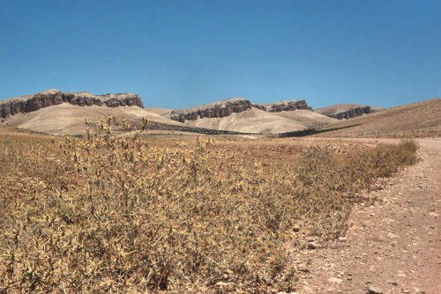

Slide 22
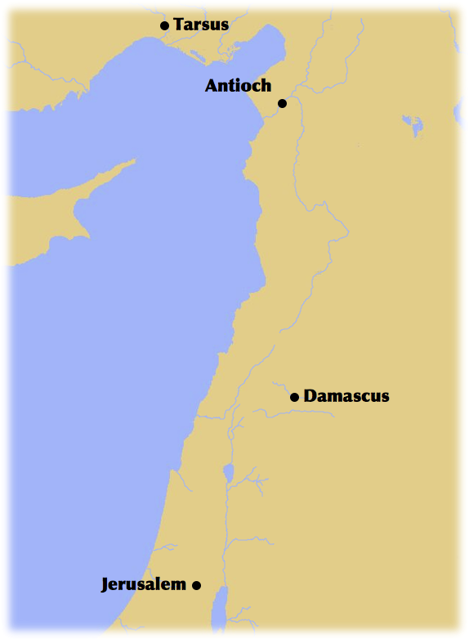
Arabia

Slide 23
“Now there were in the church at Antioch prophets and teachers, Barnabas, Simeon who was called Niger, Lucius of Cyrene, Manaen a member of the court of Herod the tetrarch, and Saul. While they were worshiping the Lord and fasting, the Holy Spirit said, ‘Set apart for me Barnabas and Saul for the work to which I have called them.’ Then after fasting and praying they laid their hands on them and sent them off.”
(Acts 13:1-3 ESV)

Slide 24
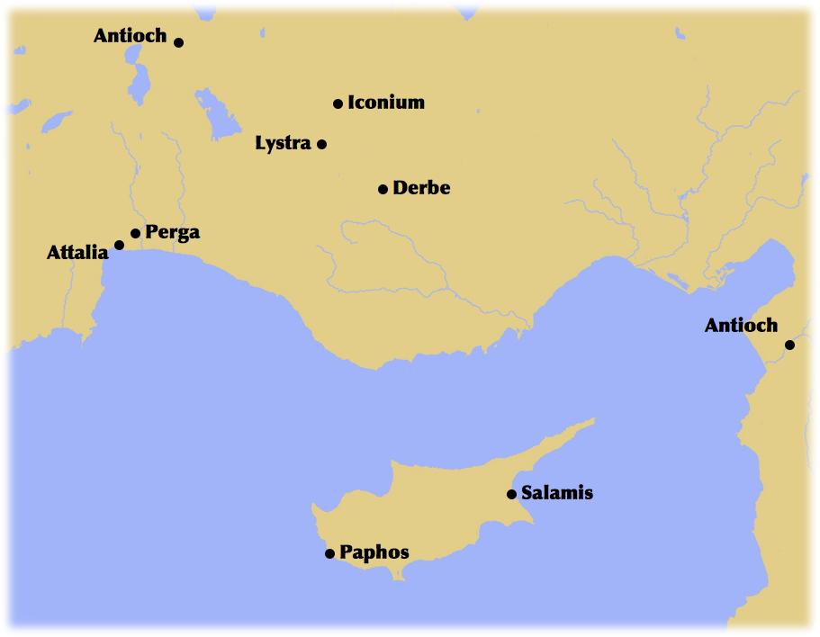
Arabia

Slide 25
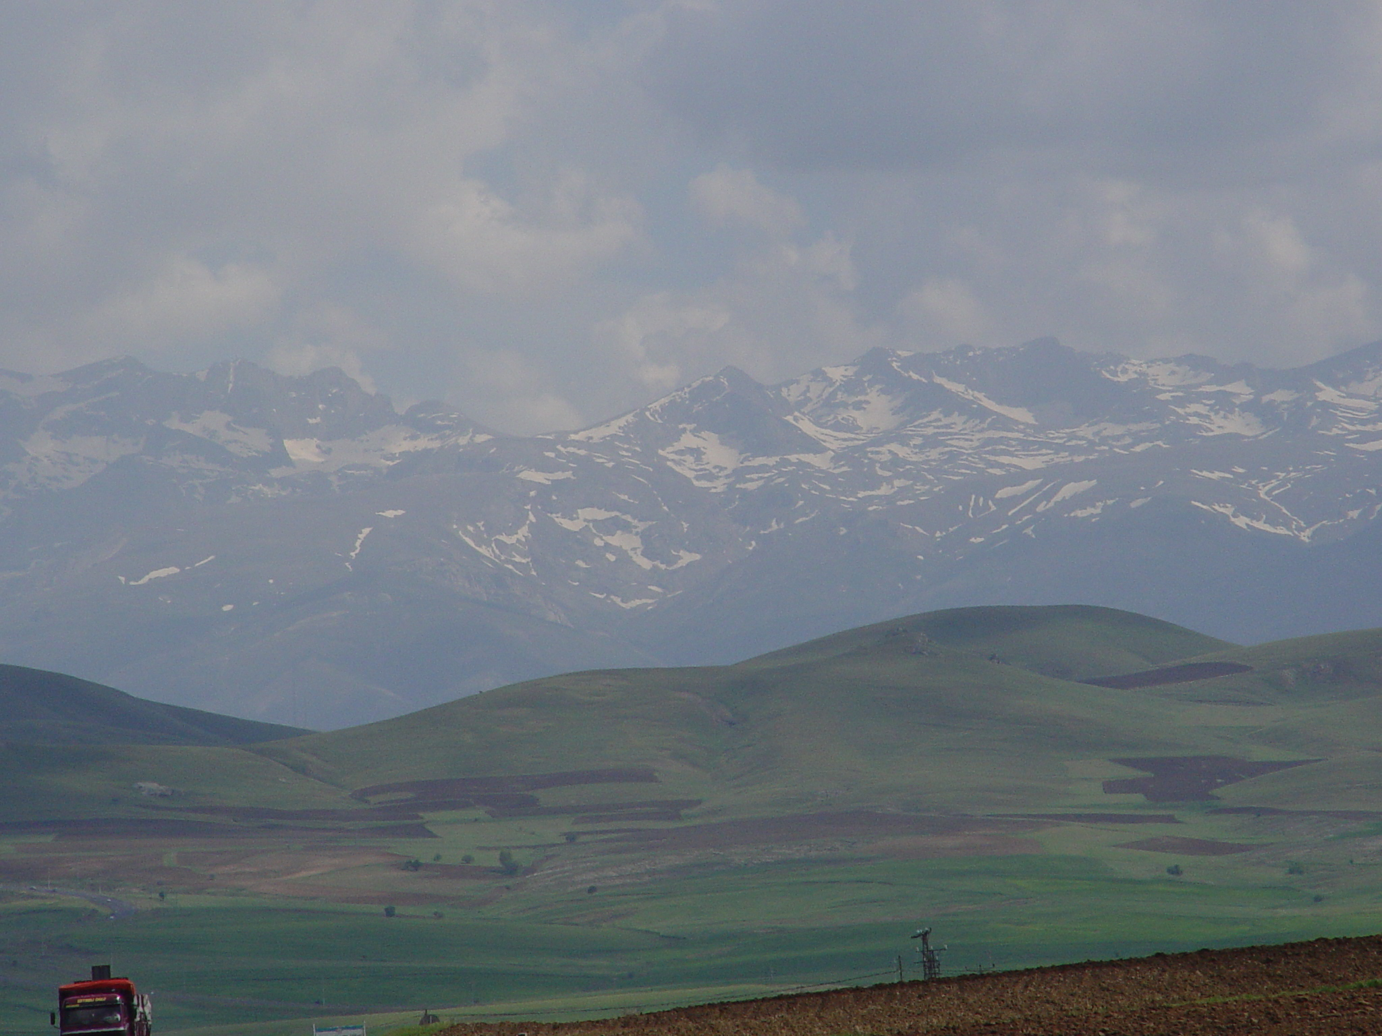

Slide 26
“I am astonished that you are so quickly deserting him who called you in the grace of Christ and are turning to a different gospel— not that there is another one, but there are some who trouble you and want to distort the gospel of Christ. But even if we or an angel from heaven should preach to you a gospel contrary to the one we preached to you, let him be accursed.”
(Galatians 1:6-8 ESV)

Slide 27
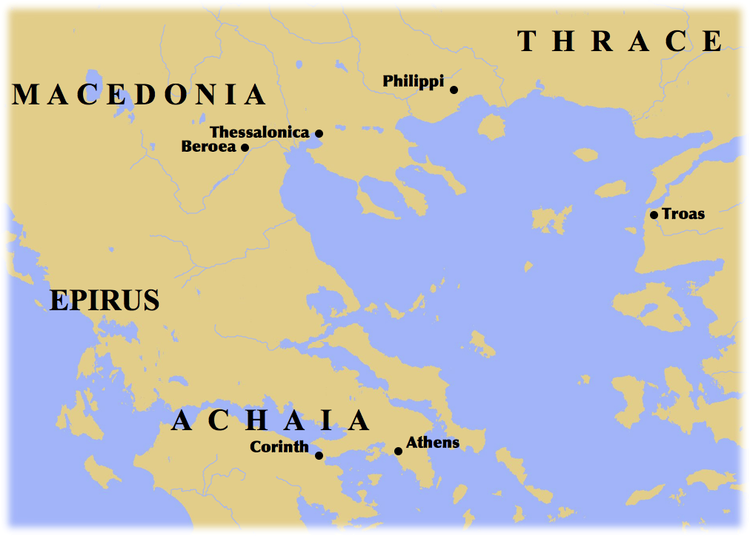

Slide 28
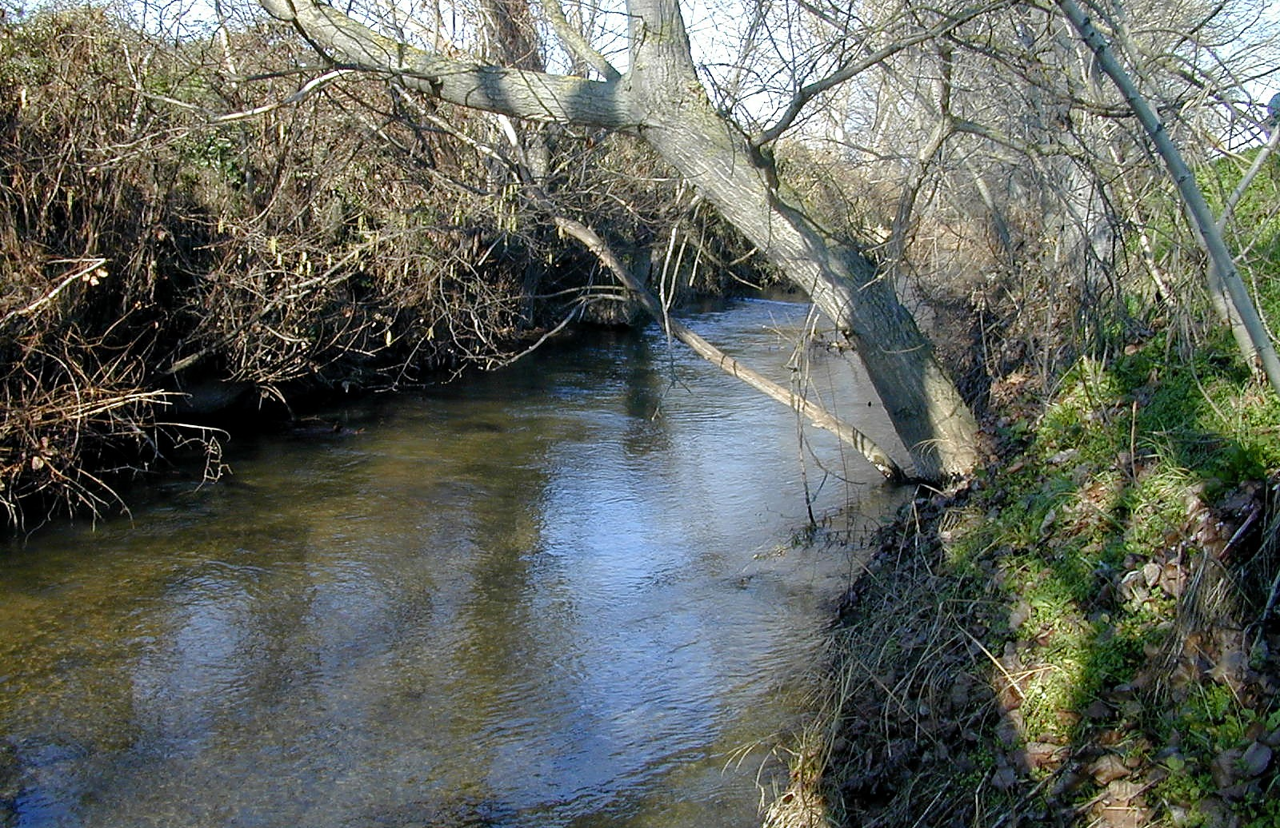

Slide 29
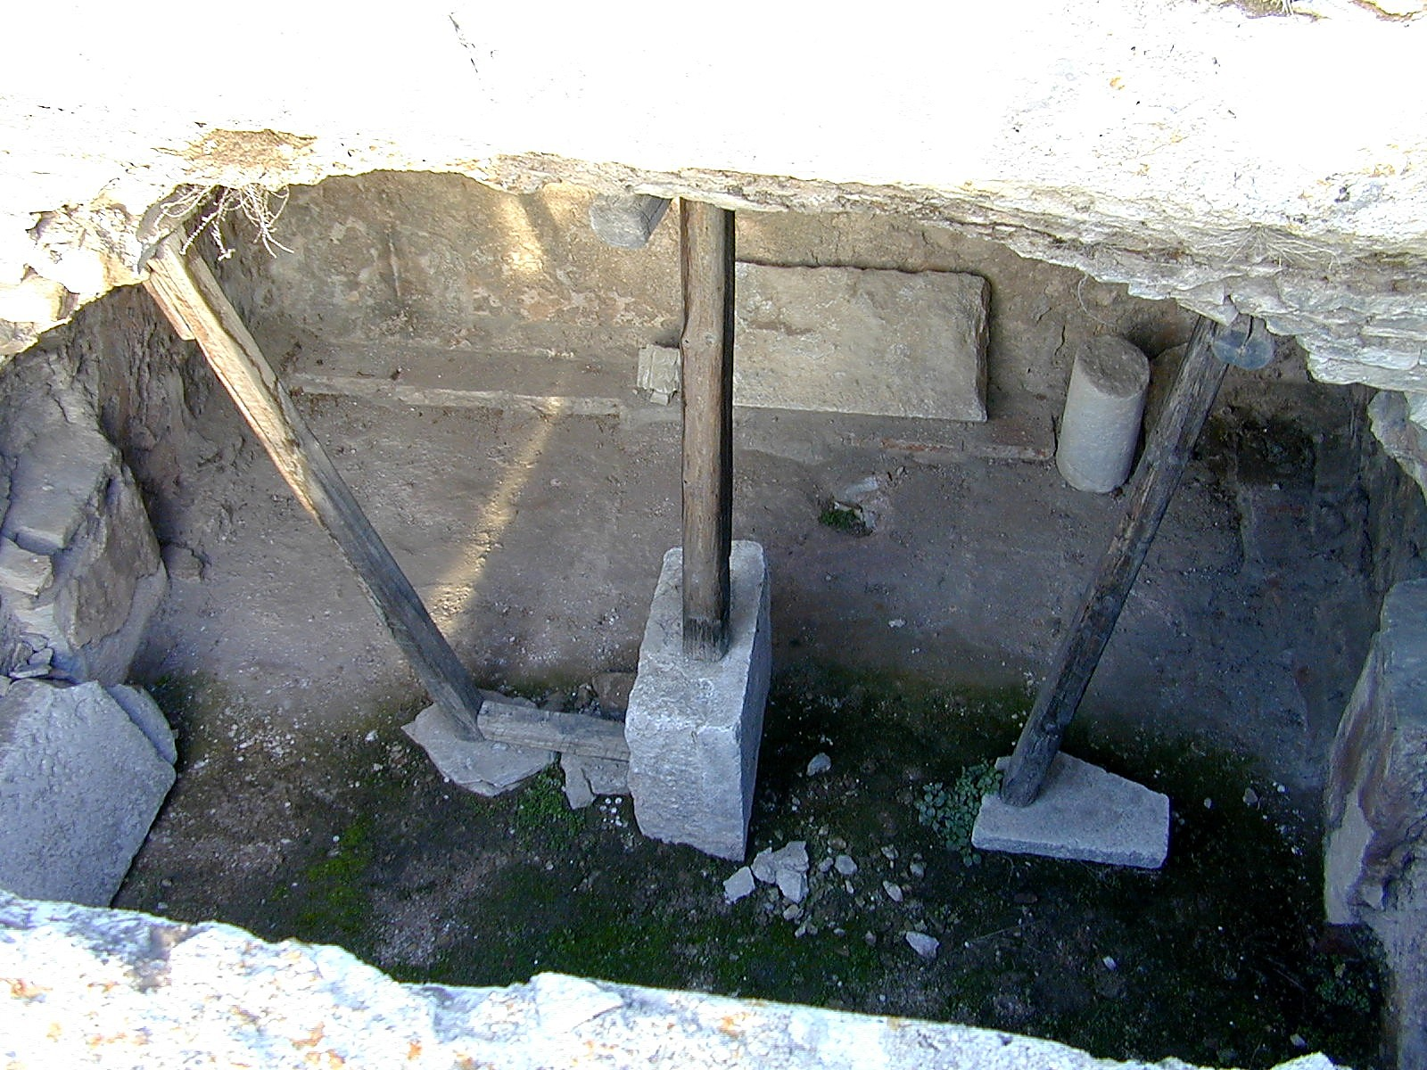

Slide 31
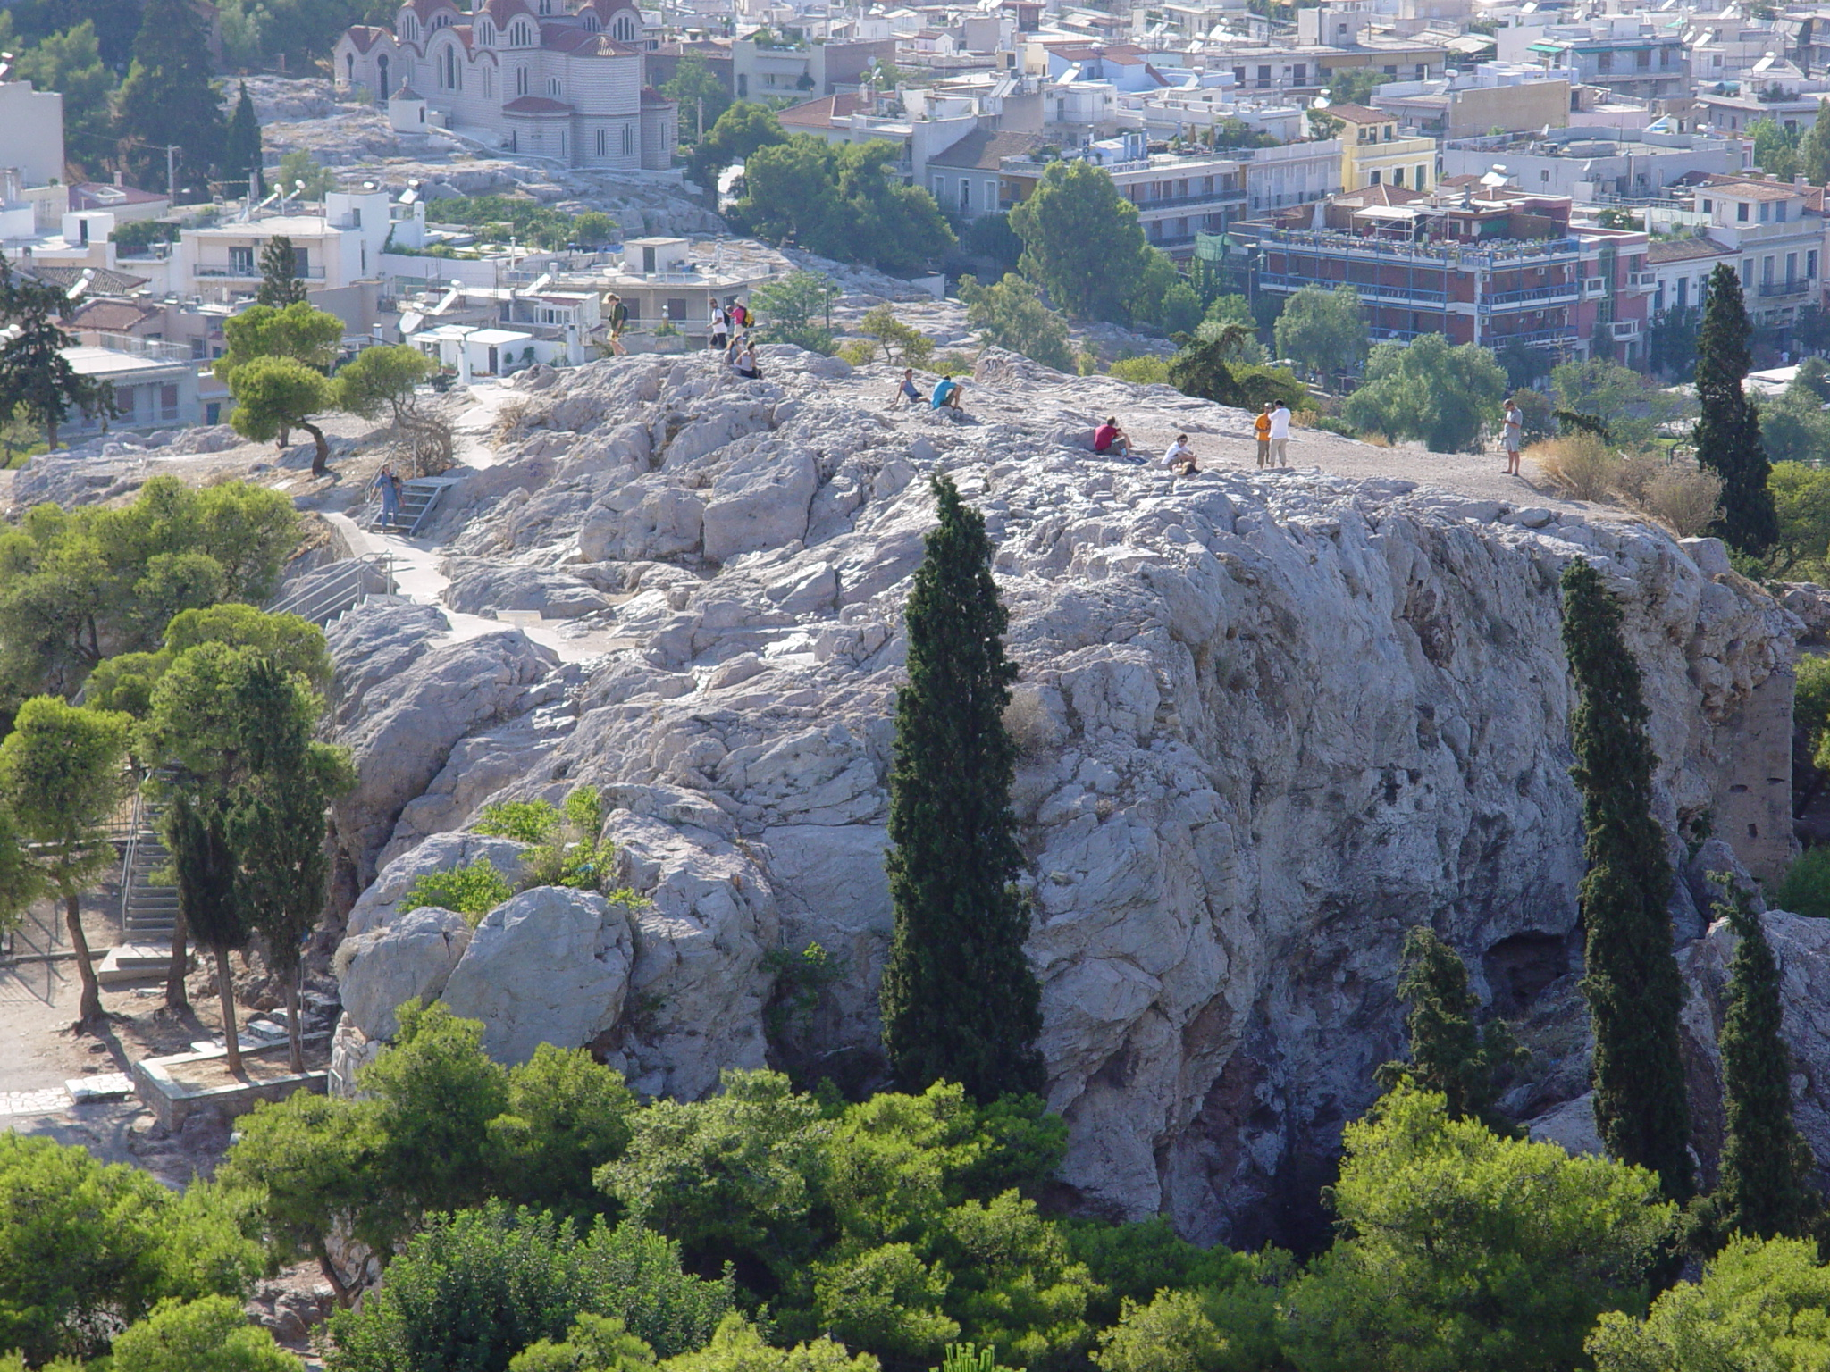

Slide 32
Writes 1st & 2nd Thessalonians

Slide 33
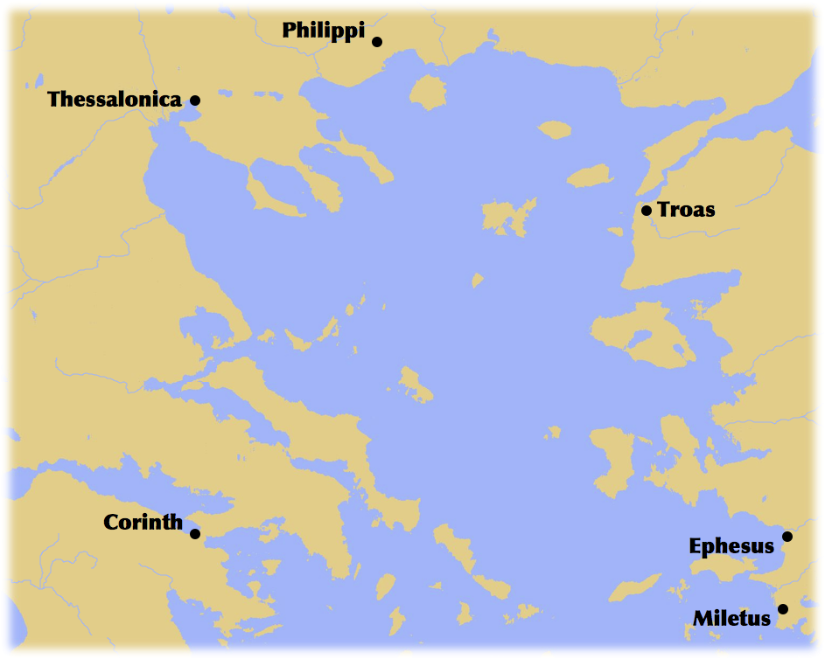

Slide 34
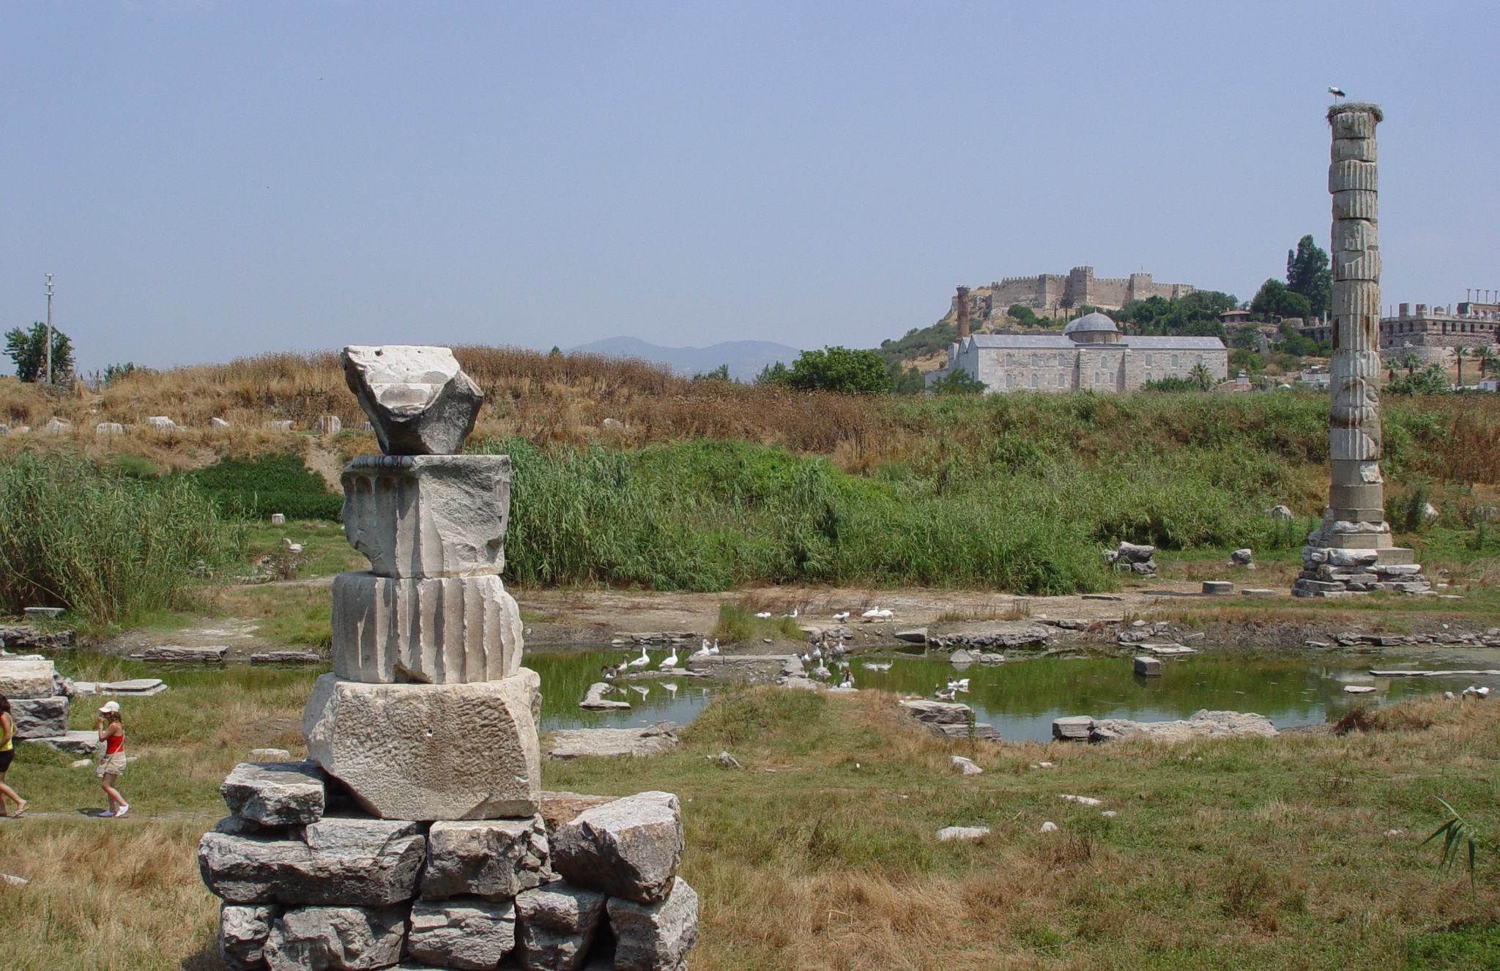

Slide 35
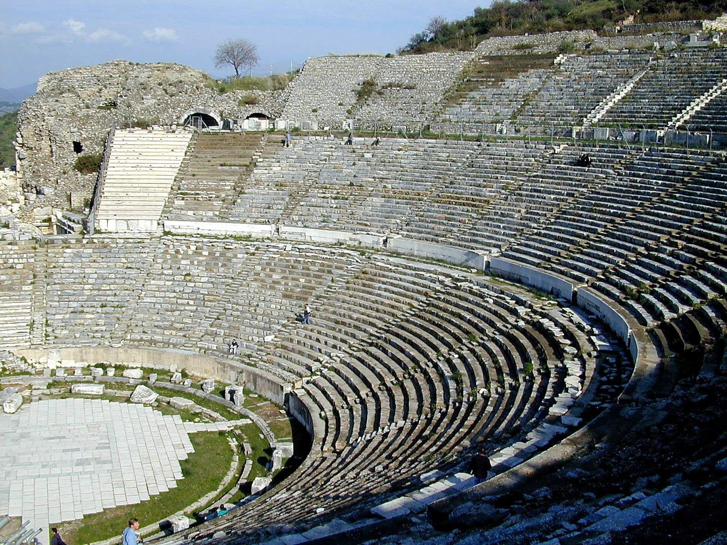

Slide 36
Writes 2nd Corinthians
Writes Romans
Writes 1st Corinthians

Slide 37
“...except that the Holy Spirit testifies to me in every city that imprisonment and afflictions await me.”
(Acts 20:23 ESV)

Slide 38
“but you will receive power when the Holy Spirit has come upon you; and you shall be My witnesses both in Jerusalem, and in all Judea and Samaria, and even to the remotest part of the earth.” (Acts 1:8)

